Slide 1

AstroHammer 1.2 Document Your Project
Yangyao CHEN

Slide 2
TOC
What is a Documentation?
Key Components of a Documentation
Tool/Formats for Documentation
Markdown
Sphinx/ReST

Slide 3
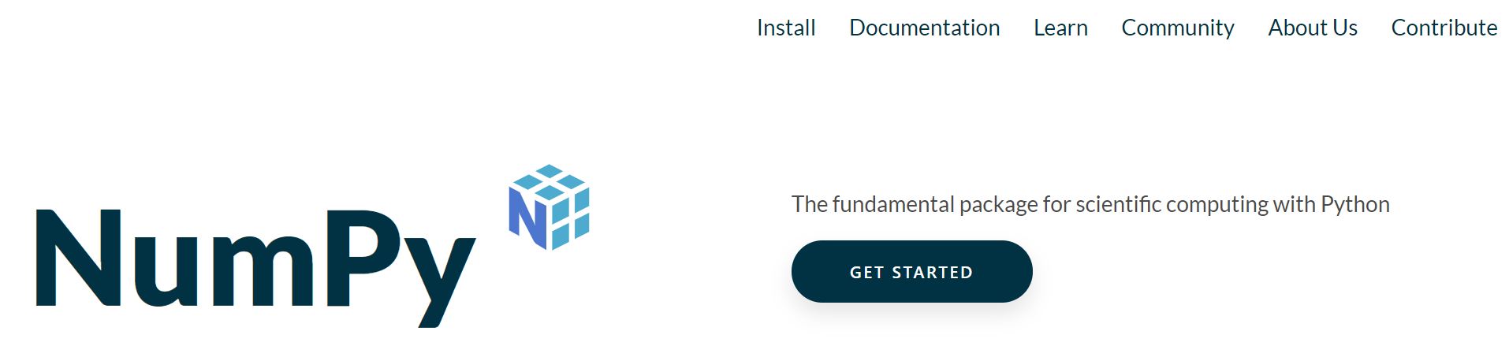
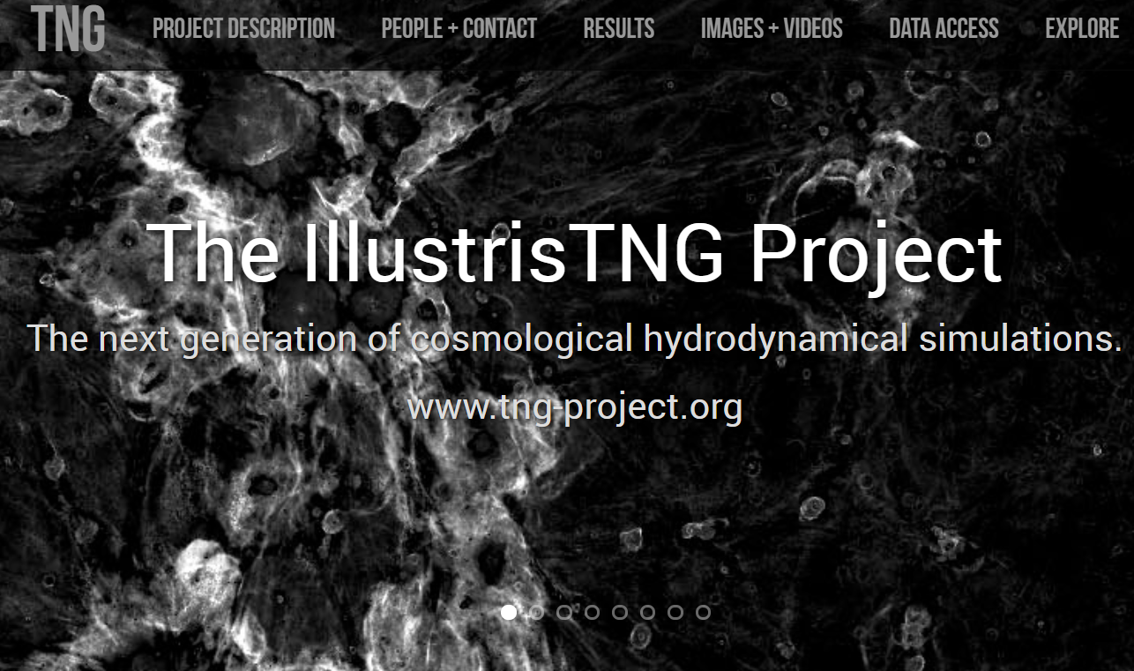
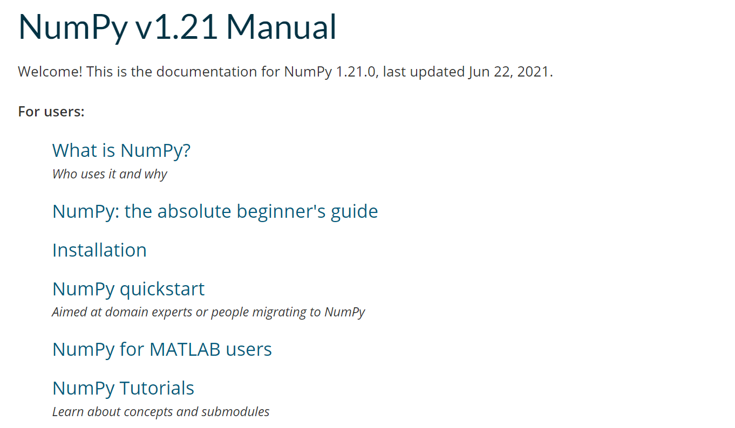
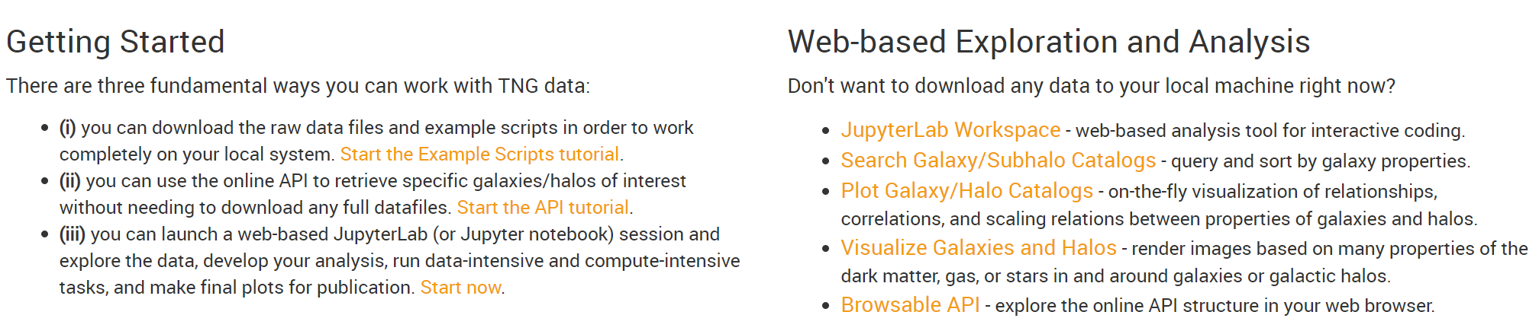
What is a Documentation?

Slide 4
What is a Documentation?
Frequently used for –
Astronomy data products.
Project introduction.
Software/code tutorial and reference manual.
Supplementary material of papers.
...
Why it is important ?
Key for a successful project.
Help yourself re-think your project.

Slide 5
Key Components of a Documentation
Brief introduction to the project.
Name, logo, motivation, target users.
Main features, advantages over other competitors.
As a reliable developer, it is also necessary to hint the drawbacks/caveats of your project.
Quick start guide.
How to download the resources, install the software, setup the run-time environment.
How to quickly begin a “hello world” example.
Where to go for the next step.
Tutorial. Main components of the project. (Step by step guides)
Detailed reference. Detail of the project functionality.
API reference: (Sub-)Modules, classes, function and variables.
Astronomy data/catalog: structure of the data, file formats, meaning of each table and fields.
Other project-related information.
License
List of contributors
How to seek for help or raise issues.

Slide 6
Tools/Formats for Documentation
Plain Text (.txt).
Simple, portable, but not expressive.
Used mainly for quick-and-dirty documentation.
Markdown (.md).
Simple, linear-layout, with basic mark-ups.
A subset of HTML.
ReST/Sphinx (.rst).
Richer features, good for API-doc.
A subset of HTML.
HTML (.html, .xml, .php).
Complex, hard to master.
Can control every detail.
NO Docx or Tex (.docx, .tex). They are not designed for documentation.
+ work-sharing platforms like Git/Github
+ document host site like read-the-docs.

Slide 7
Markdown Documentation
doc.md
doc.html/doc.pdf/...
Rendered output
The documentation pipeline
Tools for the doc generation.
Online real-time parser: https://dillinger.io/ (parser=JS, renderer=browser)
Code-repositories: https://github.com/ (parser=JS, renderer=browser)
Local IDE: vim or VSCode (parser=Markdown All in One extension, renderer=VSCode)
API for doc-parsing: showndownjs (see github)
Parser
Renderer

Slide 8
Markdown Doc Writing
Markdown has a small “standard set” syntax (see our lecture notes).
Headings
Paragraphs
Emphasis
Lists
Hyperlinks
Images
Codes
Tables
Parsers are allowed to provide extensions (read their docs before using).

Slide 9
Sphinx Documentation
The documentation pipeline.
Tools for doc-generation and doc-host.
Python package “sphinx” for doc organization and parsing (may install through “pip”).
Rich sets of themes to beatify your documentation.
Github + Read-the-docs to host your doc online.
An empty sphinx project
HTML/PDF files
Rendered output
Documents
ReST docs.
Styles sheets, templates, scripts.
Other resources.
Configurations.
Parser
Renderer

Slide 10
Sphinx Doc Writing – Start Your Doc
Install required packages
Build a new virtual environment, if possible.
pip install sphinx => (doc-parser library)
pip install sphinx-rtd-theme => (a widely-used theme)
Start a new Sphinx project
mkdir example && cd example => project root directory
sphinx-quickstart => get an empty project
# Project layout after sphinx-quickstart
example |- _build/ |- _static/ |- _templates/ |- conf.py |- index.rst |- make.bat |- Makefile

Slide 11
Sphinx Doc Writing – Configuration & Building
The “conf.py” file specify the global settings for Sphinx parser and the theme.
Use “make” to parse the source files
make html => get html file
make clean => clean the rendered output
Open “_build/html/index.html” with browser to see the output.
(Optional) upload it to Github and host it with Read-the-docs
# conf.py
import sphinx_rtd_theme
extensions = [ "sphinx_rtd_theme" ]
html_theme = "sphinx_rtd_theme"
html_theme_options = {
"navigation_depth": -1
}

Slide 12
Sphinx Doc Writing - Syntax
Basic syntax of markdown is also available in Sphinx.
Headings, Paragraphs, Emphasis, Lists, Hyperlinks, Images, Codes, Tables.
TOC trees can be constructed to link multiple documents into a joint one. (see the lecture notes)
Language API documentation is simple in Sphinx. (see the lecture notes).

