Slide 1
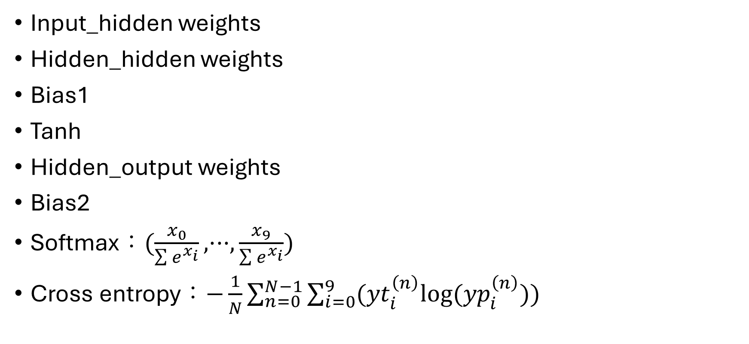
Variables and functions we need
Input_hidden weights
Hidden_hidden weights
Bias1
Tanh
Hidden_output weights
Bias2
Softmax：$(\frac{x_{0}}{\sum{e^{x_{i}}}}, ···,\frac{x_{9}}{\sum{e^{x_{i}}}})$
Cross entropy：$−\frac{1}{N}\sum_{n=0}^{N−1}{\sum_{i=0}^{9}{({yt}_{i}^{\left(n\right)}log⁡({yp}_{i}^{\left(n\right)}))}}$

Slide 2


















$$O^{\left\langle T\right\rangle }$$
$$Y$$
$$crossentropy$$
$$softmax$$
$$u^{\left\langle T\right\rangle }$$
$$b_{2}$$
$$V$$
$$W$$
$$tanh$$
$$W$$
$$h^{\left\langle T−1\right\rangle }$$
$$a^{\left\langle T\right\rangle }$$
$$h^{\left\langle T\right\rangle }$$
$$b_{1}$$
$$U$$
$$U$$
$$x^{\left\langle T\right\rangle }$$
$$x^{\left\langle T+1\right\rangle }$$

Slide 3
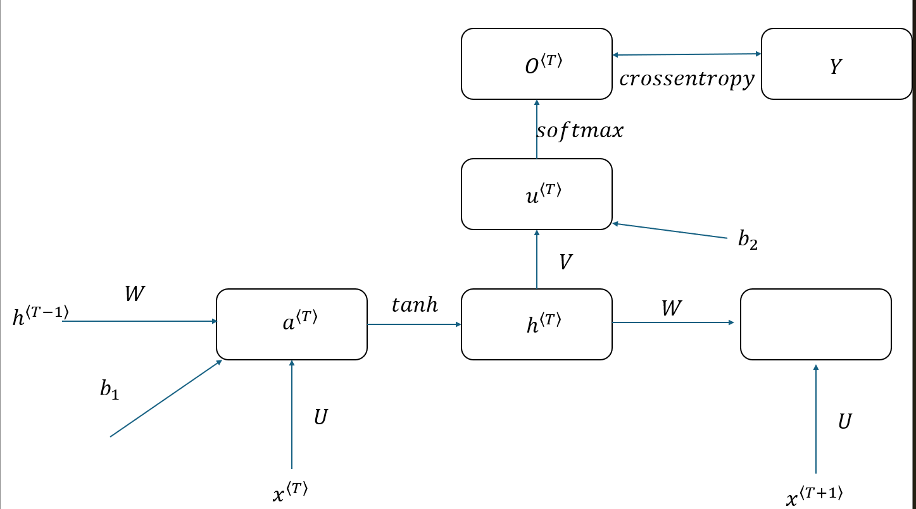

Forward
$a^{\left\langle T\right\rangle }=U∗x^{\left\langle T\right\rangle }+W∗h^{\left\langle T−1\right\rangle }+ b_{1}$
$h^{\left\langle T\right\rangle }=tanh⁡(a^{\left\langle T\right\rangle })$ (hidden state)
$u^{\left\langle T\right\rangle }=V∗h^{\left\langle T\right\rangle }+ b_{2}$
$O^{\left\langle T\right\rangle }=softmax(u^{\left\langle T\right\rangle })$ (output at time T)
$Loss=−\sum_{i=0}^{9}{Y_{i}∗log⁡(O_{i}^{\left\langle T\right\rangle })}$

Slide 4

In this case, we have 28*28 images with 10 categories
Time steps：28
Input： $x_{28×1}$
Hidden state：$h_{256×1}$
Biases：${b1}_{256×1}, {b2}_{10×1}$
Weights：$U_{256×28}, W_{256×256}, V_{10×256}$

Slide 5

Back propagation：gradient descent
Want to know：
$\frac{∂Loss}{∂V} , \frac{∂Loss}{∂b_{2}} , \frac{∂Loss}{∂U} , \frac{∂Loss}{∂W} , \frac{∂Loss}{∂b_{1}}$

Slide 6
Forward
$a^{\left\langle T\right\rangle }=U∗x^{\left\langle T\right\rangle }+W∗h^{\left\langle T−1\right\rangle }+ b_{1}$
$h^{\left\langle T\right\rangle }=tanh⁡(a^{\left\langle T\right\rangle })$ (hidden state)
$u^{\left\langle T\right\rangle }=V∗h^{\left\langle T\right\rangle }+ b_{2}$
$O^{\left\langle T\right\rangle }=softmax(u^{\left\langle T\right\rangle })$ (output at time T)
$Loss=−\sum_{i=0}^{9}{Y_{i}∗log⁡(O_{i}^{\left\langle T\right\rangle })}$

Slide 7


$$\frac{∂Loss}{∂V}$$
For example, $\frac{∂Loss}{∂v_{12}}$
$\left(\begin{matrix}\begin{matrix}v_{00} & v_{01} & v_{02} \\ v_{10} & v_{11} & v_{12} \\ v_{20} & v_{21} & v_{22}\end{matrix} & ⋯ & \\ ⋮ & ⋱ & ⋮ \\ & ⋯ & \end{matrix}\right)∗\begin{matrix}h_{0} \\ h_{1} \\ \begin{aligned}h_{2} \\ ⋮\end{aligned}\end{matrix}+ \begin{matrix}b_{0} \\ ⋮ \\ b_{9}\end{matrix}= \begin{matrix}\begin{aligned}u_{0} \\ u_{1}\end{aligned} \\ ⋮ \\ u_{9}\end{matrix}$
$\frac{∂Loss}{∂v_{12}}= \frac{∂Loss}{∂u_{1}}∗\frac{∂u_{1}}{∂v_{12}}$
$\frac{∂u_{1}}{∂v_{12}}= h_{2} and \frac{∂Loss}{∂u_{1}}= \sum_{i=0}^{9}{\frac{∂Loss}{∂O_{i}}∗\frac{∂O_{i}}{∂u_{1}}}$

Slide 8


$$\frac{∂Loss}{∂u_{1}}= \sum_{i=0}^{9}{\frac{∂Loss}{∂O_{i}}∗\frac{∂O_{i}}{∂u_{1}}}$$
$\frac{∂Loss}{∂O_{i}}=−\frac{Y_{i}}{O_{i}}$
For i = 1, $\frac{∂O_{i}}{∂u_{1}}= O_{1}\left(1−O_{1}\right)$
For i $≠$ 1, $\frac{∂O_{i}}{∂u_{1}}= {−O_{i}∗O}_{1}$
$\frac{∂Loss}{∂u_{1}}=−Y_{1}+ O_{1}∗(\sum_{i=0}^{9}{Y_{i}})$
Since we use one-hot code $\sum_{i=0}^{9}{Y_{i}}=1$
Hence, $\frac{∂Loss}{∂u_{1}}= O_{1}−Y_{1}$
$\frac{∂Loss}{∂v_{12}}=\left(O_{1}−Y_{1}\right)∗h_{2}$, that is, $\frac{∂Loss}{∂v_{ij}}=\frac{1}{N}∗\sum_{n=0}^{N−1}{\left({O^{\left\langle T\right\rangle }}_{i}^{n}−Y_{i}^{n}\right)∗{h^{\left\langle T\right\rangle }}_{j}^{n}}$

Slide 9


Similar to $\frac{∂Loss}{∂{b2}_{1}}= \sum_{i=0}^{9}{\frac{∂Loss}{∂O_{i}}∗\frac{∂O_{i}}{∂{b2}_{1}}}$
$\frac{∂Loss}{∂{b2}_{1}}=\left(O_{1}−Y_{1}\right)$, that is, $\frac{∂Loss}{∂{b2}_{i}}=\frac{1}{N}∗\sum_{n=0}^{N−1}{\left({O^{\left\langle T\right\rangle }}_{i}^{n}−Y_{i}^{n}\right)}$

Slide 10

Note that both of $\frac{∂Loss}{∂V} , \frac{∂Loss}{∂b_{2}}$ and following terms have $\left({O^{\left\langle T\right\rangle }}_{i}^{n}−Y_{i}^{n}\right)$
Hence, in programming we let delta as $\left({O^{\left\langle T\right\rangle }}_{}^{n}−Y_{}^{n}\right)$
Now we compute $\frac{∂Loss}{∂U} , \frac{∂Loss}{∂W} , \frac{∂Loss}{∂b_{1}}$

Slide 11
Forward
$a^{\left\langle T\right\rangle }=U∗x^{\left\langle T\right\rangle }+W∗h^{\left\langle T−1\right\rangle }+ b_{1}$
$h^{\left\langle T\right\rangle }=tanh⁡(a^{\left\langle T\right\rangle })$ (hidden state)
$u^{\left\langle T\right\rangle }=V∗h^{\left\langle T\right\rangle }+ b_{2}$
$O^{\left\langle T\right\rangle }=softmax(u^{\left\langle T\right\rangle })$ (output at time T)
$Loss=−\sum_{i=0}^{9}{Y_{i}∗log⁡(O_{i}^{\left\langle T\right\rangle })}$

Slide 12
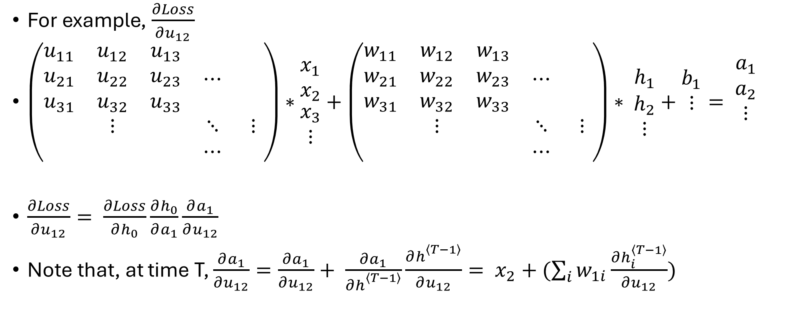

$$\frac{∂Loss}{∂U}$$
For example, $\frac{∂Loss}{∂u_{12}}$
$\left(\begin{matrix}\begin{matrix}u_{11} & u_{12} & u_{13} \\ u_{21} & u_{22} & u_{23} \\ u_{31} & u_{32} & u_{33}\end{matrix} & ⋯ & \\ ⋮ & ⋱ & ⋮ \\ & ⋯ & \end{matrix}\right)∗\begin{matrix}x_{1} \\ x_{2} \\ \begin{aligned}x_{3} \\ ⋮\end{aligned}\end{matrix}+\left(\begin{matrix}\begin{matrix}w_{11} & w_{12} & w_{13} \\ w_{21} & w_{22} & w_{23} \\ w_{31} & w_{32} & w_{33}\end{matrix} & ⋯ & \\ ⋮ & ⋱ & ⋮ \\ & ⋯ & \end{matrix}\right)∗ \begin{matrix}h_{1} \\ h_{2} \\ ⋮\end{matrix}+\begin{matrix}b_{1} \\ ⋮ \\ \end{matrix}= \begin{matrix}\begin{aligned}a_{1} \\ a_{2}\end{aligned} \\ ⋮ \\ \end{matrix}$
$\frac{∂Loss}{∂u_{12}}= \frac{∂Loss}{∂h_{0}}\frac{∂h_{0}}{∂a_{1}}\frac{∂a_{1}}{∂u_{12}}$
Note that, at time T, $\frac{∂a_{1}}{∂u_{12}}=\frac{∂a_{1}}{∂u_{12}}+ \frac{∂a_{1}}{∂h_{}^{\left\langle T−1\right\rangle }}\frac{∂h_{}^{\left\langle T−1\right\rangle }}{∂u_{12}}= x_{2}+(\sum_{i}{w_{1i}}\frac{∂h_{i}^{\left\langle T−1\right\rangle }}{∂u_{12}})$

Slide 13
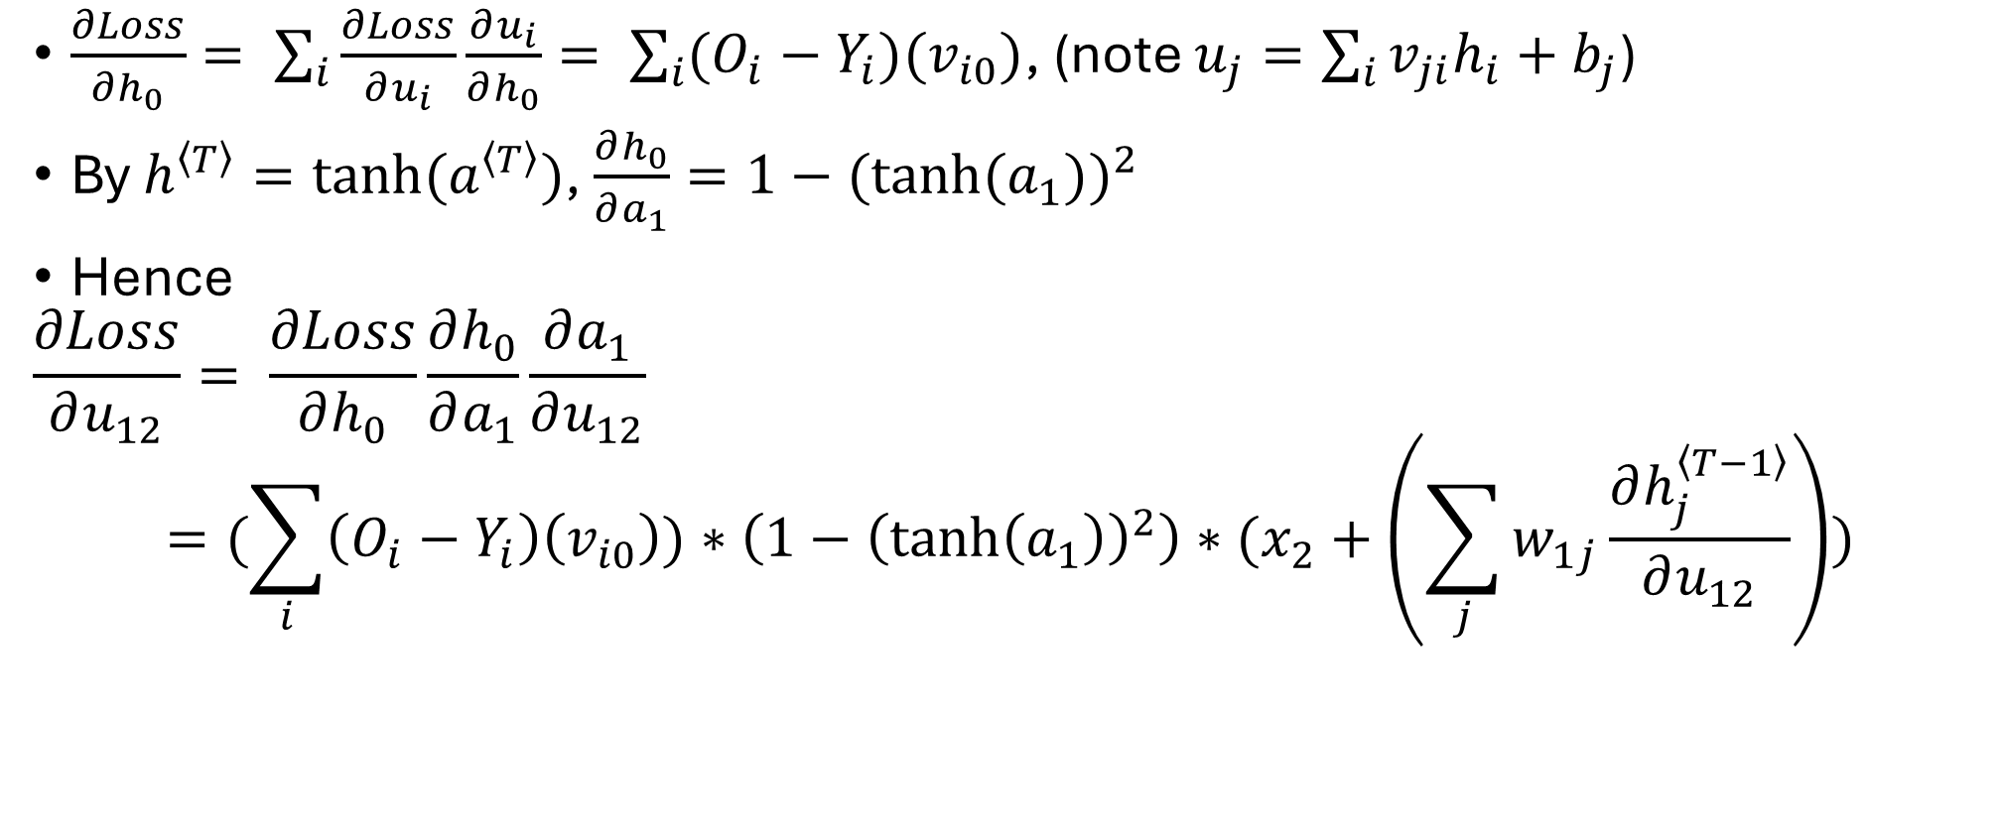

$$\frac{∂Loss}{∂h_{0}}\frac{∂h_{0}}{∂a_{1}}$$
$\frac{∂Loss}{∂h_{0}}= \sum_{i}{\frac{∂Loss}{∂u_{i}}\frac{∂u_{i}}{∂h_{0}}= \sum_{i}{(O_{i}−Y_{i})(v_{i0})}}$, (note $u_{j}=\sum_{i}{v_{ji}h_{i}+b_{j}}$)
By $h^{\left\langle T\right\rangle }=tanh⁡(a^{\left\langle T\right\rangle })$, $\frac{∂h_{0}}{∂a_{1}}=1−{(tanh⁡(a_{1}))}^{2}$
Hence
$$\frac{∂Loss}{∂u_{12}}= \frac{∂Loss}{∂h_{0}}\frac{∂h_{0}}{∂a_{1}}\frac{∂a_{1}}{∂u_{12}}$$
$$=(\sum_{i}{\left(O_{i}−Y_{i}\right)\left(v_{i0}\right)})∗\left(1−{\left(\tanh\left(a_{1}\right)\right)}^{2}\right)∗(x_{2}+\left(\sum_{j}{w_{1j}}\frac{∂h_{j}^{\left\langle T−1\right\rangle }}{∂u_{12}}\right))$$

Slide 14

$\frac{∂Loss}{∂u_{ij}}= (\sum_{k}{\left(O_{k}−Y_{k}\right)\left(v_{ki}\right)})\left(1−{\left(\tanh\left(a_{i}\right)\right)}^{2}\right)∗(x_{j}+(\sum_{l}{w_{il}}\frac{∂h_{l}^{\left\langle T−1\right\rangle }}{∂u_{ij}})\text{)}$
Formally, write $\frac{∂Loss}{∂U}=delta∗V∗\left(1−{h^{\left\langle T\right\rangle }}^{2}\right)∗\left(x^{\left\langle T\right\rangle }+W∗\frac{∂h^{\left\langle T−1\right\rangle }}{∂U}\right)$

Slide 15

Similar for $\frac{∂Loss}{∂W}$ and $\frac{∂Loss}{∂b_{1}}$
$\frac{∂Loss}{∂W}=delta∗V∗\left(1−{h^{\left\langle T\right\rangle }}^{2}\right)∗\left(h^{\left\langle T−1\right\rangle }+W∗\frac{∂h^{\left\langle T−1\right\rangle }}{∂W}\right)$
$\frac{∂Loss}{∂b_{1}}=delta∗V∗\left(1−{h^{\left\langle T\right\rangle }}^{2}\right)∗\left(1+W∗\frac{∂h^{\left\langle T−1\right\rangle }}{∂b_{1}}\right)$

Slide 16
Forward
$a^{\left\langle T\right\rangle }=U∗x^{\left\langle T\right\rangle }+W∗h^{\left\langle T−1\right\rangle }+ b_{1}$
$h^{\left\langle T\right\rangle }=tanh⁡(a^{\left\langle T\right\rangle })$ (hidden state)
$u^{\left\langle T\right\rangle }=V∗h^{\left\langle T\right\rangle }+ b_{2}$
$O^{\left\langle T\right\rangle }=softmax(u^{\left\langle T\right\rangle })$ (output at time T)
$Loss=−\sum_{i=0}^{9}{Y_{i}∗log⁡(O_{i}^{\left\langle T\right\rangle })}$

Slide 17


$\frac{∂h^{\left\langle T−1\right\rangle }}{∂U}$, $\frac{∂h^{\left\langle T−1\right\rangle }}{∂W}$, $\frac{∂h^{\left\langle T−1\right\rangle }}{∂b_{1}}$
By previous calculations,
$\frac{∂h^{\left\langle T−1\right\rangle }}{∂U}=\left(1−{h^{\left\langle T−1\right\rangle }}^{2}\right)∗\left(x^{\left\langle T\right\rangle }+W∗\frac{∂h^{\left\langle T−2\right\rangle }}{∂U}\right)$
$\frac{∂h^{\left\langle T−1\right\rangle }}{∂W}=\left(1−{h^{\left\langle T−1\right\rangle }}^{2}\right)∗\left(h^{\left\langle T−2\right\rangle }+W∗\frac{∂h^{\left\langle T−2\right\rangle }}{∂W}\right)$
$\frac{∂h^{\left\langle T−1\right\rangle }}{∂b_{1}}=\left(1−{h^{\left\langle T−1\right\rangle }}^{2}\right)∗\left(1+W∗\frac{∂h^{\left\langle T−2\right\rangle }}{∂b_{1}}\right)$
Hence, we calculate $\frac{∂Loss}{∂U}$, $\frac{∂Loss}{∂W}$, $\frac{∂Loss}{∂b_{1}}$ recursively.
Every recursive steps we need multiply $W$ and $\left(1−{h^{\left\langle T−1\right\rangle }}^{2}\right)$

Slide 18
Data preparation
We need extra dimension for time step
Three dimensions are (Time, Batch size, node/data)

