Slide 1
Equation of motion of double pendulum system
2025.07.27 Ying-Shan Chen

Slide 2



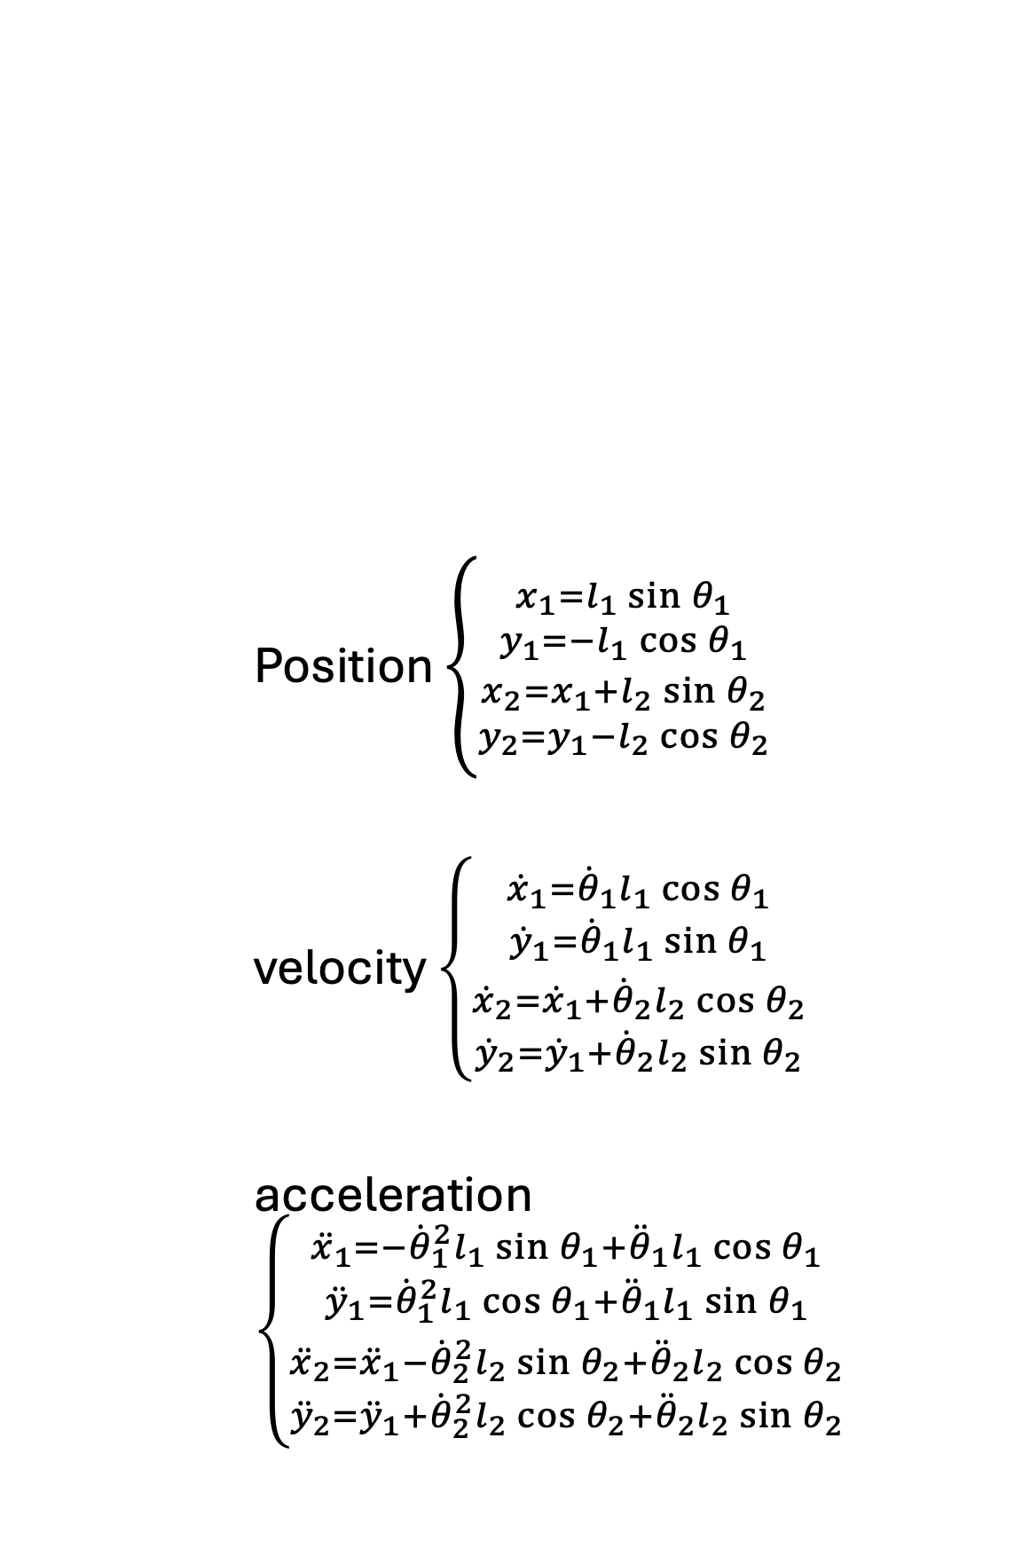







Definition
Position $\left\{\begin{aligned}{x_{1}=l_{1}\sin{θ_{1}} \atop y_{1}=−l_{1}\cos{θ_{1}}} \\ {x_{2}=x_{1}+l_{2}\sin{θ_{2}} \atop y_{2}=y_{1}−l_{2}\cos{θ_{2}}}\end{aligned}\right.$
velocity $\left\{\begin{aligned}{{\dot{x}}_{1}={\dot{θ}}_{1}l_{1}\cos{θ_{1}} \atop {\dot{y}}_{1}={\dot{θ}}_{1}l_{1}\sin{θ_{1}}} \\ {{\dot{x}}_{2}={\dot{x}}_{1}+{\dot{θ}}_{2}l_{2}\cos{θ_{2}} \atop {\dot{y}}_{2}={\dot{y}}_{1}+{\dot{θ}}_{2}l_{2}\sin{θ_{2}}}\end{aligned}\right.$
acceleration $\left\{\begin{aligned}{{\ddot{x}}_{1}=−{\dot{θ}}_{1}^{2}l_{1}\sin{θ_{1}}+{\ddot{θ}}_{1}l_{1}\cos{θ_{1}} \atop {\ddot{y}}_{1}={\dot{θ}}_{1}^{2}l_{1}\cos{θ_{1}}+{\ddot{θ}}_{1}l_{1}\sin{θ_{1}}} \\ {{\ddot{x}}_{2}={\ddot{x}}_{1}−{\dot{θ}}_{2}^{2}l_{2}\sin{θ_{2}}+{\ddot{θ}}_{2}l_{2}\cos{θ_{2}} \atop {\ddot{y}}_{2}={\ddot{y}}_{1}+{\dot{θ}}_{2}^{2}l_{2}\cos{θ_{2}}+{\ddot{θ}}_{2}l_{2}\sin{θ_{2}}}\end{aligned}\right.$
$$+y$$
$$+x$$
$$θ_{1}$$
$$l_{1}$$
$$m_{1}$$
$$\left(x_{1},y_{1}\right)$$
$$θ_{2}$$
$$l_{2}$$
$$m_{2}$$
$$\left(x_{2},y_{2}\right)$$

Slide 3



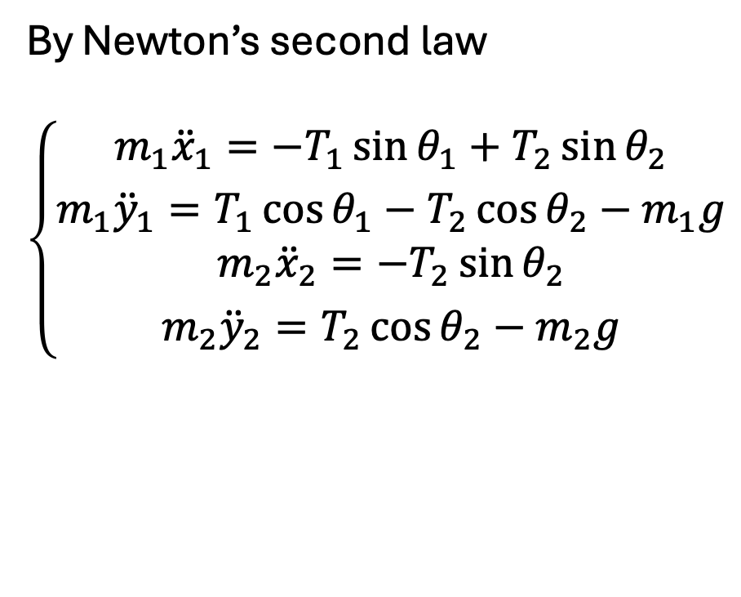





Definition
$$θ_{1}$$
$$T_{1}$$
By Newton’s second law
$$\left\{\begin{aligned}{m_{1}{\ddot{x}}_{1}=−T_{1}\sin{θ_{1}}+T_{2}\sin{θ_{2}} \atop m_{1}{\ddot{y}}_{1}=T_{1}\cos{θ_{1}}−T_{2}\cos{θ_{2}}−m_{1}g} \\ {m_{2}{\ddot{x}}_{2}=−T_{2}\sin{θ_{2}} \atop m_{2}{\ddot{y}}_{2}=T_{2}\cos{θ_{2}}−m_{2}g}\end{aligned}\right.$$
$$θ_{2}$$
$$T_{2}$$
$$−m_{1}g$$
$$θ_{2}$$
$$T_{2}$$
$$−m_{2}g$$

Slide 4
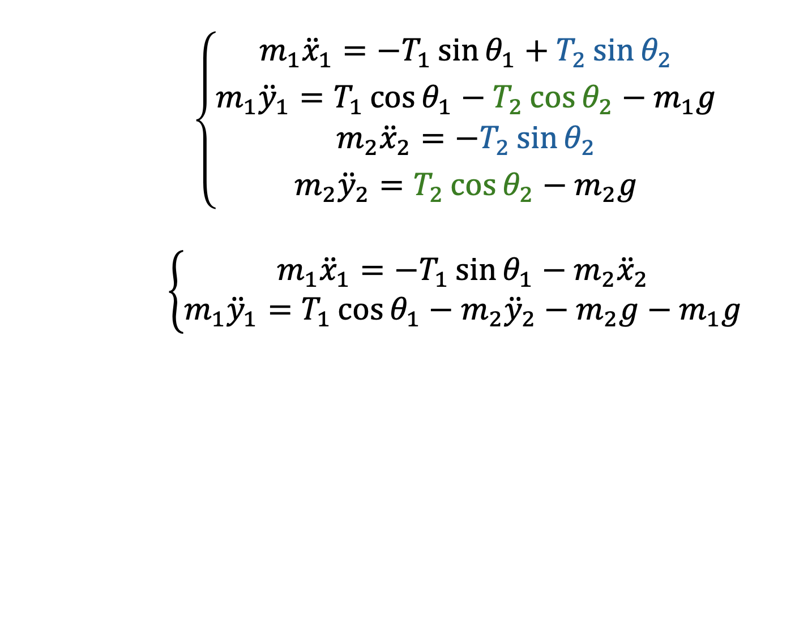
Derivation
$$\left\{\begin{aligned}{m_{1}{\ddot{x}}_{1}=−T_{1}\sin{θ_{1}}+T_{2}\sin{θ_{2}} \atop m_{1}{\ddot{y}}_{1}=T_{1}\cos{θ_{1}}−T_{2}\cos{θ_{2}}−m_{1}g} \\ {m_{2}{\ddot{x}}_{2}=−T_{2}\sin{θ_{2}} \atop m_{2}{\ddot{y}}_{2}=T_{2}\cos{θ_{2}}−m_{2}g}\end{aligned}\right.$$
$$\left\{\begin{aligned}m_{1}{\ddot{x}}_{1}=−T_{1}\sin{θ_{1}}−m_{2}{\ddot{x}}_{2} \\ m_{1}{\ddot{y}}_{1}=T_{1}\cos{θ_{1}}−m_{2}{\ddot{y}}_{2}−m_{2}g−m_{1}g\end{aligned}\right.$$

Slide 5
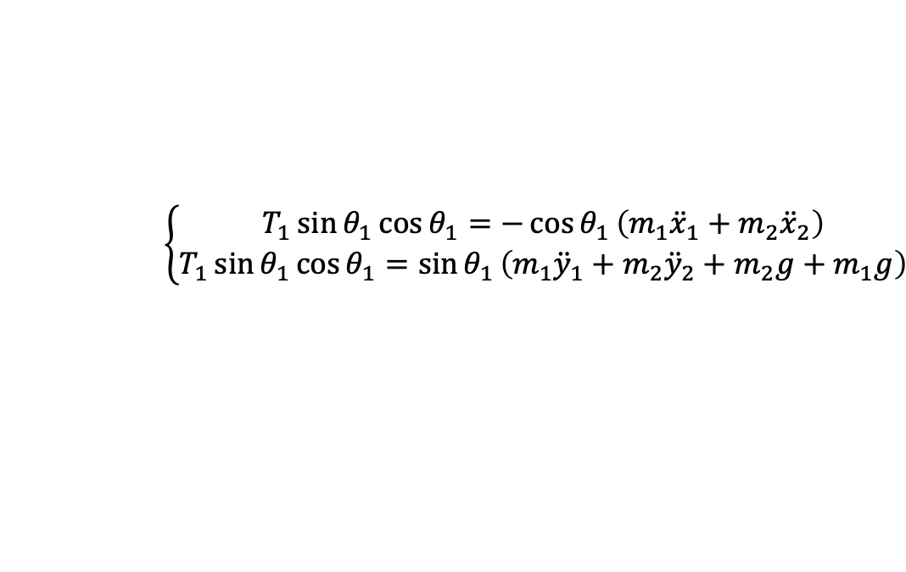
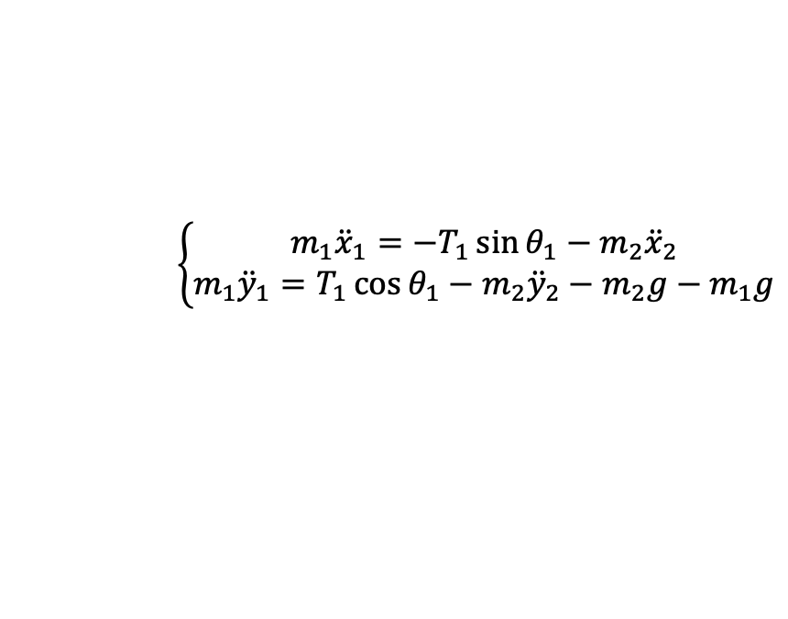


Derivation
$$×\cos{θ_{1}}$$
$$\left\{\begin{aligned}m_{1}{\ddot{x}}_{1}=−T_{1}\sin{θ_{1}}−m_{2}{\ddot{x}}_{2} \\ m_{1}{\ddot{y}}_{1}=T_{1}\cos{θ_{1}}−m_{2}{\ddot{y}}_{2}−m_{2}g−m_{1}g\end{aligned}\right.$$
$$×\sin{θ_{1}}$$
$$\left\{\begin{aligned}T_{1}\sin{θ_{1}}\cos{θ_{1}}=−\cos{θ_{1}}\left(m_{1}{\ddot{x}}_{1}+m_{2}{\ddot{x}}_{2}\right) \\ T_{1}\sin{θ_{1}}\cos{θ_{1}}=\sin{θ_{1}}\left(m_{1}{\ddot{y}}_{1}+m_{2}{\ddot{y}}_{2}+m_{2}g+m_{1}g\right)\end{aligned}\right.$$
rearrange
$$\sin{θ_{1}}\left(m_{1}{\ddot{y}}_{1}+m_{2}{\ddot{y}}_{2}+m_{2}g+m_{1}g\right)=−\cos{θ_{1}}\left(m_{1}{\ddot{x}}_{1}+m_{2}{\ddot{x}}_{2}\right)$$
combine

Slide 6
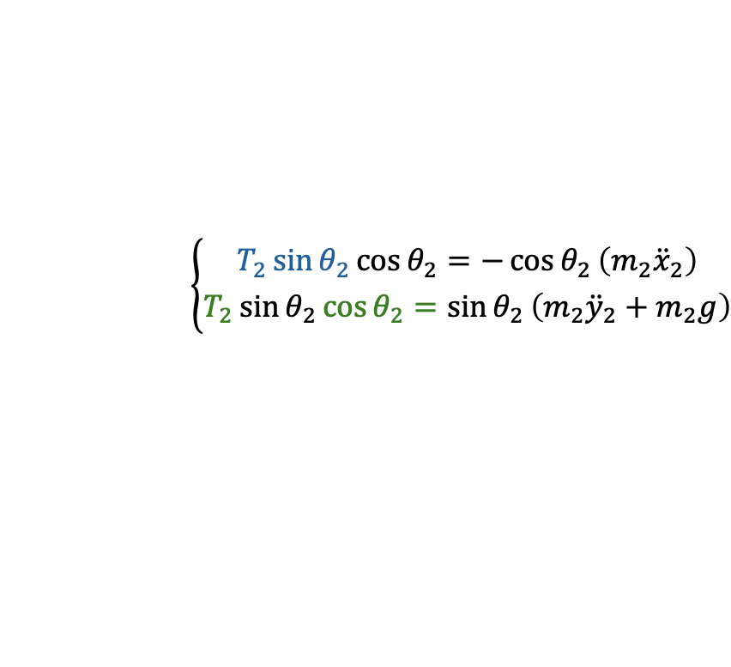
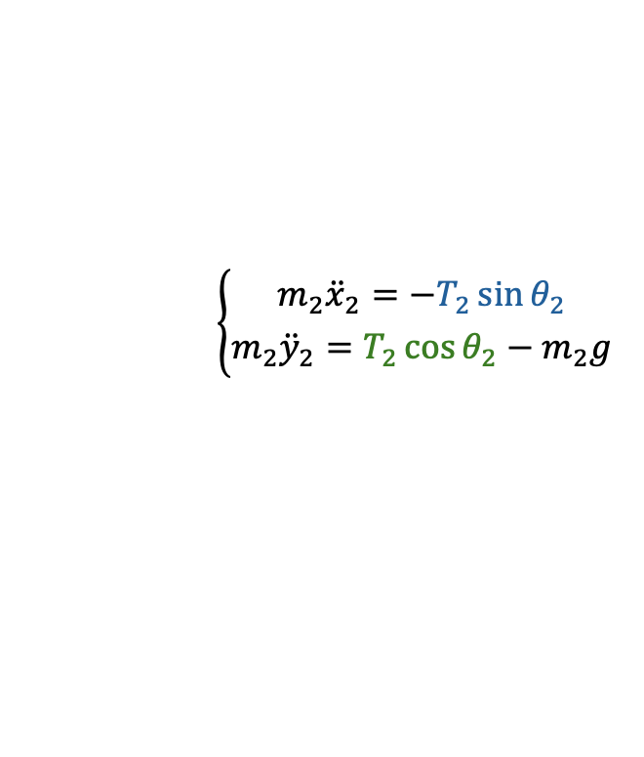


Derivation
$$×\cos{θ_{2}}$$
$$\left\{{m_{2}{\ddot{x}}_{2}=−T_{2}\sin{θ_{2}} \atop m_{2}{\ddot{y}}_{2}=T_{2}\cos{θ_{2}}−m_{2}g}\right.$$
$$×\sin{θ_{2}}$$
$$\left\{{T_{2}\sin{θ_{2}}\cos{θ_{2}}=−\cos{θ_{2}}\left(m_{2}{\ddot{x}}_{2}\right) \atop T_{2}\sin{θ_{2}}\cos{θ_{2}}=\sin{θ_{2}}\left(m_{2}{\ddot{y}}_{2}+m_{2}g\right)}\right.$$
rearrange
$$\sin{θ_{2}}\left(m_{2}{\ddot{y}}_{2}+m_{2}g\right)=−\cos{θ_{2}}\left(m_{2}{\ddot{x}}_{2}\right)$$
combine

Slide 7
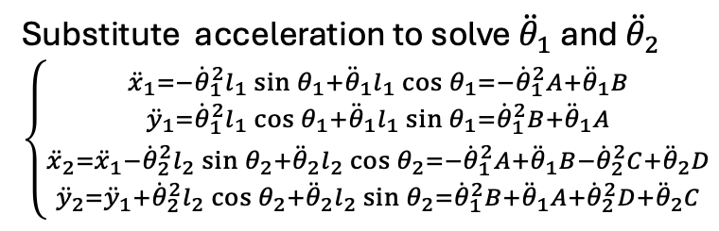
Derivation
$$\sin{θ_{1}}\left(m_{1}{\ddot{y}}_{1}+m_{2}{\ddot{y}}_{2}+m_{2}g+m_{1}g\right)=−\cos{θ_{1}}\left(m_{1}{\ddot{x}}_{1}+m_{2}{\ddot{x}}_{2}\right)$$
$$\sin{θ_{2}}\left(m_{2}{\ddot{y}}_{2}+m_{2}g\right)=−\cos{θ_{2}}\left(m_{2}{\ddot{x}}_{2}\right)$$
Substitute acceleration to solve ${\ddot{θ}}_{1}$ and ${\ddot{θ}}_{2}$ $\left\{\begin{aligned}{{\ddot{x}}_{1}=−{\dot{θ}}_{1}^{2}l_{1}\sin{θ_{1}}+{\ddot{θ}}_{1}l_{1}\cos{θ_{1}}=−{\dot{θ}}_{1}^{2}A+{\ddot{θ}}_{1}B \atop {\ddot{y}}_{1}={\dot{θ}}_{1}^{2}l_{1}\cos{θ_{1}}+{\ddot{θ}}_{1}l_{1}\sin{θ_{1}}={\dot{θ}}_{1}^{2}B+{\ddot{θ}}_{1}A} \\ {{\ddot{x}}_{2}={\ddot{x}}_{1}−{\dot{θ}}_{2}^{2}l_{2}\sin{θ_{2}}+{\ddot{θ}}_{2}l_{2}\cos{θ_{2}}=−{\dot{θ}}_{1}^{2}A+{\ddot{θ}}_{1}B−{\dot{θ}}_{2}^{2}C+{\ddot{θ}}_{2}D \atop {\ddot{y}}_{2}={\ddot{y}}_{1}+{\dot{θ}}_{2}^{2}l_{2}\cos{θ_{2}}+{\ddot{θ}}_{2}l_{2}\sin{θ_{2}}={\dot{θ}}_{1}^{2}B+{\ddot{θ}}_{1}A+{\dot{θ}}_{2}^{2}D+{\ddot{θ}}_{2}C}\end{aligned}\right.$

