Slide 1
Lecture 1
Method of Generalized
Separation of Variables
Andrei D. Polyanin

Slide 2


Simple Separation of Variables
Linear partial differential equations
Multiplicative separable solutions:
Some nonlinear first-order equations
Additive separable solutions:
Substituting (1) or (2) into the equation yields
⇓

Slide 3
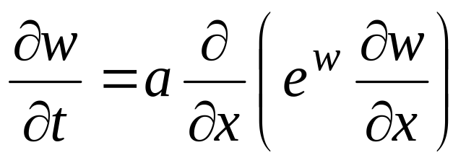
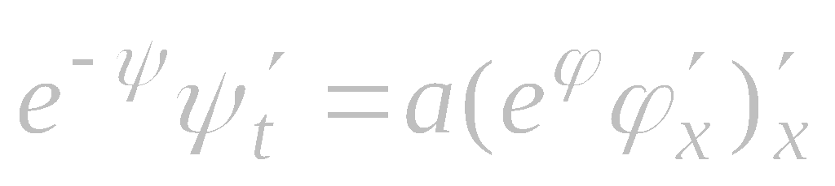
Simple Separation of Variables. Example
Consider the second-order equation
We seek an exact solution in the form (2), w(x,t) = ϕ(x) + ψ(t), to obtain

Slide 4


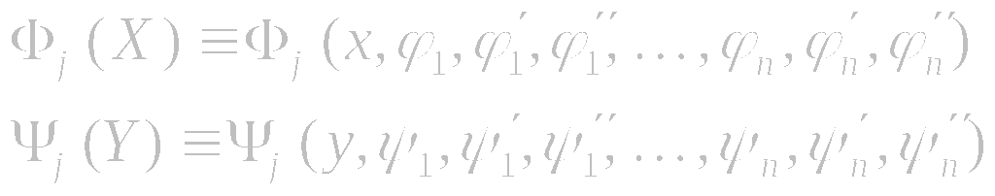
Generalized Separation of Variables
General form of exact solutions:
Partial differential equations with quadratic or power nonlinearities:
On substituting expression (1) into the differential equation (2), one arrives at a functional-differential equation
for the ϕ_{i} (x) and ψ_{i} ( y). The functionals Φ_{j} (X) and Ψ_{j} (Y ) depend only on x and y, respectively,
The formulas are written out for the case of a second-order equation (2).

Slide 5
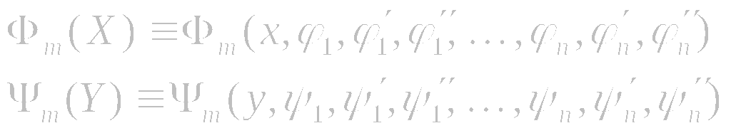
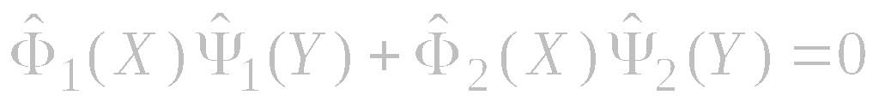
Solution of Functional-Differential Equations by Differentiation
General form of exact solutions:
1. Assume that Ψ_{k} is not identical zero for some k. Dividing the equation by Ψ_{k} and differentiating w.r.t. y, we obtain a similar equation but with fewer terms
2. We continue the above procedure until we obtain a simple separable two-term equation,
3. The case Ψ_{k} ≡ 0 should be treated separately (since we divided the equation by Ψ_{k} at the first stage).

Slide 6
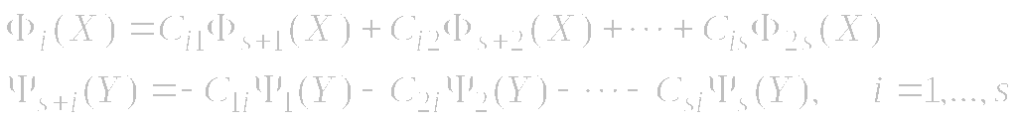

Solution of Functional-Differential Equations by Splitting
First stage. We treat the functional-differential equation as a purely functional equation*
The case of even number of terms in the equation, k = 2s. A solution dependent on s² arbitrary constants C_{ij}:
There are also “degenerate” solutions dependent on fewer arbitrary constants.
Second stage. We substitute the functionals
into solution (∗) to obtain the system of ODEs for the unknowns ϕ_{p} (x), ψ_{p} ( y).
——————
* It is the standard bilinear functional equation (the same for all problems).

Slide 7
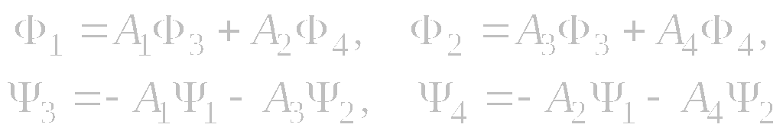
Solution of Functional-Differential Equations by Splitting
Example. The functional equation
has one solution dependent on four arbitrary constants
and also two “degenerate” solutions involving three arbitrary constants
Here A₁, A₂, A₃, and A₄ are arbitrary constants.

Slide 8
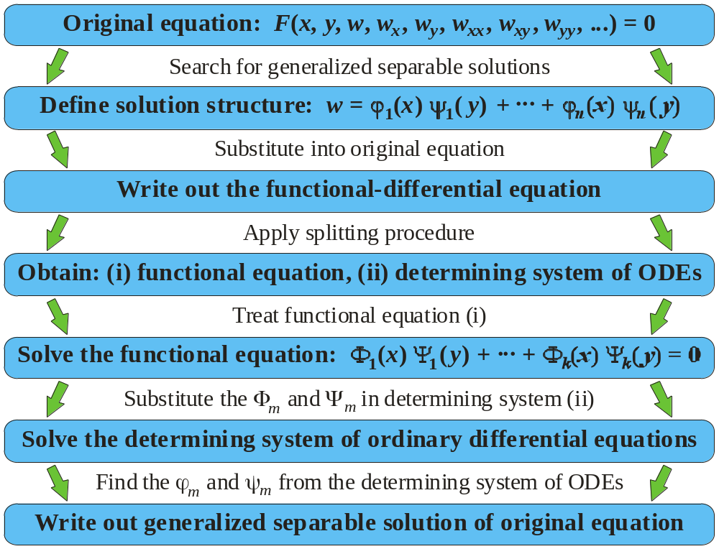
General Scheme for Constructing
Generalized Separable Solutions by the Splitting Method

Slide 9
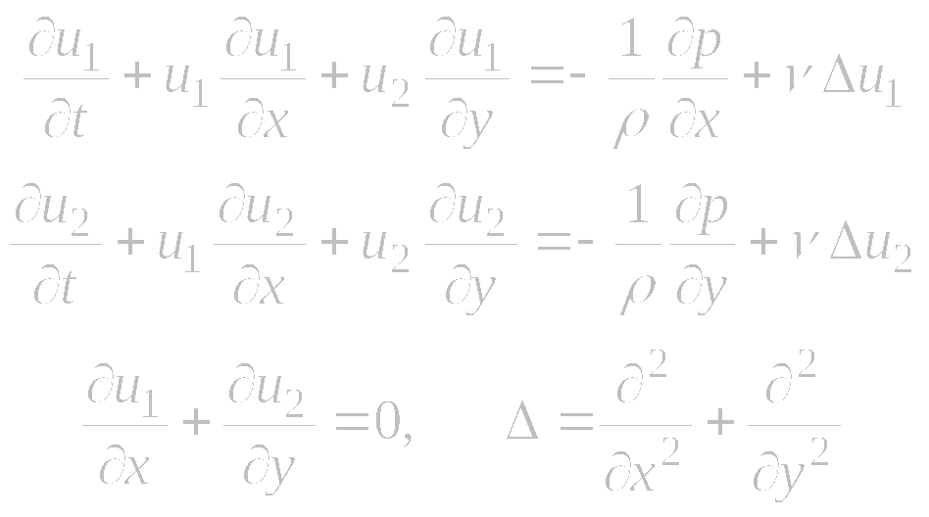
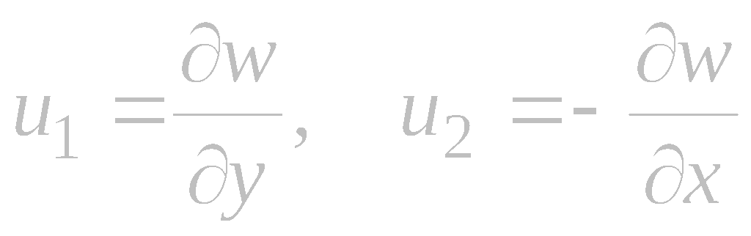
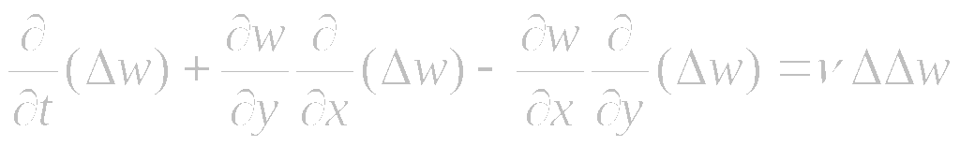
Examples
2D Navier–Stokes equations:
Introduce stream function w:
Arrive at a fourth-order nonlinear equation for w:

Slide 10
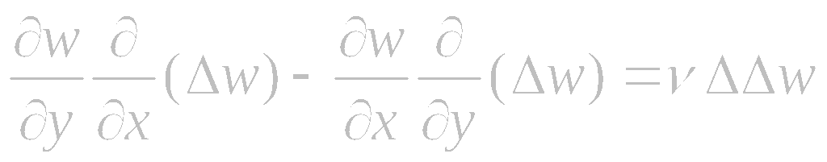
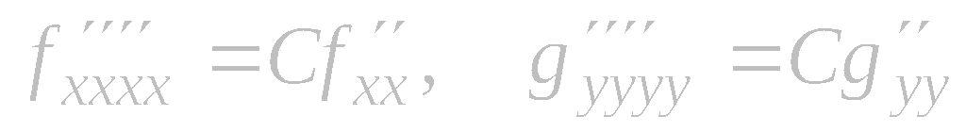


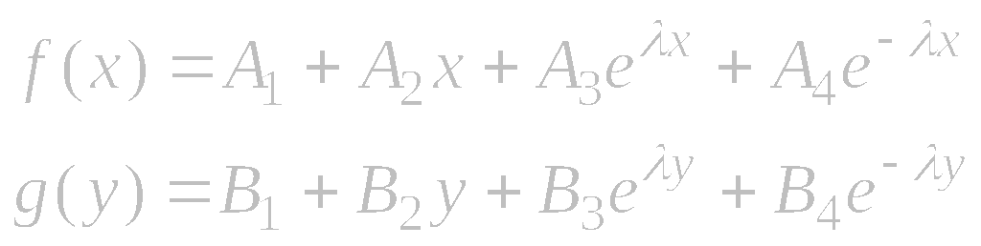
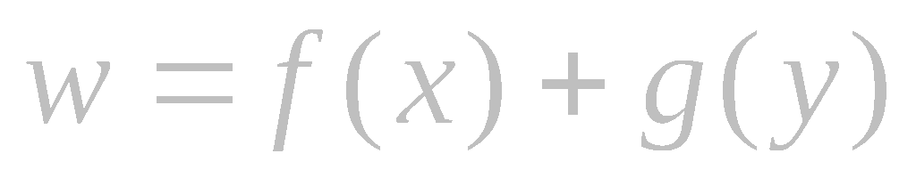

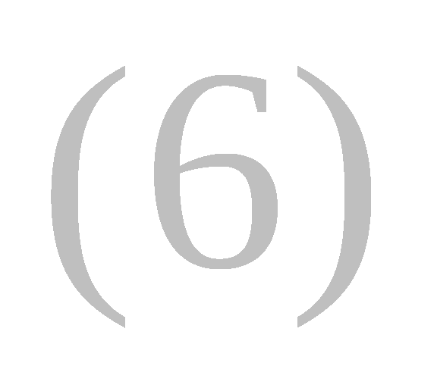
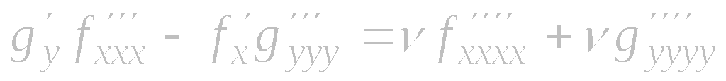

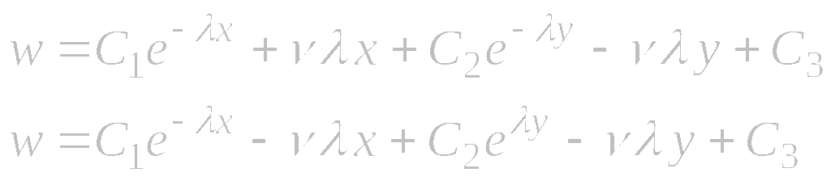
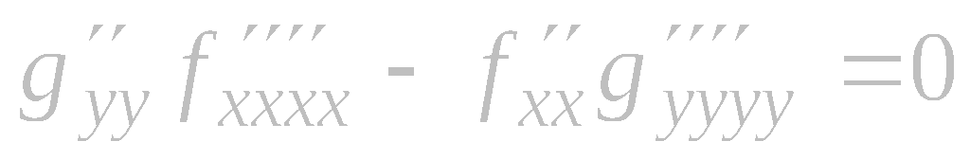

Examples
Fourth-order nonlinear equation equivalent to the 2D stationary Navier–Stokes equations:
On separating the variables in (4), we get
(C is any)
Solutions of equations (5) for C = λ² > 0:
We seek separable solutions of equation (1) in the form
Substituting (2) into (1) yields
Substituting (6) into (1), we obtain solutions of the form (2):
Differentiating (3) with respect to x
and y, we obtain

Slide 11
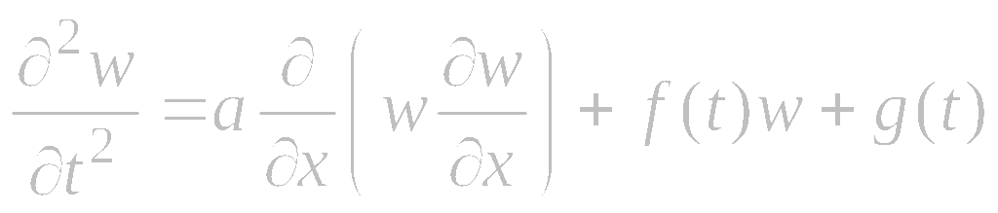
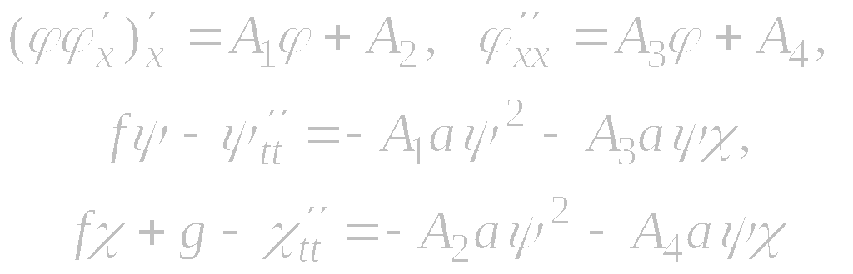
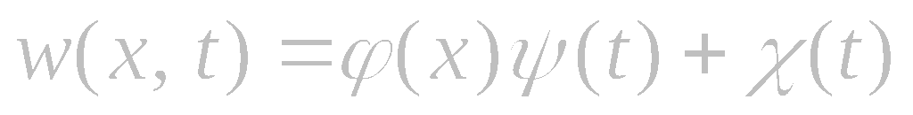
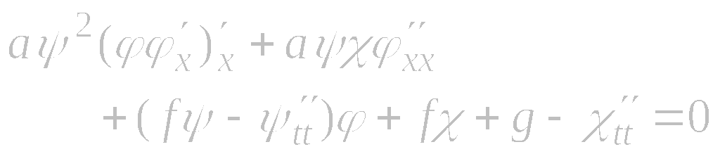
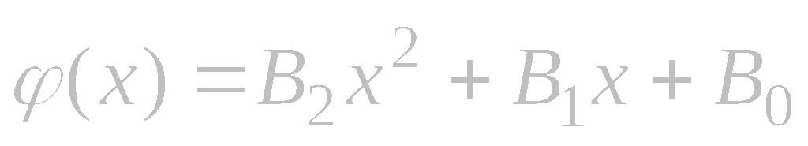
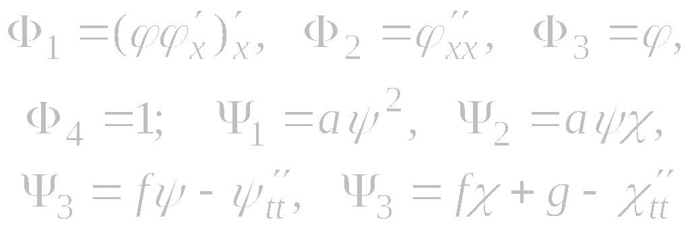
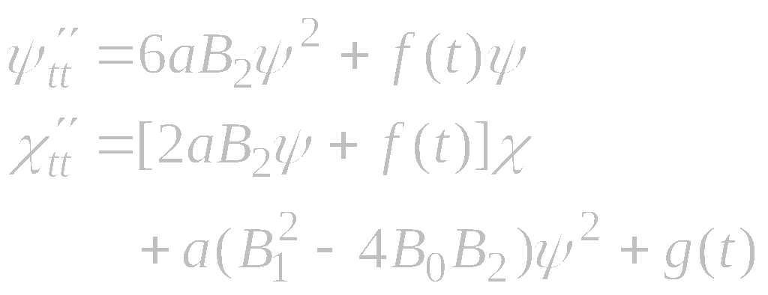
Examples
Nonlinear hyperbolic equation
The solution of the functional equation reads
We seek an exact solution in the form
Substituting this into the equation yields
The equations for ϕ are consistent if A₃ = 0. Then their solution is:
It can be treated as a four-term bilinear functional equation with
System for determining ψ(t) and χ(t):

Slide 12
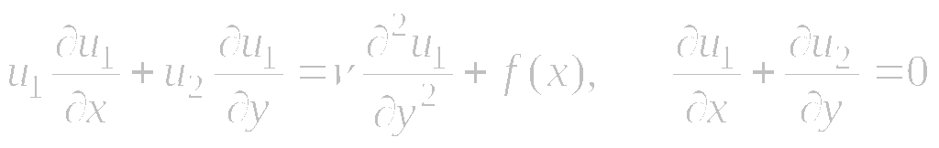
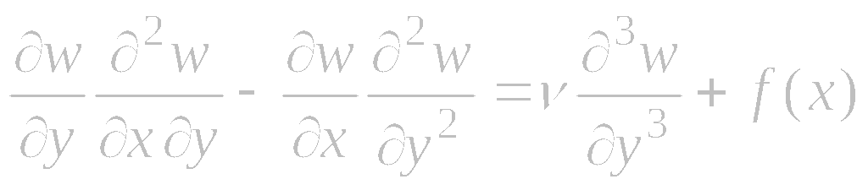
Examples
Boundary layer equations:
Introduce stream function w:
Arrive at a third-order nonlinear equation for w:

Slide 13
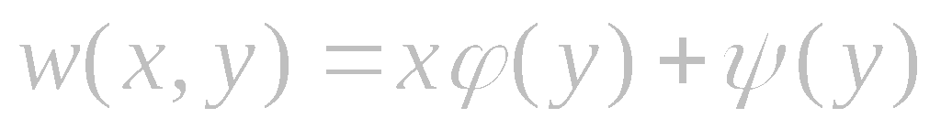
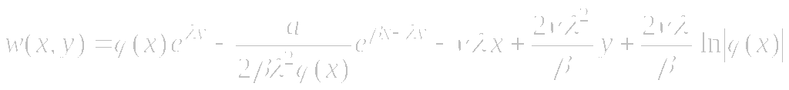
Exact Solutions of Boundary Layer Equations
Third-order nonlinear equation for the stream function:
1. Generalized separable solution for f (x) = ax + b:
where the functions ϕ and ψ are determined by the system of ODEs
2. Generalized separable solution for f (x) = ae^{β x}:
where ϕ(x) is an arbitrary function and λ is an arbitrary constant.

Slide 14
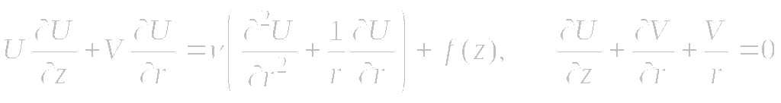
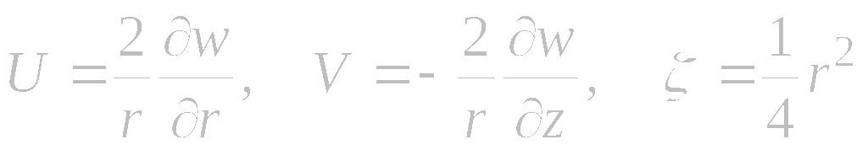
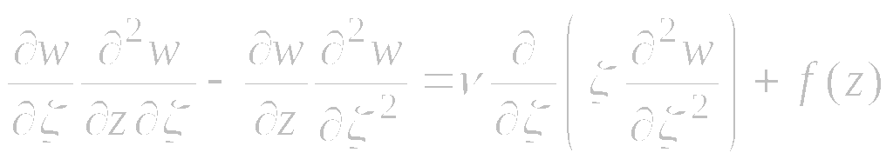
Examples
Axisymmetric boundary layer equations:
Introduce stream function w and a new variable ζ :
Arrive at a third-order nonlinear equation for w:

Slide 15
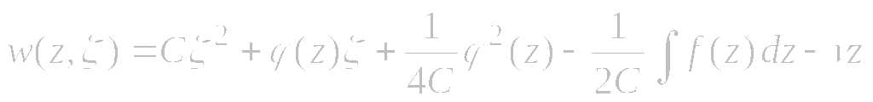

Exact Solutions of Axisymmetric Boundary Layer Equations
Third-order nonlinear equation for the stream function:
1. Generalized separable solution for arbitrary f (z):
where ϕ(z) is an arbitrary function.
2. Generalized separable solution for f (z) = az + b :
where the functions ϕ and ψ are determined by the system of ODEs

Slide 16
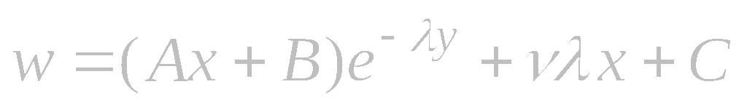
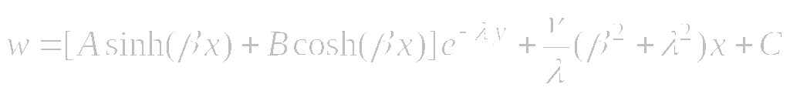
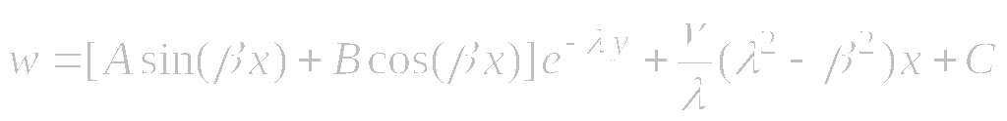
Examples. Exact Solutions of Navier–Stokes Equations
Fourth-order nonlinear equation for the stream function:
Generalized separable solutions:
where A, B, C, D, β, and λ are arbitrary constants.

Slide 17
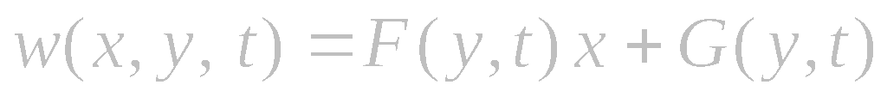
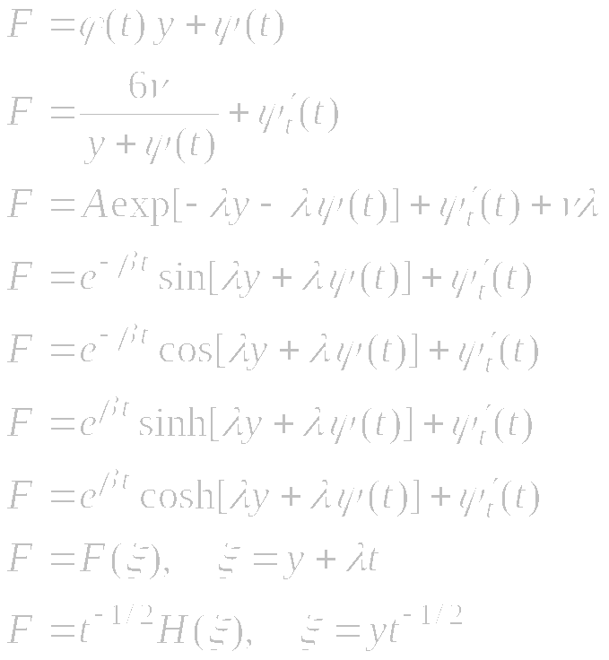
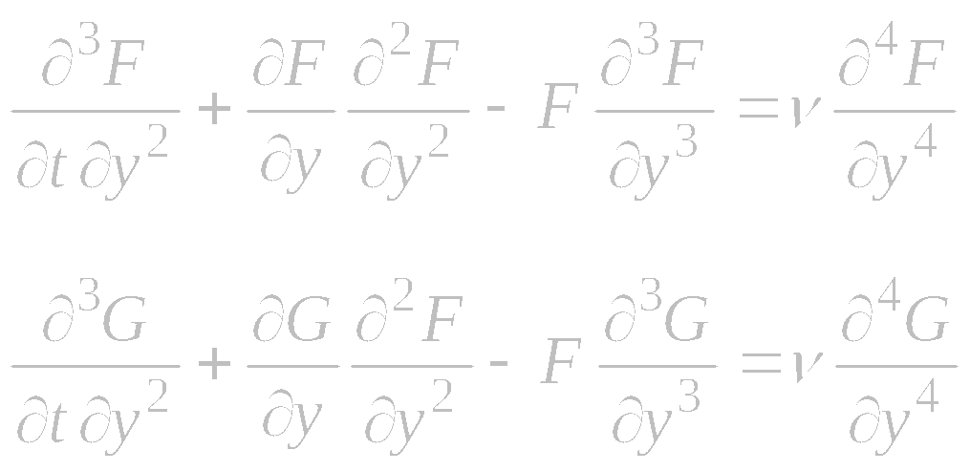
Examples. Nonstationary Navier–Stokes Equations
Exact solutions for the stream function:
Exact solutions to the first equation:
where the functions F and G are determined by the system of PDEs

Slide 18
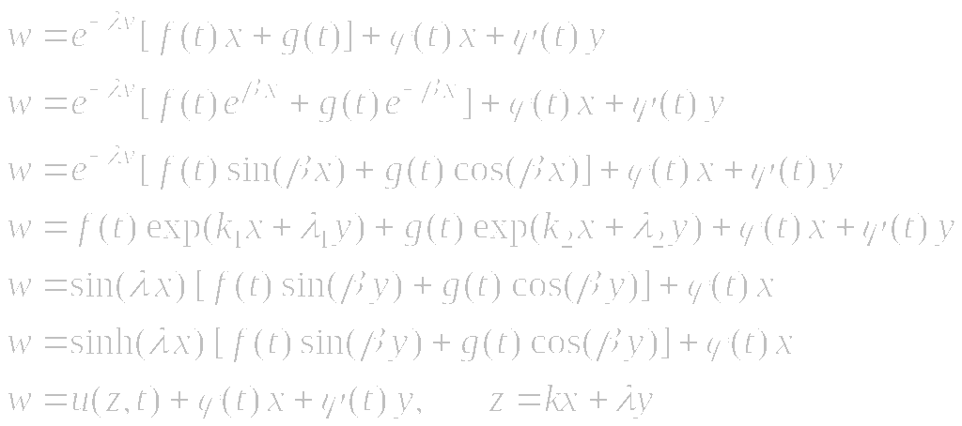
Examples. Nonstationary Navier–Stokes Equations
Exact solutions for the stream function:
where ϕ (t) and ψ (t) are arbitrary functions; the functions f (t) and g(t) are determined by a system of ODEs; and k, k₁, k₂, β, λ, λ₁, λ₂ are arbitrary constants.

Slide 19
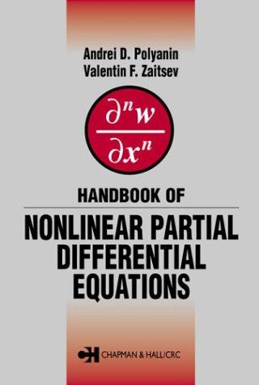
Reference
A. D. Polyanin and V. F. Zaitsev,
Handbook of Nonlinear Partial Differential Equations,
Chapman & Hall/CRC Press, 2003

