Slide 1
Lecture 2
Method of Functional
Separation of Variables
Andrei D. Polyanin

Slide 2

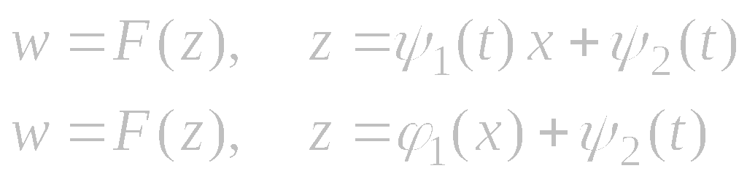
Functional Separation of Variables
General form of exact solutions:
In general, the functions ϕ_{m}(t), ψ_{m}(t), and F(z) in (∗) are not known in advance and are to be identified.
Main idea: the functional-differential equation resulting from the substitution of expression (∗) in the original PDE should be reduced to the standard bilinear functional equation (Lecture 1: Method of generalized separation of variables).
Functional separable solutions of special form:
The former solution is called a generalized travelling-wave solution.

Slide 3
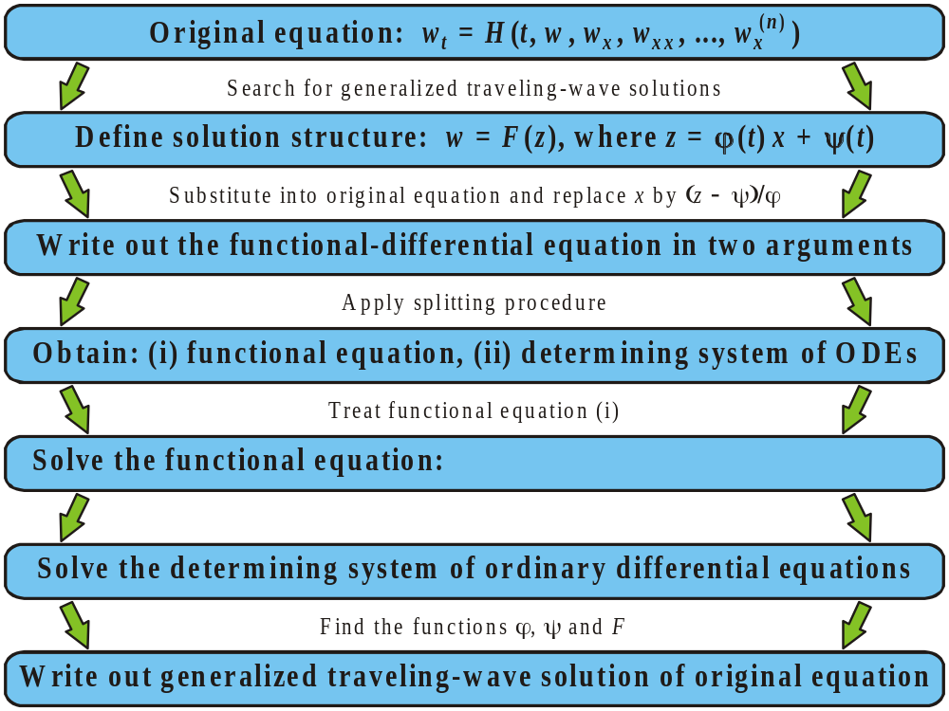
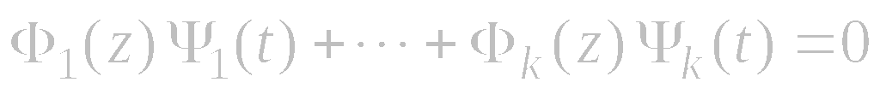
General Scheme for Constructing Generalized Traveling-Wave Solutions by the Splitting Method for Evolution Equations

Slide 4
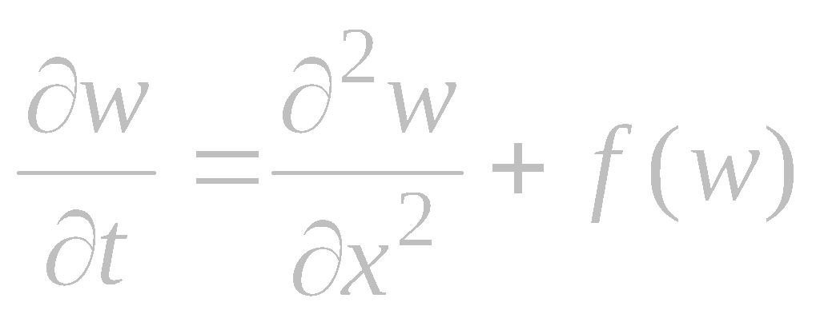

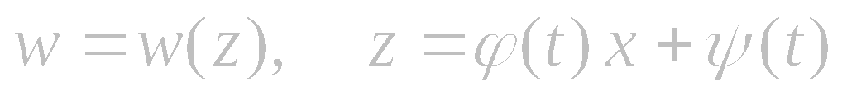

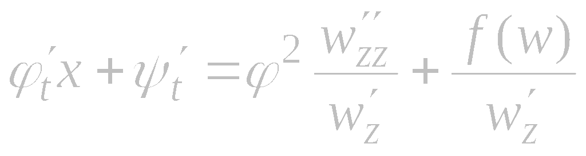

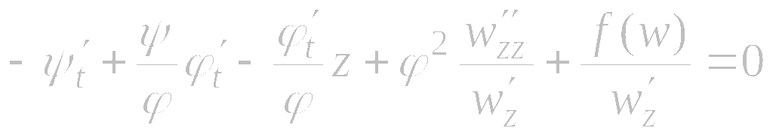
Example 1. Nonlinear Heat Equation
Consider the nonlinear heat equation
We look for generalized traveling-wave solutions of the form
The functions w(z), ϕ(t), ψ(t), and f (w) are to be determined. Substitute (2) into (1) and divide by w'_{z} to obtain
On expressing x from (2) in terms of z and substituting into (3), we get a functional-differential equation in two variables, t and z,

Slide 5
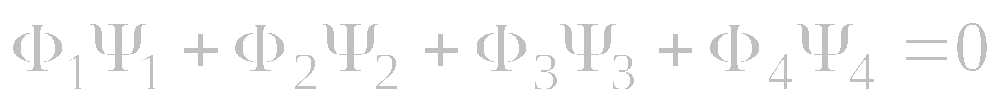
Example 1. Nonlinear Heat Equation (continued)
The functional differential equation
can be rewritten as the standard bilinear functional equation
with
Substituting these expressions into the solution of the 4-term functional equation (Lecture 1) yields the determining system of ordinary differential equations
where A₁, A₂, A₃, A₄ are arbitrary constants.

Slide 6
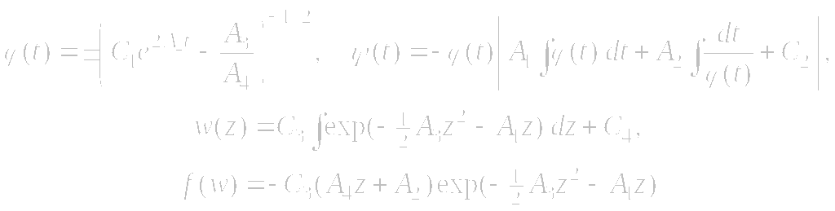
Example 1. Nonlinear Heat Equation (continued)
Determining system of ordinary differential equations:
The solution to the determining system of ODEs is given by
where C₁, …, C₄ are arbitrary parameters, A₄ ≠ 0. The dependence f = f (w) is defined by the last two relations in parametric form (z is treated as the parameter).

Slide 7
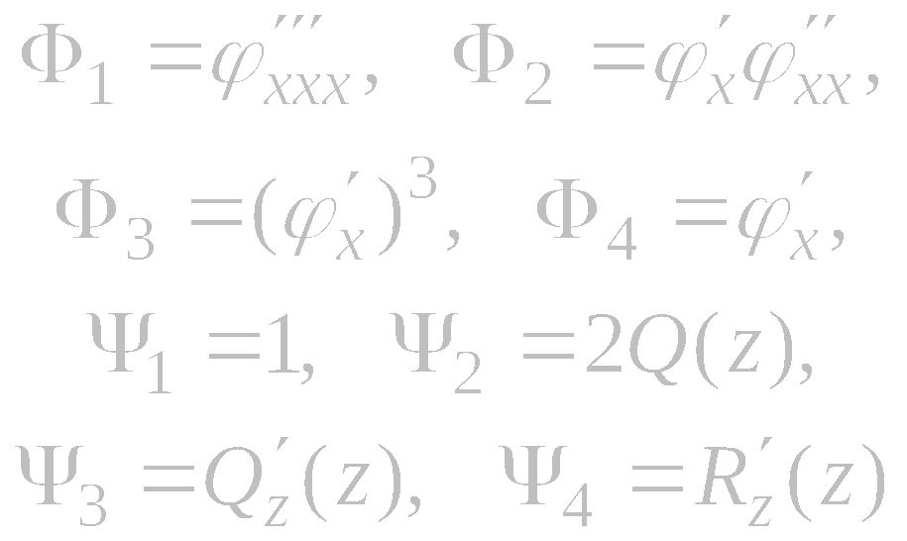
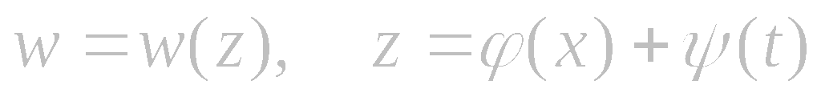

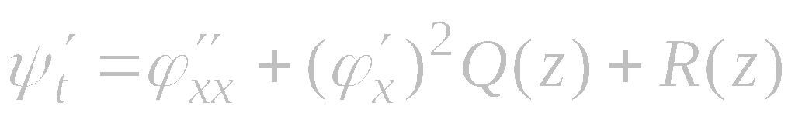
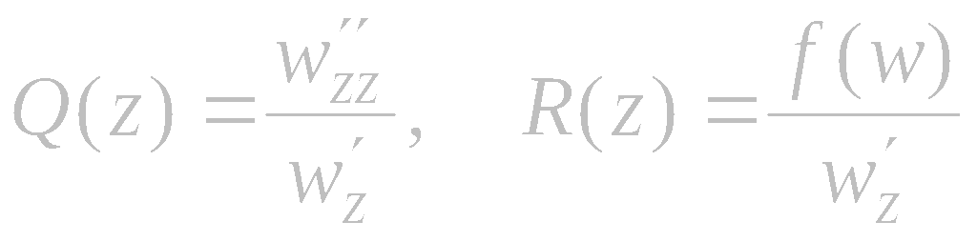
Example 2. Nonlinear Heat Equation
Again consider the nonlinear heat equation
Differentiating (3) with respect to z yields
where
We now look for functional separable solutions of the special form
Substitute (2) into (1) and divide by w'_{z} to obtain
where
Expressions (5) should then be substituted into the solution of the functional equation (4) to obtain the determining system of ODEs (see Lecture 1).

Slide 8
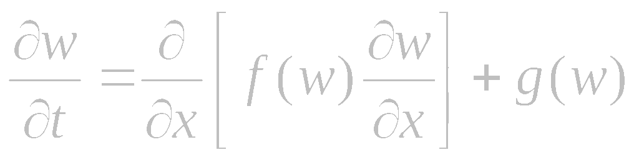
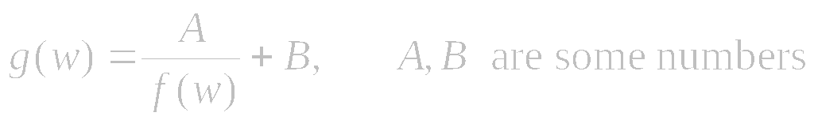
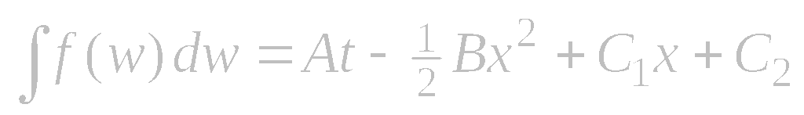
Example 3. Mass and Heat Transfer with Volume Reaction
Nonlinear equation:
First functional separable solution
Let the function f = f (w) be arbitrary and let g = g(w) be defined by
In this case, there is a functional separable solution defined implicitly by
where C₁, C₂ are arbitrary numbers.

Slide 9
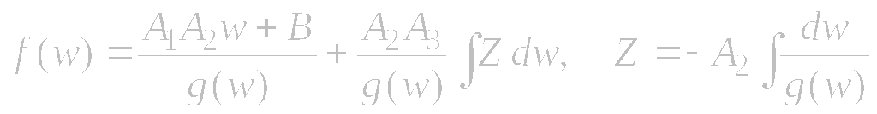
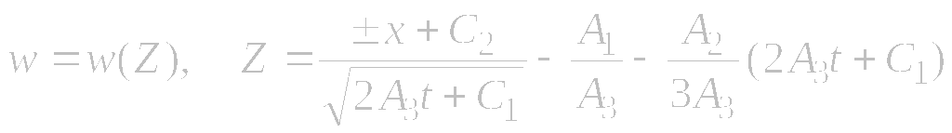
Mass and Heat Transfer with Volume Reaction (continued)
Nonlinear equation:
Second functional separable solution
Let now g = g(w) be arbitrary and let f = f (w) be defined by
where A₁, A₂, A₃ are some numbers. Then there are generalized traveling-wave solutions of the form
where w(Z) is determined by inverting the second relation in (∗) and C₁, C₂ are arbitrary numbers.

Slide 10
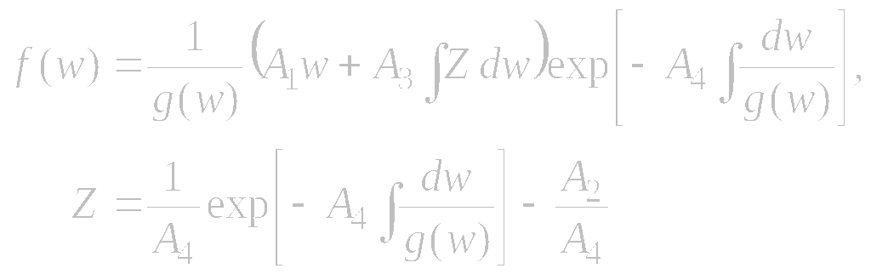

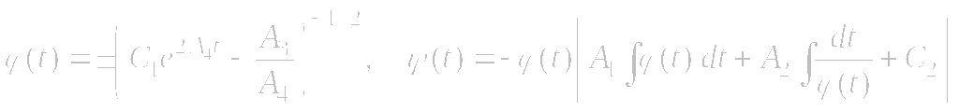
Mass and Heat Transfer with Volume Reaction (continued)
Nonlinear equation:
Third functional separable solution
Let now g = g(w) be arbitrary and let f = f (w) be defined by
where A₄ ≠ 0. Then there are generalized traveling-wave solutions of the form
where the function w(Z) is determined by the inversion of relation (∗)
and C₁, C₂ are arbitrary numbers.

Slide 11
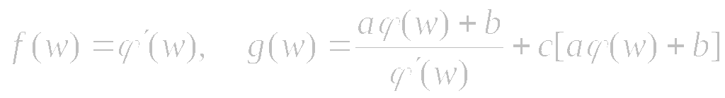
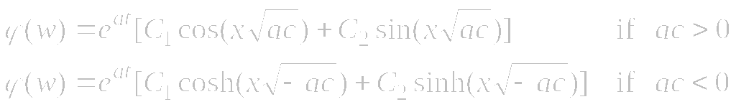
Mass and Heat Transfer with Volume Reaction (continued)
Nonlinear equation:
Fourth functional separable solution
Let the functions f = f (w) and g = g(w) be defined as follows:
where ϕ(w) is an arbitrary function and a, b, c are any numbers; the prime denotes the derivative with respect to w. Then there are functional separable solutions defined implicitly by

Slide 12
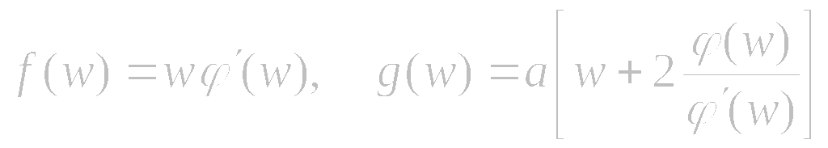
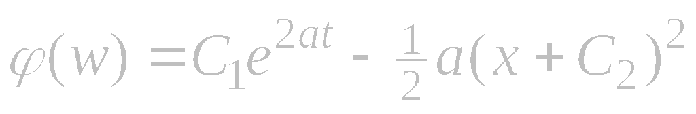
Mass and Heat Transfer with Volume Reaction (continued)
Nonlinear equation:
Fifth functional separable solution
Let the functions f = f (w) and g = g(w) be defined as follows:
where ϕ(w) is an arbitrary function and a is any numbers; the prime denotes the derivative with respect to w. Then there are functional separable solutions defined implicitly by
where C₁, C₂ are arbitrary numbers.

Slide 13
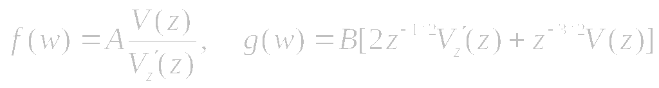

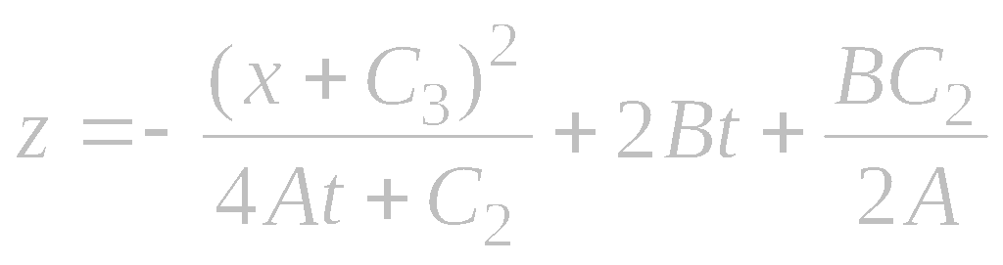
Mass and Heat Transfer with Volume Reaction (continued)
Nonlinear equation:
Sixth functional separable solution
Let the functions f = f (w) and g = g(w) be defined as follows:
where V(z) is an arbitrary function of z; A, B are arbitrary constants (AB ≠ 0); and the function z = z(w) is determined implicitly by
with C₁ being an arbitrary constant. Then there is a functional separable solution of the form (∗) where
with C₂, C₃ being arbitrary constants.

Slide 14
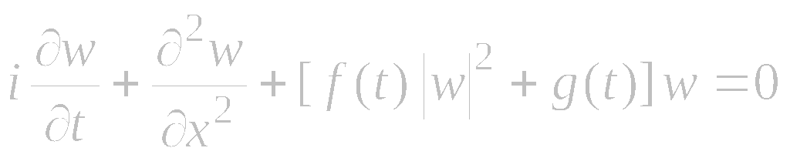
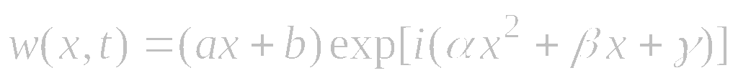
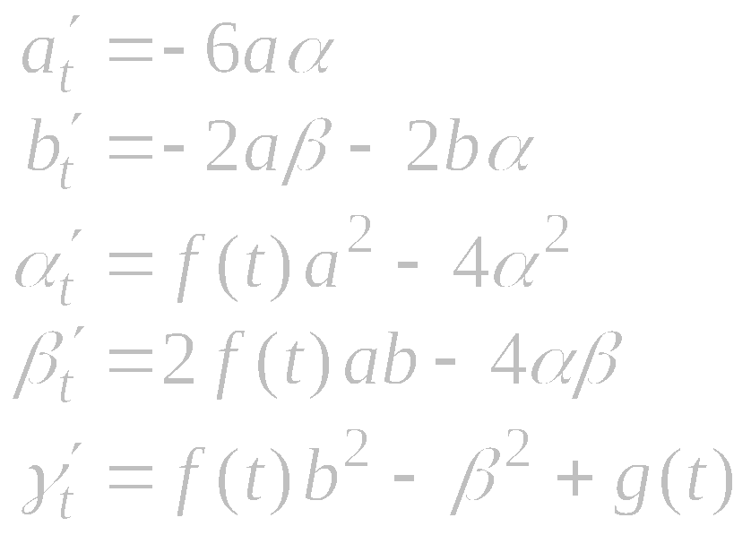
Nonlinear Schrödinger Equation with Cubic Nonlinearity
Equation:
Exact solution:
where the functions a = a(t), b = b(t), α = α (t), β = β (t), γ = γ (t) are determined by the system of ODEs

Slide 15
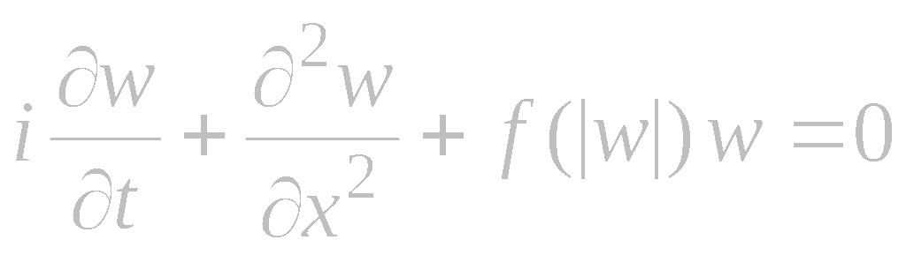

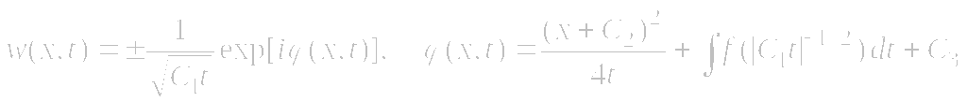
Nonlinear Schrödinger Equation of General Form
Equation:
1. Exact solution:
where A, B, C are arbitrary real constants, and the function ϕ = ϕ (t) is determined by the ordinary differential equation
2. Exact solutions:
where C₁, C₂, C₃ are arbitrary real constants.

Slide 16
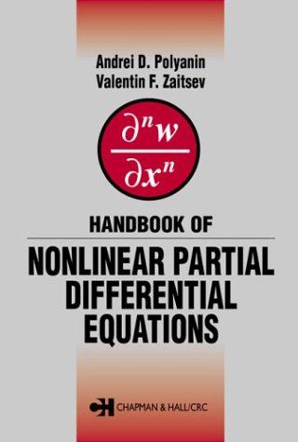
Reference
A. D. Polyanin and V. F. Zaitsev,
Handbook of Nonlinear Partial Differential Equations,
Chapman & Hall/CRC Press, 2003

