Slide 1
Lecture 3
Differential Constraints Method
Andrei D. Polyanin

Slide 2
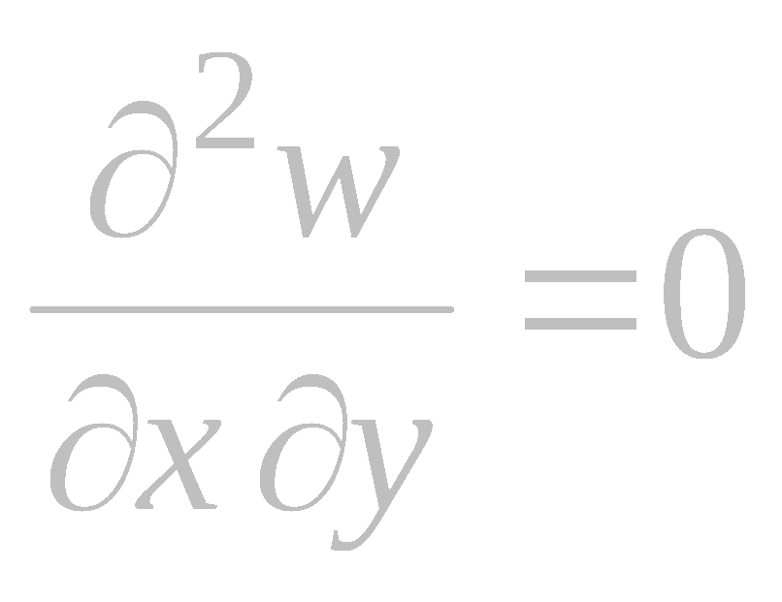

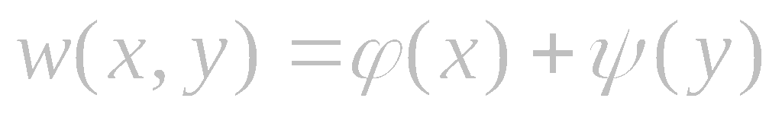

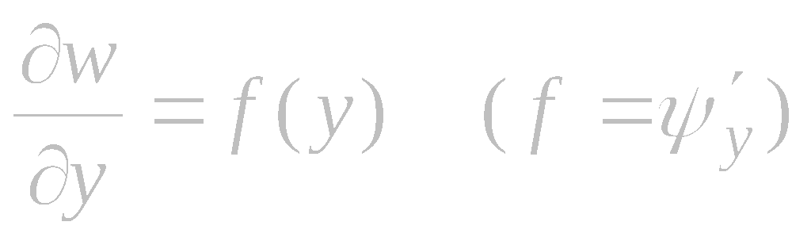

Preliminary Remarks. A Simple Example
Additive separable solutions in the case of two independent variables are sought in the form
Further, differentiating (2) with respect to x yields
Conversely, from (3) we obtain a representation of the solution in the
form (1).
Thus, the problem of finding exact solutions of the form (1) for a specific partial differential equation may be replaced by an
equivalent problem of finding exact solutions of the given equation supplemented with condition (2) or (3). Such supplementary conditions in the form of one or several differential equations will be called differential constraints.
At the initial stage, the functions ϕ(x) and ψ(y) are assumed arbitrary and are to be determined in the subsequent analysis.
Differentiating (1) with respect to y yields
Conversely, relation (2) implies a representation of the solution in the
form (1).

Slide 3
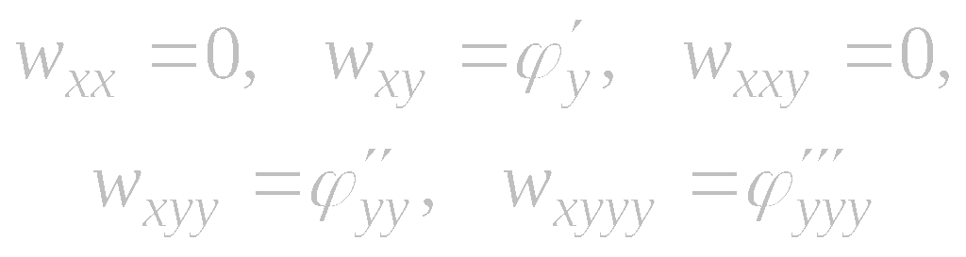
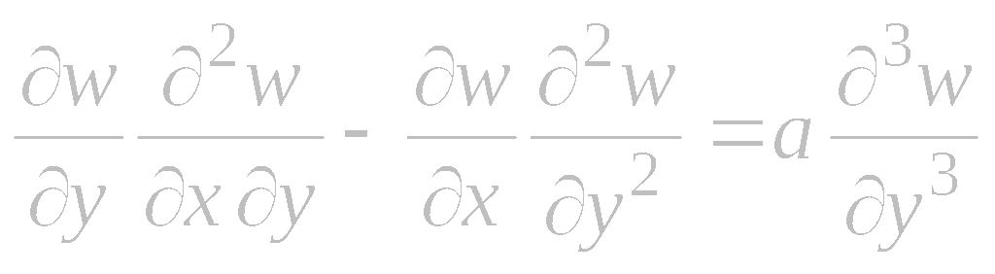
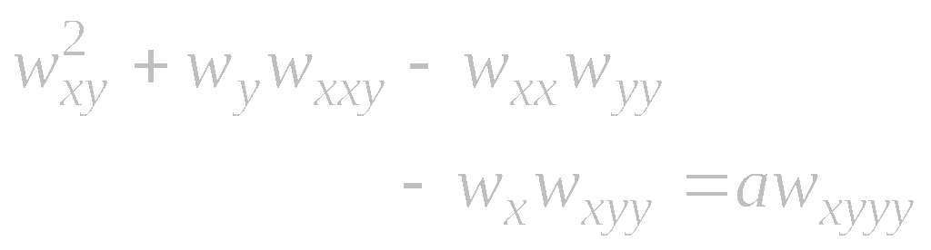

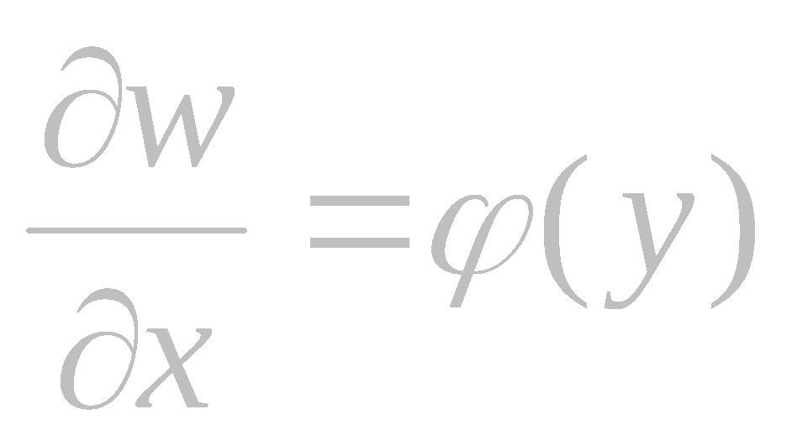
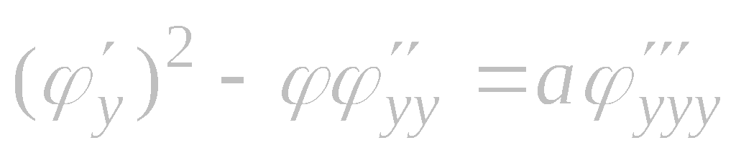

Simple Example
Consider the boundary layer equation for stream function
Differentiating (1) with respect to x yields
Let us seek a solution of equation (1) satisfying the linear first-order differential constraint
Substituting the derivatives from (2) and (3) into (4), we obtain
The unknown function ϕ (y) must satisfy the condition of compatibility of equations (1) and (2).
First stage. Successively differentiating (2) with respect to different variables, we calculate the derivatives
It is the compatibility condition for Eqs. (1) and (2).

Slide 4


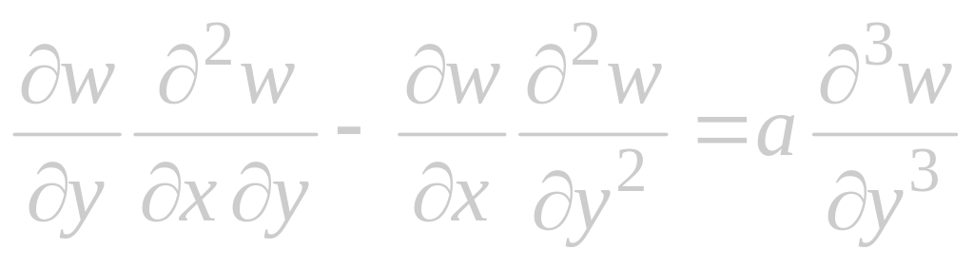



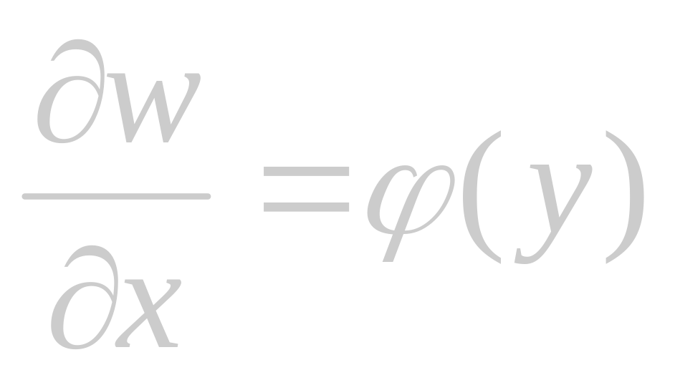

Simple Example (continued)
Second stage. In order to construct an exact solution, we integrate equation (2) to obtain
Reminder
Boundary layer equation for stream function
Third stage. The function ψ (y) is found by substituting (6) into (1) and taking into account condition (5). As a result, we arrive at the ordinary differential equation
Differential constraint
Finally, we obtain an exact solution of the form (6), with the functions ϕ and ψ described by equations (5) and (7).

Slide 5
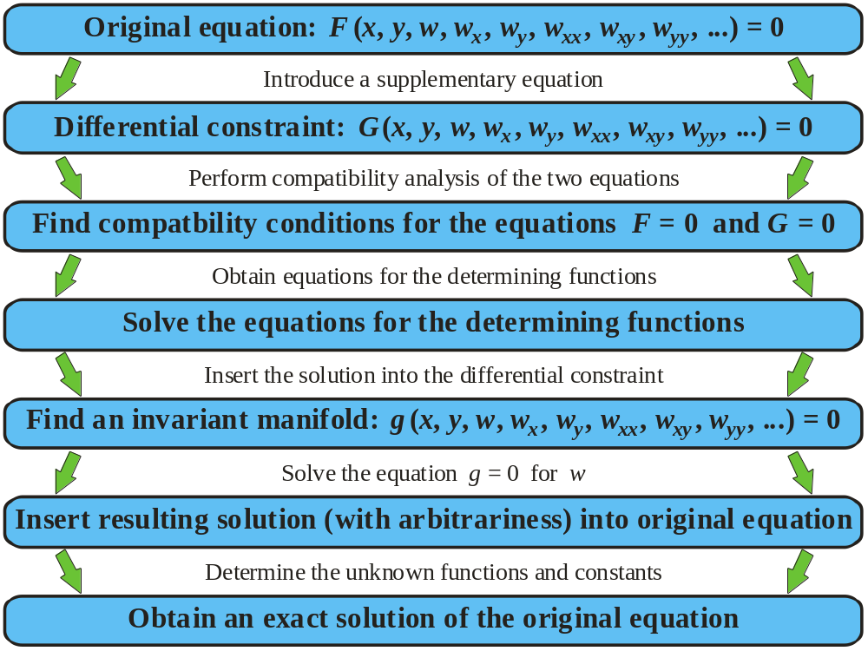
General Scheme for the Differential Constraints Method

Slide 6
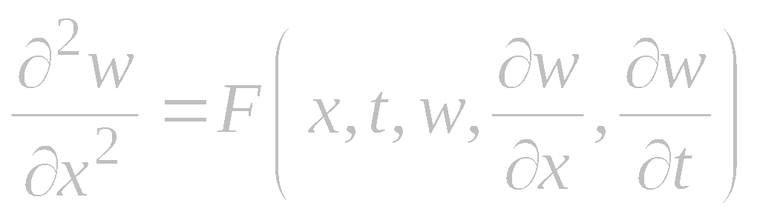
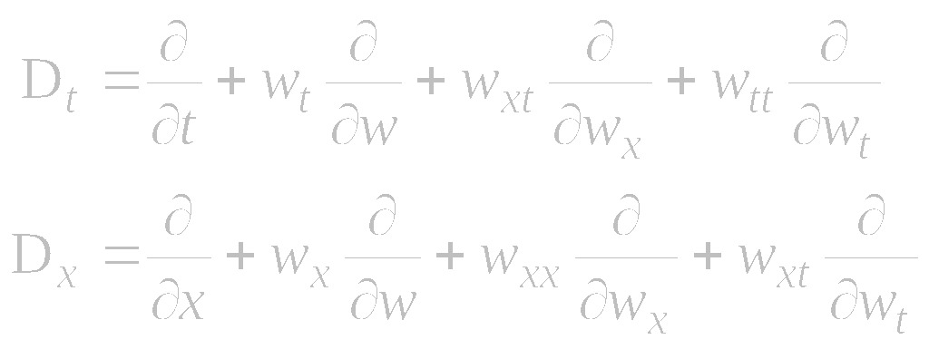
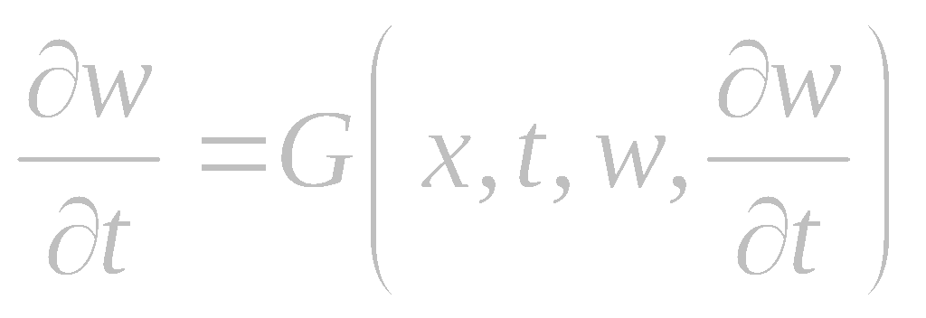
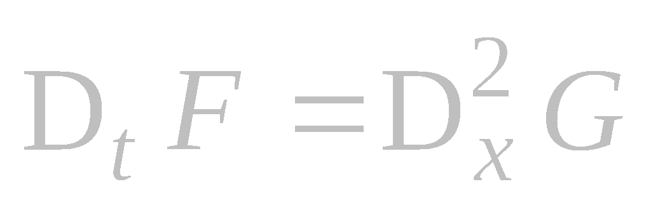
Differential Constraints Method
Consider a general second-order evolution equation solved for the highest-order derivative:
where D_{t} and D_{x} are the total differentiation operators with respect to t and x:
Let us supplement this equation with a first-order differential constraint
The partial derivatives w_{t}, w_{xx}, w_{xt}, and w_{tt} here should be expressed in terms of x, t, w, and w_{x} by means of relations (1) and (2) and those obtained by differentiation of (1) and (2).
The condition of compatibility of these equations is w_{xxt} = w_{txx}. Differentiating (1) and (2), we find that

Slide 7

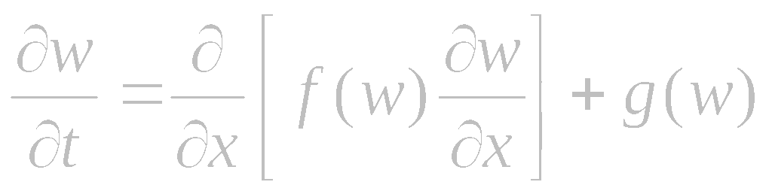
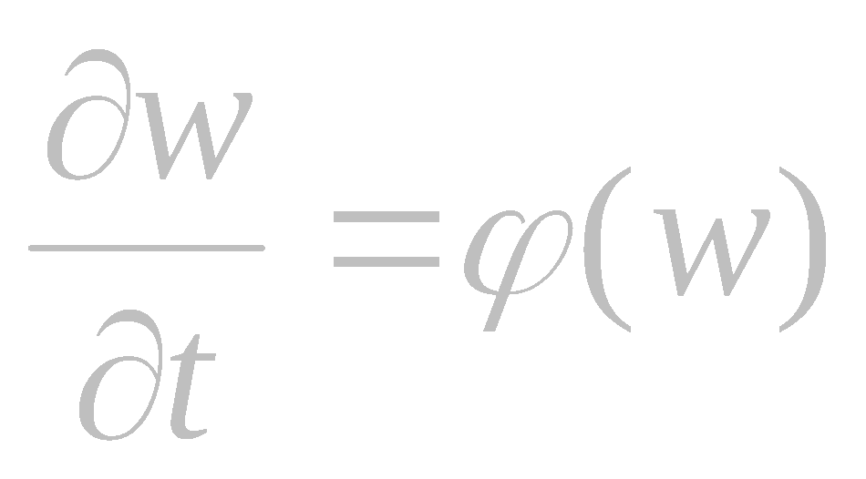
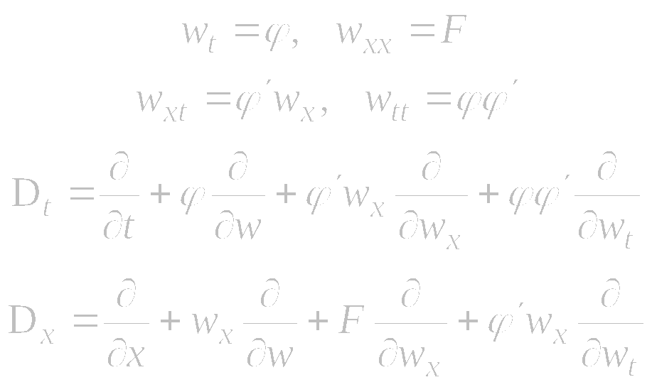
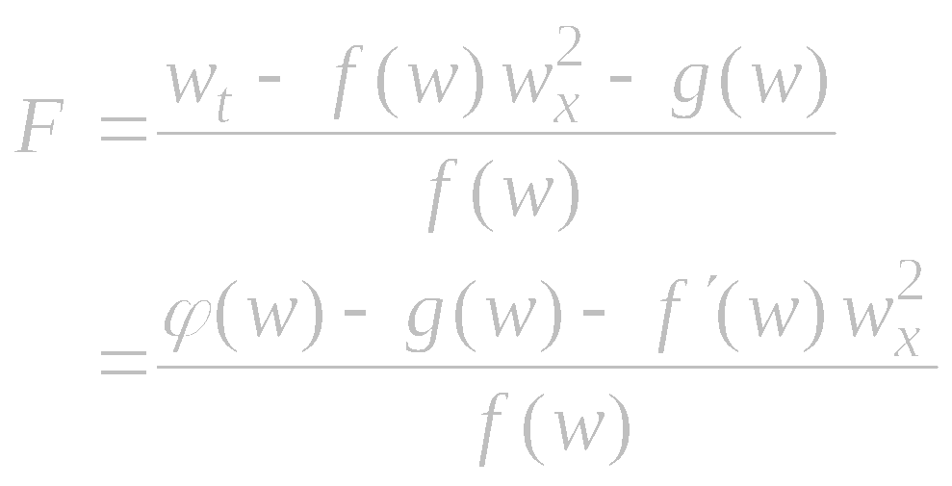
Differential Constraints Method
Example (Galaktionov, 1994). Consider a nonlinear heat equation with a source of general form:
The functions f (w), g(w), and ϕ (w) are unknown in advance and are to be determined in the subsequent analysis.
Find partial derivatives and the total differentiation operators:
Consider differential constraints of simple form:
Equations (4) and (5) are special cases of
(1) and (2) with

Slide 8
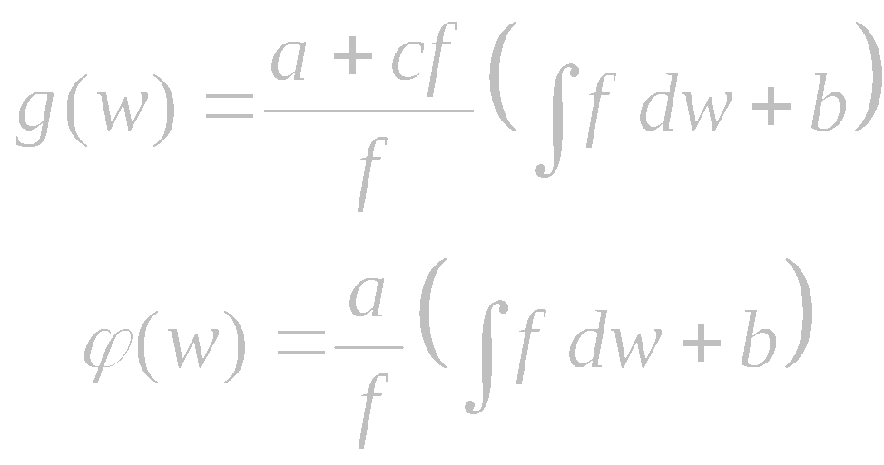
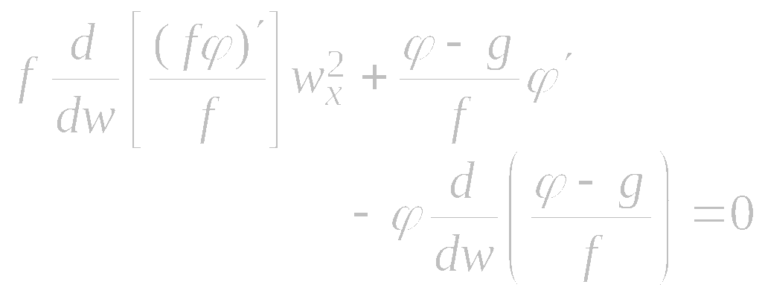
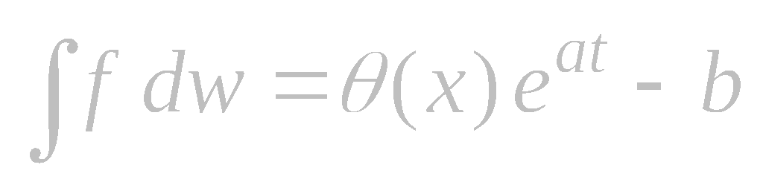

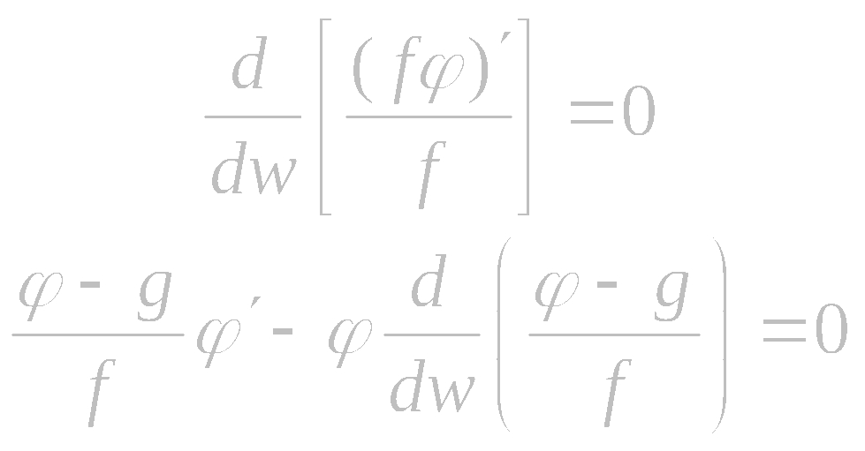
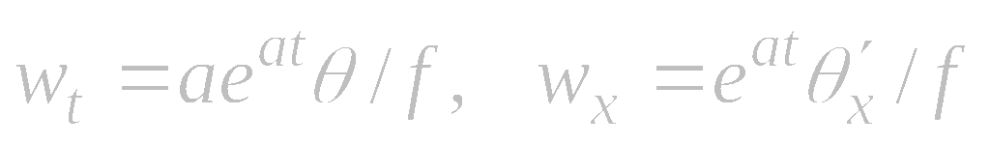
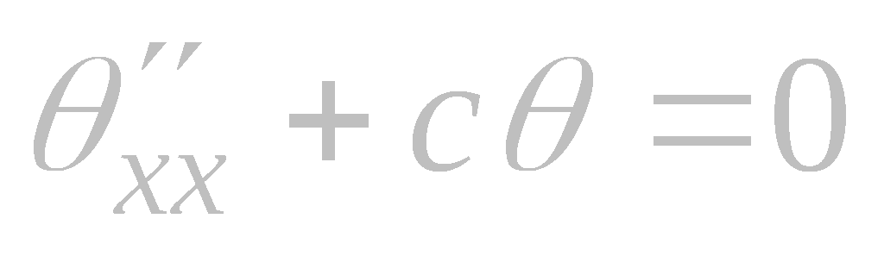
Differential Constraints Method. Example (continued)
We insert the expressions of D_{t} and D_{x} into the compatibility condition D_{t} F = D_{x}² G and rearrange terms to obtain
We substitute ϕ (w) from (7) in equation (5) and integrate to obtain
In order to ensure that this equation holds true for any w_{x}, one should set
On differentiating (8) with respect to x
and t, we get
On substituting these expressions into (4) and taking into account (7), we arrive at a linear constant-coefficient equation:
Assuming that f = f (w) is prescribed, we find the solution of equations (6):

Slide 9
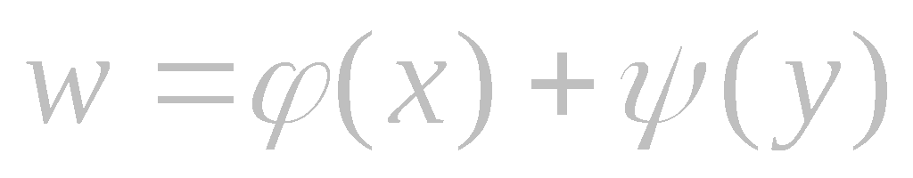



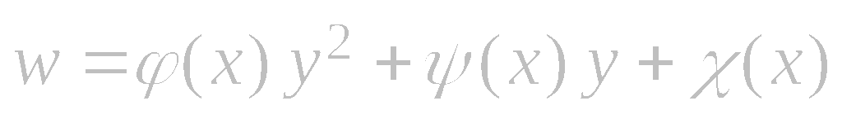







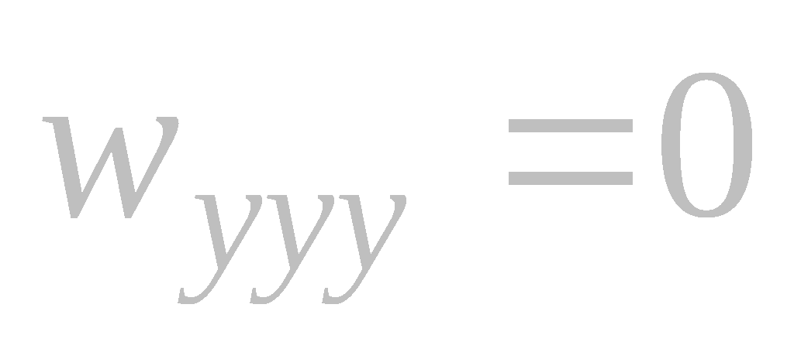


Generalized and Functional Separation of Variables vs. Differential Constraints
Table 1: Second-order differential constraints
corresponding to some classes of exact solutions representable in explicit form
Type of solution | Structure of solution | Differential constraints
Additive separable
Multiplicative separable
Generalized separable
Generalized separable
Functional separable
Functional separable
Table 2: Second-order differential constraints
corresponding to some classes of exact solutions representable in explicit form
Type of solution | Structure of solution | Differential constraints
Generalized separable
Generalized separable
Functional separable
Functional separable

Slide 10
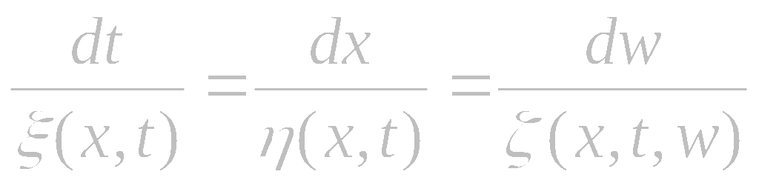
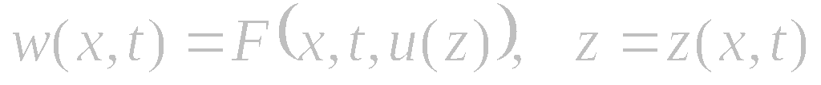
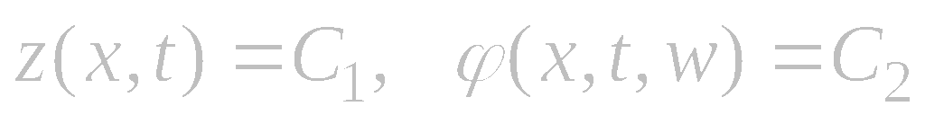
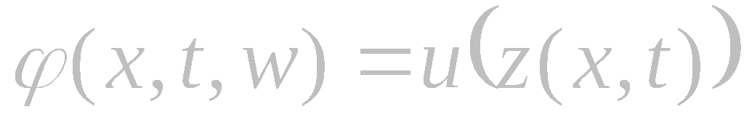
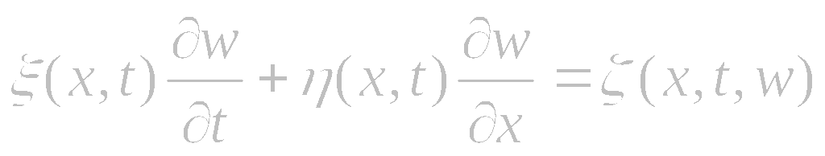
Direct Method for Similarity Reductions and Differential Constraints Method
A generalized similarity reduction based on a prescribed form of the desired solution (Clarkson, Kruskal, 1989)
Indeed, first integrals of the characteristic system of ODEs
where F(x,t,u) and z(x,t) should be selected so as to obtain ultimately a
single ODE for u(z).
Employing the solution structure (1) is equivalent to searching for a solution with the help of a first-order quasilinear differential constraint (Olver, 1994)
have the form
Therefore, the general solution of
equation (2) can be written as follows:
where u(z) is an arbitrary function. On solving (3) for w, we obtain a representation of the solution in the form (1).

Slide 11
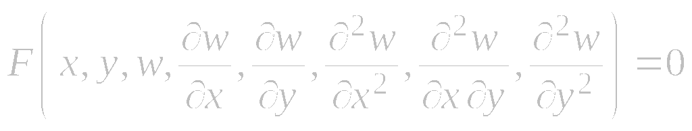
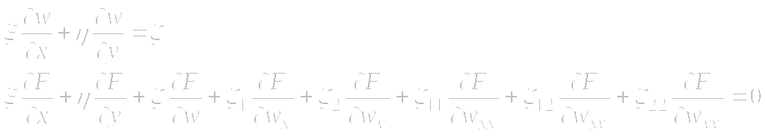
Nonclassical Method for Similarity Reductions and Differential Constraints Method
Consider the general second-order equation
Let us supplement equation (1) with two differential constraints
where ξ = ξ (x, y, w), η = η (x, y, w), and ζ = ζ (x, y, w) are unknown functions, and the coordinates of the first and the second prolongations ζ_{i} and ζ_{ij} are defined by formulas from the classical method of group analysis.
The method for the construction of exact solutions to equation (1) based on using the first-order partial differential equation (2) and the invariance condition (3) corresponds to the nonclassical method for similarity reduction (G. W. Bluman, J. D. Cole, 1969).

Slide 12
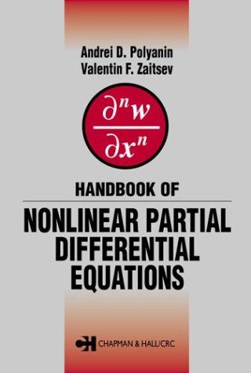
Reference
A. D. Polyanin and V. F. Zaitsev,
Handbook of Nonlinear Partial Differential Equations,
Chapman & Hall/CRC Press, 2003

