Slide 1


Exact solutions to nonlinear equations and systems of equations of general form
in mathematical physics
Andrei Polyanin¹, Alexei Zhurov^{1,2}
¹ Institute for Problems in Mechanics, Russian Academy of Sciences, Moscow
² Cardiff University, Cardiff, Wales, UK

Slide 2


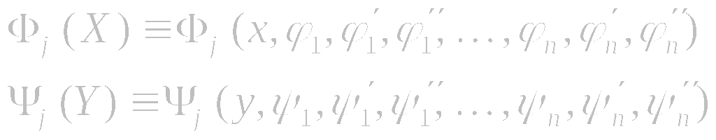
Generalized Separation of Variables
General form of exact solutions:
Partial differential equations with quadratic or power nonlinearities:
On substituting expression (1) into the differential equation (2), one arrives at a functional-differential equation
for the ϕ_{i} (x) and ψ_{i} ( y). The functionals Φ_{j} (X) and Ψ_{j} (Y ) depend only on x and y, respectively,
The formulas are written out for the case of a second-order equation (2).

Slide 3
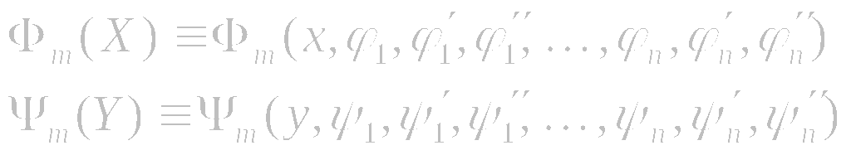
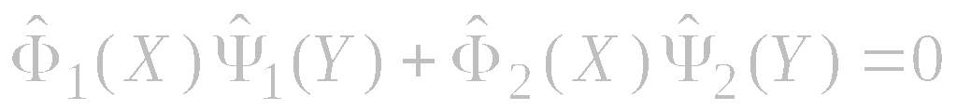
Solution of Functional-Differential Equations by Differentiation
General form of exact solutions:
1. Assume that Ψ_{k} is not identical zero for some k. Dividing the equation by Ψ_{k} and differentiating w.r.t. y, we obtain a similar equation but with fewer terms
2. We continue the above procedure until a simple separable two-term equation is obtained:
3. The case Ψ_{k} ≡ 0 should be treated separately (since we divided the equation by Ψ_{k} at the first stage).

Slide 4
Information on Solution Methods
A.D. Polyanin, V.F. Zaitsev, A.I. Zhurov, Solution methods for nonlinear equations of mathematical physics and mechanics (in Russian). Moscow: Fizmatlit, 2005.
http://eqworld.ipmnet.ru/en/education/edu-pde.htm
Methods for solving mathematical equations
http://eqworld.ipmnet.ru/en/methods.htm
http://eqworld.ipmnet.ru/ru/methods.htm
A.D. Polyanin, Lectures on solution methods for nonlinear partial differential equations of mathematical physics, 2004.
http://eqworld.ipmnet.ru/en/education/edu-pde.htm
http://eqworld.ipmnet.ru/ru/education/edu-pde.htm

Slide 5
Exact Solutions to Nonlinear Systems of
Equations

Slide 6
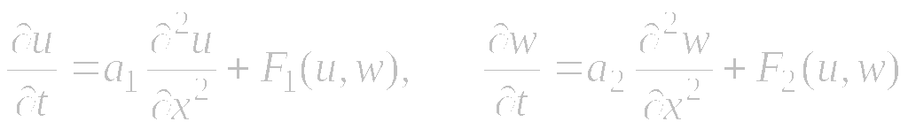
Generalized separation of variables for nonlinear systems
Consider systems of nonlinear second-order equations:
(1)
Such systems often arise in the theory of mass exchange of reactive media, combustion theory, mathematical biology, and biophysics.
We look for nonlinear systems (1), and also their generalizations, that admit exact solutions in the form:
The functions ϕ₁(w), ϕ₂(w), ψ₁(w), and ψ₂(w) are selected so that both equations of system (1) produce the same equation for θ(x,t) .

Slide 7
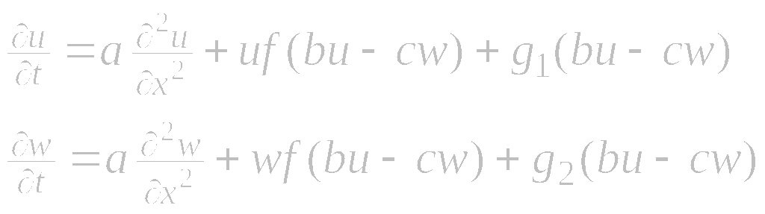
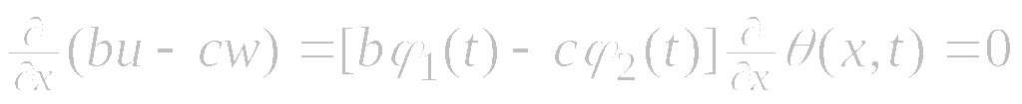

Nonlinear systems. Example 1
Consider the nonlinear system
(1)
The functions f(z), g₁(z) and g₂(z) are arbitrary .
We seek exact solutions in the form:
Let us require that the argument bu − cw is dependent on t only:
It follows that

Slide 8
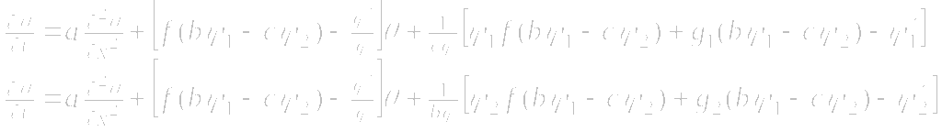
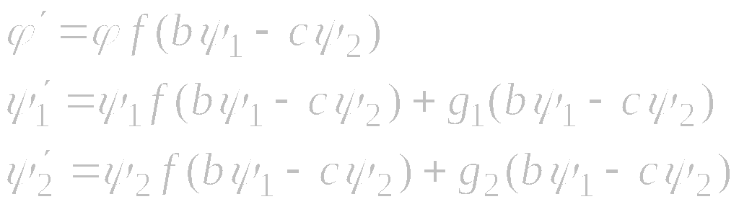
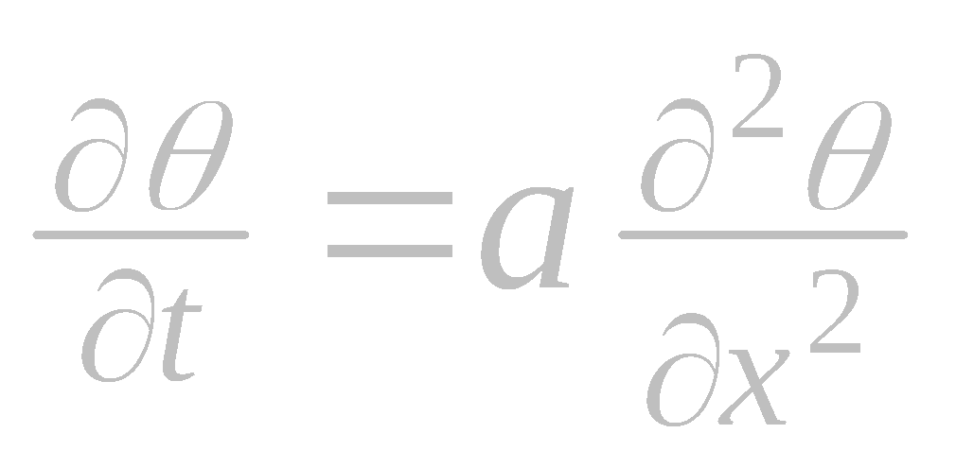
Nonlinear systems. Example 1 (continued)
This leads to the following equations
For the two equations to coincide, we must require that
(∗)
Then θ(x, t) satisfies the linear heat equation

Slide 9
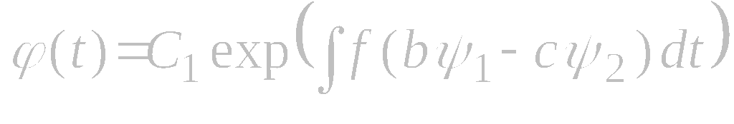
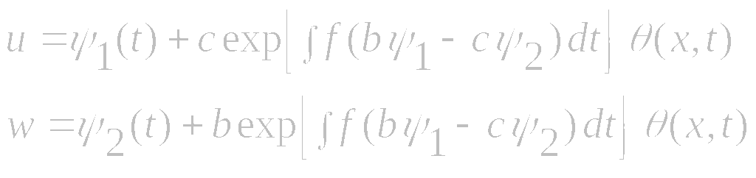
Nonlinear systems. Example 1 (continued)
Nonlinear system:
(1)
From (*) we find that
Eventually we obtain the following exact solution:

Slide 10
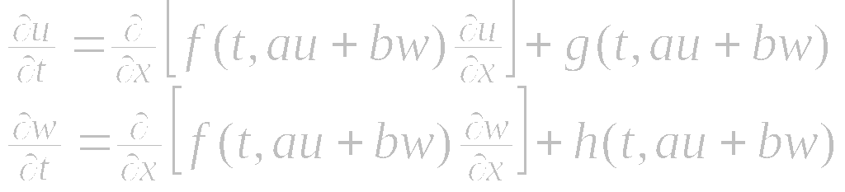
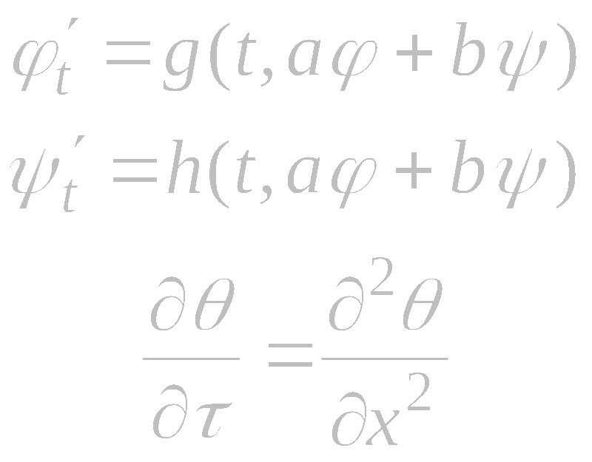
Nonlinear systems. Example 2
Nonlinear system:
It admits exact solutions of the form
where

Slide 11
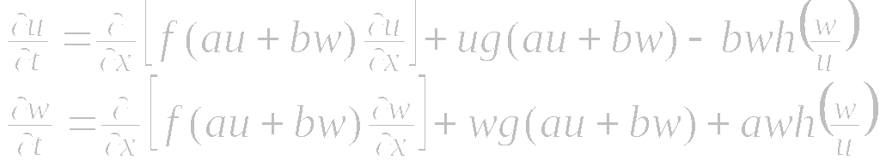
Nonlinear systems. Example 3
Nonlinear system:
Exact solution 1:
where ϕ = ϕ(t) and r = r(x, t) satisfy the equations
Exact solution 2:
Exact solution 3:

Slide 12
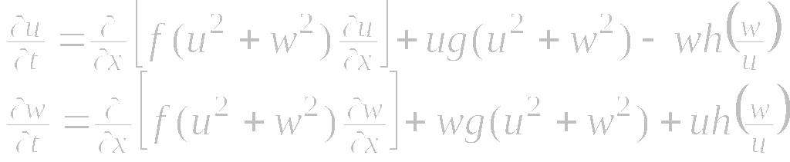
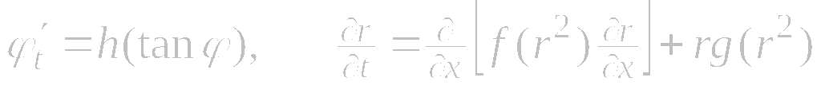
Nonlinear systems. Example 4
Nonlinear system:
Exact solution:
where ϕ = ϕ(t) and r = r(x, t) satisfy the equations

Slide 13
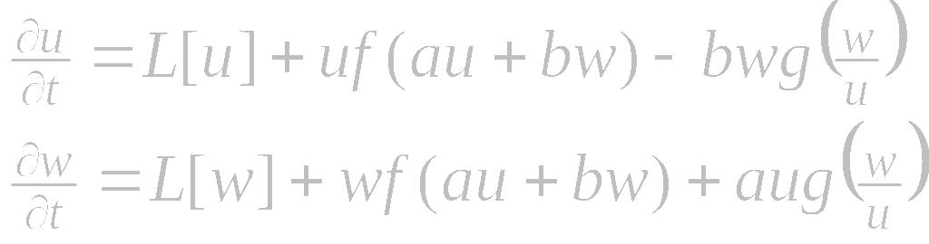
Nonlinear systems. Example 5
Nonlinear system:
where L is an arbitrary linear differential operator in x (of any order with respect to the derivatives); the coefficients can depend on x.
Exact solution 1:
where ϕ = ϕ(t) and r = r(x, t) satisfy the equations
Exact solution 2:

Slide 14
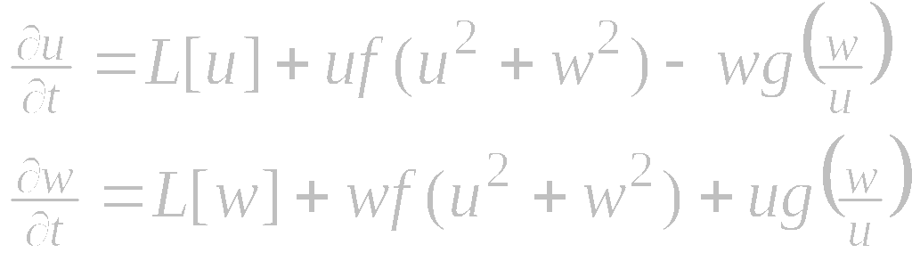
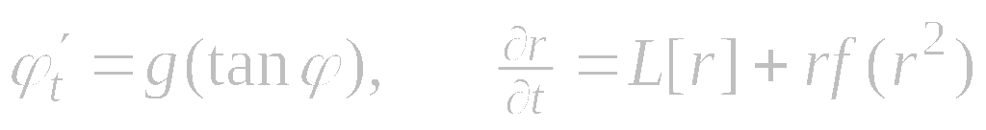
Nonlinear systems. Example 6
Nonlinear system:
where L is an arbitrary linear differential operator in x (of any order with respect to the derivatives); the coefficients can depend on x.
Exact solution:
where ϕ = ϕ(t) and r = r(x, t) satisfy the equations

Slide 15
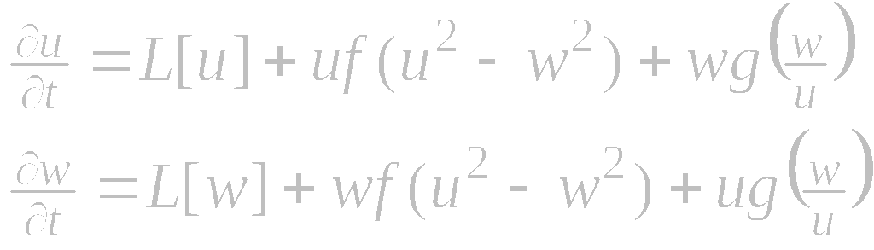
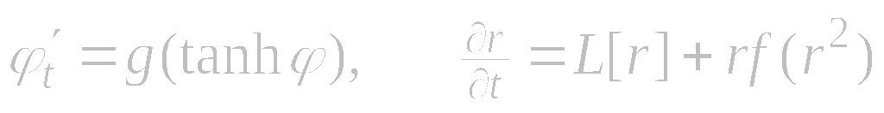
Nonlinear systems. Example 7
Nonlinear system:
where L is an arbitrary linear differential operator in x (of any order with respect to the derivatives); the coefficients can depend on x.
Exact solution:
where ϕ = ϕ(t) and r = r(x, t) satisfy the equations

Slide 16
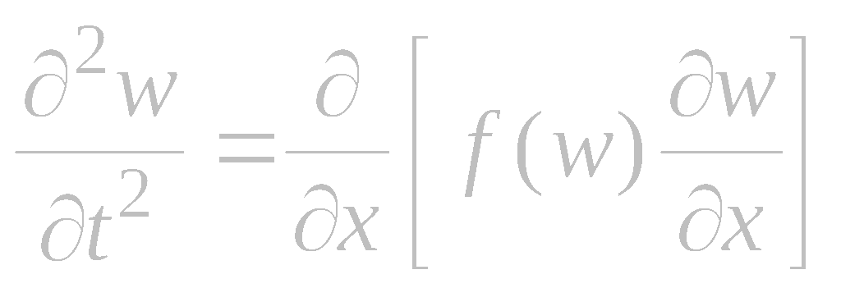
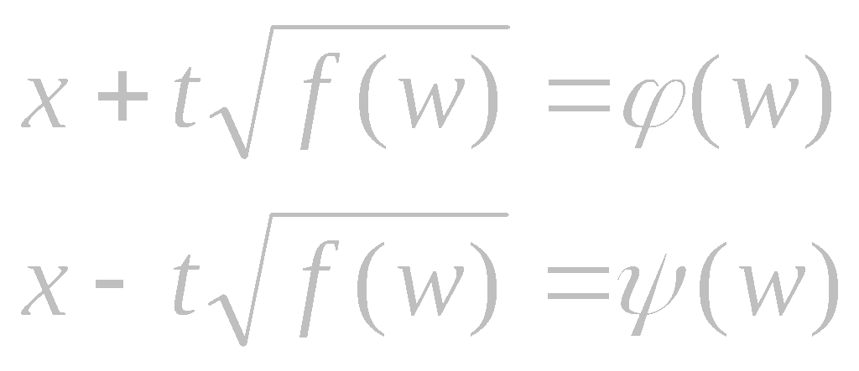
Nonlinear wave equations. Example 1
Nonlinear equation:
Arises in wave and gas dynamics.
Functional separable solutions in implicit form:
where ϕ(w) and ψ(w) are arbitrary functions.

Slide 17
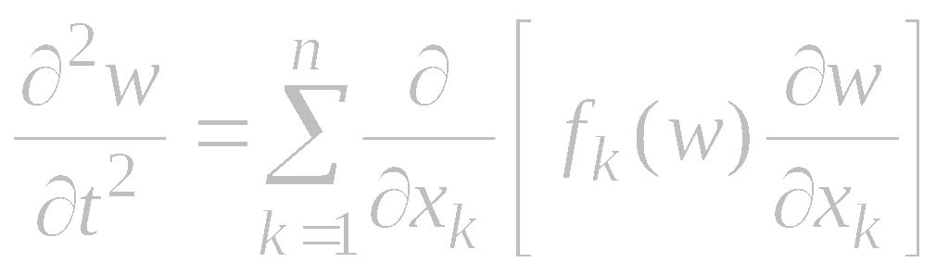
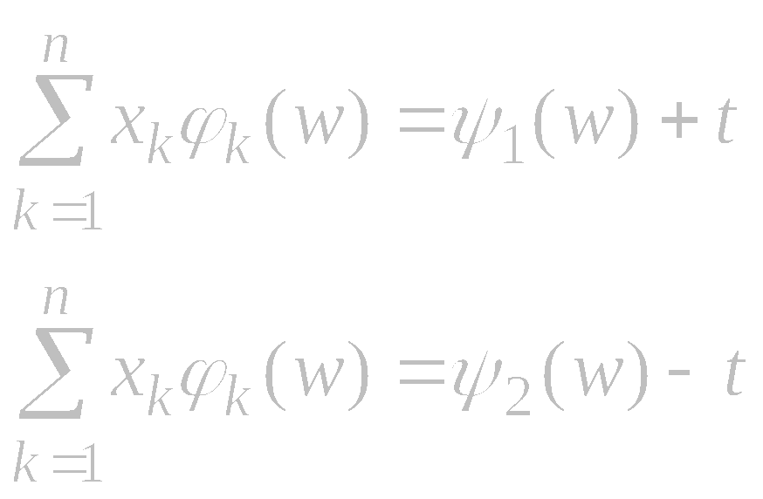
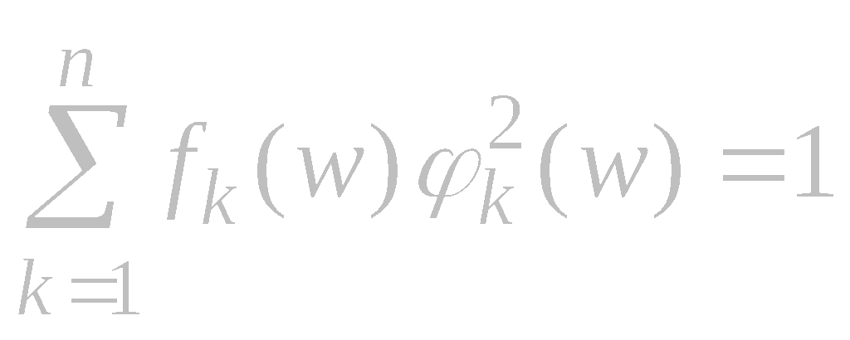
Nonlinear wave equations. Example 2
Nonlinear n-dimensional equation:
Functional separable solutions in implicit form:
where ϕ₁(w), …, ϕ_{n−1}(w), ψ₁(w), and ψ₂(w) are arbitrary functions, and the function ϕ_{n−1}(w) satisfies the normalization condition

Slide 18
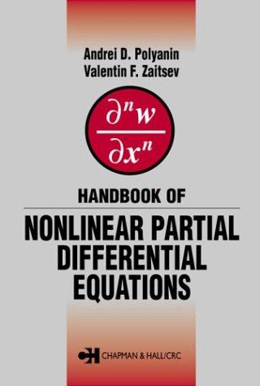
Reference
A. D. Polyanin and V. F. Zaitsev,
Handbook of Nonlinear Partial Differential Equations,
Chapman & Hall/CRC Press, 2004

Slide 19
Thank you

