Slide 1
Outcomes of the project – Phase 1 Labs on EDA EE490b
ZEHAO, CHEN
EDAlabs 2022-2023

Slide 2
Outline
Logic block
Adder block
Top ALU
Simulation benchmark
Results
Additional guidelines for grading

Slide 3
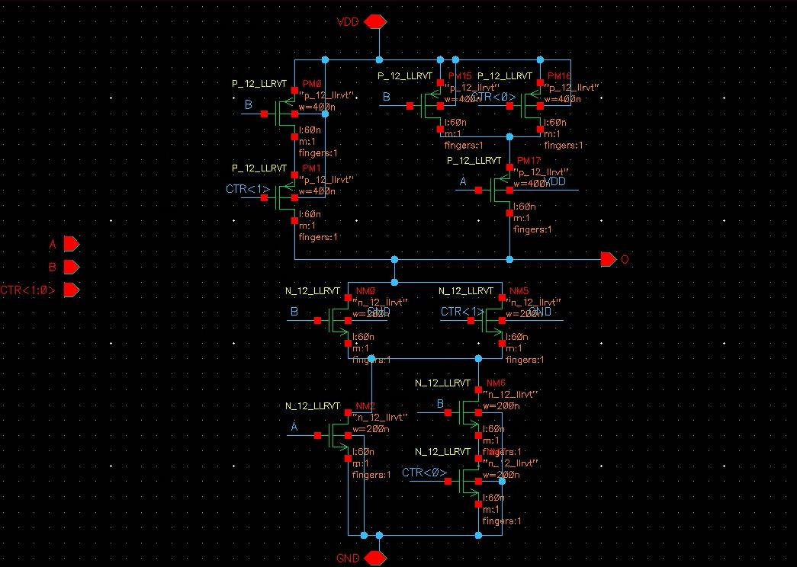
Logic block

Slide 4
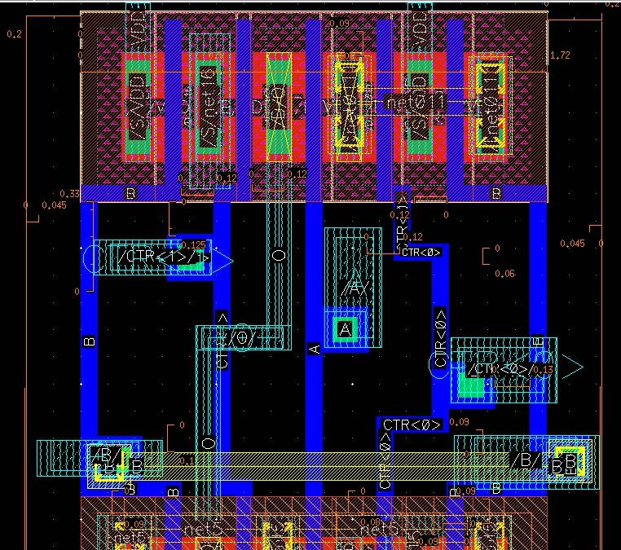
Logic block

Slide 5
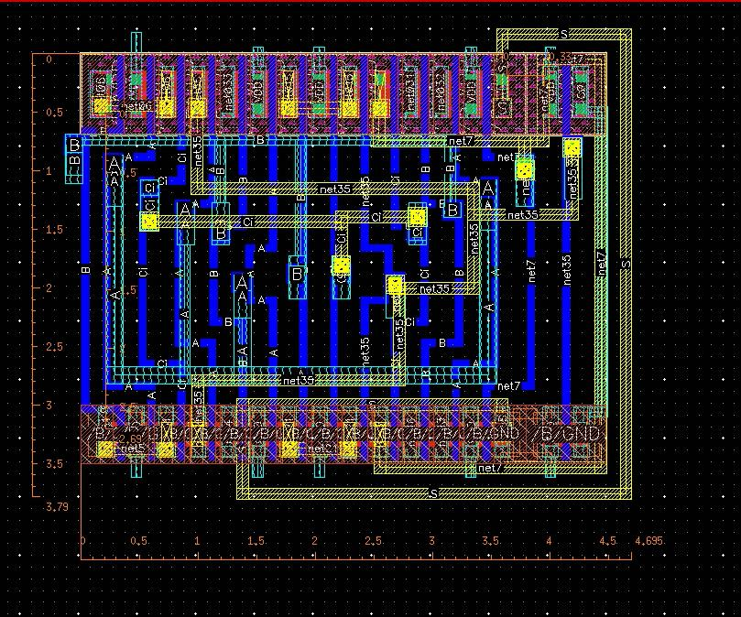
Adder block

Slide 6
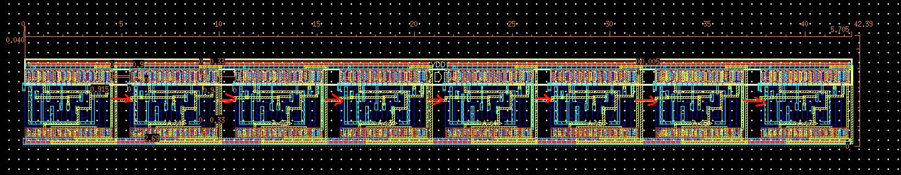
Adder block

Slide 7
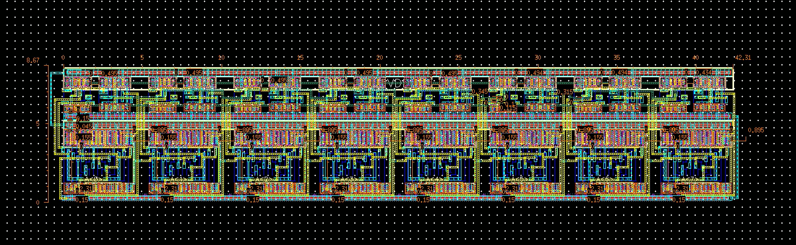
Top ALU
Area :360um²

Slide 8
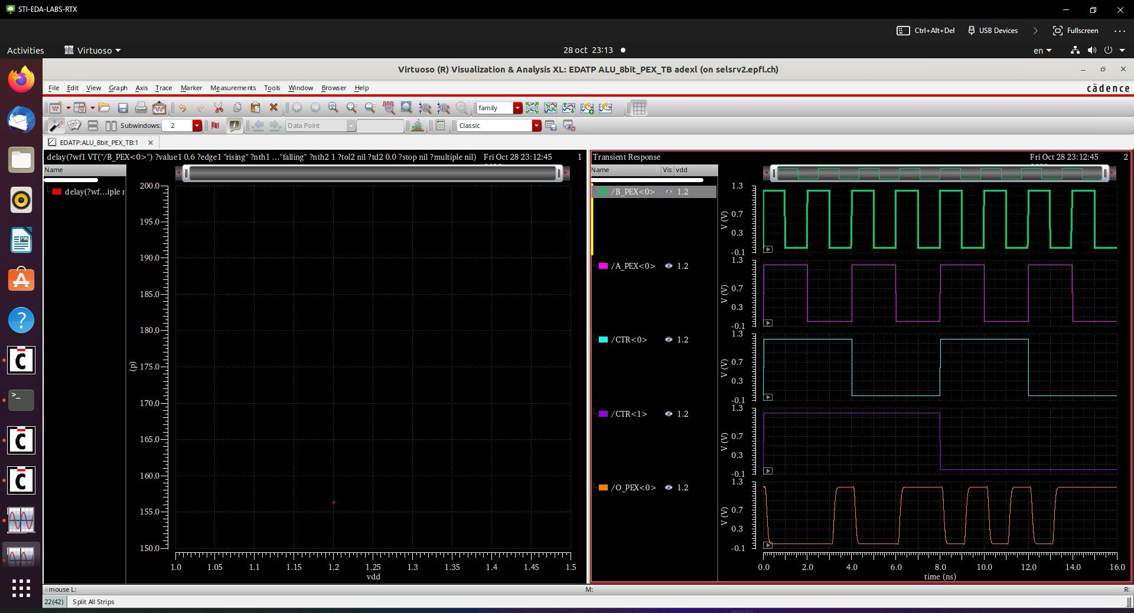
Simulation benchmark – logic

Slide 9
Simulation benchmark – adder
Post PEX, Show us a simulation of A+B where A=1111 1111, and B switches from 0000 0000 to 0000 0001 and back to 0000 0000 - call it case 1
Post PEX, Show us a simulation of A+B where A=0111 1111, and B switches from 0000 0000 to 0000 0001 and back to 0000 0000 – call it case 2
Post PEX, Show us a simulation of A+B where A=0011 1111, and B switches from 0000 0000 to 0000 0001 and back to 0000 0000 – call it case 3
Why could case 3 be interesting ? Because it do not need to pass last bit, more faster
Fill in the following table :
If for some reason your worst cases are different, go ahead and present them as well.
Rising | Time (pre-PEX) | Time (Post PEX) | Falling | Time (pre-PEX) | Time (Post PEX)
Case 1 | 595.1p | 949.4p | Case 1 | 637.4p | 979.3p
Case 2 | 548.2p | 851.2p | Case 2 | 621.2p | 960.2p
Case 3 | 536.6p | 824.3p | Case 3 | 571.2p | 875.1p

Slide 10
Additional material
Feel free to add material any justification that you believe will be useful
Any design choice you made
Anything for which you are not sure in your design
You can also add questions and suggestions which you believe would have helped you in the design.

Slide 11

Merci

