Slide 1
Outcomes of the project – Phase 2 Labs on EDA EE490b
ZEHAO, CHEN
EDAlabs 2022-2023

Slide 2
Outline
32 bits multiplier
Chosen Topology
Performances
32 bit modified ALU

Slide 3
32 bits multiplier
Chosen topology
Explain here the topology you have chosen and why

Slide 4
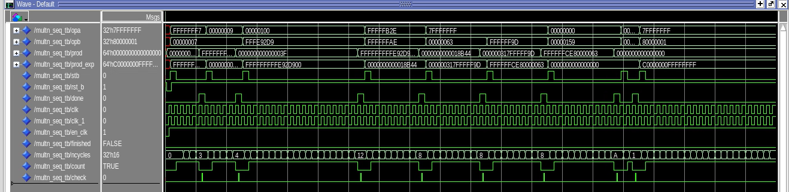
32 bits multiplier
Screenshot of the RTL simulation

Slide 5
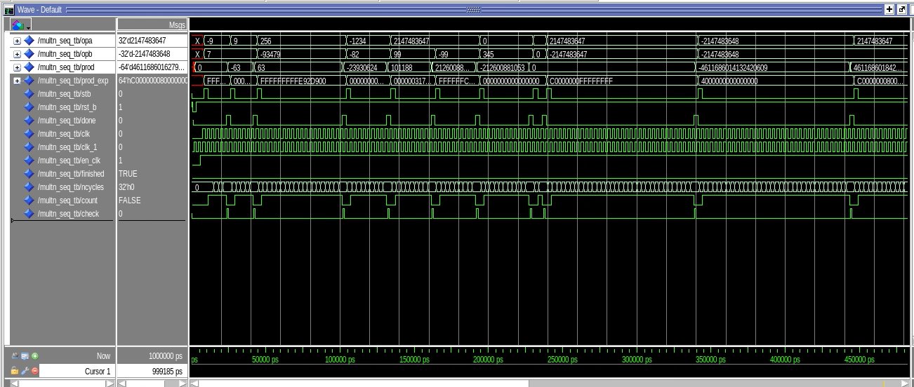
32 bits multiplier
Screenshot of the MAPPED simulation

Slide 6
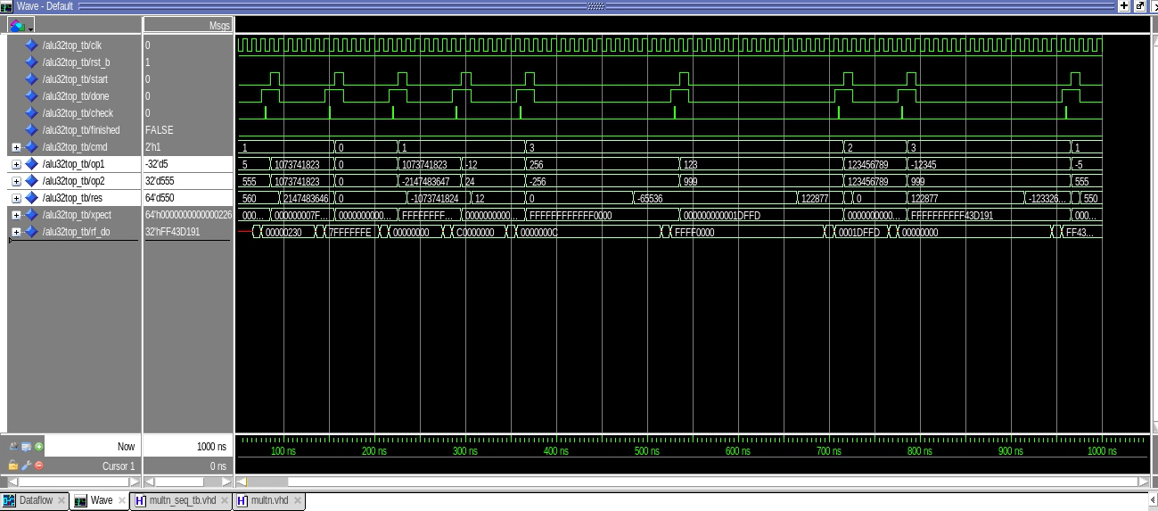
32 bits multiplier
Screenshot of the PARED simulation

Slide 7
32 bits multiplier
Performances post Synthesis (MAPPED)
Worst case cycle per multiplication : 2.5ns
Performances post PnR (PARED)
Worst case cycle per multiplication : 2.5ns
FoM post PnR =2.5 *8*7.2 = 144

Slide 8
32 bit modified ALU
What did you have to modify in the ALU ? Add a mux to select multn and crtl to keep the state when do the operations.
Screenshot of the ALU simulation :

Slide 9
Additional material
Feel free to add material any justification that you believe will be useful
Any design choice you made
Anything for which you are not sure in your design
You can also add questions and suggestions which you believe would have helped you in the design.

Slide 10
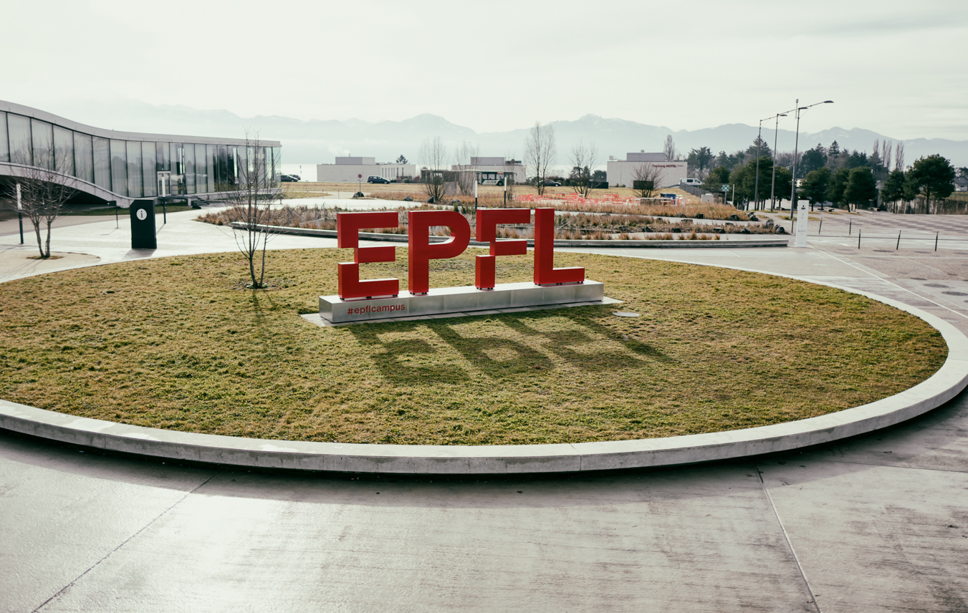
Merci

