Slide 1
Fundamentals of VLSI
Group merbers:
Yifan Zhu
Zehao Chen
23.12.2022

Slide 2
Summary of the Problem: Row Decoder
Our group designed the row-decoder of an embedded SRAM macro, which has 256 rows and 32 columns. We analyze and campare three different pre-decoding approaches: no pre-decoders, 2-4 pre-decoders and 4-16 pre-decoders. We also consider different options such as single-stage, multi-stage, sized gate, and gate with buffer. Finally, we chose the structure of the 4x Pre-decoder.
Because of the growing fan-in of the row circuit, single-stage row circuit will have more and more transistors, so it is difficult to pitch match with bit cells. Multi-stage is a good choice.
Compared with the 4x Pre-decoder, it is difficult for the 1x Pre-decoder to pitch match with bit cells. The structure of 4x Pre-decoder allows us to use very small gates at the output of the row decoder.

Slide 3
Technology Parameters
τ1=6.383ps τ2=3.832ps
In order to get τ1 and τ2, I used the testbench of ex3.
C₀ = 72aF
In order to get C0, I used the calculator of the cadence. Measured the input capacitance(cgg) of the NMOS transistor(size: L=80n W=60n).
Assumption: NMOS and PMOS of the same size have the same input capacitance. So for an inverter with gamma equal to 1, the input capacitance of the inverter is (1+beta)C₀.

Slide 4
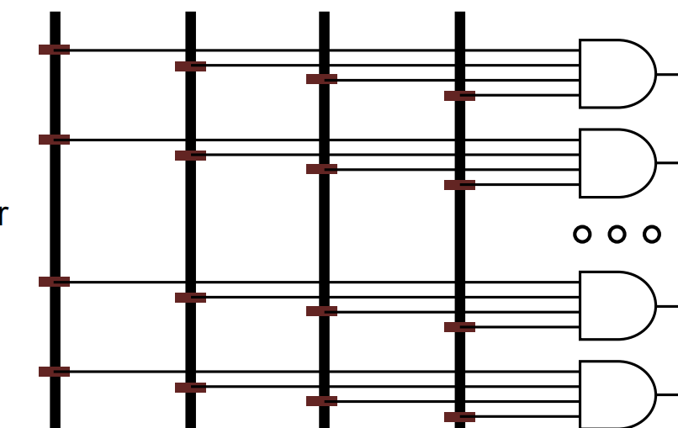
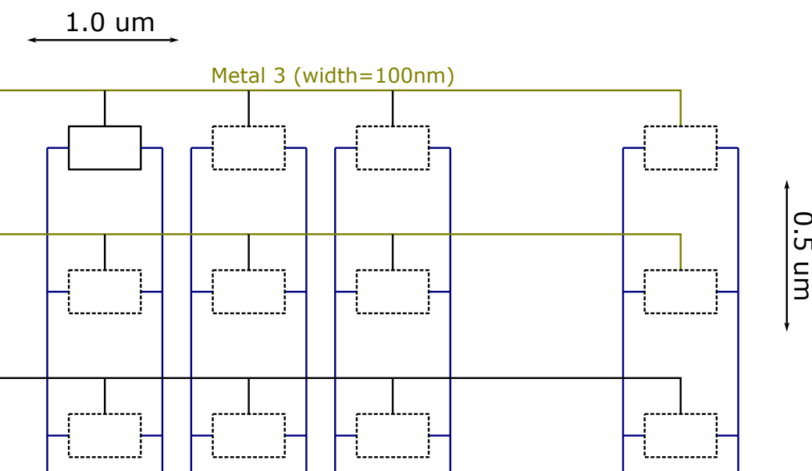
Estimated Loads and Parasitics
The wire between the post-decoder and pre-decoder.
The length of the vertical line(128um) is much greater than the length of the horizontal line( only several um). So we neglect the horizonal line.
The capacitance of this bit-cell we consider two parts, one part is the capacitance brought by the metal line 3, and the other part is the capacitance introduced by the access transistors of the SRAM.
Cwire=Ca*128*0.1+Cf*128+2*2*Cc*128*0.1/0.1
=0.6144+1.152+36.352
=38.1184 fF(about 522 C₀)
Rwire=Rsquare*128/0.1
=134.4 Ω
Cload=Ca*32*0.1+Cf*32+2*2*Cc*32*0.1/0.5+2*32*C₀
=0.1088+0.256+1.8432+4.672
=6.88fF(about 94 C₀)
Rload=Rsquare*32/0.1
=33.6Ω

Slide 5
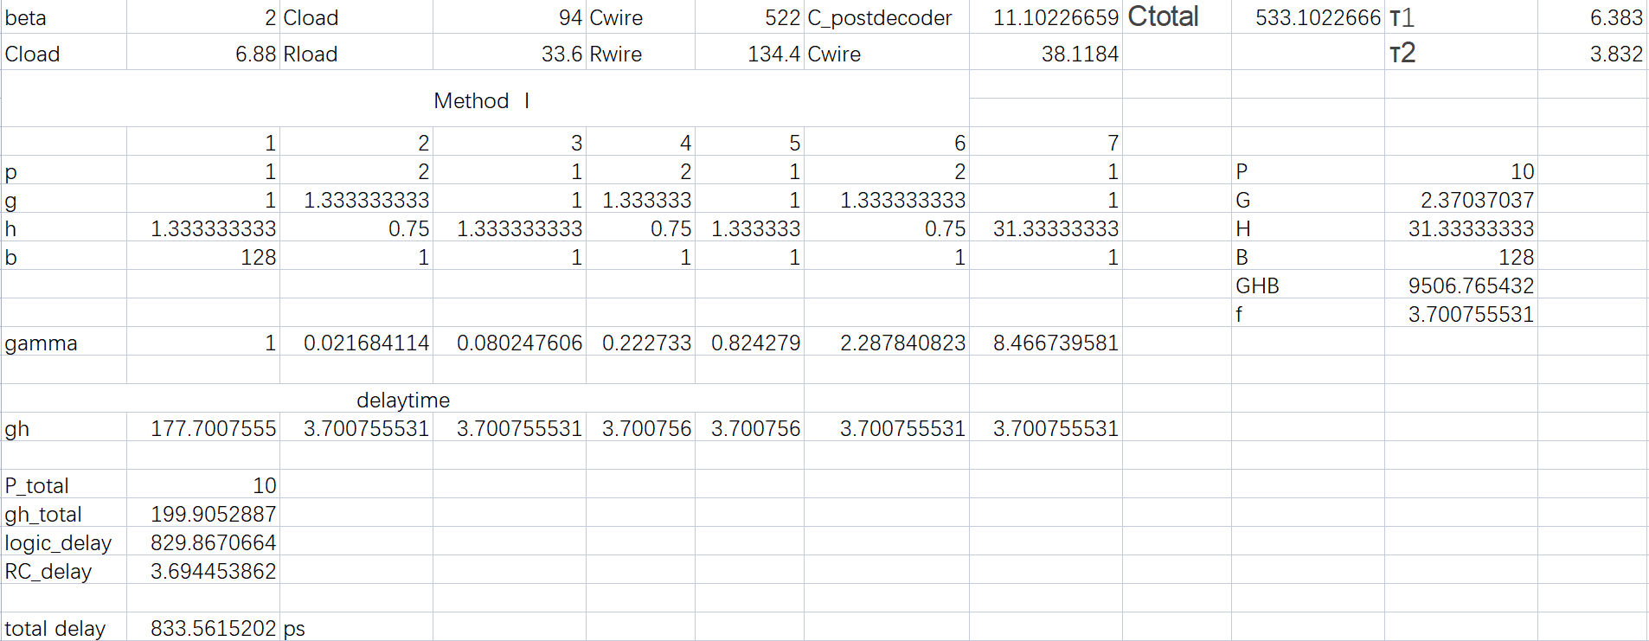
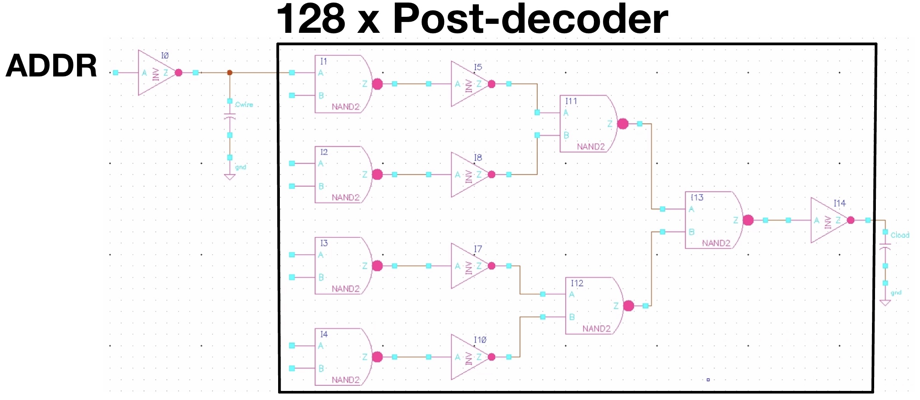
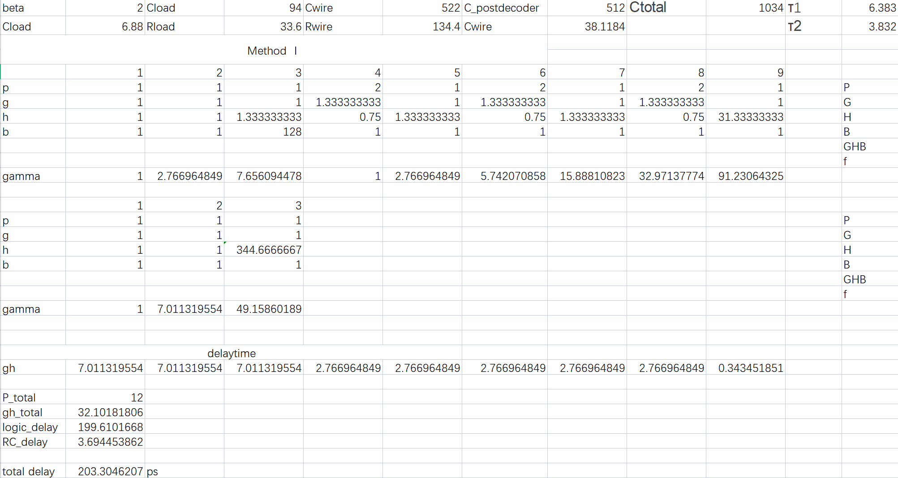
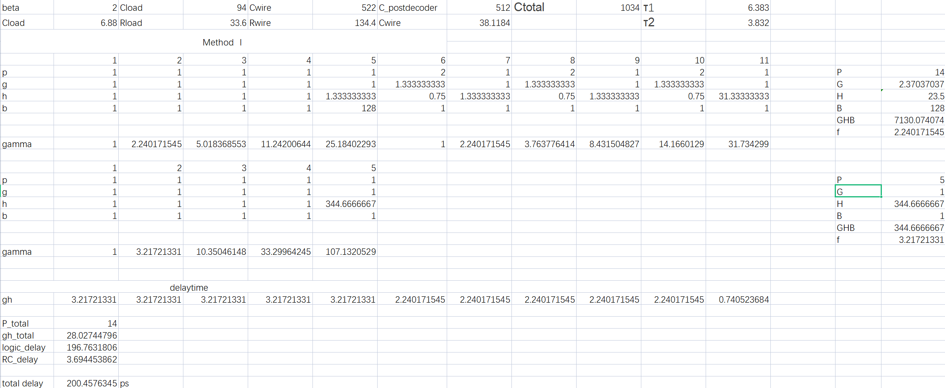
Initial Evaluation and Comparison of Architectures
Architecture: 1x (no) pre-decoder
no buffer: delay is about 834ps
1 buffer: delay is about 203ps
2 buffer: delay is about 200ps

Slide 6
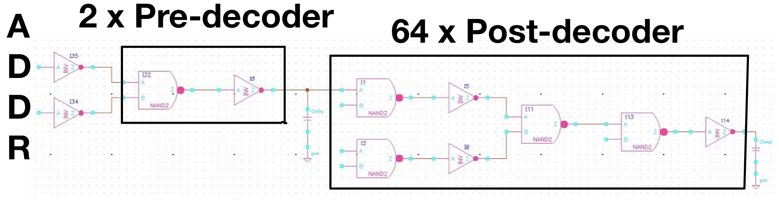
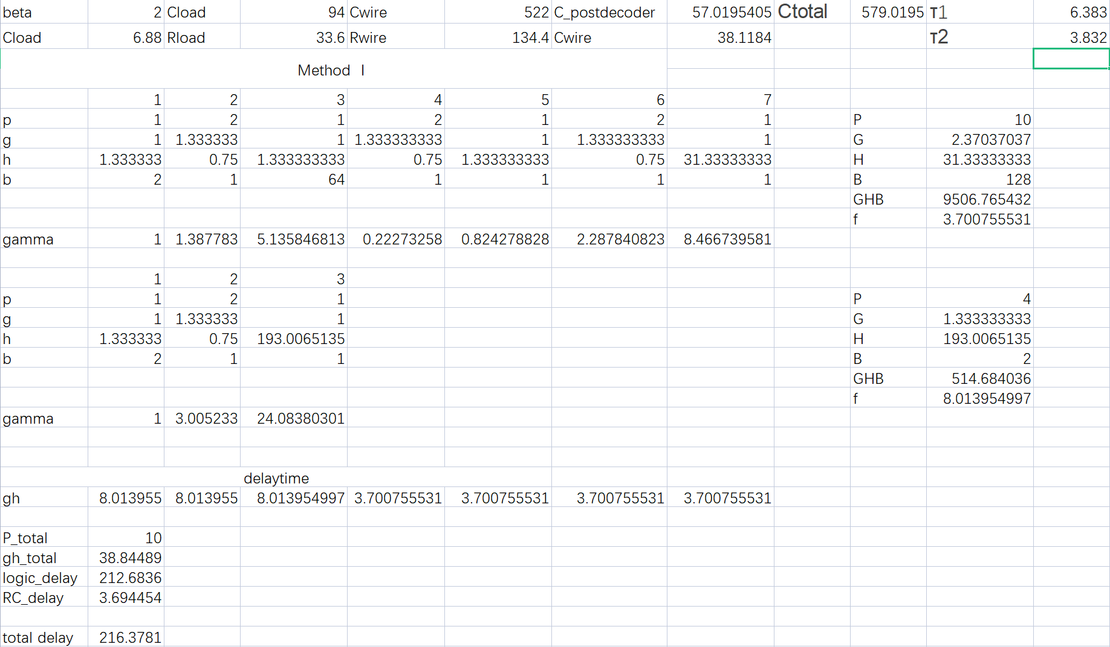
Initial Evaluation and Comparison of Architectures
Architecture: 2x pre-decoder
delay is about 216ps

Slide 7
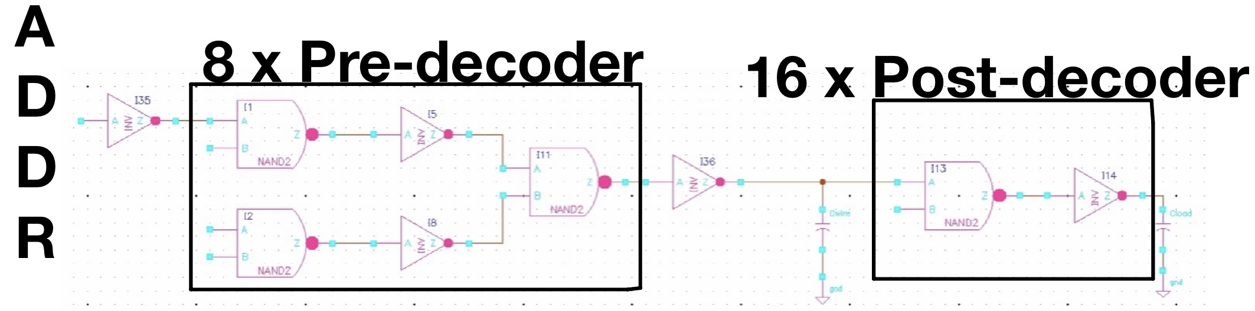
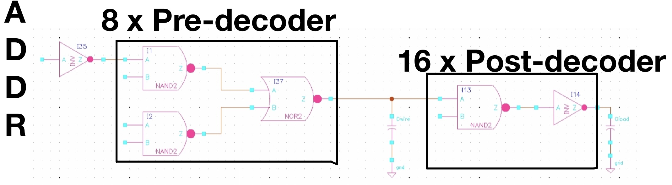
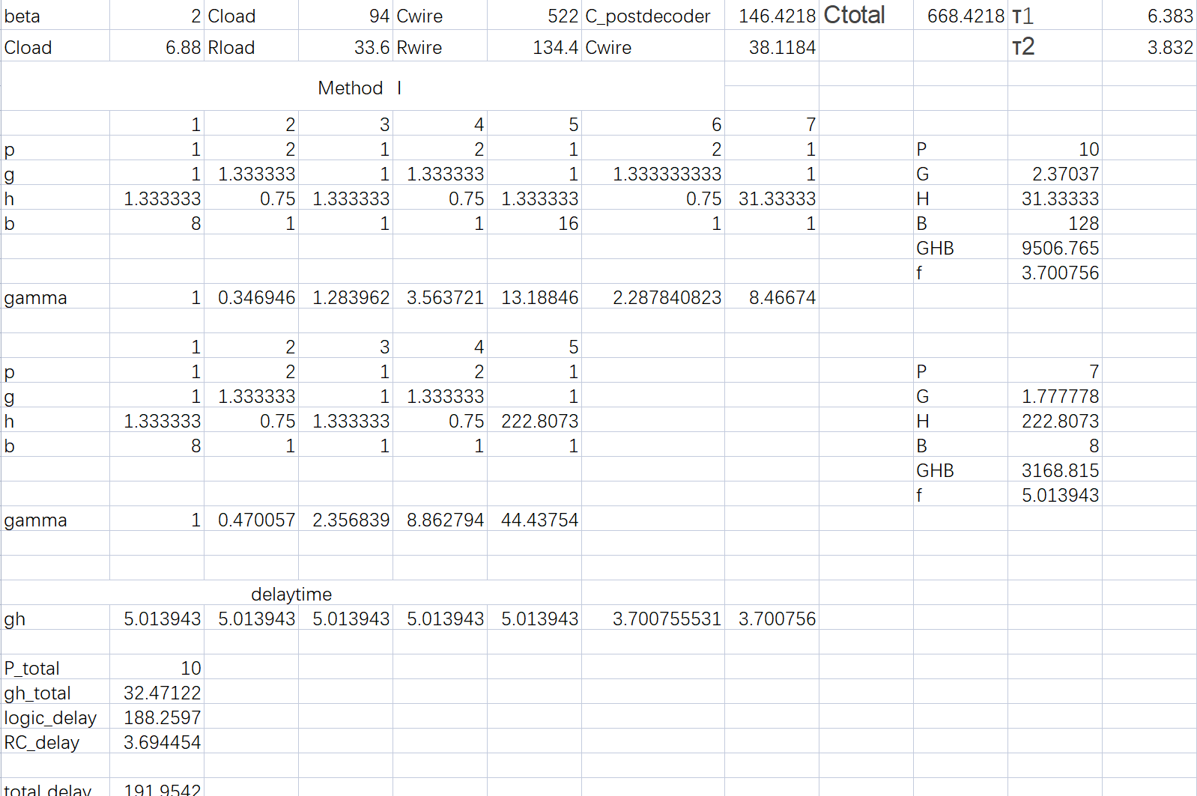
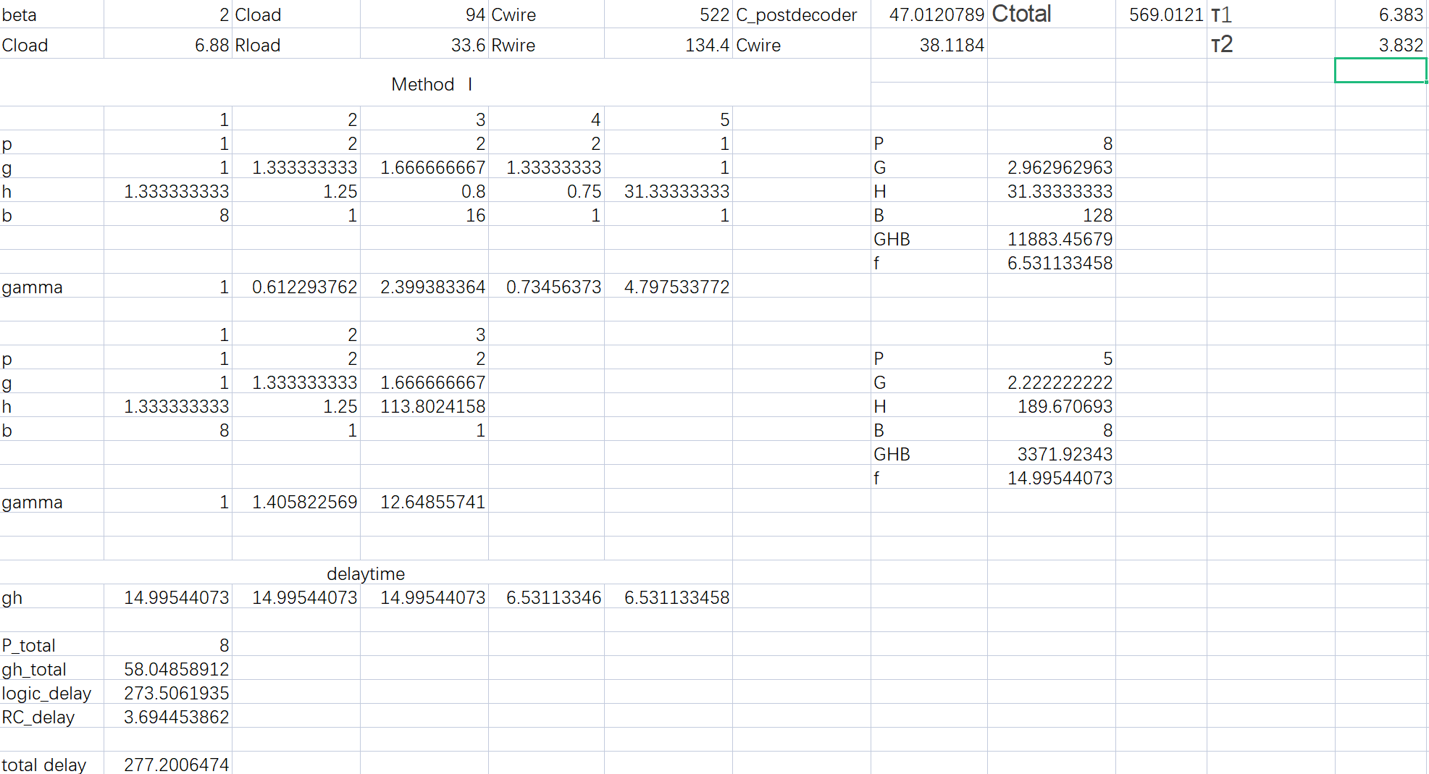
Initial Evaluation and Comparison of Architectures
Architecture: 4x pre-decoder
delay is about 192ps
delay is about 277ps

Slide 8
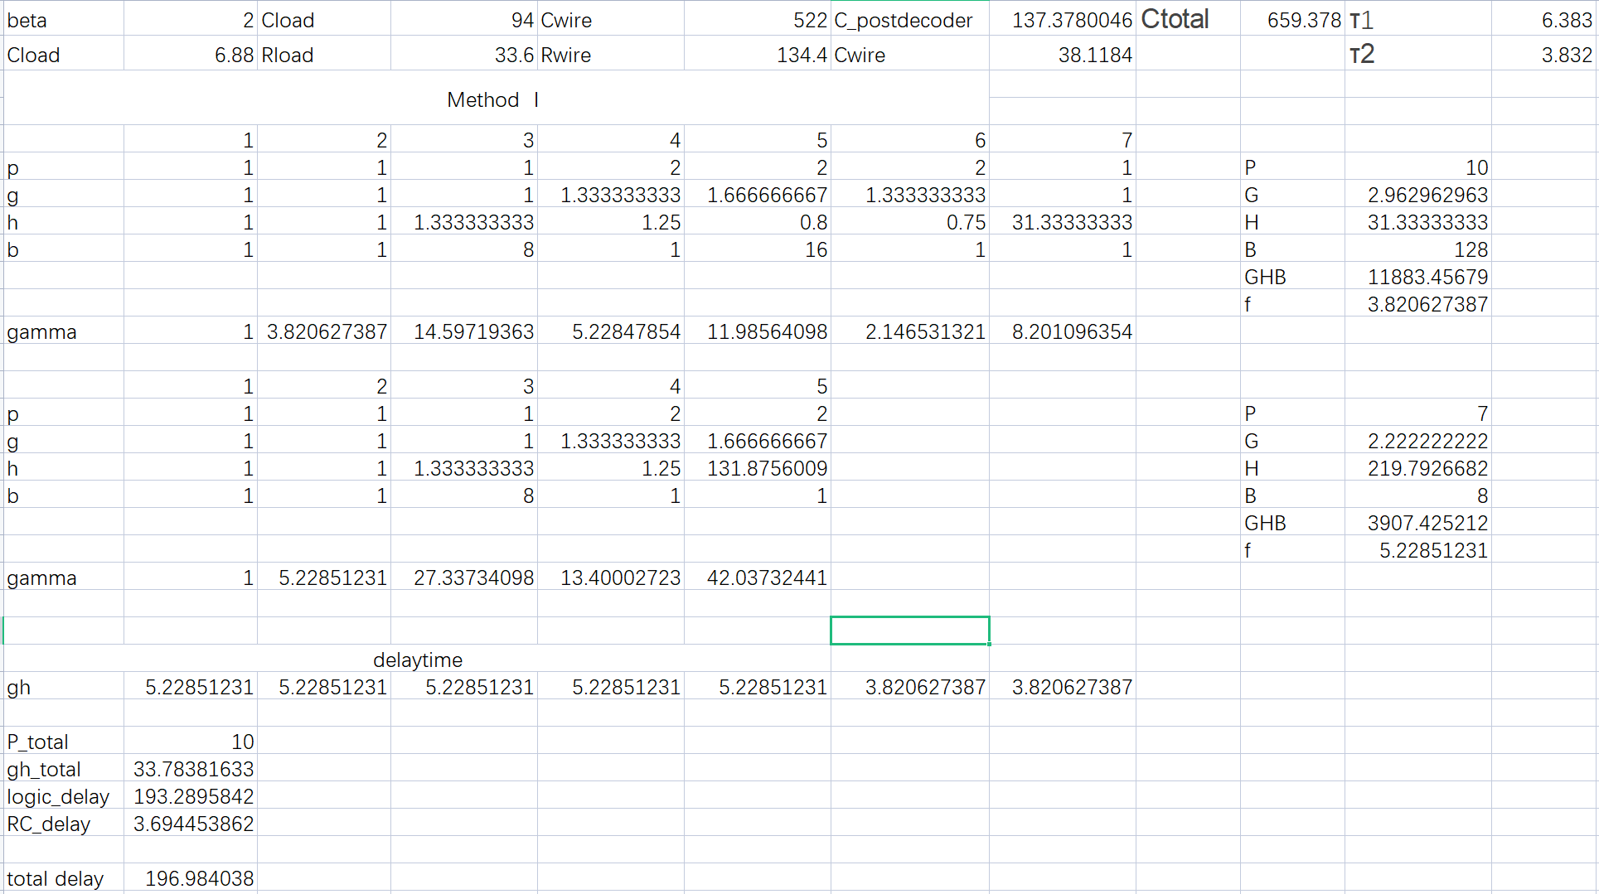
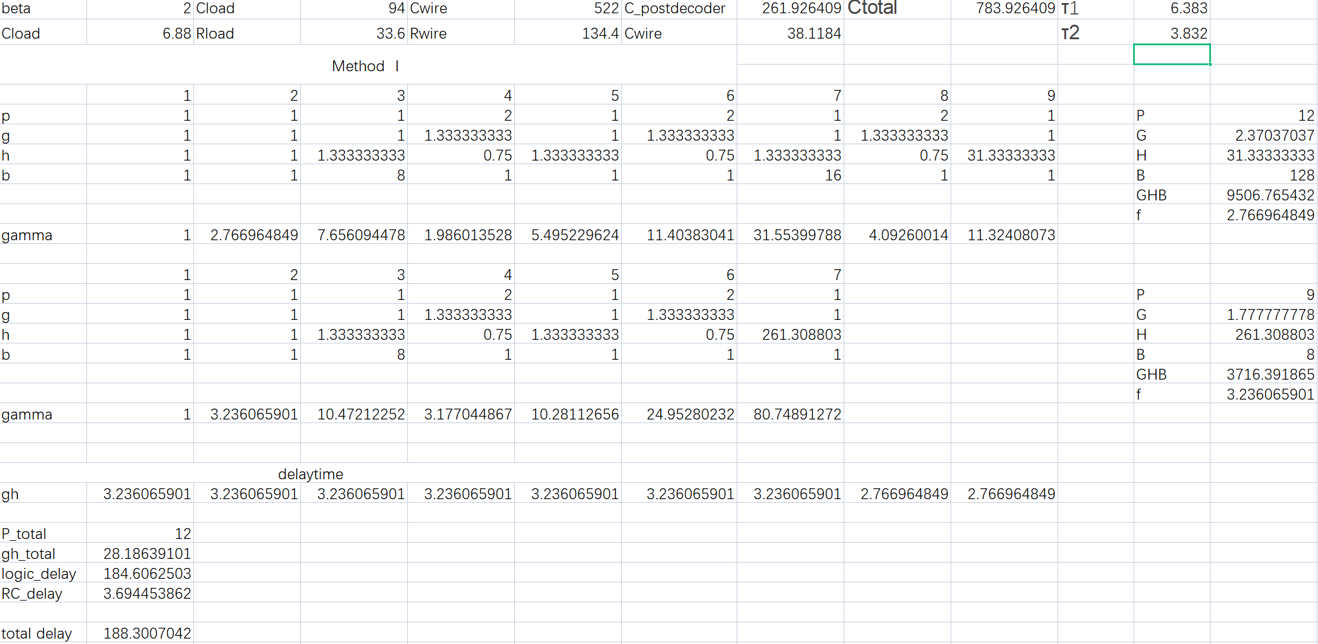
Initial Evaluation and Comparison of Architectures
Architecture: 4x pre-decoder
Add one buffer between the pre-decoder and the ADDR input.
delay is about 188ps
Add one buffer between the pre-decoder and the ADDR input
delay is about 197ps
By comparing the delay time of these three structures and different implementation methods of the same structure, 4x Pre-decoder with a buffer is the best in terms of speed.
By calculation, I predict the delay is about 188ps(0.188ns) based on the logical effort model and the parasitics for the final design.

Slide 9
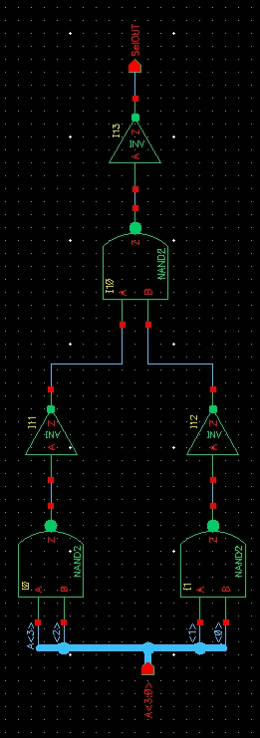
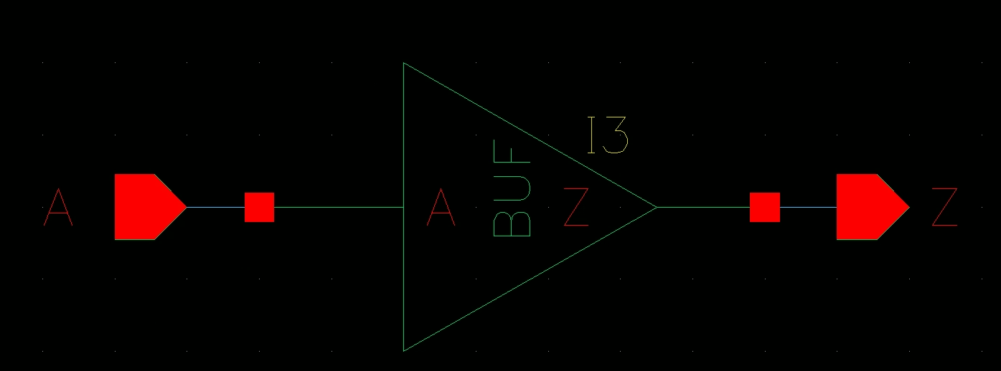
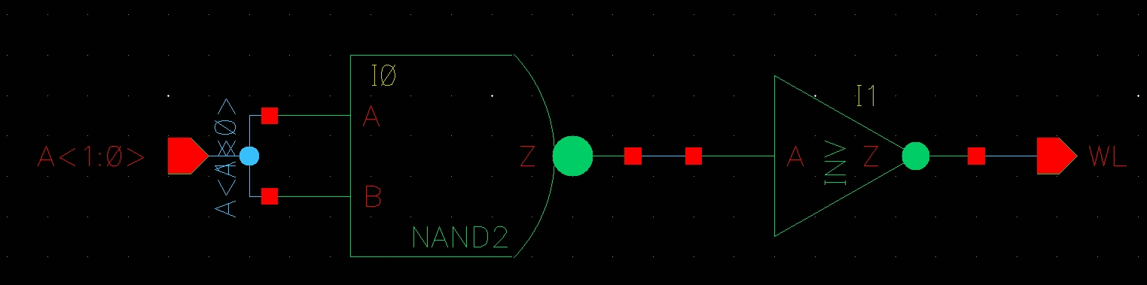
Schematic Implementation
Add a buffer between the pre-decoder and the ADDR input.
Post-decoder
4x Pre-decoder

Slide 10
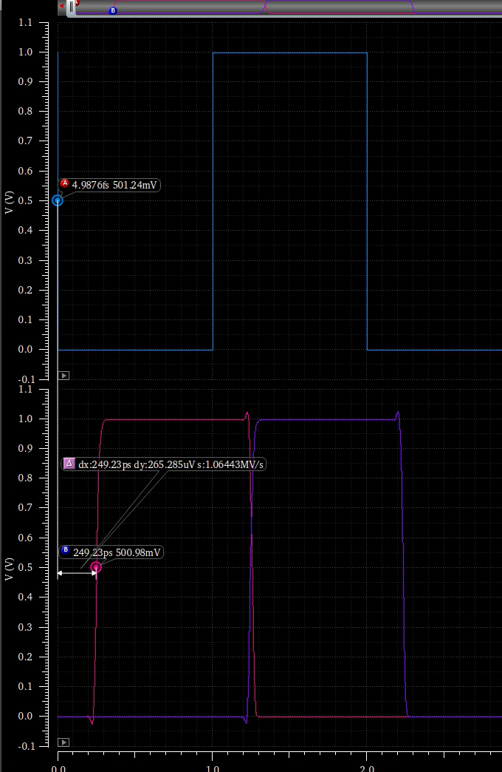
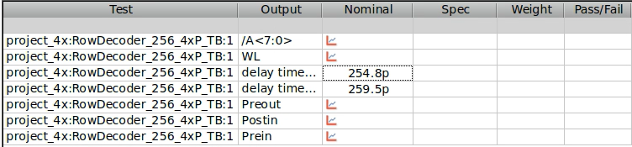
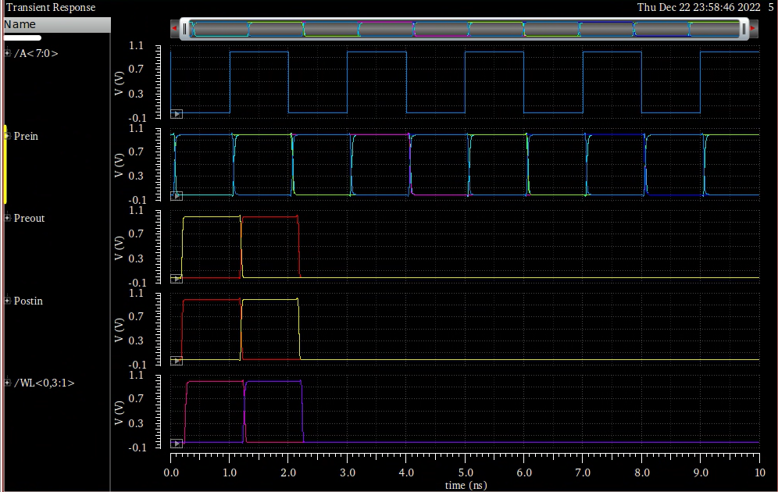
Simulation Results without Parasitics
The delay time is about 0.260ns.
Prediction delay time is 0.172ns.

Slide 11
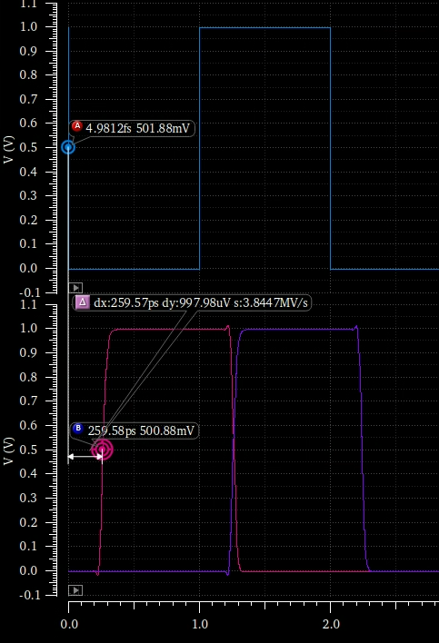
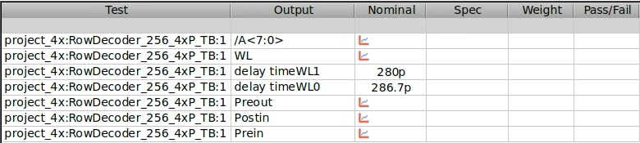
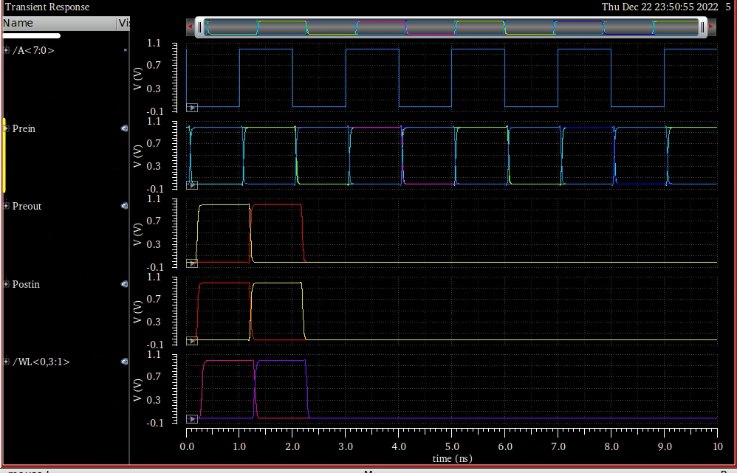
Simulation Results with Your Parasitics
The delay time is about 0.286ns.
Prediction delay time is 0.188ns.

Slide 12
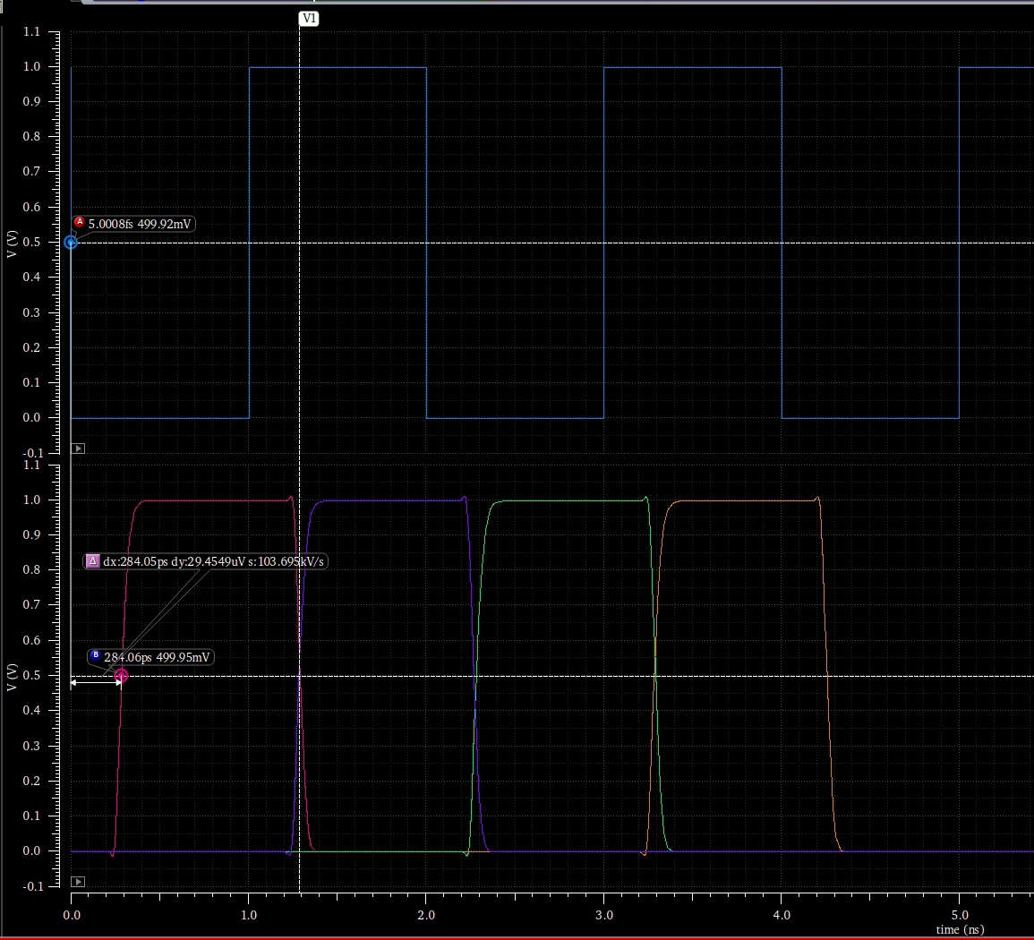
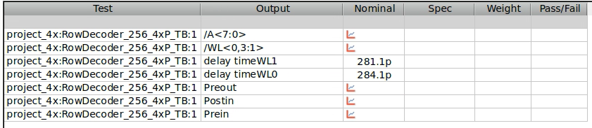
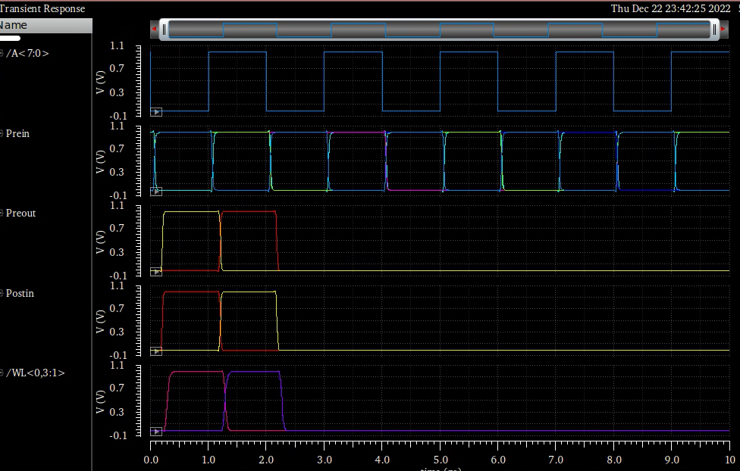
Simulation Results with FINAL Extracted Parasitics
The delay time is about 0.284ns.
Prediction delay time is 0.188ns.

Slide 13
Conclusions
We chose the structure of the 4x Pre-decoder with a buffer between the pre-decoder and the ADDR input. The delay time is about 0.284ns.
There is a certain gap between the delay time obtained by our calculation and that obtained by simulation. I think it is related to the manufacturing process. For example, I have measured that when the size of the transistor becomes larger, the change of the capacitance of the transistor is not linearly related to the size. Therefore, the calculated g and h will deviate from the actual ones, and the final calculated delay time will also be inaccurate.

