Slide 1


FACH
HOCHSCHULE
LÜBECK
Softwaretechnikprojekt
Netzwerkmonitoring mit agilen Methoden
University of Applied Sciences
Server
for perfSONAR UI app
Mirco Bohlmann, Sascha Degener, Benjamin Konrad, Fabian Misiak, Florian Rüffer, Clemens Schlei, Reinhard Winkler

Slide 2
Overview
FACH
HOCHSCHULE
LÜBECK
University of Applied Sciences
Agile methods
Process modell
Next steps
Server für perfSONAR UI App

Slide 3
Agile methods
FACH
HOCHSCHULE
LÜBECK
University of Applied Sciences
Feature Driven Development (FDD)
Pair Programming
Develop an Overall Model
Build a Features List
Play by Feature
Design by Feature
Build by Feature
Server für perfSONAR UI App

Slide 4
#1 Develop an Overall Model
FACH
HOCHSCHULE
LÜBECK
University of Applied Sciences
Server based on Java
MongoDB database
JSON files send to APP
Three Layered Architecture
Server für perfSONAR UI App

Slide 5
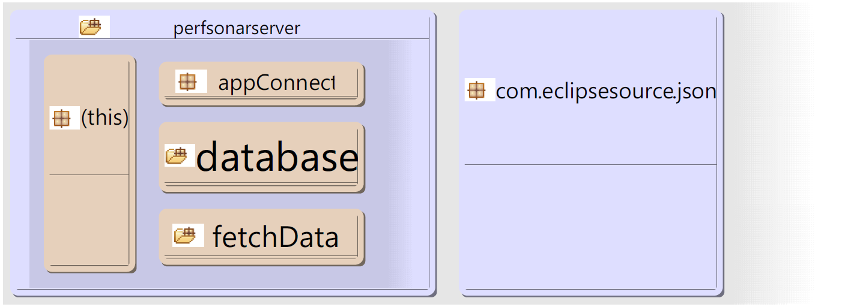
Package diagram
FACH
HOCHSCHULE
LÜBECK
University of Applied Sciences
Server für perfSONAR UI App

Slide 6
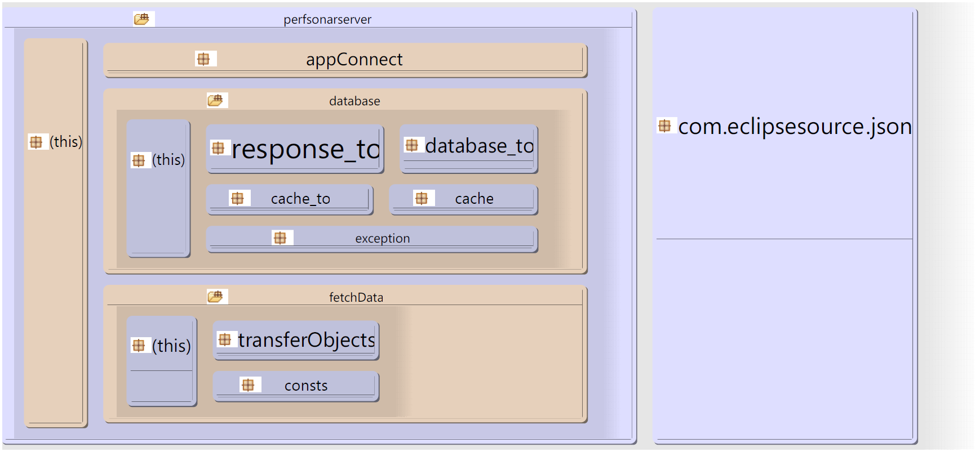
Package diagram
FACH
HOCHSCHULE
LÜBECK
University of Applied Sciences
Server für perfSONAR UI App

Slide 7
Class diagramm
FACH
HOCHSCHULE
LÜBECK
University of Applied Sciences
Fetch data
Server für perfSONAR UI App

Slide 8
#2 Build a Features List
FACH
HOCHSCHULE
LÜBECK
University of Applied Sciences
Fetch data
Transform data
Store data
Evaluate data
Receive request
Send response
Server für perfSONAR UI App

Slide 9
#3 Plan By Feature
FACH
HOCHSCHULE
LÜBECK
University of Applied Sciences
Fetch data
Transform data
Store data
Evaluate data
Receive request
Send response
Clemens Schlei,
Florian Rüffer
Sascha Degener,
Benjamin Konrad
Mirco Bohlmann,
Fabian Misiak,
Reinhard Winkler
Server für perfSONAR UI App

Slide 10
#4 Design By Feature
FACH
HOCHSCHULE
LÜBECK
University of Applied Sciences
Fetch data
  SOAP request via HTTP
Transform data
  XML to java objects
Server für perfSONAR UI App

Slide 11
#4 Design By Feature
FACH
HOCHSCHULE
LÜBECK
University of Applied Sciences
Store data
  Based on MongoDB
  Caching with chunks
  Delay, jitter and loss data
  Multithread capable
Server für perfSONAR UI App

Slide 12
#4 Design By Feature
FACH
HOCHSCHULE
LÜBECK
University of Applied Sciences
Receive Request
  Request as JSON object by app via HTTP POST
  Transform JSON to Java TO
  DB request via Java TO
Server für perfSONAR UI App

Slide 13
#4 Design By Feature
FACH
HOCHSCHULE
LÜBECK
University of Applied Sciences
Send Response
  Transform Java TO to JSON
  Send HTTP POST response to app
Server für perfSONAR UI App

Slide 14
Next Steps
FACH
HOCHSCHULE
LÜBECK
University of Applied Sciences
Fetch data
  Queue for requests
  Combine utilization interfaces for input and output
Server für perfSONAR UI App

Slide 15
Next Steps
FACH
HOCHSCHULE
LÜBECK
University of Applied Sciences
Database
  Auto update
  Implementing other features
  Delete data thread save
  Evaluate data
Server für perfSONAR UI App

Slide 16
Next Steps
FACH
HOCHSCHULE
LÜBECK
University of Applied Sciences
Communication with App
Server für perfSONAR UI App

Slide 17
FACH
HOCHSCHULE
LÜBECK
Softwaretechnikprojekt
Netzwerkmonitoring mit agilen Methoden
University of Applied Sciences
Many thanks
for your attention
Mirco Bohlmann, Sascha Degener, Benjamin Konrad, Fabian Misiak, Florian Rüffer, Clemens Schlei, Reinhard Winkler

Slide 18
FACH
HOCHSCHULE
LÜBECK
University of Applied Sciences
Server für perfSONAR UI App

