Slide 1

https://eng.ox.ac.uk/people/ziji-chen/
Who am I?
Chen Ziji
Current Position: DPhil Student at the University of Oxford (Specializing in Computing Infrastructure);
Education:
Imperial College London: Master’s Degree (2022-2023);
Sun Yat-sen University: Bachelor’s Degree (2017-2021);
Professional Experience:
Tencent Technology (2021-2022);

Slide 2
Open your mobile browser, go to www.menti.com, and then enter the code displayed on the screen.
Q1: How familiar are you with coding?
Q2: What's the first word that comes to your mind when you think of coding?
… … … …

Slide 3
Lecture0a: An Introduction to Computer Science and Python
Chen Ziji / ziji.chen@Mansfield.ox.ac.uk

Slide 4
Understanding Computers When working on the top layer, still need to understand enough of the lower layers to do our job well.
Computers are built in layers:
Maths, Physics & Chemistry
Electrical & Computer engineering
Computer Science (Theory & Architecture)
Software Engineering
Data & Computational Scientists/Engineers

Slide 5
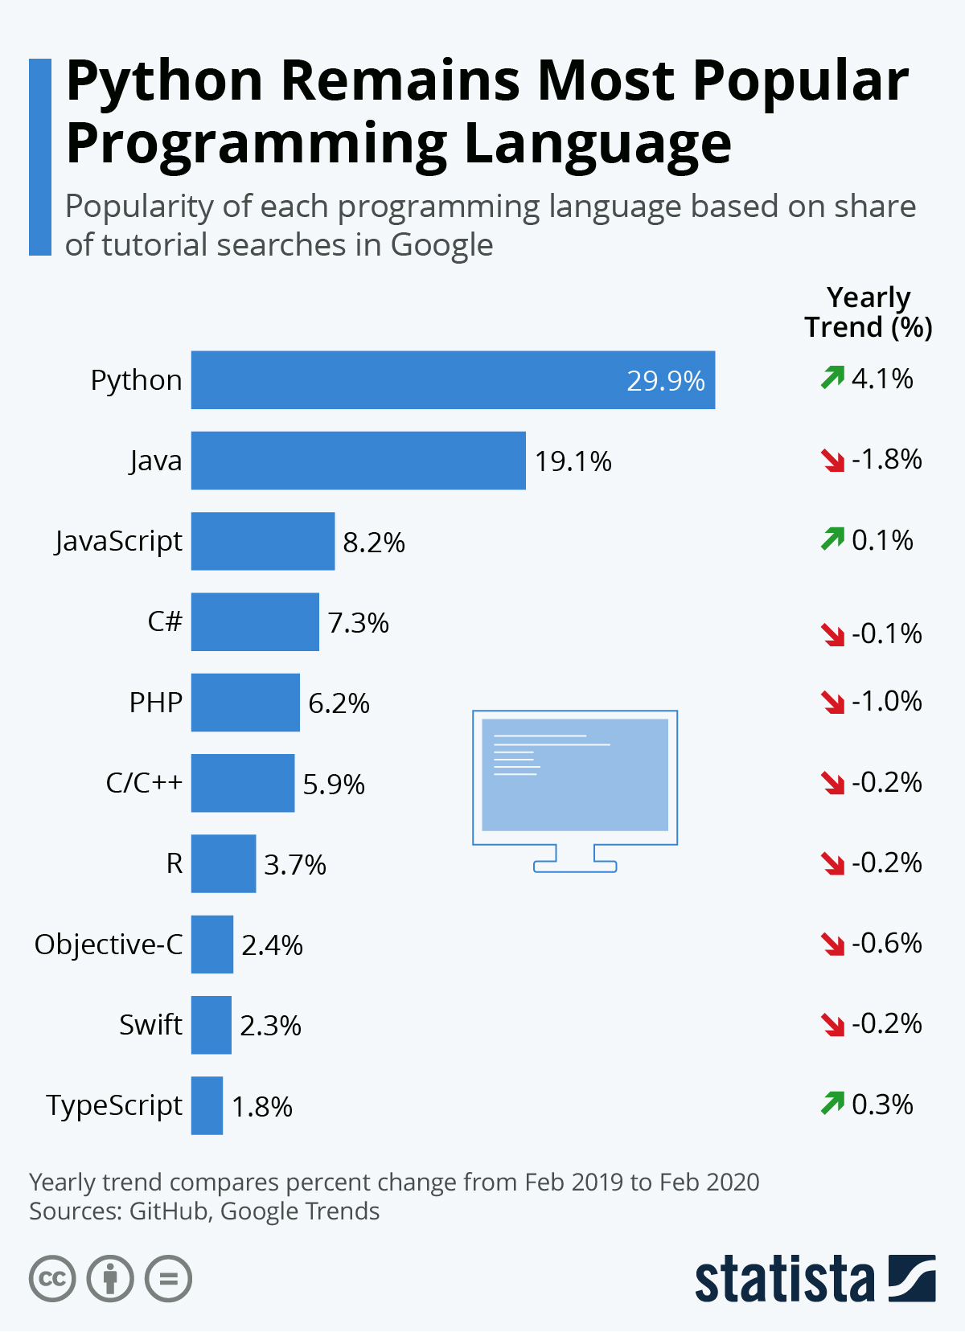
Why Python?
Popular & in demand.
General purpose interpreted programming language.
Competes with R in the Data Science space.
Large library of Machine/Deep learning packages.

Slide 6
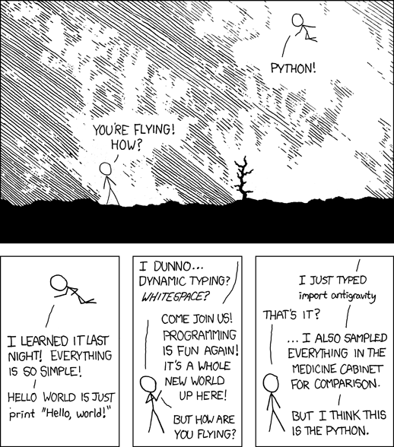
Python
Easy to do simple things.
Python does a lot of the hard work for you.
Generally not too hard to do more complex things.
Possible (not always easy) to do really complex things.

Slide 7
Open a notebook in Google Colaboratory
Colab is a hosted Jupyter Notebook service that requires no setup to use and provides free access to computing resources, including GPUs and TPUs. Colab is especially well suited to machine learning, data science, and education.
https://colab.google/

Slide 8
Lecture0b: An Introduction to Data Science and Machine Learning
Chen Ziji / ziji.chen@Mansfield.ox.ac.uk

Slide 9
Data Science and Machine Learning
Machine Learning vs General Programming
In general programming, the output is the result of applying a set of rules (the "program") to input data.
In machine learning the rules are not pre-defined: instead, the input (features) and expected outputs (labels) are given and the computer learns the rules from the underlying statistics of the data.

Slide 10
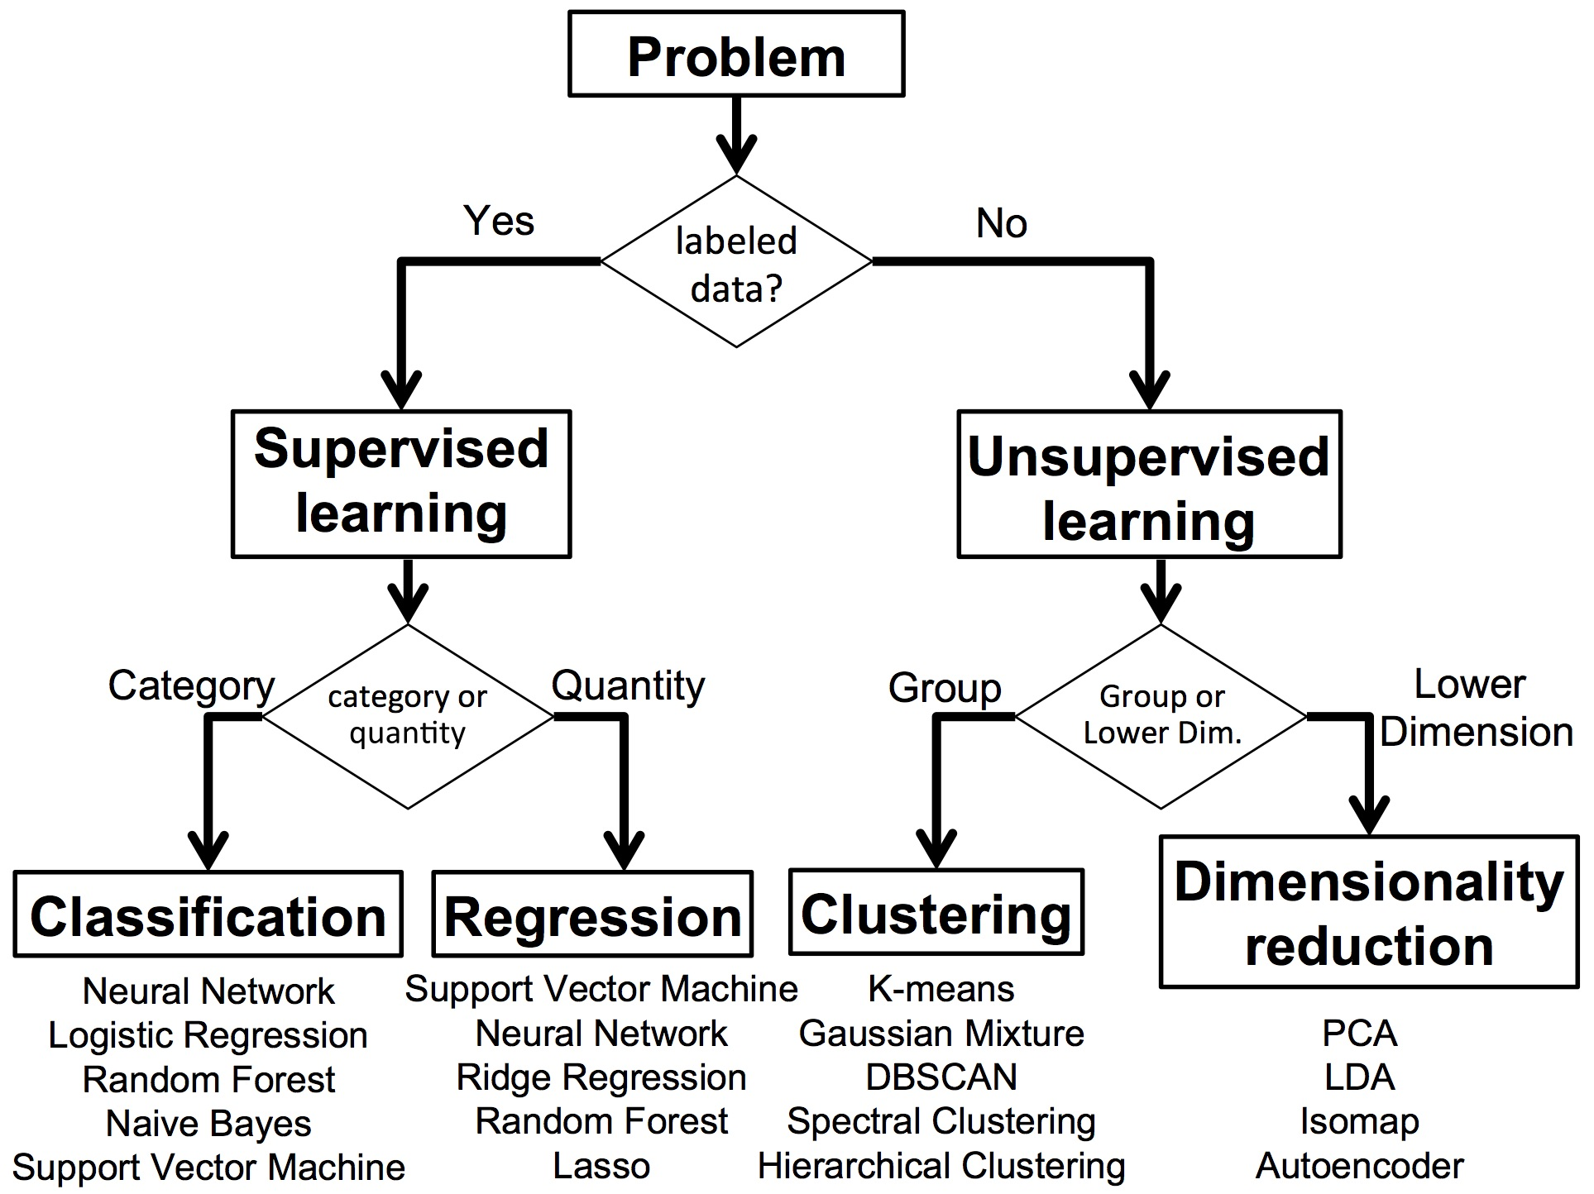
Types of Machine Learning Approaches

Slide 11
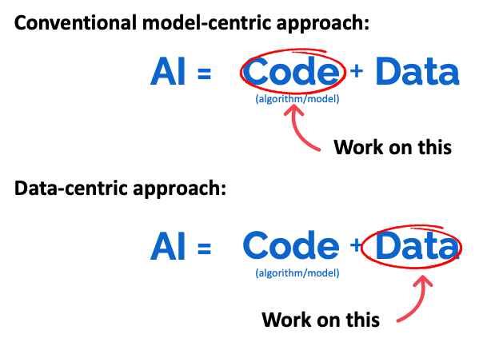
Model vs Data-Centric AI

Slide 12
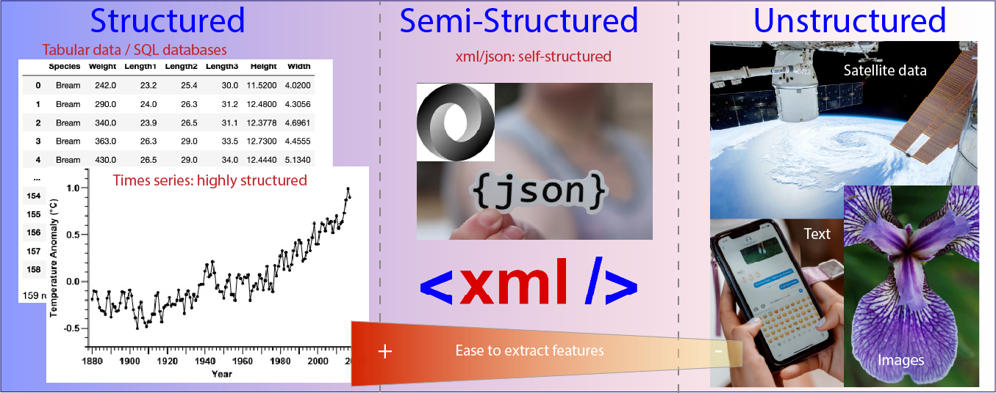
Data Types

Slide 13
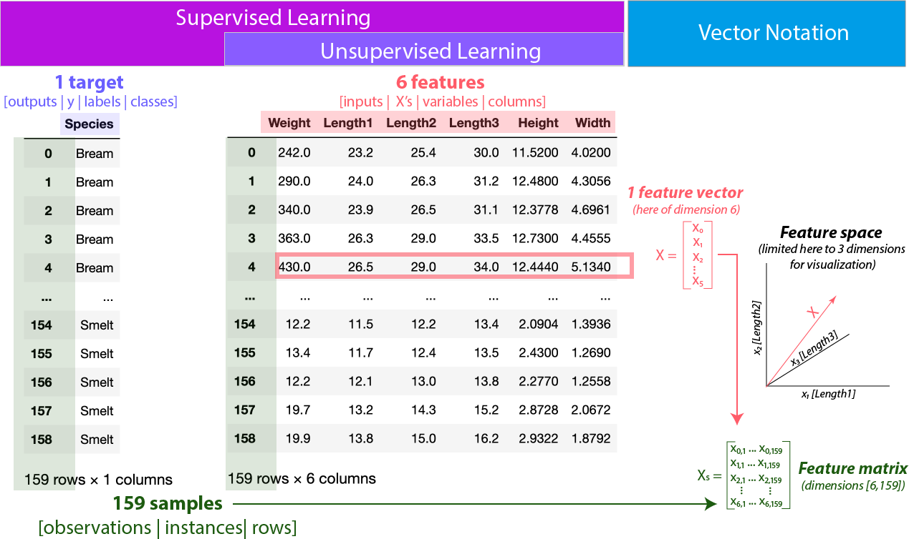
Jargon

Slide 14
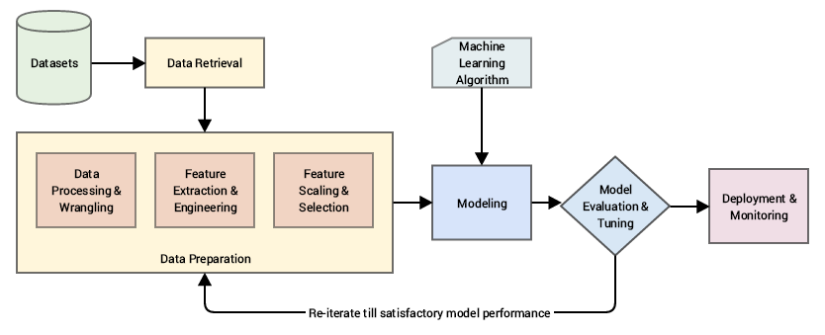
General Workflow

Slide 15
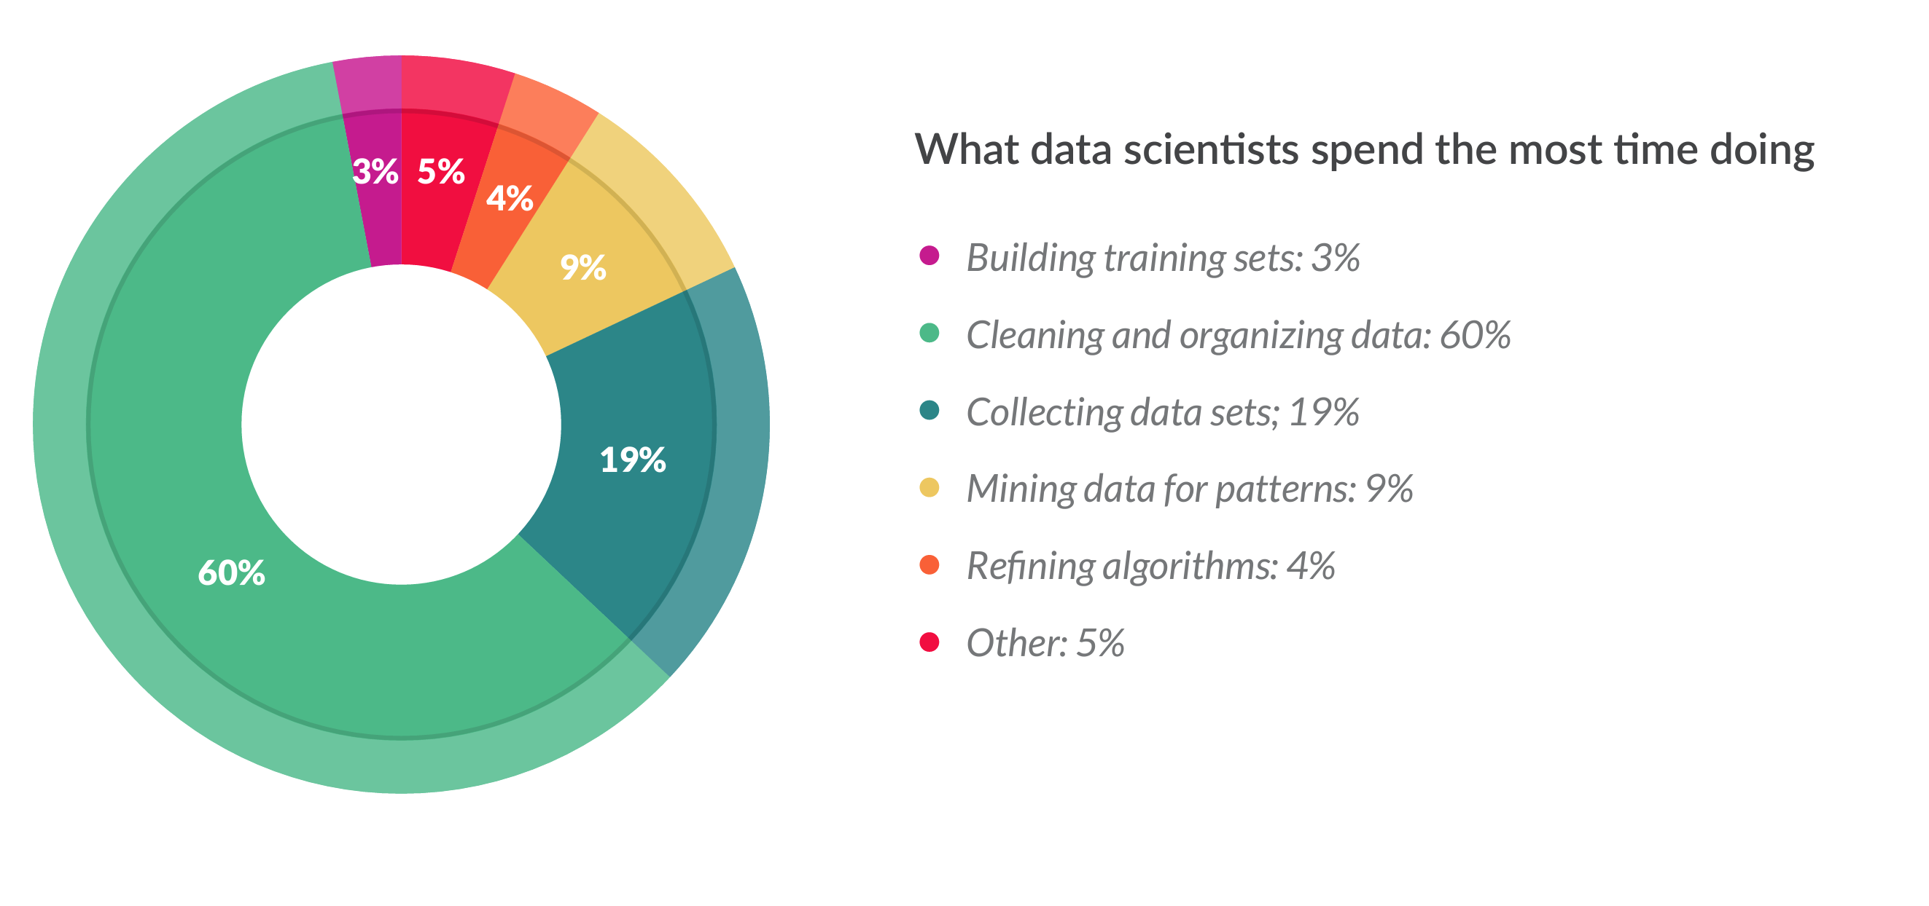
What data scientists spend the most time doing

Slide 16
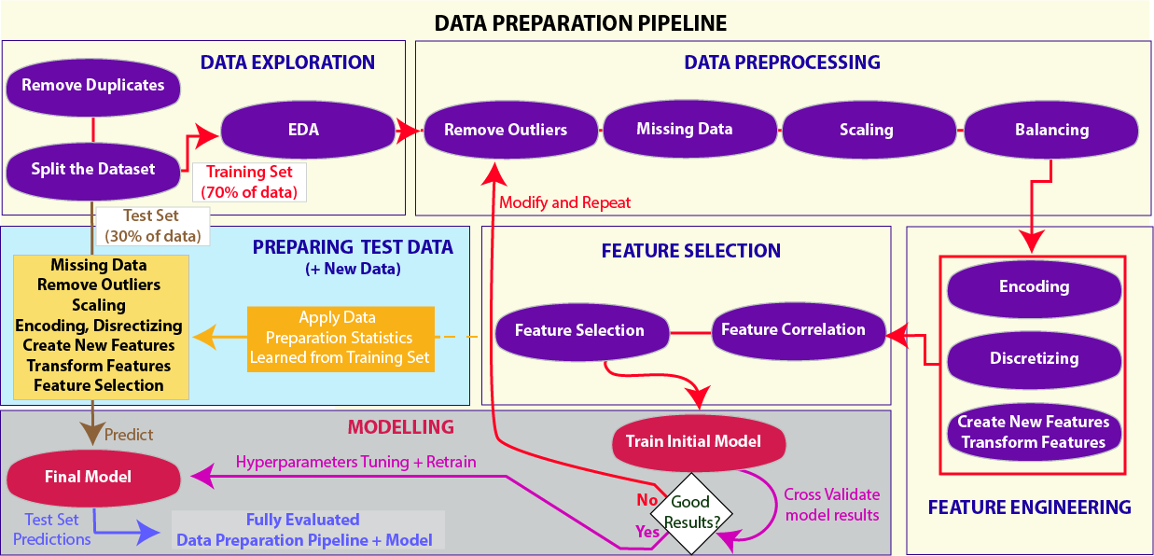
Data Preparation

Slide 17
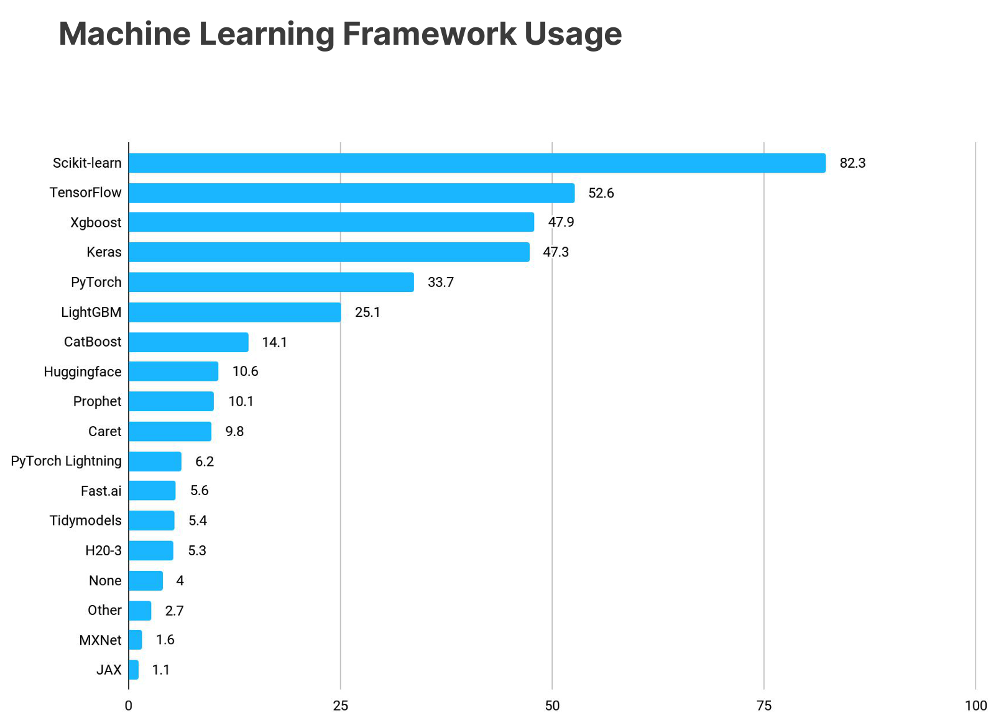
Scikit-learn

Slide 18
Open a notebook in Google Colaboratory
Colab is a hosted Jupyter Notebook service that requires no setup to use and provides free access to computing resources, including GPUs and TPUs. Colab is especially well suited to machine learning, data science, and education.
https://colab.google/

Slide 19
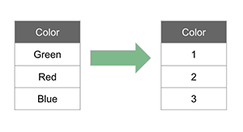
Target Encoding

Slide 20
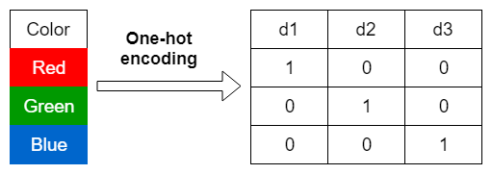
One Hot Encoding

Slide 21
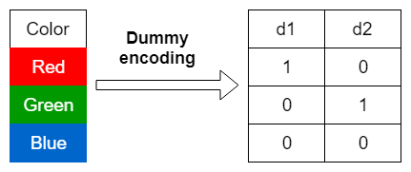
Dummy Encoding

Slide 22
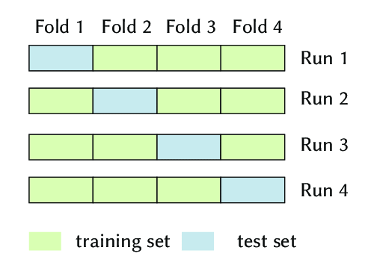
K-fold Cross Validation

Slide 23
Lecture0c: An Introduction to GPU training and CUDA
Chen Ziji / ziji.chen@Mansfield.ox.ac.uk

Slide 24
Thank you

