Slide 1


Standards of Risk Evidence Driven Behavior-Disease Model
Chenangnon Tovissode
IMCI Postdoc,
ctovissode@uidaho.edu
Prof Bert O. Baumgaertner
Department of Politics and Philosophy,
bbaum@uidaho.edu
March 31, 2023

Slide 2
Reduced efficiency of prophylactic behaviors and
long delay in information acquisition (or long time-to-reaction)
smooth away multiple waves and
increase observed epidemic peak size.

Slide 3
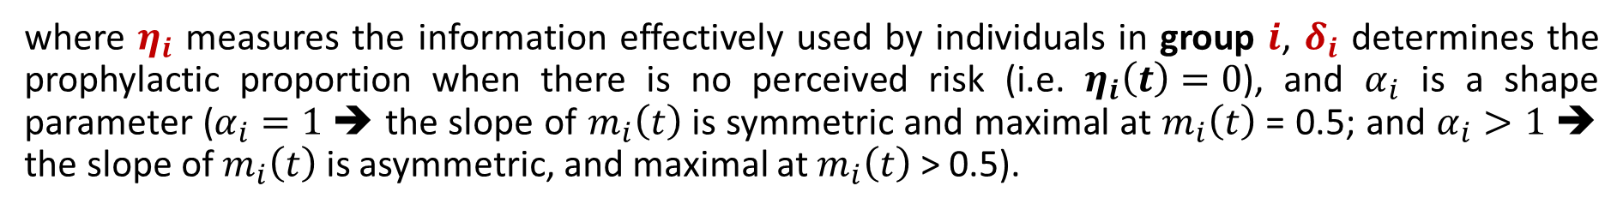



Definition of m_{i}
A Richards growth curve in terms of an information aggregate $η_{i}:$
$$m_{i}\left(t\right)={\left[1+\exp\left(δ_{i}−η_{i}(t)\right)\right]}^{−1/α_{i}}$$
where $η_{i}$ measures the information effectively used by individuals in group $i$, $δ_{i}$ determines the prophylactic proportion when there is no perceived risk (i.e. $η_{i}\left(t\right)=0$), and $α_{i}$ is a shape parameter ($α_{i}=1$ ➔ the slope of $m_{i}\left(t\right)$ is symmetric and maximal at $m_{i}\left(t\right)$ = 0.5; and $α_{i}>1$ ➔ the slope of $m_{i}\left(t\right)$ is asymmetric, and maximal at $m_{i}\left(t\right)$ > 0.5).
The information aggregate $η_{i}$ is defined at time $t$as a quadratic function of the perceived disease prevalence $P\left(t\right)$ and the relative change $Q\left(t\right)$in the number $C\left(t\right)$ of new confirmed positive cases:
$$η_{i}\left(t\right)=a_{pi}P\left(t\right)+u_{pi}{\left[P\left(t\right)\right]}^{2}+v_{i}P\left(t\right)Q\left(t\right)+u_{qi}{\left[Q\left(t\right)\right]}^{2}+a_{qi}Q\left(t\right)$$
where $a_{pi}$, $a_{qi}$, $u_{pi}$, $u_{qi}$, and $v_{i}$ are non-negative real coefficients expressing the weights of linear, interaction, and quadratic components of $P\left(t\right)$ and $Q\left(t\right)$ in $η_{i}$.

Slide 4
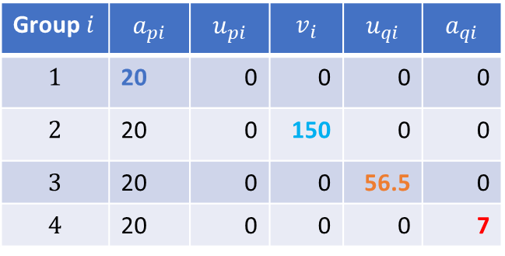

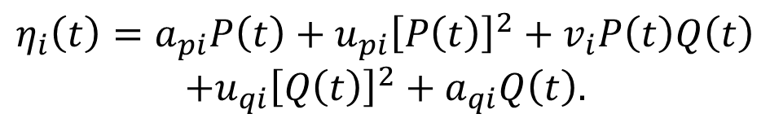

Visualisation of m_{i}
$$m_{i}\left(t\right)={\left[1+\exp\left(δ_{i}−η_{i}(t)\right)\right]}^{−1/α_{i}}.$$
$δ_{i}=2.9444,$ i.e. $m_{i}\left(0\right)=0.05.$
$$η_{i}\left(t\right)=a_{pi}P\left(t\right)+u_{pi}{\left[P\left(t\right)\right]}^{2}+v_{i}P\left(t\right)Q\left(t\right)$$
$$+u_{qi}{\left[Q\left(t\right)\right]}^{2}+a_{qi}Q\left(t\right).$$
Group $i$ | $$a_{pi}$$ | $$u_{pi}$$ | $$v_{i}$$ | $$u_{qi}$$ | $$a_{qi}$$
$$1$$ | 20 | 0 | 0 | 0 | 0
$$2$$ | 20 | 0 | 150 | 0 | 0
$$3$$ | 20 | 0 | 0 | 56.5 | 0
$$4$$ | 20 | 0 | 0 | 0 | 7

Slide 5
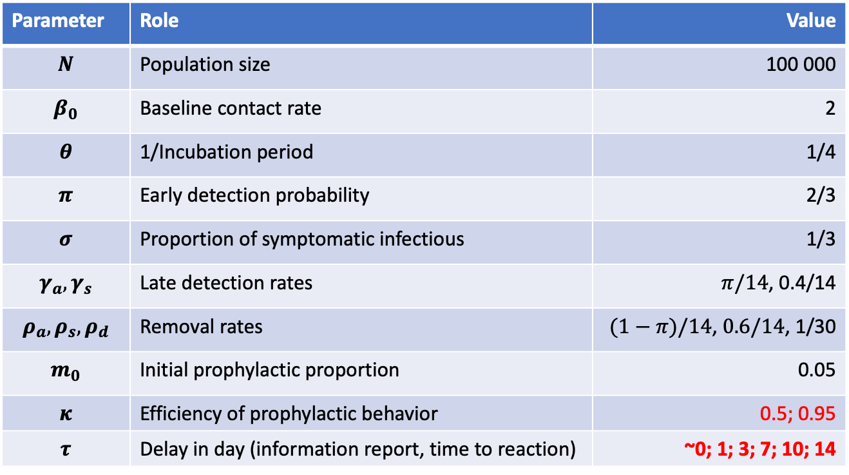
Disease Dynamic Parameters
Parameters varied in the simulations
Parameter | Role | Value
$$N$$ | Population size | 100 000
$$β_{0}$$ | Baseline contact rate | 2
$$θ$$ | 1/Incubation period | 1/4
$$π$$ | Early detection probability | 2/3
$$σ$$ | Proportion of symptomatic infectious | 1/3
$$γ_{a},γ_{s}$$ | Late detection rates | $π/14$, 0.4/14
$$ρ_{a},ρ_{s},ρ_{d}$$ | Removal rates | $(1−π)/14$, $0.6/14$, 1/30
$$m_{0}$$ | Initial prophylactic proportion | 0.05
$$κ$$ | Efficiency of prophylactic behavior | 0.5; 0.95
$$τ$$ | Delay in day (information report, time to reaction) | ~0; 1; 3; 7; 10; 14

Slide 6





Disease-only Dynamic
SEIR solution
New positive cases
$$S_{∞}=\text{0}$$
$$\underset{t}{Arg max}{C(t)}=\text{38.76} \text{days}$$
$$\max_{t}{C(t)}=\text{5} \text{241.0}$$
$$\underset{t}{Arg max}{E(t)}=\text{3}\text{8}\text{.51} \text{days}$$
$$\max_{t}{E(t)}=\text{2}\text{8 319}$$

Slide 7



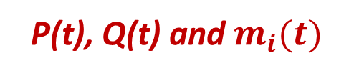
Disease-only Dynamic
Reproductive number
P(t), Q(t) and $m_{i}(t)$
$$\underset{t}{Arg max}{P(t)}=\text{47}\text{.}\text{7}\text{6} \text{days}$$
$$\underset{t}{Arg}{[ℛ\left(t\right)==1]}=\text{41}\text{.}\text{01} \text{days}$$
$$\max_{t}{P(t)}=\text{51.59\%}$$

Slide 8
Joint Disease-Behavior Dynamic
Scenarios A:
- no differential standard of risk
- all individuals pay attention to prevalence only

Slide 9

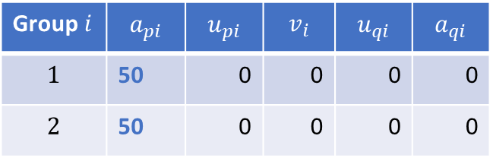


Joint Disease-Behavior Dynamic
Scenario A0:
- no differential standard of risk
- all individuals pay attention to prevalence only
Group $i$ | $$a_{pi}$$ | $$u_{pi}$$ | $$v_{i}$$ | $$u_{qi}$$ | $$a_{qi}$$
$$1$$ | 50 | 0 | 0 | 0 | 0
$$2$$ | 50 | 0 | 0 | 0 | 0
$$m_{i}\left(0\right)=0.05$$
$$κ=0.5$$
(Prophylaxis is only half-efficient)
$$τ=0$$

Slide 10




Joint Disease-Behavior Dynamic
SEIR solution
New positive cases
$$S_{∞}=\text{0}$$
$$\underset{t}{Arg max}{C(t)}=\text{43}\text{.5}\text{1} \text{days}$$
$$\max_{t}{C(t)}=\text{3}\text{ 525.50}$$
$$\underset{t}{Arg max}{E(t)}=\text{43}\text{.01} \text{days}$$
$$\max_{t}{E(t)}=\text{18}\text{ 313}$$

Slide 11



Joint Disease-Behavior Dynamic
Reproductive number
P(t), Q(t) and $m_{i}(t)$
$$\underset{t}{Arg max}{P(t)}=\text{54}\text{.26} \text{days}$$
$$\underset{t}{Arg}{[ℛ\left(t\right)==1]}=\text{46}\text{.}\text{76} \text{days}$$
$$\max_{t}{P(t)}=\text{47.20\%}$$

Slide 12

Joint Disease-Behavior Dynamic
Scenario A1:
- no differential standard of risk
- all individuals pay attention to prevalence only
Group $i$ | $$a_{pi}$$ | $$u_{pi}$$ | $$v_{i}$$ | $$u_{qi}$$ | $$a_{qi}$$
$$1$$ | 50 | 0 | 0 | 0 | 0
$$2$$ | 50 | 0 | 0 | 0 | 0
$$m_{i}\left(0\right)=0.05$$
$$κ=0.95$$
(Prophylaxis is 95% efficient)
$$τ=0$$

Slide 13
Joint Disease-Behavior Dynamic
SEIR solution
New positive cases

Slide 14
Joint Disease-Behavior Dynamic
Reproductive number
P(t), Q(t) and $m_{i}(t)$

Slide 15


Joint Disease-Behavior Dynamic
When we delay the information or increase time-to-reaction:
$$τ=1 day$$
Scenario A2:
- no differential standard of risk
- all individuals pay attention to prevalence only
Group $i$ | $$a_{pi}$$ | $$u_{pi}$$ | $$v_{i}$$ | $$u_{qi}$$ | $$a_{qi}$$
$$1$$ | 50 | 0 | 0 | 0 | 0
$$2$$ | 50 | 0 | 0 | 0 | 0
$$m_{i}\left(0\right)=0.05$$
$$κ=0.95$$
(Prophylaxis is 95% efficient)
$$τ=1 day$$

Slide 16

Joint Disease-Behavior Dynamic
When we delay the information or increase time-to-reaction:
$$τ=1 day$$
SEIR solution
New positive cases

Slide 17
Joint Disease-Behavior Dynamic
When we delay the information or increase time-to-reaction:
$$τ=1 day$$
Reproductive number
P(t), Q(t) and $m_{i}(t)$

Slide 18


Joint Disease-Behavior Dynamic
When we delay the information or increase time-to-reaction:
$$τ=3 days$$
Scenario A3:
- no differential standard of risk
- all individuals pay attention to prevalence only
Group $i$ | $$a_{pi}$$ | $$u_{pi}$$ | $$v_{i}$$ | $$u_{qi}$$ | $$a_{qi}$$
$$1$$ | 50 | 0 | 0 | 0 | 0
$$2$$ | 50 | 0 | 0 | 0 | 0
$$m_{i}\left(0\right)=0.05$$
$$κ=0.95$$
(Prophylaxis is 95% efficient)
$$τ=3 days$$

Slide 19

Joint Disease-Behavior Dynamic
When we delay the information or increase time-to-reaction:
$$τ=3 days$$
SEIR solution
New positive cases

Slide 20
Joint Disease-Behavior Dynamic
When we delay the information or increase time-to-reaction:
$$τ=3 days$$
Reproductive number
P(t), Q(t) and $m_{i}(t)$

Slide 21


Joint Disease-Behavior Dynamic
When we delay the information or increase time-to-reaction:
$$τ=1 week$$
Scenario A4:
- no differential standard of risk
- all individuals pay attention to prevalence only
Group $i$ | $$a_{pi}$$ | $$u_{pi}$$ | $$v_{i}$$ | $$u_{qi}$$ | $$a_{qi}$$
$$1$$ | 50 | 0 | 0 | 0 | 0
$$2$$ | 50 | 0 | 0 | 0 | 0
$$m_{i}\left(0\right)=0.05$$
$$κ=0.95$$
(Prophylaxis is 95% efficient)
$$τ=7 days$$

Slide 22

Joint Disease-Behavior Dynamic
When we delay the information or increase time-to-reaction:
$$τ=1 week$$
SEIR solution
New positive cases

Slide 23
Joint Disease-Behavior Dynamic
When we delay the information or increase time-to-reaction:
$$τ=1 week$$
Reproductive number
P(t), Q(t) and $m_{i}(t)$

Slide 24




Joint Disease-Behavior Dynamic
Effect of a longer information-delay
New positive cases
New positive cases
$$τ=10 days$$
$$τ=14 days$$
$$τ=10 days$$
$$τ=14 days$$

Slide 25
The following two diapos are brackects to glance at what happens to the epidemic waives when we allow individuals to predict the disease dynamic…

Slide 26


Joint Disease-Behavior Dynamic
A quick look at what happens when we allow people to predict the disease dynamic (v = 150)
Very fast oscillations in the second wave
$$τ=1 day$$
$$τ=3 days$$

Slide 27


Joint Disease-Behavior Dynamic
A quick look at what happens when we allow people to predict the disease dynamic (v = 150)
Both the second wave and oscillations are smoothed away when the information comes too late
$$τ=7 day$$
$$τ=10 days$$

Slide 28
End of the brackects Back to looking at prevalence only…

Slide 29
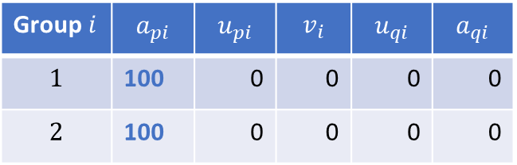
Joint Disease-Behavior Dynamic
We make the population more reactive to prevalence ($a_{pi}$ from 50 to 100).
Scenario A5:
- no differential standard of risk
- all individuals pay attention to prevalence only
Group $i$ | $$a_{pi}$$ | $$u_{pi}$$ | $$v_{i}$$ | $$u_{qi}$$ | $$a_{qi}$$
$$1$$ | 100 | 0 | 0 | 0 | 0
$$2$$ | 100 | 0 | 0 | 0 | 0
$$m_{i}\left(0\right)=0.05$$
$$κ=0.95$$
(Prophylaxis is 95% efficient)
$$τ=0$$

Slide 30
Joint Disease-Behavior Dynamic
We also delay the information or increase time-to-reaction:
$$τ=1 week$$
SEIR solution
New positive cases

Slide 31
Joint Disease-Behavior Dynamic
We also delay the information or increase time-to-reaction:
$$τ=1 week$$
Reproductive number
P(t), Q(t) and $m_{i}(t)$

Slide 32
Joint Disease-Behavior Dynamic
Effect of a longer information-delay
in the very reactive population

Slide 33
Joint Disease-Behavior Dynamic
Effect of a longer information-delay in the very reactive population
The multiple waves are smoothed away when the information comes too late
$$τ=10 days$$
$$τ=14 days$$

