Slide 1


Standards of Risk Evidence Driven Behavior-Disease Model
Chenangnon Tovissode
IMCI Postdoc,
ctovissode@uidaho.edu
Prof Bert O. Baumgaertner
Department of Politics and Philosophy,
bbaum@uidaho.edu
March 31, 2023

Slide 2
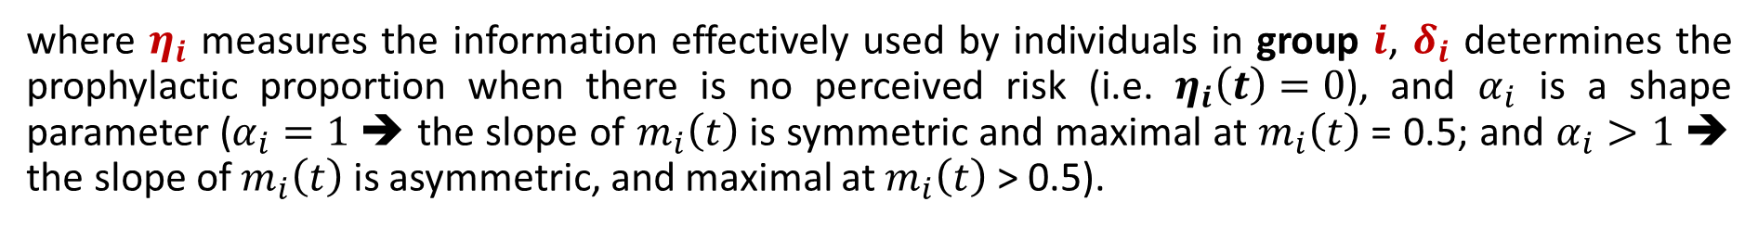



Definition of m_{i}
A Richards growth curve in terms of an information aggregate $η_{i}:$
$$m_{i}\left(t\right)={\left[1+\exp\left(δ_{i}−η_{i}(t)\right)\right]}^{−1/α_{i}}$$
where $η_{i}$ measures the information effectively used by individuals in group $i$, $δ_{i}$ determines the prophylactic proportion when there is no perceived risk (i.e. $η_{i}\left(t\right)=0$), and $α_{i}$ is a shape parameter ($α_{i}=1$ ➔ the slope of $m_{i}\left(t\right)$ is symmetric and maximal at $m_{i}\left(t\right)$ = 0.5; and $α_{i}>1$ ➔ the slope of $m_{i}\left(t\right)$ is asymmetric, and maximal at $m_{i}\left(t\right)$ > 0.5).
The information aggregate $η_{i}$ is defined at time $t$as a quadratic function of the perceived disease prevalence $P\left(t\right)$ and the relative change $Q\left(t\right)$in the number $C\left(t\right)$ of new confirmed positive cases:
$$η_{i}\left(t\right)=a_{pi}P\left(t\right)+u_{pi}{\left[P\left(t\right)\right]}^{2}+v_{i}P\left(t\right)Q\left(t\right)+u_{qi}{\left[Q\left(t\right)\right]}^{2}+a_{qi}Q\left(t\right)$$
where $a_{pi}$, $a_{qi}$, $u_{pi}$, $u_{qi}$, and $v_{i}$ are non-negative real coefficients expressing the weights of linear, quadratic and interaction components of $P\left(t\right)$ and $Q\left(t\right)$ in $η_{i}$.

Slide 3
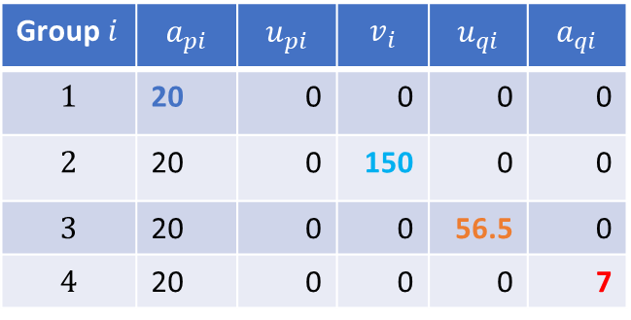

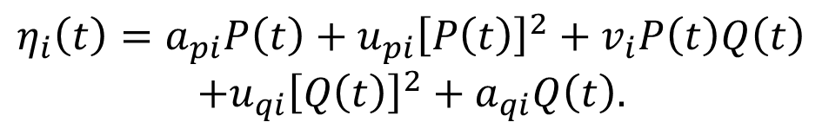

Visualisation of m_{i}
$$m_{i}\left(t\right)={\left[1+\exp\left(δ_{i}−η_{i}(t)\right)\right]}^{−1/α_{i}}.$$
$δ_{i}=2.9444,$ i.e. $m_{i}\left(0\right)=0.05.$
$$η_{i}\left(t\right)=a_{pi}P\left(t\right)+u_{pi}{\left[P\left(t\right)\right]}^{2}+v_{i}P\left(t\right)Q\left(t\right)$$
$$+u_{qi}{\left[Q\left(t\right)\right]}^{2}+a_{qi}Q\left(t\right).$$
Group $i$ | $$a_{pi}$$ | $$u_{pi}$$ | $$v_{i}$$ | $$u_{qi}$$ | $$a_{qi}$$
$$1$$ | 20 | 0 | 0 | 0 | 0
$$2$$ | 20 | 0 | 150 | 0 | 0
$$3$$ | 20 | 0 | 0 | 56.5 | 0
$$4$$ | 20 | 0 | 0 | 0 | 7

Slide 4
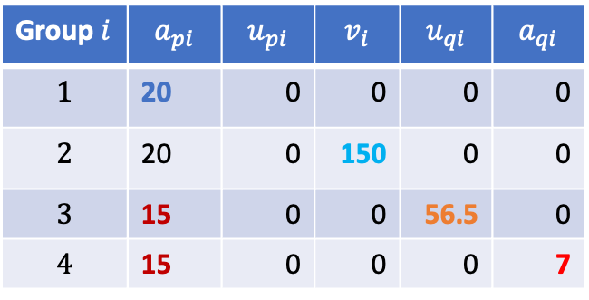

Visualisation of m_{i}
$$m_{i}\left(t\right)={\left[1+\exp\left(δ_{i}−η_{i}(t)\right)\right]}^{−1/α_{i}}.$$
$δ_{i}=2.9444,$ i.e. $m_{i}\left(0\right)=0.05.$
$$η_{i}\left(t\right)=a_{pi}P\left(t\right)+u_{pi}{\left[P\left(t\right)\right]}^{2}+v_{i}P\left(t\right)Q\left(t\right)$$
$$+u_{qi}{\left[Q\left(t\right)\right]}^{2}+a_{qi}Q\left(t\right).$$
Lowering ${ a}_{pi}$
Group $i$ | $$a_{pi}$$ | $$u_{pi}$$ | $$v_{i}$$ | $$u_{qi}$$ | $$a_{qi}$$
$$1$$ | 20 | 0 | 0 | 0 | 0
$$2$$ | 20 | 0 | 150 | 0 | 0
$$3$$ | 15 | 0 | 0 | 56.5 | 0
$$4$$ | 15 | 0 | 0 | 0 | 7

Slide 5
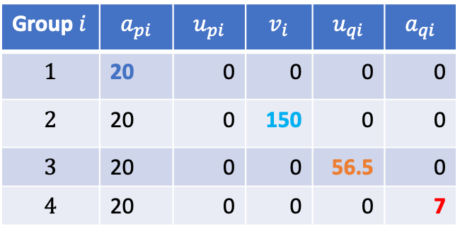

Visualisation of m_{i}
$$m_{i}\left(t\right)={\left[1+\exp\left(δ_{i}−η_{i}(t)\right)\right]}^{−1/α_{i}}.$$
$δ_{i}=2.9444,$ i.e. $m_{i}\left(0\right)=0.05.$
$$η_{i}\left(t\right)=a_{pi}P\left(t\right)+u_{pi}{\left[P\left(t\right)\right]}^{2}+v_{i}P\left(t\right)Q\left(t\right)$$
$$+u_{qi}{\left[Q\left(t\right)\right]}^{2}+a_{qi}Q\left(t\right).$$
Back to ${ a}_{pi}=20$
Group $i$ | $$a_{pi}$$ | $$u_{pi}$$ | $$v_{i}$$ | $$u_{qi}$$ | $$a_{qi}$$
$$1$$ | 20 | 0 | 0 | 0 | 0
$$2$$ | 20 | 0 | 150 | 0 | 0
$$3$$ | 20 | 0 | 0 | 56.5 | 0
$$4$$ | 20 | 0 | 0 | 0 | 7

Slide 6
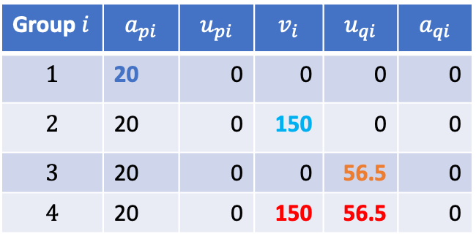
Visualisation of m_{i}
$$m_{i}\left(t\right)={\left[1+\exp\left(δ_{i}−η_{i}(t)\right)\right]}^{−1/α_{i}}.$$
$δ_{i}=2.9444,$ i.e. $m_{i}\left(0\right)=0.05.$
$$η_{i}\left(t\right)=a_{pi}P\left(t\right)+u_{pi}{\left[P\left(t\right)\right]}^{2}+v_{i}P\left(t\right)Q\left(t\right)$$
$$+u_{qi}{\left[Q\left(t\right)\right]}^{2}+a_{qi}Q\left(t\right).$$
Positive of ${ v}_{i}$ and ${ u}_{qi}$ ($i=4$ combines $i=2,3$)
Group $i$ | $$a_{pi}$$ | $$u_{pi}$$ | $$v_{i}$$ | $$u_{qi}$$ | $$a_{qi}$$
$$1$$ | 20 | 0 | 0 | 0 | 0
$$2$$ | 20 | 0 | 150 | 0 | 0
$$3$$ | 20 | 0 | 0 | 56.5 | 0
$$4$$ | 20 | 0 | 150 | 56.5 | 0

Slide 7
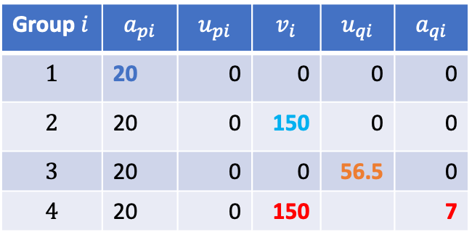
Visualisation of m_{i}
$$m_{i}\left(t\right)={\left[1+\exp\left(δ_{i}−η_{i}(t)\right)\right]}^{−1/α_{i}}.$$
$δ_{i}=2.9444,$ i.e. $m_{i}\left(0\right)=0.05.$
$$η_{i}\left(t\right)=a_{pi}P\left(t\right)+u_{pi}{\left[P\left(t\right)\right]}^{2}+v_{i}P\left(t\right)Q\left(t\right)$$
$$+u_{qi}{\left[Q\left(t\right)\right]}^{2}+a_{qi}Q\left(t\right).$$
Positive of ${ v}_{i}$ and ${ a}_{qi}$ ($i=4$ comb. $i=2,old 4$)
Group $i$ | $$a_{pi}$$ | $$u_{pi}$$ | $$v_{i}$$ | $$u_{qi}$$ | $$a_{qi}$$
$$1$$ | 20 | 0 | 0 | 0 | 0
$$2$$ | 20 | 0 | 150 | 0 | 0
$$3$$ | 20 | 0 | 0 | 56.5 | 0
$$4$$ | 20 | 0 | 150 |  | 7

Slide 8
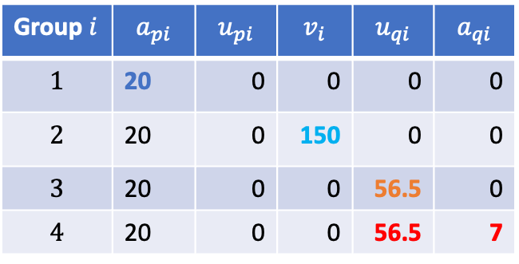
Visualisation of m_{i}
$$m_{i}\left(t\right)={\left[1+\exp\left(δ_{i}−η_{i}(t)\right)\right]}^{−1/α_{i}}.$$
$δ_{i}=2.9444,$ i.e. $m_{i}\left(0\right)=0.05.$
$$η_{i}\left(t\right)=a_{pi}P\left(t\right)+u_{pi}{\left[P\left(t\right)\right]}^{2}+v_{i}P\left(t\right)Q\left(t\right)$$
$$+u_{qi}{\left[Q\left(t\right)\right]}^{2}+a_{qi}Q\left(t\right).$$
Positive of ${ u}_{qi}$ and ${ a}_{qi}$ ($i=4$ comb. $i=3,old 4$)
Group $i$ | $$a_{pi}$$ | $$u_{pi}$$ | $$v_{i}$$ | $$u_{qi}$$ | $$a_{qi}$$
$$1$$ | 20 | 0 | 0 | 0 | 0
$$2$$ | 20 | 0 | 150 | 0 | 0
$$3$$ | 20 | 0 | 0 | 56.5 | 0
$$4$$ | 20 | 0 | 0 | 56.5 | 7

Slide 9
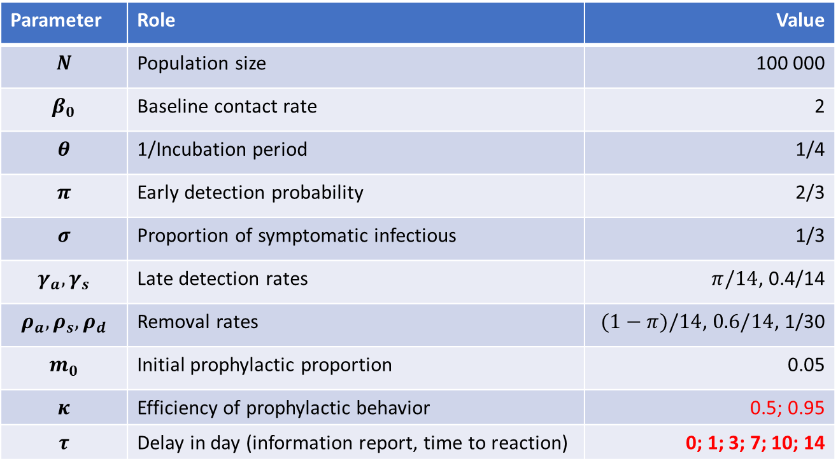
Disease Dynamic Parameters
Parameters varied in the simulations
Parameter | Role | Value
$$N$$ | Population size | 100 000
$$β_{0}$$ | Baseline contact rate | 2
$$θ$$ | 1/Incubation period | 1/4
$$π$$ | Early detection probability | 2/3
$$σ$$ | Proportion of symptomatic infectious | 1/3
$$γ_{a},γ_{s}$$ | Late detection rates | $π/14$, 0.4/14
$$ρ_{a},ρ_{s},ρ_{d}$$ | Removal rates | $(1−π)/14$, $0.6/14$, 1/30
$$m_{0}$$ | Initial prophylactic proportion | 0.05
$$κ$$ | Efficiency of prophylactic behavior | 0.5; 0.95
$$τ$$ | Delay in day (information report, time to reaction) | 0; 1; 3; 7; 10; 14

Slide 10





Disease-only Dynamic
SEIR solution
New positive cases
$$S_{∞}=\text{0}$$
$$\underset{t}{Arg max}{C(t)}=\text{38.76} \text{days}$$
$$\max_{t}{C(t)}=\text{5} \text{241.0}$$
$$\underset{t}{Arg max}{E(t)}=\text{3}\text{8}\text{.51} \text{days}$$
$$\max_{t}{E(t)}=\text{2}\text{8 319}$$

Slide 11



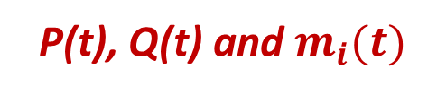
Disease-only Dynamic
Reproductive number
P(t), Q(t) and $m_{i}(t)$
$$\underset{t}{Arg max}{P(t)}=\text{47}\text{.}\text{7}\text{6} \text{days}$$
$$\underset{t}{Arg}{[ℛ\left(t\right)==1]}=\text{41}\text{.}\text{01} \text{days}$$
$$\max_{t}{P(t)}=\text{51.59\%}$$

Slide 12
Joint Disease-Behavior Dynamic
Scenarios A:
- no differential standard of risk
- all individuals pay attention to prevalence only

Slide 13

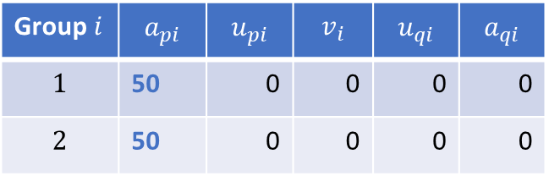


Joint Disease-Behavior Dynamic
Scenario A0:
- no differential standard of risk
- all individuals pay attention to prevalence only
Group $i$ | $$a_{pi}$$ | $$u_{pi}$$ | $$v_{i}$$ | $$u_{qi}$$ | $$a_{qi}$$
$$1$$ | 50 | 0 | 0 | 0 | 0
$$2$$ | 50 | 0 | 0 | 0 | 0
$$m_{i}\left(0\right)=0.05$$
$$κ=0.5$$
(Prophylaxis is only half-efficient)
$$τ=0$$

Slide 14




Joint Disease-Behavior Dynamic
SEIR solution
New positive cases
$$S_{∞}=\text{0}$$
$$\underset{t}{Arg max}{C(t)}=\text{43}\text{.5}\text{1} \text{days}$$
$$\max_{t}{C(t)}=\text{3}\text{ 525.50}$$
$$\underset{t}{Arg max}{E(t)}=\text{43}\text{.01} \text{days}$$
$$\max_{t}{E(t)}=\text{18}\text{ 313}$$

Slide 15



Joint Disease-Behavior Dynamic
Reproductive number
P(t), Q(t) and $m_{i}(t)$
$$\underset{t}{Arg max}{P(t)}=\text{54}\text{.26} \text{days}$$
$$\underset{t}{Arg}{[ℛ\left(t\right)==1]}=\text{46}\text{.}\text{76} \text{days}$$
$$\max_{t}{P(t)}=\text{47.20\%}$$

Slide 16

Joint Disease-Behavior Dynamic
Scenario A1:
- no differential standard of risk
- all individuals pay attention to prevalence only
Group $i$ | $$a_{pi}$$ | $$u_{pi}$$ | $$v_{i}$$ | $$u_{qi}$$ | $$a_{qi}$$
$$1$$ | 50 | 0 | 0 | 0 | 0
$$2$$ | 50 | 0 | 0 | 0 | 0
$$m_{i}\left(0\right)=0.05$$
$$κ=0.95$$
(Prophylaxis is 95% efficient)
$$τ=0$$

Slide 17
Joint Disease-Behavior Dynamic
SEIR solution
New positive cases

Slide 18
Joint Disease-Behavior Dynamic
Reproductive number
P(t), Q(t) and $m_{i}(t)$

Slide 19


Joint Disease-Behavior Dynamic
When we delay the information or increase time-to-reaction:
$$τ=1 day$$
Scenario A2:
- no differential standard of risk
- all individuals pay attention to prevalence only
Group $i$ | $$a_{pi}$$ | $$u_{pi}$$ | $$v_{i}$$ | $$u_{qi}$$ | $$a_{qi}$$
$$1$$ | 50 | 0 | 0 | 0 | 0
$$2$$ | 50 | 0 | 0 | 0 | 0
$$m_{i}\left(0\right)=0.05$$
$$κ=0.95$$
(Prophylaxis is 95% efficient)
$$τ=1 day$$

Slide 20

Joint Disease-Behavior Dynamic
When we delay the information or increase time-to-reaction:
$$τ=1 day$$
SEIR solution
New positive cases

Slide 21
Joint Disease-Behavior Dynamic
When we delay the information or increase time-to-reaction:
$$τ=1 day$$
Reproductive number
P(t), Q(t) and $m_{i}(t)$

Slide 22


Joint Disease-Behavior Dynamic
When we delay the information or increase time-to-reaction:
$$τ=3 days$$
Scenario A3:
- no differential standard of risk
- all individuals pay attention to prevalence only
Group $i$ | $$a_{pi}$$ | $$u_{pi}$$ | $$v_{i}$$ | $$u_{qi}$$ | $$a_{qi}$$
$$1$$ | 50 | 0 | 0 | 0 | 0
$$2$$ | 50 | 0 | 0 | 0 | 0
$$m_{i}\left(0\right)=0.05$$
$$κ=0.95$$
(Prophylaxis is 95% efficient)
$$τ=3 days$$

Slide 23

Joint Disease-Behavior Dynamic
When we delay the information or increase time-to-reaction:
$$τ=3 days$$
SEIR solution
New positive cases

Slide 24
Joint Disease-Behavior Dynamic
When we delay the information or increase time-to-reaction:
$$τ=3 days$$
Reproductive number
P(t), Q(t) and $m_{i}(t)$

Slide 25


Joint Disease-Behavior Dynamic
When we delay the information or increase time-to-reaction:
$$τ=1 week$$
Scenario A4:
- no differential standard of risk
- all individuals pay attention to prevalence only
Group $i$ | $$a_{pi}$$ | $$u_{pi}$$ | $$v_{i}$$ | $$u_{qi}$$ | $$a_{qi}$$
$$1$$ | 50 | 0 | 0 | 0 | 0
$$2$$ | 50 | 0 | 0 | 0 | 0
$$m_{i}\left(0\right)=0.05$$
$$κ=0.95$$
(Prophylaxis is 95% efficient)
$$τ=7 days$$

Slide 26

Joint Disease-Behavior Dynamic
When we delay the information or increase time-to-reaction:
$$τ=1 week$$
SEIR solution
New positive cases

Slide 27
Joint Disease-Behavior Dynamic
When we delay the information or increase time-to-reaction:
$$τ=1 week$$
Reproductive number
P(t), Q(t) and $m_{i}(t)$

Slide 28




Joint Disease-Behavior Dynamic
Effect of a longer information-delay
New positive cases
New positive cases
$$τ=10 days$$
$$τ=14 days$$
$$τ=10 days$$
$$τ=14 days$$

Slide 29
The following two diapos are in brackects to see quickly what happens to the epidemic waives when we allow individuals to predict the disease dynamic…

Slide 30


Joint Disease-Behavior Dynamic
A quick look at what happens when we allow people to predict the disease dynamic (v = 150)
$$τ=1 day$$
$$τ=3 days$$

Slide 31


Joint Disease-Behavior Dynamic
A quick look at what happens when we allow people to predict the disease dynamic (v = 150)
$$τ=7 day$$
$$τ=10 days$$

Slide 32
End of the brackects Back to looking at prevalence only…

Slide 33
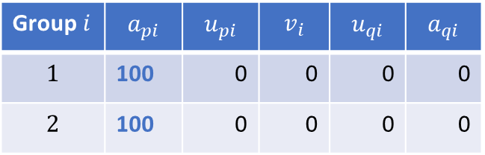
Joint Disease-Behavior Dynamic
We make the population more reactive to prevalence ($a_{pi}$ from 50 to 100).
Scenario A5:
- no differential standard of risk
- all individuals pay attention to prevalence only
Group $i$ | $$a_{pi}$$ | $$u_{pi}$$ | $$v_{i}$$ | $$u_{qi}$$ | $$a_{qi}$$
$$1$$ | 100 | 0 | 0 | 0 | 0
$$2$$ | 100 | 0 | 0 | 0 | 0
$$m_{i}\left(0\right)=0.05$$
$$κ=0.95$$
(Prophylaxis is 95% efficient)
$$τ=0$$

Slide 34
Joint Disease-Behavior Dynamic
We also delay the information or increase time-to-reaction:
$$τ=1 week$$
SEIR solution
New positive cases

Slide 35
Joint Disease-Behavior Dynamic
We also delay the information or increase time-to-reaction:
$$τ=1 week$$
Reproductive number
P(t), Q(t) and $m_{i}(t)$

Slide 36
Joint Disease-Behavior Dynamic
Effect of a longer information-delay
in the very reactive population

Slide 37
Joint Disease-Behavior Dynamic
Effect of a longer information-delay in the very reactive population
New positive cases
New positive cases
$$τ=10 days$$
$$τ=14 days$$

