Slide 1


Standards of Risk Evidence Driven Behavior-Disease Model
Chenangnon Tovissode
IMCI Postdoc,
ctovissode@uidaho.edu
Prof Bert O. Baumgaertner
Department of Politics and Philosophy,
bbaum@uidaho.edu
March 17, 2023

Slide 2
Revisiting the specification of the prophylactic proportion function

Slide 3

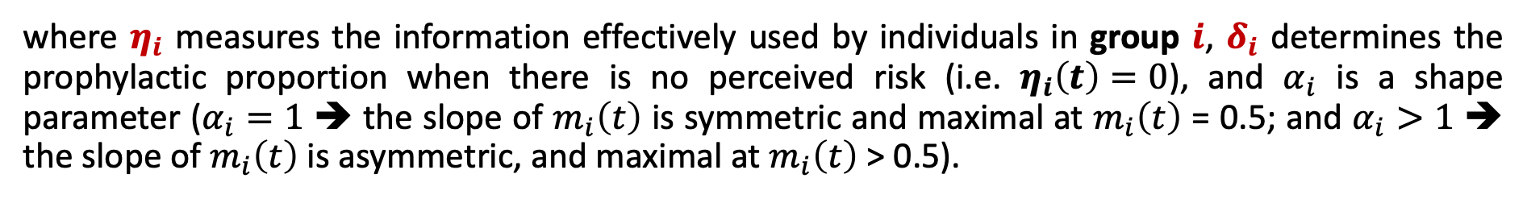
Definition of m_{i}
A Richards growth curve in terms of an information aggregate $η_{i}:$
$$m_{i}\left(t\right)={\left[1+\exp\left(δ_{i}−η_{i}(t)\right)\right]}^{−1/α_{i}}.$$
where $η_{i}$ measures the information effectively used by individuals in group $i$, $δ_{i}$ determines the prophylactic proportion when there is no perceived risk (i.e. $η_{i}\left(t\right)=0$), and $α_{i}$ is a shape parameter ($α_{i}=1$ ➔ the slope of $m_{i}\left(t\right)$ is symmetric and maximal at $m_{i}\left(t\right)$ = 0.5; and $α_{i}>1$ ➔ the slope of $m_{i}\left(t\right)$ is asymmetric, and maximal at $m_{i}\left(t\right)$ > 0.5).

Slide 4

Definition of m_{i}
A Richards growth curve in terms of an information aggregate $η_{i}:$
$$m_{i}\left(t\right)={\left[1+\exp\left(δ_{i}−η_{i}(t)\right)\right]}^{−1/α_{i}}.$$
The information aggregate $η_{i}$ is defined at time $t$as a quadratic function of the perceived disease prevalence $P\left(t\right)$ and the relative change $Q\left(t\right)$in the number $C\left(t\right)$ of new confirmed positive cases:
$$η_{i}\left(t\right)=a_{pi}P\left(t\right)+u_{pi}{\left[P\left(t\right)\right]}^{2}+v_{i}P\left(t\right)Q\left(t\right)+u_{qi}{\left[Q\left(t\right)\right]}^{2}+a_{qi}Q\left(t\right)$$
where $a_{pi}$, $a_{qi}$, $u_{pi}$, $u_{qi}$, and $v_{i}$ are non-negative real coefficients expressing the weights of linear, quadratic and interaction components of $P\left(t\right)$ and $Q\left(t\right)$ in $η_{i}$.

Slide 5
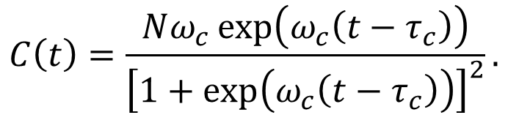
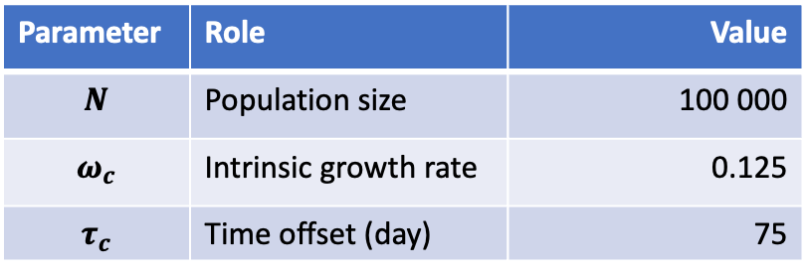
Visualisation of m_{i}
The basic pieces of information - perceived prevalence $P\left(t\right)$ and relative change $Q\left(t\right)$ in $C\left(t\right):$
Logistic number $C\left(t\right)$ of new confirmed positive cases:
$$C\left(t\right)=\frac{Nω_{c}\exp\left(ω_{c}\left(t−τ_{c}\right)\right)}{{\left[1+\exp\left(ω_{c}\left(t−τ_{c}\right)\right)\right]}^{2}}.$$
Parameter | Role | Value
$$N$$ | Population size | 100 000
$$ω_{c}$$ | Intrinsic growth rate | 0.125
$$τ_{c}$$ | Time offset (day) | 75

Slide 6
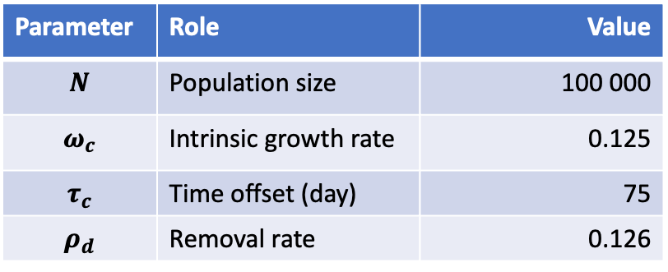
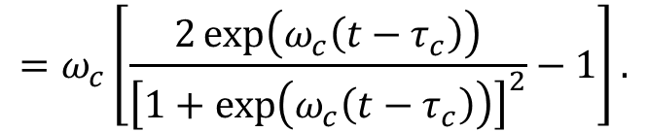
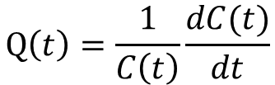
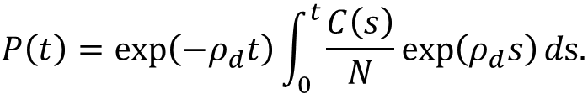
Visualisation of m_{i}
The basic pieces of information - perceived prevalence $P\left(t\right)$ and relative change $Q\left(t\right)$ in $C\left(t\right):$
$$P\left(t\right)=\exp\left(−ρ_{d}t\right)\int_{0}^{t}{\frac{C\left(s\right)}{N}\exp\left(ρ_{d}s\right)}ds.$$
$$Q\left(t\right)=\frac{1}{C\left(t\right)}\frac{dC(t)}{dt}$$
$$=ω_{c}\left[\frac{2\exp\left(ω_{c}\left(t−τ_{c}\right)\right)}{{\left[1+\exp\left(ω_{c}\left(t−τ_{c}\right)\right)\right]}^{2}}−1\right].$$
Parameter | Role | Value
$$N$$ | Population size | 100 000
$$ω_{c}$$ | Intrinsic growth rate | 0.125
$$τ_{c}$$ | Time offset (day) | 75
$$ρ_{d}$$ | Removal rate | 0.126

Slide 7
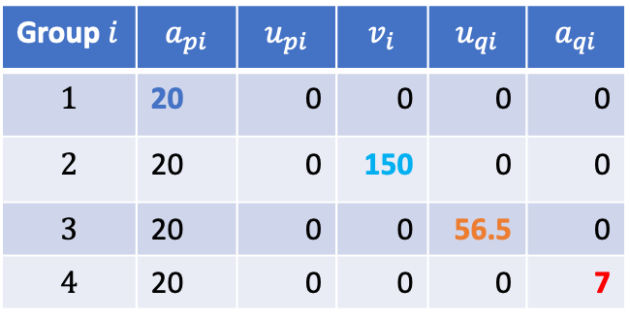

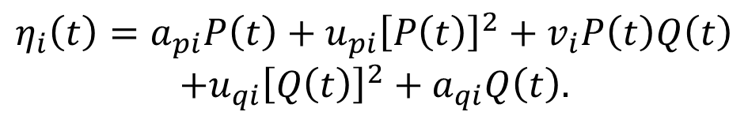

Visualisation of m_{i}
$$m_{i}\left(t\right)={\left[1+\exp\left(δ_{i}−η_{i}(t)\right)\right]}^{−1/α_{i}}.$$
$δ_{i}=2.9444,$ i.e. $m_{i}\left(0\right)=0.05.$
$$η_{i}\left(t\right)=a_{pi}P\left(t\right)+u_{pi}{\left[P\left(t\right)\right]}^{2}+v_{i}P\left(t\right)Q\left(t\right)$$
$$+u_{qi}{\left[Q\left(t\right)\right]}^{2}+a_{qi}Q\left(t\right).$$
Group $i$ | $$a_{pi}$$ | $$u_{pi}$$ | $$v_{i}$$ | $$u_{qi}$$ | $$a_{qi}$$
$$1$$ | 20 | 0 | 0 | 0 | 0
$$2$$ | 20 | 0 | 150 | 0 | 0
$$3$$ | 20 | 0 | 0 | 56.5 | 0
$$4$$ | 20 | 0 | 0 | 0 | 7

Slide 8
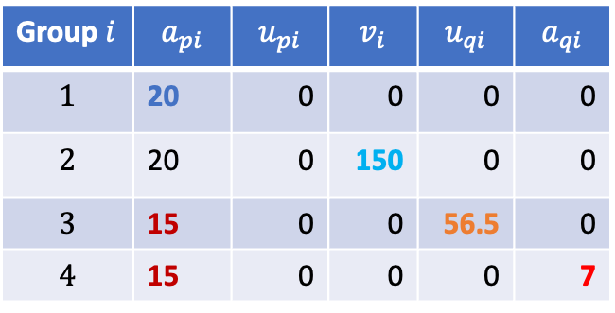

Visualisation of m_{i}
$$m_{i}\left(t\right)={\left[1+\exp\left(δ_{i}−η_{i}(t)\right)\right]}^{−1/α_{i}}.$$
$δ_{i}=2.9444,$ i.e. $m_{i}\left(0\right)=0.05.$
$$η_{i}\left(t\right)=a_{pi}P\left(t\right)+u_{pi}{\left[P\left(t\right)\right]}^{2}+v_{i}P\left(t\right)Q\left(t\right)$$
$$+u_{qi}{\left[Q\left(t\right)\right]}^{2}+a_{qi}Q\left(t\right).$$
Lowering ${ a}_{pi}$
Group $i$ | $$a_{pi}$$ | $$u_{pi}$$ | $$v_{i}$$ | $$u_{qi}$$ | $$a_{qi}$$
$$1$$ | 20 | 0 | 0 | 0 | 0
$$2$$ | 20 | 0 | 150 | 0 | 0
$$3$$ | 15 | 0 | 0 | 56.5 | 0
$$4$$ | 15 | 0 | 0 | 0 | 7

Slide 9

Visualisation of m_{i}
$$m_{i}\left(t\right)={\left[1+\exp\left(δ_{i}−η_{i}(t)\right)\right]}^{−1/α_{i}}.$$
$δ_{i}=2.9444,$ i.e. $m_{i}\left(0\right)=0.05.$
$$η_{i}\left(t\right)=a_{pi}P\left(t\right)+u_{pi}{\left[P\left(t\right)\right]}^{2}+v_{i}P\left(t\right)Q\left(t\right)$$
$$+u_{qi}{\left[Q\left(t\right)\right]}^{2}+a_{qi}Q\left(t\right).$$
Back to ${ a}_{pi}=20$
Group $i$ | $$a_{pi}$$ | $$u_{pi}$$ | $$v_{i}$$ | $$u_{qi}$$ | $$a_{qi}$$
$$1$$ | 20 | 0 | 0 | 0 | 0
$$2$$ | 20 | 0 | 150 | 0 | 0
$$3$$ | 20 | 0 | 0 | 56.5 | 0
$$4$$ | 20 | 0 | 0 | 0 | 7

Slide 10
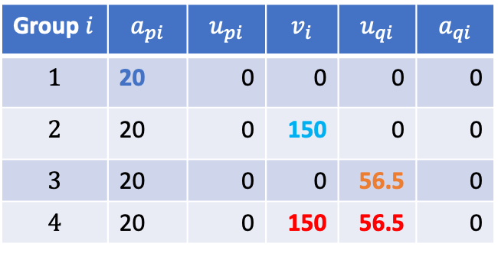
Visualisation of m_{i}
$$m_{i}\left(t\right)={\left[1+\exp\left(δ_{i}−η_{i}(t)\right)\right]}^{−1/α_{i}}.$$
$δ_{i}=2.9444,$ i.e. $m_{i}\left(0\right)=0.05.$
$$η_{i}\left(t\right)=a_{pi}P\left(t\right)+u_{pi}{\left[P\left(t\right)\right]}^{2}+v_{i}P\left(t\right)Q\left(t\right)$$
$$+u_{qi}{\left[Q\left(t\right)\right]}^{2}+a_{qi}Q\left(t\right).$$
Positive of ${ v}_{i}$ and ${ u}_{qi}$ ($i=4$ combines $i=2,3$)
Group $i$ | $$a_{pi}$$ | $$u_{pi}$$ | $$v_{i}$$ | $$u_{qi}$$ | $$a_{qi}$$
$$1$$ | 20 | 0 | 0 | 0 | 0
$$2$$ | 20 | 0 | 150 | 0 | 0
$$3$$ | 20 | 0 | 0 | 56.5 | 0
$$4$$ | 20 | 0 | 150 | 56.5 | 0

Slide 11
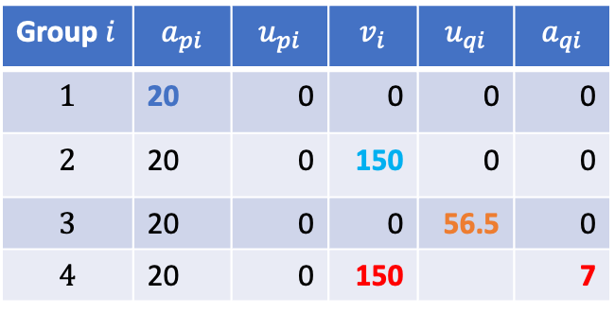
Visualisation of m_{i}
$$m_{i}\left(t\right)={\left[1+\exp\left(δ_{i}−η_{i}(t)\right)\right]}^{−1/α_{i}}.$$
$δ_{i}=2.9444,$ i.e. $m_{i}\left(0\right)=0.05.$
$$η_{i}\left(t\right)=a_{pi}P\left(t\right)+u_{pi}{\left[P\left(t\right)\right]}^{2}+v_{i}P\left(t\right)Q\left(t\right)$$
$$+u_{qi}{\left[Q\left(t\right)\right]}^{2}+a_{qi}Q\left(t\right).$$
Positive of ${ v}_{i}$ and ${ a}_{qi}$ ($i=4$ comb. $i=2,old 4$)
Group $i$ | $$a_{pi}$$ | $$u_{pi}$$ | $$v_{i}$$ | $$u_{qi}$$ | $$a_{qi}$$
$$1$$ | 20 | 0 | 0 | 0 | 0
$$2$$ | 20 | 0 | 150 | 0 | 0
$$3$$ | 20 | 0 | 0 | 56.5 | 0
$$4$$ | 20 | 0 | 150 |  | 7

Slide 12
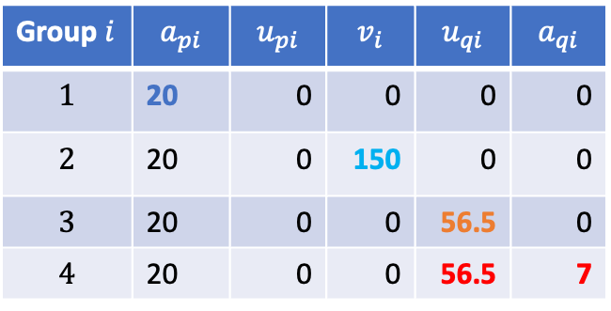
Visualisation of m_{i}
$$m_{i}\left(t\right)={\left[1+\exp\left(δ_{i}−η_{i}(t)\right)\right]}^{−1/α_{i}}.$$
$δ_{i}=2.9444,$ i.e. $m_{i}\left(0\right)=0.05.$
$$η_{i}\left(t\right)=a_{pi}P\left(t\right)+u_{pi}{\left[P\left(t\right)\right]}^{2}+v_{i}P\left(t\right)Q\left(t\right)$$
$$+u_{qi}{\left[Q\left(t\right)\right]}^{2}+a_{qi}Q\left(t\right).$$
Positive of ${ u}_{qi}$ and ${ a}_{qi}$ ($i=4$ comb. $i=3,old 4$)
Group $i$ | $$a_{pi}$$ | $$u_{pi}$$ | $$v_{i}$$ | $$u_{qi}$$ | $$a_{qi}$$
$$1$$ | 20 | 0 | 0 | 0 | 0
$$2$$ | 20 | 0 | 150 | 0 | 0
$$3$$ | 20 | 0 | 0 | 56.5 | 0
$$4$$ | 20 | 0 | 0 | 56.5 | 7

Slide 13
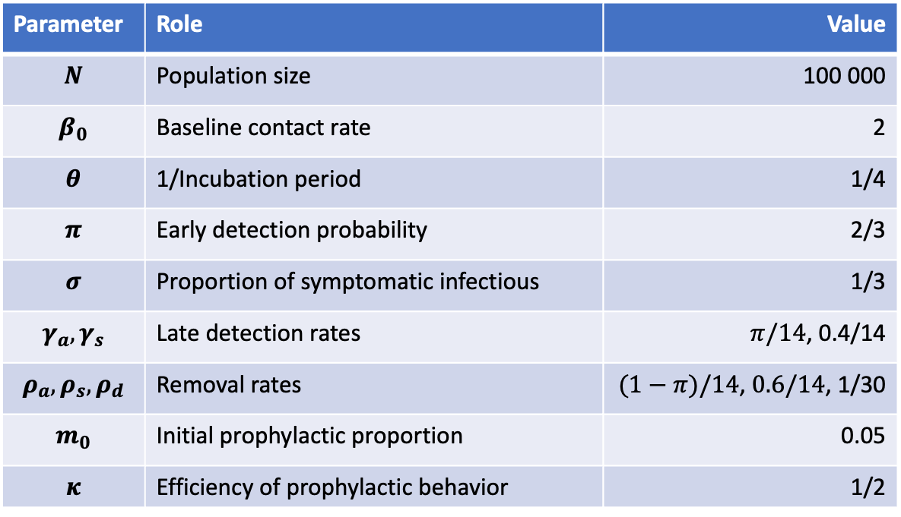
Disease Dynamic Parameters
Parameter | Role | Value
$$N$$ | Population size | 100 000
$$β_{0}$$ | Baseline contact rate | 2
$$θ$$ | 1/Incubation period | 1/4
$$π$$ | Early detection probability | 2/3
$$σ$$ | Proportion of symptomatic infectious | 1/3
$$γ_{a},γ_{s}$$ | Late detection rates | $π/14$, 0.4/14
$$ρ_{a},ρ_{s},ρ_{d}$$ | Removal rates | $(1−π)/14$, $0.6/14$, 1/30
$$m_{0}$$ | Initial prophylactic proportion | 0.05
$$κ$$ | Efficiency of prophylactic behavior | 1/2

Slide 14

Disease-only Dynamic
SEIR solution
New positive cases
$$S_{∞}=\text{0}$$

Slide 15
Disease-only Dynamic
Reproductive number
P(t) and Q(t)

Slide 16
Joint Disease-Behavior Dynamic
SEIR solution
New positive cases

Slide 18
Vary initial proportions of S_{-1} and S_{1}

