Slide 1
bEquality
Trustful, reliable and efficient platform
to further enhance gender-equality
Project:
Gender equality challenge by UBS
Outcome:
Our solution provides a reliable, transparent and automatic way of creating a gender-equality index.
Data capture can be automated with our system
With our protocol the results of the evaluation can be displayed easily and straightforward to the public
This index is useful for companies to further improve their status with respect to gender equality. It is also used by people to make investment decisions.
Major challenges:
Finding a secure way of implementing a system equivalent to E-voting.
Making cheating for companies too hard to be profitable.
Outlook:
Implementing further improvements of the E-voting prototype
making the whole process fully automatic.

Slide 2
Project Idea
Employer
Disruption potential:
Process of data gathering, data validation and evaluation is being automated with this scheme.
E-voting – via Blockchain:
Anonymous E-voting system via Blockchain technology allows presentation of opinions without any consequences.
Our E-voting system (employee survey) acts like a third party watching the data gathering process to validate the employer provided data.
Further outlooks:
These process steps can be fully automated and therefore does not has to involve a third party in the index-creation process
Evaluation step – data analysis:
Can be copied from existing gender-equality indizes
data
survey
employer
provided data
employee
survey
Data verification
evaluation

Slide 3
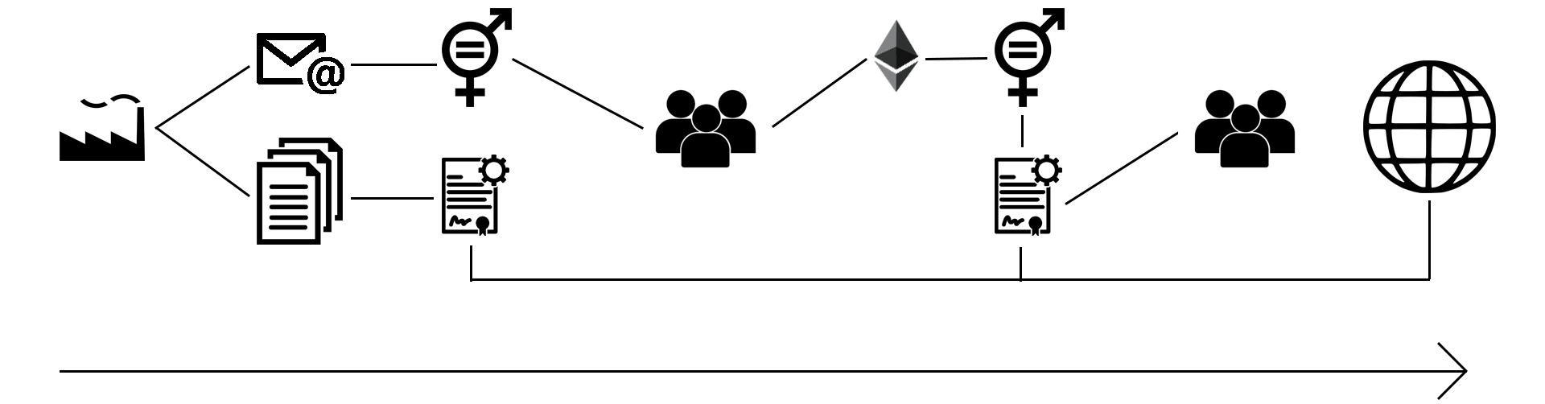
E-voting system protocol
This protocol provides for the employee to tell his opinion without further consequences.
The E-voting protocol just describes the upper branch of the graph below.
Initiation:
Company employees get a mail to create accounts on our interface, they have to set up an account protected with a password. This account creation automatically generates a public and a private key.
All public keys get collected anonymously
Survey setup:
When all public keys are collected, all accounts get set up and put money on them to pay transaction costs
All employees get notified that the survey has been set up
Survey completion:
Employees fill out their survey
Their response gets transmitted anonymously to our system via IPFS
Evaluation:
After we have got all results from employees we then can evaluate the results of the surveys and finally verify the data that is provided by the company

Slide 4
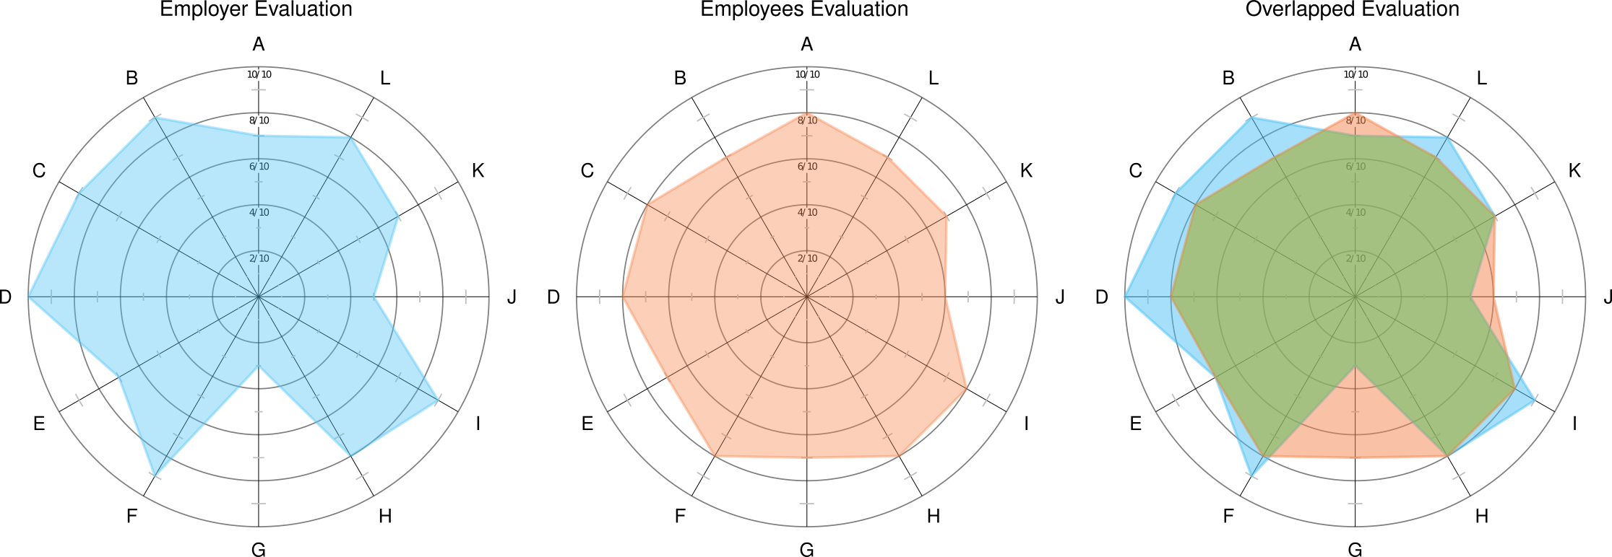
Gender equality challenge by UBS
evaluation
Evaluation of results: The evaluation of the obtained data can be done equivalently to the evaluation of already existing gender-equality indizes.
Advantage over existing indizes: Instead of just providing a one-dimensional index, as done by multiple existing indizes, we provide a multidimensional evaluation of the results.
This allows proposition of precise further improvement of company states and a transparent evaluation of the data for the private investor.

