Slide 1
A Car-to-X Communication Framework for autonomous cars with Wi-Fi Car Tracing and Traffic Light Control Optimizing

Slide 2
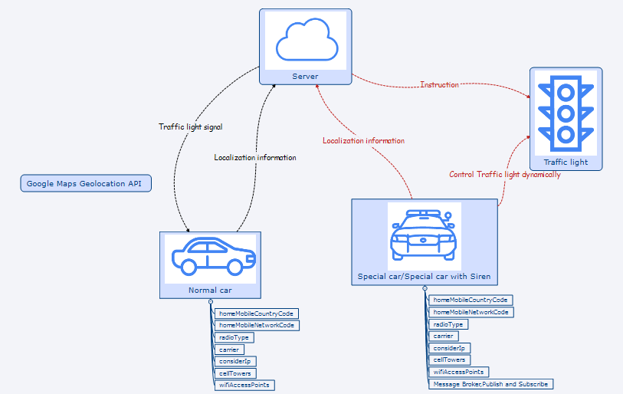
Car-to-X Communication

Slide 3


Slide 4
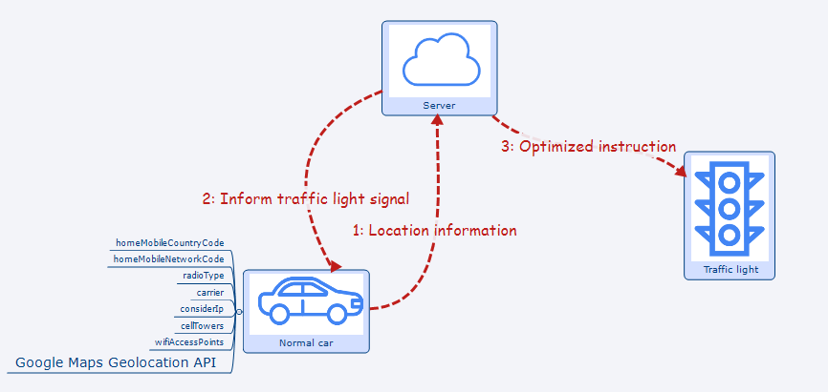

Slide 5
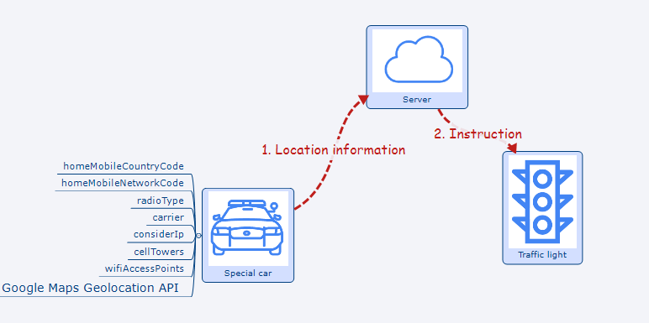

Slide 6
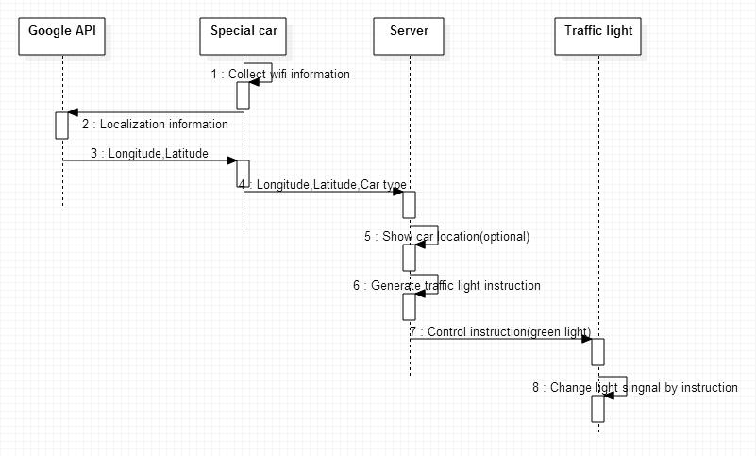

Slide 7
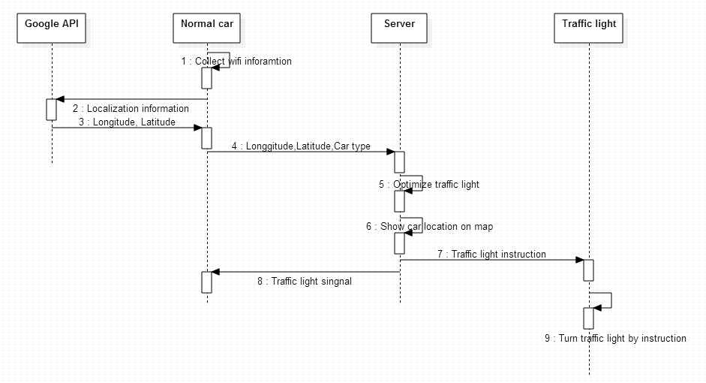

Slide 8
