Slide 1
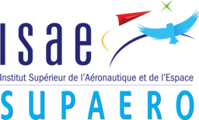
HALE Aeroecodesign
Master of Aerospace Engineering - Research Project
S2 – Progress Repot
Víctor Manuel GUADAÑO MARTÍN
Tutors: J. Morlier & E. Duriez

Slide 2
OUTLINE
STATE OF THE ART
GOAL OF THE PROJECT
MILESTONES OF THE PROJECT
Víctor M. GUADAÑO MARTÍN
HALE AEROECODESIGN

Slide 3
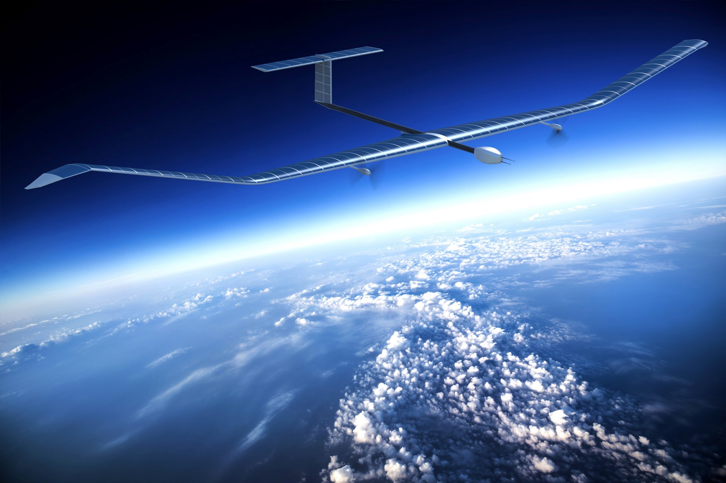
STATE OF THE ART
HALE ➤ High-Altitude Long Endurance Drone
Atmospheric satellites or atmosats
Services conventionally provided by space satellites
Environment-friendly ➤ Powered by solar energy
CO₂ emissions ➤ Manufacturing and materials
MDO ➤ Multidisciplinary Design Optimization
Optimum for the interaction of disciplines
OpenAeroStruct (based on OpenMDAO) ➤ Aerostructural optimization
Fig. 1: Airbus-built HALE Zephyr
Víctor M. GUADAÑO MARTÍN
HALE AEROECODESIGN

Slide 4
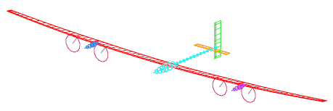
STATE OF THE ART
Table 1: Design variable values for validation case [1]
Variable | Units | HALE of [1] | FB HALE [2]
Span | m | 97.5 | -
Root chord | m | 1.4 | -
Taper ratio | - | 0.32 | -
Total mass | kg | 378 | 320
Wing surface | m² | 86.6 | 71.8
Aspect ratio | - | 94 | 29
C_{L}^{cruise} | - | 1.31 | 1.33
(C_{L}^{3/2}/C_{D})^{cruise} | - | 44.1 | 40.1
Fig. 2: Optimal HALE wing structure [1]
Fig. 3: Facebook’s single-boom HALE [2]
[1]
E. Duriez and J. Morlier, “Hale multidisciplinary design optimization with a focus on eco-material selection,” ISAE Supaero, 2020.
D. Colas, N. H. Roberts, and V. S. Suryakumar, “Hale multidisciplinary design opti-mization part i: Solar-powered single and multiple-boom aircraft,” in 2018 AviationTechnology, Integration, and Operations Conference, p. 3028, 2018.
[2]
Víctor M. GUADAÑO MARTÍN
HALE AEROECODESIGN

Slide 5
GOAL OF THE PROJECT
Refine a modified version of OpenAeroStruct presented in [1]
CO₂ footprint optimization of a HALE
Compromise solution between:
Convergence of the optimization ➤ Efficiency
Complexity of the model ➤ Realistic
[1]
E. Duriez and J. Morlier, “Hale multidisciplinary design optimization with a focus on eco-material selection,” ISAE Supaero, 2020.
Víctor M. GUADAÑO MARTÍN
HALE AEROECODESIGN

Slide 6
MILESTONES OF THE PROJECT
Task 1: Add a constraint on the wing surface
Task 2: Fix some design variables
Task 3: Turn material function into OpenMDAO component
Task 4: Set different materials for different parts of the wing
Task 5: Introduce a more complex buckling model
Task 6: Add engines as point masses
Task 7: Model a two dimensional discrete gust
Víctor M. GUADAÑO MARTÍN
HALE AEROECODESIGN

Slide 7
Task 1: Add a constraint on the wing surface
Reduce snowball effect ➤ Prevent the optimization from diverging
Maximum wing surface threshold
Task 2: Fix some design variables
Make the problem more computationally efficient
Fix some optimization variables ➤ tapper ratio, root chord…
Víctor M. GUADAÑO MARTÍN
HALE AEROECODESIGN

Slide 8
Task 3: Turn material function into OpenMDAO component
Currently ➤ Function to use material properties
OpenMDAO ➤ Modular implementation in components
Components ➤ More efficient for gradient-based optimization
Replace the function by a component
Get to know the OpenMDAO methodology
Víctor M. GUADAÑO MARTÍN
HALE AEROECODESIGN

Slide 9
Task 4: Set different materials for different parts of the wing
Currently ➤ Sigle material for the hole wing
Allow the optimization to use two different materials:
One for the spars
One for the skins
Better solution in terms of CO₂ footprint and weight
More design variables ➤ Longer optimization
Víctor M. GUADAÑO MARTÍN
HALE AEROECODESIGN

Slide 10
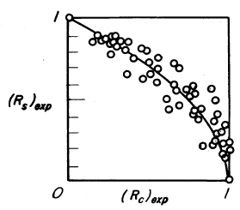
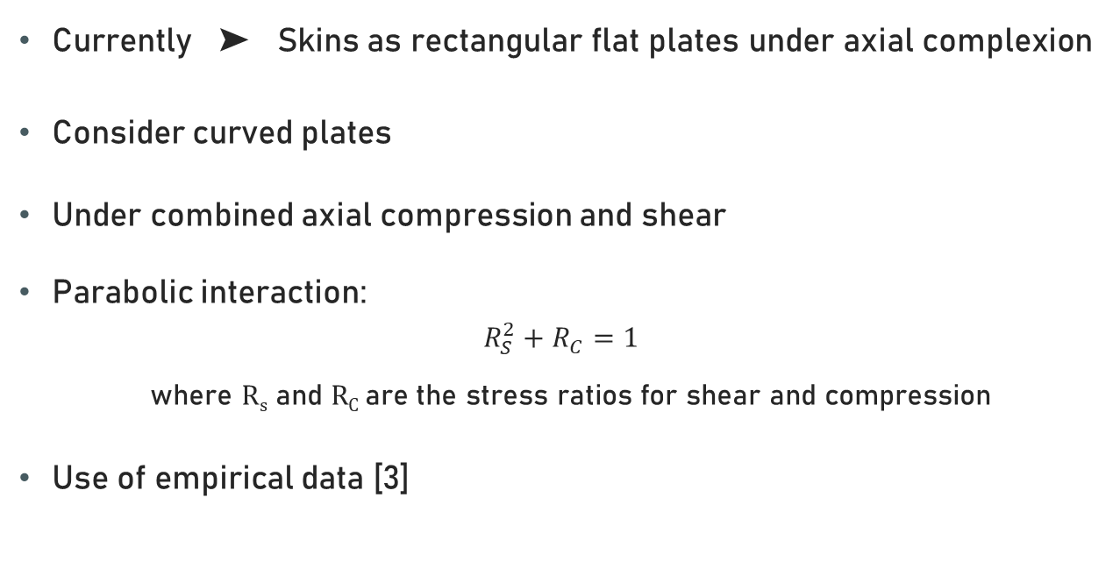
Task 5: Introduce a more complex buckling model
Currently ➤ Skins as rectangular flat plates under axial complexion
Consider curved plates
Under combined axial compression and shear
Parabolic interaction:
$$R_{S}^{2}+R_{C}=1$$
where R_{s} and R_{C} are the stress ratios for shear and compression
Use of empirical data [3]
Fig. 4: Comparison of test data with parabolic interaction curves for curved plates under combined shear and axial compression [3]
[3]
G. Gerard and H. Becker, “Handbook of structural stability. part 3. buckling of curved plates and shells.,” tech. rep., NATIONAL AERONAUTICS AND SPACE ADMIN-ISTRATION WASHINGTON DC, 1957.
Víctor M. GUADAÑO MARTÍN
HALE AEROECODESIGN

Slide 11
Task 6: Add engines as point masses
Currently ➤ Propulsion mass in the plane of symmetry
Already implemented in OpenAeroStruct
Two symmetrical engines ➤ Two symmetrical point masses
New design variable ➤ Distance from the plane of symmetry
Reduce the bending moment on the wing due to lift
Víctor M. GUADAÑO MARTÍN
HALE AEROECODESIGN

Slide 12
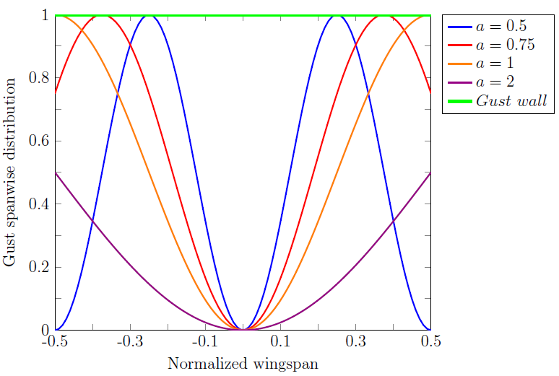
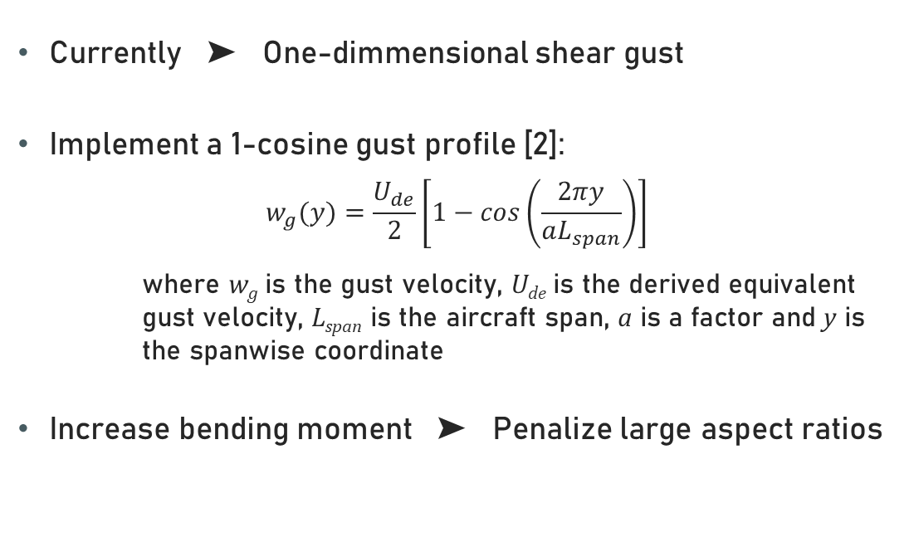
Task 7: Model a two dimensional discrete gust
Currently ➤ One-dimmensional shear gust
Implement a 1-cosine gust profile [2]:
$$w_{g}(y)=\frac{U_{de}}{2}\left[1−cos\left(\frac{2πy}{aL_{span}}\right)\right]$$
where w_{g} is the gust velocity, U_{de} is the derived equivalent gust velocity, L_{span} is the aircraft span, a is a factor and y is the spanwise coordinate
Increase bending moment ➤ Penalize large aspect ratios
Fig. 5: Spanwise distribution of 1-cosine gusts
[4]
Y. Yang, Y. Chao, and W. Zhigang, “Aeroelastic dynamic response of elastic aircraft with consideration of two-dimensional discrete gust excitation,” Chinese Journal of Aeronautics, 2019.
Víctor M. GUADAÑO MARTÍN
HALE AEROECODESIGN

Slide 13
THANks for your attention!
ANY QUESTION?
Víctor M. GUADAÑO MARTÍN
HALE AEROECODESIGN

