Slide 1
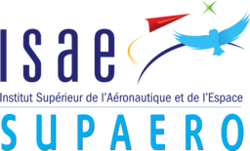
HALE Aeroecodesign
Master of Aerospace Engineering - Research Project
S2 Project Report – 26/06/2020
Víctor Manuel GUADAÑO MARTÍN
Tutors: J. Morlier & E. Duriez

Slide 2

OUTLINE
STATE OF THE ART
GOAL OF THE PROJECT
MILESTONES OF THE PROJECT
RESULTS
CONCLUSIONS
FUTURE WORK
Víctor M. GUADAÑO MARTÍN
HALE AEROECODESIGN

Slide 3
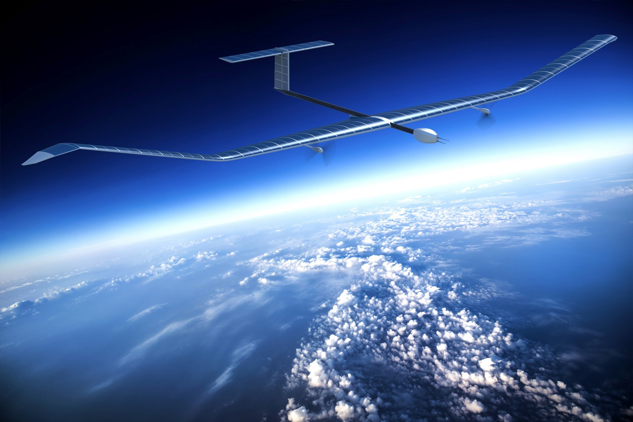
STATE OF THE ART
HALE ➤ High-Altitude Long Endurance Drone
Atmospheric satellites or atmosats
Services conventionally provided by space satellites
Environment-friendly ➤ Powered by solar energy
CO₂ emissions ➤ Manufacturing and materials
MDO ➤ Multidisciplinary Design Optimization
Optimum for the interaction of disciplines
OpenAeroStruct (based on OpenMDAO) ➤ Aerostructural optimization
Fig. 1: Airbus-built HALE Zephyr
Víctor M. GUADAÑO MARTÍN
HALE AEROECODESIGN

Slide 4
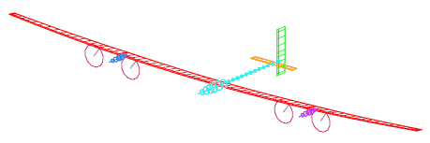
GOAL OF THE PROJECT
Refine a modified version of OpenAeroStruct presented in [1]
CO₂ footprint optimization of a HALE
Compromise solution between:
Convergence of the optimization ➤ Efficiency
Complexity of the model ➤ Realistic
Validation with Facebook’s single-boom HALE [2]
Fig. 2: Optimal HALE wing structure [1]
Fig. 3: Facebook’s single-boom HALE [2]
[1]
E. Duriez and J. Morlier, “Hale multidisciplinary design optimization with a focus on eco-material selection,” ISAE Supaero, 2020.
D. Colas, N. H. Roberts, and V. S. Suryakumar, “Hale multidisciplinary design optimization Part I: Solar-powered single and multiple-boom aircraft,” in 2018 AviationTechnology, Integration, and Operations Conference, p. 3028, 2018.
[2]
Víctor M. GUADAÑO MARTÍN
HALE AEROECODESIGN

Slide 5
MILESTONES OF THE PROJECT
Buckling model
1-cos gust
Different materials
Limit wing surface
Engines
Material components
Buckling model
1-cos gust
Different materials
Limit wing surface
Engines
Material components
COMPLETED
SEMESTER 3
Víctor M. GUADAÑO MARTÍN
HALE AEROECODESIGN

Slide 6

Add a constraint on the wing surface
Reduce snowball effect ➤ Prevent the optimization from diverging
Maximum wing surface threshold ➤ 200 m²
HALE
Weight
➤
Propulsion
Weight (batteries & solar panels)
➤
Structural
Weight
➤
Divergence
Víctor M. GUADAÑO MARTÍN
HALE AEROECODESIGN

Slide 7
Turn material function into OpenMDAO components
Component ➤ The most efficient way for gradient-based optimization
Replace the existing function by the component
Access to material properties database and interpolate:
Young’s modulus (E)
Shear modulus (G)
Get to know the OpenMDAO methodology
Failure strength
CO₂ emissions
Víctor M. GUADAÑO MARTÍN
HALE AEROECODESIGN

Slide 8
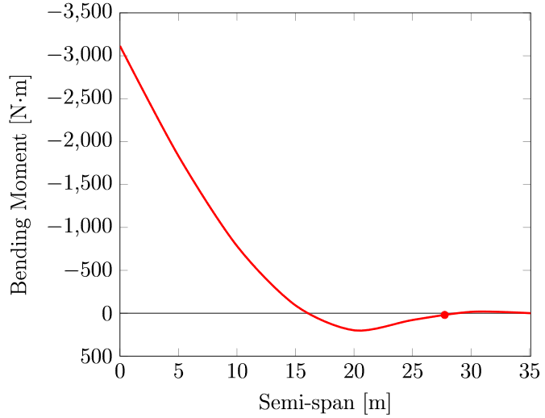
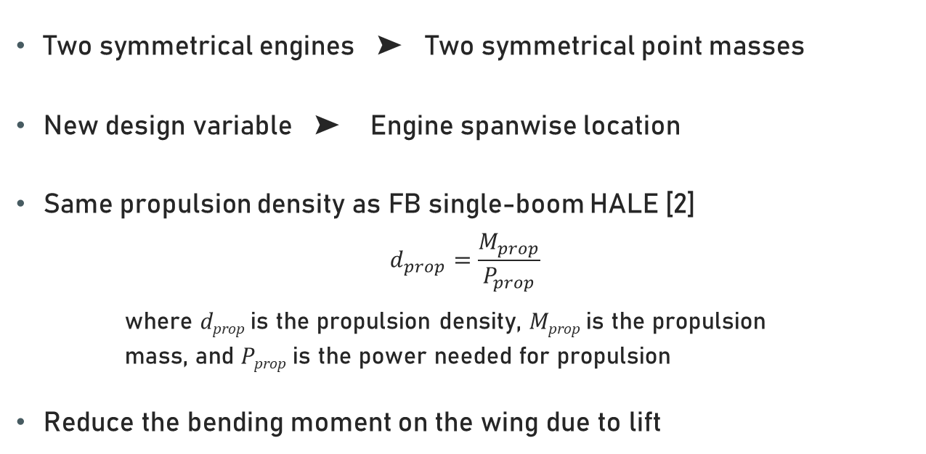
Add engines as point masses
Two symmetrical engines ➤ Two symmetrical point masses
New design variable ➤ Engine spanwise location
Same propulsion density as FB single-boom HALE [2]
$$d_{prop}=\frac{M_{prop}}{P_{prop}}$$
where d_{prop} is the propulsion density, M_{prop} is the propulsion
mass, and P_{prop} is the power needed for propulsion
Reduce the bending moment on the wing due to lift
Engine location
Fig. 4: Bending moment distribution along semi-span
[2]
D. Colas, N. H. Roberts, and V. S. Suryakumar, “Hale multidisciplinary design optimization Part I: Solar-powered single and multiple-boom aircraft,” in 2018 AviationTechnology, Integration, and Operations Conference, p. 3028, 2018.
Víctor M. GUADAÑO MARTÍN
HALE AEROECODESIGN

Slide 9
RESULTS
Table 1: Final design variable values for validation case
Variable | Units | HALE of [1] | FB HALE [2] | Results w/o engines | Results w/ engines
Span | m | 97.5 | - | 93.5 | 70.2
Root chord | m | 1.4 | - | 1.4 | 1.4
Taper ratio | - | 0.32 | - | 0.33 | 0.30
Total mass | kg | 378 | 320 | 435 | 362
Wing surface | m² | 86.6 | 71.8 | 83.4 | 61.3
Aspect ratio | - | 94 | 29 | 105 | 80
C_{L}^{cruise} | - | 1.31 | 1.33 | 1.56 | 1.77
(C_{L}^{3/2}/C_{D})^{cruise} | - | 44.1 | 40.1 | 57.8 | 72.1
y_{engine}/(b/2) | - | 0 | 0.46 | 0 | 0.79
[1]
E. Duriez and J. Morlier, “Hale multidisciplinary design optimization with a focus on eco-material selection,” ISAE Supaero, 2020.
D. Colas, N. H. Roberts, and V. S. Suryakumar, “Hale multidisciplinary design optimization Part I: Solar-powered single and multiple-boom aircraft,” in 2018 AviationTechnology, Integration, and Operations Conference, p. 3028, 2018.
[2]
Víctor M. GUADAÑO MARTÍN
HALE AEROECODESIGN

Slide 10
RESULTS
Table 2: Performance values of the optimization for validation case
Performance | Units | HALE of [1] | Results w/o engines | Results w/ engines
Cases | - | 24 | 24 | 24
Convergences | - | 7 | 12 | 11
Time | h | 2 | 3 | 4
[1]
E. Duriez and J. Morlier, “Hale multidisciplinary design optimization with a focus on eco-material selection,” ISAE Supaero, 2020.
Víctor M. GUADAÑO MARTÍN
HALE AEROECODESIGN

Slide 11
CONCLUSIONS
Without engines ➤ Better convergence and same results as in [1]
With engines ➤ Worse convergence than without engines but better results
Same differences with respect to [2] as in [1] ➤ Very high aspect ratio
Need for 1-cosine gust and more complex buckling model
[1]
E. Duriez and J. Morlier, “Hale multidisciplinary design optimization with a focus on eco-material selection,” ISAE Supaero, 2020.
D. Colas, N. H. Roberts, and V. S. Suryakumar, “Hale multidisciplinary design optimization Part I: Solar-powered single and multiple-boom aircraft,” in 2018 AviationTechnology, Integration, and Operations Conference, p. 3028, 2018.
[2]
Víctor M. GUADAÑO MARTÍN
HALE AEROECODESIGN

Slide 12
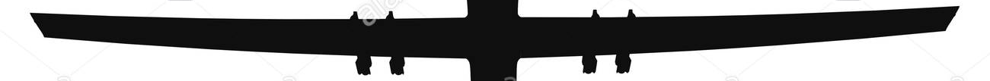
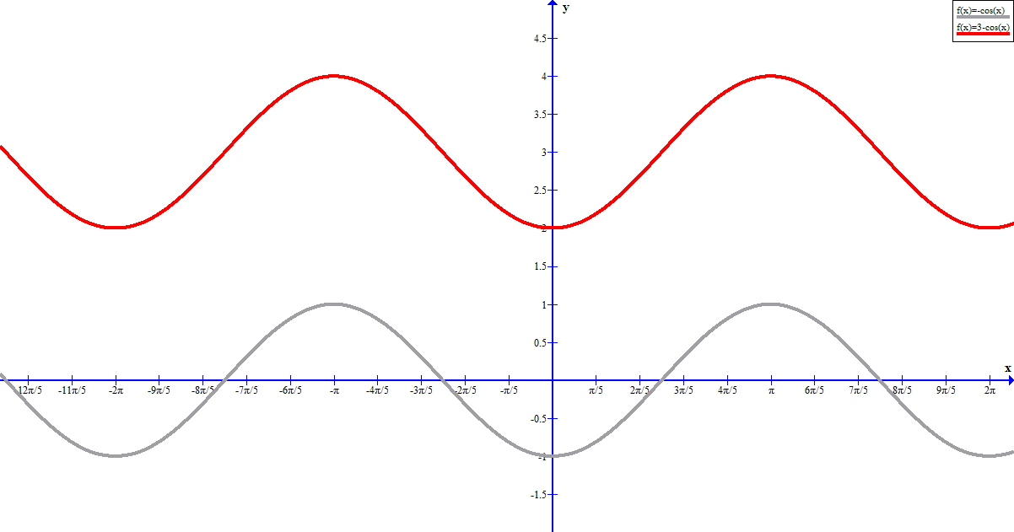
FUTURE WORK
COMPLETED
SEMESTER 3
Limit wing surface
Material components
Engines
Different materials
Buckling model
1-cos gust
Young’s modulus
Shear modulus
Yield strength
CO₂ emissions
Position
Mass
Two materials
Skins
Spars
Curved plates
Compression
Shear
Víctor M. GUADAÑO MARTÍN
HALE AEROECODESIGN

Slide 13
Set different materials for different parts of the wing
FUTURE WORK
Currently ➤ Single material for the whole wing
Allow the optimization to use two different materials:
One for the spars
One for the skins
Better solution in terms of CO₂ footprint
More design variables ➤ Longer optimization
Víctor M. GUADAÑO MARTÍN
HALE AEROECODESIGN

Slide 14
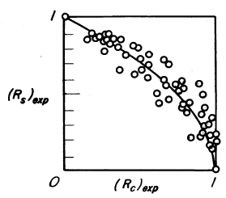
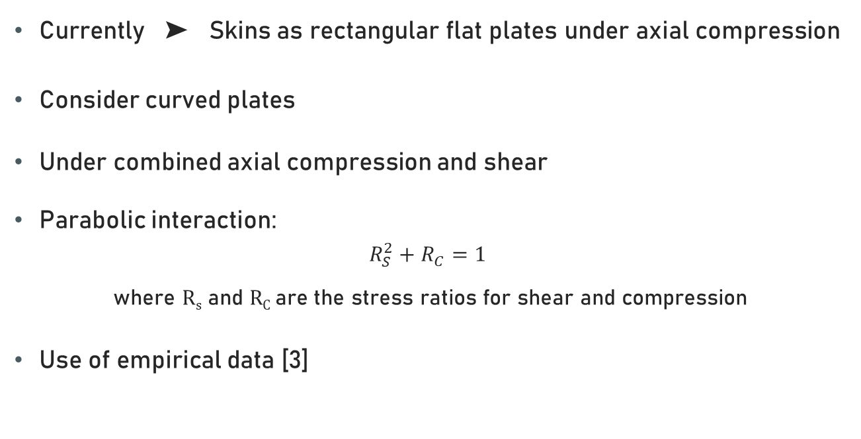
Introduce a more complex buckling model
FUTURE WORK
Currently ➤ Skins as rectangular flat plates under axial compression
Consider curved plates
Under combined axial compression and shear
Parabolic interaction:
$$R_{S}^{2}+R_{C}=1$$
where R_{s} and R_{C} are the stress ratios for shear and compression
Use of empirical data [3]
Fig. 5: Comparison of test data with parabolic interaction curves for curved plates under combined shear and axial compression [3]
[3]
G. Gerard and H. Becker, “Handbook of structural stability. part 3. buckling of curved plates and shells.,” tech. rep., NATIONAL AERONAUTICS AND SPACE ADMIN-ISTRATION WASHINGTON DC, 1957.
Víctor M. GUADAÑO MARTÍN
HALE AEROECODESIGN

Slide 15
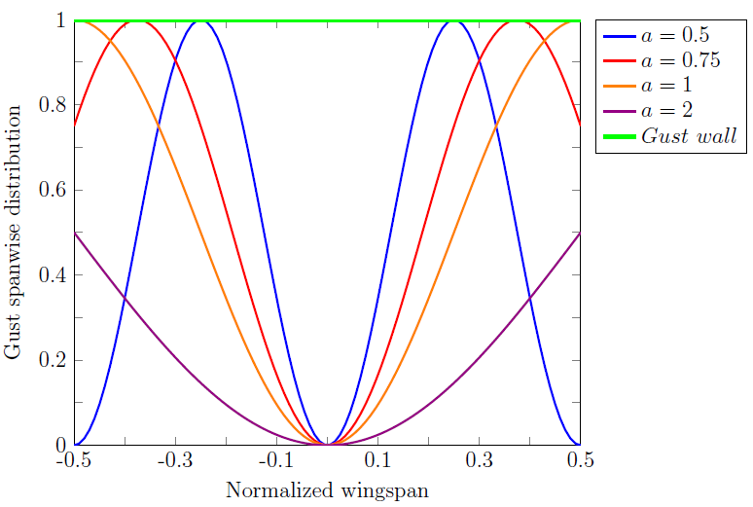
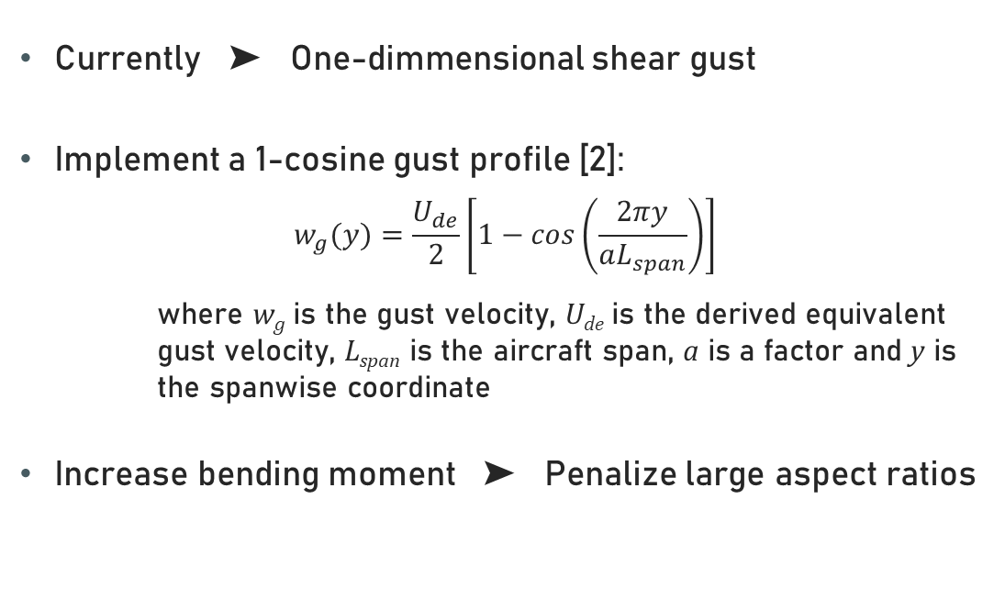
Model a two dimensional discrete gust
FUTURE WORK
Currently ➤ One-dimmensional shear gust
Implement a 1-cosine gust profile [2]:
$$w_{g}(y)=\frac{U_{de}}{2}\left[1−cos\left(\frac{2πy}{aL_{span}}\right)\right]$$
where w_{g} is the gust velocity, U_{de} is the derived equivalent gust velocity, L_{span} is the aircraft span, a is a factor and y is the spanwise coordinate
Increase bending moment ➤ Penalize large aspect ratios
Fig. 6: Spanwise distribution of 1-cosine gusts
[4]
Y. Yang, Y. Chao, and W. Zhigang, “Aeroelastic dynamic response of elastic aircraft with consideration of two-dimensional discrete gust excitation,” Chinese Journal of Aeronautics, 2019.
Víctor M. GUADAÑO MARTÍN
HALE AEROECODESIGN

Slide 16
Add a constraint on the wing surface
Reduce snowball effect ➤ Prevent the optimization from diverging
Maximum wing surface threshold ➤ 200 m²
Fix some design variables
Make the problem more computationally efficient
Fix some optimization variables ➤ tapper ratio, root chord…
Finally not used to compare the results in a better way
Víctor M. GUADAÑO MARTÍN
HALE AEROECODESIGN

Slide 17
Thanks for your attention!
“True optimization is the revolutionary contribution of modern research to decision processes”
George Dantzig
ANY QUESTION?
Víctor M. GUADAÑO MARTÍN
HALE AEROECODESIGN

