Slide 1
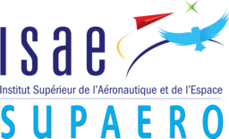
HALE Aeroecodesign
Master of Aerospace Engineering - Research Project
Progress Presentation – 20/05/2020
Víctor Manuel GUADAÑO MARTÍN
Tutors: J. Morlier & E. Duriez

Slide 2
OUTLINE
GOAL OF THE PROJECT
MILESTONES OF THE PROJECT
RESULTS
CONCLUSION
Víctor M. GUADAÑO MARTÍN
HALE AEROECODESIGN

Slide 3
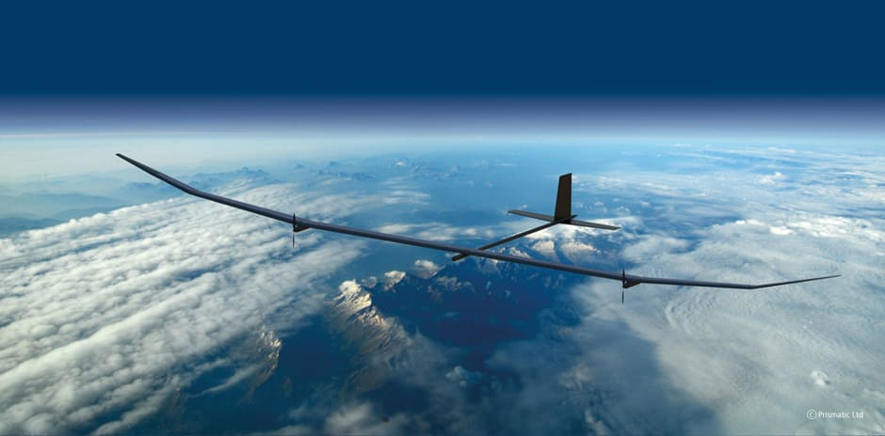
GOAL OF THE PROJECT
Refine a modified version of OpenAeroStruct presented in [1]
MDO of a HALE to minimize the CO₂ footprint
MDO ➤ Multidisciplinary Design Optimization
HALE ➤ High-Altitude Long Endurance Drone
Compromise solution between:
Convergence of the optimization ➤ Efficiency
Complexity of the model ➤ Realistic
Fig. 1: PHASA-35 HALE
[1]
E. Duriez and J. Morlier, “Hale multidisciplinary design optimization with a focus on eco-material selection,” ISAE Supaero, 2020.
Víctor M. GUADAÑO MARTÍN
HALE AEROECODESIGN

Slide 4

MILESTONES OF THE PROJECT
Task 1: Add a constraint on the wing surface
Task 2: Fix some design variables
Task 3: Turn material function into OpenMDAO component
Task 4: Set different materials for different parts of the wing
Task 5: Introduce a more complex buckling model
Task 6: Add engines as point masses
Task 7: Model a two dimensional discrete gust
Víctor M. GUADAÑO MARTÍN
HALE AEROECODESIGN

Slide 5
Add a constraint on the wing surface
Reduce snowball effect ➤ Prevent the optimization from diverging
Maximum wing surface threshold ➤ 200 m²
Fix some design variables
Make the problem more computationally efficient
Fix some optimization variables ➤ tapper ratio, root chord…
Finally not used to compare the results in a better way
Víctor M. GUADAÑO MARTÍN
HALE AEROECODESIGN

Slide 6
Turn material function into OpenMDAO component
Component ➤ More efficient for gradient-based optimization
Replace the existing function by the component
Access to material properties database and interpolate:
Young’s modulus (E)
Shear modulus (G)
Get to know the OpenMDAO methodology
Failure strength
CO₂ emissions
Víctor M. GUADAÑO MARTÍN
HALE AEROECODESIGN

Slide 7
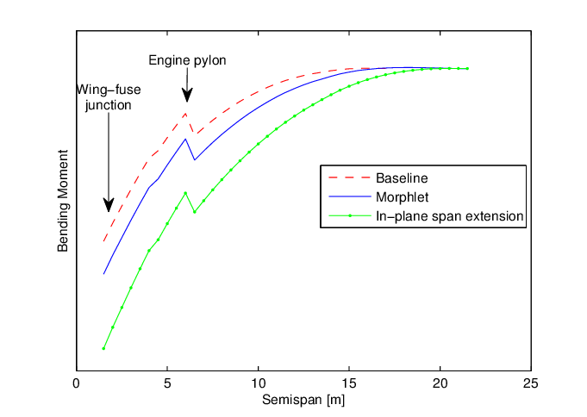
Add engines as point masses
Two symmetrical engines ➤ Two symmetrical point masses
New design variable ➤ Engines location
Same mass as FB single-boom HALE [2]
Reduce the bending moment on the wing due to lift
Fig. 2: Bending moment distribution along wing span
[2]
D. Colas, N. H. Roberts, and V. S. Suryakumar, “Hale multidisciplinary design optimization part i: Solar-powered single and multiple-boom aircraft,” in 2018 AviationTechnology, Integration, and Operations Conference, p. 3028, 2018.
Víctor M. GUADAÑO MARTÍN
HALE AEROECODESIGN

Slide 8
RESULTS
Table 1: Design variable values for validation case
Variable | Units | HALE of [1] | FB HALE [2] | Results w/o engines | Results w/ engines
Span | m | 97.5 | - | 93.5 | 73.7
Root chord | m | 1.4 | - | 1.4 | 1.4
Taper ratio | - | 0.32 | - | 0.33 | 0.30
Total mass | kg | 378 | 320 | 435 | 392
Wing surface | m² | 86.6 | 71.8 | 83.4 | 64.3
Aspect ratio | - | 94 | 29 | 105 | 84
C_{L}^{cruise} | - | 1.31 | 1.33 | 1.56 | 1.83
(C_{L}^{3/2}/C_{D})^{cruise} | - | 44.1 | 40.1 | 57.8 | 75.3
[1]
E. Duriez and J. Morlier, “Hale multidisciplinary design optimization with a focus on eco-material selection,” ISAE Supaero, 2020.
D. Colas, N. H. Roberts, and V. S. Suryakumar, “Hale multidisciplinary design optimization part i: Solar-powered single and multiple-boom aircraft,” in 2018 AviationTechnology, Integration, and Operations Conference, p. 3028, 2018.
[2]
Víctor M. GUADAÑO MARTÍN
HALE AEROECODESIGN

Slide 9
RESULTS
Table 2: Performance values of the optimization for validation
Performance | Units | HALE of [1] | Results w/o engines | Results w/ engines
Cases | - | 24 | 24 | 24
Convergences | - | 7 | 12 | 9
Time | h | 2 | 3 | 2
[1]
E. Duriez and J. Morlier, “Hale multidisciplinary design optimization with a focus on eco-material selection,” ISAE Supaero, 2020.
Víctor M. GUADAÑO MARTÍN
HALE AEROECODESIGN

Slide 10
CONCLUSIONS
Without engines ➤ Better convergence and better results than in [1]
With engines ➤ Worse convergence than without engines but better results
Same differences with respect to [2] as in [1] ➤ Very high aspect ratio
Need for 1-cosine gust and more complex buckling model
[1]
E. Duriez and J. Morlier, “Hale multidisciplinary design optimization with a focus on eco-material selection,” ISAE Supaero, 2020.
D. Colas, N. H. Roberts, and V. S. Suryakumar, “Hale multidisciplinary design optimization part i: Solar-powered single and multiple-boom aircraft,” in 2018 AviationTechnology, Integration, and Operations Conference, p. 3028, 2018.
[2]
Víctor M. GUADAÑO MARTÍN
HALE AEROECODESIGN

Slide 11
THANks for your attention!
ANY QUESTION?
Víctor M. GUADAÑO MARTÍN
HALE AEROECODESIGN

