Slide 1
Python Workshop #9
Jonathan Chen
NYCU 25SS

Slide 2
HW #8 dates

Slide 3
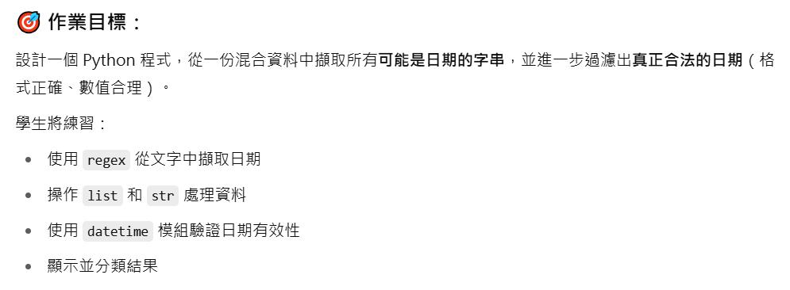
OPTIONAL!

Slide 4
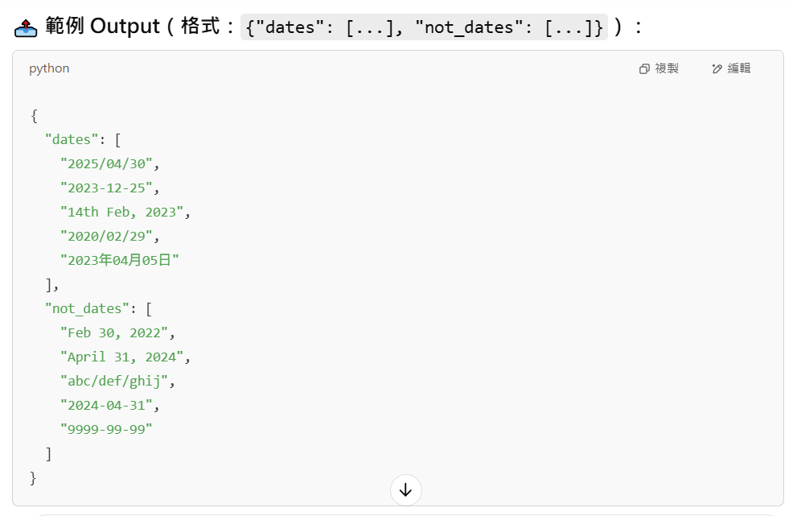

Slide 5
注意！
<name>_date.py 在 src，請”直接”編輯。
目標 dates.json 在 data，要透過相對路徑讀取。
思考如何讓 func 回傳含有兩個 list 的 dict
記得觀察 data，觀察並歸納 可能的日期格式
func 只拿一個 filePATH
File: https://medium.com/ccclub/ccclub-python-for-beginners-tutorial-bf0648108581
JSON: https://www.w3schools.com/python/python_json.asp
List: https://www.w3schools.com/python/python_lists.asp
Dictionary: https://www.w3schools.com/python/python_dictionaries.asp
Regex: https://www.w3schools.com/python/python_regex.asp

Slide 6
HOW? Step by step
0. Analyze (spec, data)
Read file (List[str])
For-loop (str-by-str)
Check (isDate == True/False)
Append to list (dates vs not_dates)
Return result (maybe print)

Slide 7
HOW? Step by step
0. Analyze (spec, data)
Read file (List[str])
For-loop (str-by-str)
Check (isDate == True/False)
Append to list (dates vs not_dates)
Return result (maybe print)

Slide 8
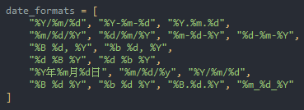
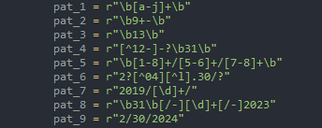
!!! PATTERN !!!

Slide 9
Week : List, dict

Slide 10
Definition: ordered, mutable, allows duplicates

Slide 11
HW #9

Slide 12
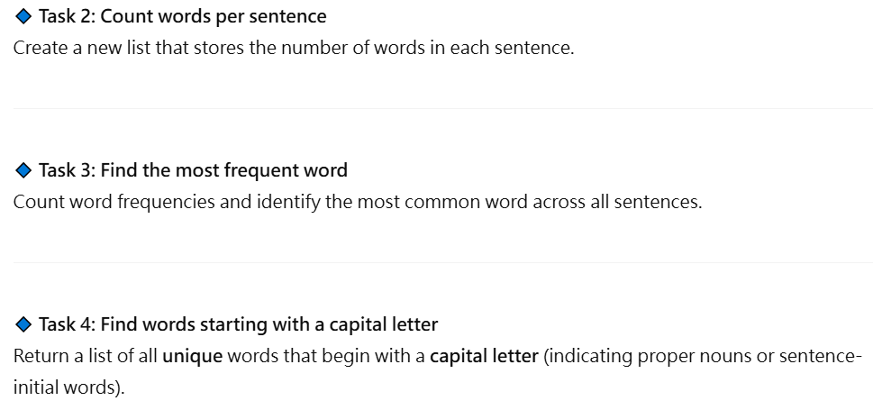

Slide 13
