Slide 1
Python Workshop #3
Jonathan Chen

Slide 2
HW #2

Slide 3
詞性 (Part of speech)
格位 (Case)
John(n.) likes(v.) Mary(n.).
我 很 → 開心(adj.)
John(Subj) likes Mary(Obj.).
我(Subj)很 開心

Slide 4
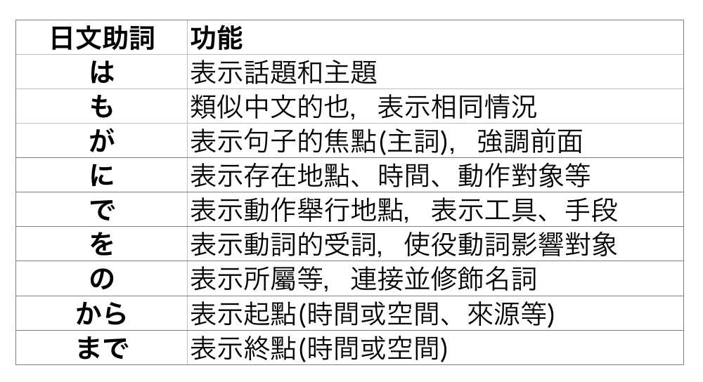

Slide 5
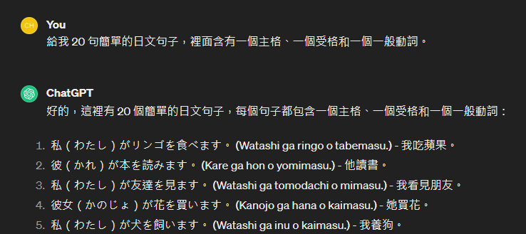

Slide 6
inputSTR = “私はラーメンを食べます”
resultDICT = {
“Subject”:”私”,
“Object”:”ラーメン”,
“Verb”:”食べ”
}
def caseparse(inputLIST):
extractSubject(inputLIST)
extractObject(inputLIST)
extractVerb (inputLIST)

Slide 7
Hint
inputSTR = “私はラーメンを食べます”
https://medium.com/ccclub/ccclub-python-for-beginners-tutorial-d26900b9280e

Slide 8
QA
Tokenize ?
https://platform.openai.com/tokenizer
2. AI? Parameterize (參數化)?
https://ai.meta.com/blog/meta-llama-3-1/ https://ppt.cc/fS6W8x

Slide 9
Break it down

Slide 10
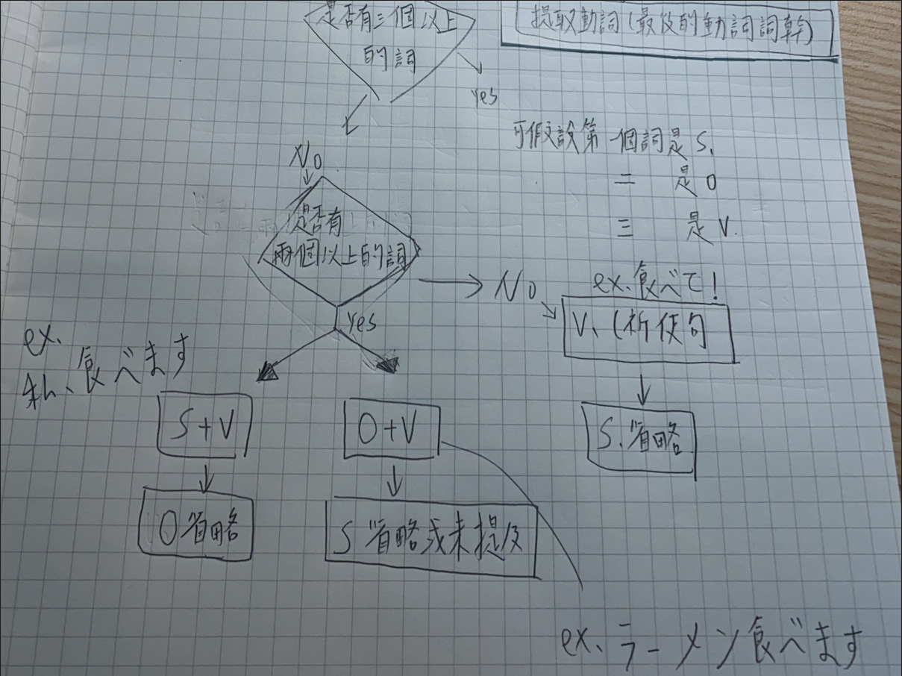

Slide 11
PyLab #3

Slide 12
Data
5
integer

Slide 13
x = 5
variable

Slide 14
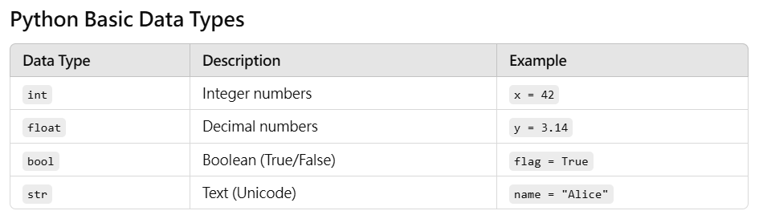
Data Type
Check with type( )
See return with print( )
https://medium.com/ccclub/ccclub-python-for-beginners-tutorial-d26900b9280e

Slide 15
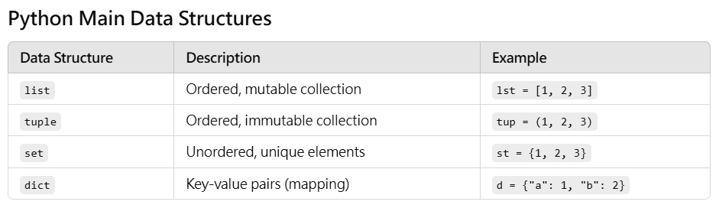
Data Structure
Check with type( )
See return with print( )
https://medium.com/ccclub/ccclub-python-for-beginners-tutorial-d26900b9280e

Slide 16
Data
type(x)
str

Slide 17
Function
input f(input) output
v ( n )
f(x) = 2x + 1

Slide 18
Data Flow
F(x) = 2x+1 x → x*2 → (x*2)+1 →re 5(int)→10(int) →11(int)

Slide 19
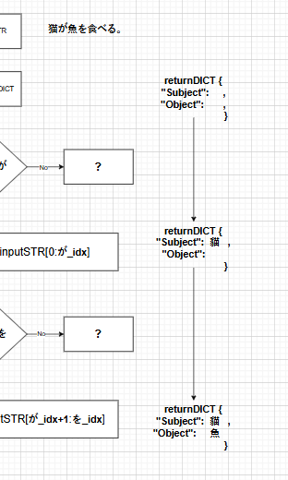
Data Flow

Slide 20
Indexing
inputSTR[ idx ]
inputSTR[start : end : sep]
“Happy Birthday”
https://medium.com/ccclub/ccclub-python-for-beginners-tutorial-d26900b9280e

Slide 21
Indexing
“Happy Birthday”
[4]
https://medium.com/ccclub/ccclub-python-for-beginners-tutorial-d26900b9280e

Slide 22
Indexing
“Happy Birthday”
[-1]
https://medium.com/ccclub/ccclub-python-for-beginners-tutorial-d26900b9280e

Slide 23
Indexing
“Happy Birthday”
[1:5:]
https://medium.com/ccclub/ccclub-python-for-beginners-tutorial-d26900b9280e

Slide 24
Indexing
“Happy Birthday”
[1:5:2]
https://medium.com/ccclub/ccclub-python-for-beginners-tutorial-d26900b9280e

Slide 25
Indexing
“Happy Birthday”
[5:9:]
https://medium.com/ccclub/ccclub-python-for-beginners-tutorial-d26900b9280e

Slide 26
Indexing
“Happy Birthday”
[3:-1:]
https://medium.com/ccclub/ccclub-python-for-beginners-tutorial-d26900b9280e

Slide 27
Indexing
patient.find(target)
n .v (n)
https://medium.com/ccclub/ccclub-python-for-beginners-tutorial-d26900b9280e

Slide 28
.find()
“Happy Birthday”
inputSTR.find(“H”)
0
https://medium.com/ccclub/ccclub-python-for-beginners-tutorial-d26900b9280e

Slide 29
.find()
“Happy Birthday”
inputSTR.find(“p”)
2
https://medium.com/ccclub/ccclub-python-for-beginners-tutorial-d26900b9280e

Slide 30
.find()
“Happy Birthday”
inputSTR.find(“B”)
6
https://medium.com/ccclub/ccclub-python-for-beginners-tutorial-d26900b9280e

Slide 31
.find()
“Happy Birthday”
inputSTR.find(“z”)
-1
https://medium.com/ccclub/ccclub-python-for-beginners-tutorial-d26900b9280e

Slide 32
inputSTR = “私はラーメンを食べます”
outputDICT = {
“Subject”:”私”,
“Object”:”ラーメン”,
“Verb”:”食べます”
}

Slide 33
inputSTR = “猫が魚を食べる”
outputDICT = {
“Subject”:”猫”,
“Object”:”魚”,
“Verb”:”食べる”
}

Slide 34
HW #3

Slide 35
BMI
BMI (w, h) = w / (h*h)
v ( n ) = ……………..
function (input) = ……………..
=output

Slide 36
HAND IN
BMI flow chart (data flow included)
BMI_xxx.py (with comments)

