Slide 1
Python Workshop #9
Jonathan Chen
NYCU 25SS

Slide 2
HW #8

Slide 3
HOW? Step by step
0. Analyze (spec, data)
Read file (List[str])
For-loop (str-by-str)
Check (isDate == True/False)
Append to list
Return result (maybe print)

Slide 4
HOW? Step by step
0. Analyze (spec, data)
Read file (List[str])
For-loop (str-by-str)
Check (isDate == True/False)
Append to list
Return result (maybe print)

Slide 5
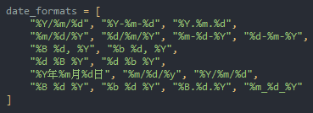
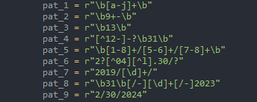
!!! PATTERN !!!

