Slide 1
Python Workshop #11
Jonathan Chen
NYCU 25SS

Slide 2
HW #10 – TW sentence parsing

Slide 3
Methods
Dictionary
N-gram corpus
Rule + target word
--- how good is good?
General
Stable
Can be fixed, altered
Cost (time/human)

Slide 4
Dictionary
(Human) List every possible word
Advantage?
Disadvantage?
--- how good is good?
General
Stable
Can be fixed, altered
Cost (time/human)

Slide 5
Ngram-Corpus
(Data) List every possible word
Advantage?
Disadvantage?
--- how good is good?
General
Stable
Can be fixed, altered
Cost (time/human)

Slide 6
Rule + target word
(Human) List important words
Advantage?
Disadvantage?
--- how good is good?
General
Stable
Can be fixed, altered
Cost (time/human)

Slide 7
Methods
Dictionary
N-gram corpus
Rule + target word
--- 蔡英文?
General
Stable
Can be fixed, altered
Cost (time/human)

Slide 8
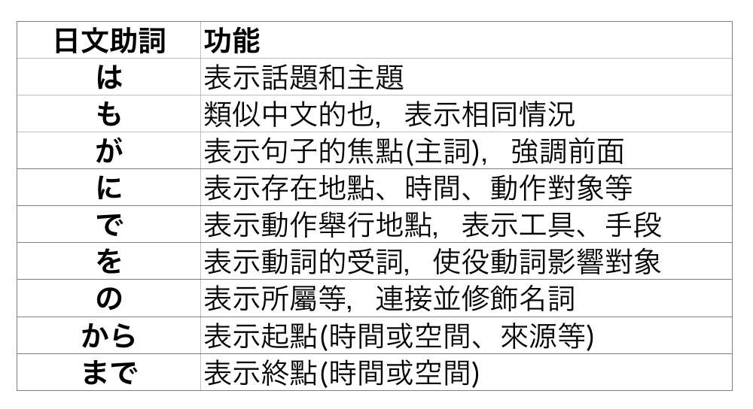
Recall case extraction

Slide 9
inputSTR = “私はラーメンを食べます”
resultDICT = {
“Subject”:”私”,
“Object”:”ラーメン”,
“Verb”:”食べ”
}
def caseparse(inputLIST):
extractSubject(inputLIST)
extractObject(inputLIST)
extractVerb (inputLIST)

Slide 10
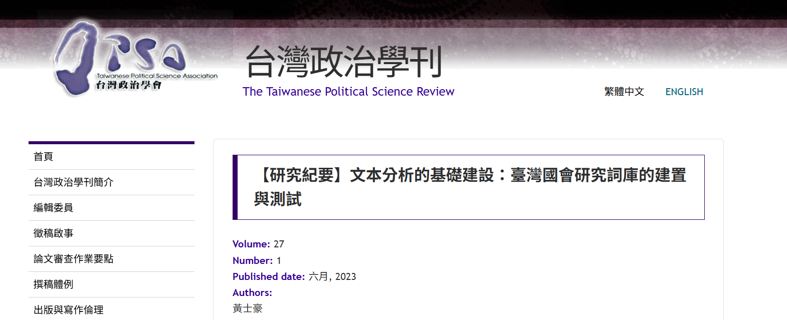

Slide 11
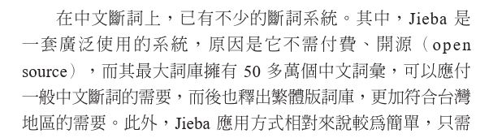
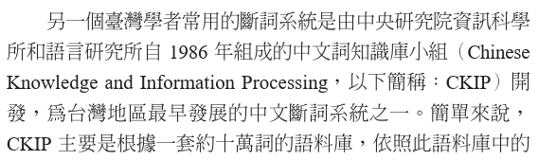

Slide 12
Thoughts?

Slide 13
Takeaways
工作坊的目標不是把你變成「會寫程式的人」。
工作坊的目的是大致了解、用用看一個工具
Maybe 這個工具可以實現一些有價值的知識和想法
--- how good is good?
General
Stable
Can be fixed, altered
Cost (time/human)
--- break things down
--- get hands dirty
THIS IS WHAT’S IMPORTANT

Slide 14
Takeaways
如果你覺得某個應用不符合需求，你可以試著去改動它，甚至自己做一個新的。
在這之前，你可以先理解它如何運作，有沒有更好的方法?

Slide 15
Final?
Filepath
File handling
List, dict

