Slide 1
Python Workshop #2
Jonathan Chen

Slide 2
Break it down -- Searching

Slide 3
Break it down -- Searching
1. Spec – search number from sorted sequence

Slide 4
Break it down -- Searching
Spec – search number from sorted sequence
Now start thinking

Slide 5
Break it down – Linear Search
Spec – search number from sorted sequence
Now start thinking – one at a time?
[1,2,3,4,5,6,7,8,9,10,11,12,13,14,15]

Slide 6
Break it down – Linear Search
Spec – search number from sorted sequence
Now start thinking – one at a time?
[1,2,3,4,5,6,7,8,9,10,11,12,13,14,15]

Slide 7
Break it down -- Searching
Spec – search number from sorted sequence
Now start thinking
robust, efficient
[1,2,3,4,5,6,7,8,9,10,11,12,13,14,15]

Slide 8
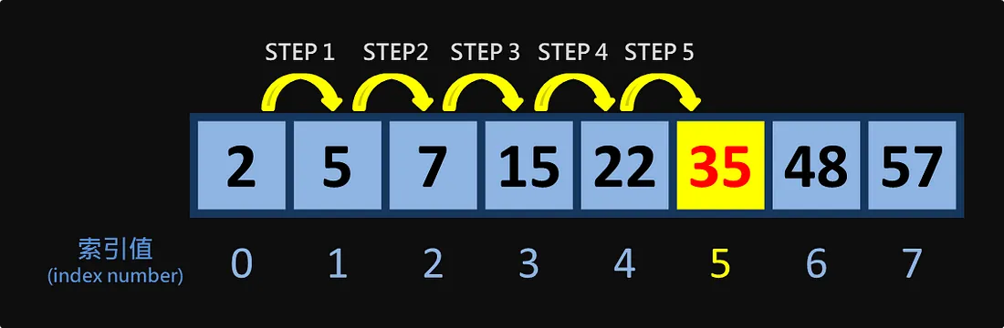
Break it down – Linear Search
Spec – search number from sorted sequence
https://medium.com/@ralph-tech/%E6%BC%94%E7%AE%97%E6%B3%95%E5%AD%B8%E7%BF%92%E7%AD%86%E8%A8%98-%E7%B7%9A%E6%80%A7%E6%90%9C%E5%B0%8B-linear-sequential-search-%E4%BA%8C%E5%85%83%E6%90%9C%E5%B0%8B-binary-search-fe55e1b6865f

Slide 9
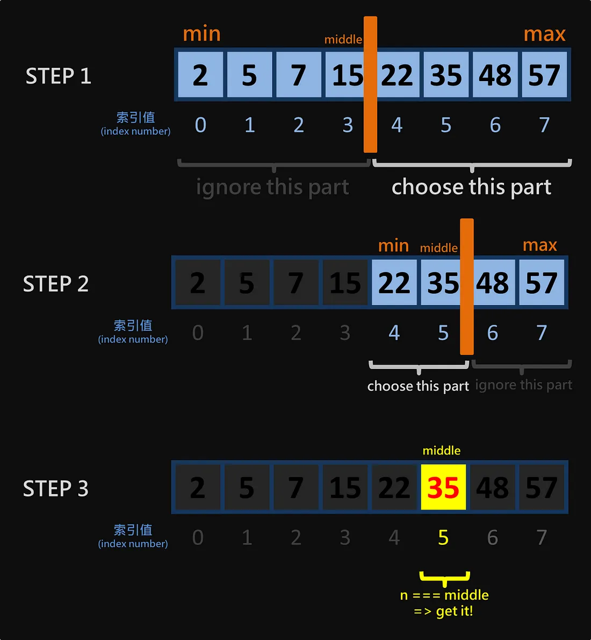
Break it down -- Searching
Spec – search number from sorted sequence
https://medium.com/@ralph-tech/%E6%BC%94%E7%AE%97%E6%B3%95%E5%AD%B8%E7%BF%92%E7%AD%86%E8%A8%98-%E7%B7%9A%E6%80%A7%E6%90%9C%E5%B0%8B-linear-sequential-search-%E4%BA%8C%E5%85%83%E6%90%9C%E5%B0%8B-binary-search-fe55e1b6865f

Slide 10
Break it down – Binary Search
Spec – search number from sorted sequence
Now start thinking
Flowchart – draw.io/pseudocode

Slide 11
Flowchart – draw.io/pseudocode
Set min/max
middle (min+max)/2
Compare
Given > mid -> ?
Given < mid -> ?
Given = mid -> found
https://zh.wikipedia.org/zh-tw/%E6%B5%81%E7%A8%8B%E5%9B%BE

Slide 12
Proposals #2

Slide 13


Natural Language Processing
Understanding
Generating
.
.
.
.
.

Slide 14
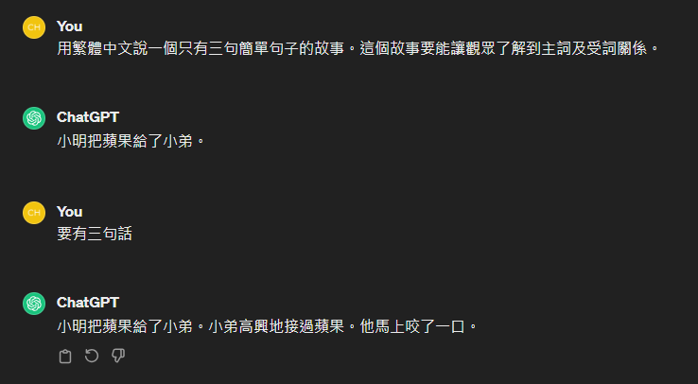
Natural Language Understanding

Slide 15
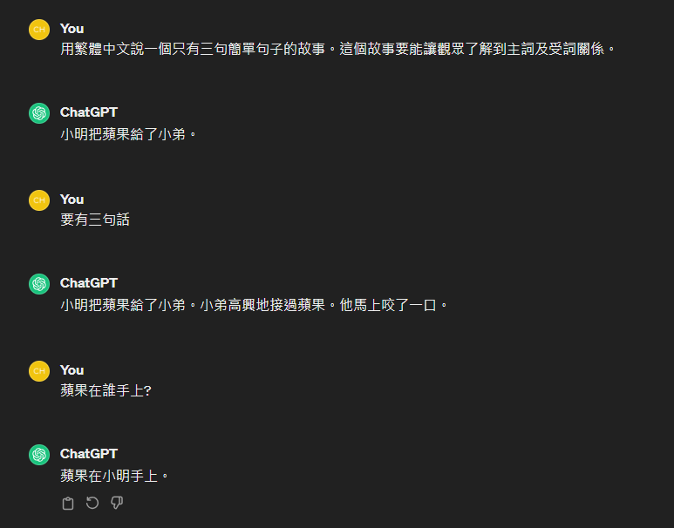

Slide 16
小明把蘋果給了小弟

Slide 17
小明把蘋果給了小弟

Slide 18



小明把蘋果給了小弟
小明(n)把蘋果(n)給了小弟(n)

Slide 19
小明把蘋果給(v)了小弟
____把____給(v)了____

Slide 20
小明把蘋果給了小弟
小明(n)把蘋果(n)給了小弟(n)
小明把蘋果給(v)了小弟

Slide 21
小明把蘋果給了小弟
小明(n)把蘋果(n)給了小弟(n)
小明把蘋果給(v)了小弟
HOW ?

Slide 22
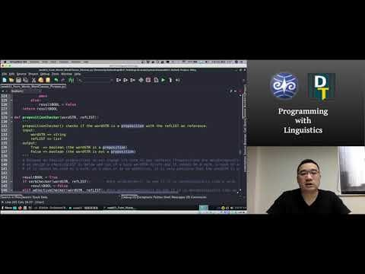
Source:https://github.com/Droidtown/NLP_TrainingLab/tree/main/Syntax101/week01

Slide 23
E.G.,

Slide 24
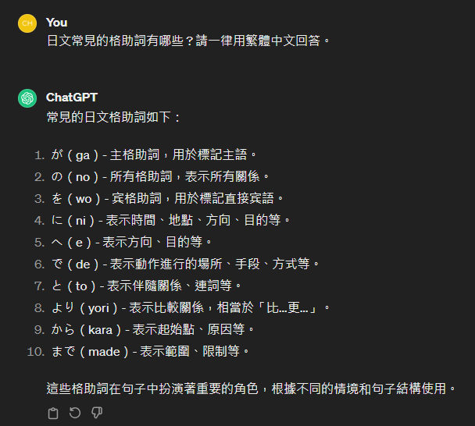

Slide 25
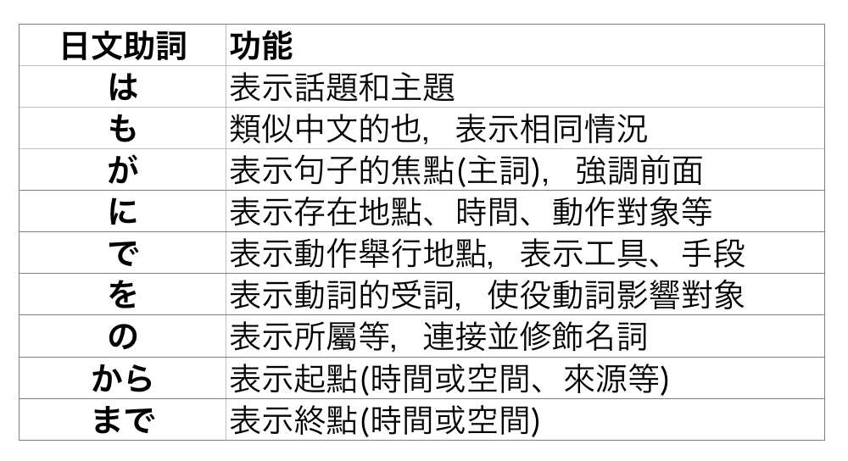

Slide 26
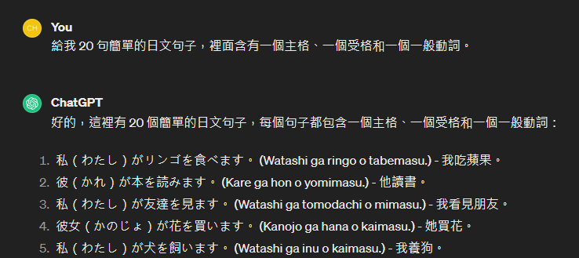

Slide 27
inputSTR = “私はラーメンを食べます”
resultDICT = {
“Subject”:”私”,
“Object”:”ラーメン”,
“Verb”:”食べ”
}
def caseparse(inputLIST):
extractSubject(inputLIST)
extractObject(inputLIST)
extractVerb (inputLIST)

Slide 28
Hint
inputSTR = “私はラーメンを食べます”
https://medium.com/ccclub/ccclub-python-for-beginners-tutorial-d26900b9280e

