Slide 1
Python Workshop #8
Jonathan Chen
NYCU 25SS

Slide 2
HW #7

Slide 3
Python Regular Expressions

Slide 4
What is a Regular Expression?
A regular expression (regex) is a sequence of characters that defines a search pattern.
Used for string matching, validation, and text manipulation.
Common in tasks like:
- Finding str patterns
- Validating str patterns
-Replacing str patterns
→ emails, specific words or phone nums

Slide 5
The re Module in Python
Python provides the re module for working with regular expressions.
Common functions:
- re.search() – Finds first match → .group()
- re.match() – Matches at the beginning of the string
- re.findall() – Returns all matches → List[matchings]
- re.sub() – Replaces patterns

Slide 6
Further Resources
Python Docs: https://docs.python.org/3/library/re.html
Regex101 (with Python flavor): https://regex101.com
https://www.w3schools.com/python/python_regex.asp
https://cheatography.com/davechild/cheat-sheets/regular-expressions/

Slide 7
HW #8 dates

Slide 8
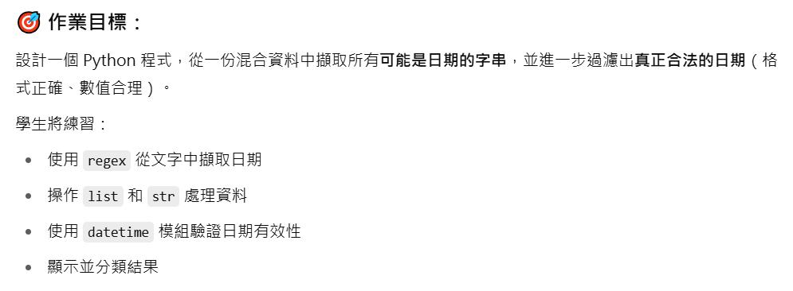
OPTIONAL!

Slide 9
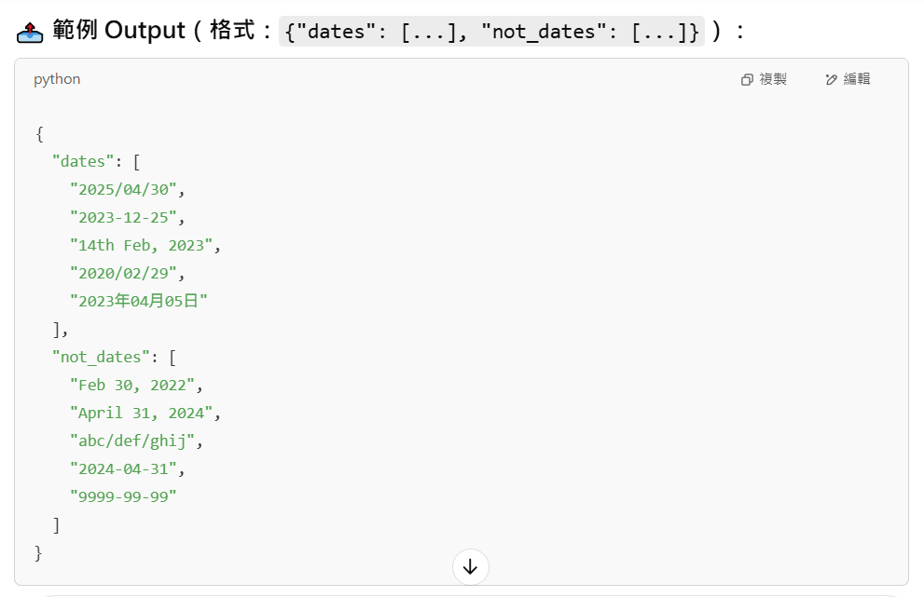

Slide 10
注意！
<name>_date.py 在 src，請”直接”編輯。
目標 dates.json 在 data，要透過相對路徑讀取。
思考如何讓 func 回傳含有兩個 list 的 dict
記得觀察 data，觀察並歸納 可能的日期格式
func 只拿一個 filePATH
File: https://medium.com/ccclub/ccclub-python-for-beginners-tutorial-bf0648108581
JSON: https://www.w3schools.com/python/python_json.asp
List: https://www.w3schools.com/python/python_lists.asp
Dictionary: https://www.w3schools.com/python/python_dictionaries.asp
Regex: https://www.w3schools.com/python/python_regex.asp

Slide 11
Spoiler: List, dict

