Slide 1
Python Workshop #2
Jonathan Chen

Slide 2


Natural Language Processing
Understanding
Generating
.
.
.
.
.

Slide 3
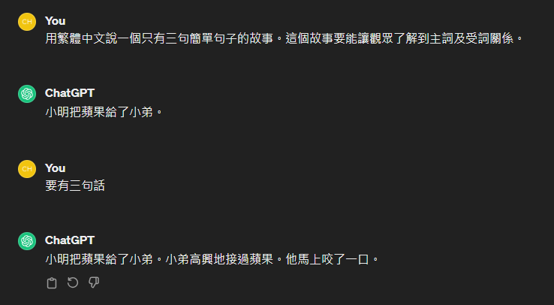
Natural Language Understanding

Slide 4
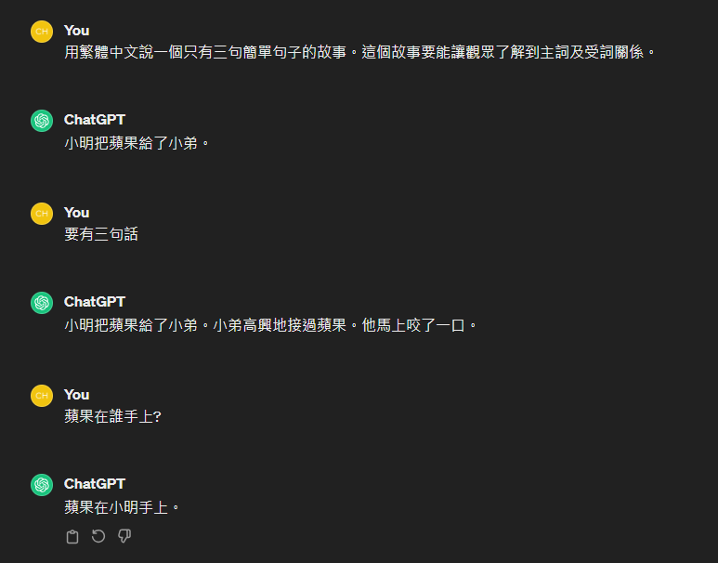

Slide 5
小明把蘋果給了小弟

Slide 6
小明把蘋果給了小弟

Slide 7



小明把蘋果給了小弟
小明(n)把蘋果(n)給了小弟(n)

Slide 8
小明把蘋果給(v)了小弟
____把____給(v)了____

Slide 9
小明把蘋果給了小弟
小明(n)把蘋果(n)給了小弟(n)
小明把蘋果給(v)了小弟

Slide 10
小明把蘋果給了小弟
小明(n)把蘋果(n)給了小弟(n)
小明把蘋果給(v)了小弟
HOW ?

Slide 11
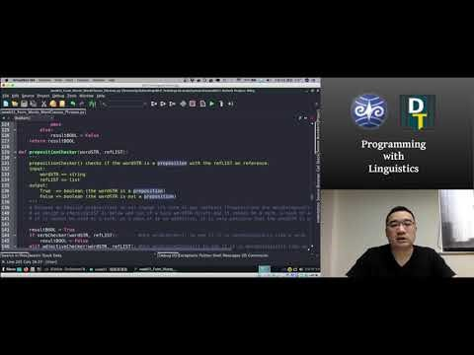
Source:https://github.com/Droidtown/NLP_TrainingLab/tree/main/Syntax101/week01

Slide 12
Hands-On
3 People/ Team
1 Function/People

Slide 13
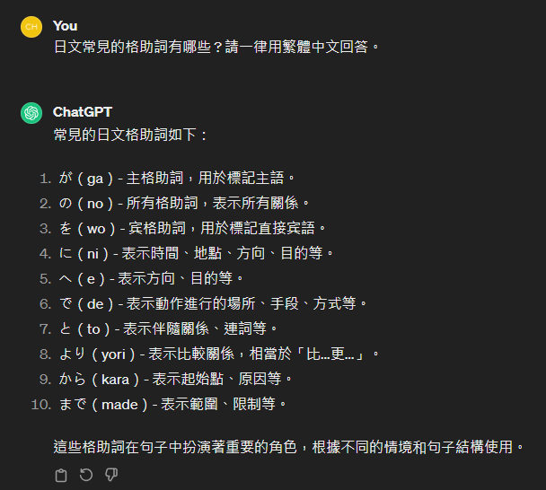

Slide 14
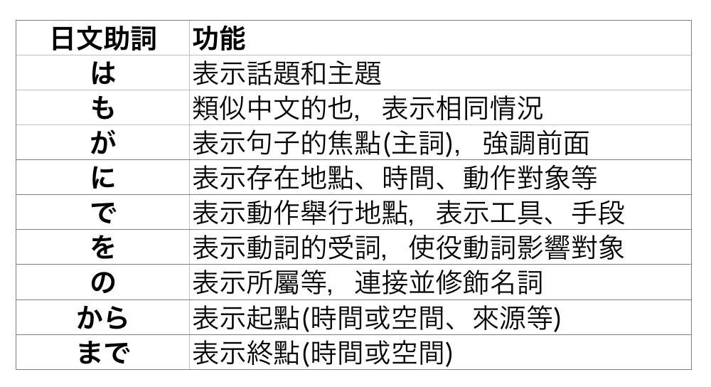

Slide 15
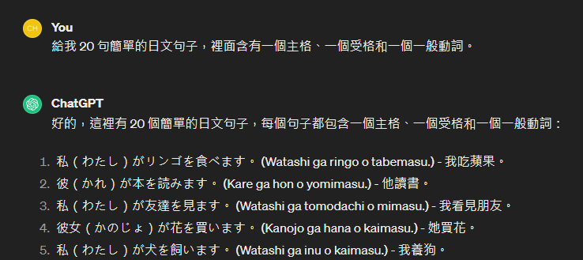

Slide 16
Spec
Collab using GitHub (One Repo)
Share the link with Jonathan.
inputSTR.txt (20 sentences)
Test using caseparse(inputLIST)
For freshman :
Lab Hour Tues 14:30~16:30 by appointment

Slide 17
inputSTR = “私はラーメンを食べます”
resultDICT = {
“Subject”:”私”,
“Object”:”ラーメン”,
“Verb”:”食べ”
}
def caseparse(inputLIST):
extractSubject(inputLIST)
extractObject(inputLIST)
extractVerb (inputLIST)

Slide 18
Hint
inputSTR = “私はラーメンを食べます”
https://chat.openai.com/
https://medium.com/ccclub/ccclub-python-for-beginners-tutorial-d26900b9280e

Slide 19
Sprint
14:50~15:40 Sprint
15:40~16:00 Share (Progress/Problem)

