Slide 1
Python Workshop #7
Jonathan Chen
NYCU 25SS

Slide 2
HW #5 read file

Slide 3
Python Regular Expressions

Slide 4
What is a Regular Expression?
A regular expression (regex) is a sequence of characters that defines a search pattern.
Used for string matching, validation, and text manipulation.
Common in tasks like:
- Finding str patterns
- Validating str patterns
-Replacing str patterns
→ emails, specific words or phone nums

Slide 5
The re Module in Python
Python provides the re module for working with regular expressions.
Common functions:
- re.search() – Finds first match → .group()
- re.match() – Matches at the beginning of the string
- re.findall() – Returns all matches → List[matchings]
- re.sub() – Replaces patterns

Slide 6
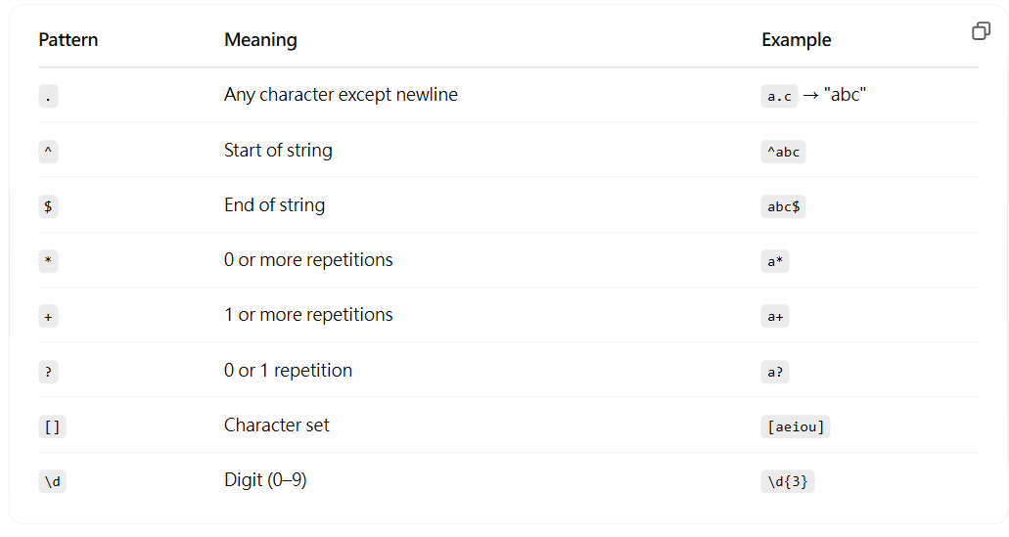
Basic Pattern Syntax

Slide 7
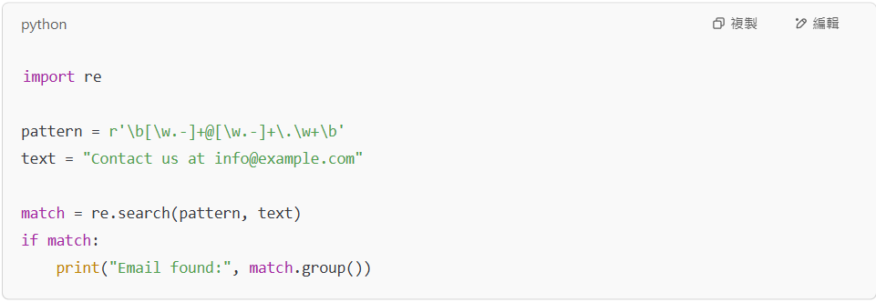
Example – Matching an Email Address

Slide 8
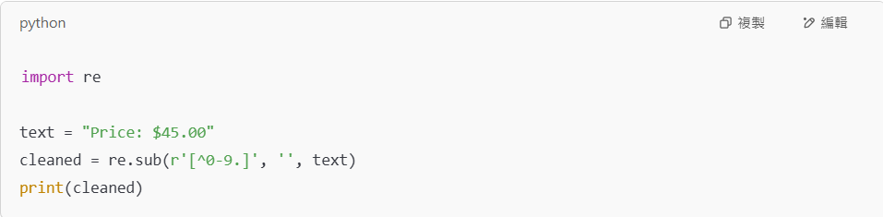
Example – Using re.sub() to Clean Text

Slide 9
Tips & Best Practices
Always use raw strings for regex:
Use re.compile() for reusability and perr'pattern'formance
Use online regex testers like https://pythex.org/ for debugging
Be cautious of greedy vs. non-greedy matching (* vs. *?)

Slide 10
Further Resources
Python Docs: https://docs.python.org/3/library/re.html
Regex101 (with Python flavor): https://regex101.com
https://cheatography.com/davechild/cheat-sheets/regular-expressions/

Slide 11
HW #6 email

Slide 12
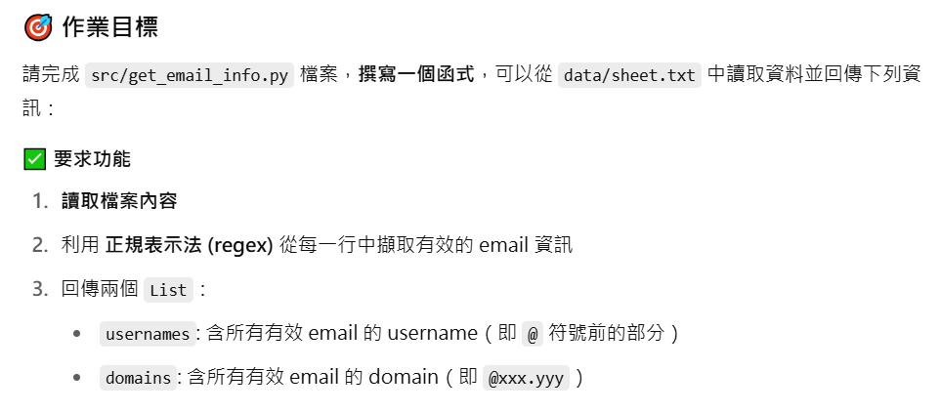

Slide 13
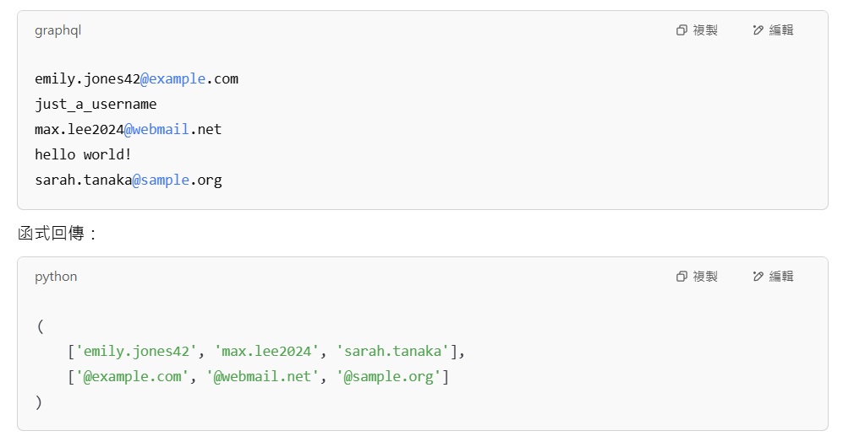

Slide 14
注意！
.py 在 src，目標 sheet.txt 在 data，要透過相對路徑讀取
思考如何讓 func 回傳兩個分開的 list
有些 str 不是 email address

