Slide 1
Python Workshop #6
Jonathan Chen
NYCU 25SS

Slide 2
midterm

Slide 3
HW #4

Slide 4
Read the .json files

Slide 5
Python Regular Expressions

Slide 6
What is a Regular Expression?
A regular expression (regex) is a sequence of characters that defines a search pattern.
Used for string matching, validation, and text manipulation.
Common in tasks like:
- Finding specific words
- Validating emails or phone numbers
- Replacing substrings

Slide 7
The re Module in Python
Python provides the re module for working with regular expressions.
Common functions:
- re.search() – Finds first match
- re.match() – Matches at the beginning of the string
- re.findall() – Returns all matches
- re.sub() – Replaces patterns

Slide 8
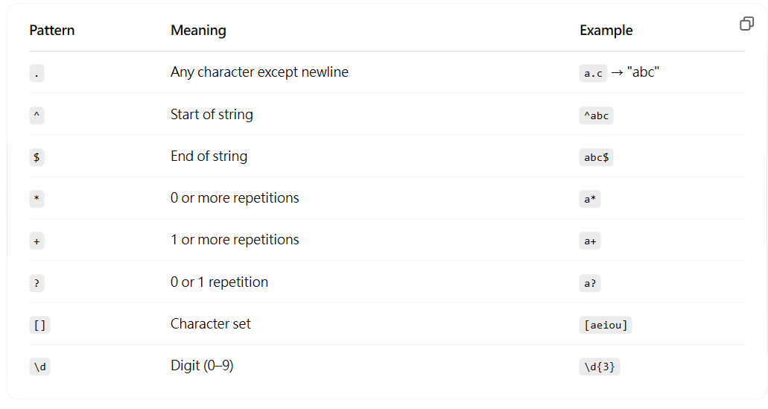
Basic Pattern Syntax

Slide 9
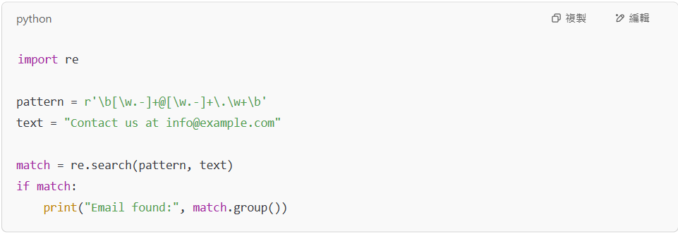
Example – Matching an Email Address

Slide 10
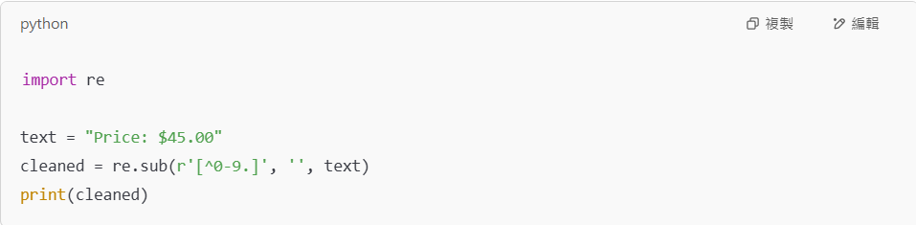
Example – Using re.sub() to Clean Text

Slide 11
Tips & Best Practices
Always use raw strings for regex: r'pattern'
Use re.compile() for reusability and performance
Use online regex testers like https://pythex.org/ for debugging
Be cautious of greedy vs. non-greedy matching (* vs. *?)

Slide 12
Further Resources
Python Docs: https://docs.python.org/3/library/re.html
Regex101 (with Python flavor): https://regex101.com
https://cheatography.com/davechild/cheat-sheets/regular-expressions/

