Slide 1

AZURE IaC GUARDRAIL | DEVELOPER JOURNEY
01
From Terraform authoring to review-ready evidence
Choose the lightest scan that answers the engineering question, then escalate to resolved-plan review.
01
02
03
04
Configure
Scan source
Resolve with plan
Review + evidence
Azure Pre-configuration
Scan Terraform Files
Scan Existing Terraform Plan
Export Auditor Evidence Pack
Root module, regions, tags, exceptions, and cost assumptions.
Immediate offline feedback from Terraform source and supported values.
Exact instances, computed values, actions, relationships, and plan-only controls.
Review remediation and export PDF, JSON, and Markdown evidence.
25 Azure services have executable controls | 139 controls | Guardrail never runs terraform apply
Quick start: choose static feedback or resolved-plan assurance
0.1.2 | PUBLIC PREVIEW

Slide 2
AZURE IaC GUARDRAIL | INSTALLATION
02
Install the approved VSIX and start reviewing in minutes
No Azure sign-in is required for offline static scanning; Terraform is only needed for module and plan workflows.
01
02
03
04
Get the release
Install in VS Code
Reload
Open Guardrail
Download the approved
azure-iac-guardrail-<version>.vsix
Extensions > Views and More Actions (...)
> Install from VSIX...
Reload VS Code when prompted and open your Terraform root module.
Press Ctrl+Shift+P and run
Azure IaC Guardrail commands.
TERMINAL OPTION
VS CODE 1.100+
TERRAFORM FOR PLANS
code --install-extension .\azure-iac-guardrail-<version>.vsix
Upgrade by installing the newer approved VSIX over the existing version.
Installation: approved VSIX deployment
0.1.2 | PUBLIC PREVIEW

Slide 3
AZURE IaC GUARDRAIL | PRE-CONFIGURATION
03
Encode team policy before the first finding appears
A workspace profile makes region, tagging, exception, and Terraform-root decisions explicit and reviewable.
Terraform root
.azure-iac-guardrail/profile.json
Required tags
Choose the root module inside the workspace.
Define mandatory keys and exact values.
"terraformRoot": "./infra"
"approvedRegions": ["uksouth"]
Approved regions
Governed exceptions
Apply shared location policy consistently.
"requiredTags": { ... }
Require owner, reason, expiry, and ticket.
"exceptions": [{ expiry, owner, ticket }]
"skippedControlIds": []
Azure Pre-configuration
Commit shared policy; keep secrets out.
Expired exceptions should fail review.
Usage scenario: workspace governance
0.1.2 | PUBLIC PREVIEW

Slide 4
AZURE IaC GUARDRAIL | STATIC SCAN
04
Get actionable Terraform feedback without executing Terraform
Static scanning stays offline and traces supported values back to source and tfvars provenance.
.tf resources
Resolved findings
Offline evaluation
Problems, results, provenance, and reviewed quick fixes.
defaults + tfvars
Scan Terraform Files
locals + conditionals
Plan required
No provider calls. No remote state. No terraform plan.
Provider functions, data sources, remote state, outputs, dynamic blocks, or computed instances.
local / cached modules
FASTEST AUTHORING FEEDBACK
Usage scenario: offline static analysis
0.1.2 | PUBLIC PREVIEW

Slide 5
AZURE IaC GUARDRAIL | PLAN FILE SCAN
05
Bring a trusted plan file into resolved assurance
Use an existing binary .tfplan or terraform show -json output produced by a trusted local or CI workflow.
Trusted workflow
Plan artifact
Guardrail scan
Review outcome
Local engineering or CI creates the plan with intended credentials and tfvars.
Select a binary .tfplan or a terraform show -json file.
Evaluate resolved resources, relationships, actions, and plan-only controls.
Inspect exposure, architecture risk, replacements, and connected blast radius.
NEVER RUNS TERRAFORM APPLY
Scan Existing Terraform Plan
PLAN FILES MAY CONTAIN SENSITIVE DATA
For binary plans, Guardrail uses your local Terraform executable to convert the plan to JSON before evaluation.
Usage scenario: scan an existing Terraform plan
0.1.2 | PUBLIC PREVIEW

Slide 6
AZURE IaC GUARDRAIL | CLOUD CANVAS PREVIEW
07
Design governed architecture before generating Terraform
Cloud Canvas connects design intent to Terraform preview while keeping unsupported services diagram-only.
ARCHITECTURE WORKSPACE
UNDO
EXPORT
Design with review built in
Service Bus
Searchable catalog + starting patterns
Web App
approved
Directional dependency connections
approved
Other service
Service-specific Terraform parameters
diagram-only
Governance status before generation
Storage Account
Terraform preview, validation, and scan
approved
PNG export and explicit generation
Cloud Canvas (Preview)
Generated Terraform is scaffolding, not deployment approval.
Usage scenario: preview Cloud Canvas
0.1.2 | PUBLIC PREVIEW

Slide 7
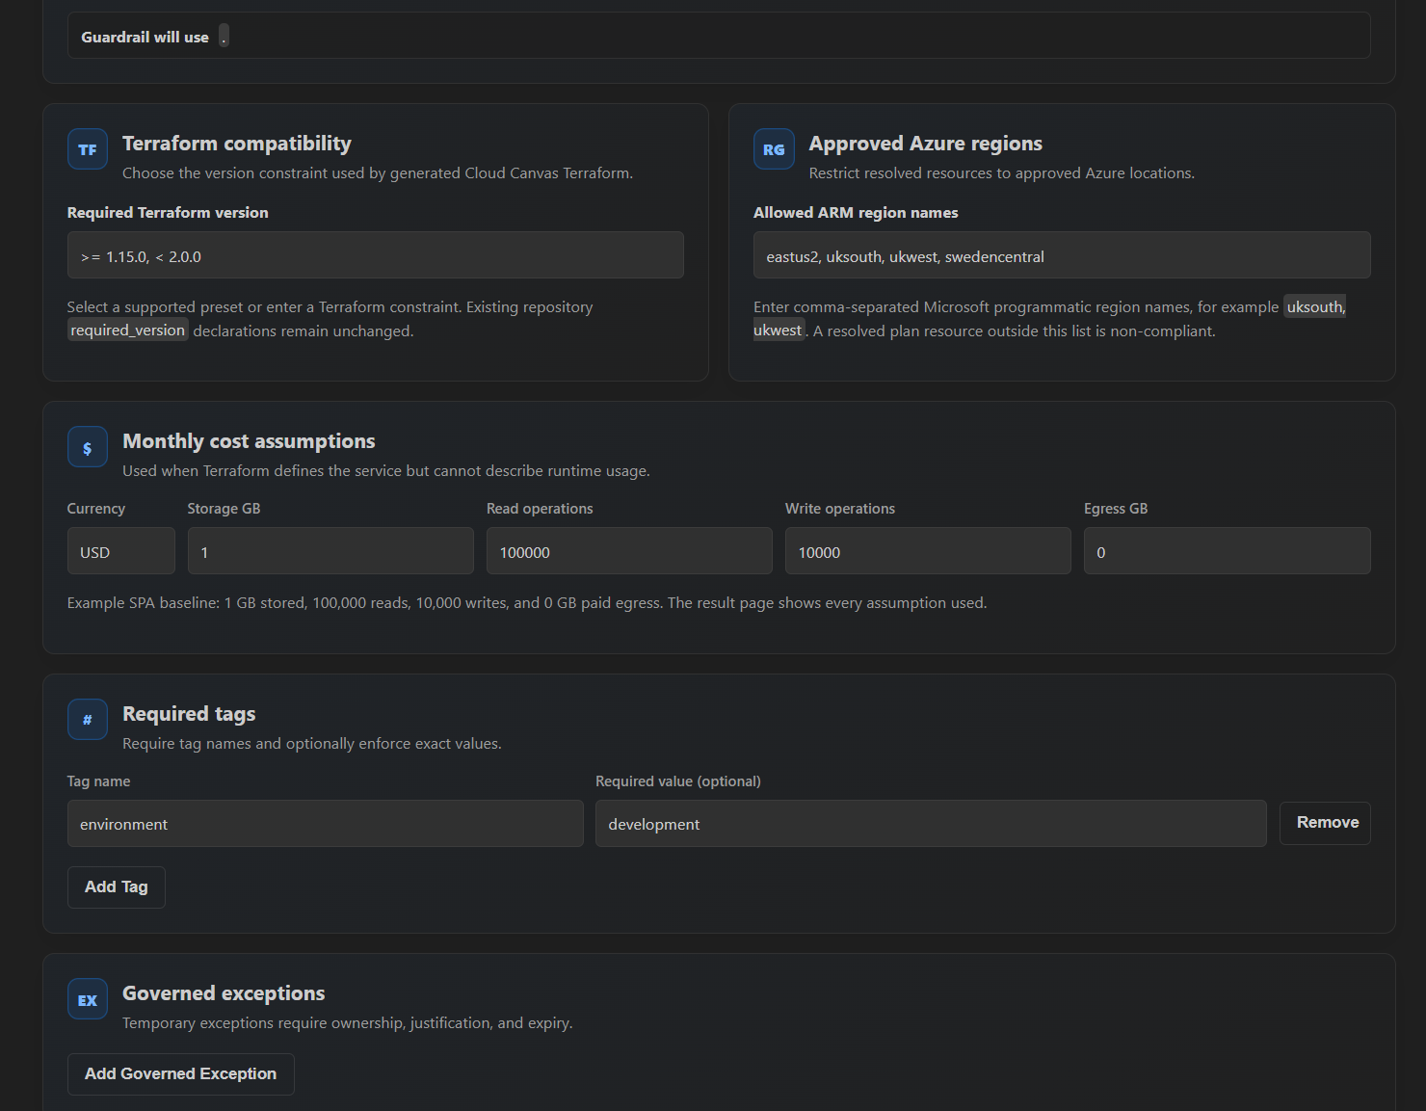
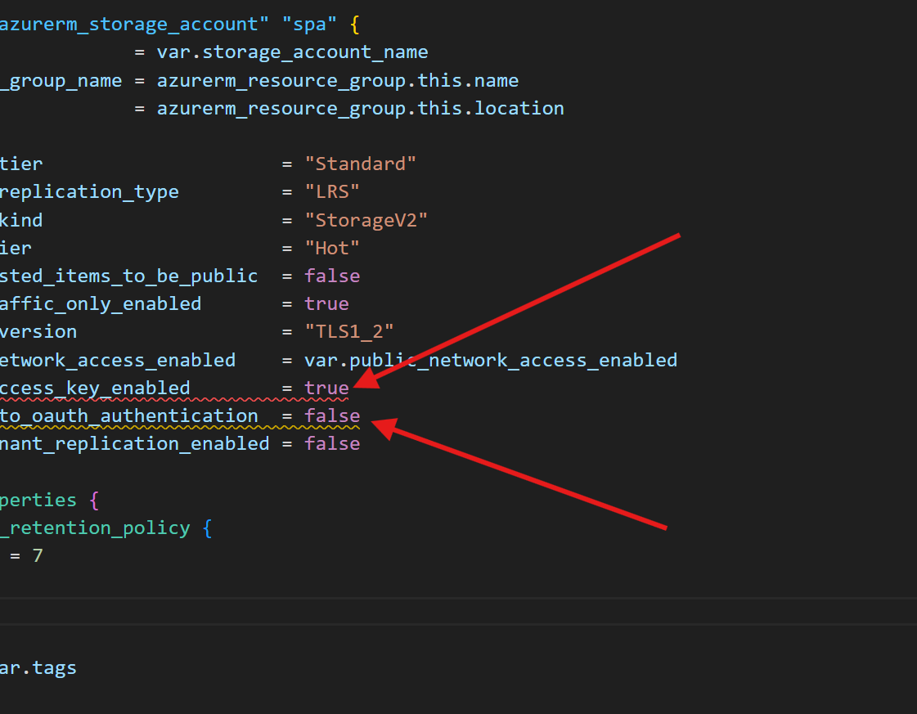
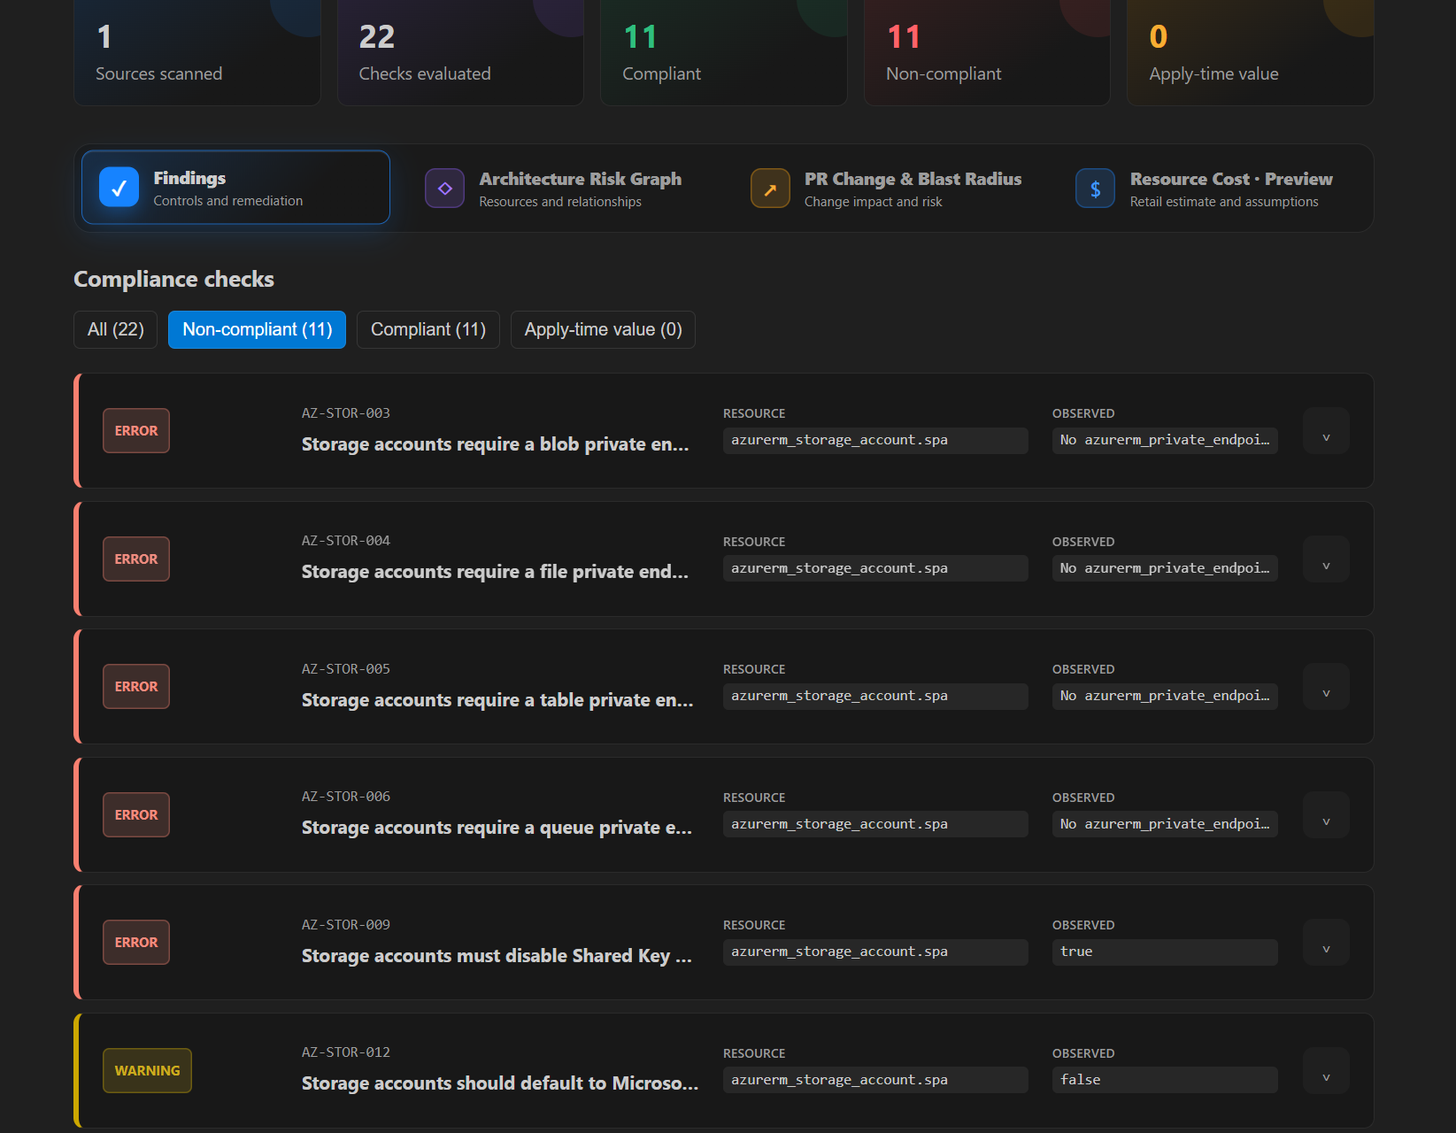
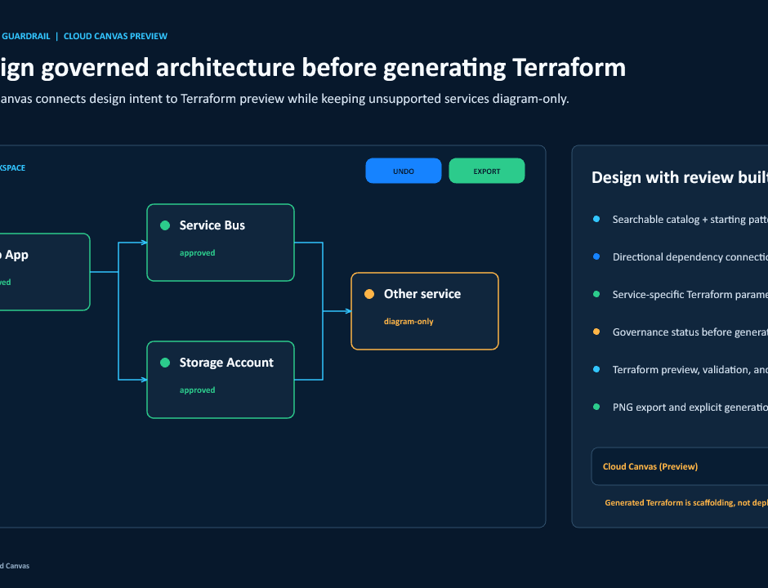
AZURE IaC GUARDRAIL | LINKEDIN PROMO
08
See Guardrail in action before Terraform ever reaches deployment
POLICY
DRIFT
RESOLVED
PREVIEW
Pre-configuration
Static scan drift
Plan scan findings
Cloud Canvas preview
Set the Terraform root, approved regions, tags, and governed exceptions before the scan begins.
Catch risky drift in source code early, with direct attention on the exact lines that need review.
Review resolved controls, blast radius, and remediation after Terraform plan values are known.
Sketch governed architecture visually, then move into Terraform preview and validation with context.
LinkedIn promo: real product flow across policy, scan, findings, and design
0.1.2 | PUBLIC PREVIEW

