Slide 1


Automating Office 365 Using PowerShell
Chendrayan Venkatesan (Chen V)
Automation Engineer
6th April 2017

Slide 2



PS C:\> $WhoAmI
Agenda?
Chendrayan Venkatesan (Chen V)
CDM MVP | PowerShell
MCC
TechNet Wiki Ninja
Blogger | Speaker | Author
Social Network | ID
Twitter | ChendrayanV
Facebook
LinkedIn
Blog Link – http://chen.about-powershell.com
#aosIndiaTour, @aOSComm

Slide 3
PS C:\> $WhoAmI
Agenda?
Chendrayan Venkatesan (Chen V)
CDM MVP | PowerShell
MCC
TechNet Wiki Ninja
Blogger | Speaker | Author
Social Network | ID
Twitter | ChendrayanV
Facebook
LinkedIn
Blog Link – http://chen.about-powershell.com
#aosIndiaTour, @aOSComm

Slide 4

Agenda
About PowerShell
Get-History
Get-Started
Writing Scripting Module
Why? Where? What? How?
platyPS for external help.
VSCode and PowerShell Extension
Integrate API / SDK with PowerShell
CSOM – SharePoint Online
EWS Managed API – Exchange Online
Best Practices
#aosIndiaTour, @aOSComm

Slide 5
PS C:\> Get-History
$PowerShell
Developer | Microsoft
Designed by | Jeffrey Snover, Bruce Payette, James Truher....
First Appeared | November 14, 2006
Stable Release | 5.1.14393 / August 2, 2016
Preview Release | 6.0.0 Alpha 16 / February 15, 2017; 23 days ago
Platform | .NET Framework , .NET Core
Channel 9: https://channel9.msdn.com/Events/PowerShell-Team/PowerShell-10-Year-Anniversary Celebrate 10 years
PowerShell Then and Now by Jeffrey Snover, Kenneth Hansen, Keith Bankston
Source: Wikipedia and PowerShell.org
#aosIndiaTour, @aOSComm

Slide 6
PS C:\>Get-Started
MSDN PowerShell (Landing Page)
PowerShell On GitHub
Hey Scripting Guy Blog!
PowerShell Gallery
(Central Repository)
User Voice
TechNet Wiki
MSDN / TechNet Script Center
Microsoft Official (PowerShell Blog)
Channel 9 | MVA
#aosIndiaTour, @aOSComm

Slide 7

PS C:\> Get-Challenge
Requirement?
Need Solutions using C# / PowerShell – IT Team Leader(s)
Choose the best solution which meet deliverables with no chaos and ON TIME – IT Project Managers
Reduce Total Cost of Ownership - IT Finance Team
Share action items before implementation – Change Advisory Board.
#aosIndiaTour, @aOSComm

Slide 8
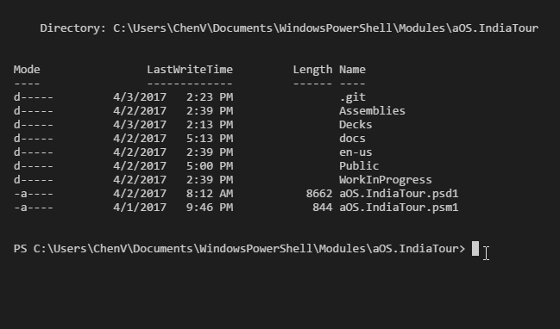
Script Module
Any Valid PowerShell script saved as .PSM1
Script Developers and Administrators use this for creating modules
Use Module manifest file to include other resources (Helps versioning and authoring)
Has a certain folder structure which allows PowerShell to discover.
More information about script module is covered in our demo
#aosIndiaTour, @aOSComm

Slide 9
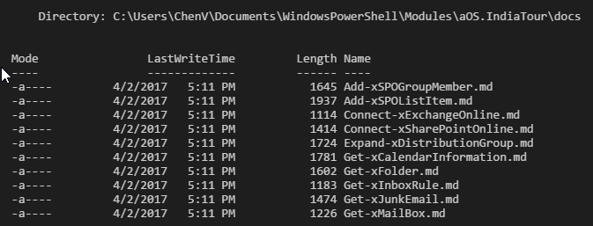
PS C:\> Install-Module platyPS
Write PowerShell help in Markdown
Easy to Share in GitHub and human-readable
PlatyPS is provided as a solution to write help as MD.
Any editor supports MD can be used.
Download from GitHub or PowerShell Gallery
#aosIndiaTour, @aOSComm

Slide 10
VS Code and PowerShell Extension
VS Code
Super light weight editor
Intellisense, Debugging, Built-in Git and Extensions
Download VS Code
For extension browse Marketplace
Follow @Code for the latest news
PowerShell Extension
Windows 7 through Windows 10 with PS 3.0 and higher
Code snippets
Basic interactive console support
Rich code editing
Open source / GitHub
#aosIndiaTour, @aOSComm

Slide 11
Integrate API / SDK in PowerShell
CSOM SDK
Evolved greatly in the latest version.
Helps to build Client Applications.
Discover artifacts properties
Run remotely no need of SharePoint Server.
Download SharePoint Online Client Components
User Voice
EWS Managed API 2.2
Using EWS Managed API access Exchange Online.
It’s an Open Source Project on GitHub
Helps to build Client Applications
#aosIndiaTour, @aOSComm

Slide 12

Best Practices
Thanks!
JayKul
Don Jones
Matt Penny
Carlos Perez
&
All Contributors!
Standard Naming Conventions.
Error handling.
Write neat and clean help files.
Build reusable code.
Security and Performance.
#aosIndiaTour, @aOSComm

Slide 13
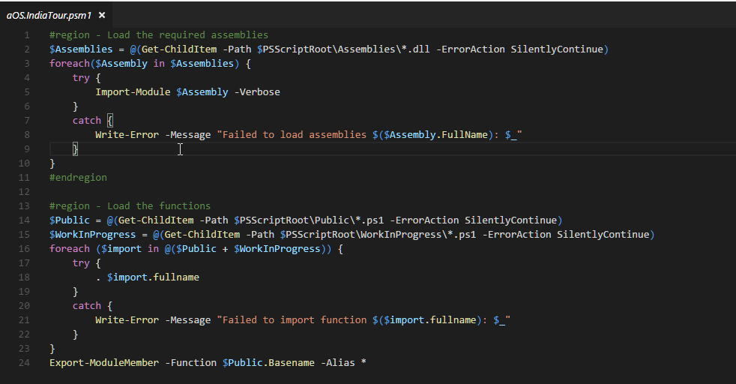
PS C:\> Start-Demo
#aosIndiaTour, @aOSComm

Slide 14
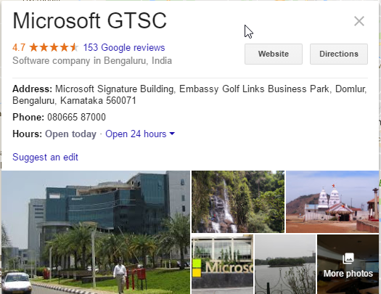
PS C:\> Set-Location
#aosIndiaTour, @aOSComm

Slide 15




