Slide 1
Retrieval Augmented Generation (RAG) for chatbots
Baobao chen
Prompt Engineering for Generative AI
July 16, 2024

Slide 2
Introduction:
Brief overview of the final project :
Use the knowledge learned in the course about AI large models to complete a chatbot that integrates with an LLM model.
Objectives and goals of the project：
Understand the utilization directions of large models and learn how to use them for building everyday applications.
Importance and relevance of the project to the course and industry：
Use the final project to understand how to leverage large models and external databases to build an automated question-answering machine, and to increase the accuracy of the model's responses.

Slide 3
Project Description :
Detailed description of the project:
To build a chatbot, when our users send a request to the chatbot, we retrieve data from an external vector database using contextual information. Finally, we send the user prompt + retrieved data + system prompt to the LLM to obtain a more accurate response.
Specific problem the project aims to solve：
This project primarily aims to improve the accuracy of large models in answering specific questions, which is affected by data latency.
Scope of the project：
FAISS Python package to realize embeddings, store data in vector database, and use LangChain to realize LLM, finally I will use streamlit build a frontend page.

Slide 4
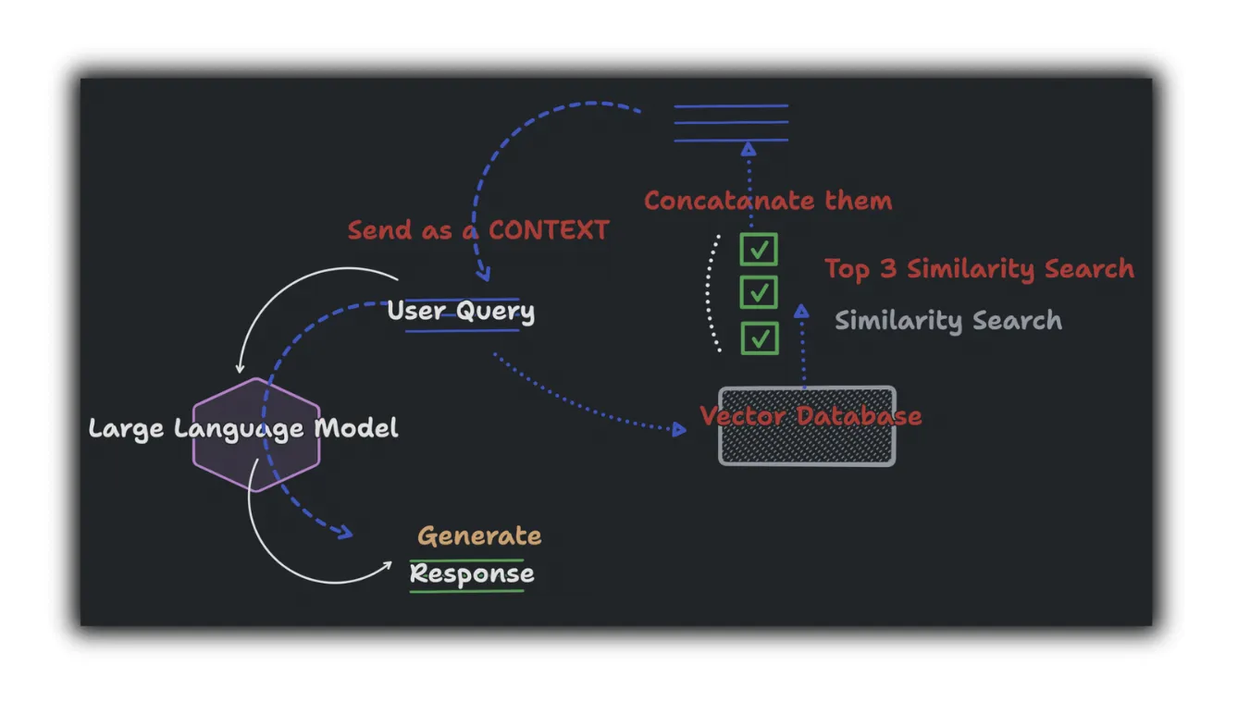
Project Architecture :
→ FAISS Python package to realize embeddings
store data in vector database
LangChain to combine LLM,
→ finally use streamlit build a frontend page.

Slide 5
Data Collection and Preprocessing:
Source and nature of the data:
official introduction materials or official statistical websites.
Steps taken for data collection：
First, extract the content from the original document, then split it into manageable chunks. Store the text in a vector database.
Data preprocessing techniques used：
from langchain.docstore.document import Document -> deal document from langchain.document_loaders import PyPDFLoader from langchain.embeddings.openai import OpenAIEmbeddings -> endbedding from langchain.text_splitter import RecursiveCharacterTextSplitter -> split words from langchain.vectorstores.faiss import FAISS -> vector from pypdf import PdfReader import faiss

Slide 6
RAG Pipeline Implementation:
Overview of the Retrieval-Augmented Generation (RAG) pipeline:
After obtaining the processed data, we vectorize the text data and then allow users to perform searches.
When a user query is made, the large model will retrieve the closest keywords from the database and generate a response based on the original document's content.
Steps involved in implementing the RAG pipeline：
Data Collection – Preprocessing -Vectorization- Storage- User Query- Retrieval- Response Generation- Feedback Loop
Challenges faced and solutions implemented：
Data Quality and Preprocessing -> the source of data may not reliable
Vectorization Accuracy -> not very accurate
Security and Privacy -> protect sensitive data

Slide 7

Performance Metrics:
Key metrics to evaluate the project:
Precision: Measures the proportion of retrieved documents that are relevant.
Human Evaluation: Involves human judges rating the quality, coherence, and relevance of the generated responses.
Consistency: Evaluates the consistency of the system's responses over multiple queries and sessions.
Methods used to calculate these metrics：
1 -
2 – evaluate accurate of response by scoring 1-5
3 - execute the standard queries at different times and under different conditions and record.
Initial results and observations:
Not come yet

Slide 8
Method to improve metrics:
Strategies to improve performance metrics and Specific changes or enhancements planned :
Enhance text cleaning and normalization processes : Implement advanced text cleaning techniques, such as removing duplicates, correcting typos, and standardizing formats.
Utilize more sophisticated embedding models for better vectorization of text : Transition to state-of-the-art transformer-based models like BERT, RoBERTa, or GPT-3 for vectorization.
Optimize the retrieval process with more efficient search algorithms. : Implement Approximate Nearest Neighbors (ANN) search algorithms like FAISS or HNSW.
Expected impact of these improvements:
Higher Precision and Recall: Cleaner data and advanced vectorization will lead to more accurate retrievals.
Faster and More Efficient Retrieval: Optimized retrieval algorithms will reduce latency and improve user experience.
Greater User Satisfaction: Continuous improvements and human-in-the-loop approaches will ensure high-quality interactions, leading to better user engagement and satisfaction

Slide 9
Deployment Plan:
Steps to deploy the application to production:
I plan to deploy it to aws service
Tools and platforms for deployment：
EC2 (run the application) -> S3 ( store your processed data )
RDS(Database Configuration) -> OpenSearch Service (Vector Database Setup)
->SageMaker(Model Hosting)
Plan for user testing and feedback：
Load Testing: Perform load testing to ensure the application can handle the expected traffic.
User Acceptance Testing (UAT): Conduct UAT to validate the application functionality and performance.

Slide 10
Future Plan:
Potential extensions and improvements for the project:
Expansion: Incorporate additional and more diverse data sources to improve the comprehensiveness and reliability of the information retrieved.
Models: Integrate more advanced NLP models or techniques, such as GPT-4 or other state-of-the-art models.
Interactivity: Develop a more interactive and user-friendly interface for end-users.
Long-term vision and next steps：
Custom Models: Train and fine-tune models for specific domains or industries to provide more accurate and specialized responses.
Streaming: Implement real-time data processing capabilities to provide the most up-to-date information.
How this project can be further developed beyond the course：
Deploy the application to more wide scope

Slide 11
Conclusion:
Summary of the project:
The Retrieval-Augmented Generation (RAG) pipeline project aims to enhance the capabilities of language models by incorporating information retrieval techniques. The project involves several key components, including data preprocessing, vectorization, storage, retrieval, and response generation. By leveraging these components, the RAG pipeline can provide accurate, relevant, and coherent responses to user queries.
Key takeaways：
Data Quality
Advanced Models
Scalability and Performance
Final thoughts：
From that course, I know by continually adapting and integrating user feedback, the RAG pipeline can set a new standard for intelligent information retrieval and generation systems.

Slide 12
Q&A round

