Slide 1
0903 Meeting
Cheng-Han Huang

Slide 2
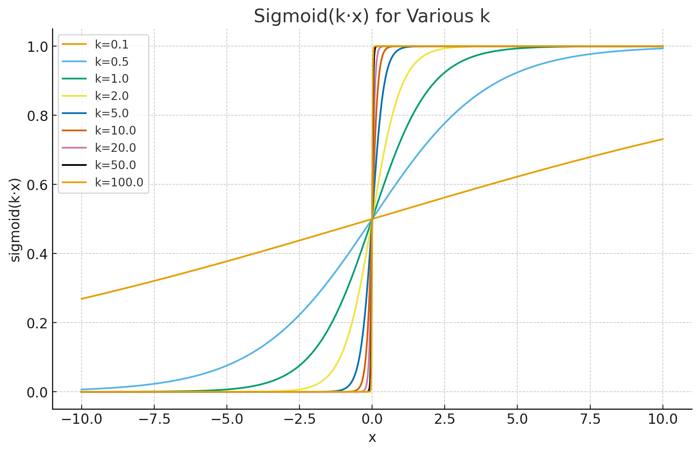
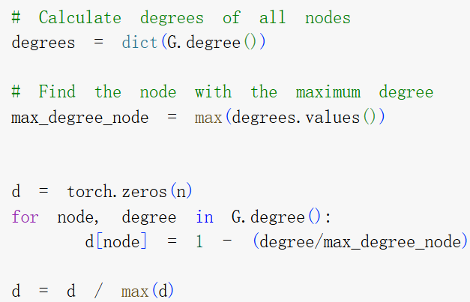
Initial clamping, sigmoiding, and no bounding
Running on the MGD method, sigmoid is centered at 0 (left), but degree-based initialization make the node values centered at the mean degree.

Slide 3
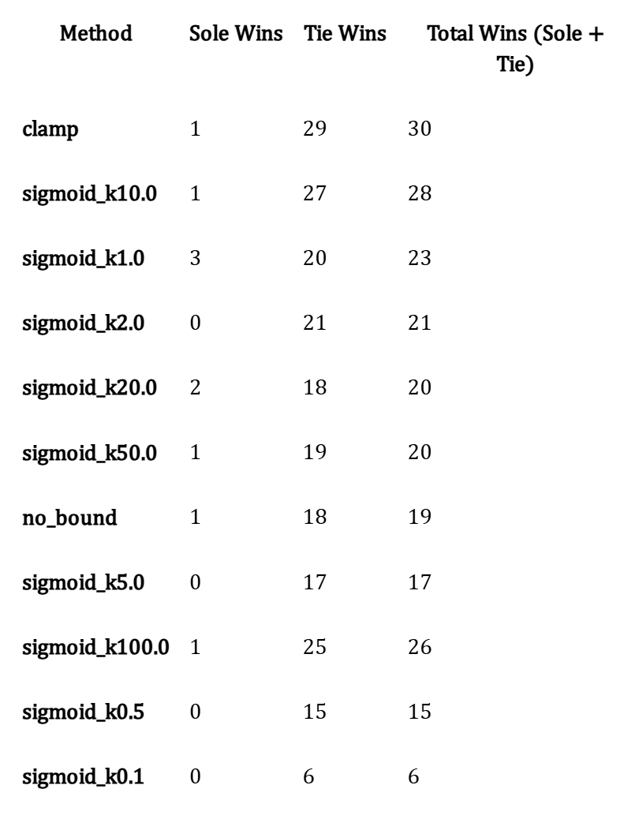
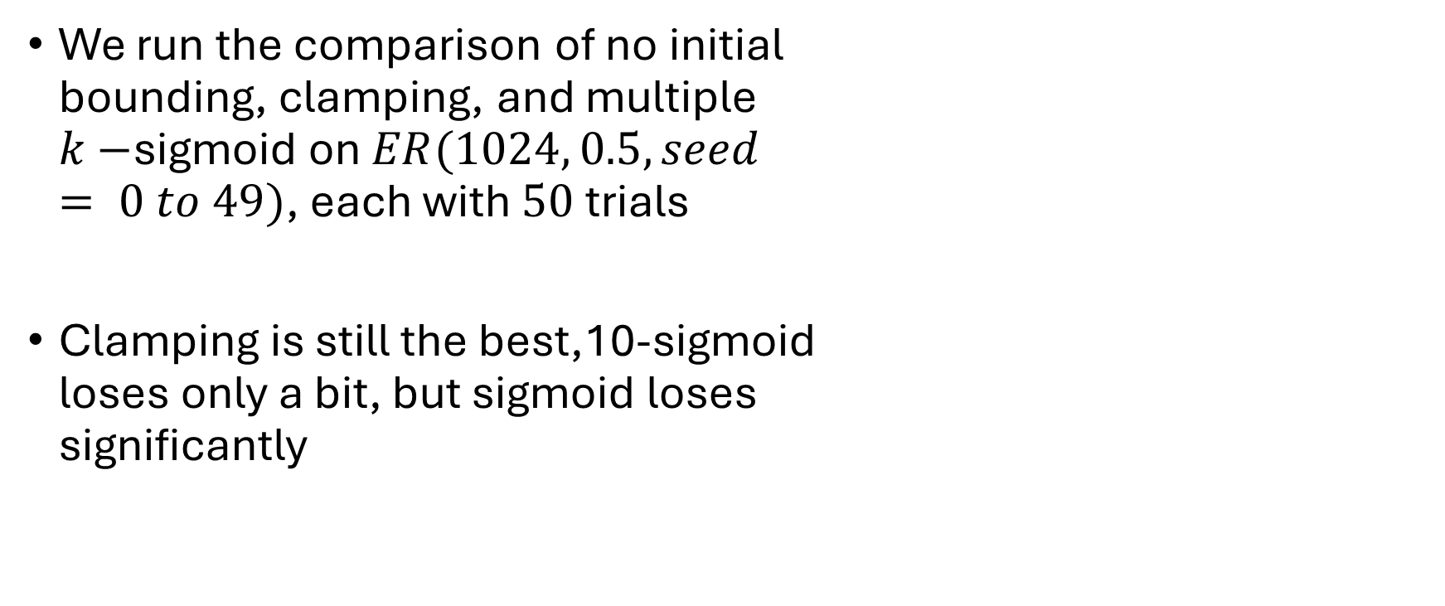
Initial clamping, sigmoiding, and no bounding
We run the comparison of no initial bounding, clamping, and multiple $k−$sigmoid on $ER(1024, 0.5, seed$ $= 0 to 49)$, each with $50$trials
Clamping is still the best,10-sigmoid loses only a bit, but sigmoid loses significantly

Slide 4
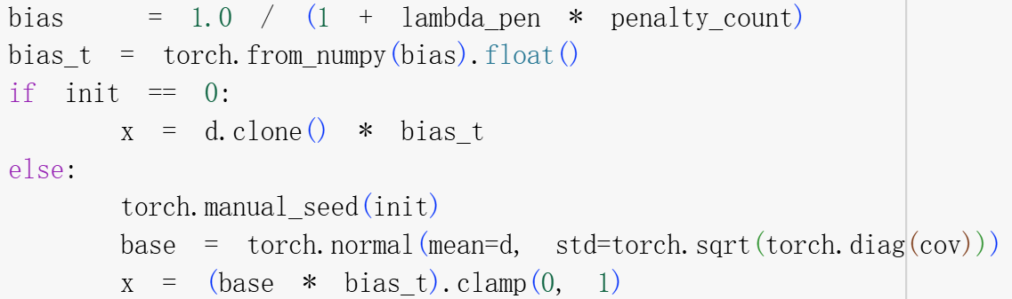

lambda_pen testing for reinitialization
We run on the combinations of $ER([500, 600, 700, 800], [0.3, 0.5, 0.7], seed = 0 to 49)$. Each seed is given $50$ sequential trials with the initialization being

Slide 5
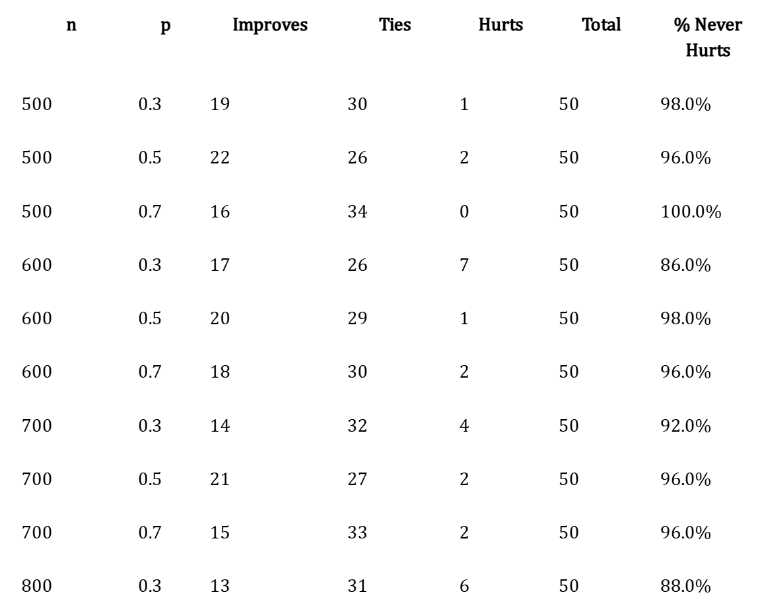
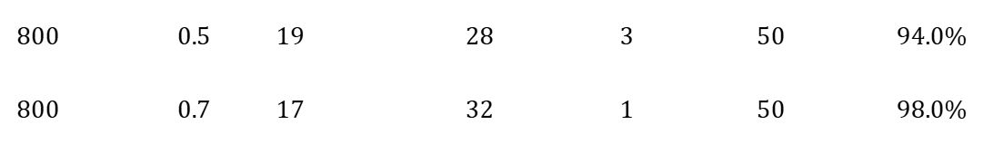
lambda_pen testing for reinitialization
The first result again compares any choice of nonzero lambda_pen against zero.
This is unfair to compare 9 times more experiments to the original ones

Slide 6
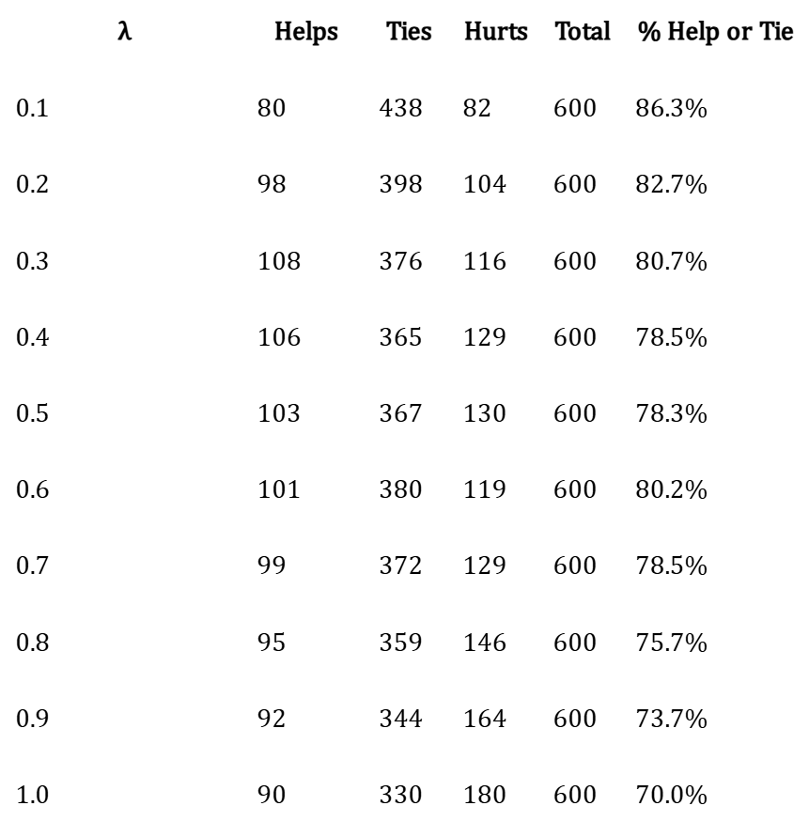
lambda_pen testing for reinitialization
We compare the per lambda comparisons against without using reinitializations.
There does not seem to be a universal good choice of lambda.
When lambda increases, we get more hurt, so maybe we shouldn’t use it at all?

Slide 7
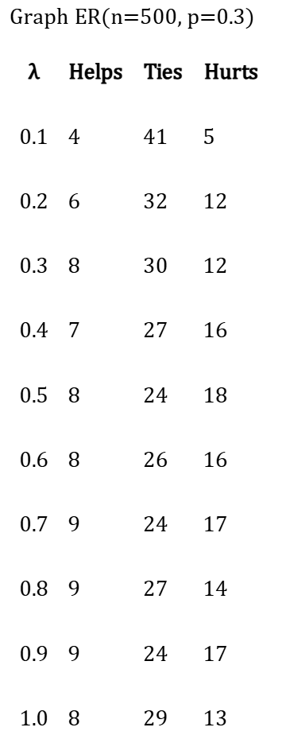
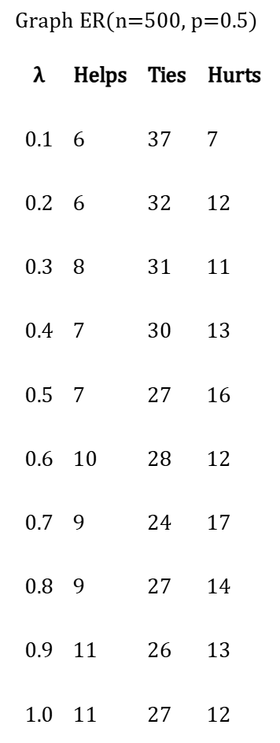
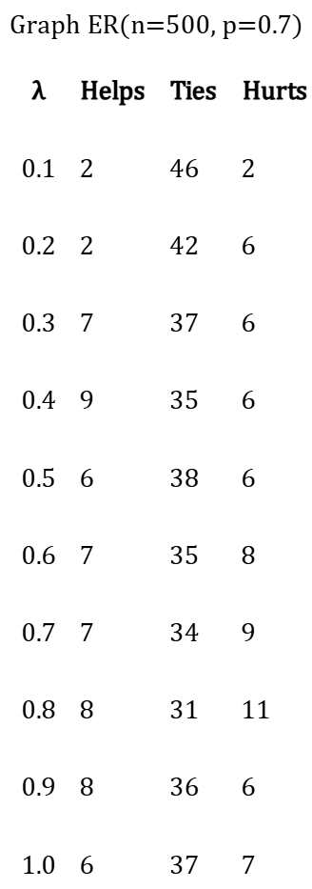
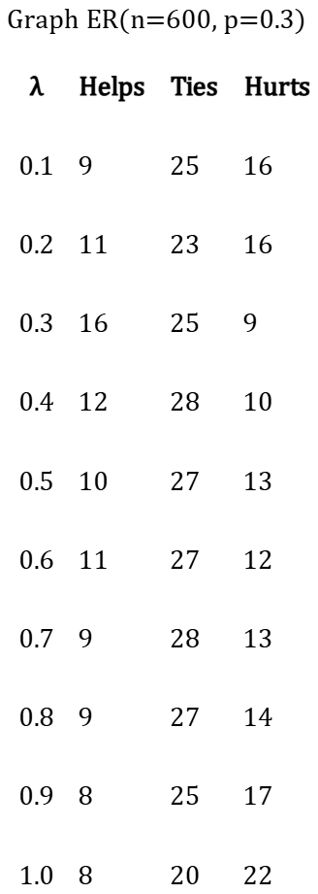
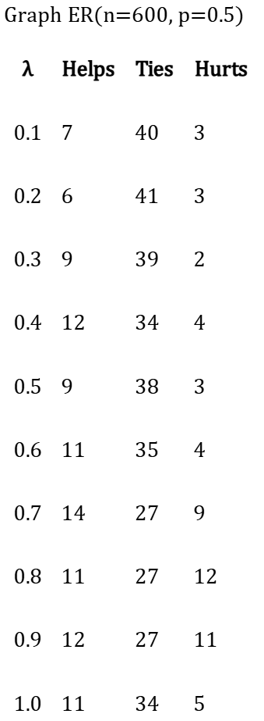
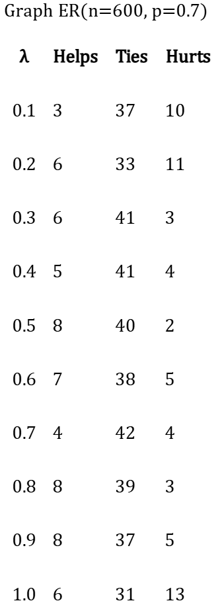
lambda_pen testing for reinitialization
More comparisons

Slide 8
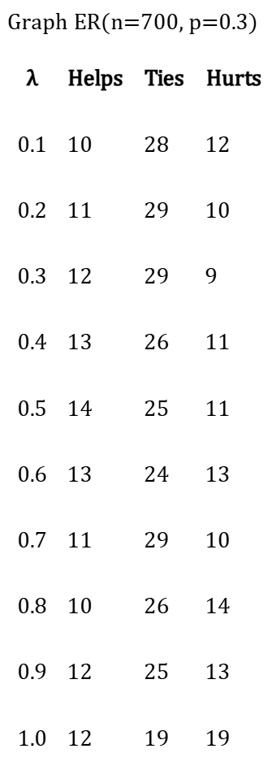
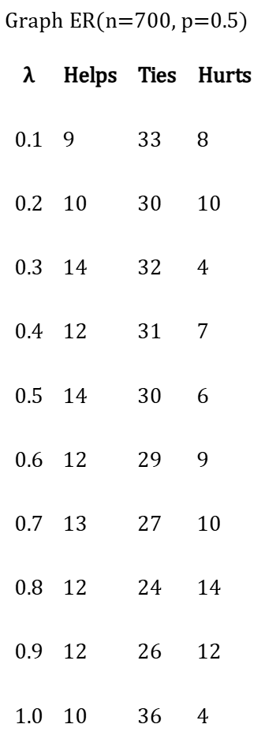
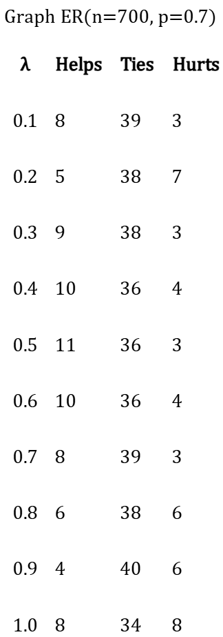
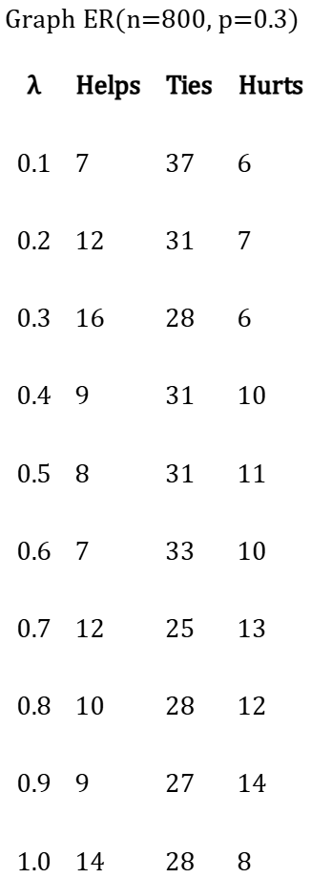
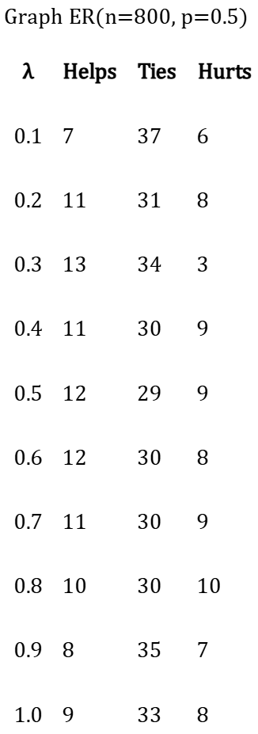
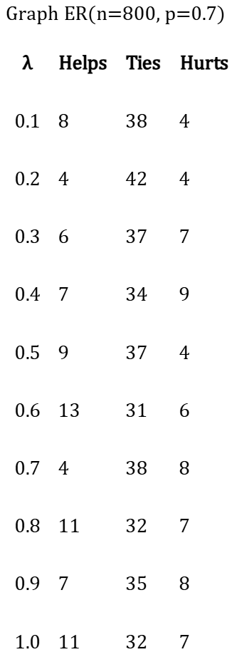
lambda_pen testing for reinitialization
More comparisons

Slide 9
lambda_pen testing for reinitialization
Observation:
Larger/denser graphs typically benefit from reinitialization, which does not align with our rougher experiments previously.
It seems like medium lambda_pens work best, smaller ones sometimes help but not always, and larger ones are less likely to help.
We try changing the value of lambda_pen during a 50 trials sequential run by initializing at 1 and decreasing by 0.1 every five trials.

Slide 10
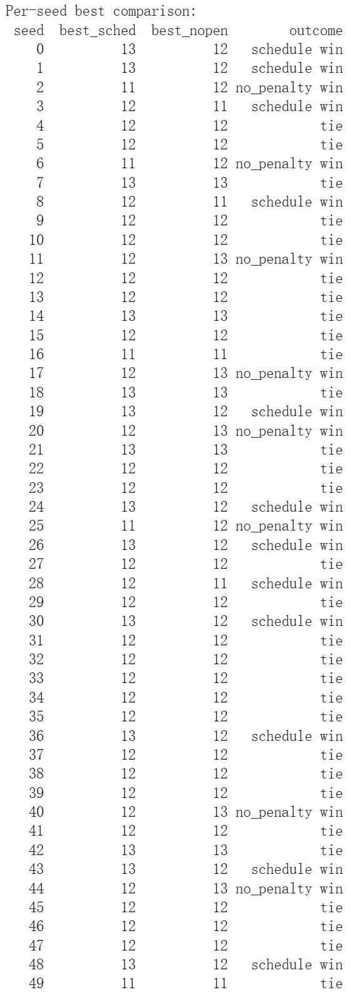
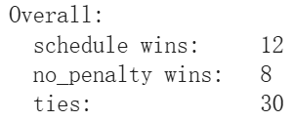

lambda_pen testing for reinitialization
Initial testing: $ER(800, 0.5, seed = 0 to 49)$, each with $50$trials
lambda_pen scheduling testing
Fixed lambda_pen testing

Slide 11
