Slide 1
DARPA Meeting
Yongliang Sun
2025.10.1

Slide 2
(u, v) pairs
The storage format of the ER graph has been changed to store (u, v) pairs instead of using an adjacency matrix.
Compared to extracting subgraphs from an adjacency matrix, using (u, v) pairs is more efficient for subgraph sampling.

Slide 3
SVRG

Slide 4
SVGR
Although the gradient in SGD is unbiased, it has high variance. SVRG reduces the variance of the gradient through a correction mechanism.
The gradient update formula of SVRG is as follows:
∇f(w̃) refers to the full gradient computed on the entire graph at the beginning of each epoch;
∇fᵢₜ(wₜ) denotes the stochastic gradient computed on the i-th randomly sampled subgraph at iteration t;
∇fᵢₜ(w̃) is the gradient of the i-th subgraph evaluated at the reference point w̃, which is selected at the beginning of the epoch.

Slide 5
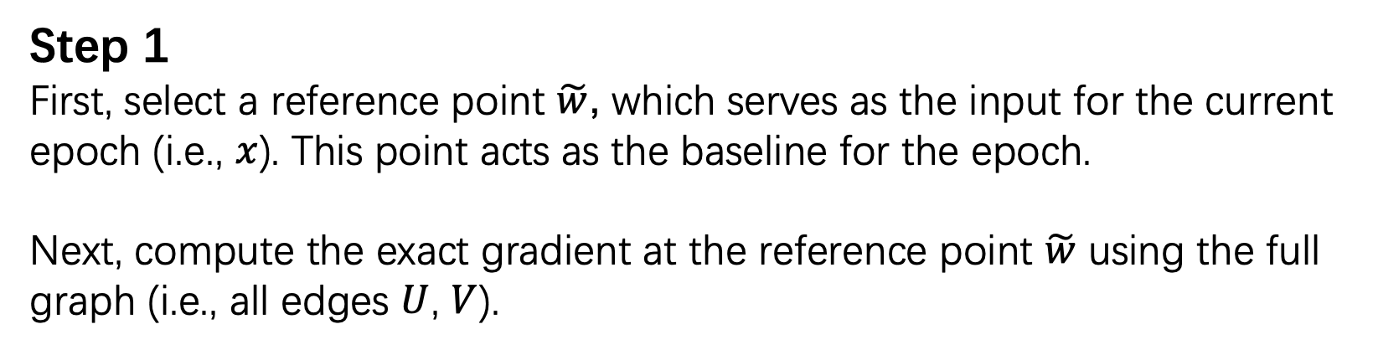
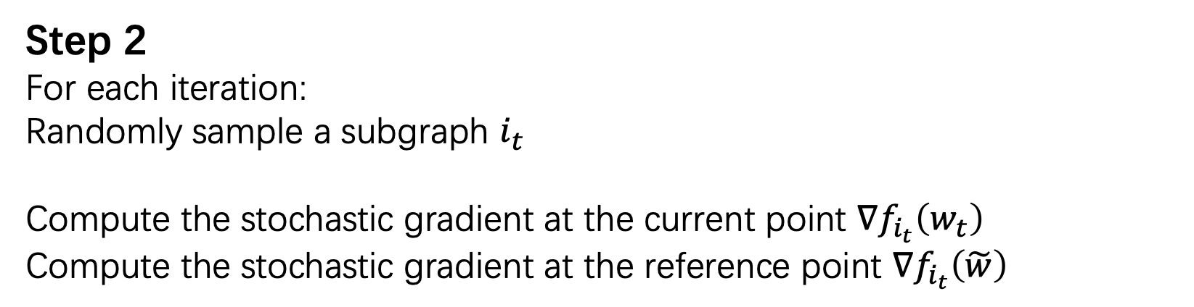
Step 1
First, select a reference point $\tilde{w}$, which serves as the input for the current epoch (i.e., $x$). This point acts as the baseline for the epoch. Next, compute the exact gradient at the reference point $\tilde{w}$ using the full graph (i.e., all edges $U$, $V$).
Step 2 For each iteration:
Randomly sample a subgraph $i_{t}$
Compute the stochastic gradient at the current point $∇f_{i_{t}}\left(w_{t}\right)$
Compute the stochastic gradient at the reference point $∇f_{i_{t}}\left(\tilde{w}\right)$

Slide 6
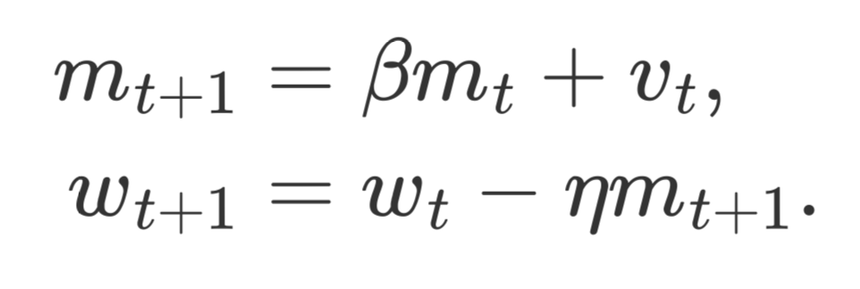
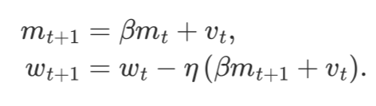
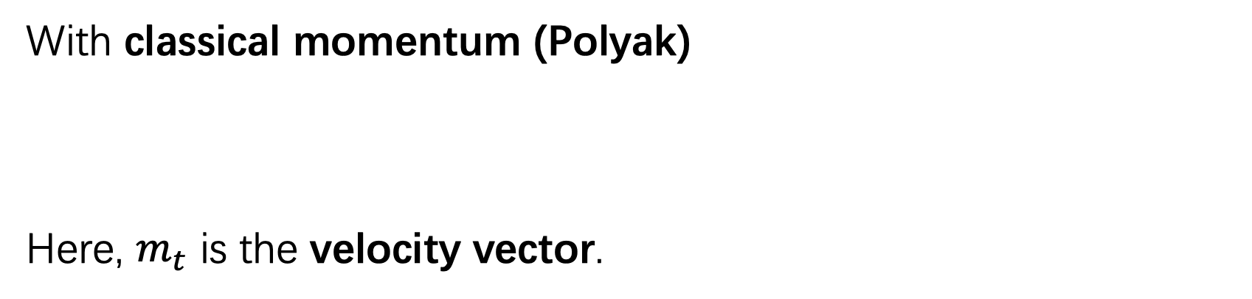
SVRG update
With classical momentum (Polyak)
Here, $m_{t}$ is the velocity vector.
With Nesterov momentum

Slide 7
Experimental Setting
In our experiments, we use ER graphs, where the number of nodes is [200, 400, 600, 800].
The probability of having an edge between two nodes is set to 0.5.
For each node size, we generate 10 different graphs using 10 random seeds. On each graph, we run 50 trials, and then we take the best result from each graph and average them.

Slide 8
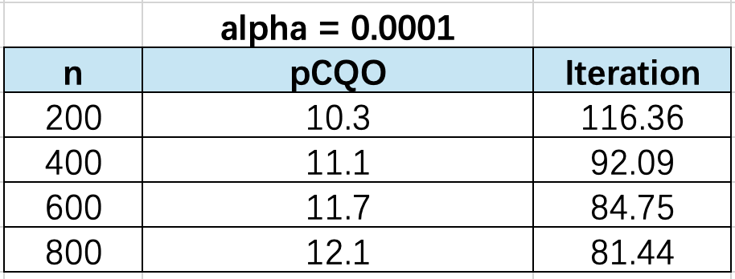
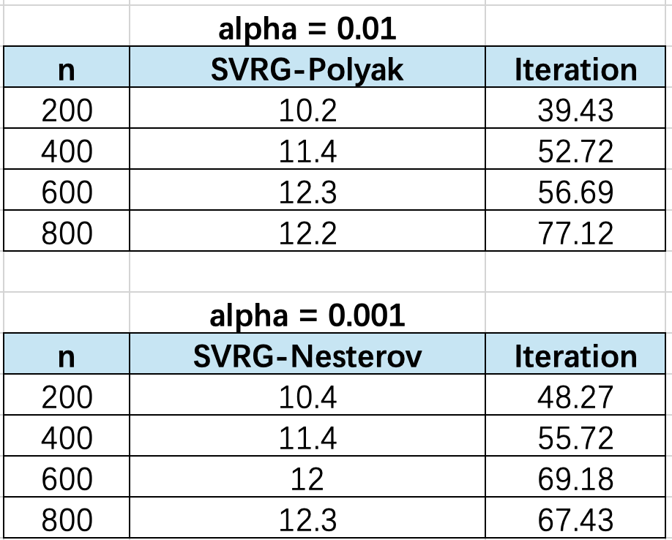
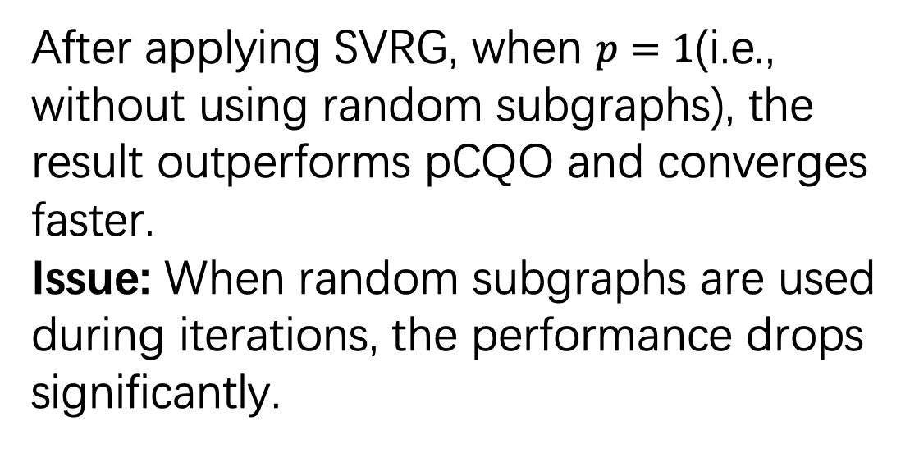
Experimental Result
After applying SVRG, when $p=1$(i.e., without using random subgraphs), the result outperforms pCQO and converges faster.
Issue: When random subgraphs are used during iterations, the performance drops significantly.

Slide 9
For next meeting
a. Analyze the reasons for the poor performance when using random subgraphs, and improve the method accordingly.
b. Compute the FLOPs.

