Slide 1
DARPA Meeting Second order methods and reinitialization on solving relaxed MIS problems
Cheng-Han Huang
2025.9.24

Slide 2
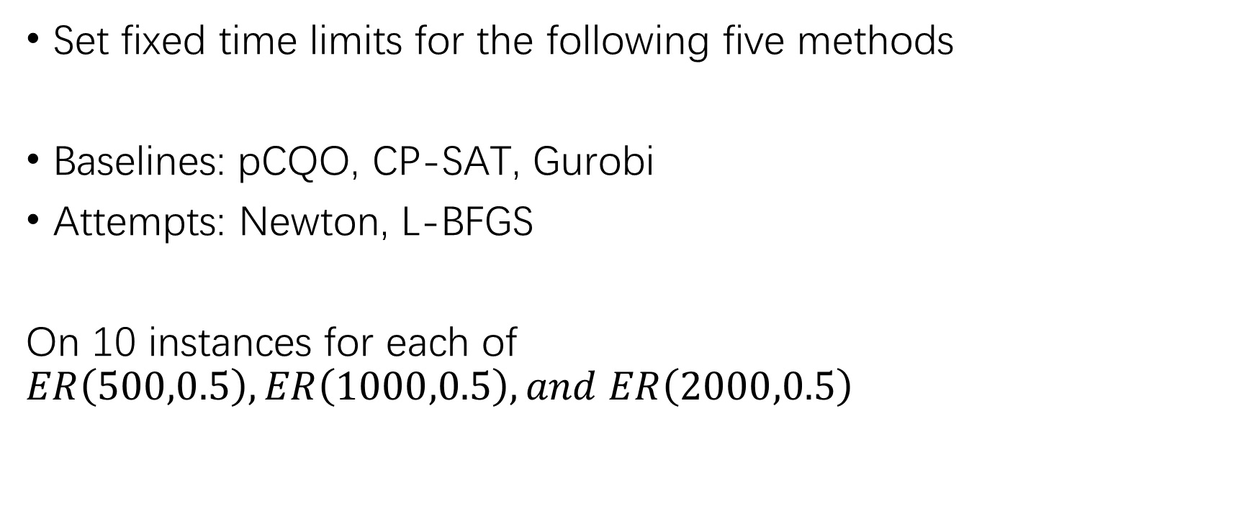
Methods Comparison
Set fixed time limits for the following five methods
Baselines: pCQO, CP-SAT, Gurobi
Attempts: Newton, L-BFGS
On 10 instances for each of $ER\left(500,0.5\right),ER\left(1000,0.5\right),and ER\left(2000,0.5\right)$

Slide 3
Methods for Solving Relaxed LP for MIS
pCQO: Baseline for solving a relaxed continuous optimization problem with MGD and a new MIS checker to replace traditional tolerance termination condition.
What we are exploring:
Newton: Follows the structure of pCQO but instead uses Newton to approach the relaxed optimization problem.
L-BFGS: Follows the structure of pCQO but instead uses Scipy’s L-BFGS-B to approach the relaxed optimization problem.

Slide 4
Description for Each Method
CP-SAT: Google’s open-source solver that turns a problem into Boolean SAT with CP propagators and largest neighborhood search
Gurobi: SOTA commercial solver that uses simplex method or interior method to branch-and-cut on LP relaxations.
Both methods are CPU-based

Slide 5
Description for Each Method
pCQO: Baseline for solving a relaxed continuous optimization problem with MGD and a new MIS checker to replace traditional tolerance termination condition.
Newton: Follows the structure of pCQO but instead uses Newton to approach the relaxed optimization problem.
L-BFGS: Follows the structure of pCQO but instead uses Scipy’s L-BFGS-B to approach the relaxed optimization problem.

Slide 6
Comparison with CPU Based Baselines
Graph, Time | MGD | CP-SAT | Gurobi | Newton | L-BFGS
ER(500,0.5), 5 sec | 12 | 12 | 8.7 | 11.2 (11.2) | 11.1 (11.1)
ER(1000,0.5), 5 sec | 11.5 | 0 | 9.5 | 11.8 (9.3) | 11.2 (11.2)
ER(1000,0.5), 10 sec | 11.8 | 11.4 | 9.5 | 12.2 (9.5) | 11.6 (11.4)
ER(2000,0.5), 10 sec | 10.8 | 0 | 10.4 | 10.5 (9.7) | 11.8 (11.8)
ER(2000,0.5), 20 sec | 12.1 | 0 | 10.4 | 10.8 (9.7) | 11.8 (11.8)
Baselines
Preliminary, brackets indicate without using the clique informed penalty
Note that both CP-SAT and Gurobi use thread-based parallelization, but the three gradient-based methods do not. The code is run on my local computer for initial results and is also able to run on advanced computational systems for future reports.

Slide 7
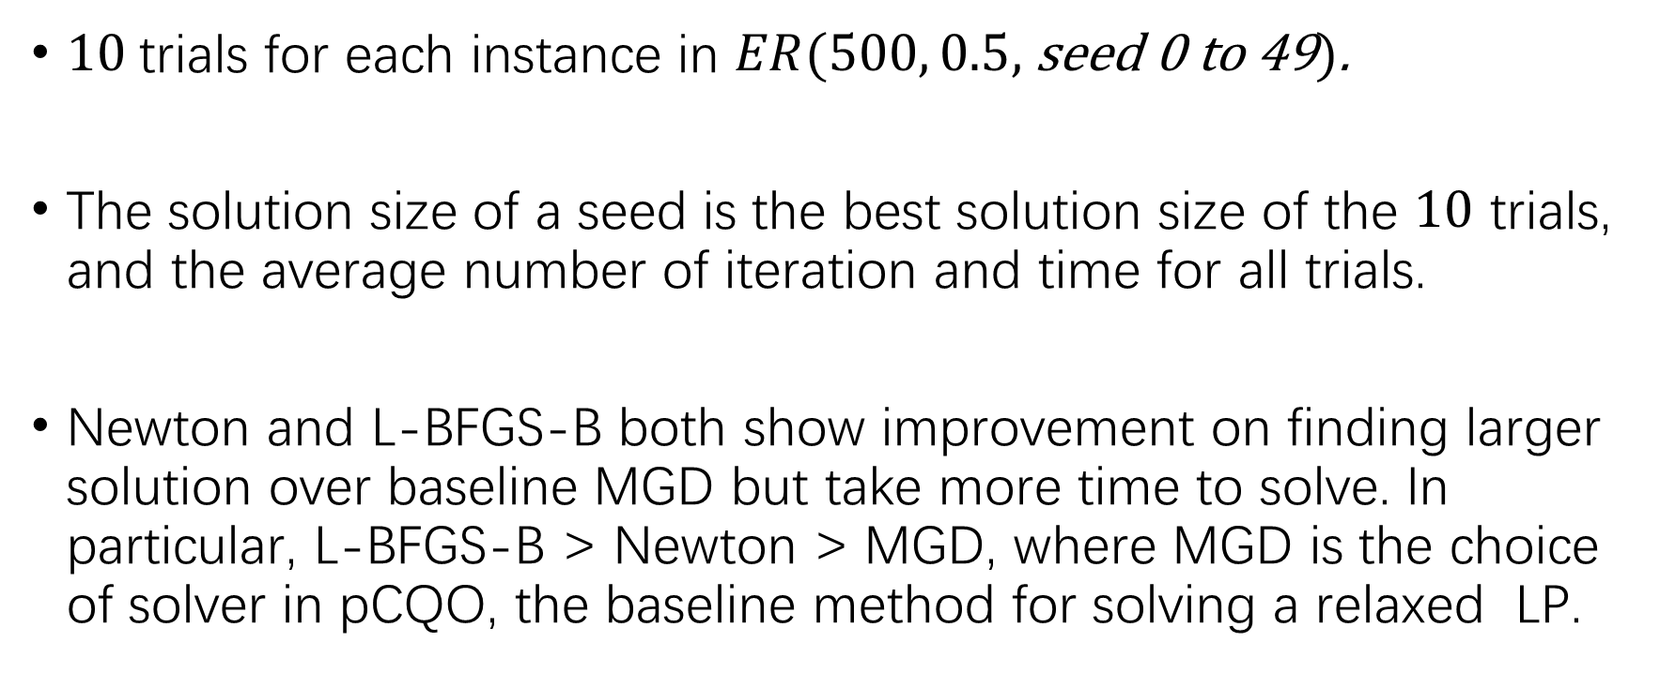
Gradient Based Methods by Number of Initializations
$10$trials for each instance in $ER(500, 0.5,$ seed 0 to 49$)$.
The solution size of a seed is the best solution size of the $10$ trials, and the average number of iteration and time for all trials.
Newton and L-BFGS-B both show improvement on finding larger solution over baseline MGD but take more time to solve. In particular, L-BFGS-B > Newton > MGD, where MGD is the choice of solver in pCQO, the baseline method for solving a relaxed LP.

Slide 8
Baseline MGD with and without Third Term
Comparison by solution size:
Comparison by iteration number/time:
 | MGD without Third Term | MGD with Third Term
Average solution size | 10.8 | 10.8
 | MGD without Third Term | MGD with Third Term
Average iteration number | 85.6 | 86.3
Average time | 0.0196 | 0.0260

Slide 9
Newton and L-BFGS-B
Comparison by solution size:
Comparison by iteration number/time:
L-BFGS-B > Newton | Tie | L-BFGS-B < Newton
13 | 32 | 5
 | L-BFGS-B | Newton
Average solution size | 11.26 | 10.96
 | L-BFGS-B | Newton
Average iteration number | 167.1 | 76.3
Average time | 0.7411 | 0.1350

Slide 10
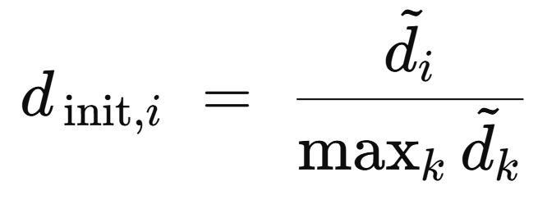
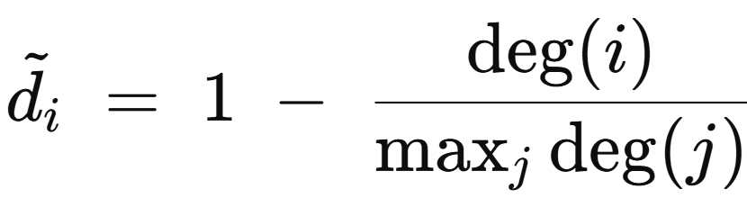
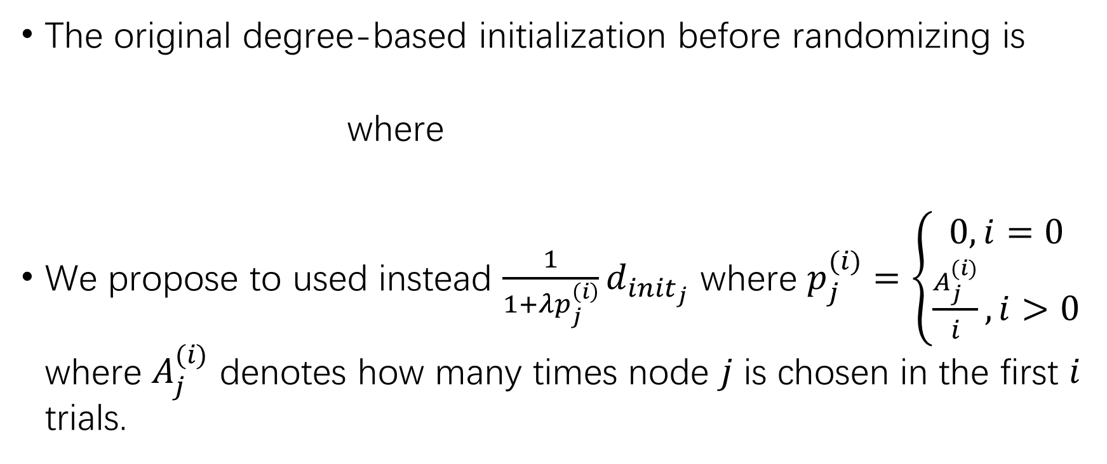
Reinitialization
The original degree-based initialization before randomizing is
where
We propose to used instead $\frac{1}{1+λp_{j}^{\left(i\right)}}d_{init_{j}}$ where $p_{j}^{(i)}=\left\{\begin{aligned}0, i=0 \\ \frac{A_{j}^{(i)}}{i}, i>0\end{aligned}\right.$ where $A_{j}^{(i)}$ denotes how many times node $j$ is chosen in the first $i$ trials.

Slide 11
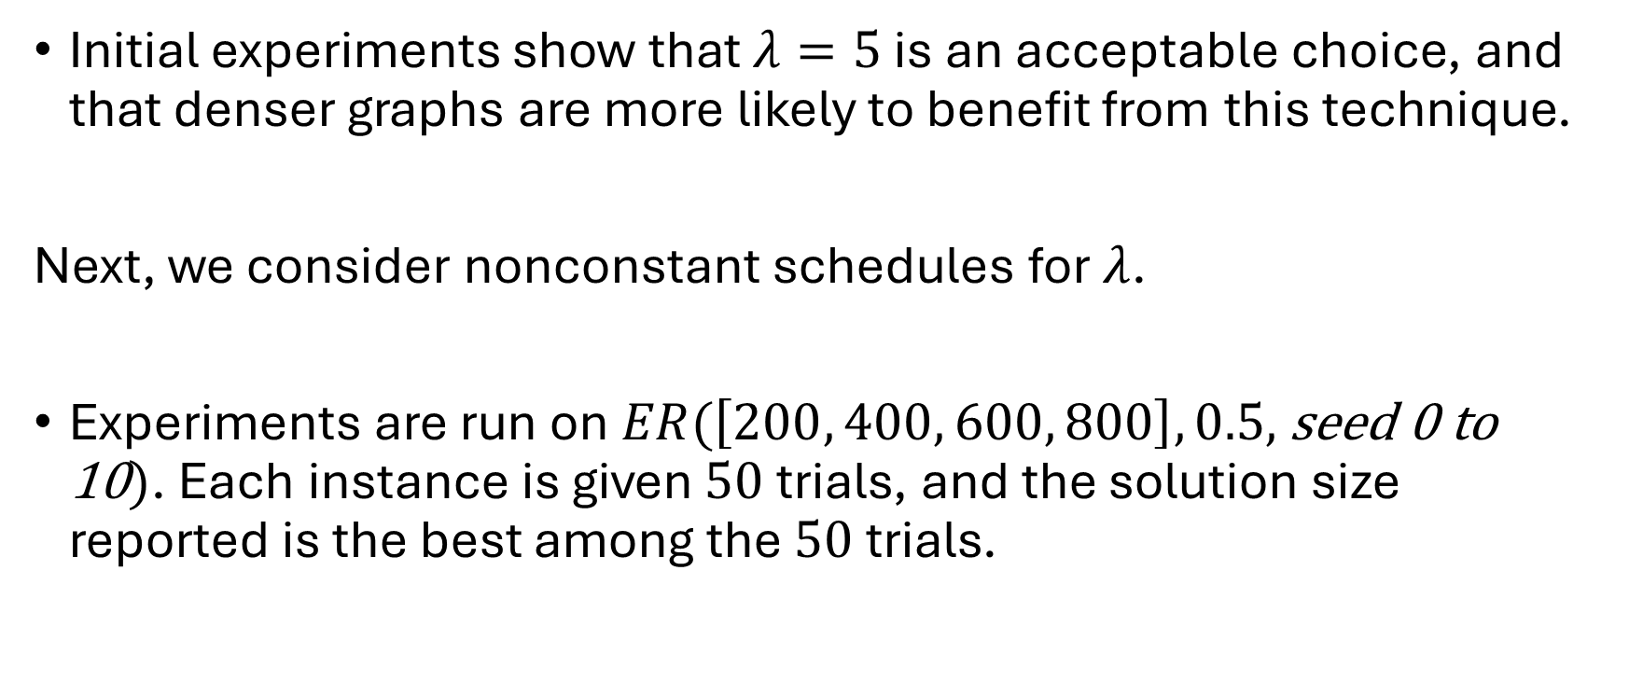
Reinitialization
Initial experiments show that $λ=5$ is an acceptable choice, and that denser graphs are more likely to benefit from this technique.
Next, we consider nonconstant schedules for $λ$.
Experiments are run on$ER(\left[200, 400, 600, 800\right], 0.5,$ seed 0 to 10$)$. Each instance is given $50$trials, and the solution size reported is the best among the $50$trials.

Slide 12
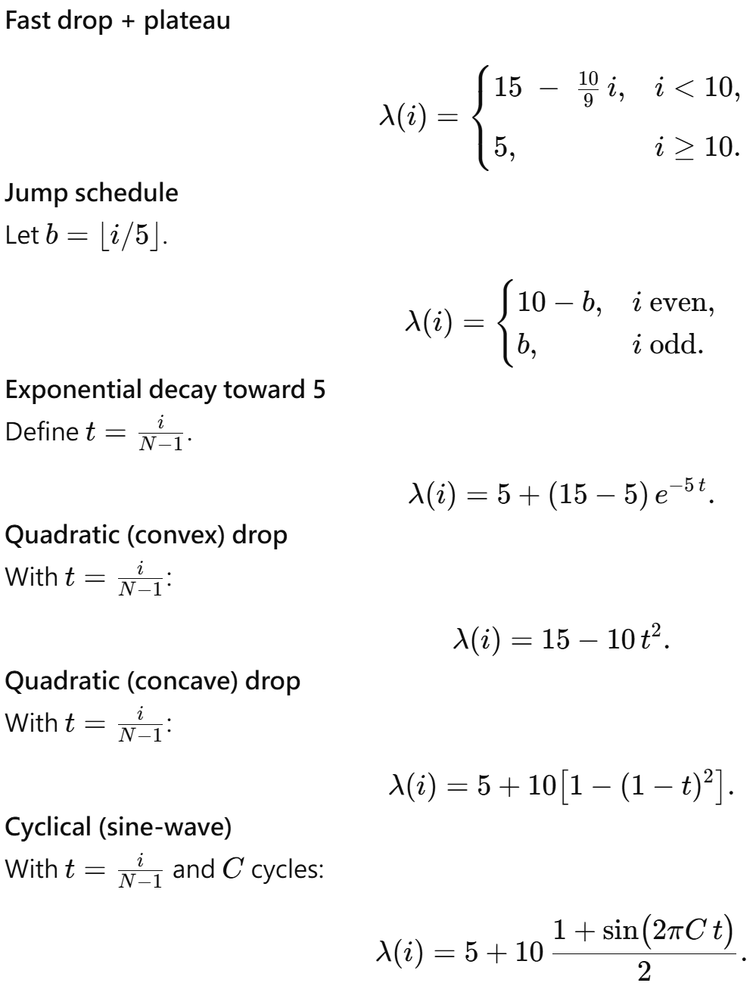
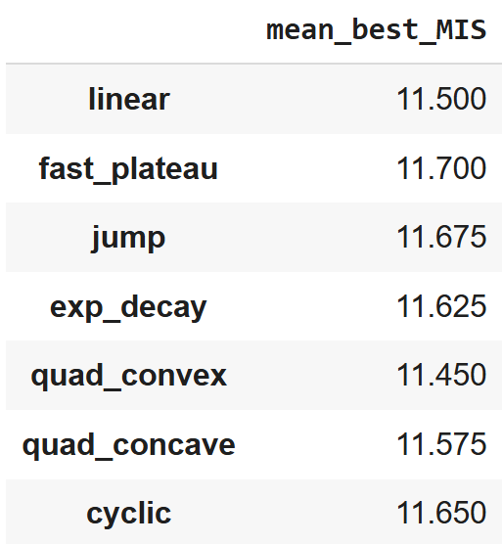

Reinitialization
Different choices of lambda schedules. $C=3$.

Slide 13
For next meeting
Newton and L-BFGS refine for time issue
How do we benefit from thread parallelization (Newton and L-BFGS)
Maybe some time later: Comparison with GPU Based Baselines (CuOPT) and iSCO

