Slide 1
DARPA Meeting Second order methods and reinitialization
Cheng-Han Huang
2025.9.24

Slide 2
Methods for Solving Relaxed LP for MIS
pCQO: Baseline for solving a relaxed continuous optimization problem with MGD and a new MIS checker to replace traditional tolerance termination condition.
What we are exploring:
Newton: Follows the structure of pCQO but instead uses Newton to approach the relaxed optimization problem.
L-BFGS: Follows the structure of pCQO but instead uses Scipy’s L-BFGS-B to approach the relaxed optimization problem.

Slide 3
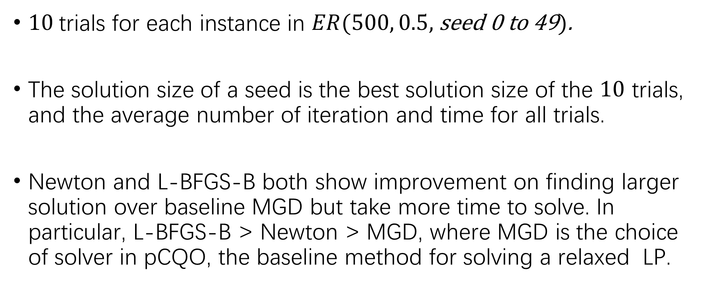
Newton and L-BFGS-B
$10$trials for each instance in $ER(500, 0.5,$ seed 0 to 49$)$.
The solution size of a seed is the best solution size of the $10$ trials, and the average number of iteration and time for all trials.
Newton and L-BFGS-B both show improvement on finding larger solution over baseline MGD but take more time to solve. In particular, L-BFGS-B > Newton > MGD, where MGD is the choice of solver in pCQO, the baseline method for solving a relaxed LP.

Slide 4
Baseline MGD with and without Third Term
Comparison by solution size:
Comparison by iteration number/time:
 | MGD without Third Term | MGD with Third Term
Average solution size | 10.8 | 10.8
 | MGD without Third Term | MGD with Third Term
Average iteration number | 85.6 | 86.3
Average time | 0.0196 | 0.0260

Slide 5
Newton and L-BFGS-B
Comparison by solution size:
Comparison by iteration number/time:
L-BFGS-B > Newton | Tie | L-BFGS-B < Newton
13 | 32 | 5
 | L-BFGS-B | Newton
Average solution size | 11.26 | 10.96
 | L-BFGS-B | Newton
Average iteration number | 167.1 | 76.3
Average time | 0.7411 | 0.1350

Slide 6
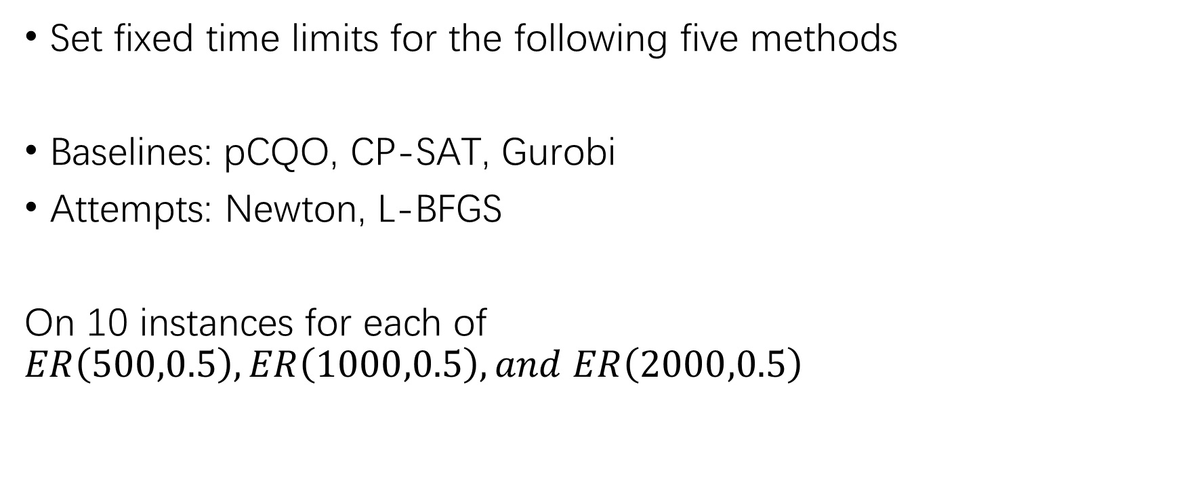
Methods Comparison
Set fixed time limits for the following five methods
Baselines: pCQO, CP-SAT, Gurobi
Attempts: Newton, L-BFGS
On 10 instances for each of $ER\left(500,0.5\right),ER\left(1000,0.5\right),and ER\left(2000,0.5\right)$

Slide 7
Description for Each Method
CP-SAT: Google’s open-source solver that turns a problem into Boolean SAT with CP propagators and largest neighborhood search
Gurobi: SOTA commercial solver that uses simplex method or interior method to branch-and-cut on LP relaxations.
Both methods are CPU-based

Slide 8
Description for Each Method
pCQO: Baseline for solving a relaxed continuous optimization problem with MGD and a new MIS checker to replace traditional tolerance termination condition.
Newton: Follows the structure of pCQO but instead uses Newton to approach the relaxed optimization problem.
L-BFGS: Follows the structure of pCQO but instead uses Scipy’s L-BFGS-B to approach the relaxed optimization problem.

Slide 9
Comparison with CPU Based Baselines
Graph, Time | MGD | CP-SAT | Gurobi | Newton | L-BFGS
ER(500,0.5), 5 sec | 12 | 12 | 8.7 | 11.2 (11.2) | 11.1 (11.1)
ER(1000,0.5), 5 sec | 11.5 | 0 | 9.5 | 11.8 (9.3) | 11.2 (11.2)
ER(1000,0.5), 10 sec | 11.8 | 11.4 | 9.5 | 12.2 (9.5) | 11.6 (11.4)
ER(2000,0.5), 10 sec | 10.8 | 0 | 10.4 | 10.5 (9.7) | 11.8 (11.8)
ER(2000,0.5), 20 sec | 12.1 | 0 | 10.4 | 10.8 (9.7) | 11.8 (11.8)
Baselines
Preliminary, brackets indicate without using the clique informed penalty
Note that both integer programming methods uses thread-based parallelization, but the three gradient-based methods do not. The code is run on my local computer for initial results and is also able to run on advanced computational systems for future reports.
Maximum iteration for the three gradient based methods are set to 150 across all runs, leading to possible failing cases which report 0 that drags down the average solution size in for larger graphs.

Slide 10
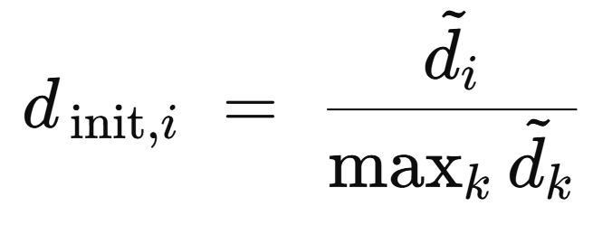
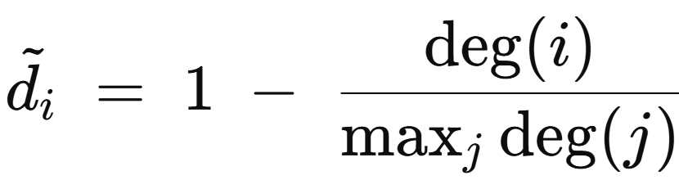
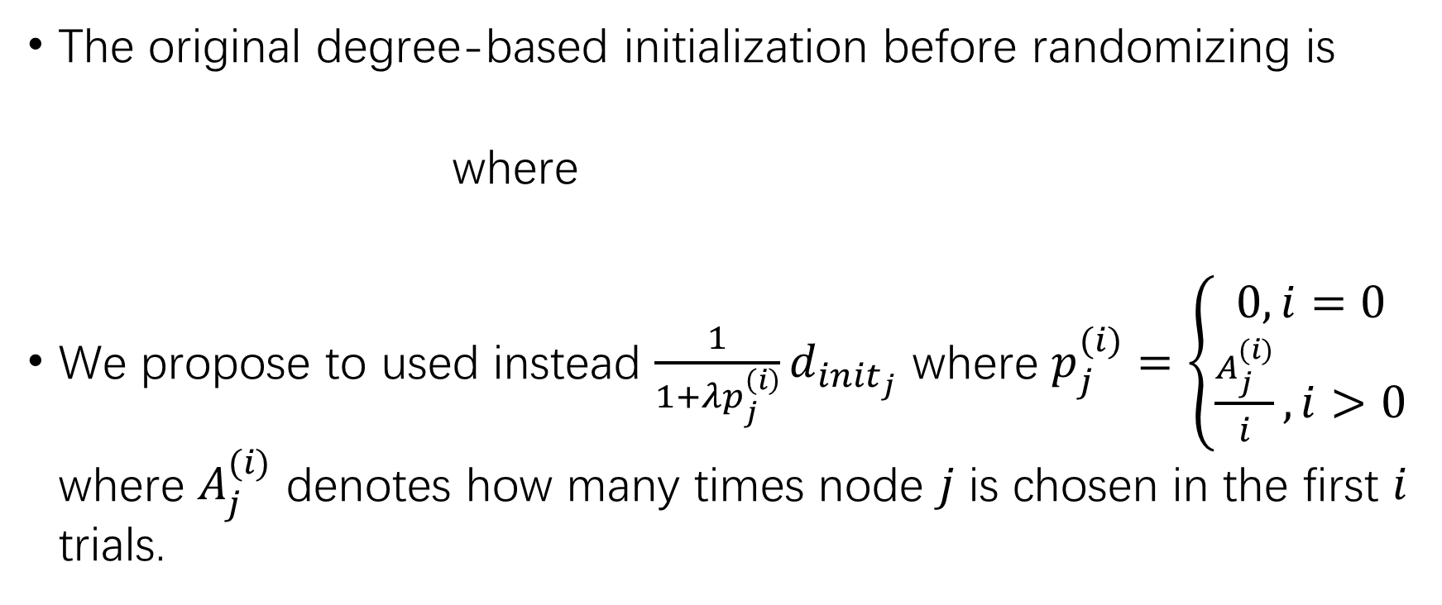
Reinitialization
The original degree-based initialization before randomizing is
where
We propose to used instead $\frac{1}{1+λp_{j}^{\left(i\right)}}d_{init_{j}}$ where $p_{j}^{(i)}=\left\{\begin{aligned}0, i=0 \\ \frac{A_{j}^{(i)}}{i}, i>0\end{aligned}\right.$ where $A_{j}^{(i)}$ denotes how many times node $j$ is chosen in the first $i$ trials.

Slide 11
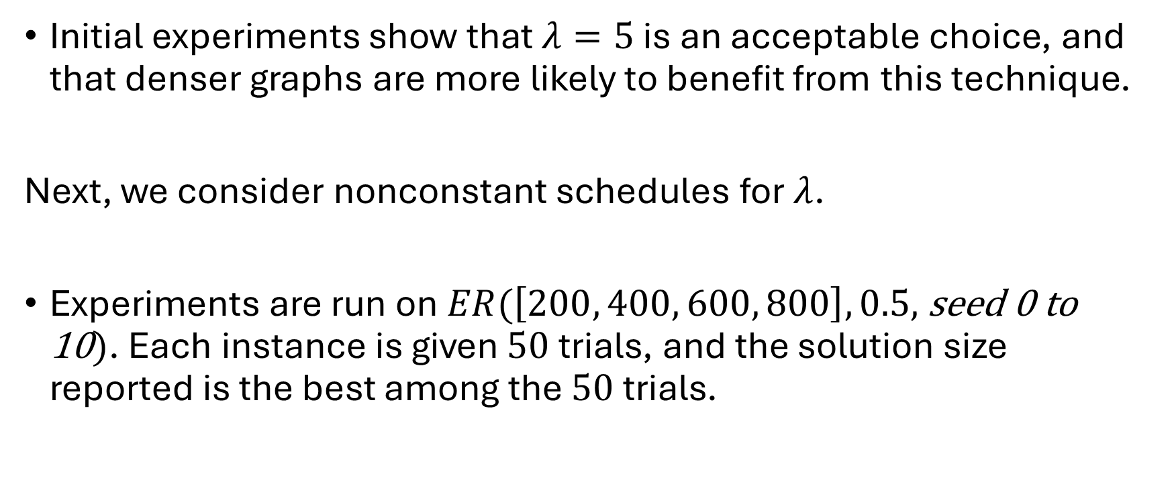
Reinitialization
Initial experiments show that $λ=5$ is an acceptable choice, and that denser graphs are more likely to benefit from this technique.
Next, we consider nonconstant schedules for $λ$.
Experiments are run on$ER(\left[200, 400, 600, 800\right], 0.5,$ seed 0 to 10$)$. Each instance is given $50$trials, and the solution size reported is the best among the $50$trials.

Slide 12
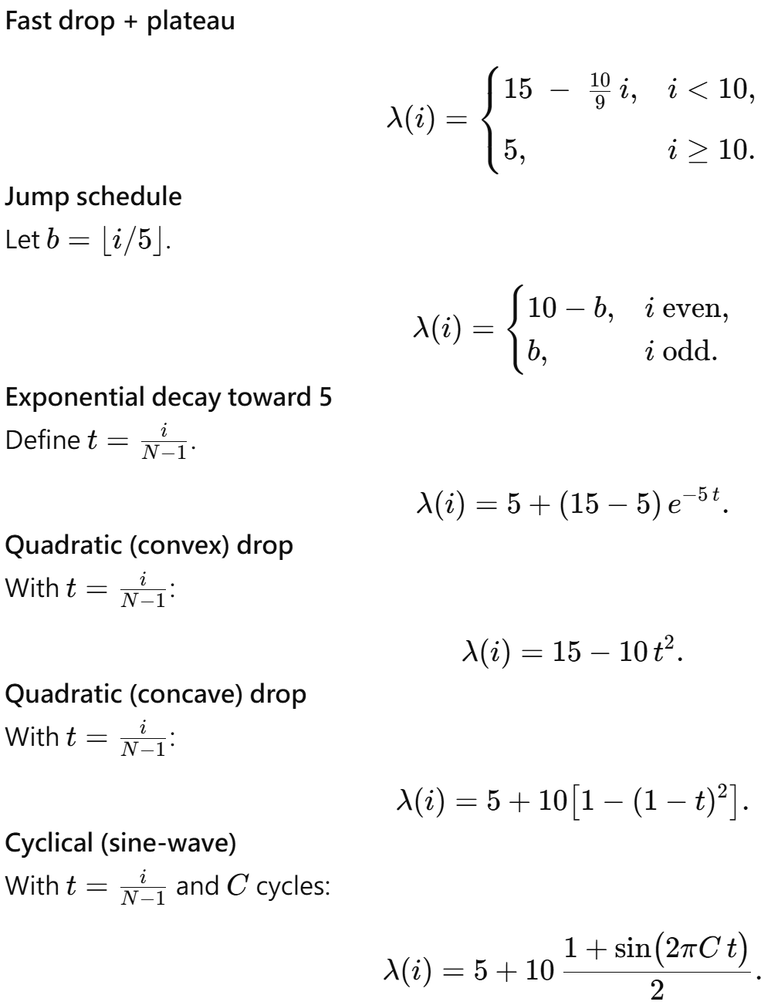
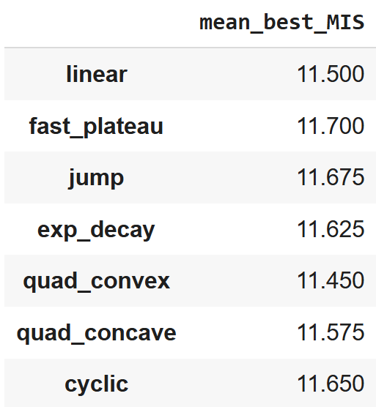

Reinitialization
Different choices of lambda schedules. $C=3$.

Slide 13
For next meeting
Newton and L-BFGS refine for time issue
How do we benefit from thread parallelization (Newton and L-BFGS)
Run on
Maybe some time later: Comparison with GPU Based Baselines (CuOPT) and iSCO

