Slide 1
1008 Meeting
Cheng-Han Huang

Slide 2
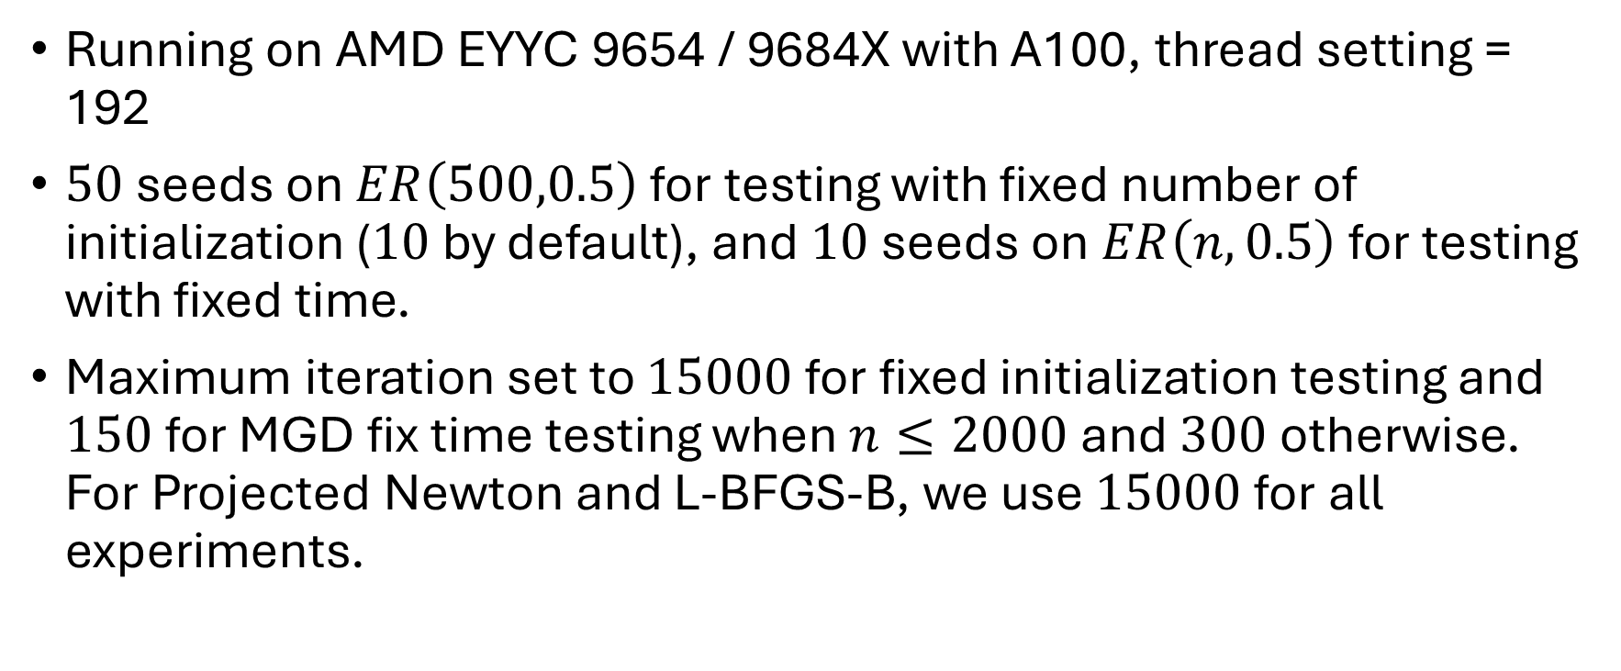
Global Setting
Running on AMD EYYC 9654 / 9684X with A100, thread setting = 192
$50$ seeds on $ER\left(500,0.5\right)$ for testing with fixed number of initialization ($10$ by default), and $10$ seeds on $ER\left(n,0.5\right)$ for testing with fixed time.
Maximum iteration set to $15000$ for fixed initialization testing and $150$ for MGD fix time testing when $n≤2000$ and $300$ otherwise. For Projected Newton and L-BFGS-B, we use $15000$ for all experiments.

Slide 3
Methods
CP-SAT: Widely used as baselines in combinatorial optimization studies. Take the integer programming form of the maximum independent set problem and solve.
MGD (pCQO) / Projected Newton / Scipy’s L-BFGS-B: Solve a relaxed optimization problem of maximum independent set that is continuous and differentiable with gradient based methods. Objective function are taken from pCQO paper with the clique informed penalty term.

Slide 4
Methods
Newton-Ours (single threaded): Projected Newton with a ‘free-set’ masking to determine points that can move legally. Only these points are computed in the algorithm. Maintain a sub-Hessian matrix for computation efficiency and recomputes only when the set of legal points or the damping matrix change. Armijo update with initial steps and backtracking scalar finetuned by grid search.
L-BFGS-Ours (single threaded): Handcrafted L-BFGS also with the free set. Armijo update with initial steps and backtracking scalar finetuned by grid search.

Slide 5
Graph, Time | MGD | CP-SAT | Projected Newton | L-BFGS-B | Newton-Ours | L-BFGS-Ours-10 | L-BFGS-Ours-20 | Yongliang’s -5 (with / without clique penalty) | Yongliang’s -10 (with / without clique penalty)
ER(500,0.5), 5 sec | 12.1 | 12.1 | 11.5 | 10.6 | 11.9 | 12.1 | 12.0 | 11.3 / 11.3 | 12.1 / 12.0
ER(1000,0.5), 5 sec | 12.4 | 12.0 | 11.6 | 11.2 | 12.8 | 11.8 | 11.8 | 12.2 / 12.6 | 13.0 / 13.1
ER(1000,0.5), 10 sec | 12.7 | 12.5 | 11.9 | 11.8 | 13.0 | 12.2 | 12.2 | 12.7 /12.6 | 13.3 / 13.3
ER(2000,0.5), 10 sec | 12.9 | 0 | 7.2 | 12.3 | 13.2 | 12.5 | 12.5 | 13.8 / 14.0 | 13.5 / 13.9
ER(2000,0.5), 20 sec | 13.2 | 11.2 | 10.7 | 12.4 | 13.4 | 12.7 | 12.7 | 14.1 / 14.1 | 13.7 /13.9
ER(3000,0.5), 30 sec | 13.3 | 0 | 7.9 | 0 | 13.9 | 13.1 | 13.4 | 14.1 / 14.2 | 14.6 / 15.0
ER(5000,0.5), 50 sec | 13.3 | 0 | 5.1 | 0 | 14.4 | 13.8 | 13.9 | 14.7 /15.0 | 15.1 / 15.3

Slide 6
Gorubi Doesn’t Perform
Compared to CP-SAT, Gorubi performs worse for the task of solving integer programming here unless the given time is too little for CP-SAT to produce even an initial sub-optimal solution.
This comparison is run on my local environment.
Graph, Time | CP-SAT | Gurobi
ER(500,0.5), 5 sec | 12 | 8.7
ER(1000,0.5), 5 sec | 0 | 9.5
ER(1000,0.5), 10 sec | 11.4 | 9.5

Slide 7
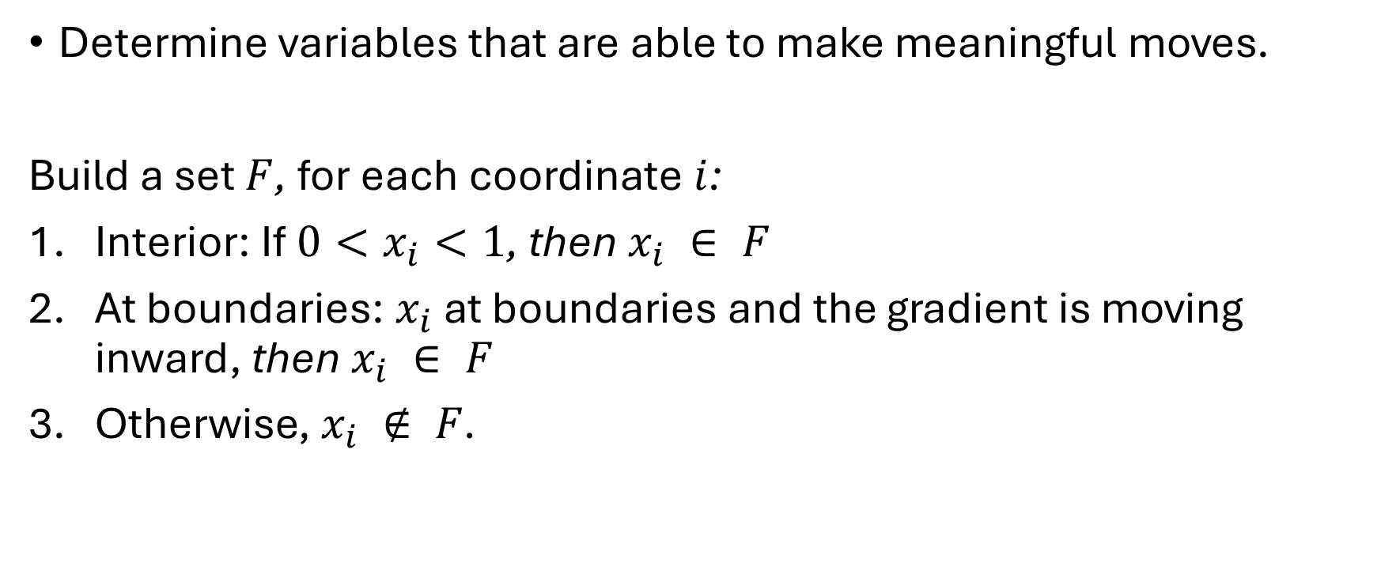
Free-Mask for Our Newton / L-BFGS
Determine variables that are able to make meaningful moves.
Build a set $F$, for each coordinate $i$:
Interior: If $0<x_{i}<1$, then $x_{i} ∈ F$
At boundaries: $x_{i}$ at boundaries and the gradient is moving inward, then $x_{i} ∈ F$
Otherwise, $x_{i} ∉ F$.

Slide 8
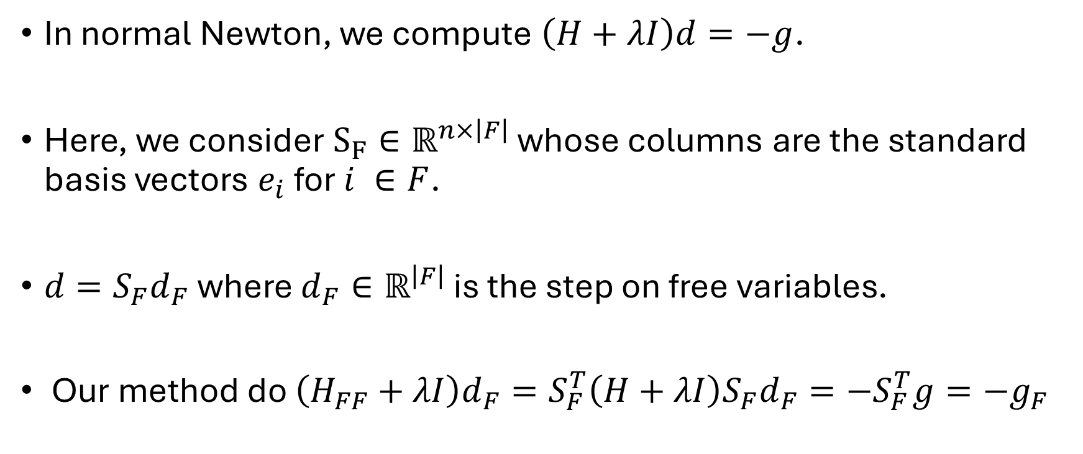
Free-Mask for Our Newton
In normal Newton, we compute $\left(H+λI\right)d=−g$.
Here, we consider $S_{F}∈ℝ^{n×\left|F\right|}$ whose columns are the standard basis vectors $e_{i}$ for $i ∈F$.
$d=S_{F}d_{F}$ where $d_{F}∈ℝ^{\left|F\right|}$ is the step on free variables.
Our method do $\left(H_{FF}+λI\right)d_{F}=S_{F}^{T}\left(H+λI\right)S_{F}d_{F}=−S_{F}^{T}g=−g_{F}$

Slide 9
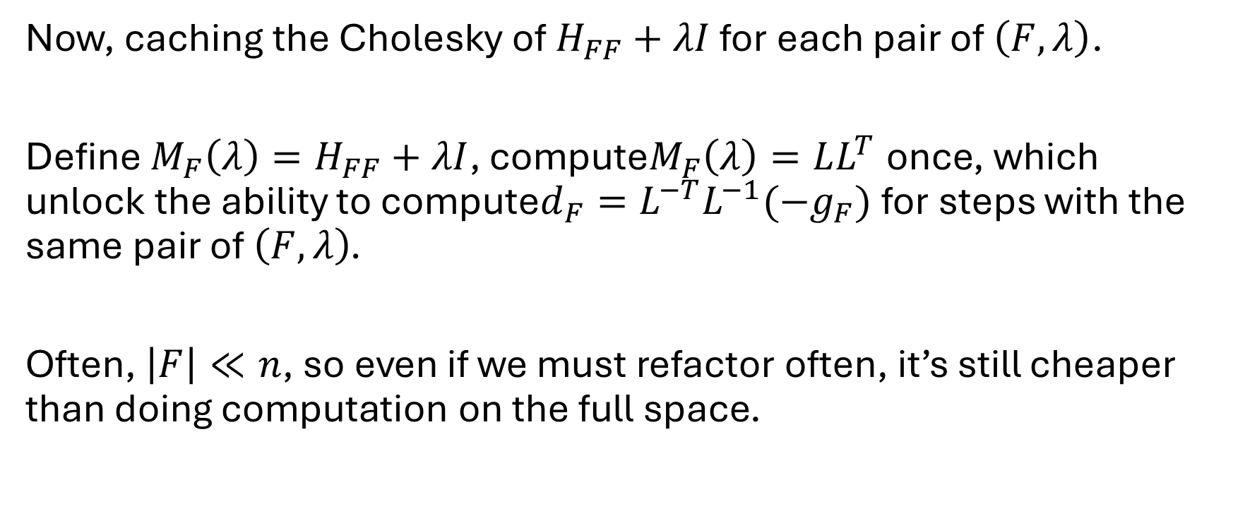
Free-Mask for Our Newton
Now, caching the Cholesky of $H_{FF}+λI$ for each pair of $\left(F,λ\right)$.
Define $M_{F}\left(λ\right)=H_{FF}+λI$, compute$M_{F}\left(λ\right)=LL^{T}$ once, which unlock the ability to compute$d_{F}=L^{−T}L^{−1}(−g_{F})$ for steps with the same pair of $\left(F,λ\right)$.
Often, $\left|F\right|≪n$, so even if we must refactor often, it’s still cheaper than doing computation on the full space.

Slide 10
Free-Mask for Our L-BFGS
Similarly, with free mask we are doing the problem on the active coordinates.
Avoid meaningless or harmful computation; projections break the secant equation at boundaries, and we don’t need to compute steps that we are going to zero out anyway.

Slide 11
Scipy’s L-BFGS-B and Our L-BFGS
Comparison by solution size: (L-BFGS-B indicates Scipy’s solver)
Comparison by iteration number/time:
 | L-BFGS-B | Ours
Average solution size | 11.28 | 10.80
 | L-BFGS-B | Ours
Average iteration number | 167.1 | 23.1
Average time | 2.2564 | 0.0613

Slide 12
Projected Newton and Our Newton
Comparison by solution size: (L-BFGS-B indicates Scipy’s solver)
Comparison by iteration number/time:
 | Projected Newton | Ours
Average solution size | 11.08 | 11.1
 | Projected Newton | Ours
Average iteration number | 76.91 | 20.69
Average time | 0.1665 | 0.0155

Slide 13
Next Meeting
Determining how to choose a good max iter
Determining or controlling memory length for L-BFGS if using
Threading for our methods
ReduMIS / iSCO baseline comparison
Try on Max Cut / TSP

Slide 14
Appendix

Slide 15
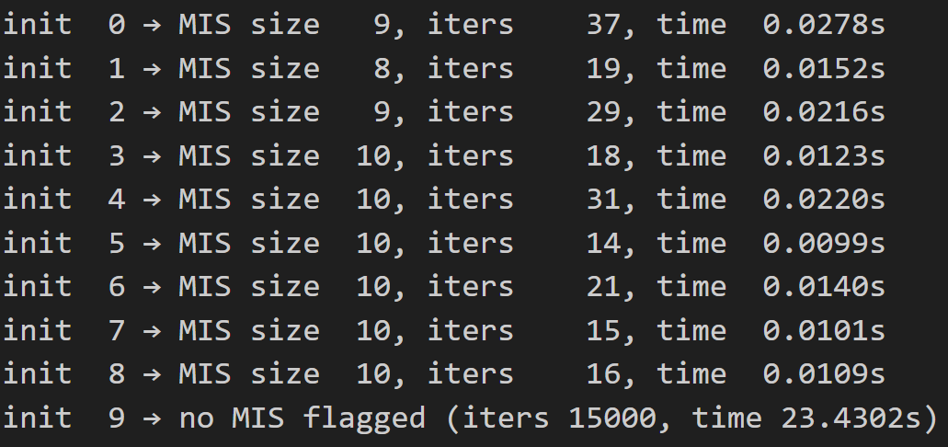
Outlier Case
We have one run taking much more steps

Slide 16
Single Thread
The same piece of Newton / L-BFGS code.
Average time with same setting
Environment / Method | Newton | Scipy’s L-BFGS-B
My Local Env | 0.1350 | 0.7411
AMD24 | 0.1665 | 2.2564

