Slide 1
Convex Hull
Andrew’s Monotone Chain

Slide 2
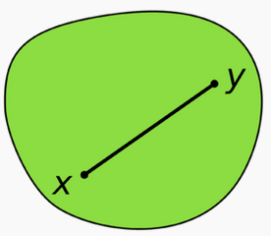
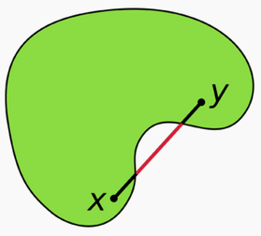
Convex Set


Every point on the straight line segment within the region
Every angle < 180 degree

Slide 3
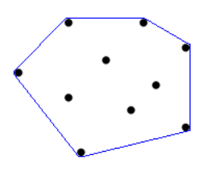
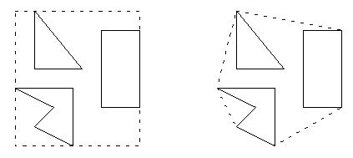
Convex Hull
The intersection of all convex sets



Slide 4
Andrew’s Monotone Chain

Slide 5
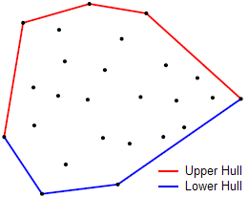
Sort the points by x-coordinate
For the sorted array (left to right, find the upper hull)
While L contains at least two points and find the last two points in L and the point P[i] make a clockwise turn: remove the last point from L
Append P[i] to L
Right to left again, find the lower hull
Remove the last point in L because it’s the same as the first point
L: A list of points in the convex hull
P: A list of points in the plane

Slide 6
Cross Product Determinant
If the value is < 0
Remove the last point from L
Else
Break the while loop

Slide 7
(-3,12)
5
(-7,8)
(1,8)
2
7
4
(-3,5)
1
6
(-7,2)
(1,2)
3
(-3,-2)

Slide 8
(-3,12)
5
(-7,8)
(1,8)
2
7
4
(-3,5)
1
6
(-7,2)
(1,2)
3
(-3,-2)

Slide 9
(-3,12)
5
(-7,8)
(1,8)
2
7
4
(-3,5)
1
6
(-7,2)
(1,2)
3
(-3,-2)

Slide 10
(-3,12)
5
(-7,8)
(1,8)
2
7
4
(-3,5)
1
6
(-7,2)
(1,2)
3
(-3,-2)

Slide 11
(-3,12)
5
(-7,8)
(1,8)
2
7
4
(-3,5)
1
6
(-7,2)
(1,2)
3
(-3,-2)

Slide 12
(-3,12)
5
(-7,8)
(1,8)
2
7
4
(-3,5)
1
6
(-7,2)
(1,2)
3
(-3,-2)

Slide 13
(-3,12)
5
(-7,8)
(1,8)
2
7
4
(-3,5)
1
6
(-7,2)
(1,2)
3
(-3,-2)

Slide 14
(-3,12)
5
(-7,8)
(1,8)
2
7
4
(-3,5)
1
6
(-7,2)
(1,2)
3
(-3,-2)

Slide 15
(-3,12)
5
(-7,8)
(1,8)
2
7
4
(-3,5)
1
6
(-7,2)
(1,2)
3
(-3,-2)

Slide 16
(-3,12)
5
(-7,8)
(1,8)
2
7
4
(-3,5)
1
6
(-7,2)
(1,2)
3
(-3,-2)

Slide 17
(-3,12)
5
(-7,8)
(1,8)
2
7
4
(-3,5)
1
6
(-7,2)
(1,2)
3
(-3,-2)

Slide 18
(-3,12)
5
(-7,8)
(1,8)
2
7
4
(-3,5)
1
6
(-7,2)
(1,2)
3
(-3,-2)

Slide 19
(-3,12)
5
(-7,8)
(1,8)
2
7
4
(-3,5)
1
6
(-7,2)
(1,2)
3
(-3,-2)

Slide 20
(-3,12)
5
(-7,8)
(1,8)
2
7
4
(-3,5)
1
6
(-7,2)
(1,2)
3
(-3,-2)

Slide 21
(-3,12)
5
(-7,8)
(1,8)
2
7
4
(-3,5)
1
6
(-7,2)
(1,2)
3
(-3,-2)

Slide 22
(-3,12)
5
(-7,8)
(1,8)
2
7
4
(-3,5)
1
6
(-7,2)
(1,2)
3
(-3,-2)
Time complexity: O(nlogn)

Slide 23
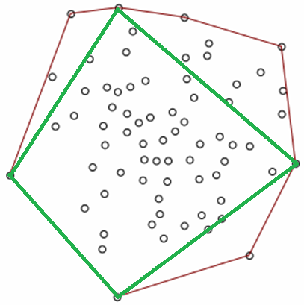
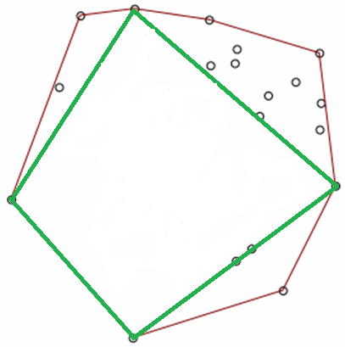
Quick Hull Algorithm
https://www.youtube.com/watch?v=3fQt5-JgNz0
Quick hull + Andrew’s

