Slide 1
Web Scraping Project: Gaming Mice on Newegg

Slide 2
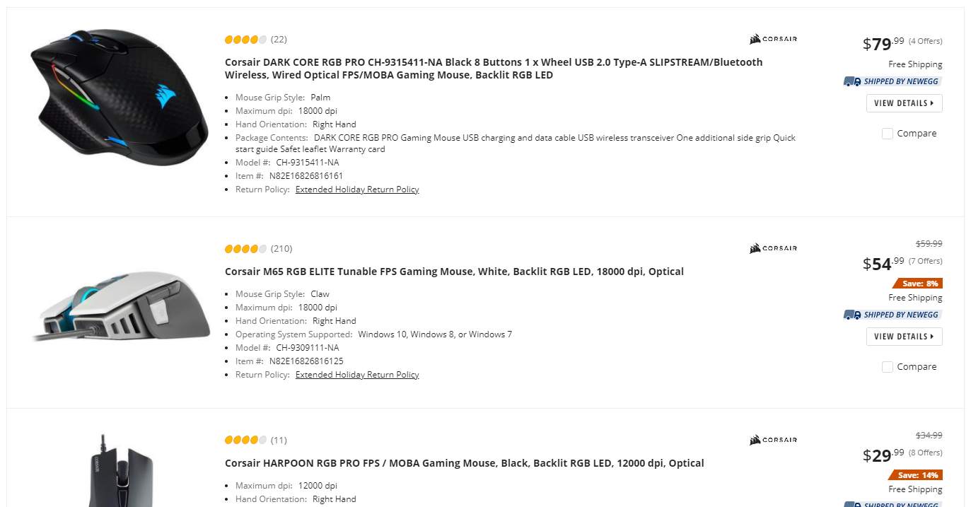
Web Scraping
The data was scraped from Newegg ~2 years ago.
This project specifically looks at new, right-handed gaming mice that ship from the U.S.
The fields scraped are:
Brand
Product Name
Model
Grip Style
Maximum DPI
Buttons
Connection Type
Color
Average Review Rating (1-5 Stars to the nearest star)
Number of Reviews
Price

Slide 3
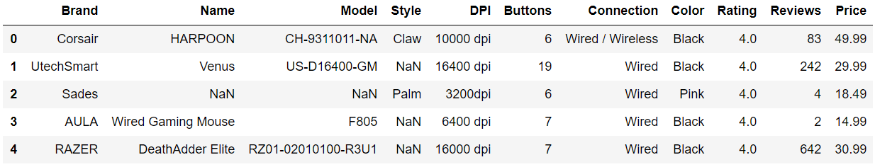
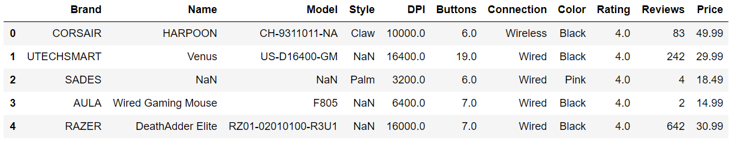
Cleaning Up Data
Notes:
Capitalize brand name
Change DPI to float
Connection, wireless/wire is considered wireless

Slide 4
Motivation
Research Question
What does the current gaming mouse market look like and what features make a gaming mouse more popular and/or highly rated.
Disclaimer: Do not have data on units sold or profit margin of mouse. Use number of reviews as a proxy metric for popularity.
Target Audience
Gaming mouse designers/manufacturers.
Can be useful in terms of gauging competitors as well as general market.
Finding out the customer base’s desirable features in the product.
Notes:
A higher rated or more popular product does not necessarily mean the company makes more money off of it.

Slide 5
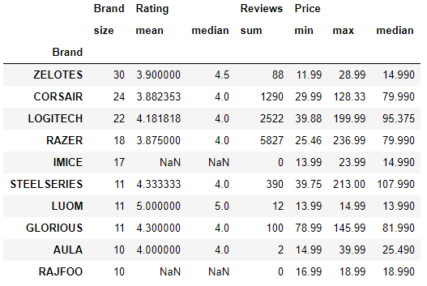
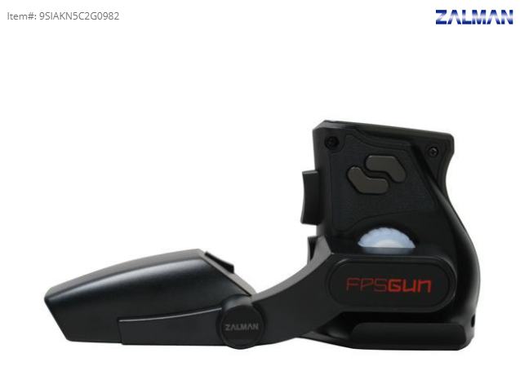
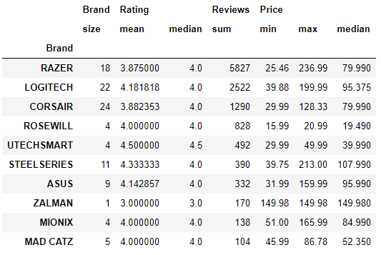
Brand
5 out of the top 10 brands with the most products only produces lower price range mice, with the max price for each product not exceeding 40 dollars and median price for all products not exceeding 30 dollars.
Despite having the most products, none of the 5 “lower price range” brands are in the top 10 most reviewed list. Out of the remaining 5, 4 are also in the top 10 most reviewed brands.
The top 10 brands with the most reviews, with the exception of 2, all have a mean rating of around 4 stars and a median of 4 stars.
Notes:
Can see that these brands that just pump out low end products are not very popular at all which is kind of ironic.
Brands with most products/reviews all tend to have good ratings of at least 4 stars. Exception is gun mouse which makes sense that it has a lot of reviews since it’s so unique.

Slide 6
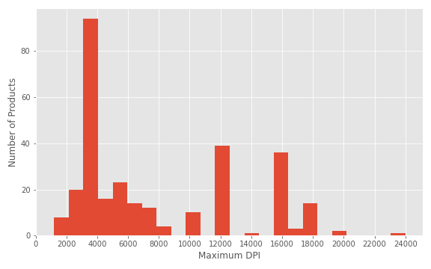
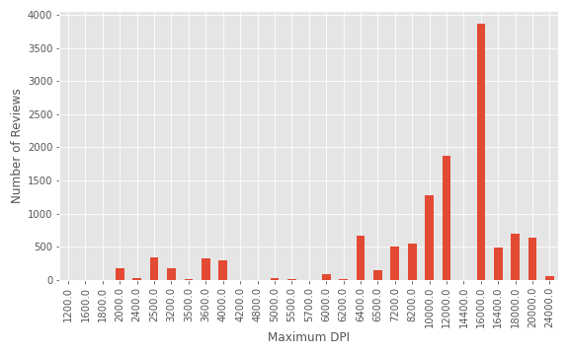
Maximum DPI
Most maximum DPIs are between 3000-4000 (specifically 3200 and 4000).
Specific DPIs are likely established cutoff points and thus occur much more frequently than others. These include 3200, 4000, 12000 and 16000.
Most popular DPI is 16000, followed by 12000 and 10000. It appears for most gamers, 16000 would be the highest they need.

Slide 7
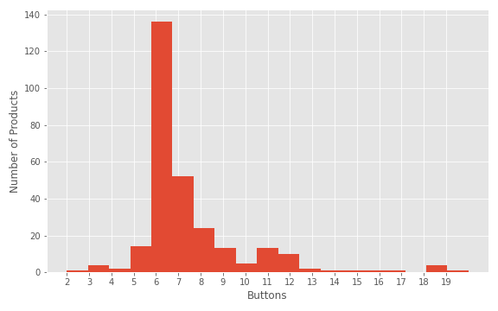
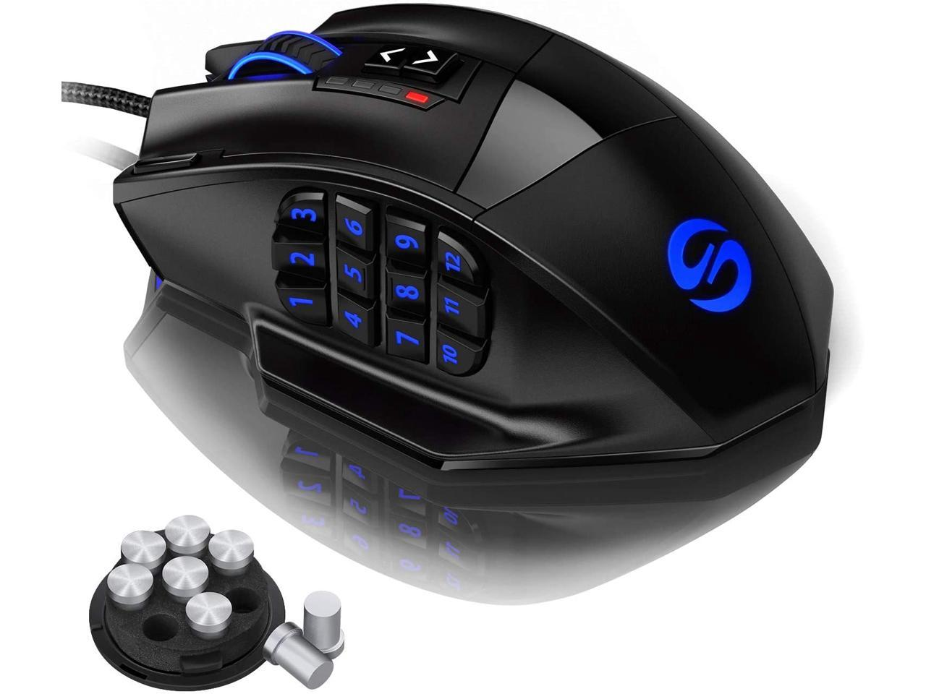
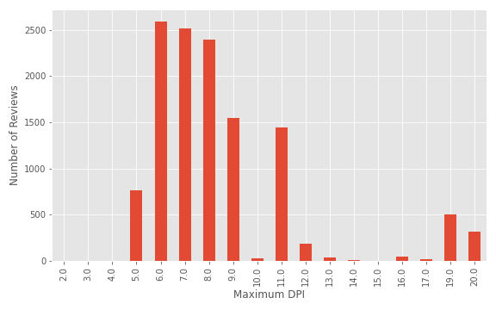
Number of Buttons
Almost half of the mice have 6 buttons.
The number of products generally decreases as the number of buttons increases but there is increase at 11/12 buttons and 19/20. This is likely due to these mice being a specific type (MMO).
From looking at the number of reviews, 6-11 buttons (with the exception of 10) are all very popular. There is little popularity for 12-17 but surge in popularity for 19 - 20.

Slide 8
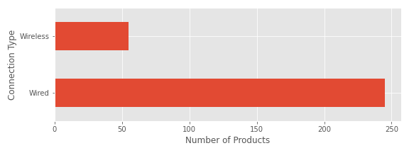
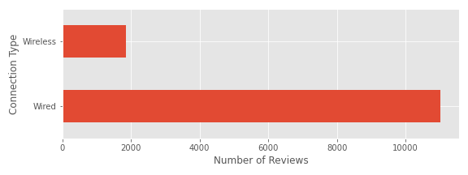
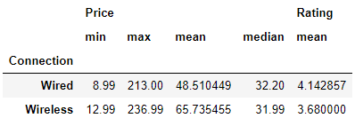
Connection Type
Around 80% of the gaming mice use wired connection. Only 20% have wireless capabilities. Popularity is similar, with wireless mice only having 20% of the number of reviews as wired.
Mean rating is slightly higher for wired mice over wireless.
Findings make sense since for gaming purposes, wired mice are considered better due to faster response time, less connectivity issues and do not have extra battery weight or need to charge.
The min, max and mean price for wireless mice are all higher than wired, but not the median price.

Slide 9
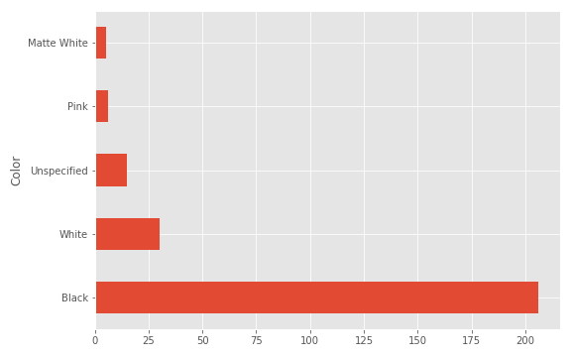
Color
224 out of 293 products are black or partially black.
Second highest color is white and only has 35 products (including Matte White).
This is likely simply due to current design trend. Most PC products are black, such as desktop cases, keyboards and monitors. Black mice are a safe bet to go with most systems.
Previously most computer products were white/beige but trend died out.
Apple products tend to be silver/chrome, but Apple computers generally cannot run games, so it makes sense that the aesthetics of gaming mice align with that of PC.

Slide 10
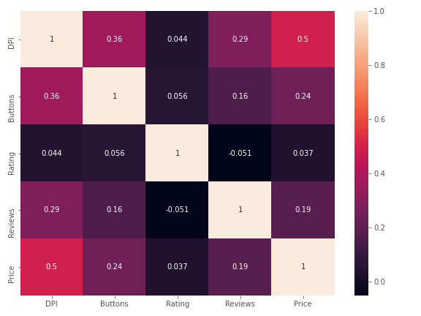
Correlation Matrix

Slide 11
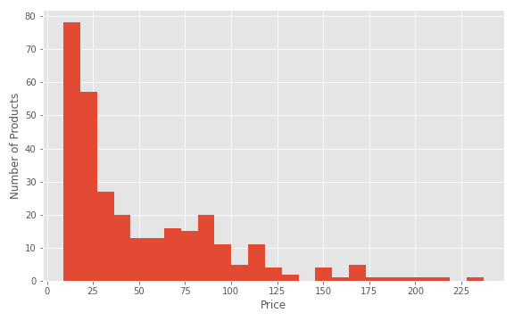
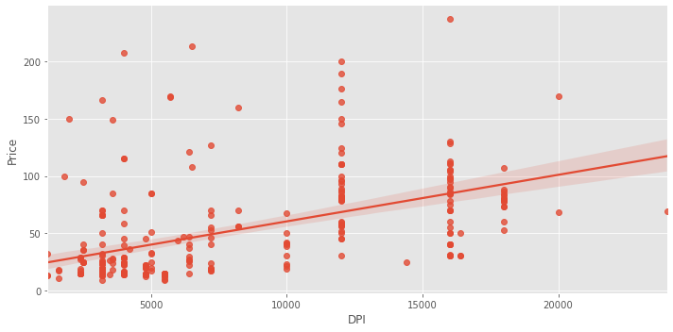
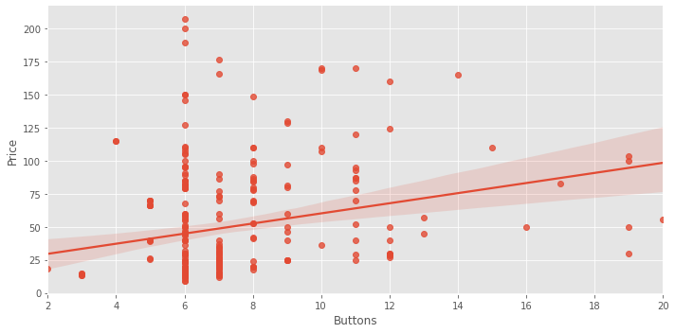
Price
153 out of 308 mice are below $30.
Generally positive correlations between DPI/Buttons to Price.
Based on correlation matrix, the DPI can be considered moderately correlated to Price where Buttons, Reviews and Rating have low or essentially no correlation.

Slide 12
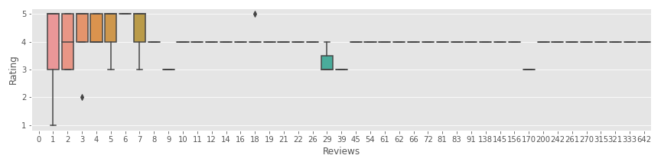
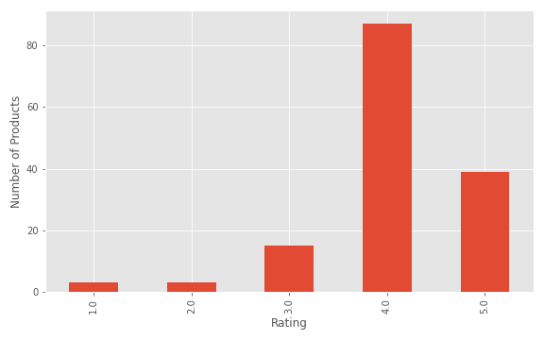
Rating
126 out of 147 products are rated 4 stars and above. It appears that much more often than not, customers are satisfied with the product they purchased.
More than half of the products are not rated by anyone. Products with lower number of reviews have more variation in the rating. For products with more than 45 reviews, only 1 product (the gun mouse) didn't have a rating of 4 stars.
Very small observed correlation between DPI/Buttons to Rating. This makes sense since people know what the features of the mouse they are buying are, so it would be strange to give a poor rating based on the customer's own decision of DPI and number of buttons.
Based on correlation matrix, it appears that the DPI, Buttons, Reviews and Price all have low or essentially no correlation with Rating.

Slide 13
Conclusion
126 out of 147 products are rated 4 stars and above. It appears that much more often than not, customers are satisfied with the product they purchased.
More than half of the products are not rated by anyone. Products with lower number of reviews have more variation in the rating. For products with more than 45 reviews, only 1 product (the gun mouse) didn't have a rating of 4 stars.
Very small observed correlation between DPI/Buttons to Rating. This makes sense since people know what the features of the mouse they are buying are, so it would be strange to give a poor rating based on the customer's own decision of DPI and number of buttons.
Based on correlation matrix, it appears that the DPI, Buttons, Reviews and Price all have low or essentially no correlation with Rating.

Slide 14
Other Factors/Future Work
Rating is to the nearest star, not very good resolution. Would also like to scrape individual ratings instead of by product. This way we can observe the total distribution of ratings.
Significant factors not looked at in project:
One of the biggest contributing factors is most likely RGB, but difficult to extract whether or not product has RGB.
Aesthetics. More "gamer" or futuristic aesthetics vs basic or more sleek designs. Secondary color.
Ergonomics/type of the mouse. For example there are mice that are vertical or are in the form factor of a gun.
Weight adjustability.

