Slide 1
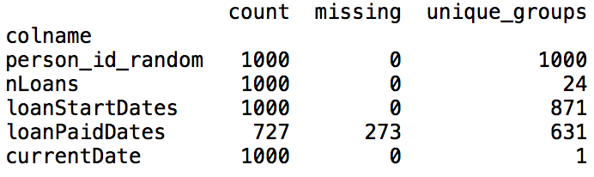
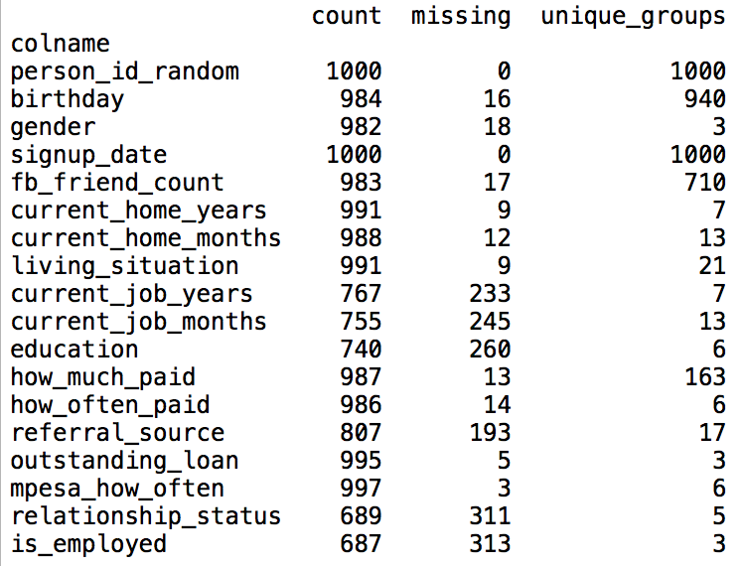
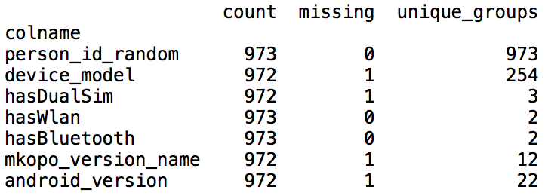
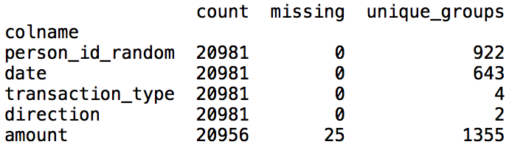
Review – Datasets
Repayment.csv
People.csv: loan application survey questions
Device.csv
Mpesa.csv

Slide 2
Question
Choose a statistical approach that will give you insight into our new customer acquisition strategy, based on the likelihood of repayment. Describe and develop variables related to our marketing optimization.

Slide 3

Question
Approach: logistic regression
Dependent variable:
Repayment: whether a borrower would repay his/her first loan;
Input variables:
(1) | gender | categorical | 2 levels
(2) | living_situation | categorical | 4 levels
(3) | education | categorical | 4 levels
(4) | how_much_paid | numerical
(5) | is_employed | categorical | 3 levels
(6) | age | numerical
(7) | hasWlan | binary | 2 levels
(8) | andrVer | categorical | 3 levels

Slide 4
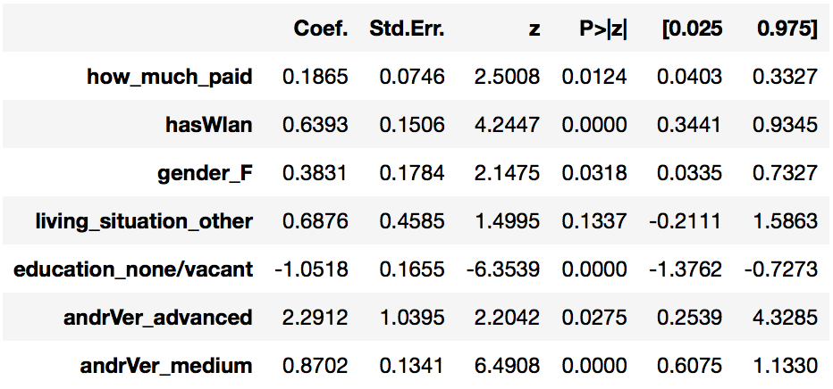
Question
Findings:
What drives the increase of repayment likelihood:
Higher android version
Female
Larger how_much_paid
Device has Wlan
What drives the decrease of repayment likelihood:
Unstated education
Unstated whether is currently employed
Summary of model after feature selection:

Slide 5
Based on the analysis, what Facebook targeting fields should we leverage to maximize our repayment outcomes? What else can you recommend to the business based on your results?

Slide 6
Question
Purpose:
To maximize repayment outcomes, we should analyze each customer’s life-time-value (LTV) instead of their likelihood of repayment in question 2.
Define target:
Life-Time-Value (LTV): whether a customer has a high LTV, binary variable;
High LTV Customer: high frequency or large historical number of loans;
Low LTV Customer: early-stage default, low frequency, small historical number of loans;
LTV is labeled based on several rules:
Rule 1: if a customer defaults within the first 3 loans, we label he/she as Low LTV Customer;
Rule 2: if a customer never defaults but has no more than 3 loans, remove the record since LTV is unclear;
Rule 3: if the median of loan intervals of a customer is within 5 weeks, label he/she as High LTV Customer;
Rule 4: if a customer has over 10 historical loans, label he/she as High LTV Customer, no matter he/she eventually defaults or not.

Slide 7
Question
Approach: logistic regression
Dependent variable:
Life-Time-Value (LTV): whether a customer has a high LTV, binary variable;
Input variables:
(1) | gender | categorical | 2 levels
(2) | living_situation | categorical | 4 levels
(3) | education | categorical | 4 levels
(4) | how_much_paid | numerical
(5) | is_employed | categorical | 3 levels
(6) | age | numerical
(7) | hasWlan | binary | 2 levels
(8) | andrVer | categorical | 3 levels

Slide 8
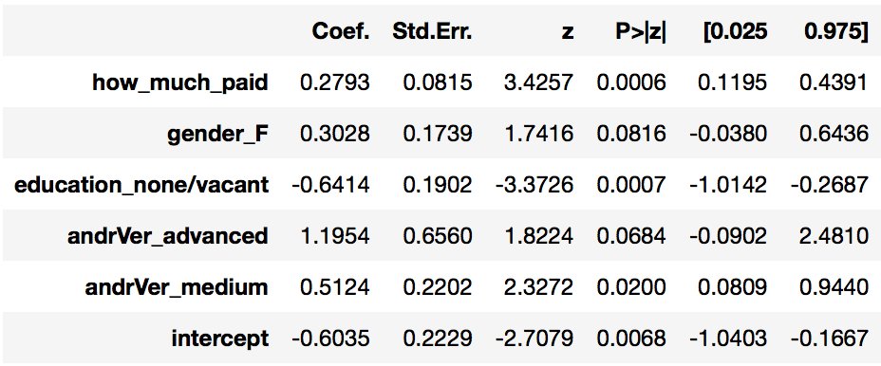
Question
Findings:
What drives the increase of High LTV likelihood:
Higher android version
Female
Larger how_much_paid
What drives the decrease of High LTV likelihood
Unstated education
Unstated whether is currently employed
Highlights:
Both LTV and Repayment are measures of a customer’s repaying performance;
Their correlation is only 0.62, but we get very similar findings on what drive better/worse performance;
Convincing as they support and validate each other;
Summary of model after feature selection:

Slide 9
Recommendation – User Acquisition
According to model results in analyzing LTV and Repayment, marketing and user acquisition on Facebook should focus on:
Devices with higher android version;
Female customers;
Customers with higher incomes;
Customers with clear employment status and education history;
Build referral program:
If a new customer was referred by any source, he/she is very likely (83%) to repay the first loan;
Target customers with more frequent financial activities:
Using Mpesa data, we identify that on average high LTV customers transact more frequently;
Target customers with stable relationship status:
Married people have better repayment as they are more likely to have stable financial condition;

Slide 10
Recommendation – Loan Application & Product
Set up some simple rules during the loan application process;
For example, the credit system should reject the loan application if it fails to collect enough device information.
Build out more flexible and customized loan plans (products) for customers;
Customers with a few historical loans demonstrate their need of loans;
They churn (with a default or not), potentially looking for other peer loan products on the market;
Potentially useful products to help with user retention include (not limited to):
Set up a credit line (with a slightly higher interest rate), instead of repaying all the amount before making a new loan; it helps retain high LTV customers as they transact more frequently;
Add more plans in addition to ‘three weekly repayments’; for example, one monthly repayment would be more appealing as there might be a seasonality effect that customers need loans to pay for monthly bills like house-rent according to ‘signup_date’ field in Data Quality Report (DQR);

