Slide 1

Search
Check-in
Current
Confirm
My Location

Slide 2




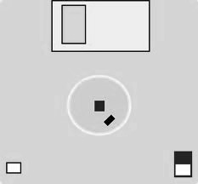

Slide 3
Check-in

Slide 5
Restaurant Name
Noodles
Rice
Price
Hot Pot
Seats
Types
Rice Dumpling
Telephone
Address

Slide 6


Slide 7


Slide 8
Do you have a class later?
How many minutes do you have eat?

