Slide 1


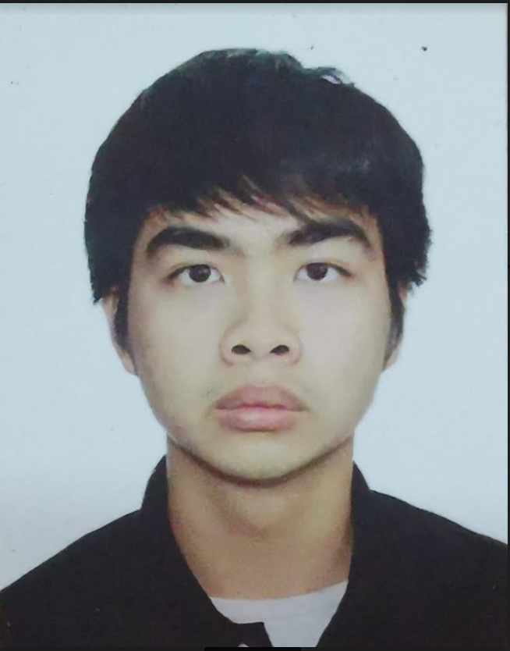
CZ4062 Computer Security
Lee Cheng Han U1920206L

Slide 2
Outline
Case Study 1 - Facebook
Case Study 2 – Blaster Worm

Slide 3
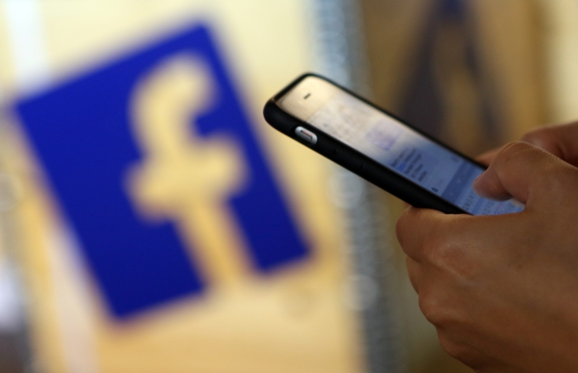
facebook data breach
50 million users
Vulnerability was first introduced in July 2017
Facebook discovered it in September 2018
User profile’s page information was stolen

Slide 4

How did the bug occur
Contact importer feature and password reset mechanism
Gain access to user ID, address, phone number, email address, names of workplaces, DOB etc

Slide 5
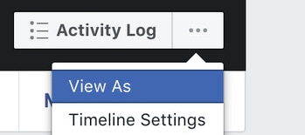

Slide 6
View As
Upload Video
Access Tokens
Blocks out any ability to enter text into compose boxes
Attackers able to upload video while using this feature
Able to use one account to access into several different services or apps

Slide 7
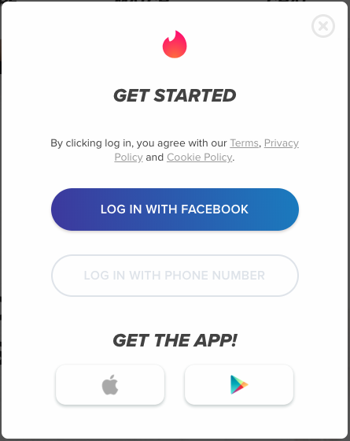
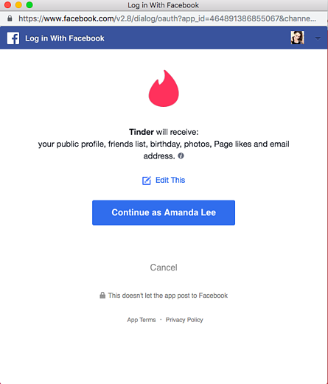
3rd party apps
Allows users to log into app using Facebook credential
Access token provides 3rd party with Facebook’s data
Available on HTML of the page

Slide 8
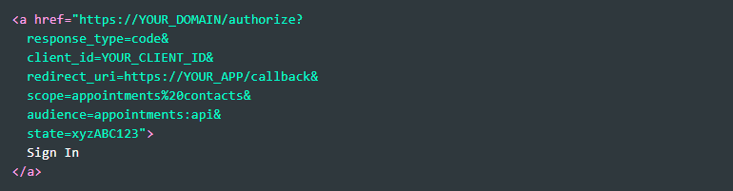
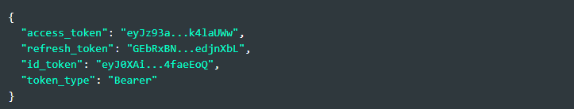
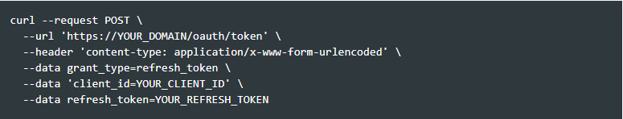
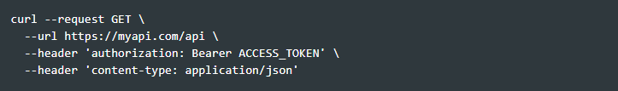
Authorization code flow
Authorize user: Request the user’s authorization and redirect back to your app with an authorization code.
Request tokens: Exchange authorization code for tokens.
Call APIs: Use the retrieved Access Tokens to call API.
Refresh tokens: Use a Refresh Token to request new tokens when the existing ones expire.

Slide 9
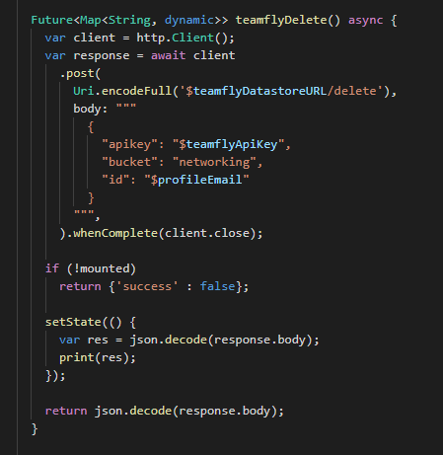
Code analysis
Javascript code
Scripting Vulnerabilities

Slide 10
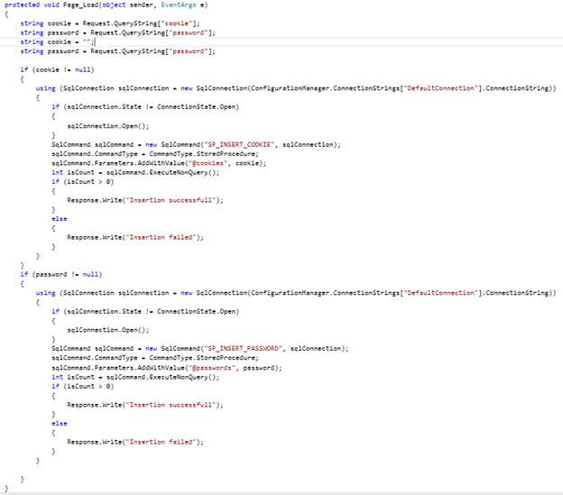
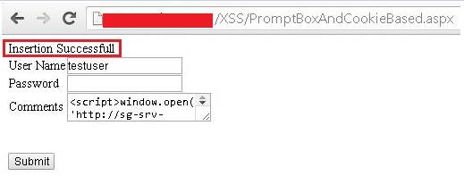

Slide 11
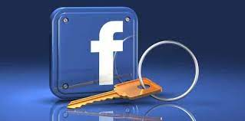
Password reset

Slide 12
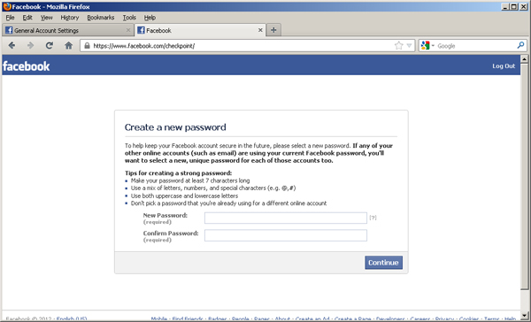
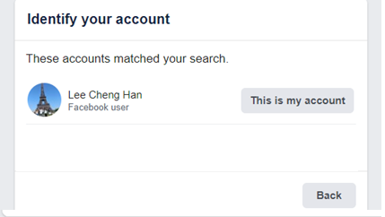
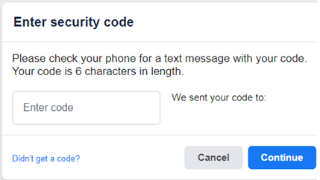
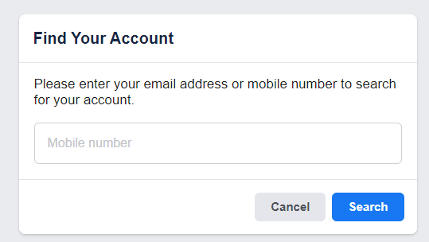
Password reset vulnerability
User could change password without entering current password
Brute force algorithm was applied

Slide 13
How to overcome it
Prevent stealing of tokens
Encoding HTML tags
Bug Bounty

Slide 14
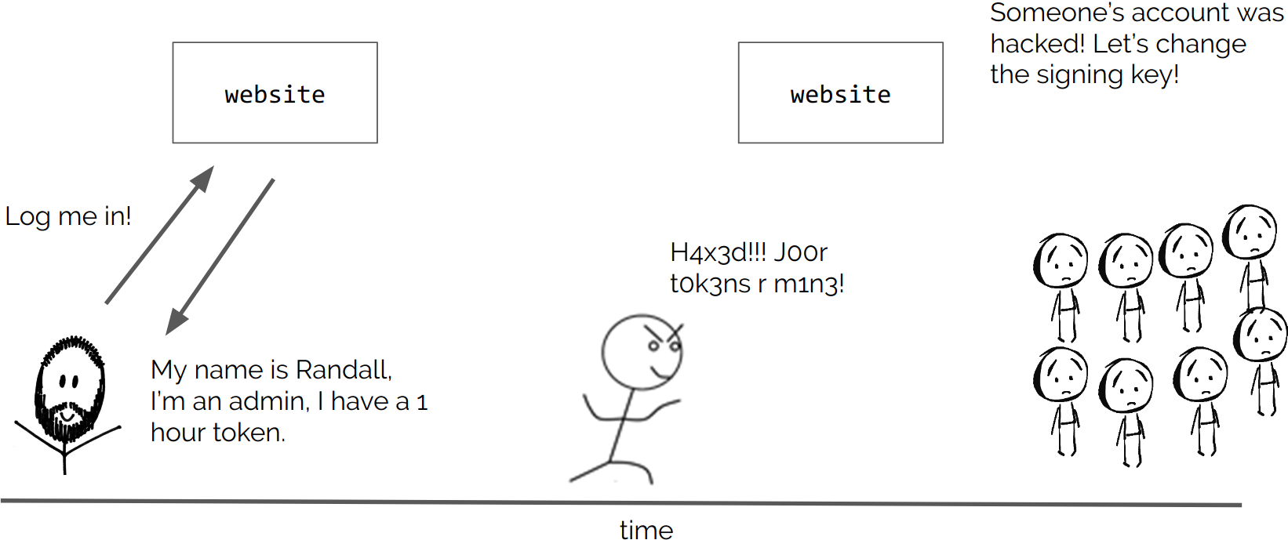
Prevent stealing tokens
Detection
Access Control List
Protected Process Light

Slide 15
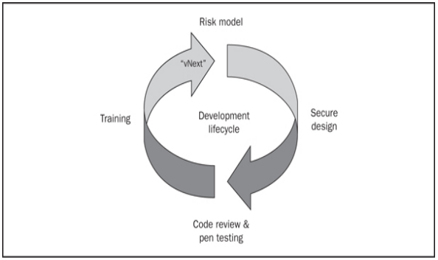
Detection
An access control list (ACL) is a list of access control entries (ACE).
Each ACE in an ACL identifies a trustee and specifies the access rights allowed, denied, or audited for that trustee.
The security descriptor for a securable object can contain two types of ACLs: a DACL and a SACL.

Slide 16
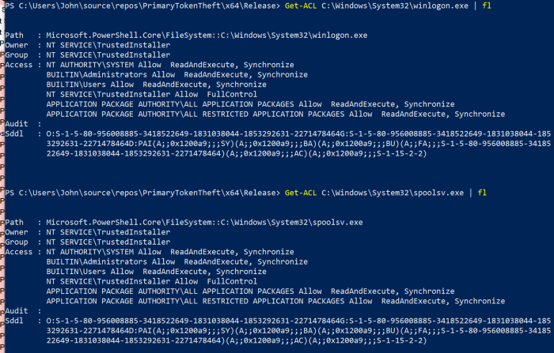
System access control lists (SACL)
Process objects to log successful/failed access attempts to the Windows Security Log
Get-ACL in PowerShell will look at the security descriptor
Mismatch in Username and Ownername
TOKEN_USER and TOKEN_OWNER

Slide 17
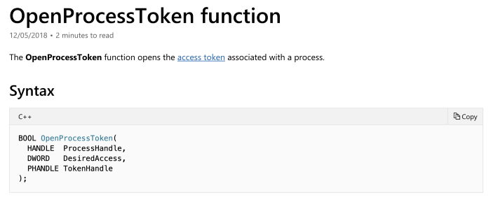
Open process token
Takes in Process handle and Access rights flag
Access denied as not TOKEN_OWNER
Protected Process Light fix issue

Slide 18
Protected process Light
The following SYSTEM processes, with Protected Process Light, can have their access token
csrss.exe
Memory Compression.exe
services.exe
smss.exe
wininit.exe

Slide 19
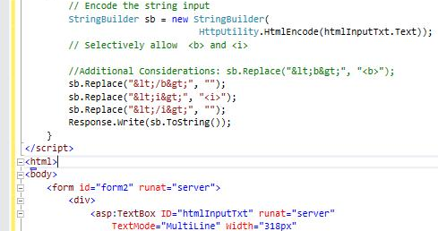
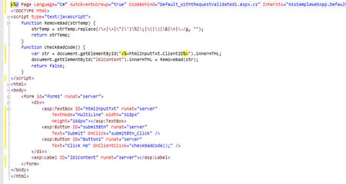
Encoding html tags
Use a StringBuilder and call the Replace method to selectively remove the encoding on the HT
Write a Regular Expression to replace HTML tags by replacing its encode characterML elements that you want to permit.

Slide 20
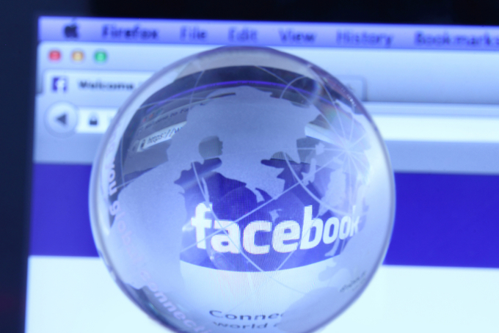
Bug bounty
Researcher earn USD$15000 for exposing a security hole
Encourage developers to report finding with monetary incentive.

Slide 21
Consequence of the bug
533 million Facebook users’ information including account creation date, bio, birthdate, Facebook IT, full name, location and relationship status.
419 million records containing user IDs and phone numbers were also leaked.
Database on open internet including 267 million Facebook users.

Slide 22
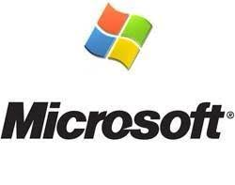
Blaster worm

Slide 23
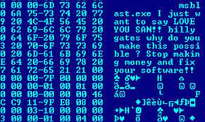
Blaster worm
Virus program that mainly targeted Microsoft platforms in 2003
Attack computers by exploiting a security flaw with Microsoft remote procedure call using TCP 135

Slide 24
How did the bug occur
Exploit a known vulnerability in Microsoft’s DCOM RPC (TCP Port 135)
Worm attempts to retrieve a copy of the file msblast.exe from the compromising host
Once this file has been retrieved it is executed and the compromised system begins scanning for vulnerable systems to compromise in the same manner.
A remote shell backdoor that listens on TCP port 4444 is also installed, allowing an attacker to issue remote commands to the compromised system.

Slide 25
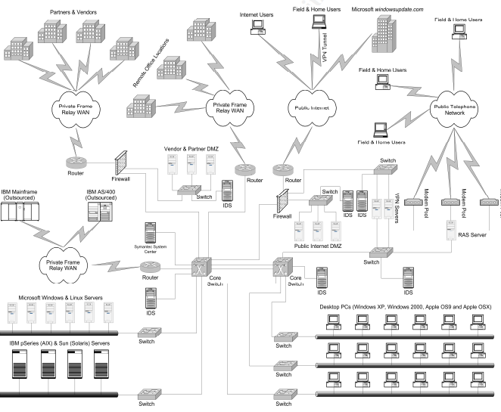
Local and wide area network

Slide 26
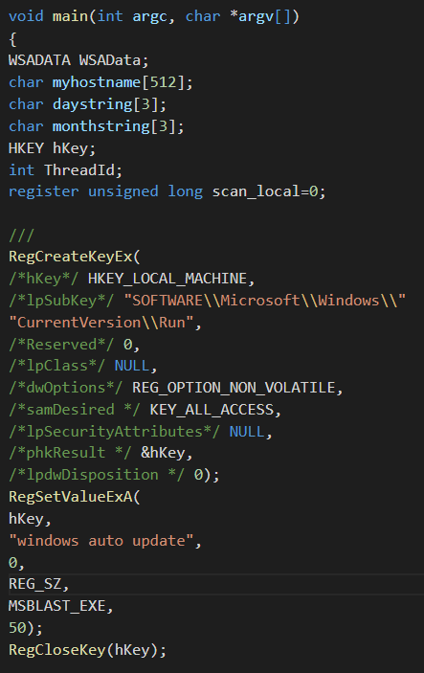

Buffer overflow exploit
Creates a registry key that will cause this worm to run every time the system restarts
Ensure the victim does not get re-infected by creating global object “BILLY”

Slide 27


Buffer overflow exploit
Worm will read itself from disk by dynamically through function call
Easier to launch attack
Worm’s network communication will cause popups for users
Ensures an internet connection is established before launching attack

Slide 28
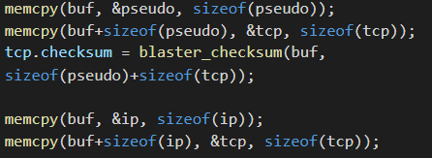
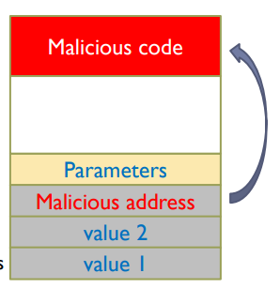
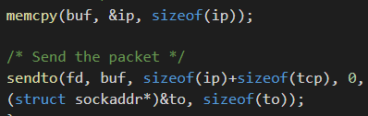
Buffer overflow exploit
Calculate TCP checksum
Copy the header
Send the packet
Stack smashing

Slide 29
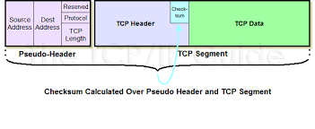
TCP checksum

Slide 30
How to overcome the bug
Antivirus
Internet Connection Firewall

Slide 31
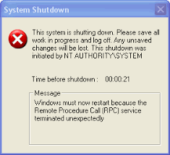
Anti-virus
File name is Msblast.exe, Nstask32.exe, Teekids.exe, Winlogin.exe, Win32sockdrv.dll, or Yuetyutr.dll in Windows\System32 folder
Updated patch whenever available
Detect, quarantining and/or deleting malicious code, to prevent malware from causing damage to your device.
Updates themselves automatically, to provide protection against the latest viruses and other types of malware.

Slide 32
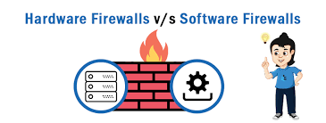
Internet connection firewall
Security devices used to stop or mitigate unauthorized access to private networks connected to the Internet
Hardware firewalls: These firewalls are released either as standalone products for corporate use, or more often, as a built-in component of a router or other networking device.
Software firewalls: These are installed on a computer or provided by an OS or network device manufacturer.

Slide 33
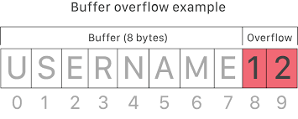
Consequence of the bug
Buffer overflow causes the RPC service to crash, leading automatically reboot
Causes instability in the RPC service
Affected more than 100,000 Microsoft computers
Affected operating systems included Windows XP, Windows NT 4.0, and Windows 2000

Slide 34

THANK YOU

