Slide 1
Solving Poisson Equation Parallelly using Finite Element Method
Cheng-Hau Yang
Dept. of Mechanical Engineering
Iowa State University

Slide 2

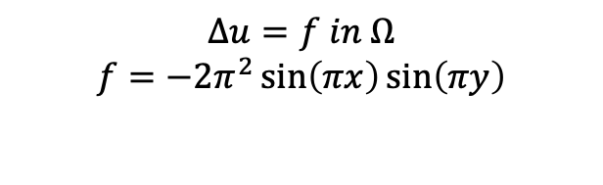




Problem Setup
$$u=0$$
$$∆u=f in Ω$$
$$f=−2π^{2}\sin\left(πx\right)\sin\left(πy\right)$$
$$u=0$$
$$u=0$$
$$u=0$$
$$Exact solution: u=\sin\left(πx\right)\sin\left(πy\right)$$

Slide 3
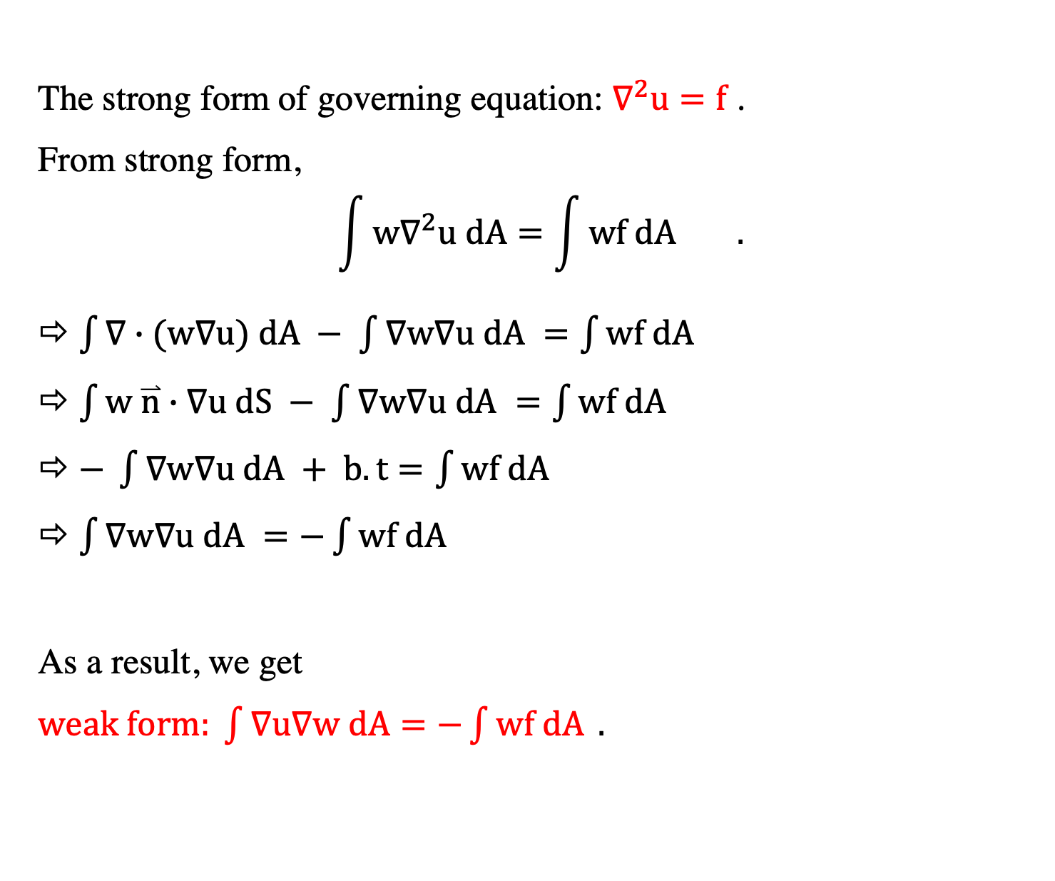
Weak Form
The strong form of governing equation: $∇^{2}u=f$ .
From strong form,
$$\int{{w∇}^{2}u dA=\int{wf dA}} .$$
$\int{∇∙(w∇u) dA − \int{∇w∇u dA }=\int{wf dA}}$
$\int{w \overset{⃑}{n}∙∇u dS − \int{∇w∇u dA }=\int{wf dA}}$
$− \int{∇w∇u dA }+ b.t=\int{wf dA}$
$\int{∇w∇u dA }=−\int{wf dA}$
As a result, we get
$weak form: \int{∇u∇w dA=−\int{wf dA} }.$

Slide 4
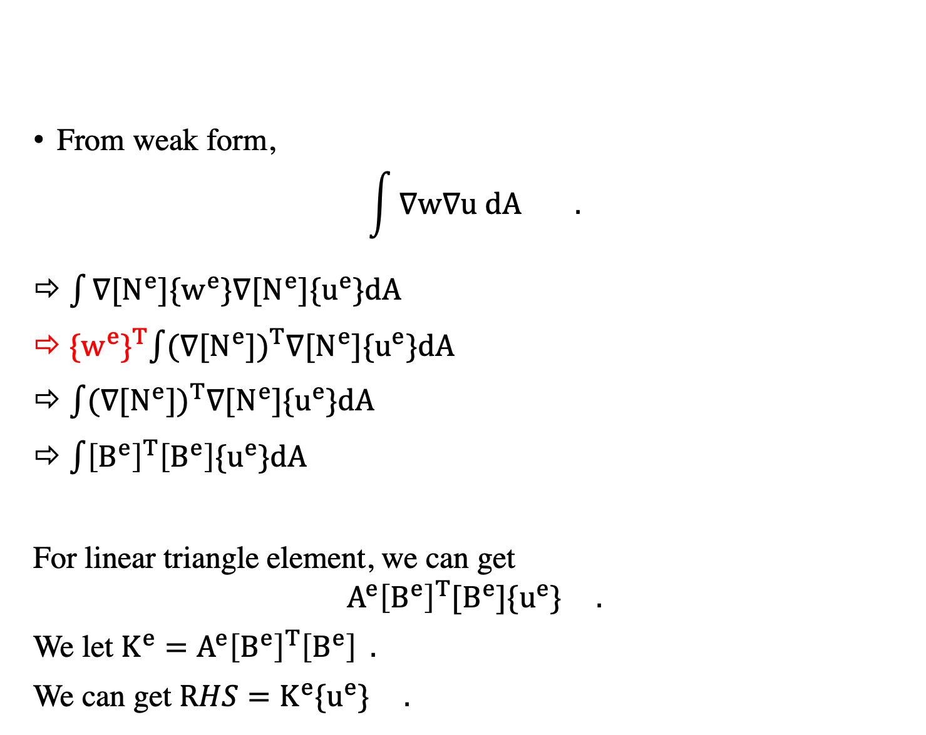
Linear triangle element: LHS ($K^{e}$: local stiffness matrix)
From weak form,
$$\int{∇w∇u dA} .$$
$\int{∇[N^{e}]\{w^{e}\}∇[N^{e}]\{u^{e}\}dA}$
${\{w^{e}\}}^{T}\int{{(∇[N^{e}])}^{T}∇[N^{e}]\{u^{e}\}dA}$
$\int{{(∇[N^{e}])}^{T}∇[N^{e}]\{u^{e}\}dA}$
$\int{{\left[B^{e}\right]}^{T}\left[B^{e}\right]\{u^{e}\}dA}$
For linear triangle element, we can get
$${A^{e}\left[B^{e}\right]}^{T}[B^{e}]\{u^{e}\} .$$
We let $K^{e}={A^{e}\left[B^{e}\right]}^{T}\left[B^{e}\right] .$
We can get $RHS=K^{e}\{u^{e}\} .$
Cancel with RHS
temp_Ke = matrix_mult_transpose(&Be, &Be);
Ke = scale_matrix(&temp_Ke, Area);

Slide 5
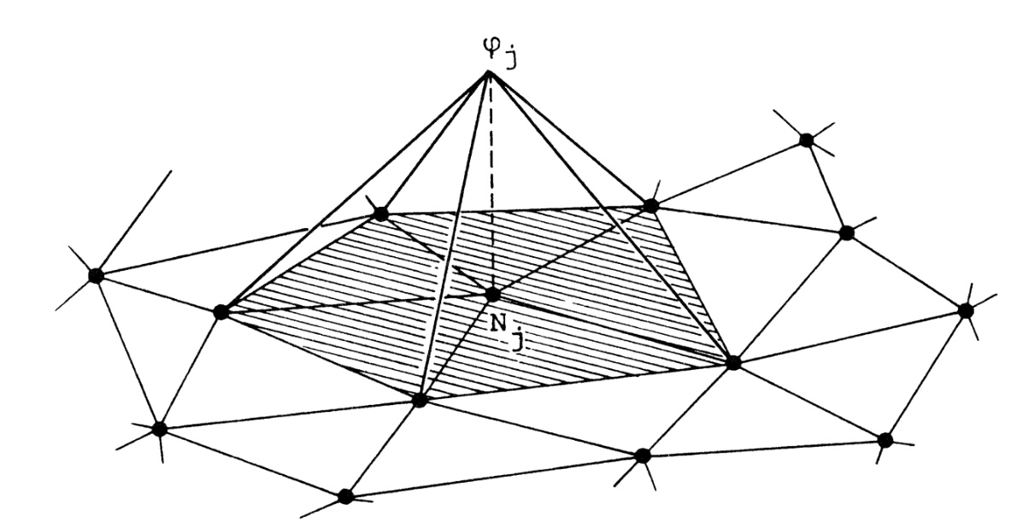
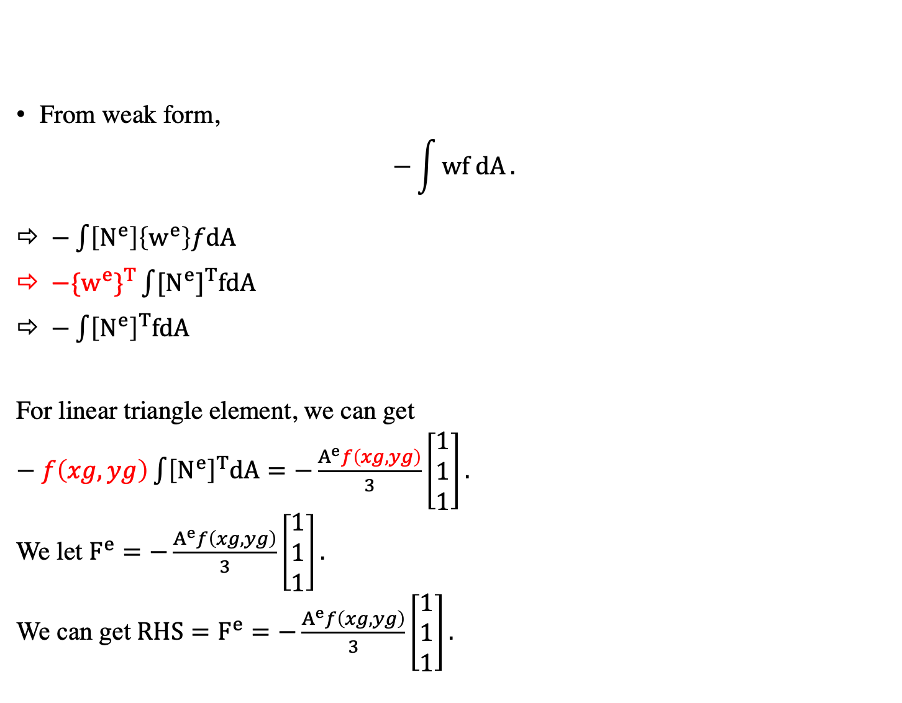
Linear triangle element: RHS ($F^{e}$: local force vector)
From weak form,
$$−\int{wf dA}.$$
$−\int{\left[N^{e}\right]\left\{w^{e}\right\}fdA}$
${−\{w^{e}\}}^{T}\int{{[N^{e}]}^{T}fdA}$
$−\int{{\left[N^{e}\right]}^{T}fdA}$
For linear triangle element, we can get
$− f\left(xg,yg\right)\int{{\left[N^{e}\right]}^{T}dA}=−\frac{A^{e}f\left(xg,yg\right)}{3}\left[\begin{aligned}1 \\ 1 \\ 1\end{aligned}\right].$
We let $F^{e}=−\frac{A^{e}f\left(xg,yg\right)}{3}\left[\begin{aligned}1 \\ 1 \\ 1\end{aligned}\right].$
We can get $RHS=F^{e}=−\frac{A^{e}f\left(xg,yg\right)}{3}\left[\begin{aligned}1 \\ 1 \\ 1\end{aligned}\right].$
double xg = (mget(Global_Coords, (int)vget(tri_nodes_number, 1), 1) + mget(Global_Coords, (int)vget(tri_nodes_number, 2), 1) + mget(Global_Coords, (int)vget(tri_nodes_number, 3), 1)) / 3;
double yg = (mget(Global_Coords, (int)vget(tri_nodes_number, 1), 2) + mget(Global_Coords, (int)vget(tri_nodes_number, 2), 2) + mget(Global_Coords, (int)vget(tri_nodes_number, 3), 2)) / 3;
double eval_f = 2 * M_PI * M_PI * sin(M_PI * xg) * sin(M_PI * yg);
for (int i = 1; i <= 3; i++)
{
vget(Fe, i) = Area * eval_f / 3;
}
Cancel with LHS
Numerical solution of partial differential equations by the finite element method. Acta Appl Math 18, 184–186 (1990). https://doi.org/10.1007/BF00046566

Slide 6
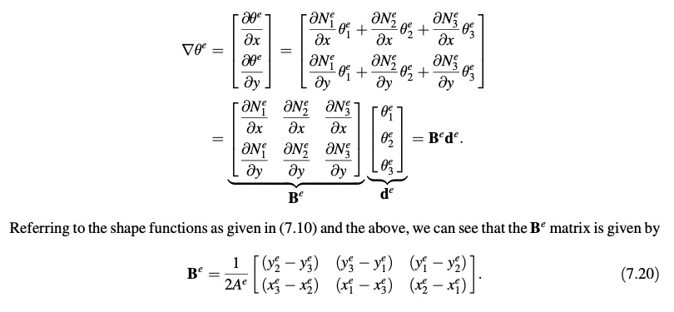
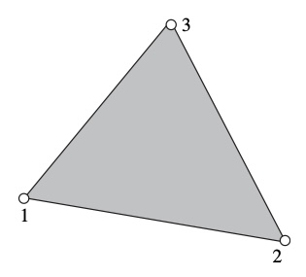
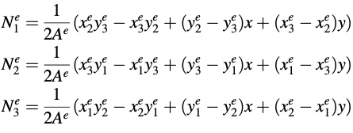
Derivatives of Shape Functions
J. Fish and T. Belytschko, A first course in finite element, John Wiley & Sons, Ltd, West Sussex, UK, 2007.

Slide 7
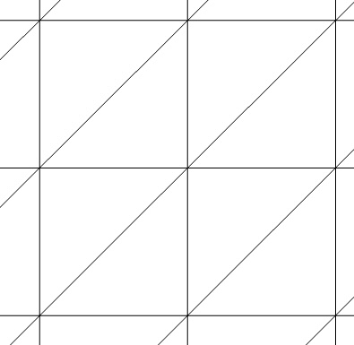

Parallel Procedures
Calculate
In each processor, calculate local Ae and Fe
Assemble
Send from slaves to master to assemble global A and F
Distribute
Distribute global A and F to each processor
Solve
Solve CG
inner product of two vectors: GlobalSum
norm of residual: GlobalSum
matrix-vector product
Visualize
Visualize results from each processor
Output
From each processor calculate the errors and output the L2 norm from master
$$\left[\begin{aligned} \\ \\ \\ \\ \\ \\ \end{aligned}\begin{aligned} \\ \\ \\ \\ \\ \\ \end{aligned}\begin{aligned} \\ \\ \\ \\ \\ \\ \end{aligned}\begin{aligned} \\ \\ \\ \\ \\ \\ \end{aligned}\begin{aligned} \\ \\ \\ \\ \\ \\ \end{aligned}\begin{aligned} \\ \\ \\ \\ \\ \\ \end{aligned}\begin{aligned} \\ \\ \\ \\ \\ \\ \end{aligned}\right]\left[\begin{aligned} \\ \\ \\ \\ \\ \\ \end{aligned}\right]=\left[\begin{aligned} \\ \\ \\ \\ \\ \\ \end{aligned}\right]$$
Save Sparse A

Slide 8
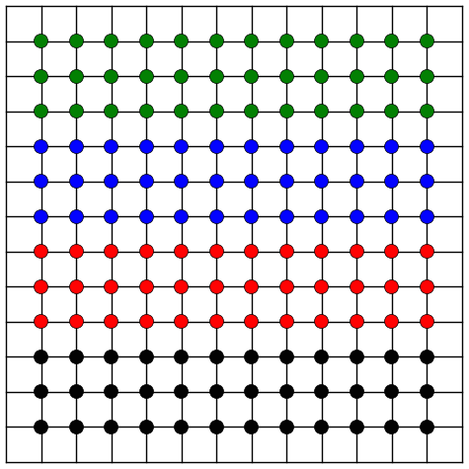
Matrix-vector product
void send_boundary_data2D (const int my_rank, const int comm_sz,
const std::vector<double> &Uold,const int m)
{
const int last_rank = comm_sz - 1;
if (last_rank == 0)
{
return;
}
int old_size = m;
std::vector<double> Utop(Uold.end() - m,Uold.end());
std::vector<double> Ubot(Uold.begin(), Uold.begin() + m);
if (my_rank == 0)
{
MPI_Send(&old_size, 1, MPI_INT, 1, 999, MPI_COMM_WORLD);
MPI_Send(&Utop[0], Utop.size(), MPI_DOUBLE, 1, 999, MPI_COMM_WORLD);
}
else if (my_rank == last_rank)
{
MPI_Send(&old_size, 1, MPI_INT, last_rank - 1, 999, MPI_COMM_WORLD);
MPI_Send(&Ubot[0], Ubot.size(), MPI_DOUBLE, last_rank - 1, 999,
MPI_COMM_WORLD);
}
else
{
MPI_Send(&old_size, 1, MPI_INT, my_rank - 1, 999, MPI_COMM_WORLD);
MPI_Send(&old_size, 1, MPI_INT, my_rank + 1, 999, MPI_COMM_WORLD);
MPI_Send(&Ubot[0], Ubot.size(), MPI_DOUBLE, my_rank - 1, 999,
MPI_COMM_WORLD);
MPI_Send(&Utop[0], Utop.size(), MPI_DOUBLE, my_rank + 1, 999,
MPI_COMM_WORLD);
}
}
J. Rossmanith, Lecture 23: Some MPI Examples, High-Performance Computing
$$\left[\begin{aligned} \\ \\ \\ \\ \\ \\ \end{aligned}\begin{aligned} \\ \\ \\ \\ \\ \\ \end{aligned}\begin{aligned} \\ \\ \\ \\ \\ \\ \end{aligned}\begin{aligned} \\ \\ \\ \\ \\ \\ \end{aligned}\begin{aligned} \\ \\ \\ \\ \\ \\ \end{aligned}\begin{aligned} \\ \\ \\ \\ \\ \\ \end{aligned}\begin{aligned} \\ \\ \\ \\ \\ \\ \end{aligned}\right]\left[\begin{aligned} \\ \\ \\ \\ \\ \\ \end{aligned}\right]=\left[\begin{aligned} \\ \\ \\ \\ \\ \\ \end{aligned}\right]$$
Save Sparse A

Slide 9



Visualization
/// Output Tecplot
FILE *outfiletec = NULL;
char filenametec[256];
sprintf(filenametec, "%s_%d_%d.tec", "output", my_rank, comm_sz);
outfiletec = fopen(filenametec, "w");
fprintf(outfiletec, "%s \n", "Titile = 'Poisson' ");
fprintf(outfiletec, "%s \n", "VARIABLES = X, Y, U, Error, Rank");
fprintf(outfiletec, "zone N= %d, E = %d", NodesPerProc, Local_Nele);
fprintf(outfiletec, "\n");
fprintf(outfiletec, "DATAPACKING=POINT, ZONETYPE=FETRIANGLE");
fprintf(outfiletec, "\n");
for (int i = 1 + NodesAddPerProc * my_rank; i <= NodesAddPerProc * my_rank + NodesPerProc; i++)
{
double Exact = sin(M_PI * mget(Global_Coords, i, 1)) * sin(M_PI * mget(Global_Coords, i, 2));
fprintf(outfiletec, "%25.20e %25.20e %25.20e %25.20e %d\n", mget(Global_Coords, i, 1), mget(Global_Coords, i, 2), u_all[i - 1], fabs(Exact - u_all[i - 1]), my_rank);
}
int find_min_matrix(const matrix *A);
for (int i = 1; i <= Local_Nele; i++)
{
fprintf(outfiletec, "%d %d %d", (int)mget(Local_NodesNum, i, 1) - find_min_matrix(&Local_NodesNum) + 1,
(int)mget(Local_NodesNum, i, 2) - find_min_matrix(&Local_NodesNum) + 1, (int)mget(Local_NodesNum, i, 3) - find_min_matrix(&Local_NodesNum) + 1);
if (i != Local_Nele)
{
fprintf(outfiletec, "\n");
}
}
fclose(outfiletec);

Slide 10
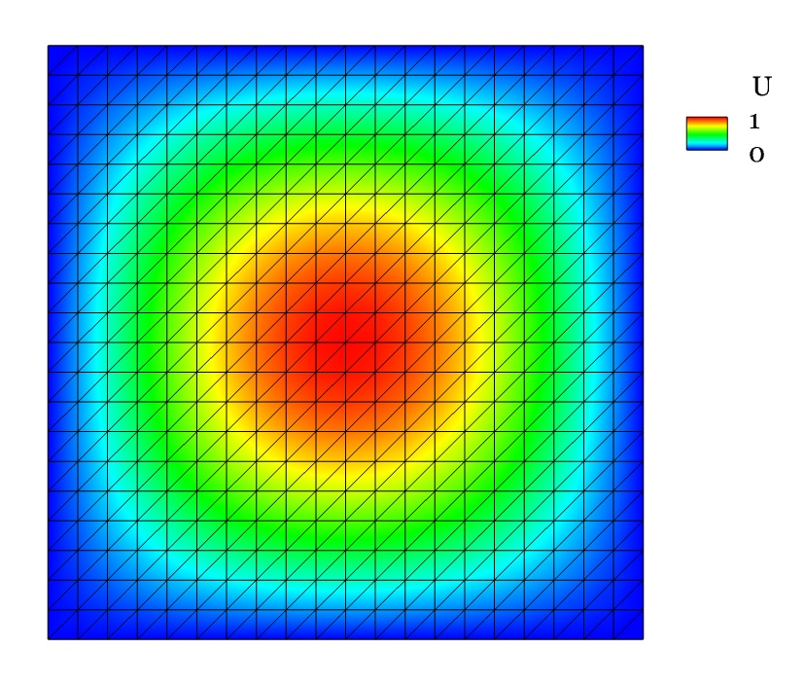
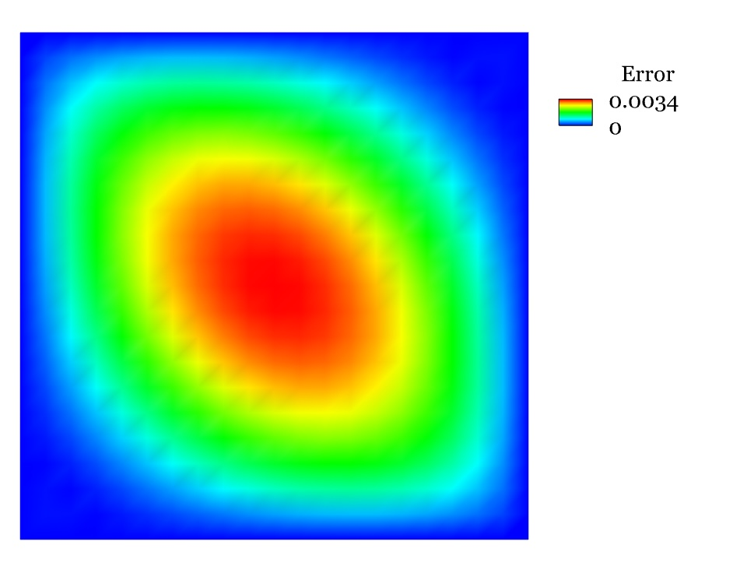
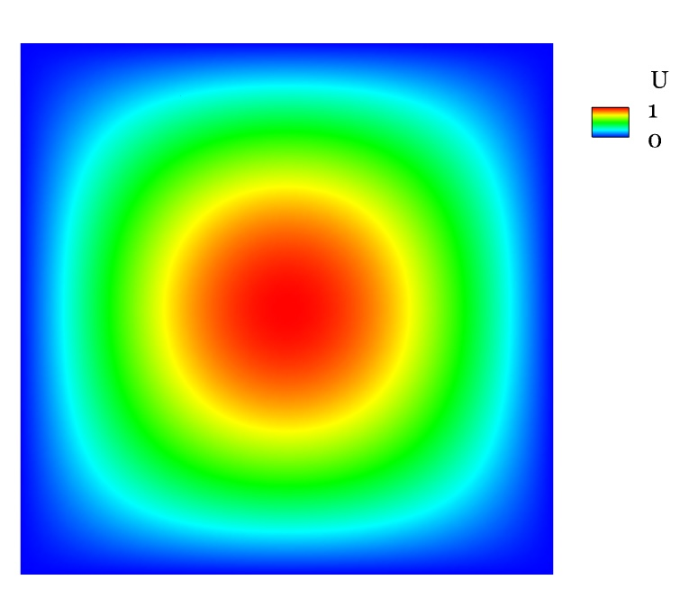
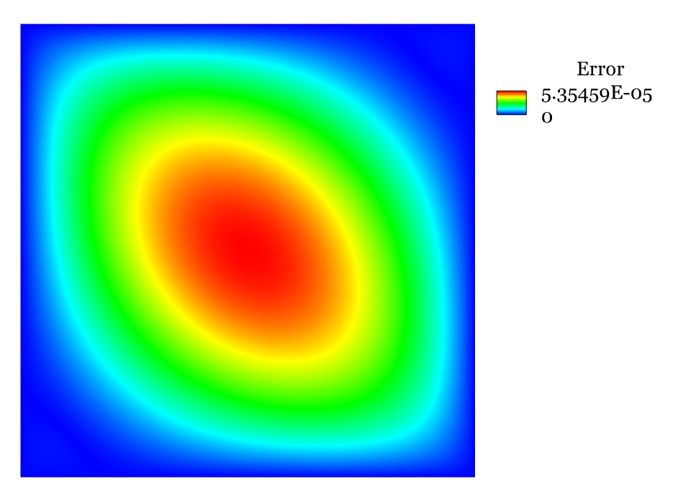
Results
m = 21
m = 161

Slide 11
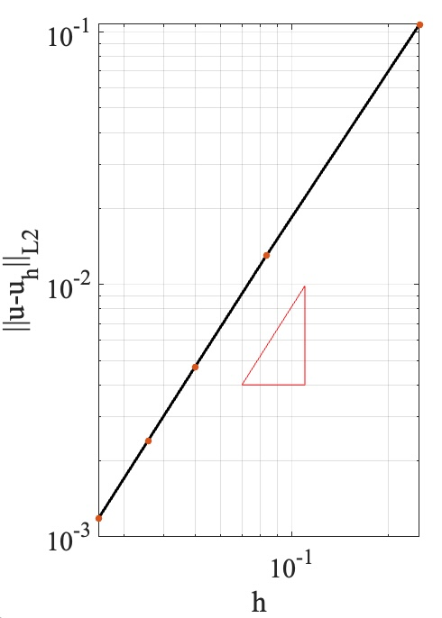
Mesh Convergence Study
h | 1/4 | 1/12 | 1/20 | 1/28 | 1/40
1 | 0.107 | 0.013 | 0.0047 | 0.0024 | 0.0012
2 | 0.107 | 0.013 | 0.0047 | 0.0024 | 0.0012
4 | 0.107 | 0.013 | 0.0047 | 0.0024 | 0.0012
/// calculate L2 norm
double global_error;
double local_error = 0;
for (int e = 1; e <= Local_Nele; e++)
{ // Loop over element
// center point
double xg = (mget(Global_Coords, (int)mget(Local_NodesNum, e, 1), 1)
+ mget(Global_Coords, (int)mget(Local_NodesNum, e, 2), 1)
+ mget(Global_Coords, (int)mget(Local_NodesNum, e, 3), 1)) / 3;
double yg = (mget(Global_Coords, (int)mget(Local_NodesNum, e, 1), 2)
+ mget(Global_Coords, (int)mget(Local_NodesNum, e, 2), 2)
+ mget(Global_Coords, (int)mget(Local_NodesNum, e, 3), 2)) / 3;
double u_exact = sin(M_PI * xg) * sin(M_PI * yg);
double u_numerical=(u_all[(int)mget(Local_NodesNum, e, 1)-1]
+ u_all[(int)mget(Local_NodesNum, e, 2)-1]
+ u_all[(int)mget(Local_NodesNum, e, 3)-1])/3;
double Area = 1 / ((double)m-1) / ((double)m-1) /2;
local_error += Area* (u_exact-u_numerical)*(u_exact-u_numerical);
}
MPI_Reduce(&local_error,&global_error,1,MPI_DOUBLE,MPI_SUM,0,MPI_COMM_WORLD);
2
1

Slide 12

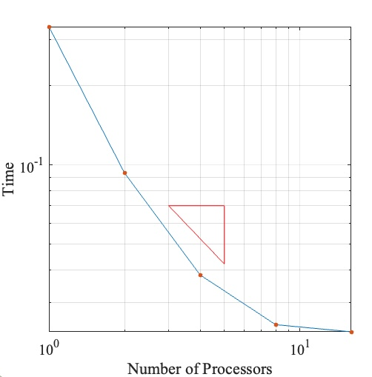
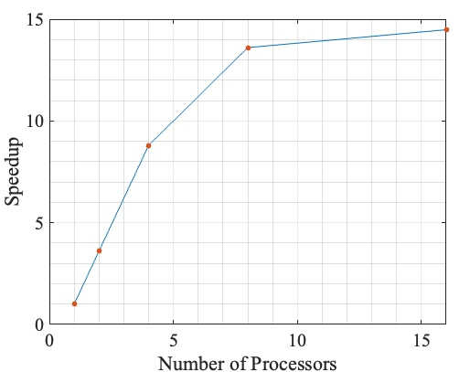
Scalability - 1
Number of Processors | Time | Speedup
1 | 0.336 s | 1
2 | 0.0933 s | 3.6
4 | 0.0382 s | 8.8
8 | 0.0247 s | 13.6
16 | 0.0232 s | 14.5
m = 33
Nodes = 1089
1
1

Slide 13
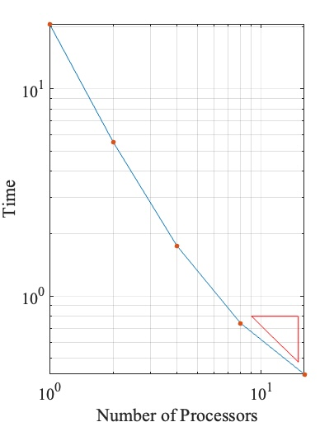
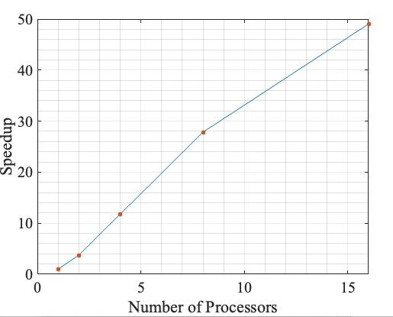
Scalability - 2
Number of Processors | Time | Speedup
1 | 20.6 s | 1
2 | 5.54 s | 3.71
4 | 1.75 s | 11.77
8 | 0.74 s | 27.84
16 | 0.42 s | 49.05
m = 81
Nodes = 6561
1
1

Slide 14
Thank you!

