Slide 1

Gene List Analysis Report
Hint: Each slide has notes that explain the analysis!
http://metascape.org
Please cite Zhou et al. Nature Commun. 2019 10(1):1523
May 1, 2024
Notes:
This analysis report is automatically generated by Metascape (https://metascape.org).

Slide 2
Gene List Summary
Name | Total | Unique | _Color_
down_common_genes | 304 | 304 | #E41A1C
down_epi_only | 275 | 275 | #377EB8
down_mes_only | 438 | 438 | #4DAF4A
down_mes_up_epi | 185 | 185 | #984EA3
up_common_genes | 195 | 195 | #FF7F00
up_epi_only | 159 | 159 | #FFFF33
up_mes_down_epi | 235 | 235 | #A65628
up_mes_only | 295 | 295 | #F781BF
Please check online Metascape User Manual for explanation of each annotation field.
Notes:
Metascape first automatically converts you input identifiers (Entrez Gene ID, RefSeq, Ensembl ID, UnProt ID or Symbol) into Human Entrez Gene ID. For example, input identifiers can be from human, mouse or rat orthologs, which can be mapped into human (or “analysis as” species) based on both EggNOG and Homologene databases.
The background of each row is the color code used in the various plots within this report, where each color is consistently used to code a corresponding gene list.

Slide 3
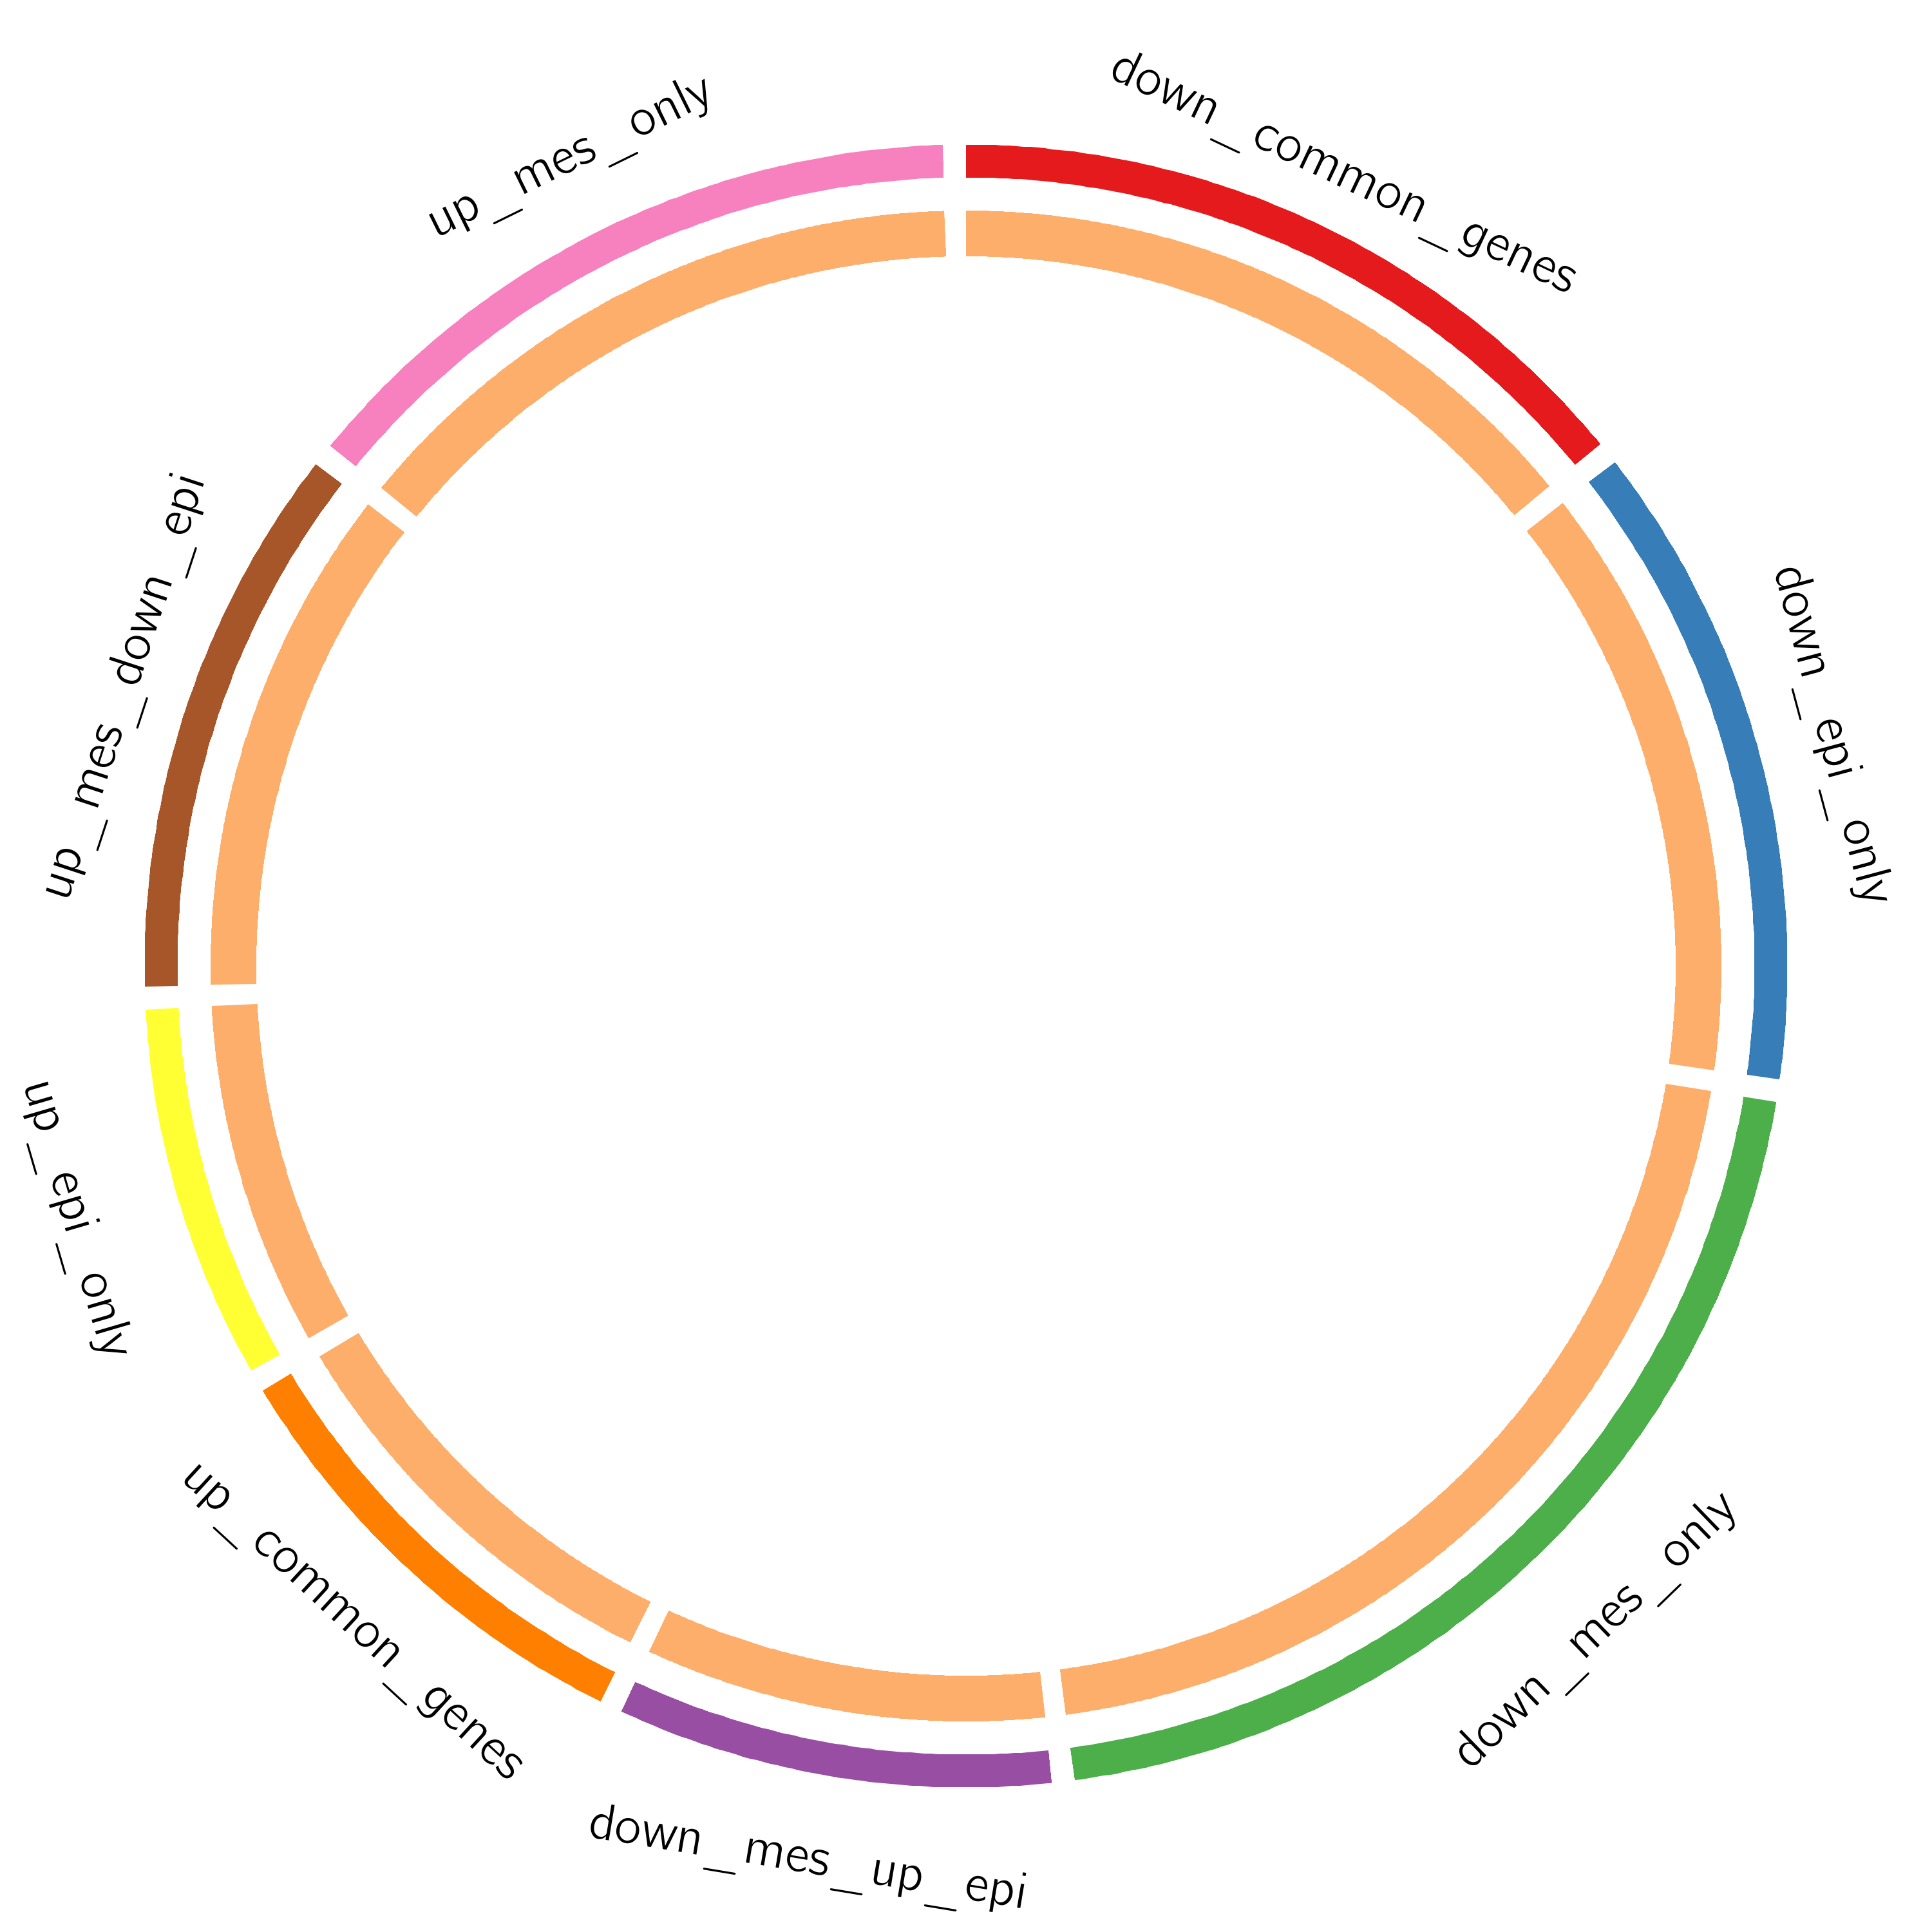
Gene Overlap Analysis
Notes:
The Circos plot shows how genes from the input gene lists overlap.
On the outside, each arc represents the identity of each gene list, using the same color code as the color used for table rows in slide #2.
On the inside, each arc represents a gene list, where each gene member of that list is assigned a spot on the arc. Dark orange color represents the genes that are shared by multiple lists and light orange color represents genes that are unique to that gene list.
Purple lines link the same gene that are shared by multiple gene lists (notice a gene that appears in two gene lists will be mapped once onto each gene list, therefore, the two positions are purple linked).
The greater the number of purple links and the longer the dark orange arcs implies greater overlap among the input gene lists.

Slide 4
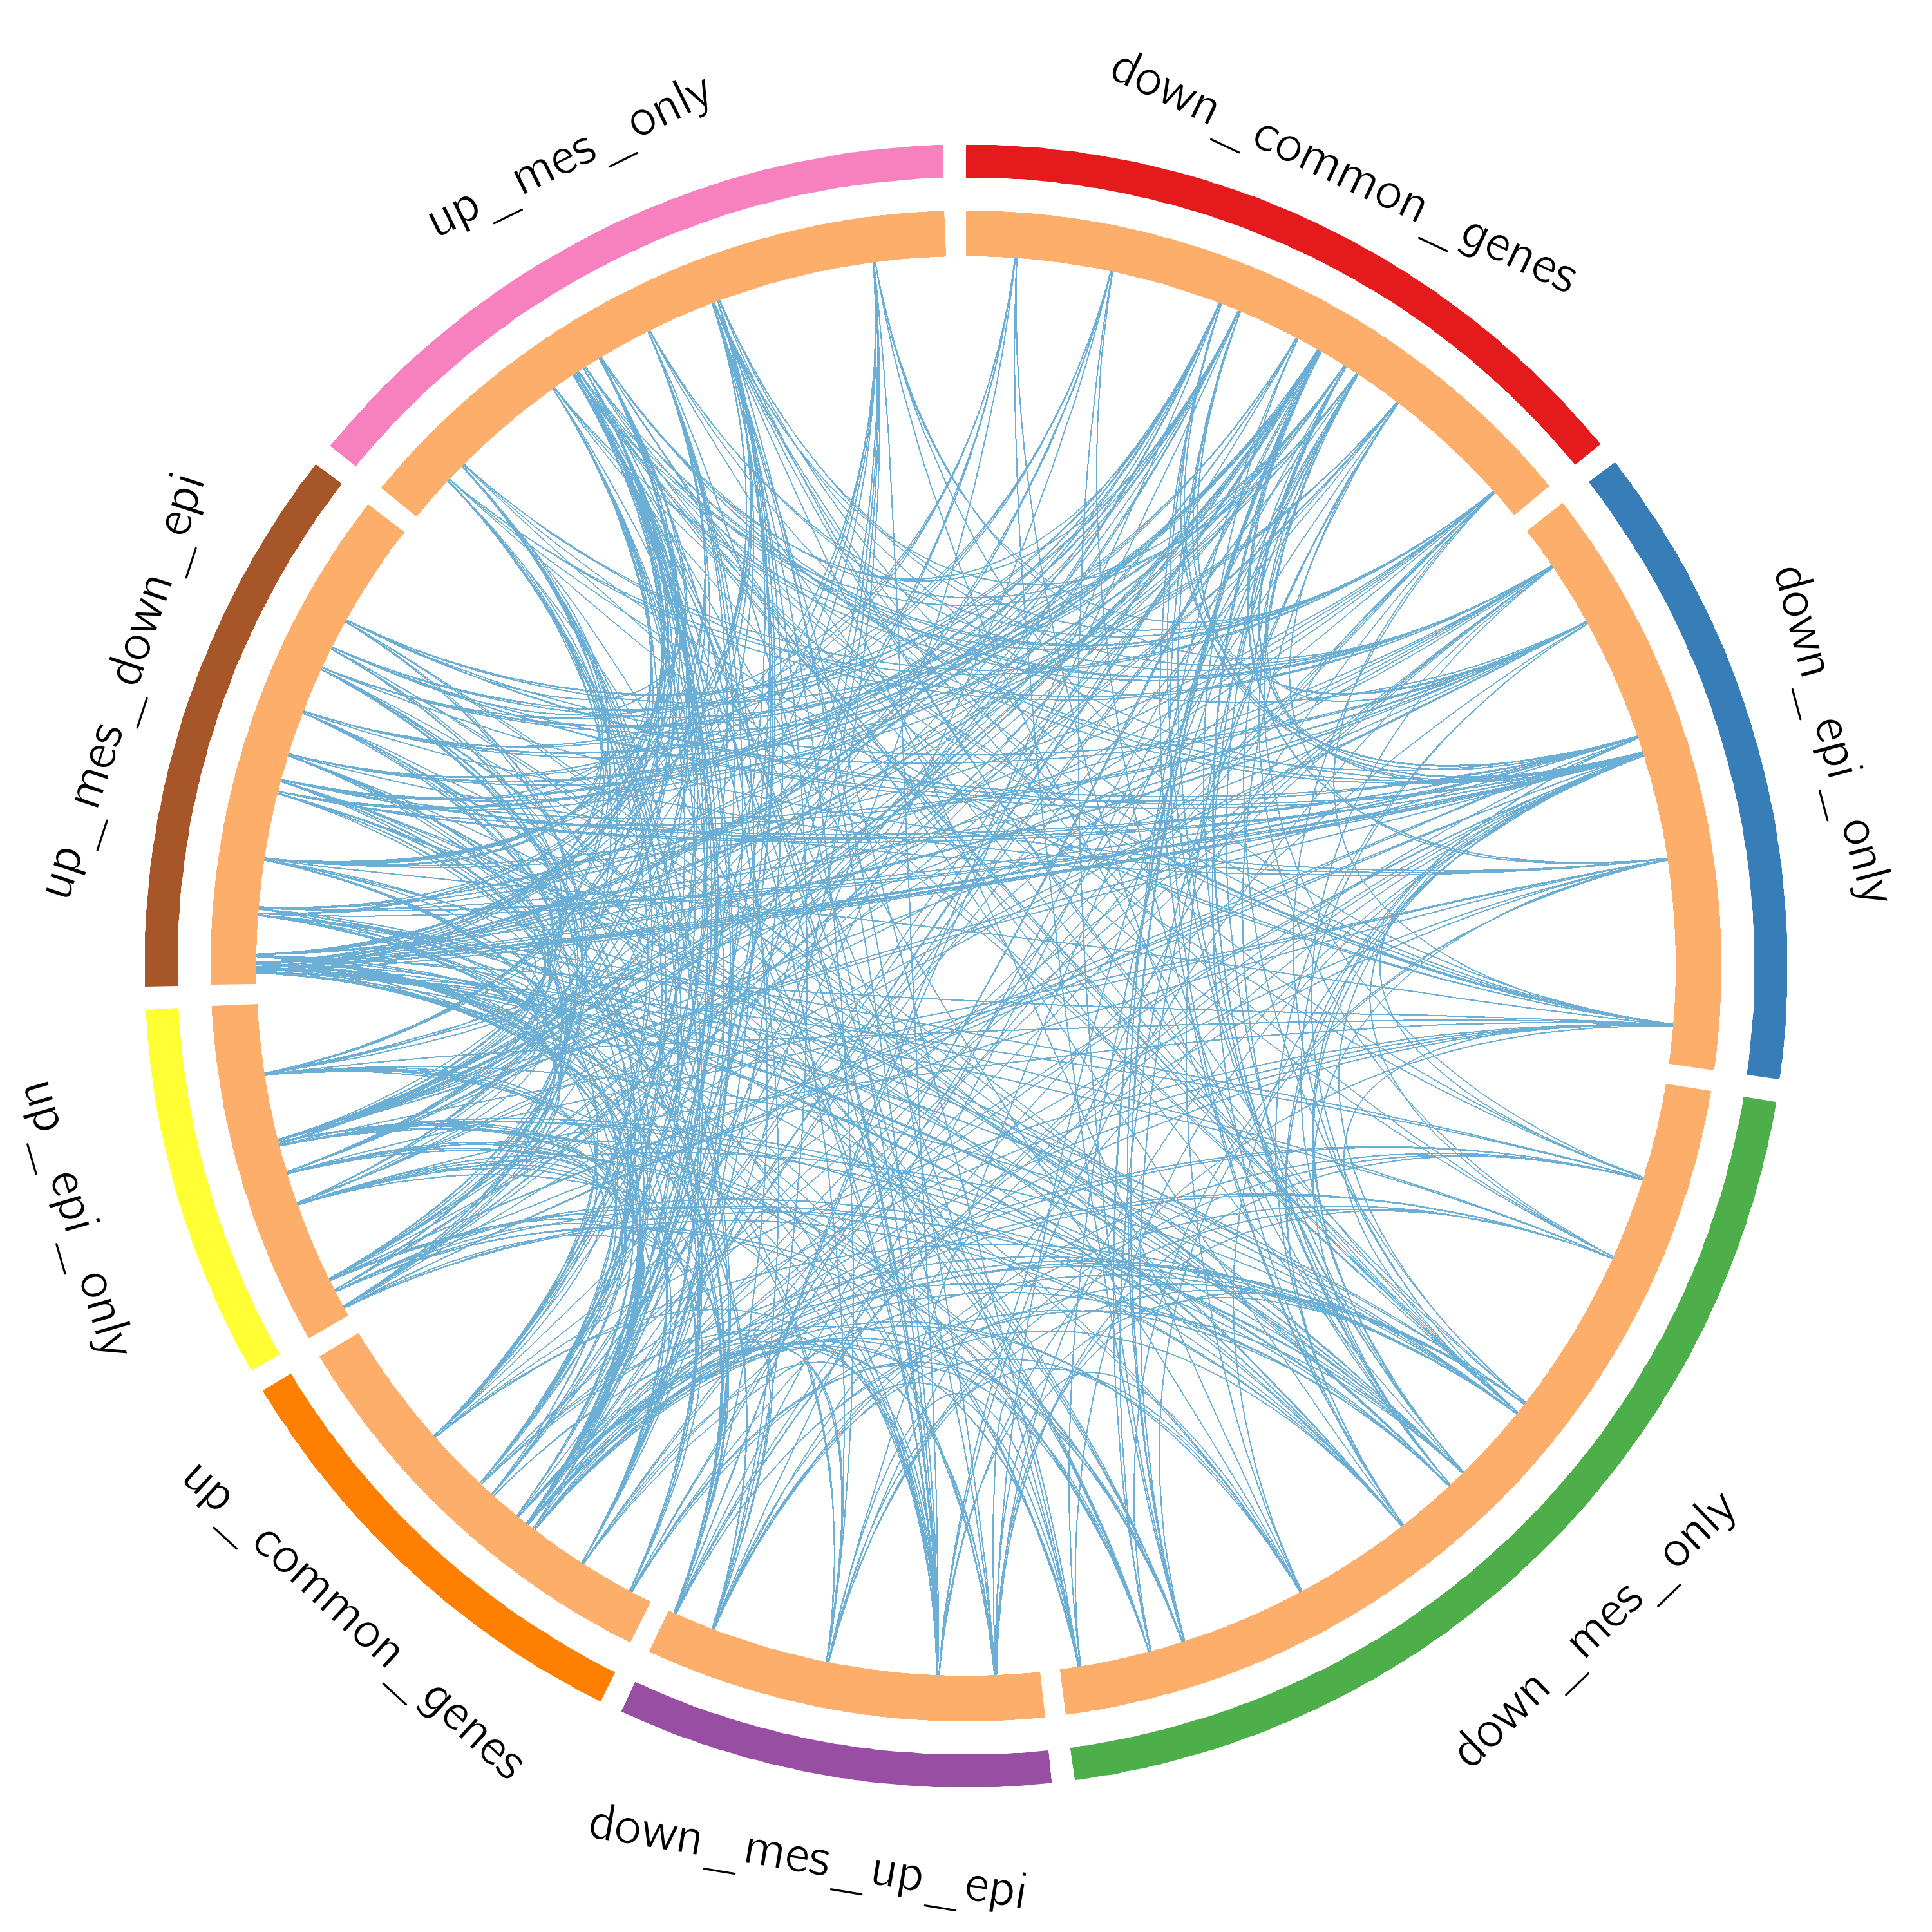
Gene Overlap Analysis
Expanded via Shared Enriched Ontologies
Notes:
The Circos plot shows how genes from the input gene lists overlap.
On the outside, each arc represents the identity of each gene list, using the same color code as the color used for table rows in slide #2.
On the inside, each arc represents a gene list, where each gene member of that list is assigned a spot on the arc. Dark orange color represents the genes that are shared by multiple lists and light orange color represents genes that are unique to that gene list.
Purple lines link the same gene that are shared by multiple gene lists (notice a gene that appears in two gene lists will be mapped once onto each gene list, therefore, the two positions are purple linked). Blue lines link the genes, although different, fall under the same ontology term (the term has to statistically significantly enriched and with size no larger than 100).
The greater the number of purple links and the longer the dark orange arcs implies greater overlap among the input gene lists. Blue links indicate the amount of functional overlap among the input gene lists. It is common in meta-analysis that we observe little directly overlap among studies, due to the variations in the biological assays used. However, we tend to see a lot more functional overlap, as these studies probably pick up different subset of gene members of the same biological processes.

Slide 5
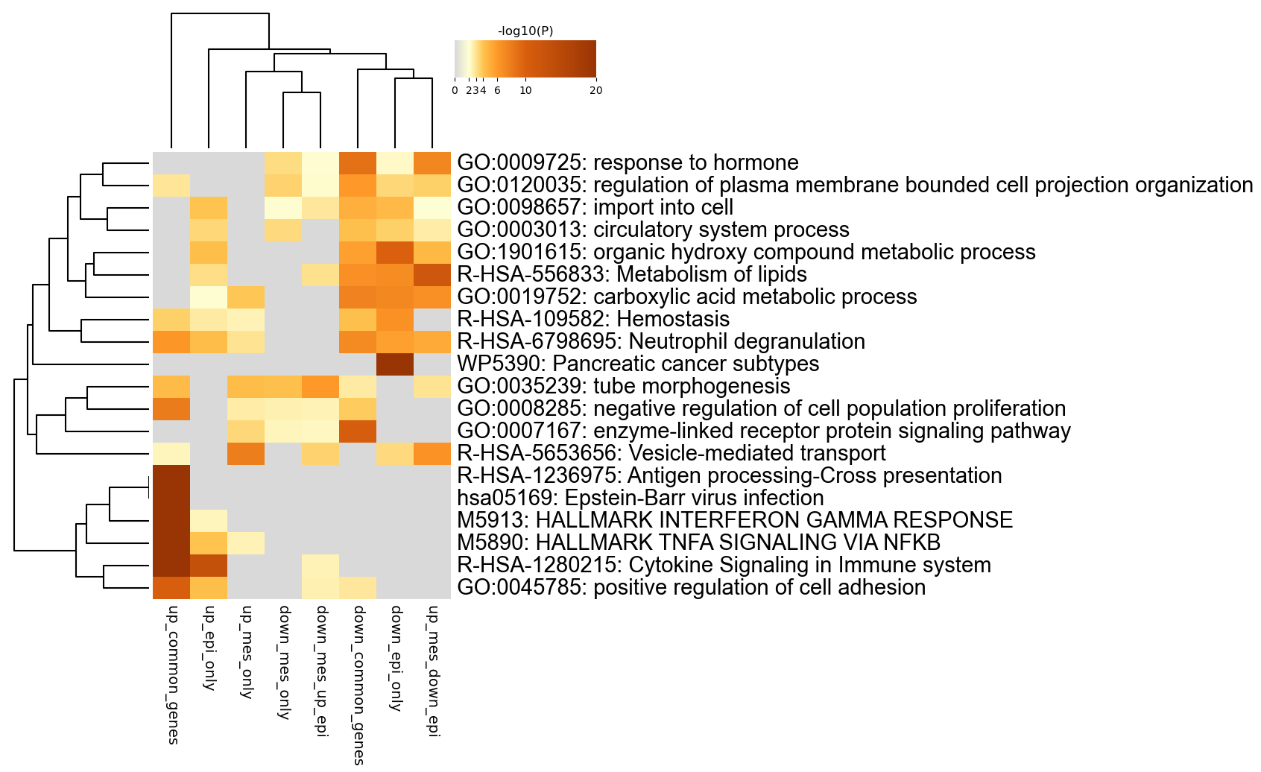
Enriched Ontology Clusters
Across Studies
Notes:
We first identified all statistically enriched terms (can be GO/KEGG terms, canonical pathways, hall mark gene sets, etc., based on the default choices under Express Analysis or your choice during Custom Analysis), accumulative hypergeometric p-values and enrichment factors were calculated and used for filtering. Remaining significant terms were then hierarchically clustered into a tree based on Kappa-statistical similarities among their gene memberships (similar to what is used in NCI DAVID site). Then 0.3 kappa score was applied as the threshold to cast the tree into term clusters. The terms within each cluster are exported in the Excel spreadsheet named “Enrichment Analysis”.
We selected the term with the best p-value within each cluster as its representative term and display them in a dendrogram. The heatmap cells are colored by their p-values, white cells indicate the lack of enrichment for that term in the corresponding gene list. We also export files behind this heatmap (.cdt, .gtr, .atr, and .jtv files), so that one can visualize it interactively using JTreeView program (http://sourceforge.net/projects/jtreeview/). The PDF version of the graph can be found in the zip package.
If you want to view the complete list of enriched terms, please download the .zip file and check Enrichment_GO/GO_AllLists.csv.
Note: gene lists containing more than 3000 genes are not analyzed. Please use a more stringent hit calling criterion, as you most likely have retained too many genes.

Slide 6
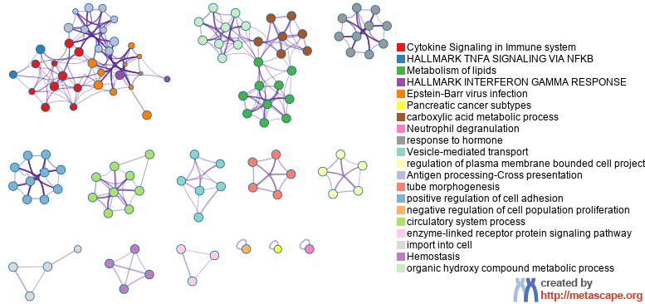
Enriched Ontology Clusters
Colored by Cluster ID
Notes:
We selected a subset of representative terms from the full cluster and converted them into a network layout. More specifically, each term is represented by a circle node, where its size is proportional to the number of input genes fall under that term, and its color represent its cluster identity (i.e., nodes of the same color belong to the same cluster). Terms with a similarity score > 0.3 are linked by an edge (the thickness of the edge represents the similarity score). The network is visualized with Cytoscape with “force-directed” layout and with edge bundled for clarity. One term from each cluster is selected to have its term description shown as label.

Slide 7
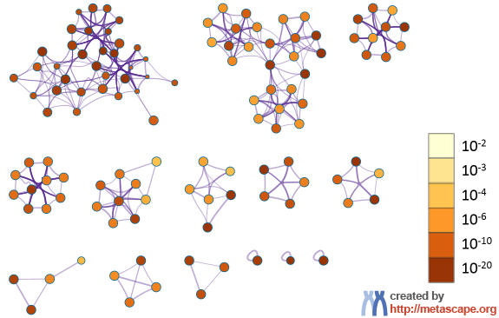
Enriched Ontology Clusters
Colored by p-Value
Notes:
The same enrichment network has its nodes colored by p-value, as shown in the legend. The dark the color, the more statistically significant the node is (see legend for p-value ranges).

Slide 8
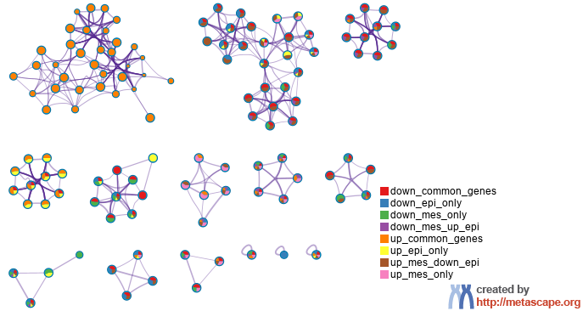
Enriched Ontology Clusters
Pied by Gene Counts Across Studies
Notes:
The same enrichment network has its nodes displayed as pies. Each pie sector is proportional to the number of hits originated from a gene list.
Color code for pie sector represents a gene list and is consistent with the colors used for table rows in slide #2.

Slide 9
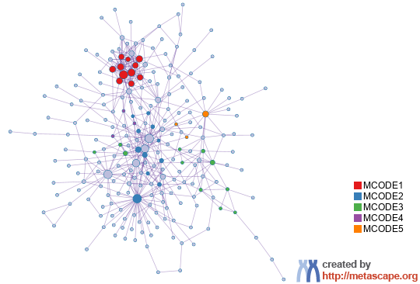
Protein-protein Interaction Network
Gene List: down_common_genes
Notes:
All protein-protein interactions among input genes were extracted from PPI data source and formed a PPI network.
GO enrichment analysis was applied to the network to extract “biological meanings”.

Slide 10
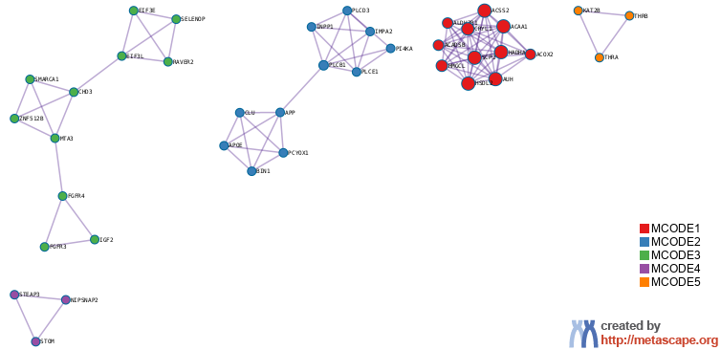
PPI MCODE Components
Gene List: down_common_genes
Notes:
MCODE algorithm was then applied to this network to identify neighborhoods where proteins are densely connected. Each MCODE network is assigned a unique color.

Slide 11
Biological Interpretation
PPI Network & MCODE Components
Gene List: down_common_genes
Network | Annotation
down_common_genes | GO:0007167|enzyme-linked receptor protein signaling pathway|-13.6;GO:0007169|transmembrane receptor protein tyrosine kinase signaling pathway|-12.0;GO:0009725|response to hormone|-11.1
down_common_genes_MCODE_ALL | hsa00562|Inositol phosphate metabolism|-9.3;GO:0016054|organic acid catabolic process|-9.3;GO:0046395|carboxylic acid catabolic process|-9.3
down_common_genes_SUB1_MCODE_1 | GO:0044282|small molecule catabolic process|-15.7;GO:0046395|carboxylic acid catabolic process|-14.8;GO:0016054|organic acid catabolic process|-14.8
down_common_genes_SUB1_MCODE_2 | hsa00562|Inositol phosphate metabolism|-13.1;hsa04070|Phosphatidylinositol signaling system|-12.4;R-HSA-1483249|Inositol phosphate metabolism|-11.3
down_common_genes_SUB1_MCODE_3 | R-HSA-2428928|IRS-related events triggered by IGF1R|-6.1;R-HSA-2428924|IGF1R signaling cascade|-6.1;R-HSA-2404192|Signaling by Type 1 Insulin-like Growth Factor 1 Receptor (IGF1R)|-6.1
down_common_genes_SUB1_MCODE_4 | R-HSA-9013409|RHOJ GTPase cycle|-8.2;R-HSA-9012999|RHO GTPase cycle|-5.5;R-HSA-194315|Signaling by Rho GTPases|-4.9
down_common_genes_SUB1_MCODE_5 | hsa04919|Thyroid hormone signaling pathway|-7.2;GO:0006366|transcription by RNA polymerase II|-5.7;GO:0032870|cellular response to hormone stimulus|-5.3
Notes:
GO enrichment analysis was applied to each MCODE network to extract “biological meanings” from the network component, where top three best p-value terms were retained.

Slide 12
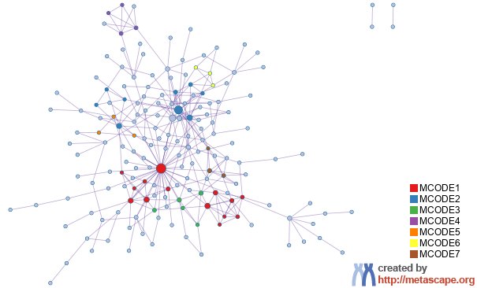
Protein-protein Interaction Network
Gene List: down_epi_only

Slide 13
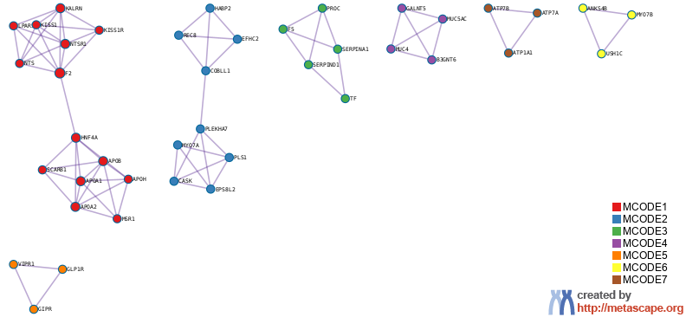
PPI MCODE Components
Gene List: down_epi_only

Slide 14
Biological Interpretation
PPI Network & MCODE Components
Gene List: down_epi_only
Network | Annotation
down_epi_only | WP5390|Pancreatic cancer subtypes|-12.7;GO:0010817|regulation of hormone levels|-10.1;GO:1901615|organic hydroxy compound metabolic process|-10.1
down_epi_only_MCODE_ALL | R-HSA-381426|Regulation of Insulin-like Growth Factor (IGF) transport and uptake by Insulin-like Growth Factor Binding Proteins (IGFBPs)|-13.1;R-HSA-8957275|Post-translational protein phosphorylation|-11.8;GO:0034381|plasma lipoprotein particle clearance|-9.8
down_epi_only_SUB1_MCODE_1 | GO:0034381|plasma lipoprotein particle clearance|-12.4;R-HSA-416476|G alpha (q) signalling events|-11.6;hsa04979|Cholesterol metabolism|-10.7
down_epi_only_SUB1_MCODE_2 | R-HSA-9662361|Sensory processing of sound by outer hair cells of the cochlea|-8.9;R-HSA-9662360|Sensory processing of sound by inner hair cells of the cochlea|-8.5;R-HSA-9659379|Sensory processing of sound|-8.3
down_epi_only_SUB1_MCODE_3 | R-HSA-8957275|Post-translational protein phosphorylation|-12.3;R-HSA-381426|Regulation of Insulin-like Growth Factor (IGF) transport and uptake by Insulin-like Growth Factor Binding Proteins (IGFBPs)|-12.0;WP558|Complement and coagulation cascades|-10.2
down_epi_only_SUB1_MCODE_4 | R-HSA-913709|O-linked glycosylation of mucins|-10.7;R-HSA-5173105|O-linked glycosylation|-9.8
down_epi_only_SUB1_MCODE_5 | WP334|GPCRs class B secretin like|-9.4;R-HSA-420092|Glucagon-type ligand receptors|-8.9;R-HSA-373080|Class B/2 (Secretin family receptors)|-7.5
down_epi_only_SUB1_MCODE_6 | GO:1904970|brush border assembly|-10.9;WP5380|5q35 copy number variation|-7.3
down_epi_only_SUB1_MCODE_7 | R-HSA-936837|Ion transport by P-type ATPases|-8.2;hsa04978|Mineral absorption|-8.1;R-HSA-983712|Ion channel transport|-6.6

Slide 15
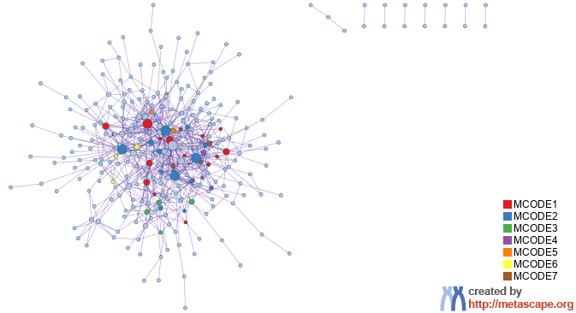
Protein-protein Interaction Network
Gene List: down_mes_only

Slide 16
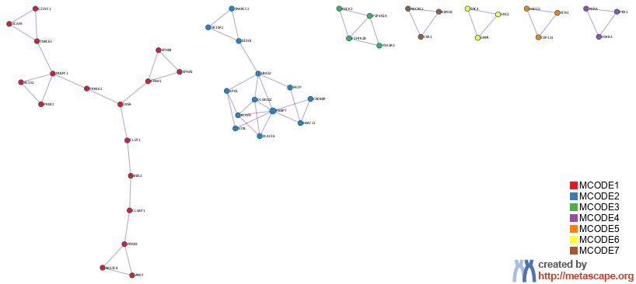
PPI MCODE Components
Gene List: down_mes_only

Slide 17
Biological Interpretation
PPI Network & MCODE Components
Gene List: down_mes_only
Network | Annotation
down_mes_only | R-HSA-1852241|Organelle biogenesis and maintenance|-10.7;GO:0006325|chromatin organization|-8.2;M5925|HALLMARK E2F TARGETS|-7.0
down_mes_only_MCODE_ALL | R-HSA-1852241|Organelle biogenesis and maintenance|-9.2;R-HSA-68877|Mitotic Prometaphase|-7.6;R-HSA-3700989|Transcriptional Regulation by TP53|-7.2
down_mes_only_SUB1_MCODE_1 | GO:0048013|ephrin receptor signaling pathway|-5.6;GO:0007169|transmembrane receptor protein tyrosine kinase signaling pathway|-5.6;hsa04360|Axon guidance|-5.5
down_mes_only_SUB1_MCODE_2 | M101|PID HDAC CLASSI PATHWAY|-7.8;R-HSA-8951664|Neddylation|-7.4;M219|PID HEDGEHOG GLI PATHWAY|-6.0
down_mes_only_SUB1_MCODE_3 | WP51|Regulation of actin cytoskeleton|-9.2;hsa04810|Regulation of actin cytoskeleton|-8.5;R-HSA-1660499|Synthesis of PIPs at the plasma membrane|-7.7
down_mes_only_SUB1_MCODE_4 | R-HSA-5617472|Activation of anterior HOX genes in hindbrain development during early embryogenesis|-7.2;R-HSA-5619507|Activation of HOX genes during differentiation|-7.2
down_mes_only_SUB1_MCODE_5 | R-HSA-380284|Loss of proteins required for interphase microtubule organization from the centrosome|-7.9;R-HSA-380259|Loss of Nlp from mitotic centrosomes|-7.9;R-HSA-8854518|AURKA Activation by TPX2|-7.9
down_mes_only_SUB1_MCODE_7 | GO:0006325|chromatin organization|-4.7

Slide 18
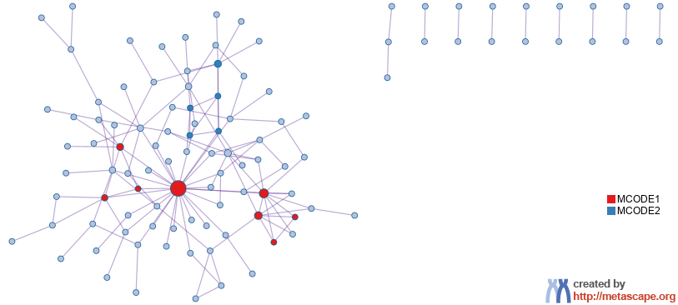
Protein-protein Interaction Network
Gene List: down_mes_up_epi

Slide 19
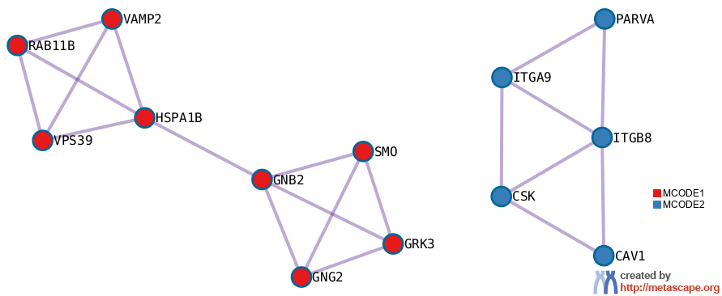
PPI MCODE Components
Gene List: down_mes_up_epi

Slide 20
Biological Interpretation
PPI Network & MCODE Components
Gene List: down_mes_up_epi
Network | Annotation
down_mes_up_epi | GO:0000165|MAPK cascade|-6.1;GO:0001933|negative regulation of protein phosphorylation|-6.0;GO:2001233|regulation of apoptotic signaling pathway|-5.8
down_mes_up_epi_MCODE_ALL | WP185|Integrin mediated cell adhesion|-7.1;WP3932|Focal adhesion PI3K Akt mTOR signaling pathway|-6.9;WP306|Focal adhesion|-5.9
down_mes_up_epi_SUB1_MCODE_1 | R-HSA-422356|Regulation of insulin secretion|-6.0;hsa05032|Morphine addiction|-5.8;R-HSA-373080|Class B/2 (Secretin family receptors)|-5.8
down_mes_up_epi_SUB1_MCODE_2 | WP185|Integrin mediated cell adhesion|-9.2;WP306|Focal adhesion|-8.0;hsa04510|Focal adhesion|-8.0

Slide 21
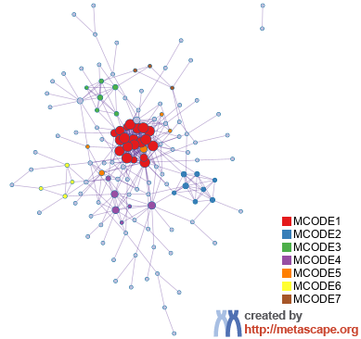
Protein-protein Interaction Network
Gene List: up_common_genes

Slide 22
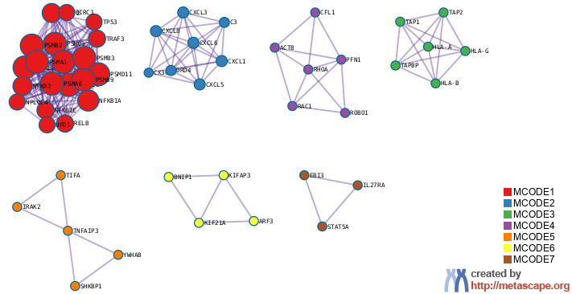
PPI MCODE Components
Gene List: up_common_genes

Slide 23
Biological Interpretation
PPI Network & MCODE Components
Gene List: up_common_genes
Network | Annotation
up_common_genes | R-HSA-1280215|Cytokine Signaling in Immune system|-35.1;M5890|HALLMARK TNFA SIGNALING VIA NFKB|-28.2;hsa05169|Epstein-Barr virus infection|-26.6
up_common_genes_MCODE_ALL | R-HSA-1280215|Cytokine Signaling in Immune system|-30.2;R-HSA-1236974|ER-Phagosome pathway|-28.1;R-HSA-1236975|Antigen processing-Cross presentation|-26.9
up_common_genes_SUB1_MCODE_1 | R-HSA-5668541|TNFR2 non-canonical NF-kB pathway|-33.4;R-HSA-9020702|Interleukin-1 signaling|-29.7;R-HSA-5688426|Deubiquitination|-28.6
up_common_genes_SUB1_MCODE_2 | R-HSA-418594|G alpha (i) signalling events|-15.9;R-HSA-373076|Class A/1 (Rhodopsin-like receptors)|-15.7;R-HSA-380108|Chemokine receptors bind chemokines|-14.9
up_common_genes_SUB1_MCODE_3 | GO:0019885|antigen processing and presentation of endogenous peptide antigen via MHC class I|-19.0;GO:0002483|antigen processing and presentation of endogenous peptide antigen|-18.8;R-HSA-983170|Antigen Presentation: Folding, assembly and peptide loading of class I MHC|-18.4
up_common_genes_SUB1_MCODE_4 | WP51|Regulation of actin cytoskeleton|-10.8;WP524|G13 signaling pathway|-10.5;R-HSA-422475|Axon guidance|-10.5
up_common_genes_SUB1_MCODE_5 | GO:0002221|pattern recognition receptor signaling pathway|-6.2;GO:0002758|innate immune response-activating signaling pathway|-6.0;GO:0002218|activation of innate immune response|-5.8
up_common_genes_SUB1_MCODE_6 | R-HSA-6811434|COPI-dependent Golgi-to-ER retrograde traffic|-10.0;R-HSA-8856688|Golgi-to-ER retrograde transport|-9.4;R-HSA-6811442|Intra-Golgi and retrograde Golgi-to-ER traffic|-8.7
up_common_genes_SUB1_MCODE_7 | M36|PID IL27 PATHWAY|-9.3;hsa04659|Th17 cell differentiation|-7.4;GO:0019221|cytokine-mediated signaling pathway|-5.7

Slide 24
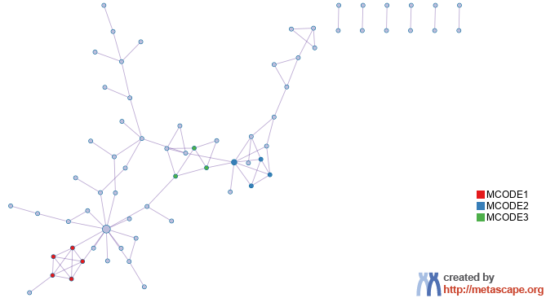
Protein-protein Interaction Network
Gene List: up_epi_only

Slide 25
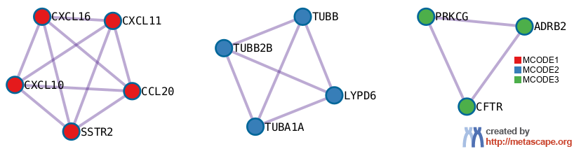
PPI MCODE Components
Gene List: up_epi_only

Slide 26
Biological Interpretation
PPI Network & MCODE Components
Gene List: up_epi_only
Network | Annotation
up_epi_only | R-HSA-1280215|Cytokine Signaling in Immune system|-17.7;R-HSA-913531|Interferon Signaling|-10.6;GO:0045087|innate immune response|-9.7
up_epi_only_MCODE_ALL | GO:0072678|T cell migration|-9.2;R-HSA-418594|G alpha (i) signalling events|-9.0;R-HSA-388396|GPCR downstream signalling|-8.9
up_epi_only_SUB1_MCODE_1 | GO:0072678|T cell migration|-11.2;R-HSA-375276|Peptide ligand-binding receptors|-10.9;GO:0048247|lymphocyte chemotaxis|-10.5
up_epi_only_SUB1_MCODE_2 | WP2272|Pathogenic Escherichia coli infection|-7.6;WP2359|Parkin ubiquitin proteasomal system pathway|-7.3;hsa04540|Gap junction|-7.0

Slide 27
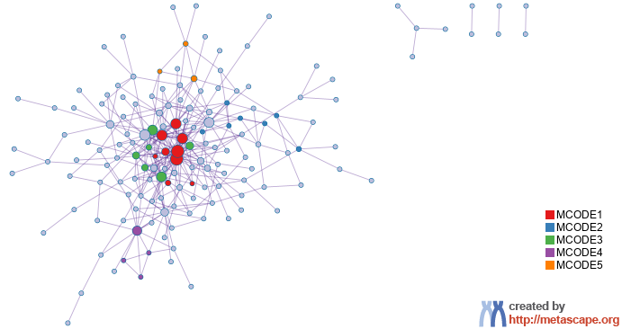
Protein-protein Interaction Network
Gene List: up_mes_down_epi

Slide 28
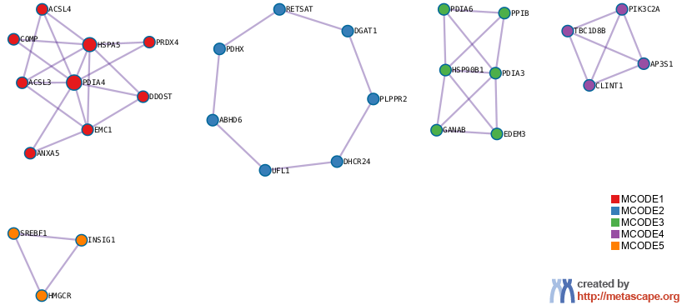
PPI MCODE Components
Gene List: up_mes_down_epi

Slide 29
Biological Interpretation
PPI Network & MCODE Components
Gene List: up_mes_down_epi
Network | Annotation
up_mes_down_epi | M5924|HALLMARK MTORC1 SIGNALING|-15.4;R-HSA-556833|Metabolism of lipids|-14.7;GO:0008610|lipid biosynthetic process|-12.3
up_mes_down_epi_MCODE_ALL | hsa04141|Protein processing in endoplasmic reticulum|-11.5;GO:0051604|protein maturation|-9.3;WP4718|Cholesterol metabolism with Bloch and Kandutsch Russell pathways|-9.1
up_mes_down_epi_SUB1_MCODE_1 | GO:0051604|protein maturation|-5.1;hsa04141|Protein processing in endoplasmic reticulum|-4.8;GO:0006457|protein folding|-4.5
up_mes_down_epi_SUB1_MCODE_2 | GO:0120254|olefinic compound metabolic process|-5.4;GO:0006066|alcohol metabolic process|-4.4;GO:1901615|organic hydroxy compound metabolic process|-3.9
up_mes_down_epi_SUB1_MCODE_3 | hsa04141|Protein processing in endoplasmic reticulum|-10.5;R-HSA-901042|Calnexin/calreticulin cycle|-8.0;R-HSA-532668|N-glycan trimming in the ER and Calnexin/Calreticulin cycle|-7.5
up_mes_down_epi_SUB1_MCODE_4 | R-HSA-432722|Golgi Associated Vesicle Biogenesis|-11.0;R-HSA-199992|trans-Golgi Network Vesicle Budding|-10.5;R-HSA-199991|Membrane Trafficking|-6.7
up_mes_down_epi_SUB1_MCODE_5 | GO:1902653|secondary alcohol biosynthetic process|-8.8;GO:0006695|cholesterol biosynthetic process|-8.8;GO:0016126|sterol biosynthetic process|-8.5

Slide 30
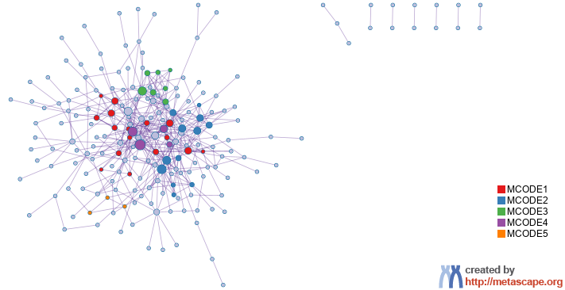
Protein-protein Interaction Network
Gene List: up_mes_only

Slide 31
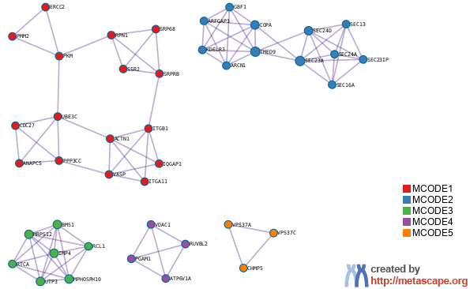
PPI MCODE Components
Gene List: up_mes_only

Slide 32
Biological Interpretation
PPI Network & MCODE Components
Gene List: up_mes_only
Network | Annotation
up_mes_only | R-HSA-446203|Asparagine N-linked glycosylation|-14.5;GO:0006888|endoplasmic reticulum to Golgi vesicle-mediated transport|-11.4;R-HSA-5653656|Vesicle-mediated transport|-11.1
up_mes_only_MCODE_ALL | R-HSA-199977|ER to Golgi Anterograde Transport|-17.7;R-HSA-446203|Asparagine N-linked glycosylation|-17.5;GO:0006888|endoplasmic reticulum to Golgi vesicle-mediated transport|-16.8
up_mes_only_SUB1_MCODE_1 | R-HSA-446353|Cell-extracellular matrix interactions|-7.0;R-HSA-1799339|SRP-dependent cotranslational protein targeting to membrane|-6.5;GO:0006613|cotranslational protein targeting to membrane|-6.2
up_mes_only_SUB1_MCODE_2 | R-HSA-199977|ER to Golgi Anterograde Transport|-27.7;R-HSA-948021|Transport to the Golgi and subsequent modification|-26.7;GO:0006888|endoplasmic reticulum to Golgi vesicle-mediated transport|-25.3
up_mes_only_SUB1_MCODE_3 | GO:0030490|maturation of SSU-rRNA|-12.5;R-HSA-6790901|rRNA modification in the nucleus and cytosol|-12.2;GO:0042274|ribosomal small subunit biogenesis|-11.1
up_mes_only_SUB1_MCODE_4 | GO:0031329|regulation of cellular catabolic process|-4.2
up_mes_only_SUB1_MCODE_5 | GO:0039702|viral budding via host ESCRT complex|-9.5;GO:0046755|viral budding|-9.3;GO:0032511|late endosome to vacuole transport via multivesicular body sorting pathway|-9.2

Slide 33
Evidence Weighting by Machine Learning Approach
Notes:
In the precision-recall plot, the precision is defined as TP/(TP+FP), and recall (a.k.a. TPR) is defined as TP/(TP+FN). If the evidence matrix is effective, we expect precision decreases as recall increases, which implies the hits ranked to the top are more likely true positives (higher precision). AUC (area under curve) in the plot represents the average precision value. The precision value expected for a random hit prioritization algorithm can be read from the last data point of the step curve, where all genes were classified as hits (recall = 1).
The second plot shows how the number of true positives increase as we include more genes. A good result would show the TPR curve to be significantly above the diagonal line, where the diagonal line represents the result achieved by random hit prioritization.
The third plot is a bar graph showing the relative weights assigned to each evidence line (up to top ten lines). If an evidence line contributes negatively, it will be colored in orange, otherwise, in blue.
The last plot shows the predicted probability of benchmark genes, a good result would place many benchmark genes (shown as orange "+") towards the upper portion of the curve (with probability above 50%). If benchmark genes are centered around 50%, it implies true hit status cannot be effectively predicted from the underlying evidence line (we will see a low prediction accuracy).
If these plots strongly support the effective of evidence lines in retrospectively recapturing benchmark genes, the predicted evidence score and probability can then be used to prioritize gene candidates.
Please see https://en.wikipedia.org/wiki/Sensitivity_and_specificity for a summary of terminologies such as TP, FP, TN, FN, TPR, Precision, Recall, etc.

Slide 34


metascape.org
bioinformatics for biologists
Hint: If you have multiple related gene lists, upload them in one Excel file will trigger meta analyses.
Easy, Fresh & Free
Submit gene identifiers, one click on Expression Analysis. Done!
Interpretable results: visualizations, methods, pptx, xslx, zip
Best Practices for Gene List Analyses
Rich annotations for thousands of genes at once
Pathway & process enrichment analysis
Protein-protein interaction network analysis
Overlap analysis across multiple gene lists
Common and unique pathways across multiple studies
Support key model organisms
Scalable
Docker containers available for bioinformaticians
Notes:
Thank you for using Metascape, you are welcome to past question to our public forum: https://metascape.freeforums.net, or email us with your private questions at “metascape.team at gmail.com”.

