Slide 1

Gene List Analysis Report
Hint: Each slide has notes that explain the analysis!
http://metascape.org
Please cite Zhou et al. Nature Commun. 2019 10(1):1523
Jan 3, 2024
Notes:
This analysis report is automatically generated by Metascape (https://metascape.org).

Slide 2
Gene List Summary
Name | Total | Unique | _Color_
modules_mes_black_sorted_top300 | 300 | 300 | #E41A1C
modules_mes_blue_sorted_top300 | 300 | 300 | #377EB8
modules_mes_green_sorted_top300 | 300 | 300 | #4DAF4A
modules_mes_grey_sorted_top300 | 297 | 297 | #984EA3
modules_mes_pink_sorted_top300 | 299 | 299 | #FF7F00
modules_mes_red_sorted_top300 | 300 | 300 | #FFFF33
Please check online Metascape User Manual for explanation of each annotation field.
Notes:
Metascape first automatically converts you input identifiers (Entrez Gene ID, RefSeq, Ensembl ID, UnProt ID or Symbol) into Human Entrez Gene ID. For example, input identifiers can be from human, mouse or rat orthologs, which can be mapped into human (or “analysis as” species) based on both EggNOG and Homologene databases.
The background of each row is the color code used in the various plots within this report, where each color is consistently used to code a corresponding gene list.

Slide 3
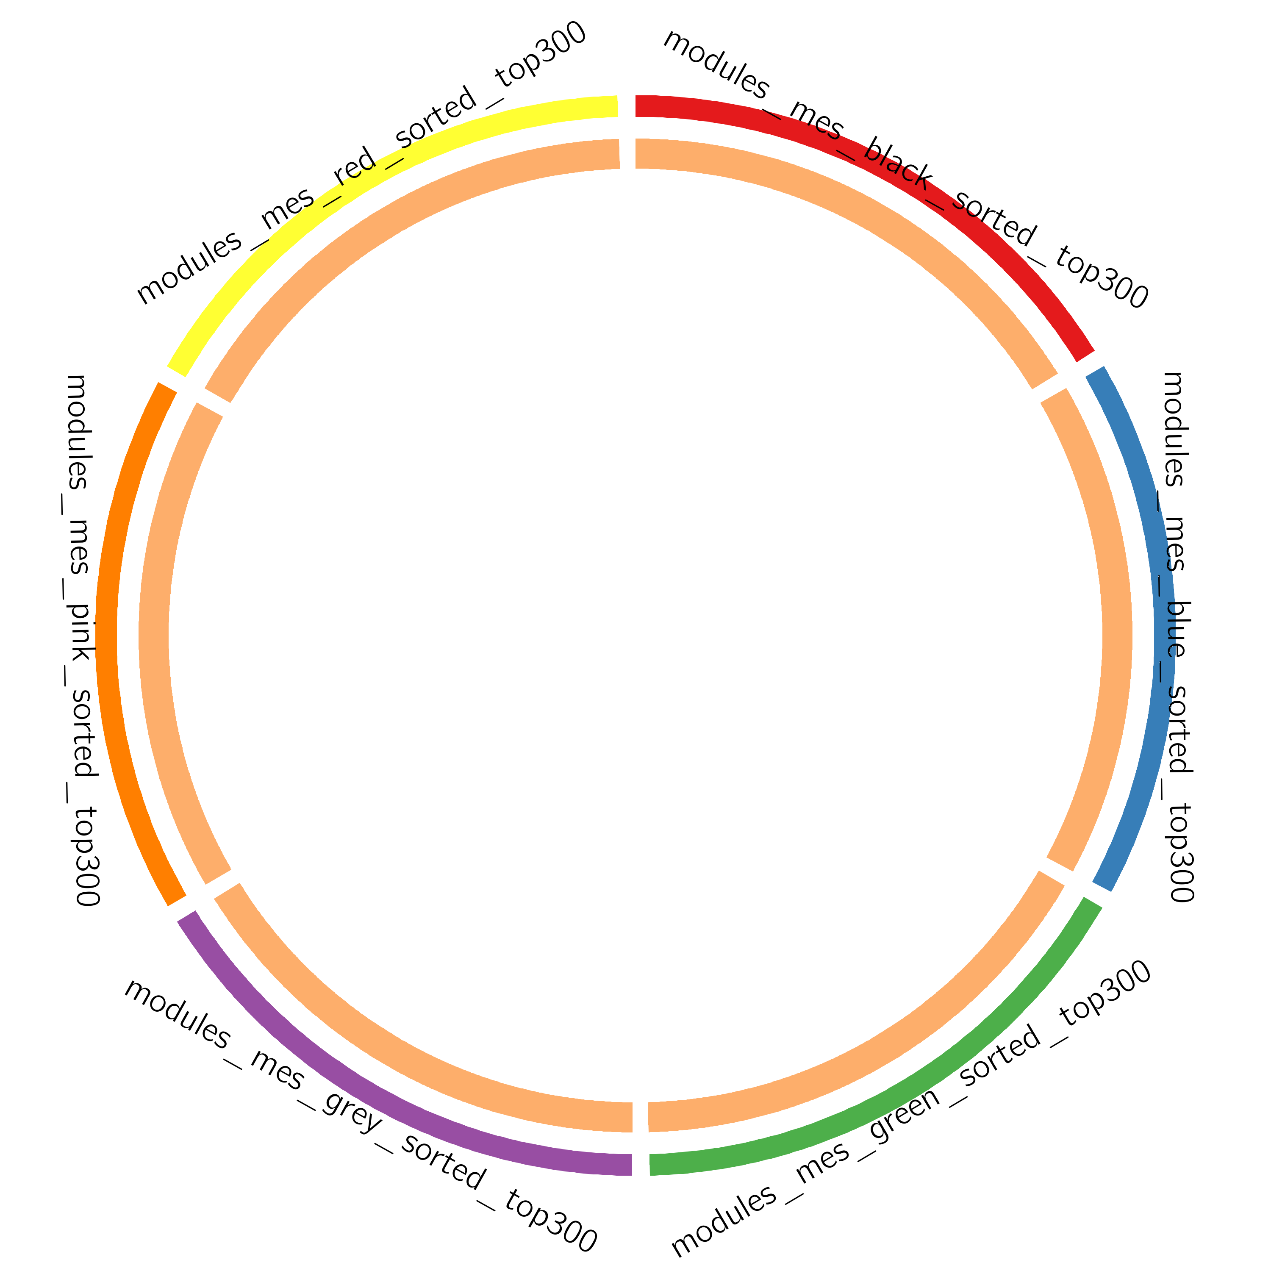
Gene Overlap Analysis
Notes:
The Circos plot shows how genes from the input gene lists overlap.
On the outside, each arc represents the identity of each gene list, using the same color code as the color used for table rows in slide #2.
On the inside, each arc represents a gene list, where each gene member of that list is assigned a spot on the arc. Dark orange color represents the genes that are shared by multiple lists and light orange color represents genes that are unique to that gene list.
Purple lines link the same gene that are shared by multiple gene lists (notice a gene that appears in two gene lists will be mapped once onto each gene list, therefore, the two positions are purple linked).
The greater the number of purple links and the longer the dark orange arcs implies greater overlap among the input gene lists.

Slide 4
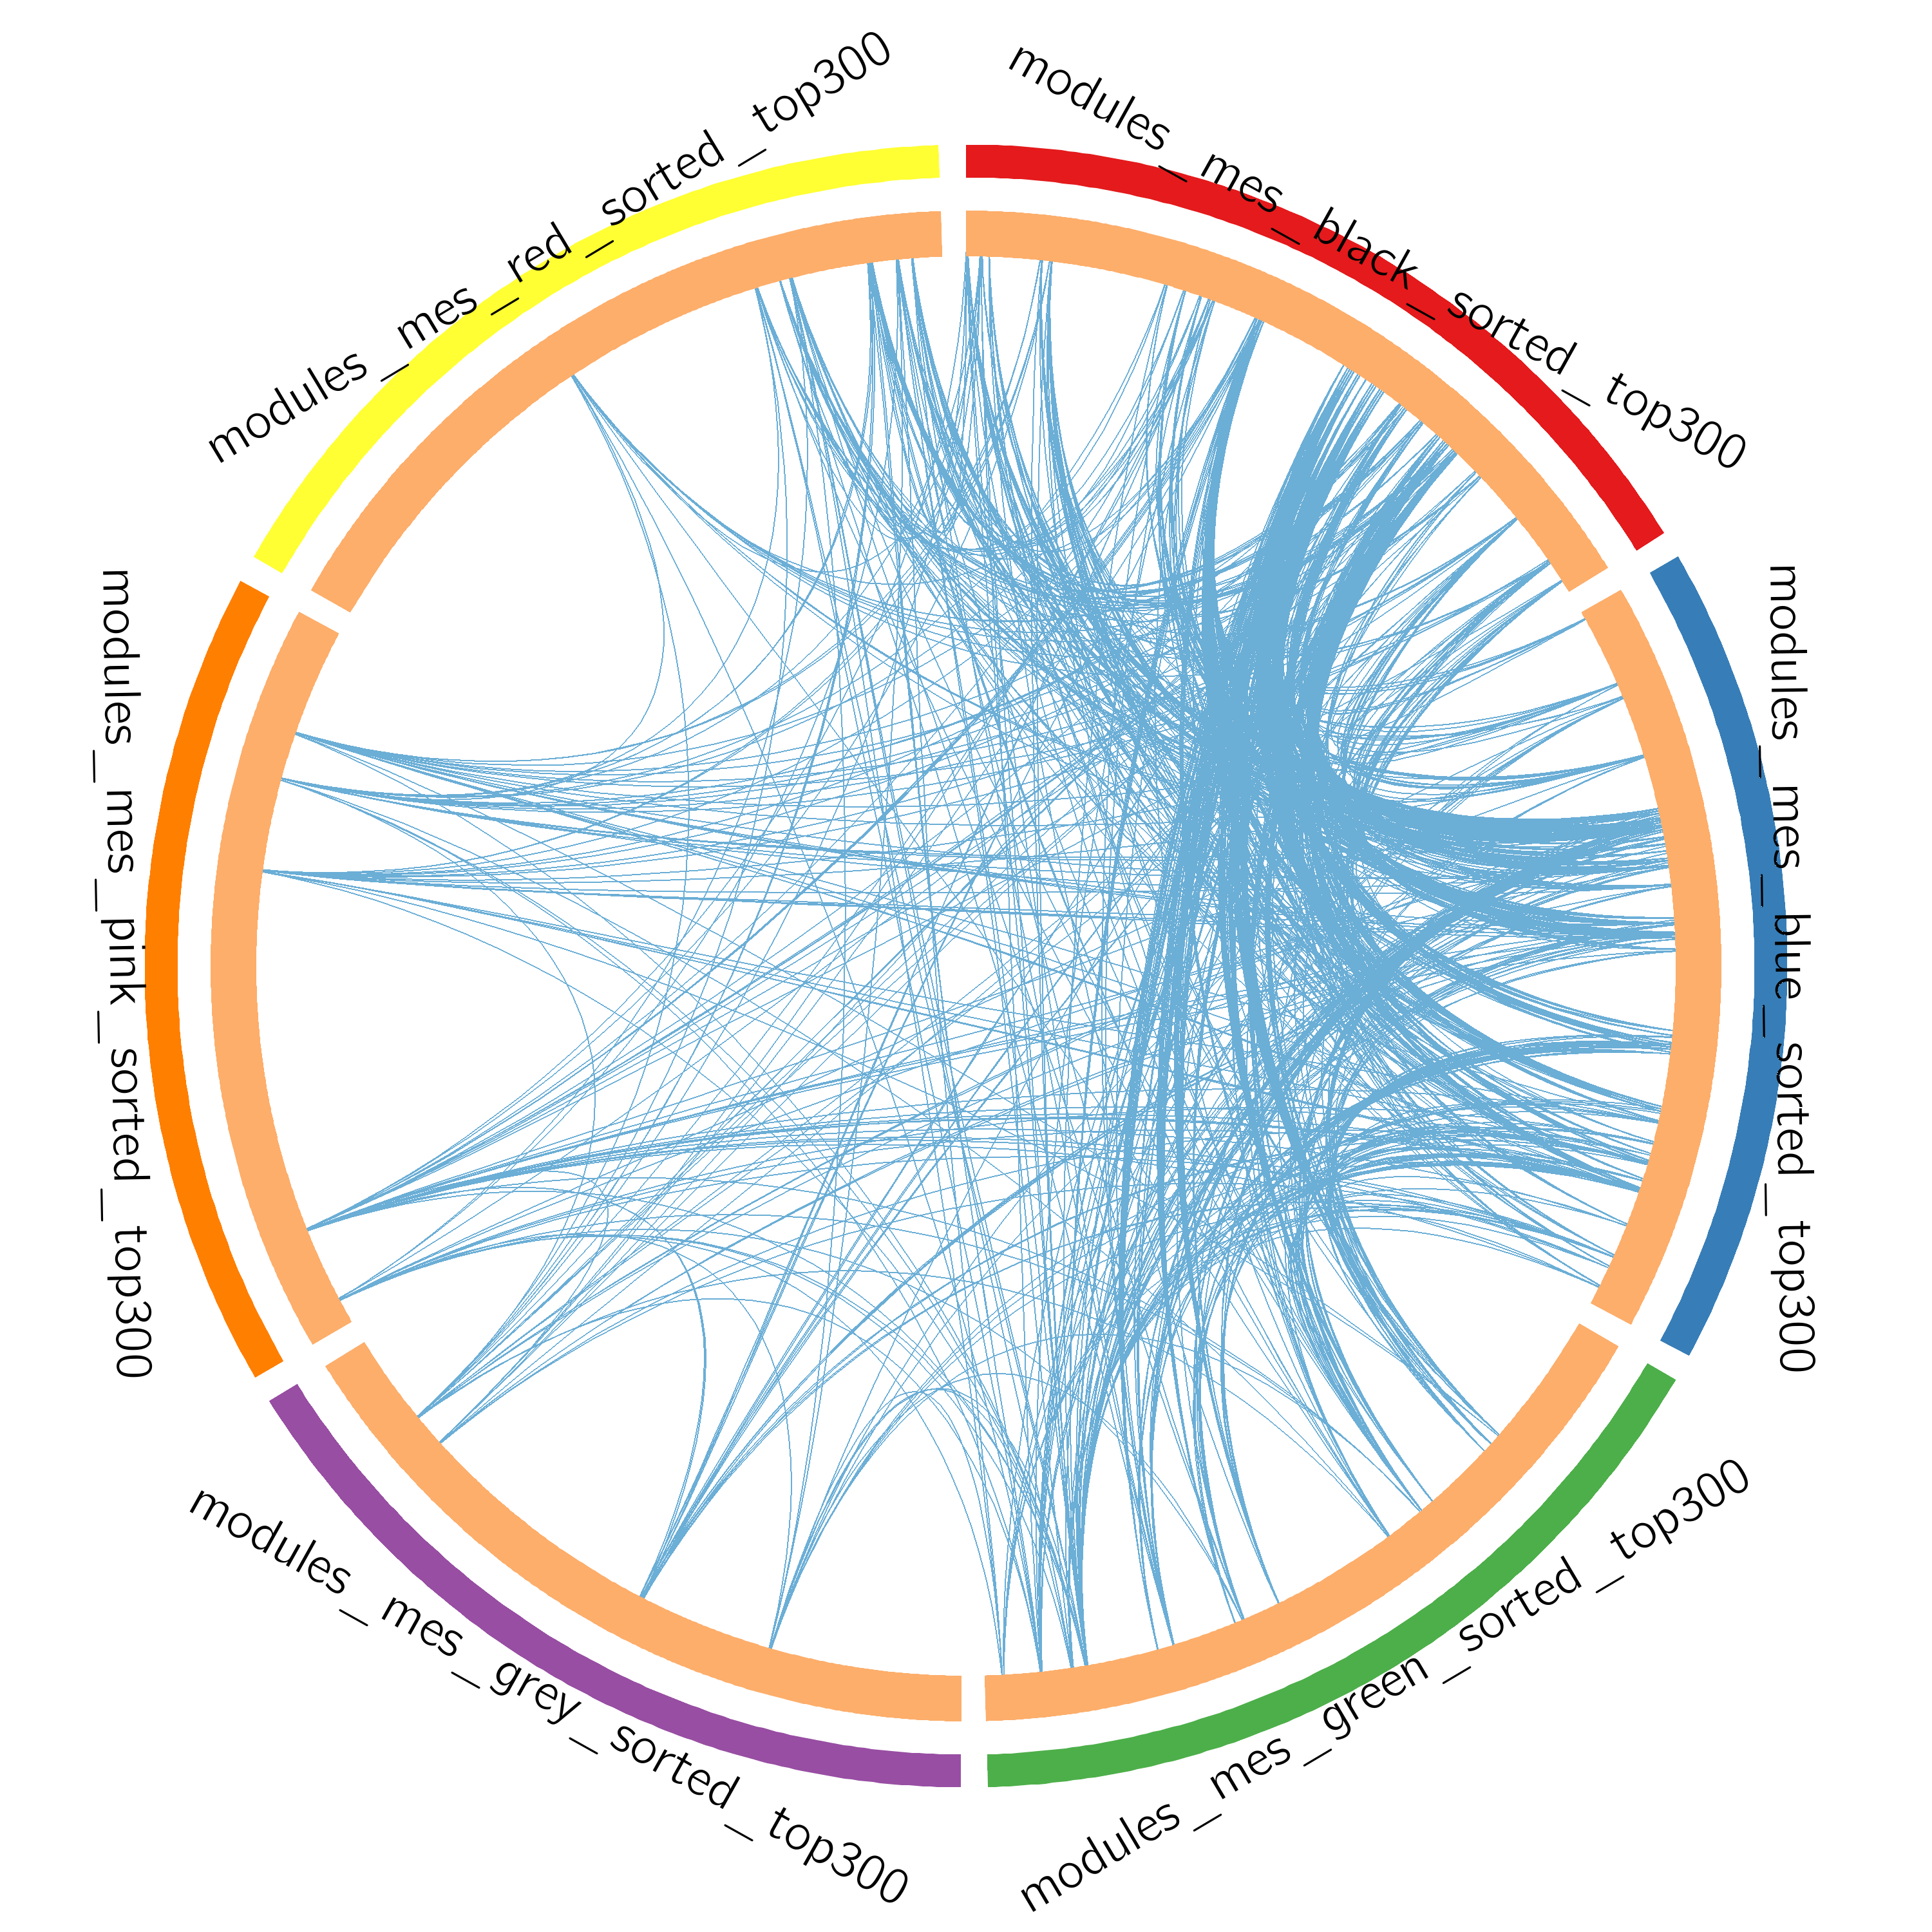
Gene Overlap Analysis
Expanded via Shared Enriched Ontologies
Notes:
The Circos plot shows how genes from the input gene lists overlap.
On the outside, each arc represents the identity of each gene list, using the same color code as the color used for table rows in slide #2.
On the inside, each arc represents a gene list, where each gene member of that list is assigned a spot on the arc. Dark orange color represents the genes that are shared by multiple lists and light orange color represents genes that are unique to that gene list.
Purple lines link the same gene that are shared by multiple gene lists (notice a gene that appears in two gene lists will be mapped once onto each gene list, therefore, the two positions are purple linked). Blue lines link the genes, although different, fall under the same ontology term (the term has to statistically significantly enriched and with size no larger than 100).
The greater the number of purple links and the longer the dark orange arcs implies greater overlap among the input gene lists. Blue links indicate the amount of functional overlap among the input gene lists. It is common in meta-analysis that we observe little directly overlap among studies, due to the variations in the biological assays used. However, we tend to see a lot more functional overlap, as these studies probably pick up different subset of gene members of the same biological processes.

Slide 5
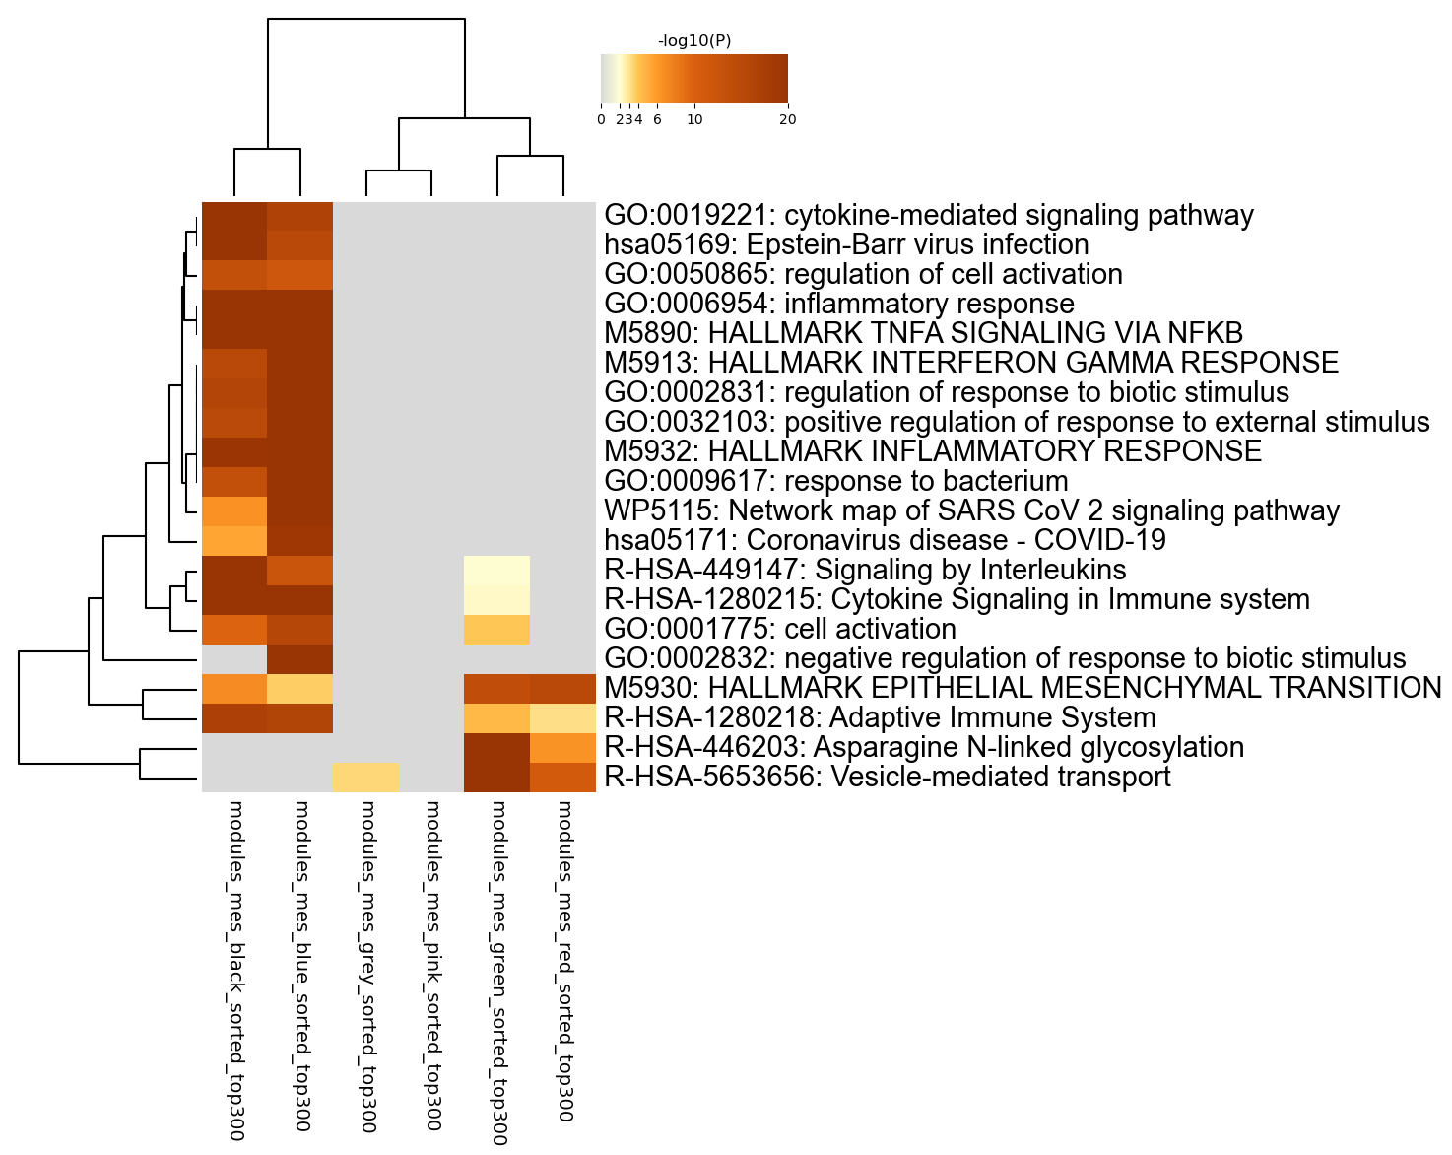
Enriched Ontology Clusters
Across Studies
Notes:
We first identified all statistically enriched terms (can be GO/KEGG terms, canonical pathways, hall mark gene sets, etc., based on the default choices under Express Analysis or your choice during Custom Analysis), accumulative hypergeometric p-values and enrichment factors were calculated and used for filtering. Remaining significant terms were then hierarchically clustered into a tree based on Kappa-statistical similarities among their gene memberships (similar to what is used in NCI DAVID site). Then 0.3 kappa score was applied as the threshold to cast the tree into term clusters. The terms within each cluster are exported in the Excel spreadsheet named “Enrichment Analysis”.
We selected the term with the best p-value within each cluster as its representative term and display them in a dendrogram. The heatmap cells are colored by their p-values, white cells indicate the lack of enrichment for that term in the corresponding gene list. We also export files behind this heatmap (.cdt, .gtr, .atr, and .jtv files), so that one can visualize it interactively using JTreeView program (http://sourceforge.net/projects/jtreeview/). The PDF version of the graph can be found in the zip package.
If you want to view the complete list of enriched terms, please download the .zip file and check Enrichment_GO/GO_AllLists.csv.
Note: gene lists containing more than 3000 genes are not analyzed. Please use a more stringent hit calling criterion, as you most likely have retained too many genes.

Slide 6
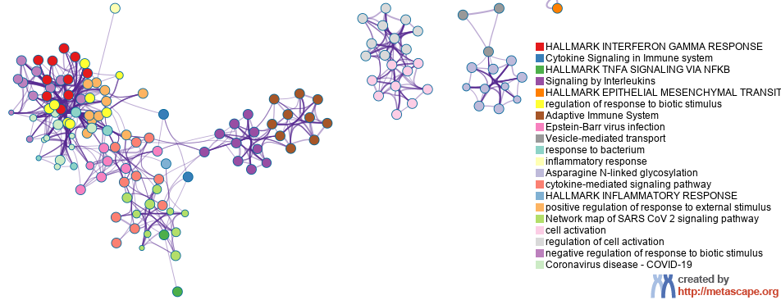
Enriched Ontology Clusters
Colored by Cluster ID
Notes:
We selected a subset of representative terms from the full cluster and converted them into a network layout. More specifically, each term is represented by a circle node, where its size is proportional to the number of input genes fall under that term, and its color represent its cluster identity (i.e., nodes of the same color belong to the same cluster). Terms with a similarity score > 0.3 are linked by an edge (the thickness of the edge represents the similarity score). The network is visualized with Cytoscape with “force-directed” layout and with edge bundled for clarity. One term from each cluster is selected to have its term description shown as label.

Slide 7
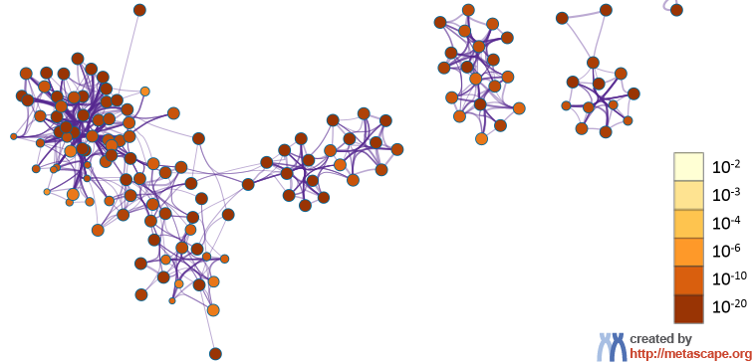
Enriched Ontology Clusters
Colored by p-Value
Notes:
The same enrichment network has its nodes colored by p-value, as shown in the legend. The dark the color, the more statistically significant the node is (see legend for p-value ranges).

Slide 8
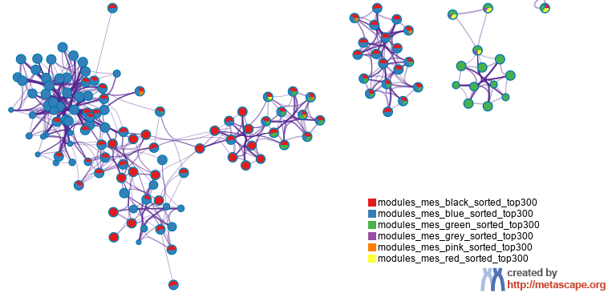
Enriched Ontology Clusters
Pied by Gene Counts Across Studies
Notes:
The same enrichment network has its nodes displayed as pies. Each pie sector is proportional to the number of hits originated from a gene list.
Color code for pie sector represents a gene list and is consistent with the colors used for table rows in slide #2.

Slide 9
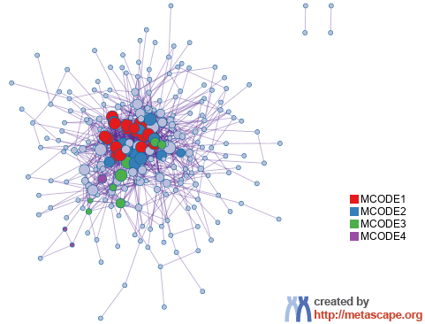
Protein-protein Interaction Network
Gene List: modules_mes_black_sorted_top300
Notes:
All protein-protein interactions among input genes were extracted from PPI data source and formed a PPI network.
GO enrichment analysis was applied to the network to extract “biological meanings”.

Slide 10
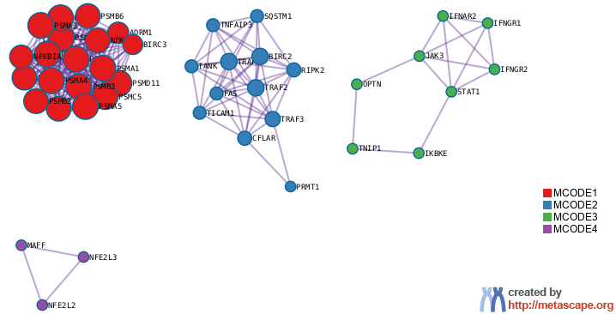
PPI MCODE Components
Gene List: modules_mes_black_sorted_top300
Notes:
MCODE algorithm was then applied to this network to identify neighborhoods where proteins are densely connected. Each MCODE network is assigned a unique color.

Slide 11
Biological Interpretation
PPI Network & MCODE Components
Gene List: modules_mes_black_sorted_top300
Network | Annotation
modules_mes_black_sorted_top300 | M5890|HALLMARK TNFA SIGNALING VIA NFKB|-44.6;R-HSA-1280215|Cytokine Signaling in Immune system|-43.0;R-HSA-449147|Signaling by Interleukins|-38.4
modules_mes_black_sorted_top300_MCODE_ALL | R-HSA-9020702|Interleukin-1 signaling|-37.5;R-HSA-5688426|Deubiquitination|-35.0;R-HSA-446652|Interleukin-1 family signaling|-34.8
modules_mes_black_sorted_top300_SUB1_MCODE_1 | R-HSA-1169091|Activation of NF-kappaB in B cells|-43.9;R-HSA-2871837|FCERI mediated NF-kB activation|-42.2;R-HSA-1168372|Downstream signaling events of B Cell Receptor (BCR)|-42.1
modules_mes_black_sorted_top300_SUB1_MCODE_2 | GO:0043122|regulation of canonical NF-kappaB signal transduction|-18.6;R-HSA-73887|Death Receptor Signaling|-15.7;hsa04064|NF-kappa B signaling pathway|-14.4
modules_mes_black_sorted_top300_SUB1_MCODE_3 | GO:0140888|interferon-mediated signaling pathway|-11.8;WP4197|Immune response to tuberculosis|-10.8;GO:0045087|innate immune response|-10.3
Notes:
GO enrichment analysis was applied to each MCODE network to extract “biological meanings” from the network component, where top three best p-value terms were retained.

Slide 12
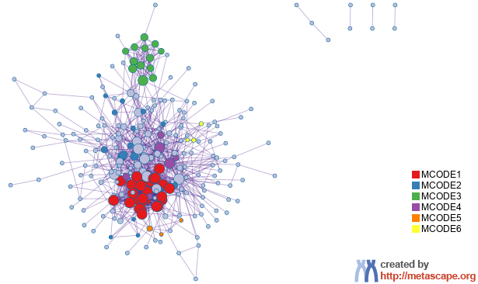
Protein-protein Interaction Network
Gene List: modules_mes_blue_sorted_top300

Slide 13
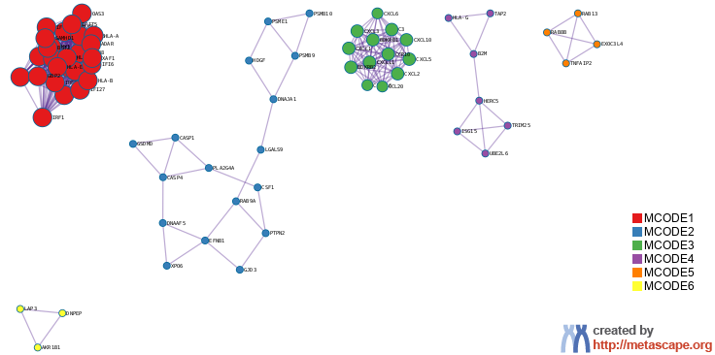
PPI MCODE Components
Gene List: modules_mes_blue_sorted_top300

Slide 14
Biological Interpretation
PPI Network & MCODE Components
Gene List: modules_mes_blue_sorted_top300
Network | Annotation
modules_mes_blue_sorted_top300 | M5913|HALLMARK INTERFERON GAMMA RESPONSE|-100.0;M5911|HALLMARK INTERFERON ALPHA RESPONSE|-89.5;GO:0045087|innate immune response|-56.2
modules_mes_blue_sorted_top300_MCODE_ALL | M5913|HALLMARK INTERFERON GAMMA RESPONSE|-59.7;R-HSA-909733|Interferon alpha/beta signaling|-58.1;R-HSA-1280215|Cytokine Signaling in Immune system|-52.9
modules_mes_blue_sorted_top300_SUB1_MCODE_1 | R-HSA-909733|Interferon alpha/beta signaling|-72.3;R-HSA-913531|Interferon Signaling|-56.0;R-HSA-1280215|Cytokine Signaling in Immune system|-43.0
modules_mes_blue_sorted_top300_SUB1_MCODE_2 | M5913|HALLMARK INTERFERON GAMMA RESPONSE|-11.0;R-HSA-449147|Signaling by Interleukins|-10.1;R-HSA-446652|Interleukin-1 family signaling|-9.8
modules_mes_blue_sorted_top300_SUB1_MCODE_3 | R-HSA-375276|Peptide ligand-binding receptors|-28.5;R-HSA-418594|G alpha (i) signalling events|-25.8;R-HSA-373076|Class A/1 (Rhodopsin-like receptors)|-25.5
modules_mes_blue_sorted_top300_SUB1_MCODE_4 | R-HSA-913531|Interferon Signaling|-11.5;R-HSA-936440|Negative regulators of DDX58/IFIH1 signaling|-10.3;GO:0032020|ISG15-protein conjugation|-9.8
modules_mes_blue_sorted_top300_SUB1_MCODE_5 | GO:0006887|exocytosis|-8.4;GO:0032940|secretion by cell|-7.5;GO:0140352|export from cell|-7.2

Slide 15
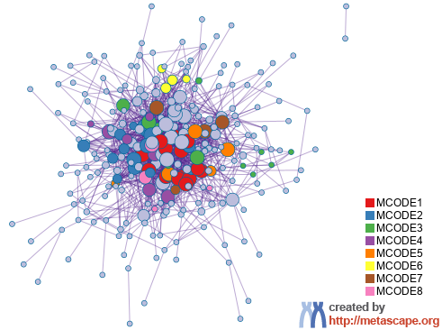
Protein-protein Interaction Network
Gene List: modules_mes_green_sorted_top300

Slide 16
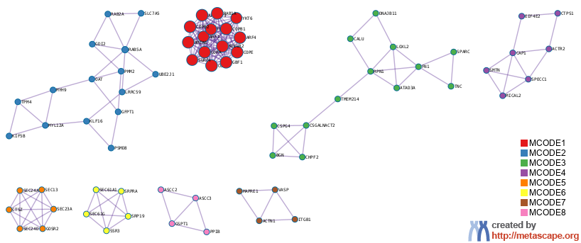
PPI MCODE Components
Gene List: modules_mes_green_sorted_top300

Slide 17
Biological Interpretation
PPI Network & MCODE Components
Gene List: modules_mes_green_sorted_top300
Network | Annotation
modules_mes_green_sorted_top300 | R-HSA-446203|Asparagine N-linked glycosylation|-26.6;GO:0048193|Golgi vesicle transport|-22.9;R-HSA-199991|Membrane Trafficking|-21.8
modules_mes_green_sorted_top300_MCODE_ALL | R-HSA-199977|ER to Golgi Anterograde Transport|-29.5;R-HSA-446203|Asparagine N-linked glycosylation|-28.4;R-HSA-948021|Transport to the Golgi and subsequent modification|-27.8
modules_mes_green_sorted_top300_SUB1_MCODE_1 | R-HSA-6811434|COPI-dependent Golgi-to-ER retrograde traffic|-34.0;R-HSA-6807878|COPI-mediated anterograde transport|-33.9;R-HSA-6811442|Intra-Golgi and retrograde Golgi-to-ER traffic|-32.9
modules_mes_green_sorted_top300_SUB1_MCODE_2 | hsa04814|Motor proteins|-5.7;R-HSA-9725370|Signaling by ALK fusions and activated point mutants|-5.6;R-HSA-9700206|Signaling by ALK in cancer|-5.6
modules_mes_green_sorted_top300_SUB1_MCODE_3 | R-HSA-2022870|Chondroitin sulfate biosynthesis|-10.0;M5930|HALLMARK EPITHELIAL MESENCHYMAL TRANSITION|-9.9;R-HSA-1793185|Chondroitin sulfate/dermatan sulfate metabolism|-8.3
modules_mes_green_sorted_top300_SUB1_MCODE_4 | GO:0030036|actin cytoskeleton organization|-7.4;GO:0030029|actin filament-based process|-7.2;GO:0007015|actin filament organization|-4.6
modules_mes_green_sorted_top300_SUB1_MCODE_5 | R-HSA-204005|COPII-mediated vesicle transport|-16.0;R-HSA-5694530|Cargo concentration in the ER|-14.2;R-HSA-199977|ER to Golgi Anterograde Transport|-13.8
modules_mes_green_sorted_top300_SUB1_MCODE_6 | GO:0045047|protein targeting to ER|-14.2;GO:0072599|establishment of protein localization to endoplasmic reticulum|-14.0;GO:0070972|protein localization to endoplasmic reticulum|-13.1
modules_mes_green_sorted_top300_SUB1_MCODE_7 | R-HSA-446353|Cell-extracellular matrix interactions|-9.2;GO:0097435|supramolecular fiber organization|-6.8;R-HSA-446728|Cell junction organization|-6.7
modules_mes_green_sorted_top300_SUB1_MCODE_8 | GO:0022411|cellular component disassembly|-5.2;GO:0006412|translation|-5.1;GO:0043043|peptide biosynthetic process|-5.0

Slide 18
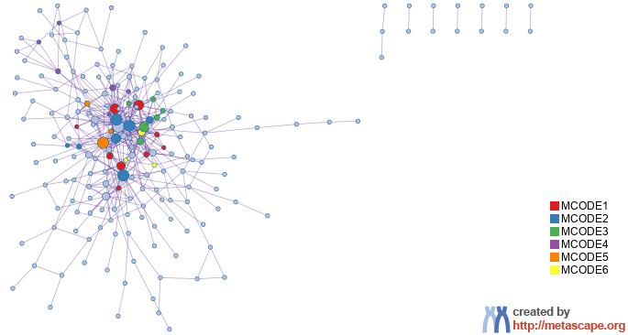
Protein-protein Interaction Network
Gene List: modules_mes_grey_sorted_top300

Slide 19
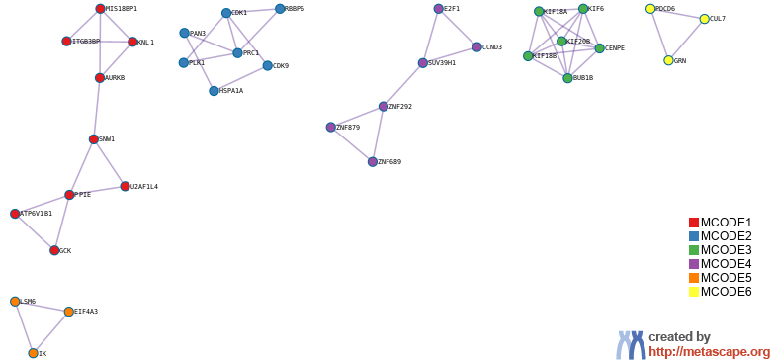
PPI MCODE Components
Gene List: modules_mes_grey_sorted_top300

Slide 20
Biological Interpretation
PPI Network & MCODE Components
Gene List: modules_mes_grey_sorted_top300
Network | Annotation
modules_mes_grey_sorted_top300 | GO:0051301|cell division|-11.2;GO:0000278|mitotic cell cycle|-10.2;GO:1903047|mitotic cell cycle process|-9.7
modules_mes_grey_sorted_top300_MCODE_ALL | GO:0051301|cell division|-14.2;GO:1903047|mitotic cell cycle process|-12.8;GO:0010564|regulation of cell cycle process|-12.2
modules_mes_grey_sorted_top300_SUB1_MCODE_1 | R-HSA-774815|Nucleosome assembly|-6.0;R-HSA-606279|Deposition of new CENPA-containing nucleosomes at the centromere|-6.0;R-HSA-141424|Amplification of signal from the kinetochores|-5.6
modules_mes_grey_sorted_top300_SUB1_MCODE_2 | M129|PID PLK1 PATHWAY|-6.9;GO:1902850|microtubule cytoskeleton organization involved in mitosis|-5.6;GO:0006260|DNA replication|-5.0
modules_mes_grey_sorted_top300_SUB1_MCODE_3 | R-HSA-983189|Kinesins|-12.9;R-HSA-6811434|COPI-dependent Golgi-to-ER retrograde traffic|-11.7;R-HSA-8856688|Golgi-to-ER retrograde transport|-11.0
modules_mes_grey_sorted_top300_SUB1_MCODE_4 | M279|PID RB 1PATHWAY|-6.7;WP2446|Retinoblastoma gene in cancer|-6.3
modules_mes_grey_sorted_top300_SUB1_MCODE_5 | R-HSA-72163|mRNA Splicing - Major Pathway|-6.5;R-HSA-72172|mRNA Splicing|-6.5;GO:0000398|mRNA splicing, via spliceosome|-6.1

Slide 21
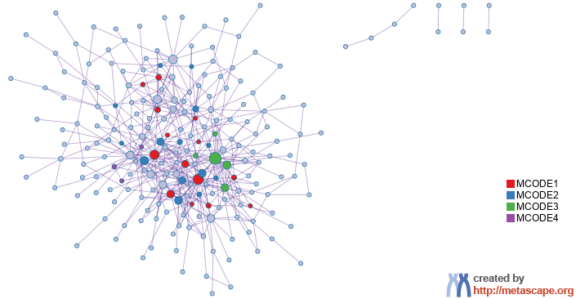
Protein-protein Interaction Network
Gene List: modules_mes_pink_sorted_top300

Slide 22
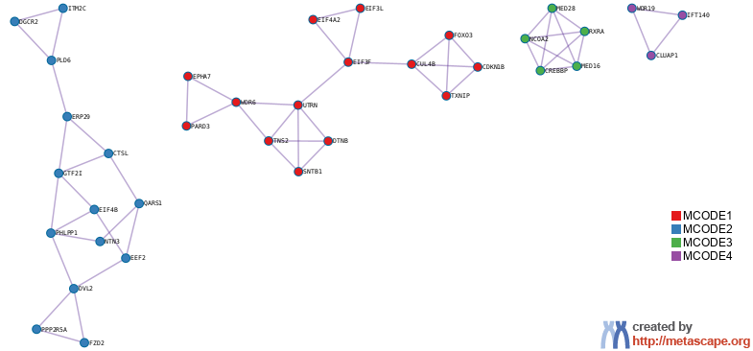
PPI MCODE Components
Gene List: modules_mes_pink_sorted_top300

Slide 23
Biological Interpretation
PPI Network & MCODE Components
Gene List: modules_mes_pink_sorted_top300
Network | Annotation
modules_mes_pink_sorted_top300 | GO:0048568|embryonic organ development|-9.9;GO:0048598|embryonic morphogenesis|-9.5;GO:0048562|embryonic organ morphogenesis|-9.3
modules_mes_pink_sorted_top300_MCODE_ALL | R-HSA-381340|Transcriptional regulation of white adipocyte differentiation|-7.3;R-HSA-9617629|Regulation of FOXO transcriptional activity by acetylation|-6.7;R-HSA-1989781|PPARA activates gene expression|-6.6
modules_mes_pink_sorted_top300_SUB1_MCODE_1 | GO:0002183|cytoplasmic translational initiation|-6.4;R-HSA-72649|Translation initiation complex formation|-5.6;R-HSA-72702|Ribosomal scanning and start codon recognition|-5.6
modules_mes_pink_sorted_top300_SUB1_MCODE_2 | R-HSA-4641262|Disassembly of the destruction complex and recruitment of AXIN to the membrane|-6.5;GO:2001233|regulation of apoptotic signaling pathway|-4.6;hsa04150|mTOR signaling pathway|-4.3
modules_mes_pink_sorted_top300_SUB1_MCODE_3 | R-HSA-381340|Transcriptional regulation of white adipocyte differentiation|-12.8;R-HSA-1989781|PPARA activates gene expression|-12.1;R-HSA-400206|Regulation of lipid metabolism by PPARalpha|-12.1
modules_mes_pink_sorted_top300_SUB1_MCODE_4 | GO:0042073|intraciliary transport|-8.4;R-HSA-5620924|Intraflagellar transport|-8.3;WP5234|Bardet Biedl syndrome|-7.6

Slide 24
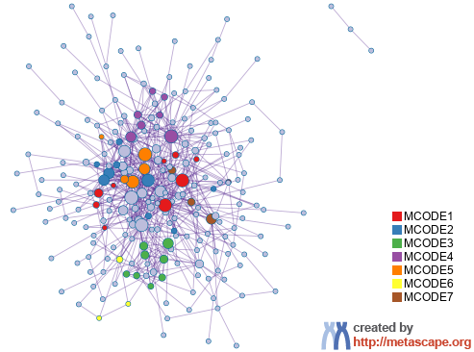
Protein-protein Interaction Network
Gene List: modules_mes_red_sorted_top300

Slide 25
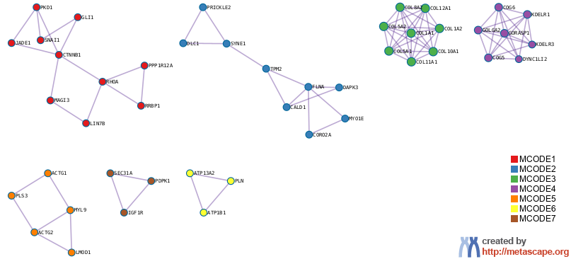
PPI MCODE Components
Gene List: modules_mes_red_sorted_top300

Slide 26
Biological Interpretation
PPI Network & MCODE Components
Gene List: modules_mes_red_sorted_top300
Network | Annotation
modules_mes_red_sorted_top300 | M5930|HALLMARK EPITHELIAL MESENCHYMAL TRANSITION|-15.9;GO:0030036|actin cytoskeleton organization|-12.8;M160|PID AVB3 INTEGRIN PATHWAY|-12.3
modules_mes_red_sorted_top300_MCODE_ALL | M160|PID AVB3 INTEGRIN PATHWAY|-16.9;GO:0097435|supramolecular fiber organization|-15.9;M3005|NABA COLLAGENS|-14.7
modules_mes_red_sorted_top300_SUB1_MCODE_1 | GO:0001503|ossification|-7.8;GO:0001649|osteoblast differentiation|-7.1;WP2839|Hair follicle development organogenesis part 2 of 3|-6.9
modules_mes_red_sorted_top300_SUB1_MCODE_2 | GO:0030036|actin cytoskeleton organization|-6.7;GO:0030029|actin filament-based process|-6.4;GO:0007015|actin filament organization|-6.1
modules_mes_red_sorted_top300_SUB1_MCODE_3 | M3005|NABA COLLAGENS|-23.0;R-HSA-8948216|Collagen chain trimerization|-23.0;M198|PID SYNDECAN 1 PATHWAY|-22.8
modules_mes_red_sorted_top300_SUB1_MCODE_4 | R-HSA-6807878|COPI-mediated anterograde transport|-17.4;R-HSA-199977|ER to Golgi Anterograde Transport|-16.1;R-HSA-948021|Transport to the Golgi and subsequent modification|-15.5
modules_mes_red_sorted_top300_SUB1_MCODE_5 | R-HSA-445355|Smooth Muscle Contraction|-7.5;GO:0030239|myofibril assembly|-6.9;GO:0055002|striated muscle cell development|-6.9
modules_mes_red_sorted_top300_SUB1_MCODE_6 | R-HSA-936837|Ion transport by P-type ATPases|-8.2;R-HSA-983712|Ion channel transport|-6.6;GO:0006874|intracellular calcium ion homeostasis|-6.5

Slide 27
Evidence Weighting by Machine Learning Approach
Notes:
In the precision-recall plot, the precision is defined as TP/(TP+FP), and recall (a.k.a. TPR) is defined as TP/(TP+FN). If the evidence matrix is effective, we expect precision decreases as recall increases, which implies the hits ranked to the top are more likely true positives (higher precision). AUC (area under curve) in the plot represents the average precision value. The precision value expected for a random hit prioritization algorithm can be read from the last data point of the step curve, where all genes were classified as hits (recall = 1).
The second plot shows how the number of true positives increase as we include more genes. A good result would show the TPR curve to be significantly above the diagonal line, where the diagonal line represents the result achieved by random hit prioritization.
The third plot is a bar graph showing the relative weights assigned to each evidence line (up to top ten lines). If an evidence line contributes negatively, it will be colored in orange, otherwise, in blue.
The last plot shows the predicted probability of benchmark genes, a good result would place many benchmark genes (shown as orange "+") towards the upper portion of the curve (with probability above 50%). If benchmark genes are centered around 50%, it implies true hit status cannot be effectively predicted from the underlying evidence line (we will see a low prediction accuracy).
If these plots strongly support the effective of evidence lines in retrospectively recapturing benchmark genes, the predicted evidence score and probability can then be used to prioritize gene candidates.
Please see https://en.wikipedia.org/wiki/Sensitivity_and_specificity for a summary of terminologies such as TP, FP, TN, FN, TPR, Precision, Recall, etc.

Slide 28


metascape.org
bioinformatics for biologists
Hint: If you have multiple related gene lists, upload them in one Excel file will trigger meta analyses.
Easy, Fresh & Free
Submit gene identifiers, one click on Expression Analysis. Done!
Interpretable results: visualizations, methods, pptx, xslx, zip
Best Practices for Gene List Analyses
Rich annotations for thousands of genes at once
Pathway & process enrichment analysis
Protein-protein interaction network analysis
Overlap analysis across multiple gene lists
Common and unique pathways across multiple studies
Support key model organisms
Scalable
Docker containers available for bioinformaticians
Notes:
Thank you for using Metascape, you are welcome to past question to our public forum: https://metascape.freeforums.net, or email us with your private questions at “metascape.team at gmail.com”.

