Slide 1

Gene List Analysis Report
Hint: Each slide has notes that explain the analysis!
http://metascape.org
Please cite Zhou et al. Nature Commun. 2019 10(1):1523
Feb 8, 2024
Notes:
This analysis report is automatically generated by Metascape (https://metascape.org).

Slide 2
Gene List Summary
Name | Total | Unique | _Color_
down_common_genes | 233 | 233 | #E41A1C
down_epi_only | 367 | 367 | #377EB8
down_mes_only | 333 | 333 | #4DAF4A
down_mes_up_epi | 194 | 194 | #984EA3
up_common_genes | 234 | 234 | #FF7F00
up_epi_only | 370 | 370 | #FFFF33
up_mes_down_epi | 189 | 189 | #A65628
up_mes_only | 281 | 281 | #F781BF
Please check online Metascape User Manual for explanation of each annotation field.
Notes:
Metascape first automatically converts you input identifiers (Entrez Gene ID, RefSeq, Ensembl ID, UnProt ID or Symbol) into Human Entrez Gene ID. For example, input identifiers can be from human, mouse or rat orthologs, which can be mapped into human (or “analysis as” species) based on both EggNOG and Homologene databases.
The background of each row is the color code used in the various plots within this report, where each color is consistently used to code a corresponding gene list.

Slide 3
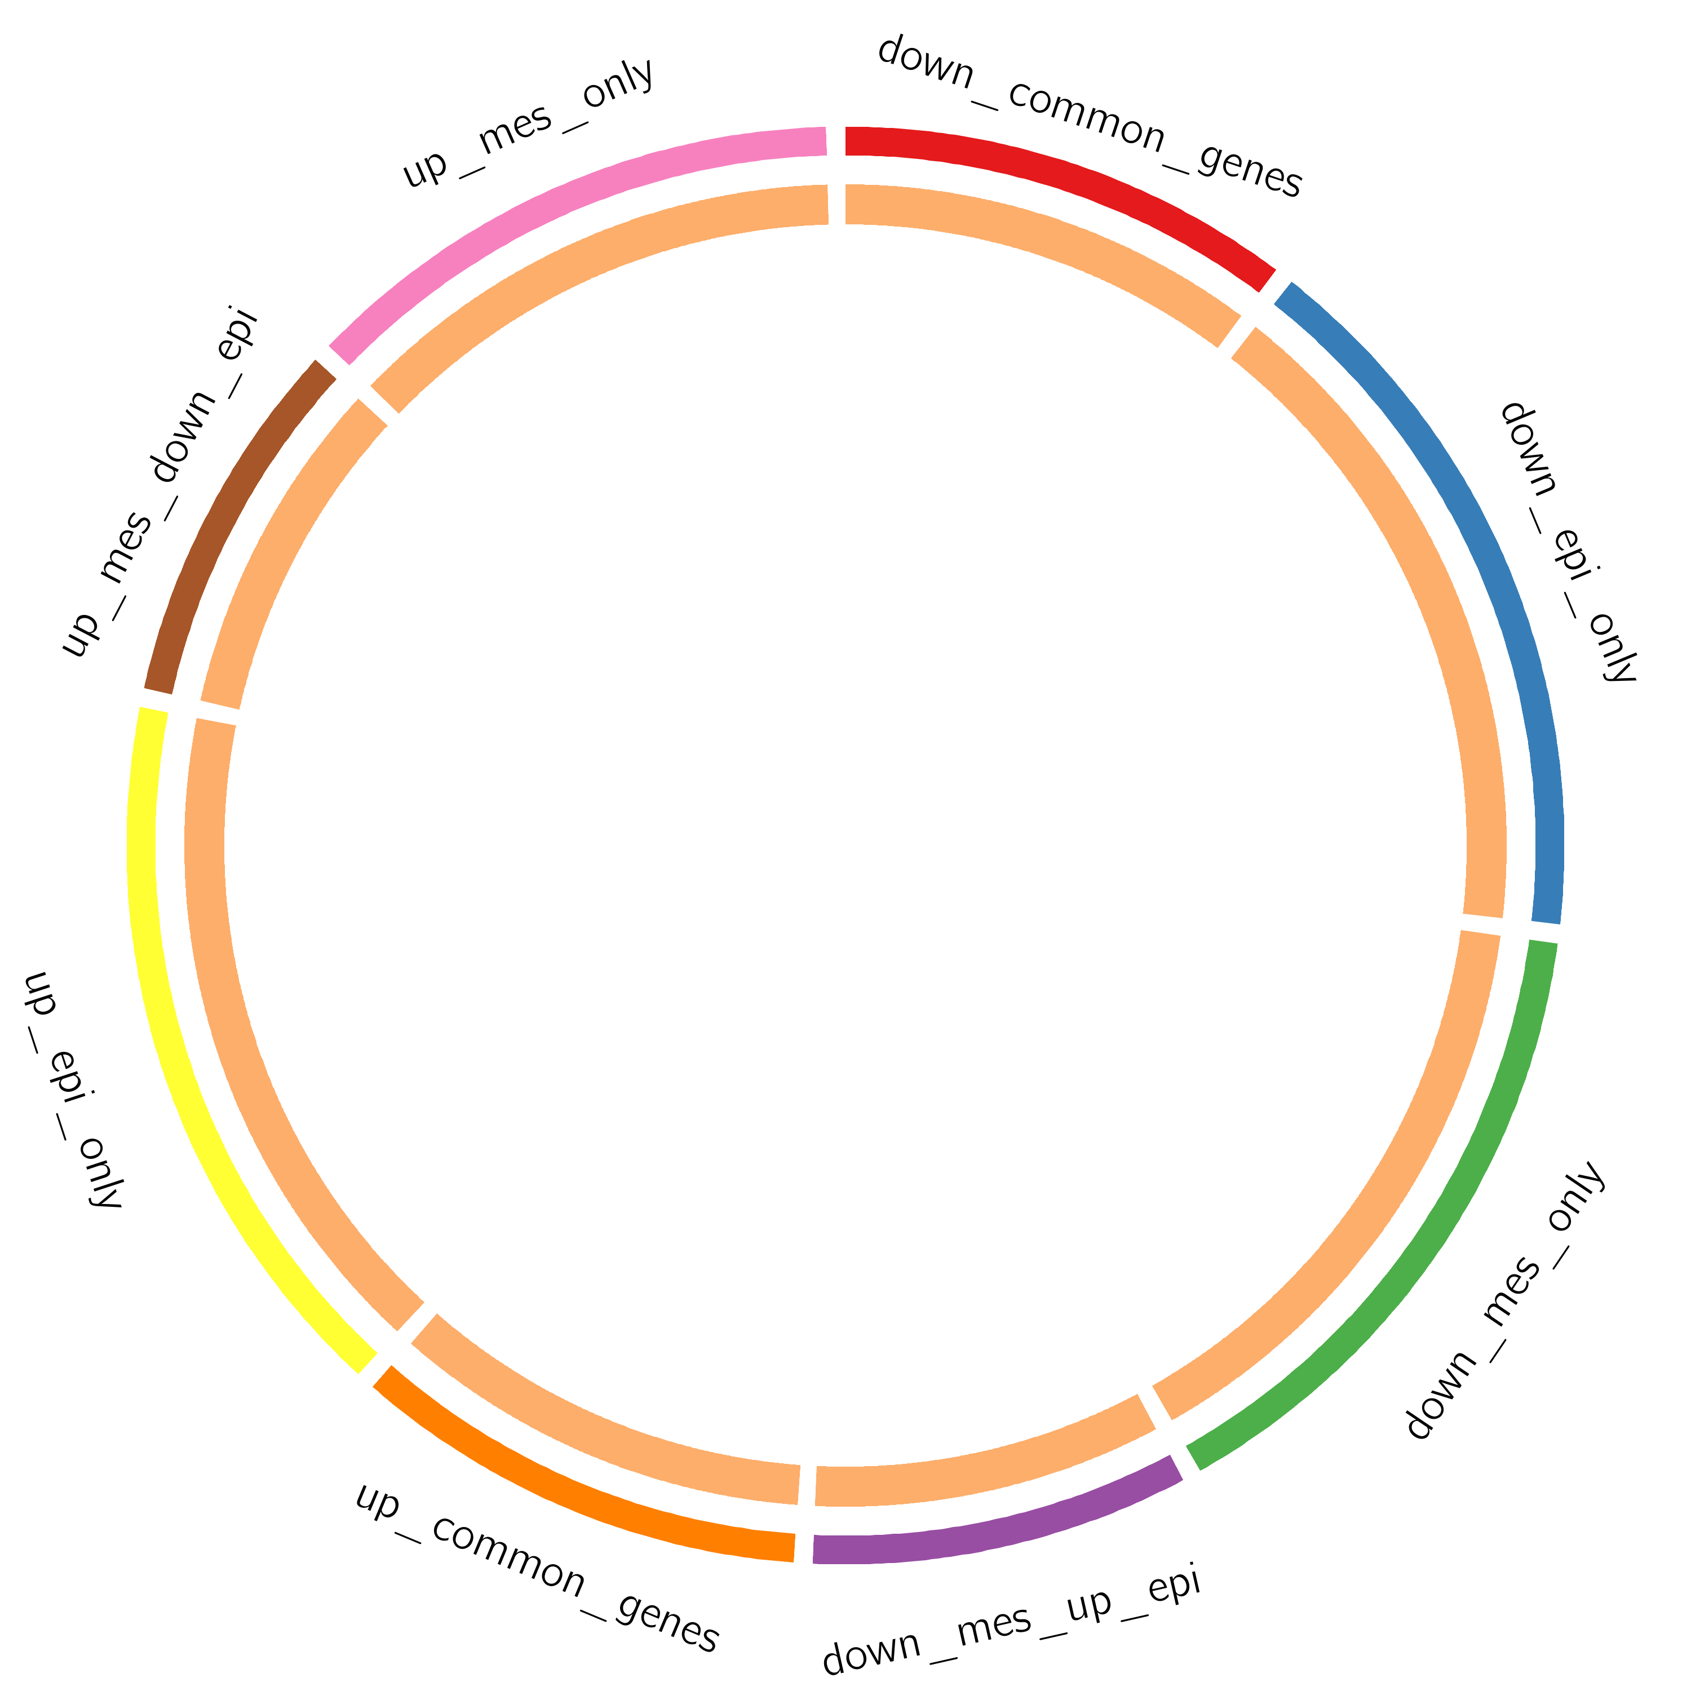
Gene Overlap Analysis
Notes:
The Circos plot shows how genes from the input gene lists overlap.
On the outside, each arc represents the identity of each gene list, using the same color code as the color used for table rows in slide #2.
On the inside, each arc represents a gene list, where each gene member of that list is assigned a spot on the arc. Dark orange color represents the genes that are shared by multiple lists and light orange color represents genes that are unique to that gene list.
Purple lines link the same gene that are shared by multiple gene lists (notice a gene that appears in two gene lists will be mapped once onto each gene list, therefore, the two positions are purple linked).
The greater the number of purple links and the longer the dark orange arcs implies greater overlap among the input gene lists.

Slide 4
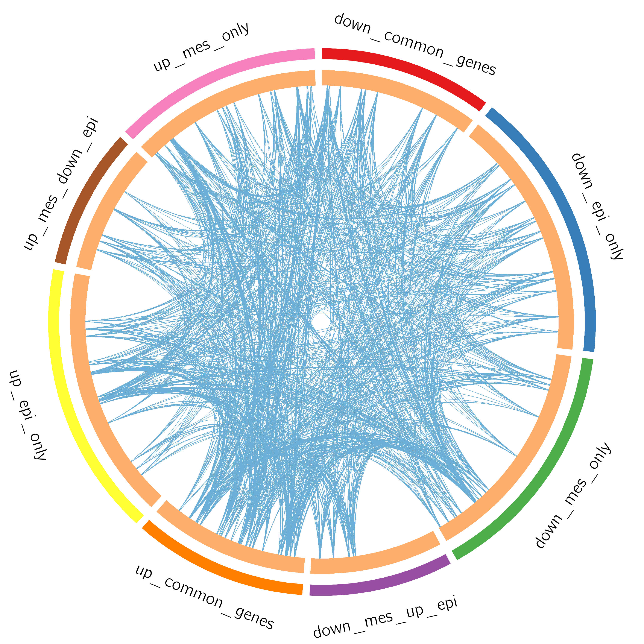
Gene Overlap Analysis
Expanded via Shared Enriched Ontologies
Notes:
The Circos plot shows how genes from the input gene lists overlap.
On the outside, each arc represents the identity of each gene list, using the same color code as the color used for table rows in slide #2.
On the inside, each arc represents a gene list, where each gene member of that list is assigned a spot on the arc. Dark orange color represents the genes that are shared by multiple lists and light orange color represents genes that are unique to that gene list.
Purple lines link the same gene that are shared by multiple gene lists (notice a gene that appears in two gene lists will be mapped once onto each gene list, therefore, the two positions are purple linked). Blue lines link the genes, although different, fall under the same ontology term (the term has to statistically significantly enriched and with size no larger than 100).
The greater the number of purple links and the longer the dark orange arcs implies greater overlap among the input gene lists. Blue links indicate the amount of functional overlap among the input gene lists. It is common in meta-analysis that we observe little directly overlap among studies, due to the variations in the biological assays used. However, we tend to see a lot more functional overlap, as these studies probably pick up different subset of gene members of the same biological processes.

Slide 5
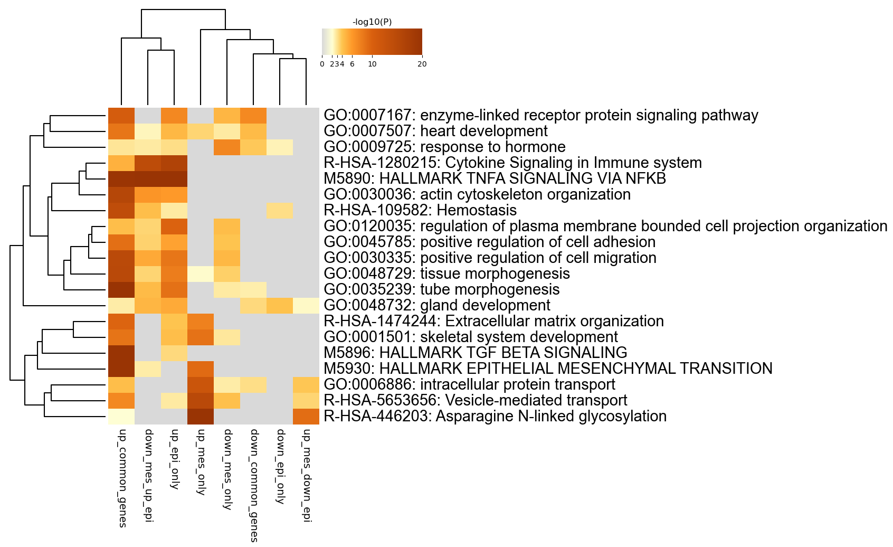
Enriched Ontology Clusters
Across Studies
Notes:
We first identified all statistically enriched terms (can be GO/KEGG terms, canonical pathways, hall mark gene sets, etc., based on the default choices under Express Analysis or your choice during Custom Analysis), accumulative hypergeometric p-values and enrichment factors were calculated and used for filtering. Remaining significant terms were then hierarchically clustered into a tree based on Kappa-statistical similarities among their gene memberships (similar to what is used in NCI DAVID site). Then 0.3 kappa score was applied as the threshold to cast the tree into term clusters. The terms within each cluster are exported in the Excel spreadsheet named “Enrichment Analysis”.
We selected the term with the best p-value within each cluster as its representative term and display them in a dendrogram. The heatmap cells are colored by their p-values, white cells indicate the lack of enrichment for that term in the corresponding gene list. We also export files behind this heatmap (.cdt, .gtr, .atr, and .jtv files), so that one can visualize it interactively using JTreeView program (http://sourceforge.net/projects/jtreeview/). The PDF version of the graph can be found in the zip package.
If you want to view the complete list of enriched terms, please download the .zip file and check Enrichment_GO/GO_AllLists.csv.
Note: gene lists containing more than 3000 genes are not analyzed. Please use a more stringent hit calling criterion, as you most likely have retained too many genes.

Slide 6
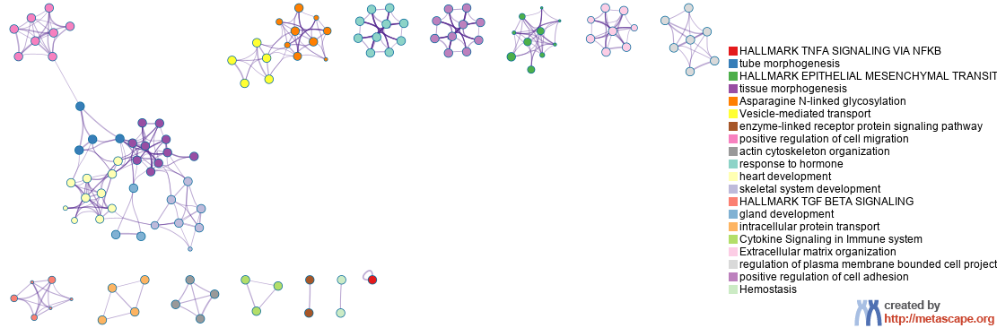
Enriched Ontology Clusters
Colored by Cluster ID
Notes:
We selected a subset of representative terms from the full cluster and converted them into a network layout. More specifically, each term is represented by a circle node, where its size is proportional to the number of input genes fall under that term, and its color represent its cluster identity (i.e., nodes of the same color belong to the same cluster). Terms with a similarity score > 0.3 are linked by an edge (the thickness of the edge represents the similarity score). The network is visualized with Cytoscape with “force-directed” layout and with edge bundled for clarity. One term from each cluster is selected to have its term description shown as label.

Slide 7
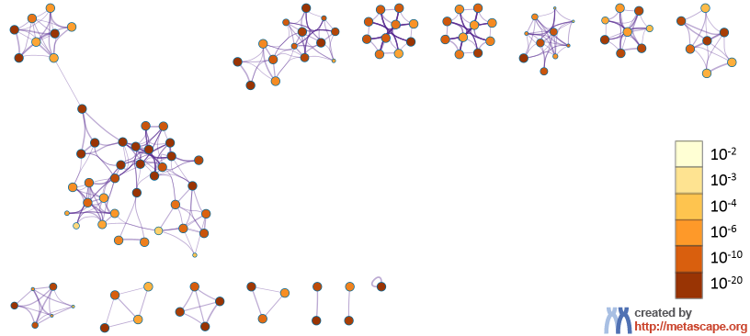
Enriched Ontology Clusters
Colored by p-Value
Notes:
The same enrichment network has its nodes colored by p-value, as shown in the legend. The dark the color, the more statistically significant the node is (see legend for p-value ranges).

Slide 8
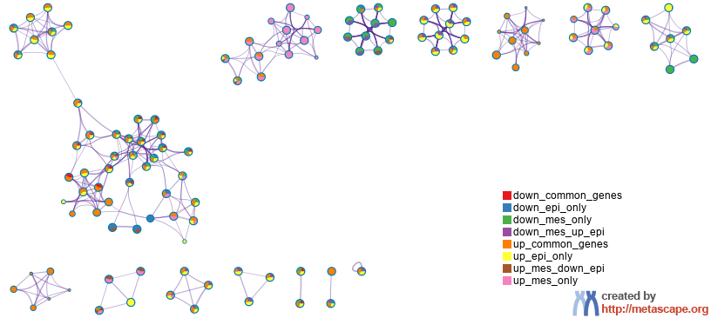
Enriched Ontology Clusters
Pied by Gene Counts Across Studies
Notes:
The same enrichment network has its nodes displayed as pies. Each pie sector is proportional to the number of hits originated from a gene list.
Color code for pie sector represents a gene list and is consistent with the colors used for table rows in slide #2.

Slide 9
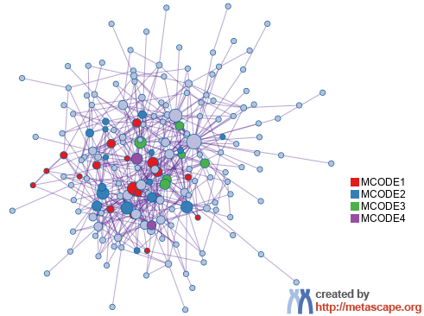
Protein-protein Interaction Network
Gene List: down_common_genes
Notes:
All protein-protein interactions among input genes were extracted from PPI data source and formed a PPI network.
GO enrichment analysis was applied to the network to extract “biological meanings”.

Slide 10
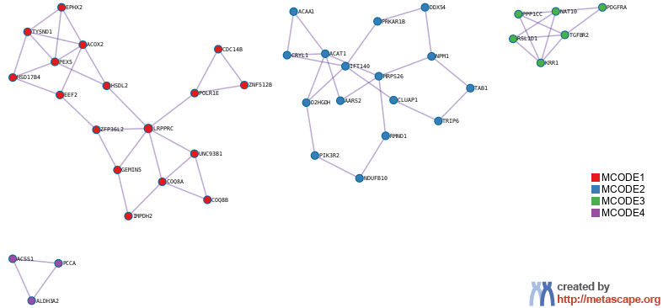
PPI MCODE Components
Gene List: down_common_genes
Notes:
MCODE algorithm was then applied to this network to identify neighborhoods where proteins are densely connected. Each MCODE network is assigned a unique color.

Slide 11
Biological Interpretation
PPI Network & MCODE Components
Gene List: down_common_genes
Network | Annotation
down_common_genes | GO:0044282|small molecule catabolic process|-13.4;GO:0016054|organic acid catabolic process|-13.2;GO:0046395|carboxylic acid catabolic process|-13.2
down_common_genes_MCODE_ALL | GO:0072329|monocarboxylic acid catabolic process|-9.6;R-HSA-9033241|Peroxisomal protein import|-9.5;GO:0006631|fatty acid metabolic process|-9.3
down_common_genes_SUB1_MCODE_1 | R-HSA-9033241|Peroxisomal protein import|-9.7;R-HSA-9609507|Protein localization|-7.6;hsa04146|Peroxisome|-6.9
down_common_genes_SUB1_MCODE_2 | GO:0072329|monocarboxylic acid catabolic process|-4.5;GO:0031503|protein-containing complex localization|-4.1;GO:0090407|organophosphate biosynthetic process|-3.8
down_common_genes_SUB1_MCODE_3 | GO:0006364|rRNA processing|-5.1;GO:0016072|rRNA metabolic process|-5.0;GO:0042254|ribosome biogenesis|-4.7
down_common_genes_SUB1_MCODE_4 | GO:0006631|fatty acid metabolic process|-5.9;GO:0032787|monocarboxylic acid metabolic process|-5.3
Notes:
GO enrichment analysis was applied to each MCODE network to extract “biological meanings” from the network component, where top three best p-value terms were retained.

Slide 12
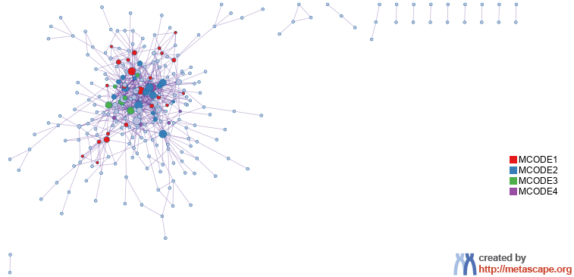
Protein-protein Interaction Network
Gene List: down_epi_only

Slide 13
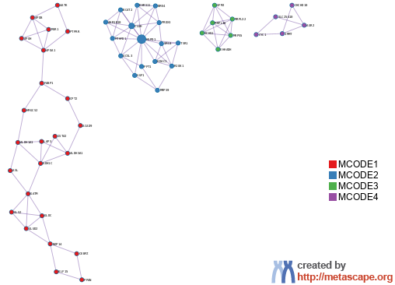
PPI MCODE Components
Gene List: down_epi_only

Slide 14
Biological Interpretation
PPI Network & MCODE Components
Gene List: down_epi_only
Network | Annotation
down_epi_only | GO:0044282|small molecule catabolic process|-16.1;GO:0046395|carboxylic acid catabolic process|-12.7;GO:0016054|organic acid catabolic process|-12.7
down_epi_only_MCODE_ALL | M5935|HALLMARK FATTY ACID METABOLISM|-9.6;GO:0043604|amide biosynthetic process|-8.8;WP3942|PPAR signaling pathway|-8.8
down_epi_only_SUB1_MCODE_1 | M5935|HALLMARK FATTY ACID METABOLISM|-8.6;GO:0044283|small molecule biosynthetic process|-7.3;WP4583|Biomarkers for urea cycle disorders|-7.0
down_epi_only_SUB1_MCODE_2 | GO:0009152|purine ribonucleotide biosynthetic process|-5.6;GO:0009260|ribonucleotide biosynthetic process|-5.5;GO:0046390|ribose phosphate biosynthetic process|-5.4
down_epi_only_SUB1_MCODE_3 | R-HSA-5419276|Mitochondrial translation termination|-9.0;R-HSA-5368287|Mitochondrial translation|-8.9;GO:0032543|mitochondrial translation|-8.6
down_epi_only_SUB1_MCODE_4 | M5905|HALLMARK ADIPOGENESIS|-8.0

Slide 15
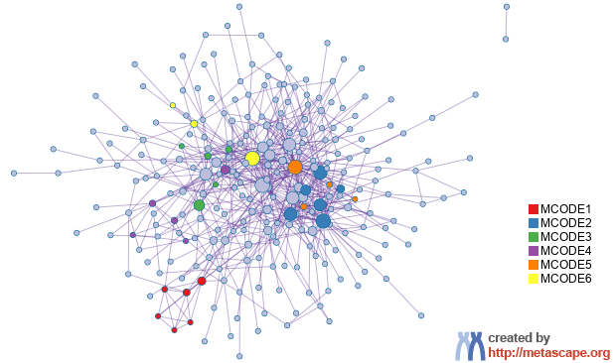
Protein-protein Interaction Network
Gene List: down_mes_only

Slide 16
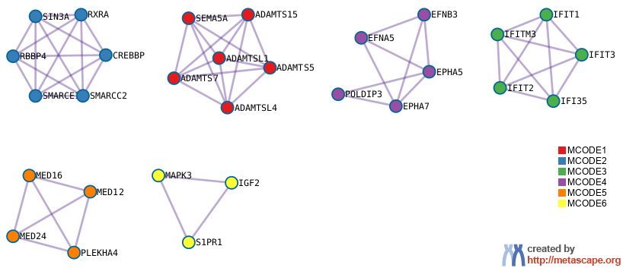
PPI MCODE Components
Gene List: down_mes_only

Slide 17
Biological Interpretation
PPI Network & MCODE Components
Gene List: down_mes_only
Network | Annotation
down_mes_only | GO:0060322|head development|-11.2;GO:0007420|brain development|-9.8;GO:0009725|response to hormone|-8.4
down_mes_only_MCODE_ALL | R-HSA-5083635|Defective B3GALTL causes PpS|-12.0;R-HSA-5173214|O-glycosylation of TSR domain-containing proteins|-11.9;hsa04919|Thyroid hormone signaling pathway|-10.7
down_mes_only_SUB1_MCODE_1 | R-HSA-5083635|Defective B3GALTL causes PpS|-17.7;R-HSA-5173214|O-glycosylation of TSR domain-containing proteins|-17.6;R-HSA-3906995|Diseases associated with O-glycosylation of proteins|-16.0
down_mes_only_SUB1_MCODE_2 | M13404|BIOCARTA VDR PATHWAY|-11.3;WP4204|Tumor suppressor activity of SMARCB1|-7.7;GO:0006338|chromatin remodeling|-7.6
down_mes_only_SUB1_MCODE_3 | R-HSA-909733|Interferon alpha/beta signaling|-13.0;M5913|HALLMARK INTERFERON GAMMA RESPONSE|-10.9;R-HSA-913531|Interferon Signaling|-10.3
down_mes_only_SUB1_MCODE_4 | GO:0048013|ephrin receptor signaling pathway|-10.5;R-HSA-3928665|EPH-ephrin mediated repulsion of cells|-10.4;R-HSA-2682334|EPH-Ephrin signaling|-9.4
down_mes_only_SUB1_MCODE_5 | GO:0060261|positive regulation of transcription initiation by RNA polymerase II|-7.5;GO:2000144|positive regulation of DNA-templated transcription initiation|-7.4;GO:0060260|regulation of transcription initiation by RNA polymerase II|-7.3

Slide 18
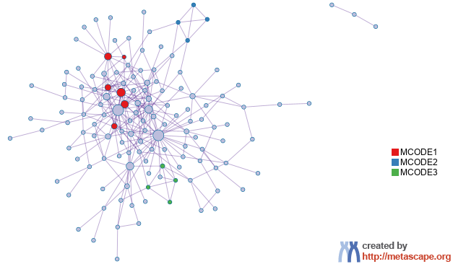
Protein-protein Interaction Network
Gene List: down_mes_up_epi

Slide 19
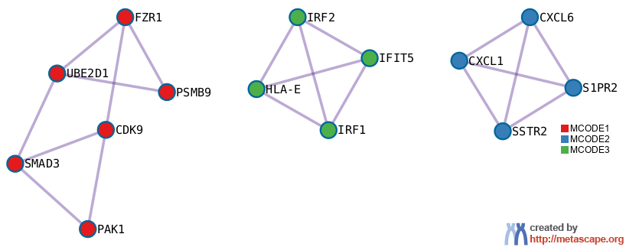
PPI MCODE Components
Gene List: down_mes_up_epi

Slide 20
Biological Interpretation
PPI Network & MCODE Components
Gene List: down_mes_up_epi
Network | Annotation
down_mes_up_epi | M5890|HALLMARK TNFA SIGNALING VIA NFKB|-22.1;R-HSA-1280215|Cytokine Signaling in Immune system|-17.7;M5913|HALLMARK INTERFERON GAMMA RESPONSE|-15.0
down_mes_up_epi_MCODE_ALL | R-HSA-1280215|Cytokine Signaling in Immune system|-9.3;R-HSA-909733|Interferon alpha/beta signaling|-7.4;WP619|Type II interferon signaling|-6.2
down_mes_up_epi_SUB1_MCODE_1 | R-HSA-2173793|Transcriptional activity of SMAD2/SMAD3:SMAD4 heterotrimer|-7.0;R-HSA-174084|Autodegradation of Cdh1 by Cdh1:APC/C|-6.8;R-HSA-69017|CDK-mediated phosphorylation and removal of Cdc6|-6.6
down_mes_up_epi_SUB1_MCODE_2 | R-HSA-418594|G alpha (i) signalling events|-7.9;R-HSA-373076|Class A/1 (Rhodopsin-like receptors)|-7.8;R-HSA-500792|GPCR ligand binding|-7.2
down_mes_up_epi_SUB1_MCODE_3 | R-HSA-909733|Interferon alpha/beta signaling|-10.4;R-HSA-913531|Interferon Signaling|-8.2;R-HSA-877300|Interferon gamma signaling|-6.9

Slide 21
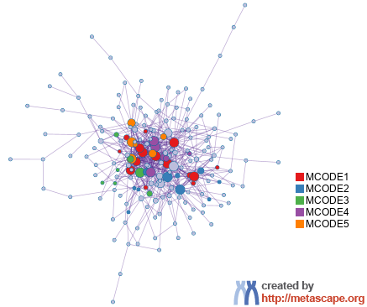
Protein-protein Interaction Network
Gene List: up_common_genes

Slide 22
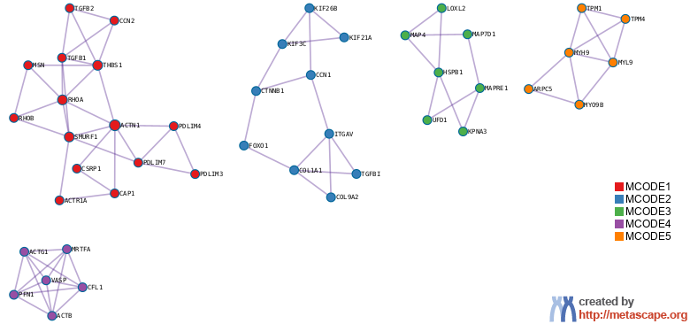
PPI MCODE Components
Gene List: up_common_genes

Slide 23
Biological Interpretation
PPI Network & MCODE Components
Gene List: up_common_genes
Network | Annotation
up_common_genes | M5930|HALLMARK EPITHELIAL MESENCHYMAL TRANSITION|-28.6;GO:0035239|tube morphogenesis|-21.9;GO:0001944|vasculature development|-21.8
up_common_genes_MCODE_ALL | GO:0030029|actin filament-based process|-22.0;GO:0030036|actin cytoskeleton organization|-21.4;M5930|HALLMARK EPITHELIAL MESENCHYMAL TRANSITION|-17.9
up_common_genes_SUB1_MCODE_1 | R-HSA-76002|Platelet activation, signaling and aggregation|-10.7;GO:0061061|muscle structure development|-10.4;M286|PID TGFBR PATHWAY|-10.4
up_common_genes_SUB1_MCODE_2 | M53|PID INTEGRIN3 PATHWAY|-9.1;GO:0001568|blood vessel development|-8.3;GO:0001944|vasculature development|-8.2
up_common_genes_SUB1_MCODE_3 | GO:0006886|intracellular protein transport|-3.8;GO:0000226|microtubule cytoskeleton organization|-3.7;GO:0097435|supramolecular fiber organization|-3.6
up_common_genes_SUB1_MCODE_4 | M16801|SIG REGULATION OF THE ACTIN CYTOSKELETON BY RHO GTPASES|-10.7;GO:0030036|actin cytoskeleton organization|-10.5;GO:0030029|actin filament-based process|-10.2
up_common_genes_SUB1_MCODE_5 | hsa04814|Motor proteins|-10.2;GO:0030029|actin filament-based process|-10.2;GO:0030036|actin cytoskeleton organization|-8.0

Slide 24
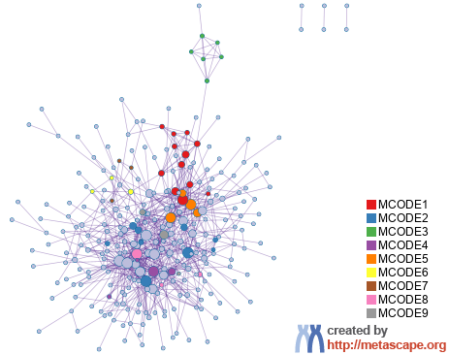
Protein-protein Interaction Network
Gene List: up_epi_only

Slide 25
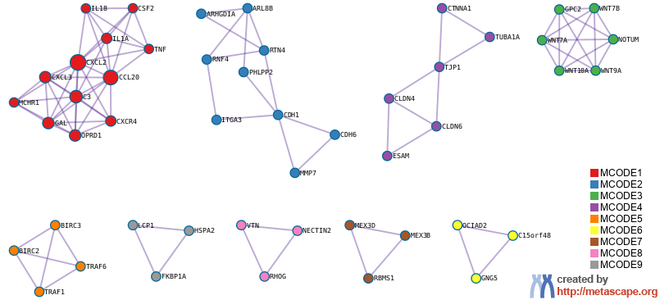
PPI MCODE Components
Gene List: up_epi_only

Slide 26
Biological Interpretation
PPI Network & MCODE Components
Gene List: up_epi_only
Network | Annotation
up_epi_only | M5890|HALLMARK TNFA SIGNALING VIA NFKB|-22.6;R-HSA-1280215|Cytokine Signaling in Immune system|-19.9;M5932|HALLMARK INFLAMMATORY RESPONSE|-12.1
up_epi_only_MCODE_ALL | WP4239|Epithelial to mesenchymal transition in colorectal cancer|-13.0;WP3617|Photodynamic therapy induced NF kB survival signaling|-12.9;R-HSA-500792|GPCR ligand binding|-12.4
up_epi_only_SUB1_MCODE_1 | R-HSA-375276|Peptide ligand-binding receptors|-14.8;hsa05323|Rheumatoid arthritis|-14.8;R-HSA-6783783|Interleukin-10 signaling|-14.0
up_epi_only_SUB1_MCODE_2 | M153|PID P75 NTR PATHWAY|-6.0;WP4541|Hippo Merlin signaling dysregulation|-5.3;GO:0031345|negative regulation of cell projection organization|-4.7
up_epi_only_SUB1_MCODE_3 | R-HSA-3238698|WNT ligand biogenesis and trafficking|-11.2;hsa04310|Wnt signaling pathway|-10.5;hsa05217|Basal cell carcinoma|-9.6
up_epi_only_SUB1_MCODE_4 | GO:0007043|cell-cell junction assembly|-11.2;GO:0034330|cell junction organization|-10.5;GO:0045216|cell-cell junction organization|-10.4
up_epi_only_SUB1_MCODE_5 | M45|PID CD40 PATHWAY|-12.0;GO:0033209|tumor necrosis factor-mediated signaling pathway|-10.9;hsa05222|Small cell lung cancer|-10.1

Slide 27
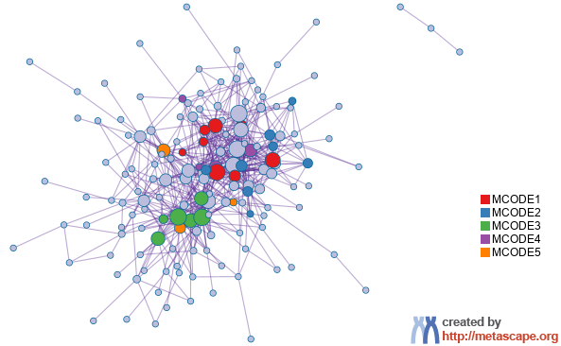
Protein-protein Interaction Network
Gene List: up_mes_down_epi

Slide 28
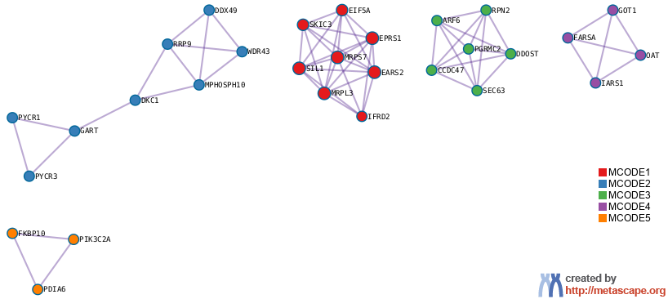
PPI MCODE Components
Gene List: up_mes_down_epi

Slide 29
Biological Interpretation
PPI Network & MCODE Components
Gene List: up_mes_down_epi
Network | Annotation
up_mes_down_epi | M5924|HALLMARK MTORC1 SIGNALING|-12.7;hsa04141|Protein processing in endoplasmic reticulum|-12.5;GO:0006457|protein folding|-12.2
up_mes_down_epi_MCODE_ALL | GO:0006520|amino acid metabolic process|-11.3;R-HSA-72766|Translation|-9.6;GO:0034660|ncRNA metabolic process|-9.0
up_mes_down_epi_SUB1_MCODE_1 | GO:0006412|translation|-9.9;GO:0043043|peptide biosynthetic process|-9.7;GO:0006518|peptide metabolic process|-9.2
up_mes_down_epi_SUB1_MCODE_2 | R-HSA-6790901|rRNA modification in the nucleus and cytosol|-11.8;R-HSA-8868773|rRNA processing in the nucleus and cytosol|-9.2;R-HSA-72312|rRNA processing|-9.1
up_mes_down_epi_SUB1_MCODE_3 | hsa04141|Protein processing in endoplasmic reticulum|-5.5;GO:0072657|protein localization to membrane|-4.1;GO:0051668|localization within membrane|-3.9
up_mes_down_epi_SUB1_MCODE_4 | GO:0006520|amino acid metabolic process|-8.1;WP3925|Amino acid metabolism|-7.0;R-HSA-71291|Metabolism of amino acids and derivatives|-5.1

Slide 30
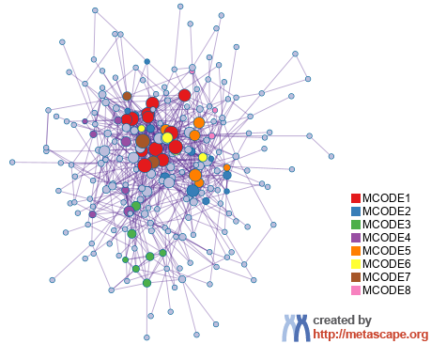
Protein-protein Interaction Network
Gene List: up_mes_only

Slide 31
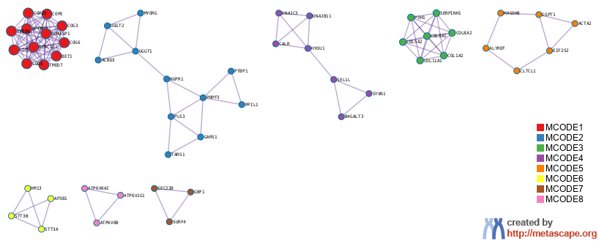
PPI MCODE Components
Gene List: up_mes_only

Slide 32
Biological Interpretation
PPI Network & MCODE Components
Gene List: up_mes_only
Network | Annotation
up_mes_only | R-HSA-446203|Asparagine N-linked glycosylation|-28.0;GO:0048193|Golgi vesicle transport|-22.8;R-HSA-948021|Transport to the Golgi and subsequent modification|-19.6
up_mes_only_MCODE_ALL | R-HSA-446203|Asparagine N-linked glycosylation|-27.9;R-HSA-948021|Transport to the Golgi and subsequent modification|-20.8;R-HSA-6807878|COPI-mediated anterograde transport|-20.7
up_mes_only_SUB1_MCODE_1 | R-HSA-6807878|COPI-mediated anterograde transport|-30.0;R-HSA-199977|ER to Golgi Anterograde Transport|-27.7;R-HSA-948021|Transport to the Golgi and subsequent modification|-26.7
up_mes_only_SUB1_MCODE_2 | R-HSA-72163|mRNA Splicing - Major Pathway|-4.3;R-HSA-72172|mRNA Splicing|-4.3;R-HSA-72203|Processing of Capped Intron-Containing Pre-mRNA|-3.9
up_mes_only_SUB1_MCODE_3 | R-HSA-1650814|Collagen biosynthesis and modifying enzymes|-18.7;R-HSA-1474290|Collagen formation|-17.8;R-HSA-1474244|Extracellular matrix organization|-14.1
up_mes_only_SUB1_MCODE_4 | hsa04141|Protein processing in endoplasmic reticulum|-12.7;R-HSA-381119|Unfolded Protein Response (UPR)|-11.2;R-HSA-381038|XBP1(S) activates chaperone genes|-9.6
up_mes_only_SUB1_MCODE_5 | hsa03015|mRNA surveillance pathway|-6.2;R-HSA-422475|Axon guidance|-3.9;R-HSA-9675108|Nervous system development|-3.9
up_mes_only_SUB1_MCODE_7 | R-HSA-6811434|COPI-dependent Golgi-to-ER retrograde traffic|-7.5;R-HSA-8856688|Golgi-to-ER retrograde transport|-7.1;GO:0007030|Golgi organization|-7.0
up_mes_only_SUB1_MCODE_8 | R-HSA-77387|Insulin receptor recycling|-9.1;R-HSA-917977|Transferrin endocytosis and recycling|-9.0;R-HSA-1222556|ROS and RNS production in phagocytes|-8.8

Slide 33
Evidence Weighting by Machine Learning Approach
Notes:
In the precision-recall plot, the precision is defined as TP/(TP+FP), and recall (a.k.a. TPR) is defined as TP/(TP+FN). If the evidence matrix is effective, we expect precision decreases as recall increases, which implies the hits ranked to the top are more likely true positives (higher precision). AUC (area under curve) in the plot represents the average precision value. The precision value expected for a random hit prioritization algorithm can be read from the last data point of the step curve, where all genes were classified as hits (recall = 1).
The second plot shows how the number of true positives increase as we include more genes. A good result would show the TPR curve to be significantly above the diagonal line, where the diagonal line represents the result achieved by random hit prioritization.
The third plot is a bar graph showing the relative weights assigned to each evidence line (up to top ten lines). If an evidence line contributes negatively, it will be colored in orange, otherwise, in blue.
The last plot shows the predicted probability of benchmark genes, a good result would place many benchmark genes (shown as orange "+") towards the upper portion of the curve (with probability above 50%). If benchmark genes are centered around 50%, it implies true hit status cannot be effectively predicted from the underlying evidence line (we will see a low prediction accuracy).
If these plots strongly support the effective of evidence lines in retrospectively recapturing benchmark genes, the predicted evidence score and probability can then be used to prioritize gene candidates.
Please see https://en.wikipedia.org/wiki/Sensitivity_and_specificity for a summary of terminologies such as TP, FP, TN, FN, TPR, Precision, Recall, etc.

Slide 34


metascape.org
bioinformatics for biologists
Hint: If you have multiple related gene lists, upload them in one Excel file will trigger meta analyses.
Easy, Fresh & Free
Submit gene identifiers, one click on Expression Analysis. Done!
Interpretable results: visualizations, methods, pptx, xslx, zip
Best Practices for Gene List Analyses
Rich annotations for thousands of genes at once
Pathway & process enrichment analysis
Protein-protein interaction network analysis
Overlap analysis across multiple gene lists
Common and unique pathways across multiple studies
Support key model organisms
Scalable
Docker containers available for bioinformaticians
Notes:
Thank you for using Metascape, you are welcome to past question to our public forum: https://metascape.freeforums.net, or email us with your private questions at “metascape.team at gmail.com”.

