Slide 1

Gene List Analysis Report
Hint: Each slide has notes that explain the analysis!
http://metascape.org
Please cite Zhou et al. Nature Commun. 2019 10(1):1523
May 1, 2024
Notes:
This analysis report is automatically generated by Metascape (https://metascape.org).

Slide 2
Gene List Summary
Name | Total | Unique | _Color_
down_common_genes | 354 | 354 | #E41A1C
down_epi_only | 349 | 349 | #377EB8
down_mes_only | 278 | 278 | #4DAF4A
down_mes_up_epi | 198 | 198 | #984EA3
up_common_genes | 325 | 325 | #FF7F00
up_epi_only | 220 | 220 | #FFFF33
up_mes_down_epi | 268 | 268 | #A65628
up_mes_only | 214 | 214 | #F781BF
Please check online Metascape User Manual for explanation of each annotation field.
Notes:
Metascape first automatically converts you input identifiers (Entrez Gene ID, RefSeq, Ensembl ID, UnProt ID or Symbol) into Human Entrez Gene ID. For example, input identifiers can be from human, mouse or rat orthologs, which can be mapped into human (or “analysis as” species) based on both EggNOG and Homologene databases.
The background of each row is the color code used in the various plots within this report, where each color is consistently used to code a corresponding gene list.

Slide 3
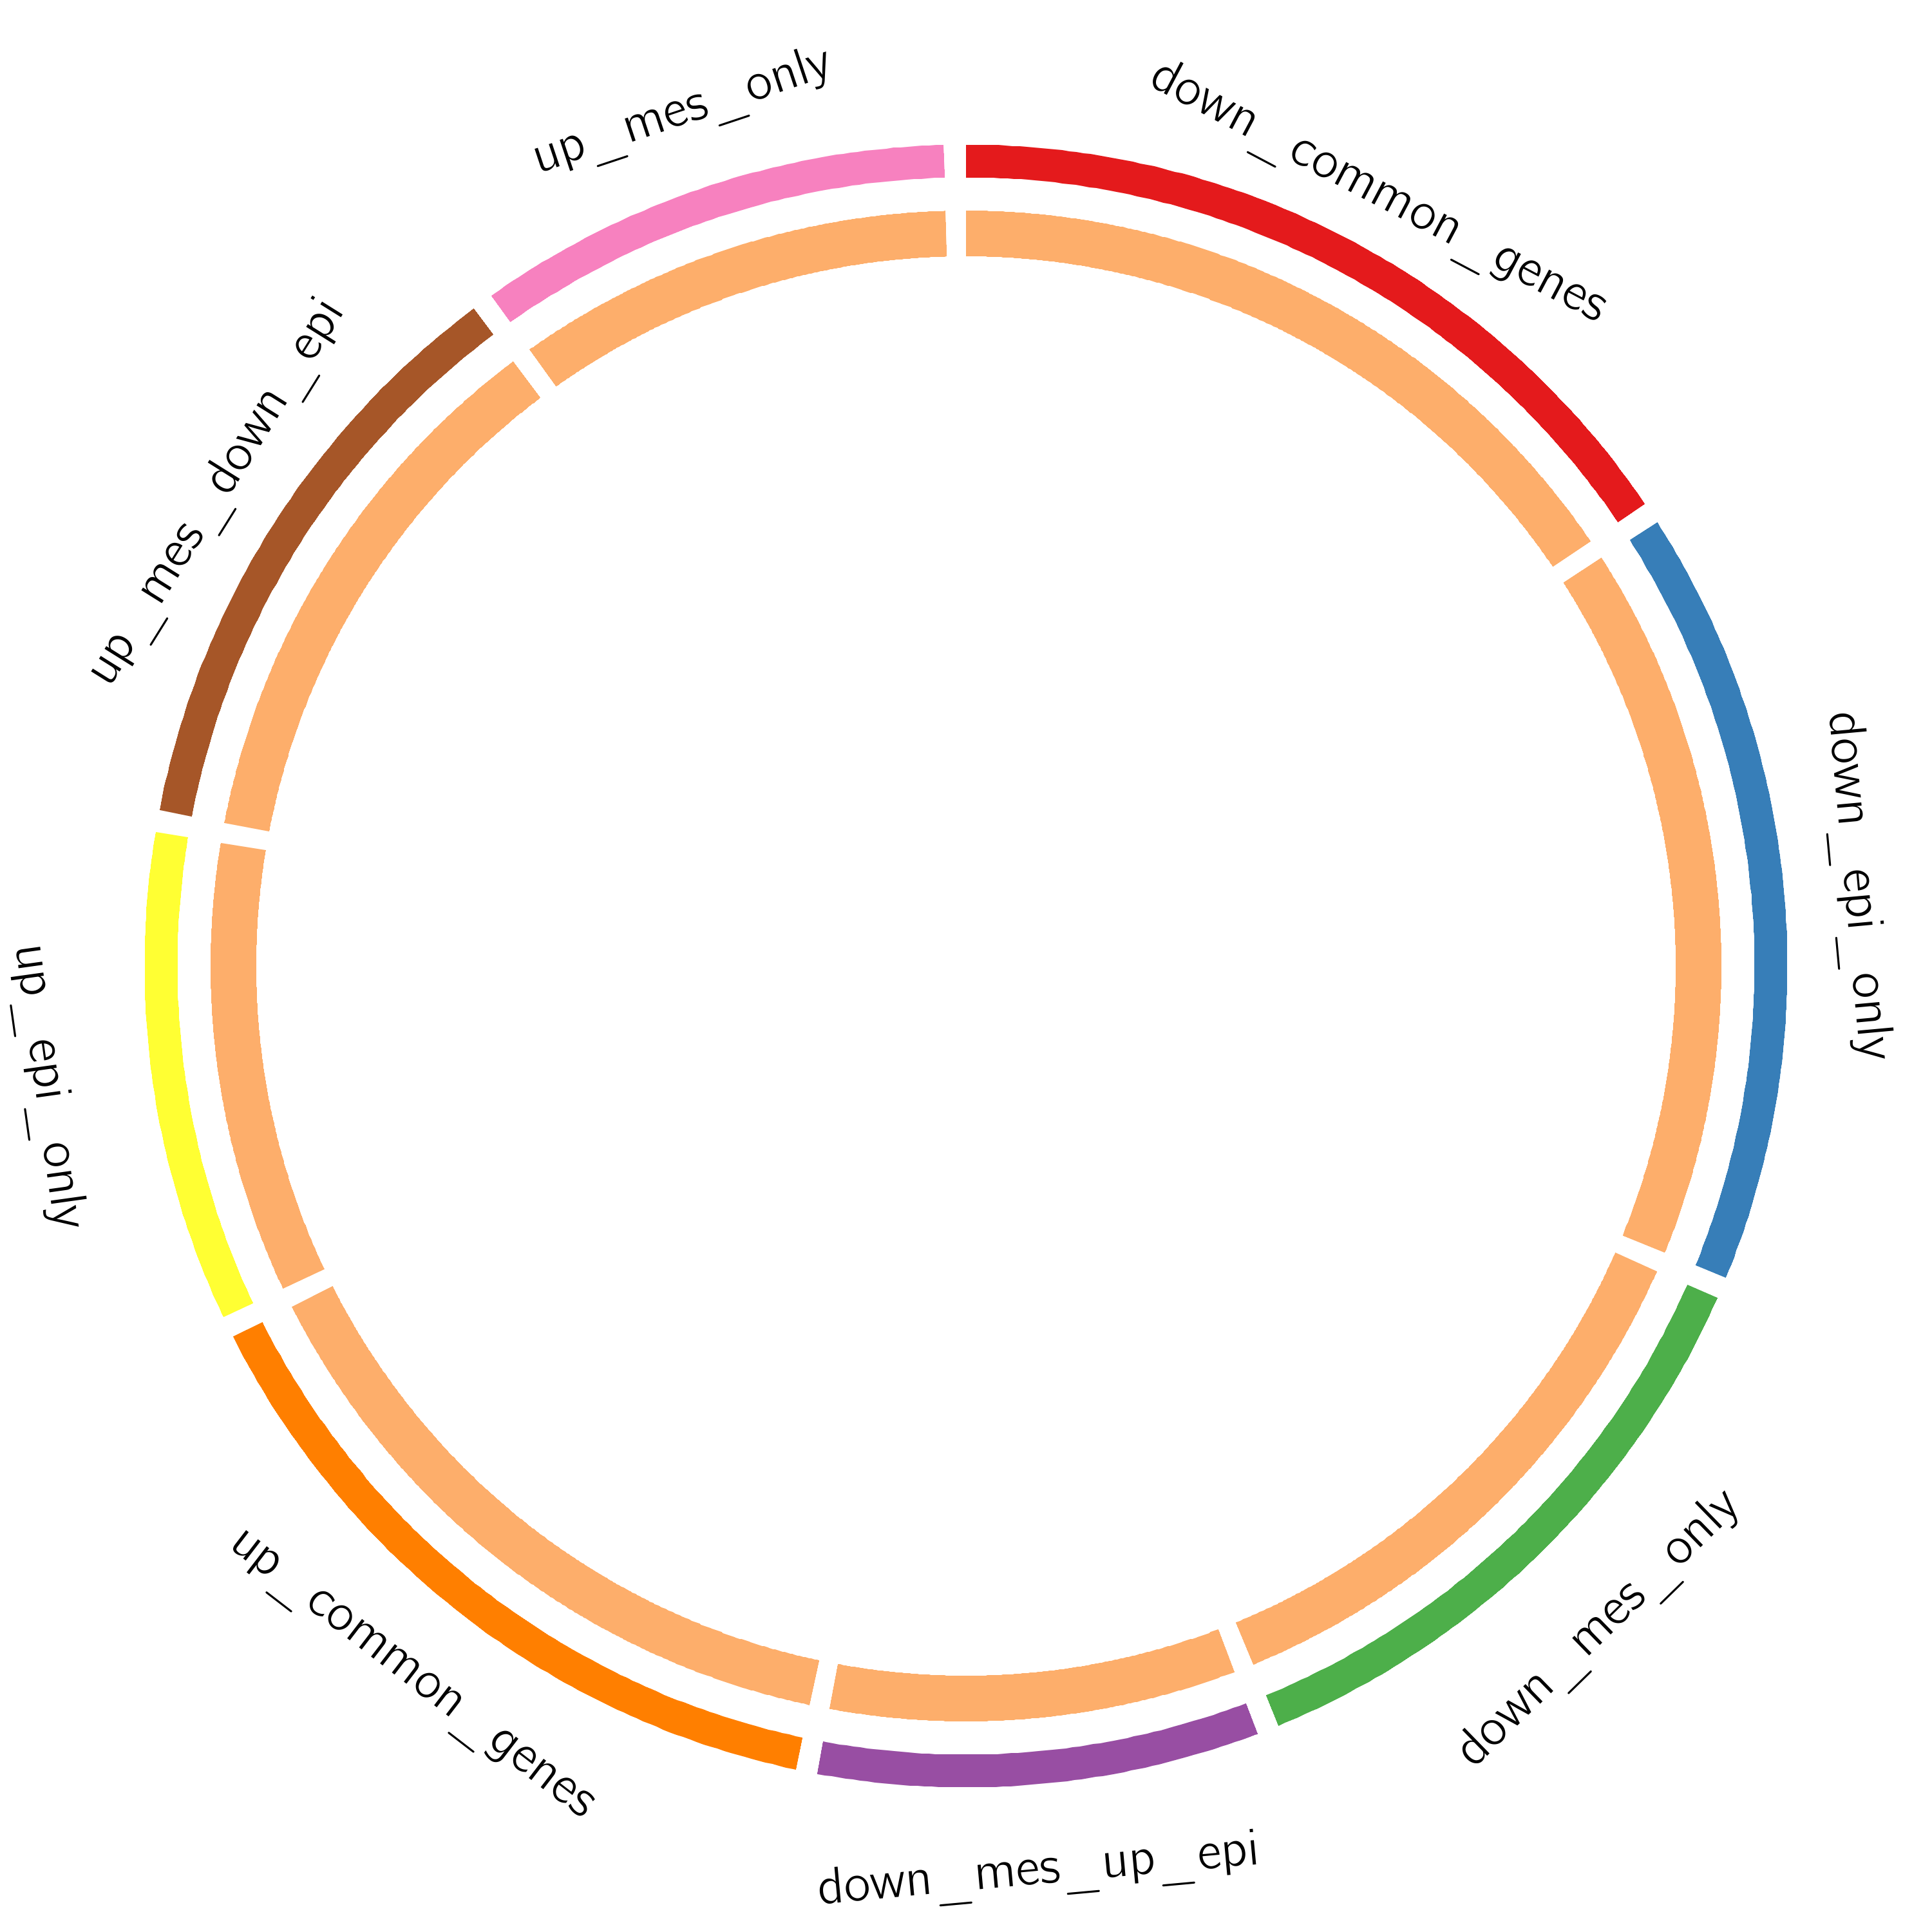
Gene Overlap Analysis
Notes:
The Circos plot shows how genes from the input gene lists overlap.
On the outside, each arc represents the identity of each gene list, using the same color code as the color used for table rows in slide #2.
On the inside, each arc represents a gene list, where each gene member of that list is assigned a spot on the arc. Dark orange color represents the genes that are shared by multiple lists and light orange color represents genes that are unique to that gene list.
Purple lines link the same gene that are shared by multiple gene lists (notice a gene that appears in two gene lists will be mapped once onto each gene list, therefore, the two positions are purple linked).
The greater the number of purple links and the longer the dark orange arcs implies greater overlap among the input gene lists.

Slide 4
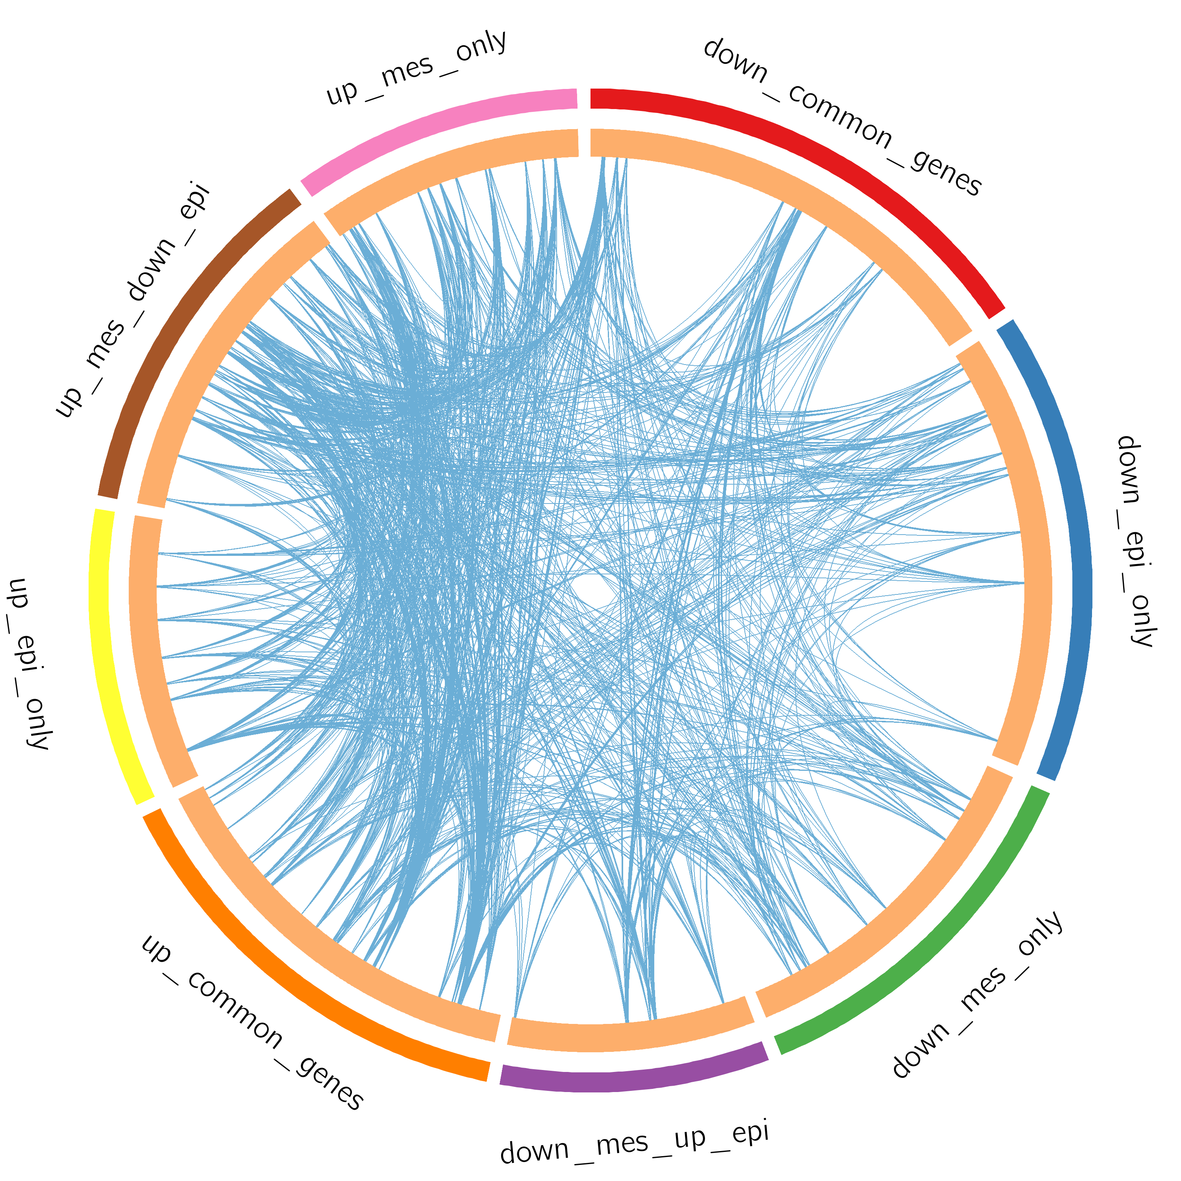
Gene Overlap Analysis
Expanded via Shared Enriched Ontologies
Notes:
The Circos plot shows how genes from the input gene lists overlap.
On the outside, each arc represents the identity of each gene list, using the same color code as the color used for table rows in slide #2.
On the inside, each arc represents a gene list, where each gene member of that list is assigned a spot on the arc. Dark orange color represents the genes that are shared by multiple lists and light orange color represents genes that are unique to that gene list.
Purple lines link the same gene that are shared by multiple gene lists (notice a gene that appears in two gene lists will be mapped once onto each gene list, therefore, the two positions are purple linked). Blue lines link the genes, although different, fall under the same ontology term (the term has to statistically significantly enriched and with size no larger than 100).
The greater the number of purple links and the longer the dark orange arcs implies greater overlap among the input gene lists. Blue links indicate the amount of functional overlap among the input gene lists. It is common in meta-analysis that we observe little directly overlap among studies, due to the variations in the biological assays used. However, we tend to see a lot more functional overlap, as these studies probably pick up different subset of gene members of the same biological processes.

Slide 5
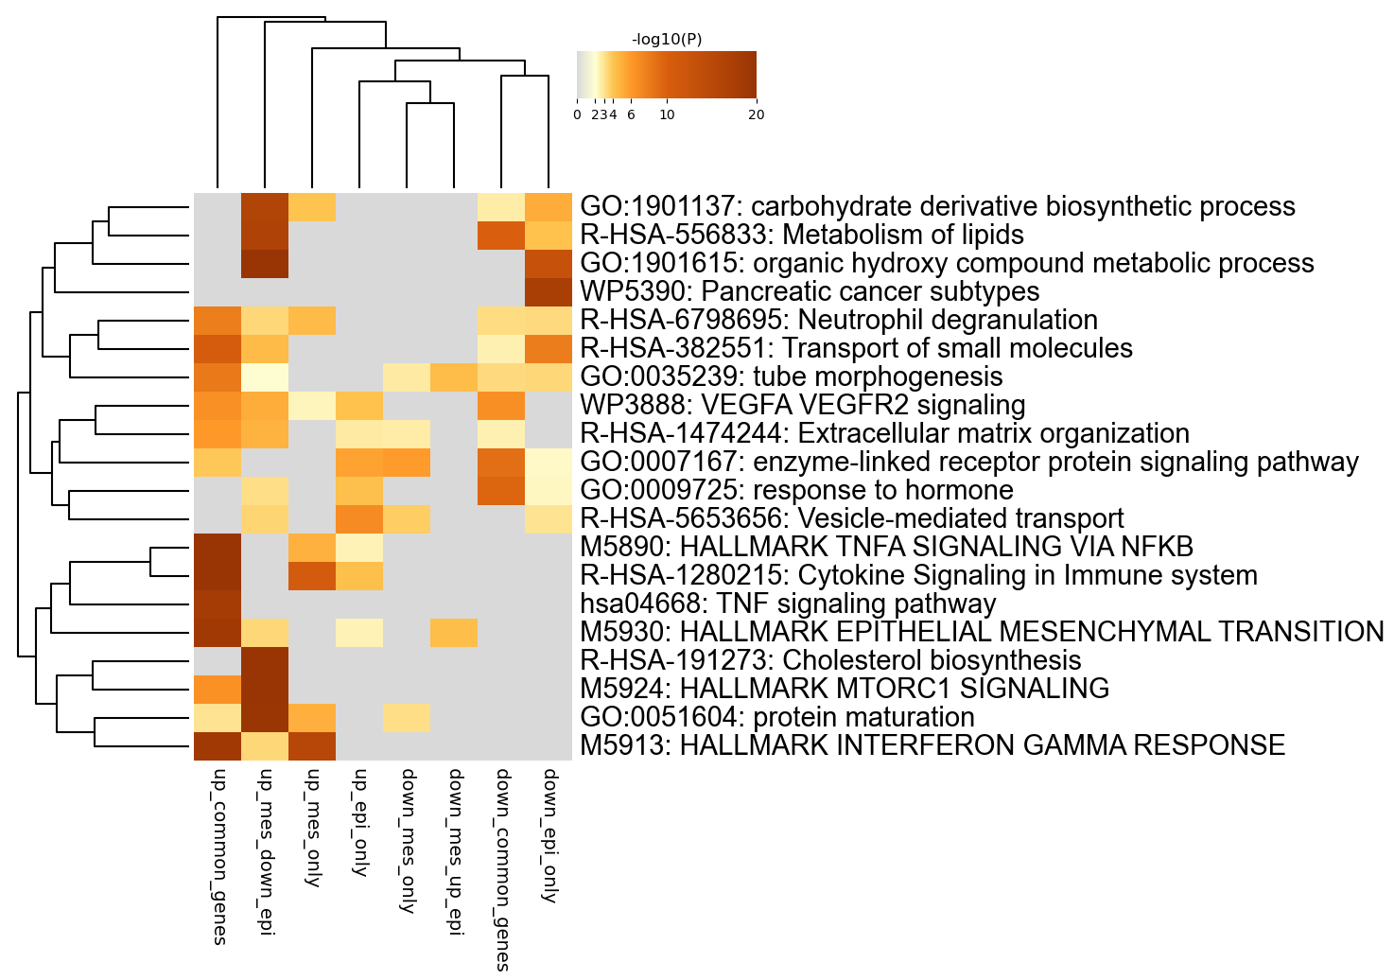
Enriched Ontology Clusters
Across Studies
Notes:
We first identified all statistically enriched terms (can be GO/KEGG terms, canonical pathways, hall mark gene sets, etc., based on the default choices under Express Analysis or your choice during Custom Analysis), accumulative hypergeometric p-values and enrichment factors were calculated and used for filtering. Remaining significant terms were then hierarchically clustered into a tree based on Kappa-statistical similarities among their gene memberships (similar to what is used in NCI DAVID site). Then 0.3 kappa score was applied as the threshold to cast the tree into term clusters. The terms within each cluster are exported in the Excel spreadsheet named “Enrichment Analysis”.
We selected the term with the best p-value within each cluster as its representative term and display them in a dendrogram. The heatmap cells are colored by their p-values, white cells indicate the lack of enrichment for that term in the corresponding gene list. We also export files behind this heatmap (.cdt, .gtr, .atr, and .jtv files), so that one can visualize it interactively using JTreeView program (http://sourceforge.net/projects/jtreeview/). The PDF version of the graph can be found in the zip package.
If you want to view the complete list of enriched terms, please download the .zip file and check Enrichment_GO/GO_AllLists.csv.
Note: gene lists containing more than 3000 genes are not analyzed. Please use a more stringent hit calling criterion, as you most likely have retained too many genes.

Slide 6
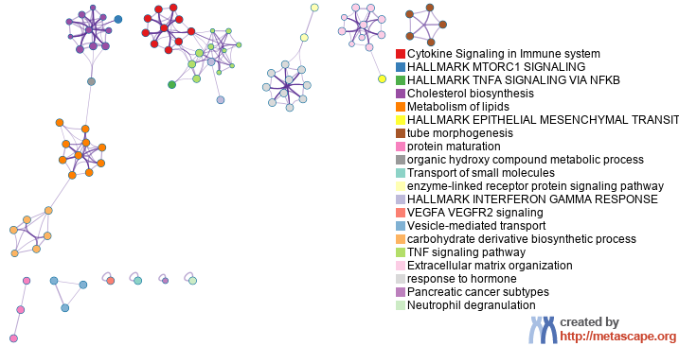
Enriched Ontology Clusters
Colored by Cluster ID
Notes:
We selected a subset of representative terms from the full cluster and converted them into a network layout. More specifically, each term is represented by a circle node, where its size is proportional to the number of input genes fall under that term, and its color represent its cluster identity (i.e., nodes of the same color belong to the same cluster). Terms with a similarity score > 0.3 are linked by an edge (the thickness of the edge represents the similarity score). The network is visualized with Cytoscape with “force-directed” layout and with edge bundled for clarity. One term from each cluster is selected to have its term description shown as label.

Slide 7
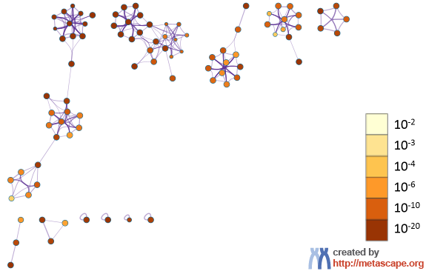
Enriched Ontology Clusters
Colored by p-Value
Notes:
The same enrichment network has its nodes colored by p-value, as shown in the legend. The dark the color, the more statistically significant the node is (see legend for p-value ranges).

Slide 8
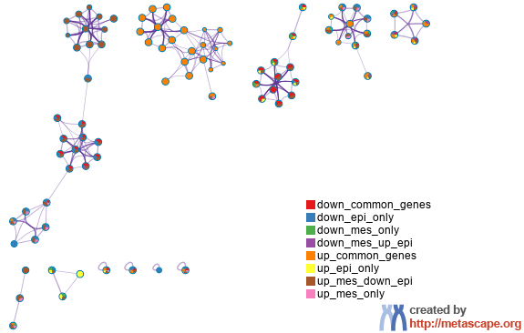
Enriched Ontology Clusters
Pied by Gene Counts Across Studies
Notes:
The same enrichment network has its nodes displayed as pies. Each pie sector is proportional to the number of hits originated from a gene list.
Color code for pie sector represents a gene list and is consistent with the colors used for table rows in slide #2.

Slide 9
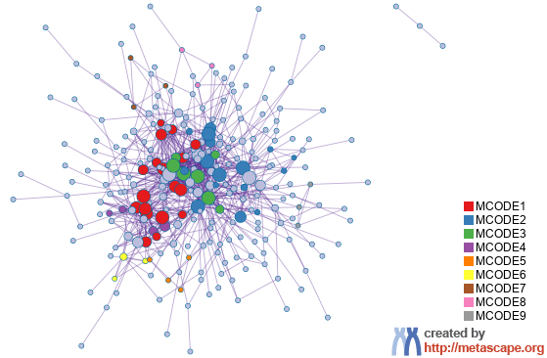
Protein-protein Interaction Network
Gene List: down_common_genes
Notes:
All protein-protein interactions among input genes were extracted from PPI data source and formed a PPI network.
GO enrichment analysis was applied to the network to extract “biological meanings”.

Slide 10
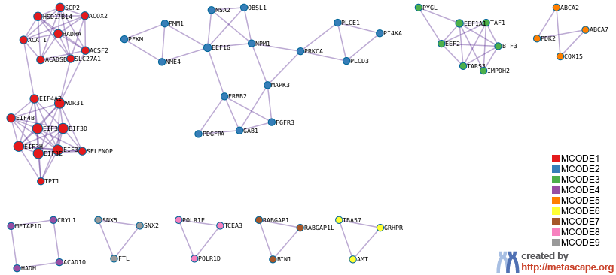
PPI MCODE Components
Gene List: down_common_genes
Notes:
MCODE algorithm was then applied to this network to identify neighborhoods where proteins are densely connected. Each MCODE network is assigned a unique color.

Slide 11
Biological Interpretation
PPI Network & MCODE Components
Gene List: down_common_genes
Network | Annotation
down_common_genes | WP107|Translation factors|-10.8;GO:1902532|negative regulation of intracellular signal transduction|-10.1;R-HSA-556833|Metabolism of lipids|-9.9
down_common_genes_MCODE_ALL | WP107|Translation factors|-15.2;R-HSA-72649|Translation initiation complex formation|-10.5;R-HSA-72702|Ribosomal scanning and start codon recognition|-10.5
down_common_genes_SUB1_MCODE_1 | R-HSA-72649|Translation initiation complex formation|-14.6;R-HSA-72702|Ribosomal scanning and start codon recognition|-14.6;R-HSA-72662|Activation of the mRNA upon binding of the cap-binding complex and eIFs, and subsequent binding to 43S|-14.6
down_common_genes_SUB1_MCODE_2 | hsa01521|EGFR tyrosine kinase inhibitor resistance|-11.7;WP4806|EGFR tyrosine kinase inhibitor resistance|-11.5;hsa05230|Central carbon metabolism in cancer|-9.6
down_common_genes_SUB1_MCODE_3 | R-HSA-6798695|Neutrophil degranulation|-5.7;GO:0006412|translation|-4.1;GO:0043043|peptide biosynthetic process|-4.0
down_common_genes_SUB1_MCODE_4 | GO:0072329|monocarboxylic acid catabolic process|-6.7;GO:0016054|organic acid catabolic process|-5.8;GO:0046395|carboxylic acid catabolic process|-5.8
down_common_genes_SUB1_MCODE_5 | GO:0019216|regulation of lipid metabolic process|-5.3;GO:0034248|regulation of amide metabolic process|-4.7
down_common_genes_SUB1_MCODE_7 | GO:0051336|regulation of hydrolase activity|-4.8
down_common_genes_SUB1_MCODE_8 | GO:0006354|DNA-templated transcription elongation|-8.4;GO:0006351|DNA-templated transcription|-5.3;GO:0032774|RNA biosynthetic process|-5.2
down_common_genes_SUB1_MCODE_9 | R-HSA-432722|Golgi Associated Vesicle Biogenesis|-8.2;R-HSA-199992|trans-Golgi Network Vesicle Budding|-7.9;R-HSA-199991|Membrane Trafficking|-5.0
Notes:
GO enrichment analysis was applied to each MCODE network to extract “biological meanings” from the network component, where top three best p-value terms were retained.

Slide 12
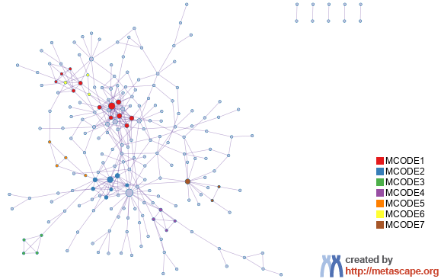
Protein-protein Interaction Network
Gene List: down_epi_only

Slide 13
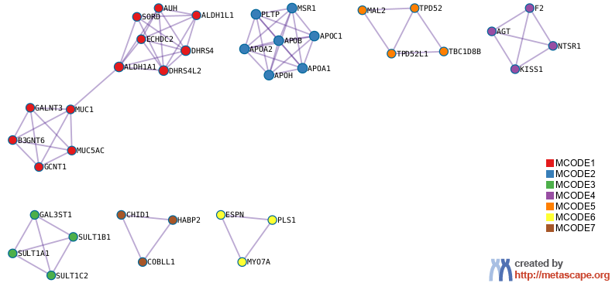
PPI MCODE Components
Gene List: down_epi_only

Slide 14
Biological Interpretation
PPI Network & MCODE Components
Gene List: down_epi_only
Network | Annotation
down_epi_only | GO:1901615|organic hydroxy compound metabolic process|-17.0;GO:0006066|alcohol metabolic process|-14.7;GO:0010817|regulation of hormone levels|-12.1
down_epi_only_MCODE_ALL | GO:0097006|regulation of plasma lipoprotein particle levels|-12.1;GO:0034368|protein-lipid complex remodeling|-11.8;GO:0034369|plasma lipoprotein particle remodeling|-11.8
down_epi_only_SUB1_MCODE_1 | R-HSA-913709|O-linked glycosylation of mucins|-10.6;R-HSA-5173105|O-linked glycosylation|-9.3;R-HSA-5083625|Defective GALNT3 causes HFTC|-7.4
down_epi_only_SUB1_MCODE_2 | hsa04979|Cholesterol metabolism|-15.9;GO:0097006|regulation of plasma lipoprotein particle levels|-15.5;WP5304|Cholesterol metabolism|-15.0
down_epi_only_SUB1_MCODE_3 | WP692|Sulfation biotransformation reaction|-9.2;WP702|Metapathway biotransformation Phase I and II|-8.9;GO:0051923|sulfation|-8.9
down_epi_only_SUB1_MCODE_4 | R-HSA-375276|Peptide ligand-binding receptors|-8.7;R-HSA-416476|G alpha (q) signalling events|-8.6;R-HSA-373076|Class A/1 (Rhodopsin-like receptors)|-7.8
down_epi_only_SUB1_MCODE_5 | R-HSA-432722|Golgi Associated Vesicle Biogenesis|-7.6;R-HSA-199992|trans-Golgi Network Vesicle Budding|-7.3;R-HSA-199991|Membrane Trafficking|-4.4
down_epi_only_SUB1_MCODE_6 | R-HSA-9662361|Sensory processing of sound by outer hair cells of the cochlea|-8.3;R-HSA-9662360|Sensory processing of sound by inner hair cells of the cochlea|-7.9;R-HSA-9659379|Sensory processing of sound|-7.8

Slide 15
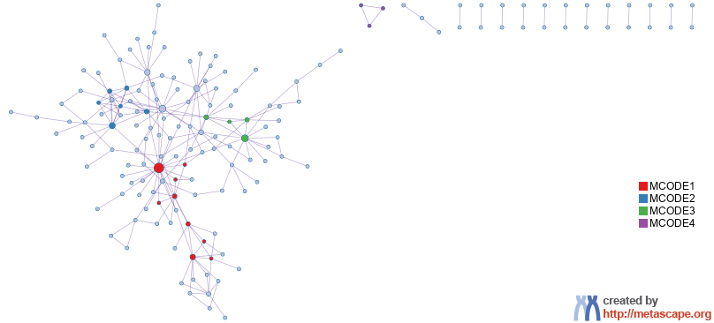
Protein-protein Interaction Network
Gene List: down_mes_only

Slide 16
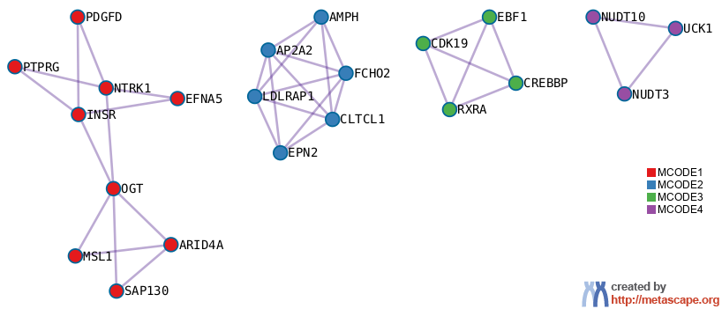
PPI MCODE Components
Gene List: down_mes_only

Slide 17
Biological Interpretation
PPI Network & MCODE Components
Gene List: down_mes_only
Network | Annotation
down_mes_only | GO:0007167|enzyme-linked receptor protein signaling pathway|-7.4;GO:0007169|transmembrane receptor protein tyrosine kinase signaling pathway|-7.2;GO:0006897|endocytosis|-6.8
down_mes_only_MCODE_ALL | R-HSA-8856828|Clathrin-mediated endocytosis|-9.1;R-HSA-8856825|Cargo recognition for clathrin-mediated endocytosis|-7.9;GO:0006897|endocytosis|-7.2
down_mes_only_SUB1_MCODE_1 | GO:1902455|negative regulation of stem cell population maintenance|-7.3;GO:0007169|transmembrane receptor protein tyrosine kinase signaling pathway|-7.2;WP5087|Pleural mesothelioma|-7.1
down_mes_only_SUB1_MCODE_2 | R-HSA-8856828|Clathrin-mediated endocytosis|-13.9;R-HSA-8856825|Cargo recognition for clathrin-mediated endocytosis|-11.5;GO:0006897|endocytosis|-10.6
down_mes_only_SUB1_MCODE_3 | R-HSA-381340|Transcriptional regulation of white adipocyte differentiation|-10.3;R-HSA-9843745|Adipogenesis|-9.8;R-HSA-1989781|PPARA activates gene expression|-6.6
down_mes_only_SUB2_MCODE_4 | GO:0009259|ribonucleotide metabolic process|-5.6;GO:0019693|ribose phosphate metabolic process|-5.6;GO:0009117|nucleotide metabolic process|-5.3

Slide 18
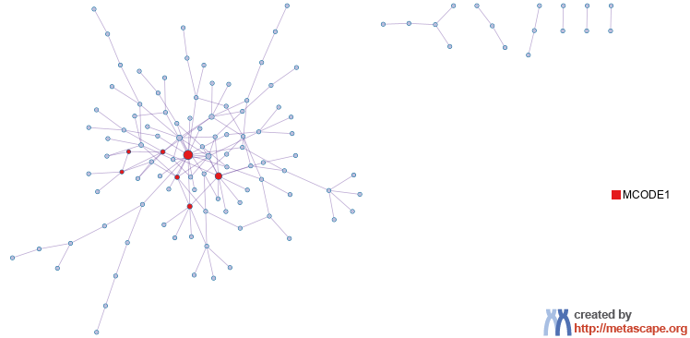
Protein-protein Interaction Network
Gene List: down_mes_up_epi

Slide 19
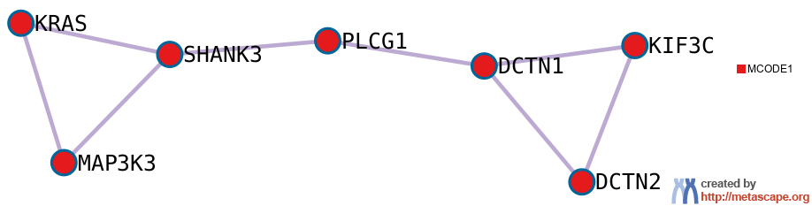
PPI MCODE Components
Gene List: down_mes_up_epi

Slide 20
Biological Interpretation
PPI Network & MCODE Components
Gene List: down_mes_up_epi
Network | Annotation
down_mes_up_epi | GO:0032989|cellular anatomical entity morphogenesis|-9.6;GO:0048667|cell morphogenesis involved in neuron differentiation|-8.6;GO:0048812|neuron projection morphogenesis|-8.1
down_mes_up_epi_MCODE_ALL | R-HSA-1280218|Adaptive Immune System|-6.7;hsa05235|PD-L1 expression and PD-1 checkpoint pathway in cancer|-6.1;hsa05022|Pathways of neurodegeneration - multiple diseases|-5.7
down_mes_up_epi_SUB1_MCODE_1 | R-HSA-1280218|Adaptive Immune System|-6.7;hsa05235|PD-L1 expression and PD-1 checkpoint pathway in cancer|-6.1;hsa05022|Pathways of neurodegeneration - multiple diseases|-5.7

Slide 21
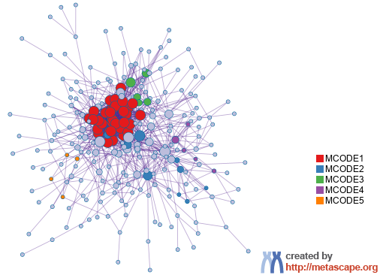
Protein-protein Interaction Network
Gene List: up_common_genes

Slide 22
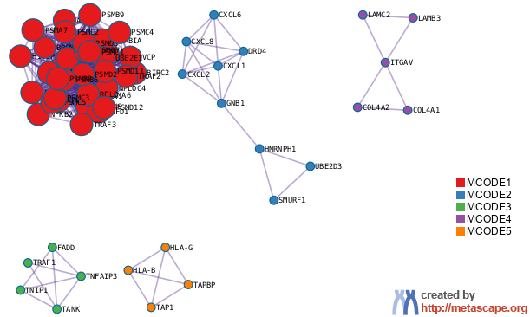
PPI MCODE Components
Gene List: up_common_genes

Slide 23
Biological Interpretation
PPI Network & MCODE Components
Gene List: up_common_genes
Network | Annotation
up_common_genes | R-HSA-1280215|Cytokine Signaling in Immune system|-45.8;M5890|HALLMARK TNFA SIGNALING VIA NFKB|-35.1;hsa05169|Epstein-Barr virus infection|-34.9
up_common_genes_MCODE_ALL | R-HSA-5668541|TNFR2 non-canonical NF-kB pathway|-49.0;R-HSA-1236975|Antigen processing-Cross presentation|-46.2;hsa03050|Proteasome|-45.7
up_common_genes_SUB1_MCODE_1 | R-HSA-5668541|TNFR2 non-canonical NF-kB pathway|-56.9;R-HSA-5676590|NIK-->noncanonical NF-kB signaling|-51.6;hsa03050|Proteasome|-51.4
up_common_genes_SUB1_MCODE_2 | R-HSA-418594|G alpha (i) signalling events|-10.0;R-HSA-500792|GPCR ligand binding|-9.0;hsa04062|Chemokine signaling pathway|-8.9
up_common_genes_SUB1_MCODE_3 | GO:0043122|regulation of canonical NF-kappaB signal transduction|-10.1;WP231|TNF alpha signaling pathway|-9.5;M10082|BIOCARTA TNFR2 PATHWAY|-8.8
up_common_genes_SUB1_MCODE_4 | R-HSA-3000157|Laminin interactions|-15.2;R-HSA-3000171|Non-integrin membrane-ECM interactions|-13.6;R-HSA-2214320|Anchoring fibril formation|-12.7
up_common_genes_SUB1_MCODE_5 | GO:0019885|antigen processing and presentation of endogenous peptide antigen via MHC class I|-12.6;GO:0002483|antigen processing and presentation of endogenous peptide antigen|-12.4;R-HSA-983170|Antigen Presentation: Folding, assembly and peptide loading of class I MHC|-12.2

Slide 24
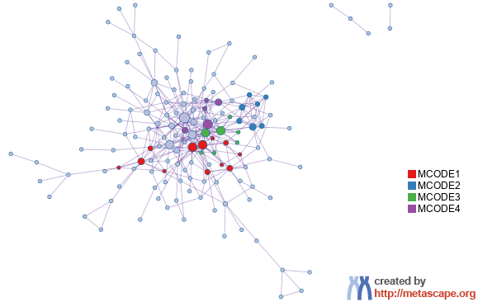
Protein-protein Interaction Network
Gene List: up_epi_only

Slide 25
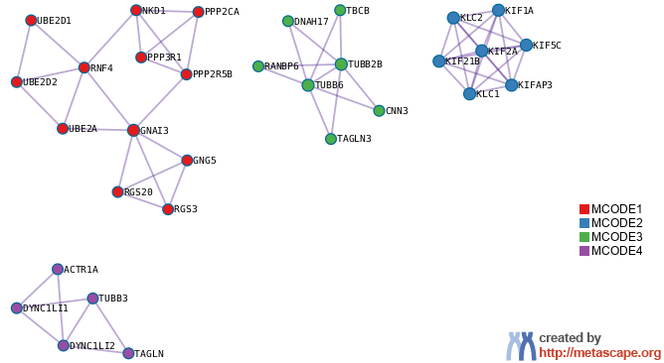
PPI MCODE Components
Gene List: up_epi_only

Slide 26
Biological Interpretation
PPI Network & MCODE Components
Gene List: up_epi_only
Network | Annotation
up_epi_only | R-HSA-1280218|Adaptive Immune System|-16.2;hsa04814|Motor proteins|-14.8;R-HSA-8856688|Golgi-to-ER retrograde transport|-13.0
up_epi_only_MCODE_ALL | hsa04814|Motor proteins|-22.6;R-HSA-8856688|Golgi-to-ER retrograde transport|-20.4;R-HSA-1280218|Adaptive Immune System|-18.9
up_epi_only_SUB1_MCODE_1 | R-HSA-418594|G alpha (i) signalling events|-9.0;R-HSA-1280218|Adaptive Immune System|-8.3;GO:0070936|protein K48-linked ubiquitination|-7.7
up_epi_only_SUB1_MCODE_2 | R-HSA-983189|Kinesins|-15.5;hsa04814|Motor proteins|-15.4;R-HSA-6811434|COPI-dependent Golgi-to-ER retrograde traffic|-14.1
up_epi_only_SUB1_MCODE_3 | R-HSA-389977|Post-chaperonin tubulin folding pathway|-7.9;R-HSA-391251|Protein folding|-6.0;GO:0000226|microtubule cytoskeleton organization|-5.4
up_epi_only_SUB1_MCODE_4 | R-HSA-6811436|COPI-independent Golgi-to-ER retrograde traffic|-10.4;R-HSA-3371497|HSP90 chaperone cycle for steroid hormone receptors (SHR) in the presence of ligand|-10.3;R-HSA-6807878|COPI-mediated anterograde transport|-9.2

Slide 27
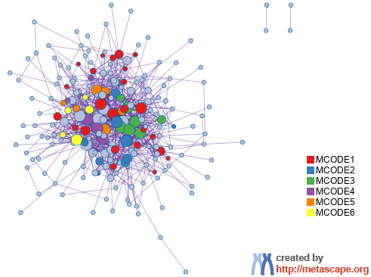
Protein-protein Interaction Network
Gene List: up_mes_down_epi

Slide 28
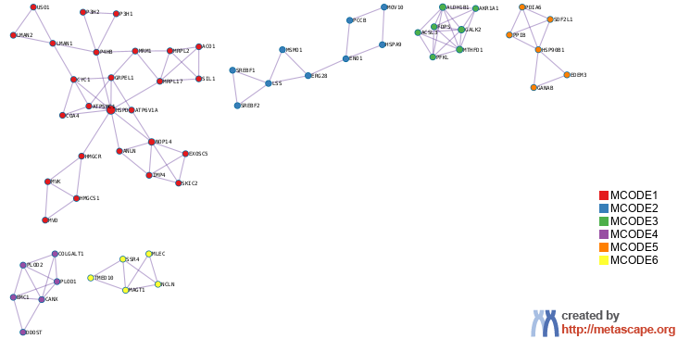
PPI MCODE Components
Gene List: up_mes_down_epi

Slide 29
Biological Interpretation
PPI Network & MCODE Components
Gene List: up_mes_down_epi
Network | Annotation
up_mes_down_epi | M5924|HALLMARK MTORC1 SIGNALING|-37.7;R-HSA-191273|Cholesterol biosynthesis|-27.5;GO:0016126|sterol biosynthetic process|-27.0
up_mes_down_epi_MCODE_ALL | R-HSA-191273|Cholesterol biosynthesis|-18.0;WP4718|Cholesterol metabolism with Bloch and Kandutsch Russell pathways|-17.8;M5924|HALLMARK MTORC1 SIGNALING|-16.0
up_mes_down_epi_SUB1_MCODE_1 | WP3963|Mevalonate pathway|-10.8;WP4190|Mevalonate arm of cholesterol biosynthesis pathway|-9.5;WP197|Cholesterol biosynthesis pathway|-9.2
up_mes_down_epi_SUB1_MCODE_2 | R-HSA-191273|Cholesterol biosynthesis|-10.2;GO:0016125|sterol metabolic process|-9.7;GO:0016126|sterol biosynthetic process|-9.3
up_mes_down_epi_SUB1_MCODE_3 | hsa00010|Glycolysis / Gluconeogenesis|-6.4;GO:0005975|carbohydrate metabolic process|-5.8;GO:0090407|organophosphate biosynthetic process|-5.5
up_mes_down_epi_SUB1_MCODE_4 | WP4786|Type I collagen synthesis in the context of osteogenesis imperfecta|-7.6;hsa00310|Lysine degradation|-6.8;R-HSA-1650814|Collagen biosynthesis and modifying enzymes|-6.7
up_mes_down_epi_SUB1_MCODE_5 | hsa04141|Protein processing in endoplasmic reticulum|-7.8;GO:0006457|protein folding|-7.4;GO:0034976|response to endoplasmic reticulum stress|-7.3
up_mes_down_epi_SUB1_MCODE_6 | R-HSA-446203|Asparagine N-linked glycosylation|-5.0

Slide 30
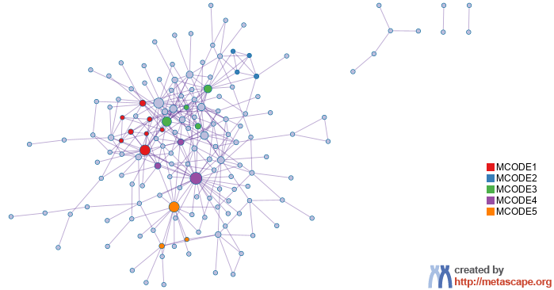
Protein-protein Interaction Network
Gene List: up_mes_only

Slide 31
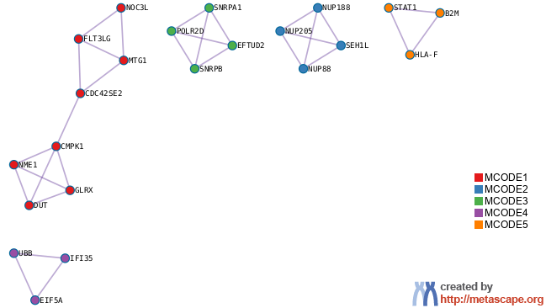
PPI MCODE Components
Gene List: up_mes_only

Slide 32
Biological Interpretation
PPI Network & MCODE Components
Gene List: up_mes_only
Network | Annotation
up_mes_only | M5913|HALLMARK INTERFERON GAMMA RESPONSE|-15.5;R-HSA-1280215|Cytokine Signaling in Immune system|-13.5;R-HSA-913531|Interferon Signaling|-13.3
up_mes_only_MCODE_ALL | R-HSA-9705683|SARS-CoV-2-host interactions|-14.0;R-HSA-9705671|SARS-CoV-2 activates/modulates innate and adaptive immune responses|-13.7;R-HSA-913531|Interferon Signaling|-12.9
up_mes_only_SUB1_MCODE_1 | R-HSA-499943|Interconversion of nucleotide di- and triphosphates|-10.3;R-HSA-15869|Metabolism of nucleotides|-8.1;GO:0006221|pyrimidine nucleotide biosynthetic process|-7.2
up_mes_only_SUB1_MCODE_2 | R-HSA-170822|Regulation of Glucokinase by Glucokinase Regulatory Protein|-12.0;R-HSA-168271|Transport of Ribonucleoproteins into the Host Nucleus|-12.0;R-HSA-5619107|Defective TPR may confer susceptibility towards thyroid papillary carcinoma (TPC)|-12.0
up_mes_only_SUB1_MCODE_3 | R-HSA-72163|mRNA Splicing - Major Pathway|-8.7;R-HSA-72172|mRNA Splicing|-8.6;R-HSA-72203|Processing of Capped Intron-Containing Pre-mRNA|-8.1
up_mes_only_SUB1_MCODE_5 | R-HSA-877300|Interferon gamma signaling|-7.5;R-HSA-9705671|SARS-CoV-2 activates/modulates innate and adaptive immune responses|-7.2;hsa05169|Epstein-Barr virus infection|-6.5

Slide 33
Evidence Weighting by Machine Learning Approach
Notes:
In the precision-recall plot, the precision is defined as TP/(TP+FP), and recall (a.k.a. TPR) is defined as TP/(TP+FN). If the evidence matrix is effective, we expect precision decreases as recall increases, which implies the hits ranked to the top are more likely true positives (higher precision). AUC (area under curve) in the plot represents the average precision value. The precision value expected for a random hit prioritization algorithm can be read from the last data point of the step curve, where all genes were classified as hits (recall = 1).
The second plot shows how the number of true positives increase as we include more genes. A good result would show the TPR curve to be significantly above the diagonal line, where the diagonal line represents the result achieved by random hit prioritization.
The third plot is a bar graph showing the relative weights assigned to each evidence line (up to top ten lines). If an evidence line contributes negatively, it will be colored in orange, otherwise, in blue.
The last plot shows the predicted probability of benchmark genes, a good result would place many benchmark genes (shown as orange "+") towards the upper portion of the curve (with probability above 50%). If benchmark genes are centered around 50%, it implies true hit status cannot be effectively predicted from the underlying evidence line (we will see a low prediction accuracy).
If these plots strongly support the effective of evidence lines in retrospectively recapturing benchmark genes, the predicted evidence score and probability can then be used to prioritize gene candidates.
Please see https://en.wikipedia.org/wiki/Sensitivity_and_specificity for a summary of terminologies such as TP, FP, TN, FN, TPR, Precision, Recall, etc.

Slide 34


metascape.org
bioinformatics for biologists
Hint: If you have multiple related gene lists, upload them in one Excel file will trigger meta analyses.
Easy, Fresh & Free
Submit gene identifiers, one click on Expression Analysis. Done!
Interpretable results: visualizations, methods, pptx, xslx, zip
Best Practices for Gene List Analyses
Rich annotations for thousands of genes at once
Pathway & process enrichment analysis
Protein-protein interaction network analysis
Overlap analysis across multiple gene lists
Common and unique pathways across multiple studies
Support key model organisms
Scalable
Docker containers available for bioinformaticians
Notes:
Thank you for using Metascape, you are welcome to past question to our public forum: https://metascape.freeforums.net, or email us with your private questions at “metascape.team at gmail.com”.

