Slide 1

Gene List Analysis Report
Hint: Each slide has notes that explain the analysis!
http://metascape.org
Please cite Zhou et al. Nature Commun. 2019 10(1):1523
Mar 17, 2025
Notes:
This analysis report is automatically generated by Metascape (https://metascape.org).

Slide 2
Gene List Summary
You gene list contains 438 identifiers, 438 human Entrez Gene IDs.
Please check online Metascape User Manual for explanation of each annotation field.
Notes:
Metascape first automatically converts you input identifiers (Entrez Gene ID, RefSeq, Ensembl ID, UnProt ID or Symbol) into Human Entrez Gene ID. For example, input identifiers can be from human, mouse or rat orthologs, which can be mapped into human (or “analysis as” species) based on both EggNOG and Homologene databases.

Slide 3
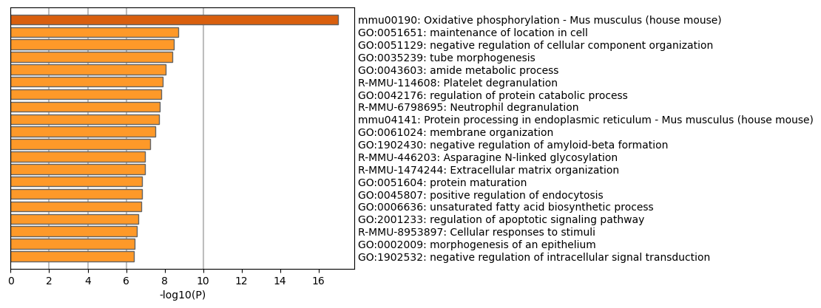
Enriched Ontology Clusters
Across Studies
Notes:
We first identified all statistically enriched terms (can be GO/KEGG terms, canonical pathways, hall mark gene sets, etc., based on the default choices under Express Analysis or your choice during Custom Analysis), accumulative hypergeometric p-values and enrichment factors were calculated and used for filtering. Remaining significant terms were then hierarchically clustered into a tree based on Kappa-statistical similarities among their gene memberships (similar to what is used in NCI DAVID site). Then 0.3 kappa score was applied as the threshold to cast the tree into term clusters. The terms within each cluster are exported in the Excel spreadsheet named “Enrichment Analysis”.
If you want to view the complete list of enriched terms, please download the .zip file and check Enrichment_GO/GO_AllLists.csv.
Note: gene lists containing more than 3000 genes are not analyzed. Please use a more stringent hit calling criterion, as you most likely have retained too many genes.

Slide 4
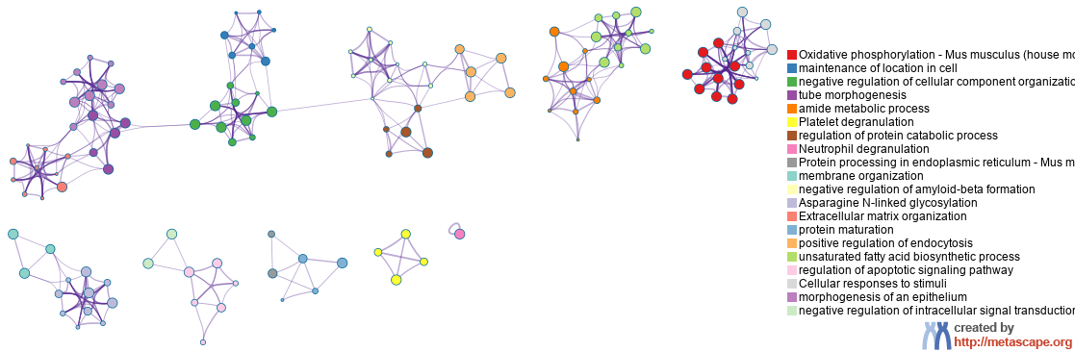
Enriched Ontology Clusters
Colored by Cluster ID
Notes:
We selected a subset of representative terms from the full cluster and converted them into a network layout. More specifically, each term is represented by a circle node, where its size is proportional to the number of input genes fall under that term, and its color represent its cluster identity (i.e., nodes of the same color belong to the same cluster). Terms with a similarity score > 0.3 are linked by an edge (the thickness of the edge represents the similarity score). The network is visualized with Cytoscape with “force-directed” layout and with edge bundled for clarity. One term from each cluster is selected to have its term description shown as label.

Slide 5
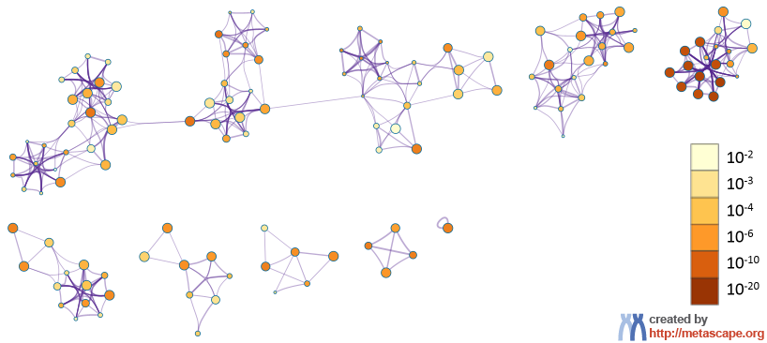
Enriched Ontology Clusters
Colored by p-Value
Notes:
The same enrichment network has its nodes colored by p-value, as shown in the legend. The dark the color, the more statistically significant the node is (see legend for p-value ranges).

Slide 6
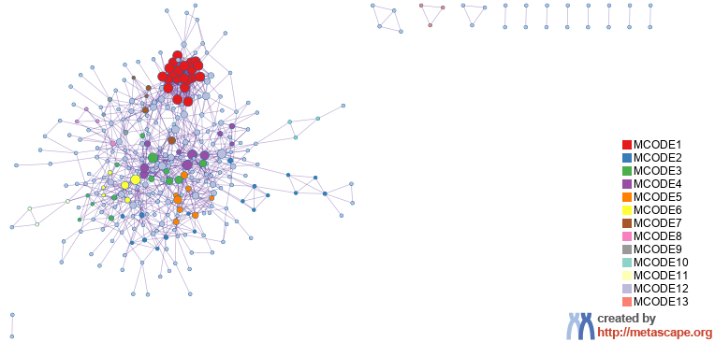
Protein-protein Interaction Network
Notes:
All protein-protein interactions among input genes were extracted from PPI data source and formed a PPI network.
GO enrichment analysis was applied to the network to extract “biological meanings”.

Slide 7
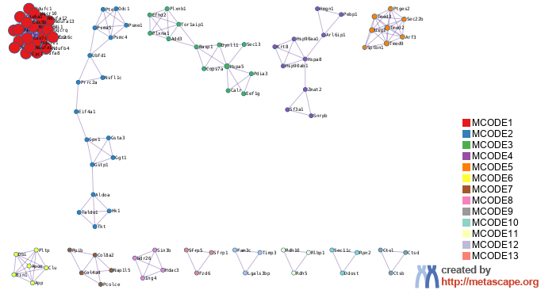
PPI MCODE Components
Notes:
MCODE algorithm was then applied to this network to identify neighborhoods where proteins are densely connected.

Slide 8
Biological Interpretation
PPI Network & MCODE Components
Network | Annotation
hits | mmu00190|Oxidative phosphorylation - Mus musculus (house mouse)|-20.4;GO:0006119|oxidative phosphorylation|-19.5;GO:0009060|aerobic respiration|-19.5
hits_MCODE_ALL | GO:0006119|oxidative phosphorylation|-26.8;mmu00190|Oxidative phosphorylation - Mus musculus (house mouse)|-25.4;mmu05020|Prion disease - Mus musculus (house mouse)|-24.8
hits_SUB1_MCODE_1 | GO:0006119|oxidative phosphorylation|-47.8;mmu00190|Oxidative phosphorylation - Mus musculus (house mouse)|-46.4;mmu04932|Non-alcoholic fatty liver disease - Mus musculus (house mouse)|-45.0
hits_SUB1_MCODE_2 | mmu00480|Glutathione metabolism - Mus musculus (house mouse)|-8.6;GO:0006749|glutathione metabolic process|-6.8;WP4466|Oxidative stress and redox pathway|-6.1
hits_SUB1_MCODE_3 | R-MMU-983170|Antigen Presentation: Folding, assembly and peptide loading of class I MHC|-8.2;R-MMU-194315|Signaling by Rho GTPases|-7.9;R-MMU-9716542|Signaling by Rho GTPases, Miro GTPases and RHOBTB3|-7.8
hits_SUB1_MCODE_4 | R-MMU-3371568|Attenuation phase|-7.7;R-MMU-3371571|HSF1-dependent transactivation|-6.9;GO:0022618|protein-RNA complex assembly|-6.0
hits_SUB1_MCODE_5 | R-MMU-199977|ER to Golgi Anterograde Transport|-14.3;R-MMU-948021|Transport to the Golgi and subsequent modification|-13.8;R-MMU-6807878|COPI-mediated anterograde transport|-12.8
hits_SUB1_MCODE_6 | GO:1902991|regulation of amyloid precursor protein catabolic process|-9.5;GO:1905906|regulation of amyloid fibril formation|-8.1;GO:1900221|regulation of amyloid-beta clearance|-8.0
hits_SUB1_MCODE_7 | R-MMU-2022090|Assembly of collagen fibrils and other multimeric structures|-7.0;R-MMU-1650814|Collagen biosynthesis and modifying enzymes|-6.8;R-MMU-1474290|Collagen formation|-6.5
hits_SUB1_MCODE_9 | R-MMU-2132295|MHC class II antigen presentation|-6.7;R-MMU-1474228|Degradation of the extracellular matrix|-6.7;mmu04210|Apoptosis - Mus musculus (house mouse)|-6.6
hits_SUB1_MCODE_11 | R-MMU-2453902|The canonical retinoid cycle in rods (twilight vision)|-9.1;WP1259|Retinol metabolism|-8.2;R-MMU-2187338|Visual phototransduction|-7.2
hits_SUB3_MCODE_12 | R-MMU-114608|Platelet degranulation|-6.8;R-MMU-76005|Response to elevated platelet cytosolic Ca2+|-6.8;R-MMU-76002|Platelet activation, signaling and aggregation|-5.8
hits_SUB4_MCODE_13 | GO:0035567|non-canonical Wnt signaling pathway|-8.3;GO:0060070|canonical Wnt signaling pathway|-6.9;GO:0090090|negative regulation of canonical Wnt signaling pathway|-6.6
Notes:
GO enrichment analysis was applied to each MCODE network to extract “biological meanings” from the network component, where top three best p-value terms were retained.

Slide 9


metascape.org
bioinformatics for biologists
Hint: If you have multiple related gene lists, upload them in one Excel file will trigger meta analyses.
Easy, Fresh & Free
Submit gene identifiers, one click on Expression Analysis. Done!
Interpretable results: visualizations, methods, pptx, xslx, zip
Best Practices for Gene List Analyses
Rich annotations for thousands of genes at once
Pathway & process enrichment analysis
Protein-protein interaction network analysis
Overlap analysis across multiple gene lists
Common and unique pathways across multiple studies
Support key model organisms
Scalable
Docker containers available for bioinformaticians
Notes:
Thank you for using Metascape, you are welcome to past question to our public forum: https://metascape.freeforums.net, or email us with your private questions at “metascape.team at gmail.com”.

