Slide 1

https://ntust-spice.tk/

Slide 2
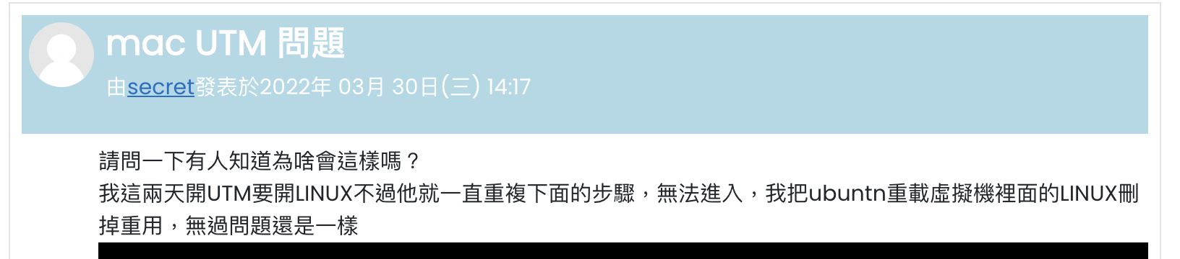
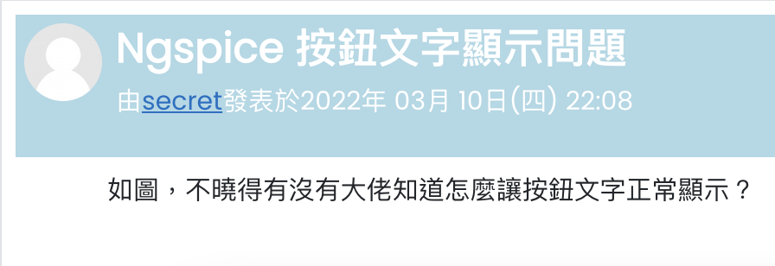
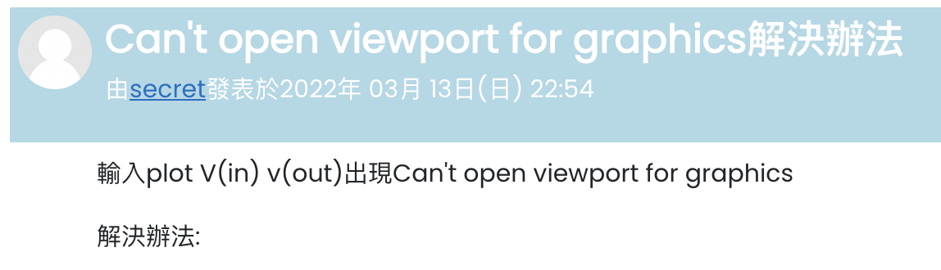

Slide 3

可以讓我好好仿真嚒…

Slide 4
仿真，不該是難題

Slide 5





Slide 6


Slide 7
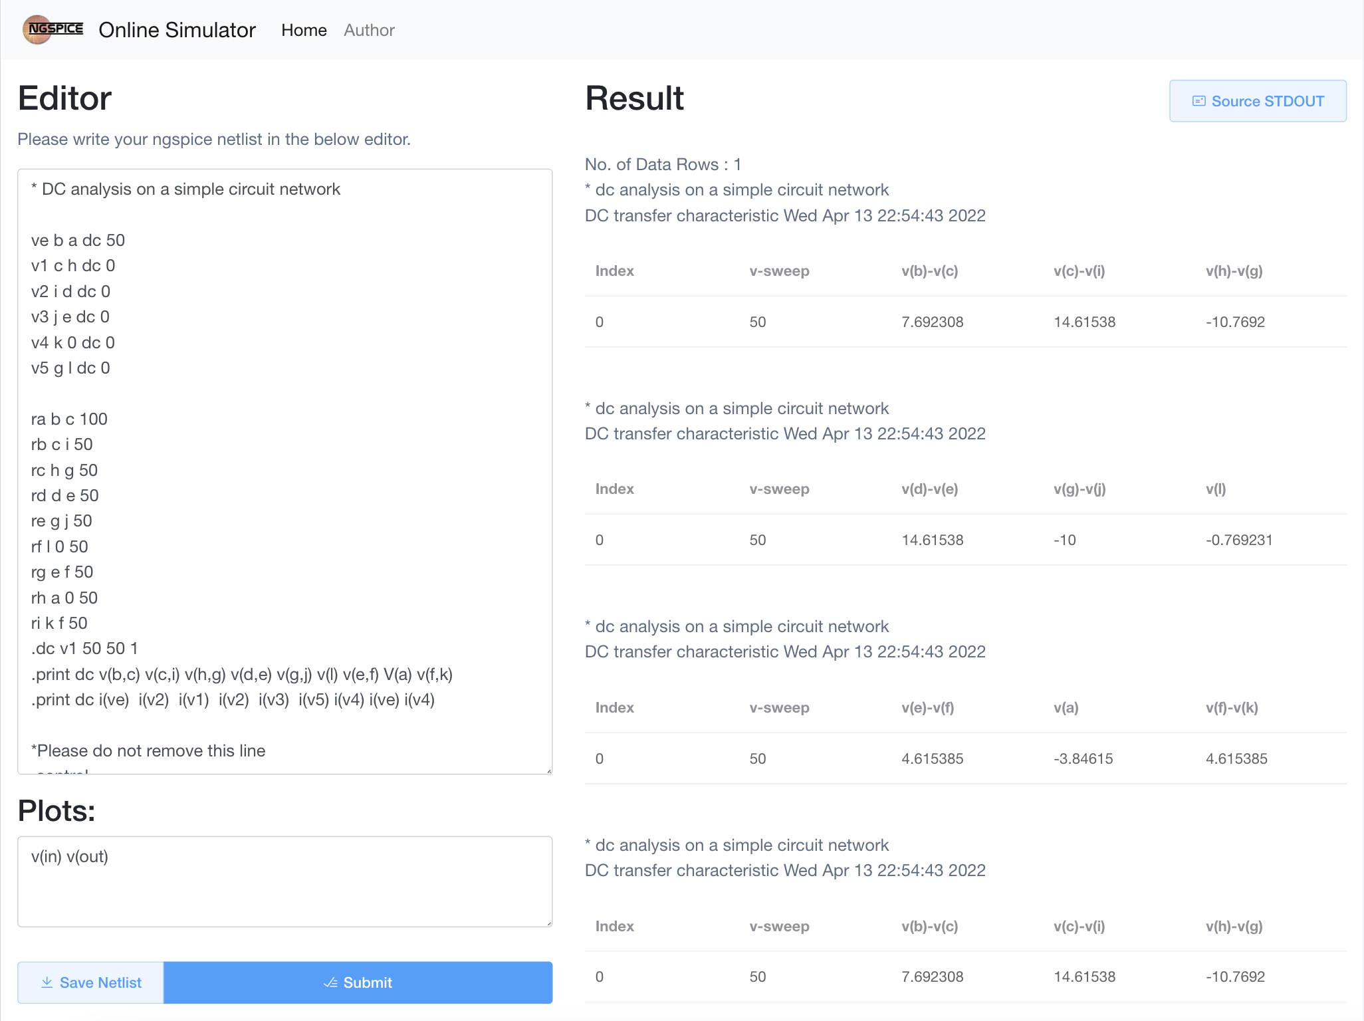

Slide 8
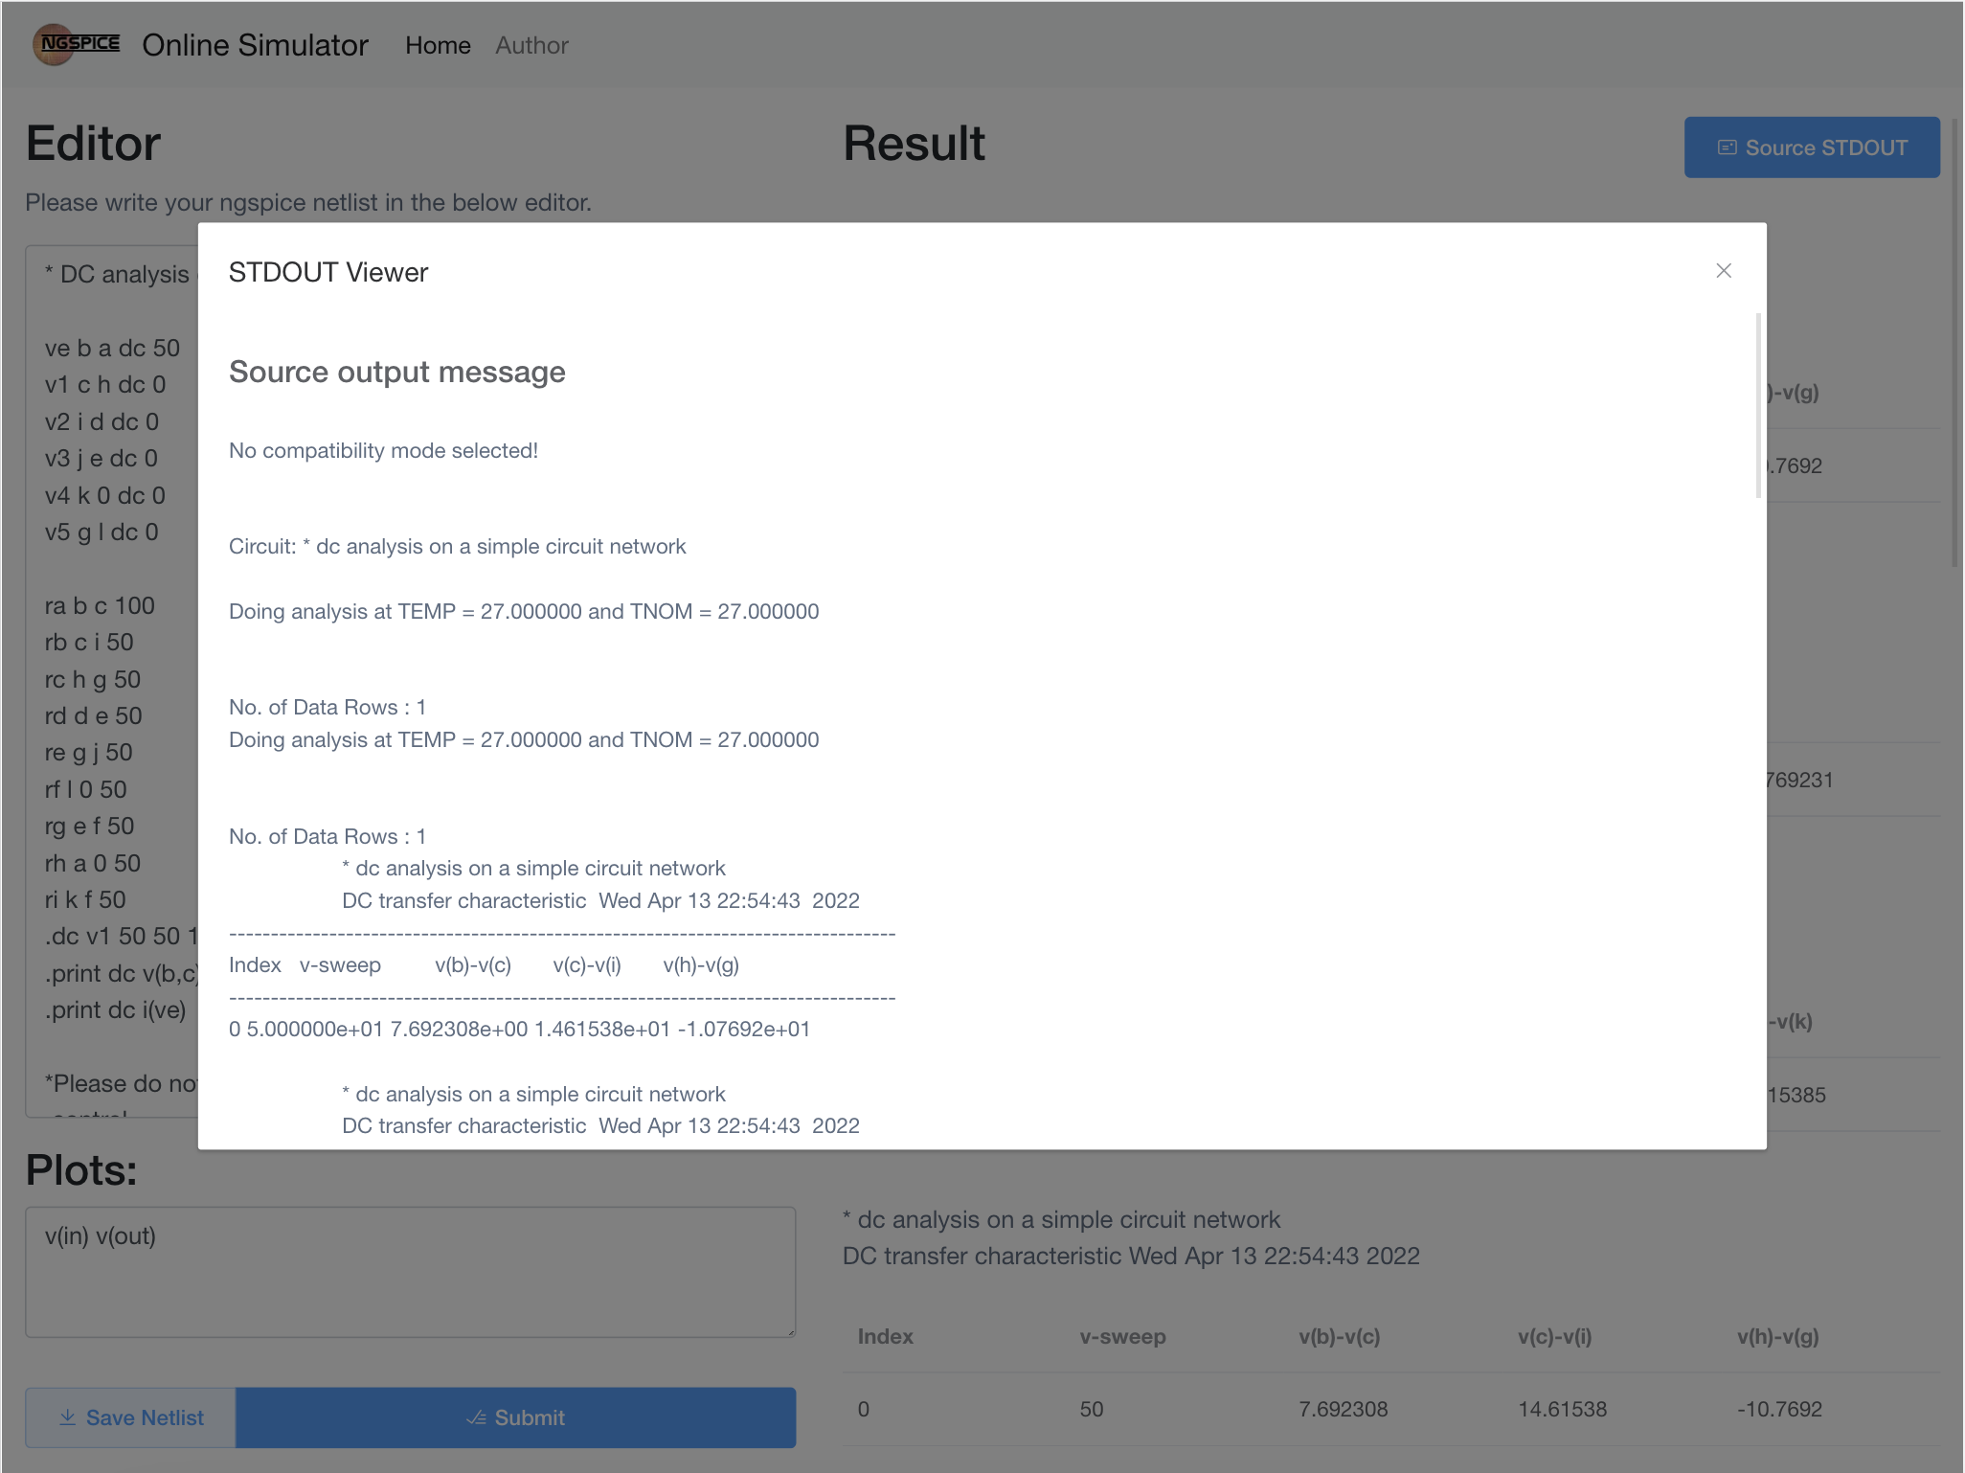

Slide 9
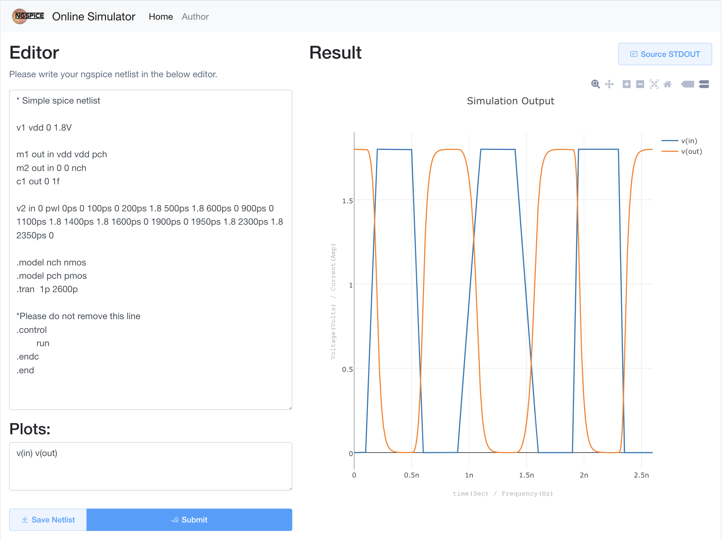

Slide 10
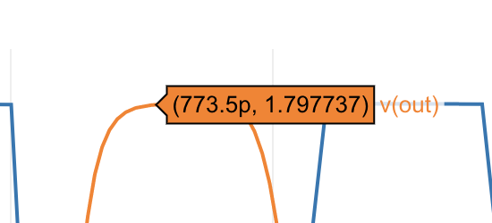


Slide 11
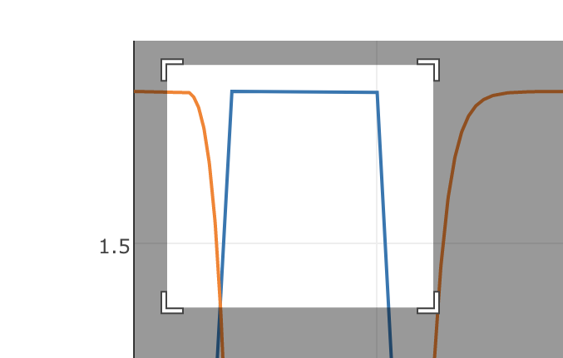


Slide 12
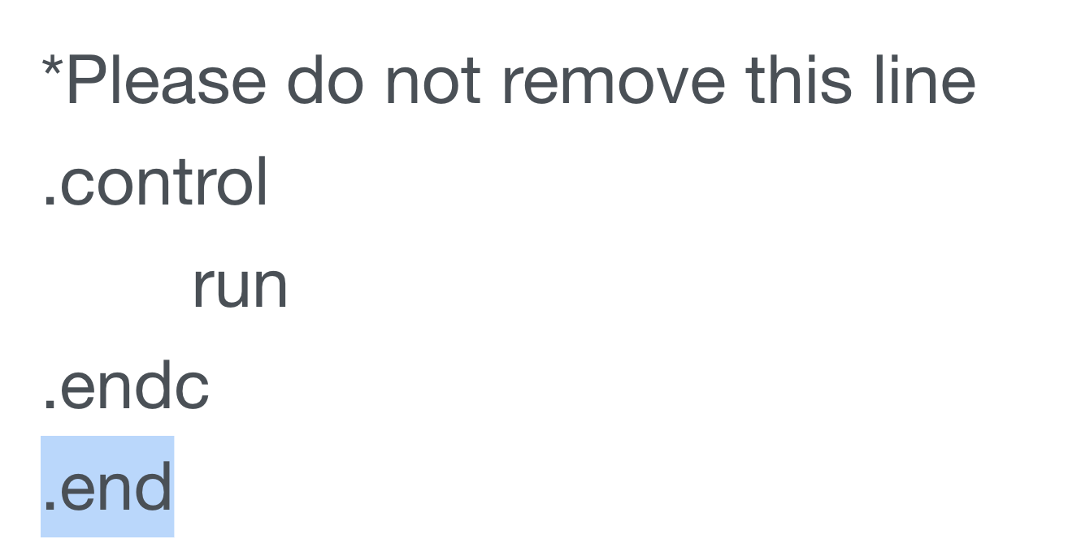

Slide 13
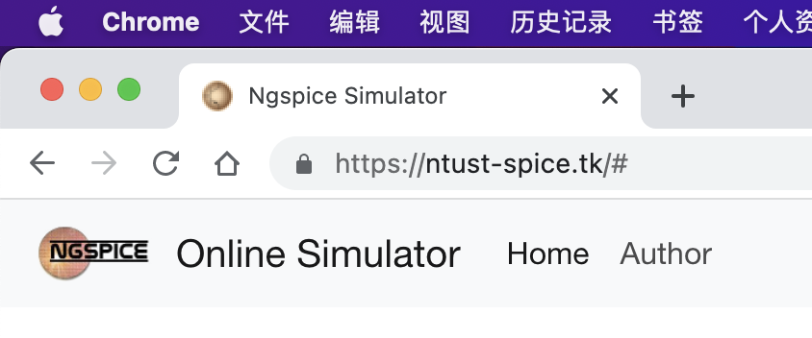
??????????

Slide 14
Future

Slide 15



Coming soon
You are the best helper.

Slide 16

Account

Slide 17

Save spice code in your account

Slide 18

and share it

Slide 19






Multilingual Support

Slide 20
You are the best helper.

