Slide 1

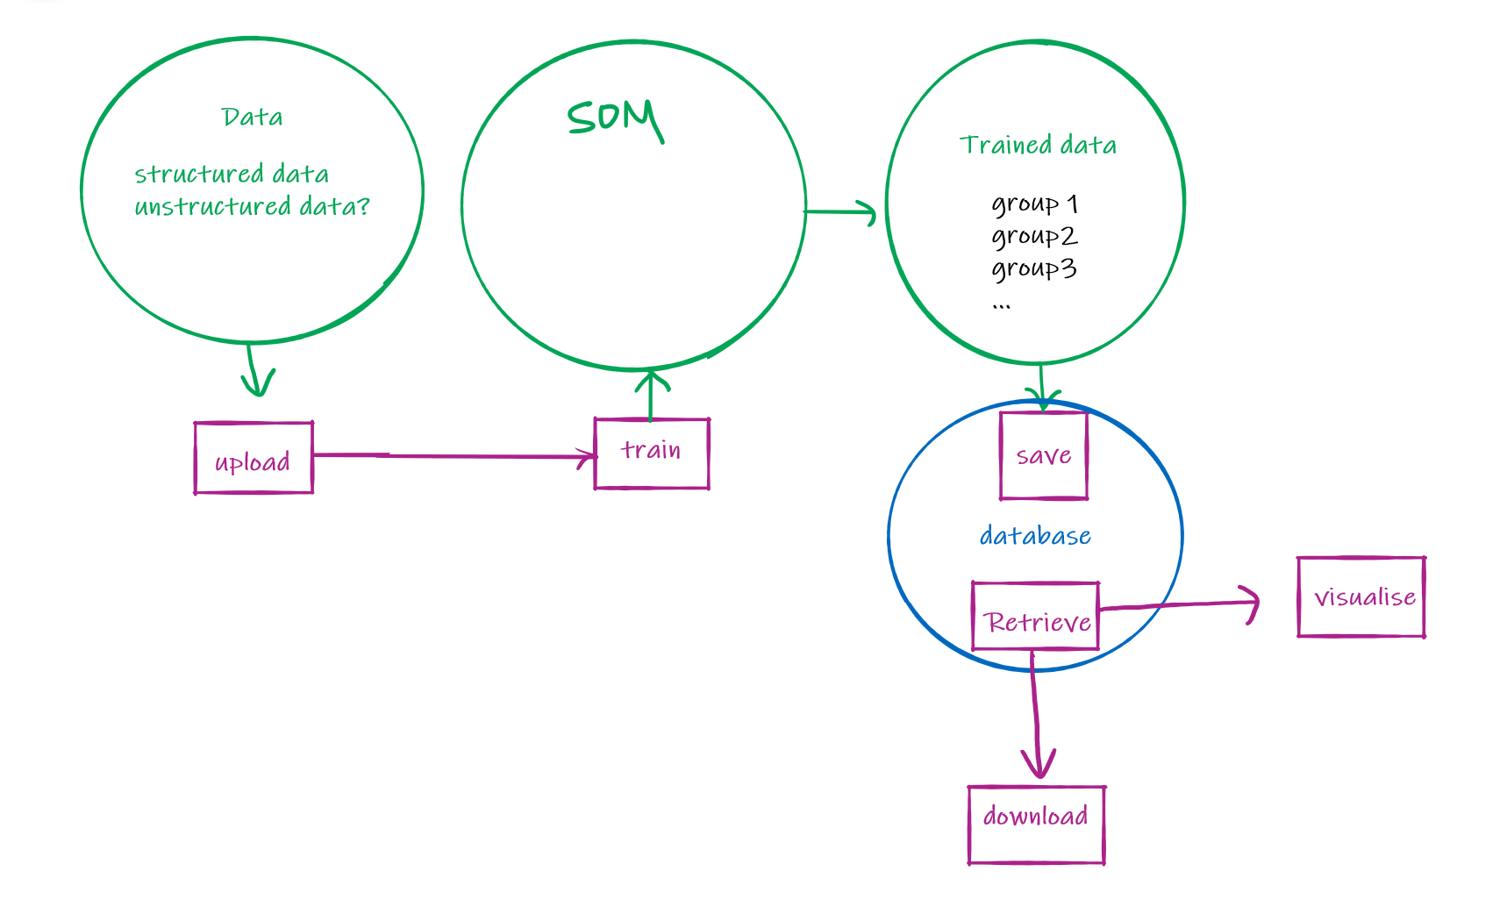
Q1.
Will the SOM data be provided?
If not, the expected data are structured or unstructured?
Q2.
Will a trained model be provided?
Or it needs us to train a SOM model?
Q3.
Is Tuning Hyperparameters needed on the web interface?
If it is, what hyperparameters are needed?
Dimensional reduction
Unsupervised learning
Visualisation
Q4.
What kind of visualization are expected?
Heatmap? Clustering map? …

Slide 2
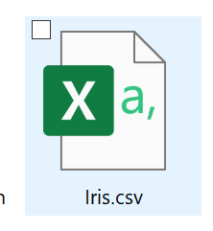


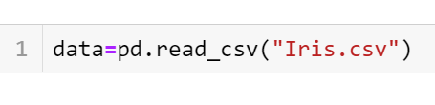

The formats of datasets are diverse
(csv, xlsx, txt…)
We may strict the training models of users.
To train the model, the name of the training function must be train(). Then we will use som.train() in our code.
Consider of time limitation, users are only allowed to upload models written by python first.
If we have more time, we can explore models with more languages
Output data for visualisation
A user upload a dataset file and a model file
The formats of models are diverse
(p, pkl…)
Read the dataset
Our job 1:
Read files.
Read the model
Is there any need for the type of data, such as numpy array or torch tensor?
Do we need to do data preprocessing job? Or it can be done in the uploaded model?
Our job 2:
Transfer the data into numpy array
Data preprocessing
Input data
Training

Slide 3
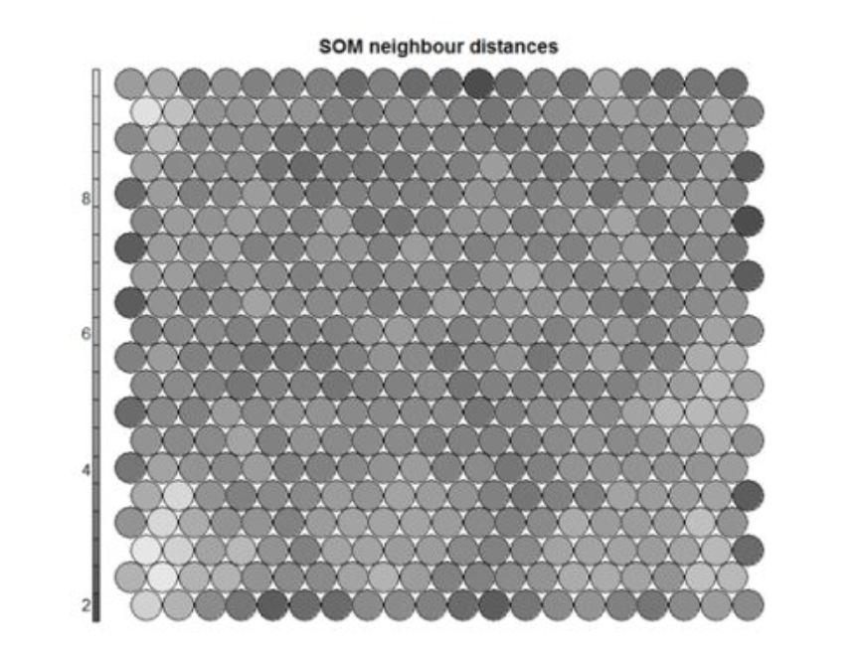
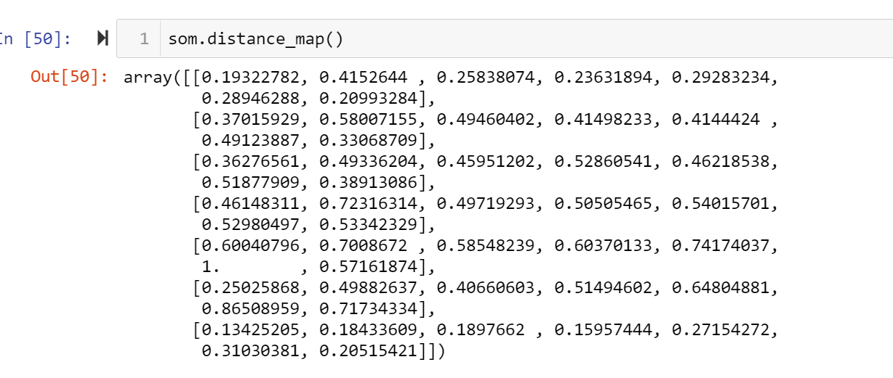
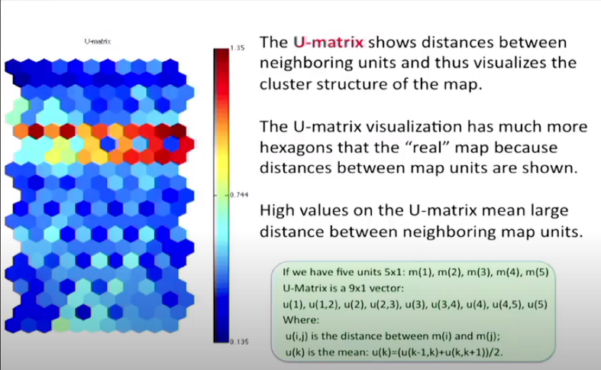
Our problems for visualisation
Visualisation in U-Matrix
1. What kind of data should be outputted from the model for plotting U-Matrix?
2. We read lots of articles about SOM and U-Matrix, but it is still a bit hard for us to understand U-Matrix.
e.g. what does each grid/hexagon stands for in the U-Matrix?
What can people understand from U-Matrix?
3. What specific interaction do you expect from the visualisation.
e.g. When your cursor is hovered onto a grid, what kind of information you want to know?
May we have some tutorials or other materials for practicing and understanding U-Matrix and its plotting?

Slide 4
Dimensional reduction
Unsupervised learning
Visualisation

Slide 5
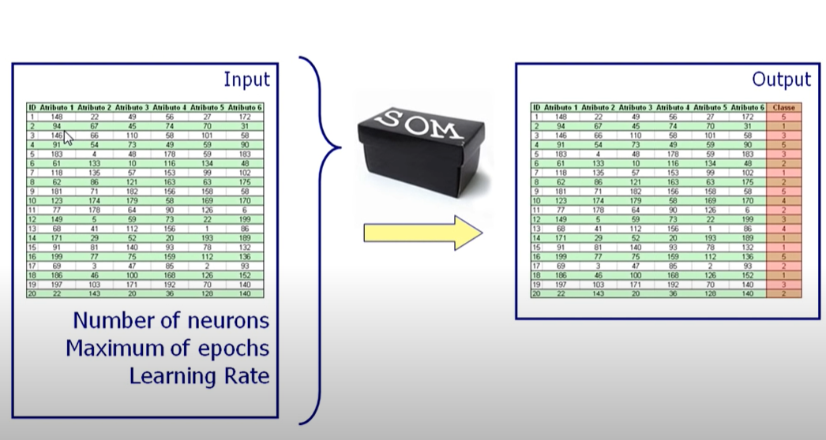
Seems like SOM cannot return the number of clusters directly
SOM + other clustering algorithms (e.g. K-Means)
download

Slide 6



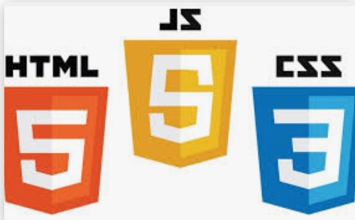



Roles
Team Leader: Yuqi Mao | Frontend: Jiayu Huang, Yuqi Mao
 | Backend & Database: Mingyi Li, Cheng Liang, Anzi Liu

Slide 7
What did we do from last meeting?

Slide 8
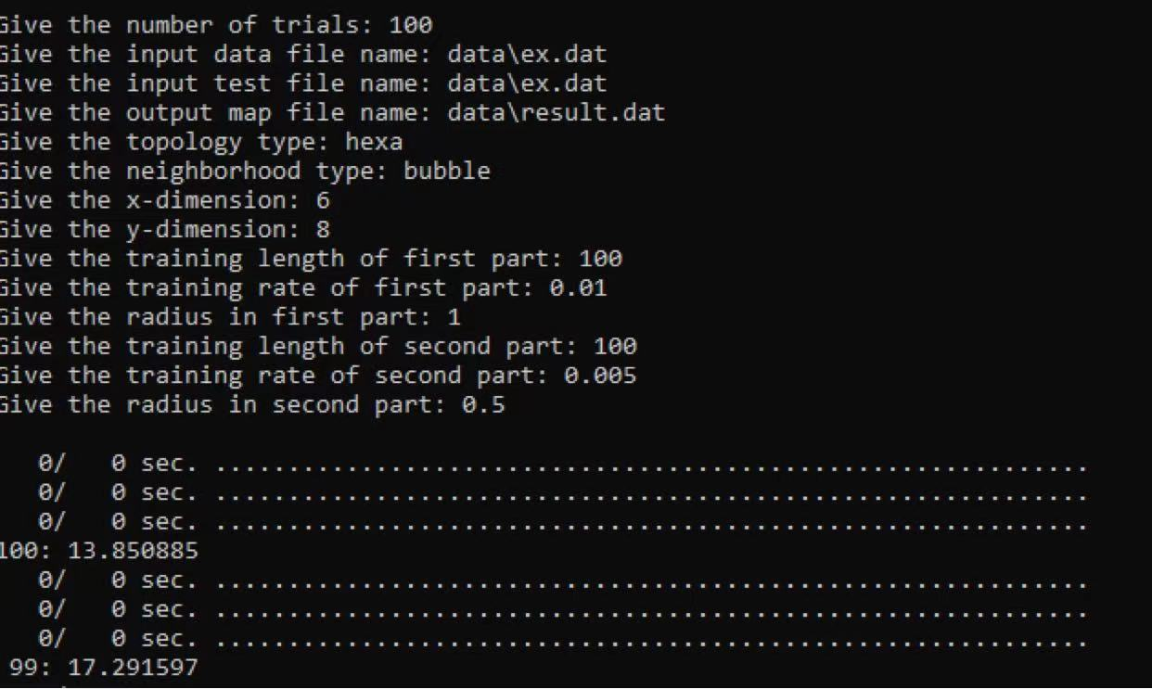
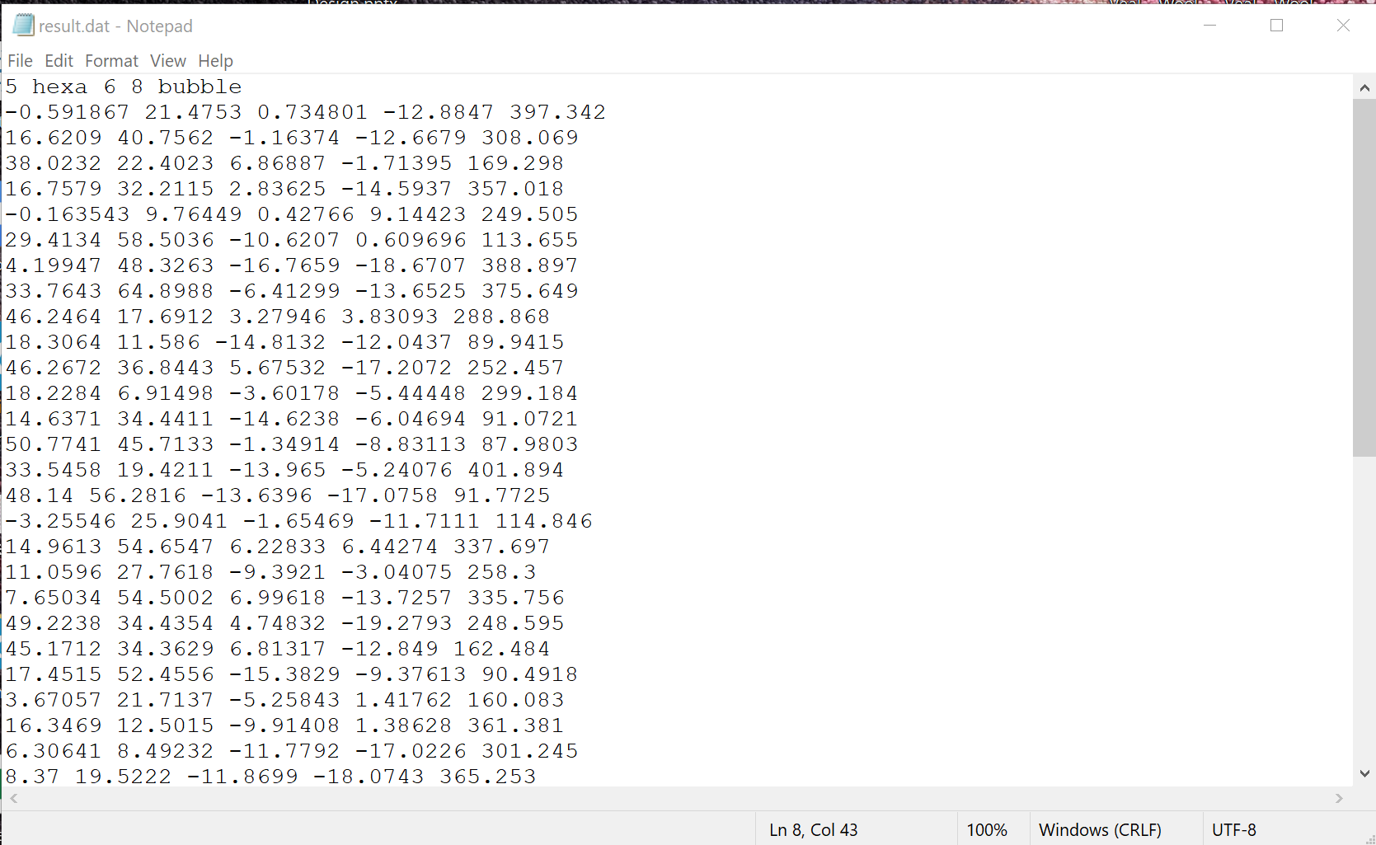
Got a SOM model:

Slide 9
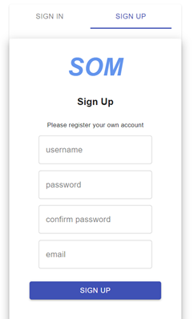

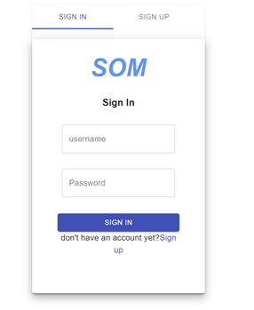

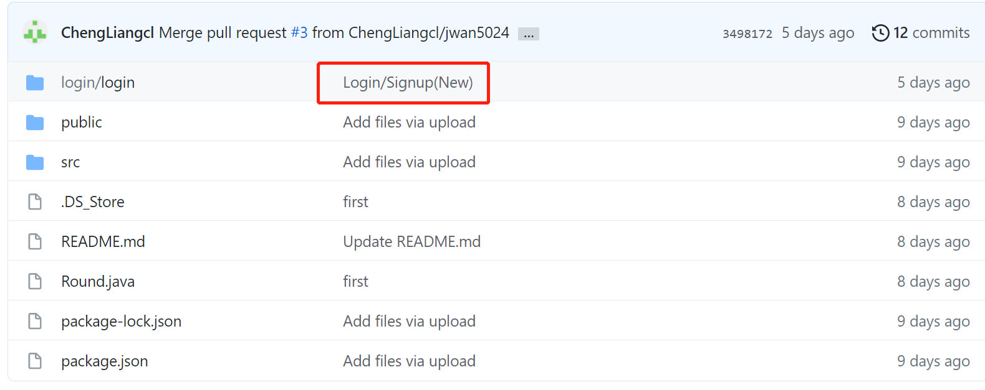
Sign up / Log in
Frond-end:
Backend & Database

Slide 10
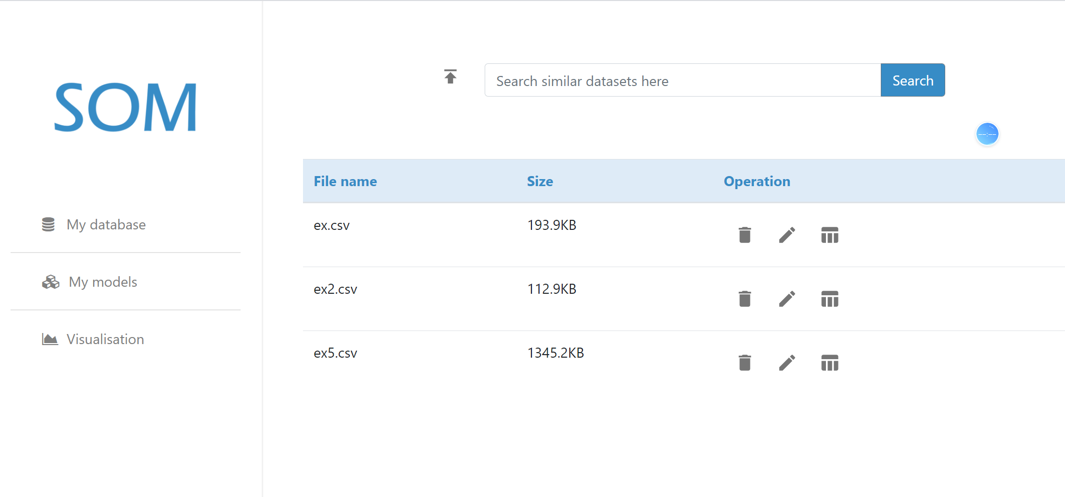
My Database
Able to fetch dataset info from the python flask server.
Able to upload a dataset file to the python flask server and response to it
Frond-end:
Backend & Database
We are working on it now !

Slide 11
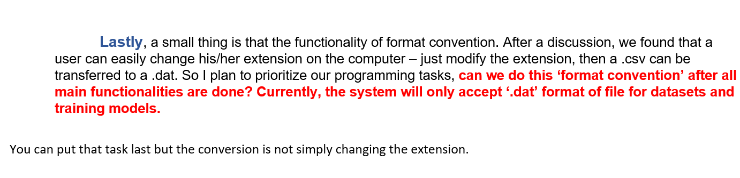
Questions for Requrements

Slide 12
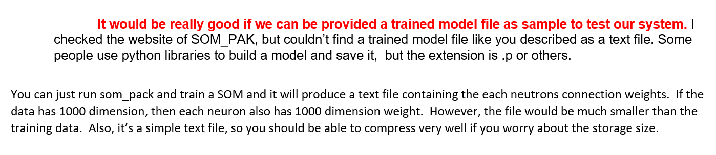
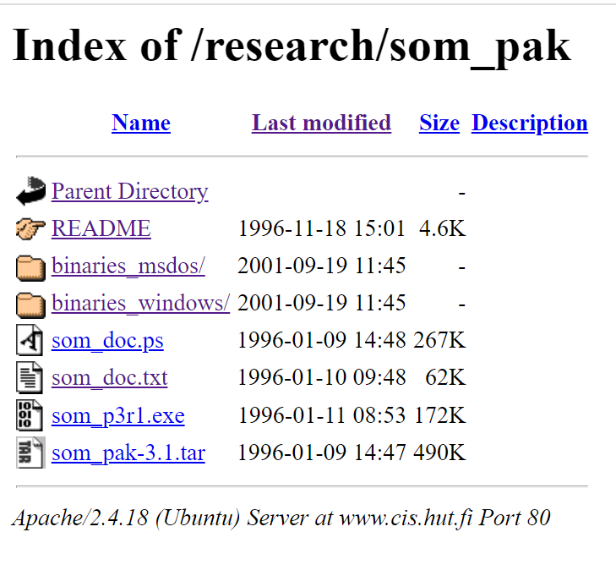
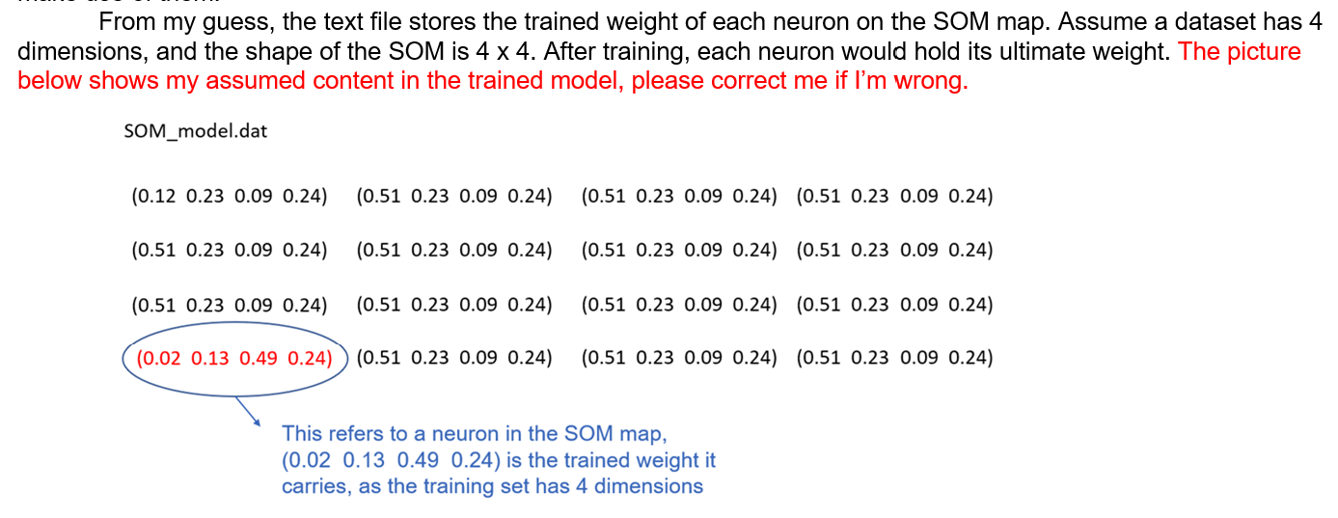

Slide 13





SOM
C:/User/MyDatabase
browse
ID
File name
Type
01
Iris
csv
My database
02
Students
CSV
My models
Data training
Visualisation

Slide 14


SOM
Input the id of your dataset
Search
My database
Data training
Visualisation

Slide 15


SOM
Search
Input the id of your dataset
ID
Name
Type
01
Iris
csv
Training
My database
Hyperparams Tuning zone
Data training
Visualisation

Slide 16



SOM
Search
Input the id of your dataset
Training
My database
Data training
ID
Name
Type
State
Visualisation
01
Iris
csv
02
Students
csv

Slide 17
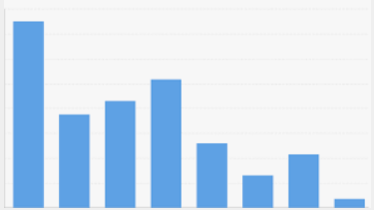
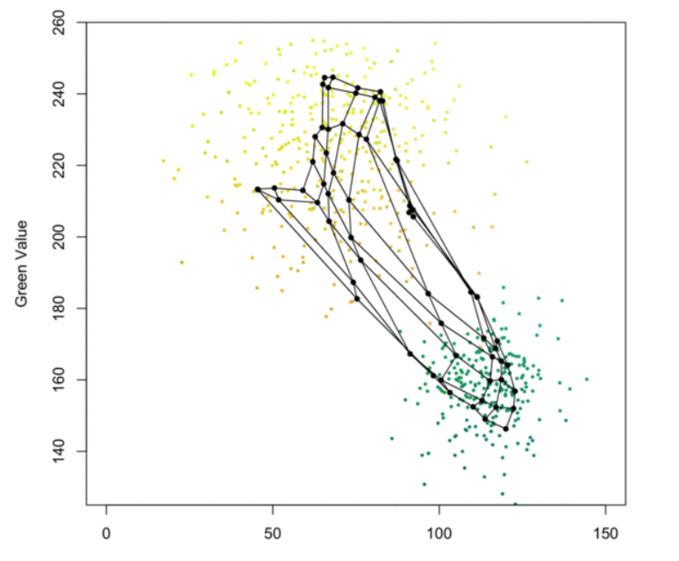
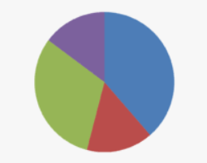
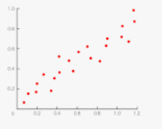

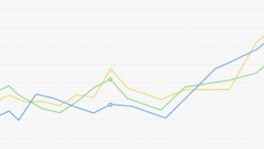
SOM
My database
Data training
Visualization

Slide 18
Other Discussion
1.
Why do you want a system like this? What kind of problems you want to solve through this system.
2.
What specific functionalities do you expect (except those we showed just now)?
3.
If the trained model is given, should we do the data preprocessing job? Or it’s in the model already.
4.
Confirm the frequency and time of the meeting
5.
Slack

Slide 19
Is it possible to provide a super GPU for data model training?
What minimum accuracy of the model do you expect?

